Slide 1
Development of the BCM' abort and luminosity system at the HL-LHC based on poly-crystalline CVD diamond pixel-pad detectors
14th Trento Workshop on Advanced Silicon Radiator Detectors, 25. 02. 2019
Bojan Hiti (Jožef Stefan Institute, Ljubljana, Slovenia) on behalf of RD42 Collaboration

Slide 2
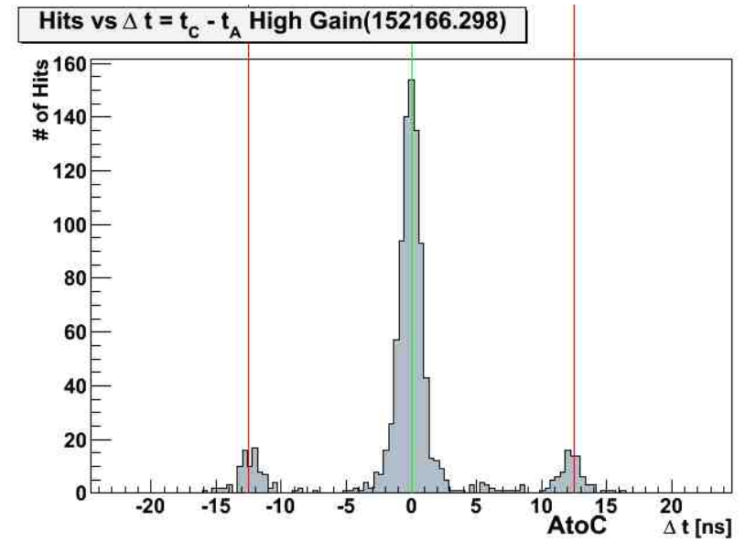
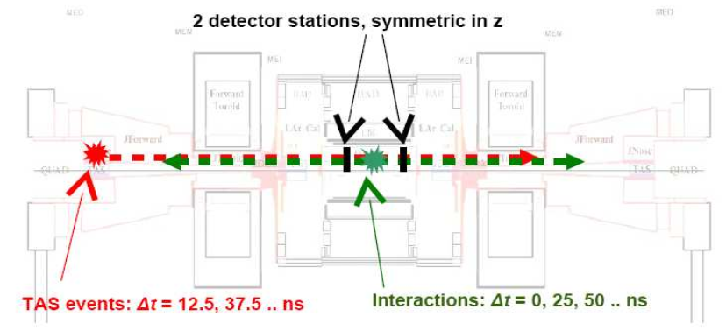
ATLAS BCM and BCM'
Current ATLAS abort and luminosity system: Beam Condition Monitor (BCM)
2 stations (A and C); z = ±184 cm, r = 55 mm, η = 4.2, 6.25 ns from IP
Single pad pCVD diamond sensor (10 x 10 mm²) + fast readout electronics (2 ns rise time)
1.5 MIPs / pp collision → at high pile-up occupancy causes performance problems
After HL-LHC upgrade (2024—2026) luminosity will increase by factor 5
Robust solution for the entire range of particle rates → BCM' (BCM Prime) – developed within RD42
collisions
in-time
background
out of time

Slide 3
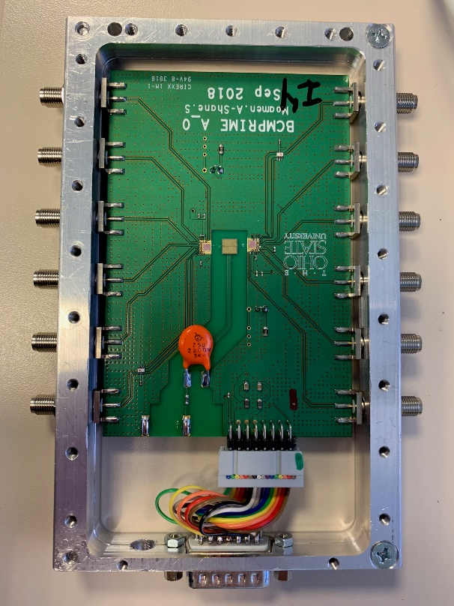
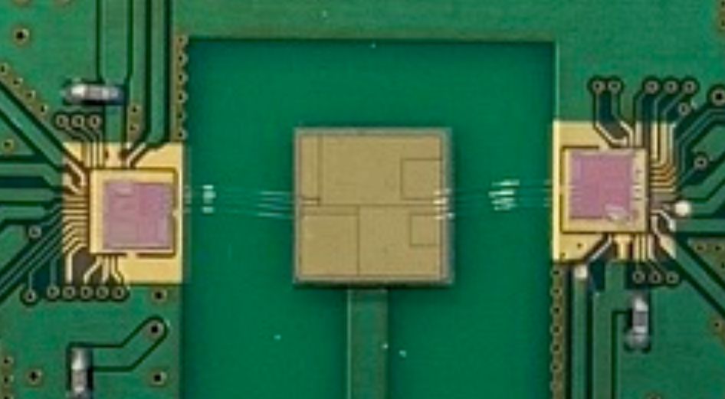
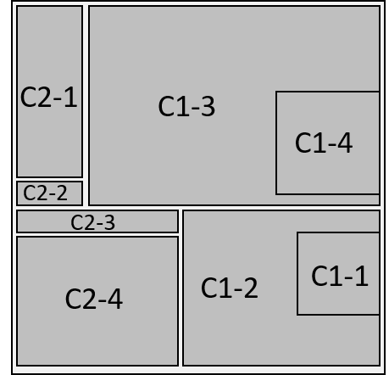
BCM' upgrade for HL-LHC
pCVD diamond sensor, segmented into 8 pads → flexible acceptance
Custom analogue front end ASIC (by OSU)
65 nm TSMC process, 4 readout channels
Separate front end functionality for Abort (high rate) and Luminosity (low noise)
Current amplifier; < 1 ns rise time, fast (∼10 ns) baseline restoration
Require 100 ps time resolution for beam diagnostics
Design for large pitch bump bonding or wire bonding interconnections
First prototypes available in September 2018
Presenting first results from beam tests at CERN SPS and PSI in October 2018
5 mm
5 mm
ASIC
diamond
ASIC
thickness 500 μm

Slide 4
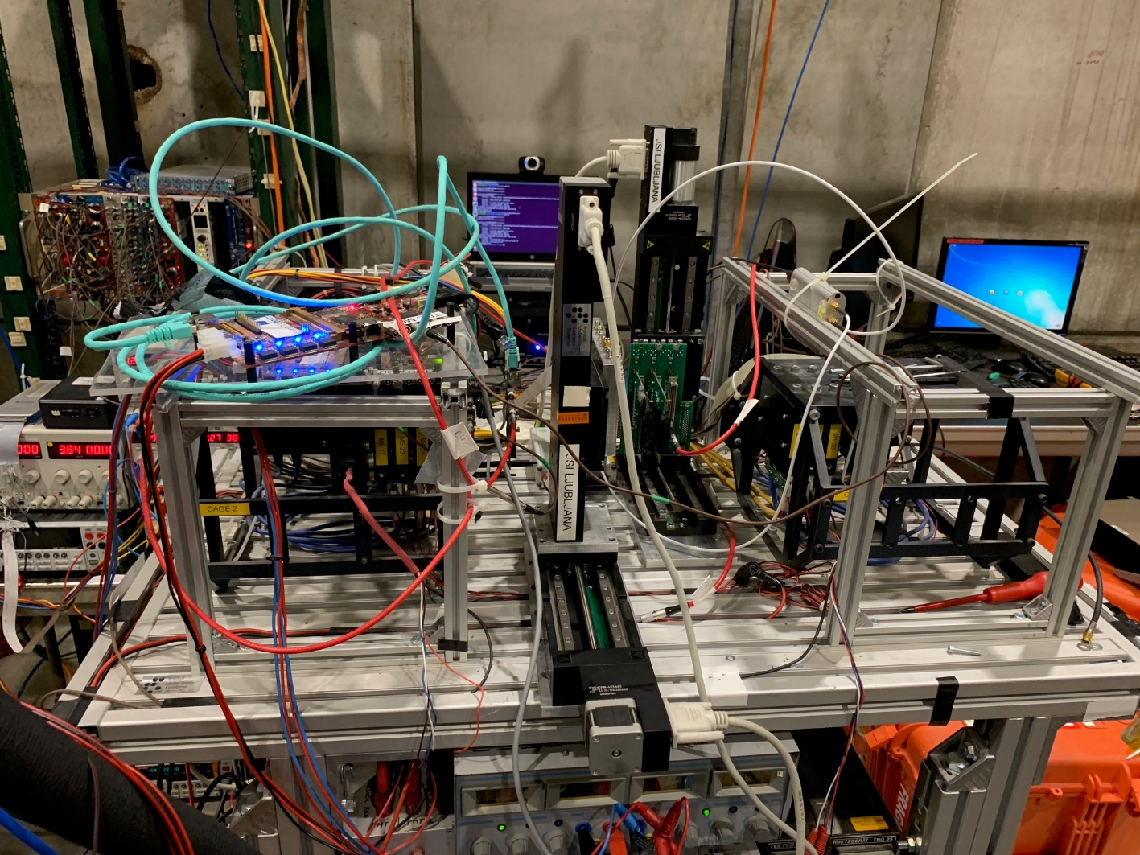
CERN H6 test beam
CERN SPS H6 test beam: 120 GeV hadrons
KarTel (Mimosa) beam telescope
Tracking resolution ≈ 3 μm
DRS 4 analog readout
3 GS/s acquisition rate, 700 MHz bandwidth
DUT:
+ 1000 V bias voltage on diamond
Output oscillated if more than one channel per chip active → Recorded two channels per run
Dataset:
All channels measured (separate runs)
several 10k tracks per channel
DUT
3 planes + timing + ROI
3 planes

Slide 5
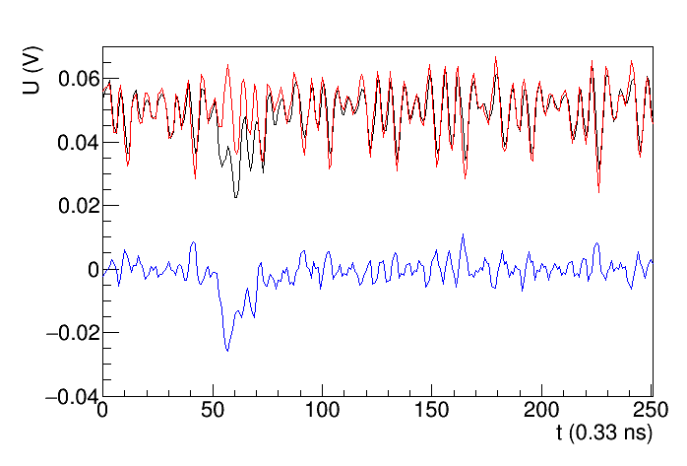
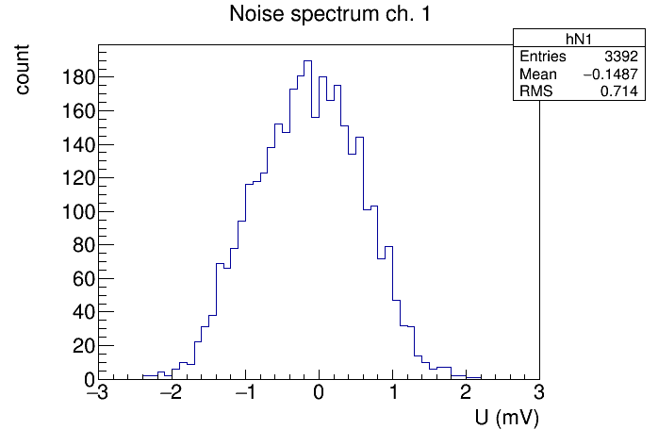
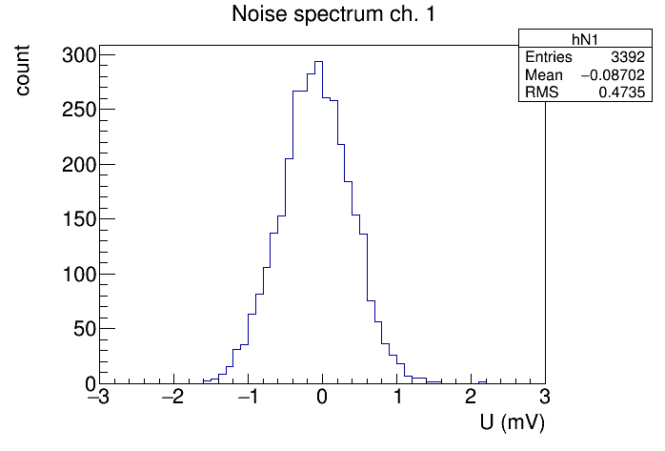
Signals and pick-up
baseline of ch. 1 & 2 offset by 0.05 V for clarity
ch. 1
ch. 2
Large pick-up from the setup/environment
Same shape in all channels → Mitigation by subtracting two waveforms
(ch1 – ch2) or (ch2 – ch1) depending on track position
Pick-up reduced by factor 2
In addition baseline correction
ch. 1 – ch. 2
Noise before subtraction
Noise after subtraction

Slide 6
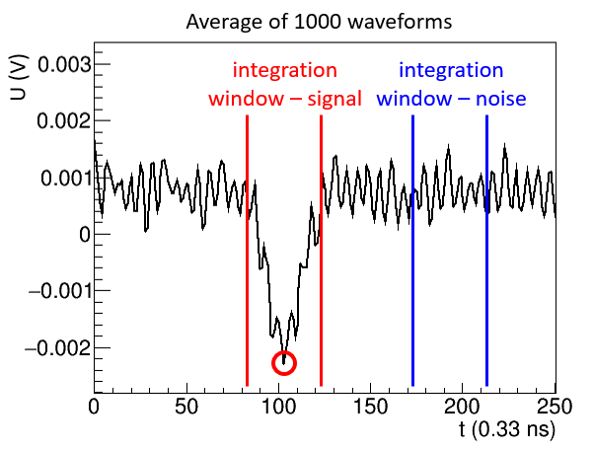
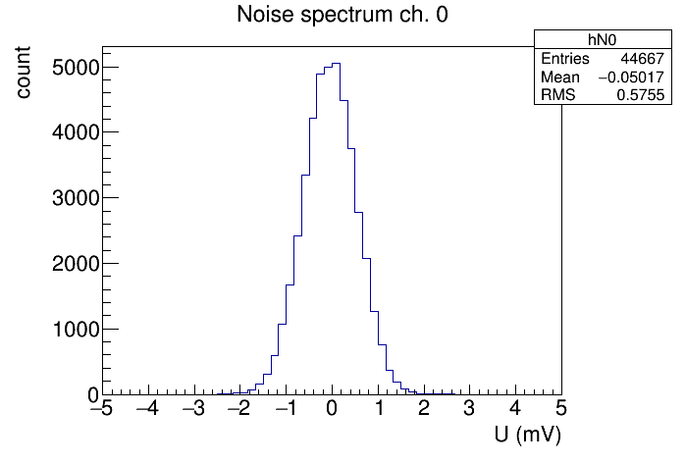
Signal measurement
Average waveform of 1000 acquisitons
Select an integration window around the peak [t_{min}, t_{max}]
Signal = Integral around the peak
Long integration window [– 6 ns, 6 ns] to mitigate for noise
Hit criterium: signal threshold = 4σ above noise
$$S=\frac{1}{t_{\max{ }}− t_{min}}\int_{t_{\min{ }}}^{t_{max}}{Udt}$$
Noise spectrum
+4σ
noise level varies by factor 2, depending on the channel

Slide 7
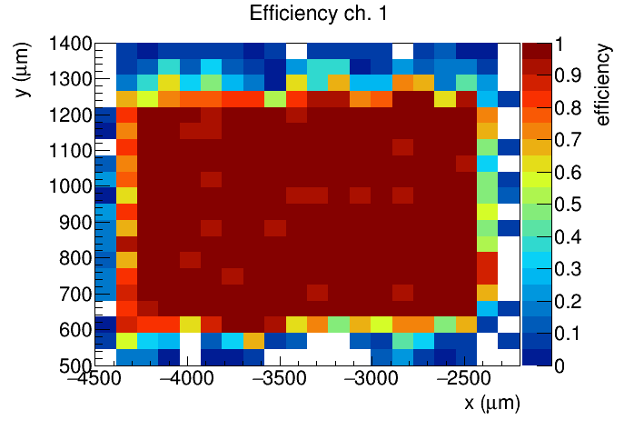
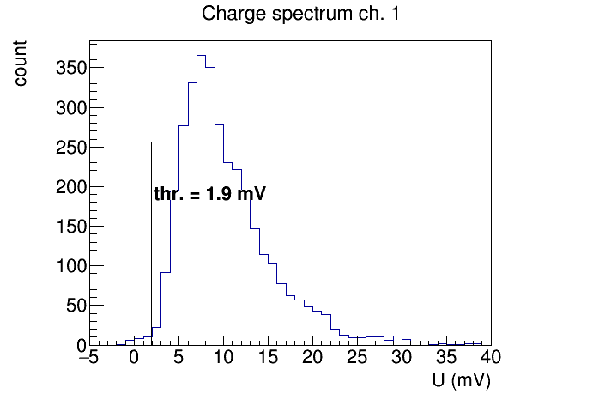
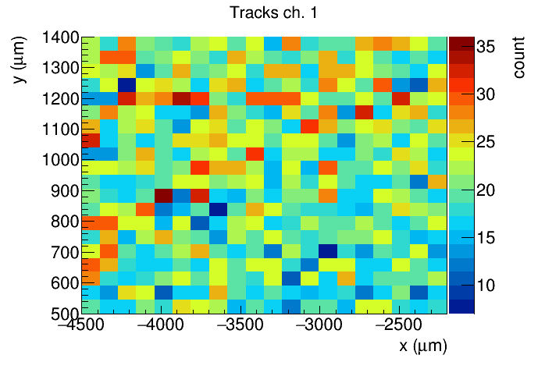
Efficiency measurement Chip 2 channel 1 (1000 V)
Efficiency Chip 2 ch. 1
+ 1000 V
Signal Spectrum
> 99 % hits above threshold
Measured in the fiducial region at + 1000 V
MPV = 7.5 mV, mean 9.8 mV
Noise RMS = 0.5 mV
S/N ratio (mean) ≈ 20
avg. eff. 99.0 %
Noise Spectrum
Tracks through sample
≈ 25 tracks per bin

Slide 8
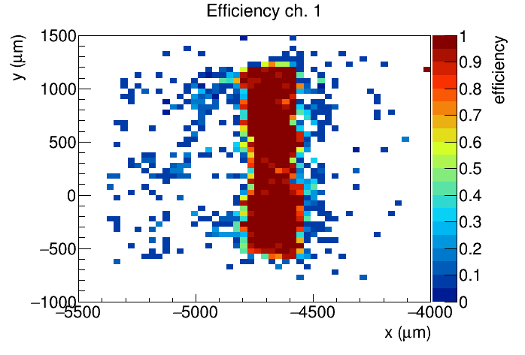
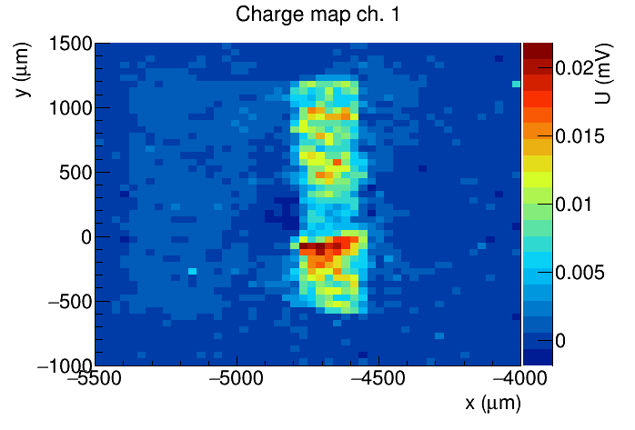
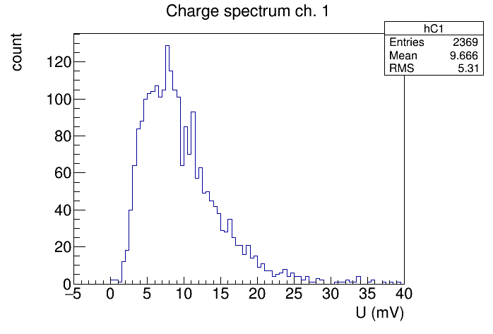
Chip 2 channel 3
Efficiency Chip 2 ch. 3
+ 1000 V
Signal Size Chip 2 ch. 3
U (V)
Signal Spectrum
High resolution run on a small pad
Efficiency > 99 % in fiducial region
Signal size varies with position (pCVD diamond)
Should average out over large pad
thr 2.3 mV

Slide 9
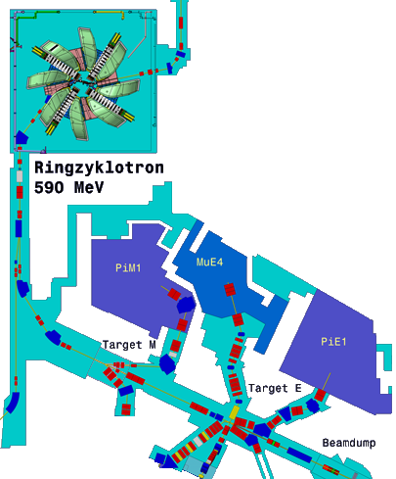
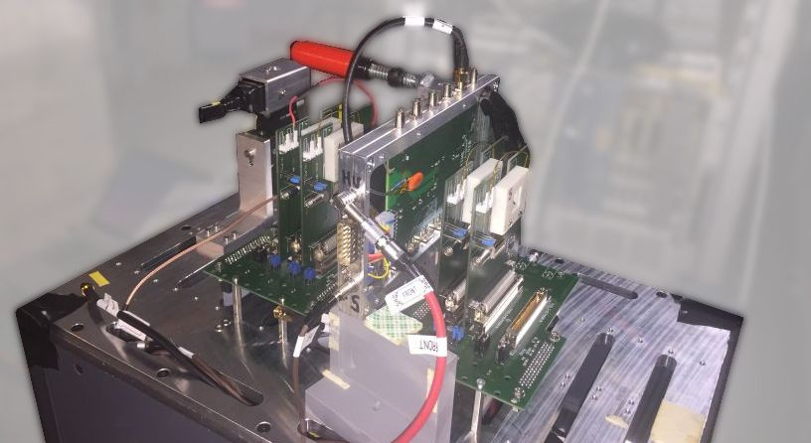
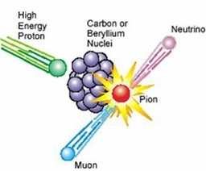
PSI test beam
High Intensity Proton Accelerator (HIPA) at PSI, beam line PiM1, 260 MeV/c pions
PSI beam telescope + multiple scattering → lower resolution
DRS 4 readout, modifications to reduce ringing
Measurements at positive and negative bias voltage: ± 200 V, ± 300 V (sample 1), ± 500 V, ± 1000 V (sample 2)

Slide 10
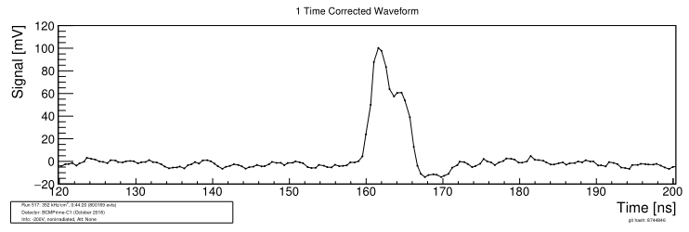
Waveforms at PSI
Much lower noise than at CERN – no pickup
Average rise time ∼ 1.4 ns, baseline restoration after 10 ns
DRS 4 analog bandwidth (700 MHz) may be the limiting factor
Analysis: Integration time [—1.5 ns, 3 ns]
V_{Bias} = +200 V
V_{Bias} = –200 V

Slide 11
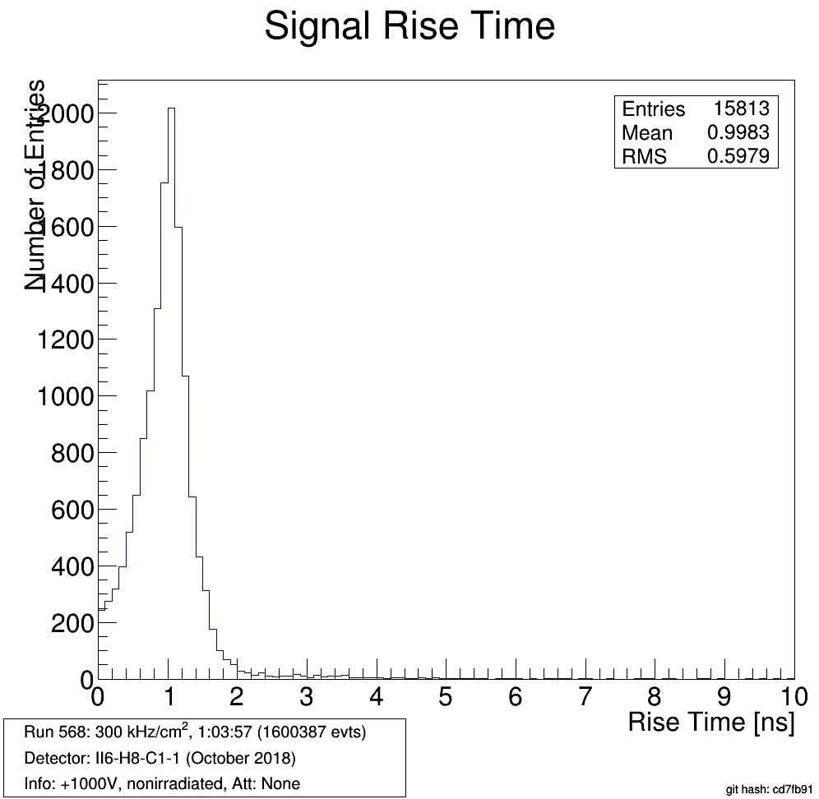
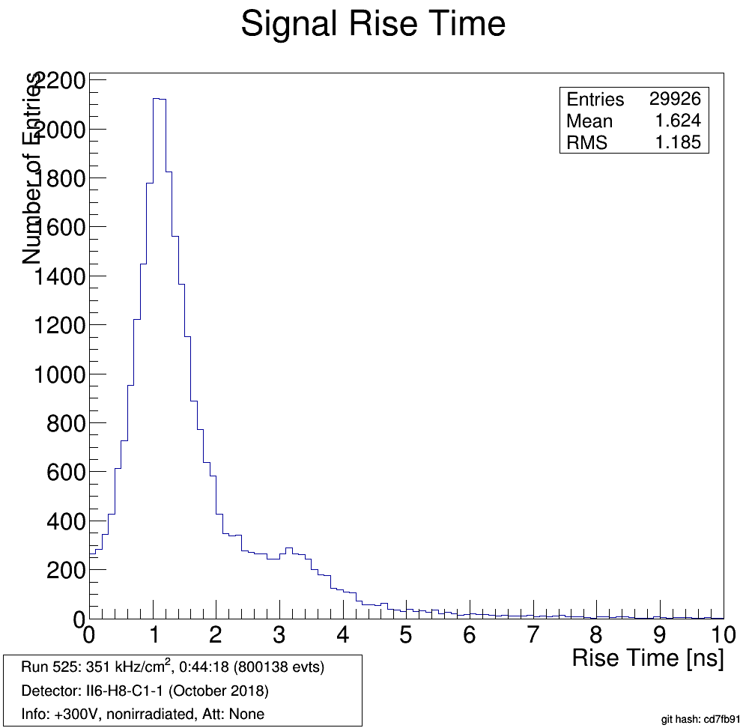
Signal Rise Time
+ 1000 V
+ 300 V
Rise time ≈ 1 ns
Improves with bias voltage – very few outliers at 1000 V

Slide 12
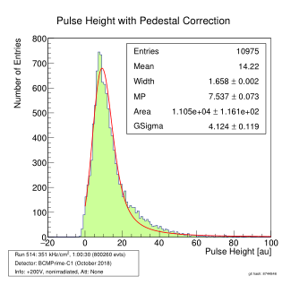
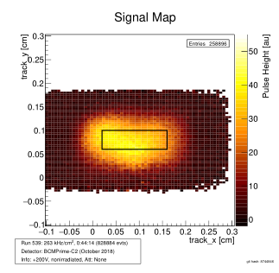
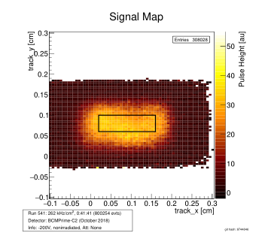
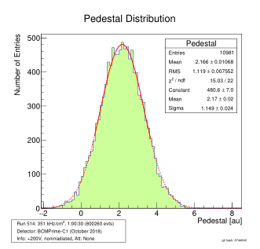
Charge measurement + 200 V
+ 200 V
- 200 V
Charge measurement in fiducial region
10 % difference for different sign of V_{bias} at low voltages (0.4 V/μm)
Distribution fitted with convoluted Landau + gaussian
Noise distribution independent of bias voltage, offset is a feature of DRS 4

Slide 13
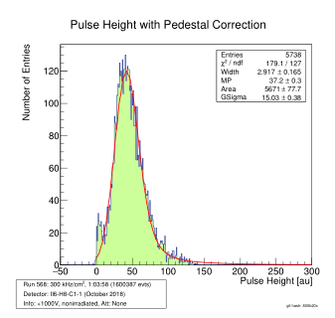
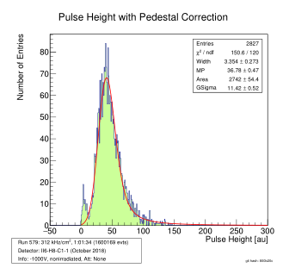
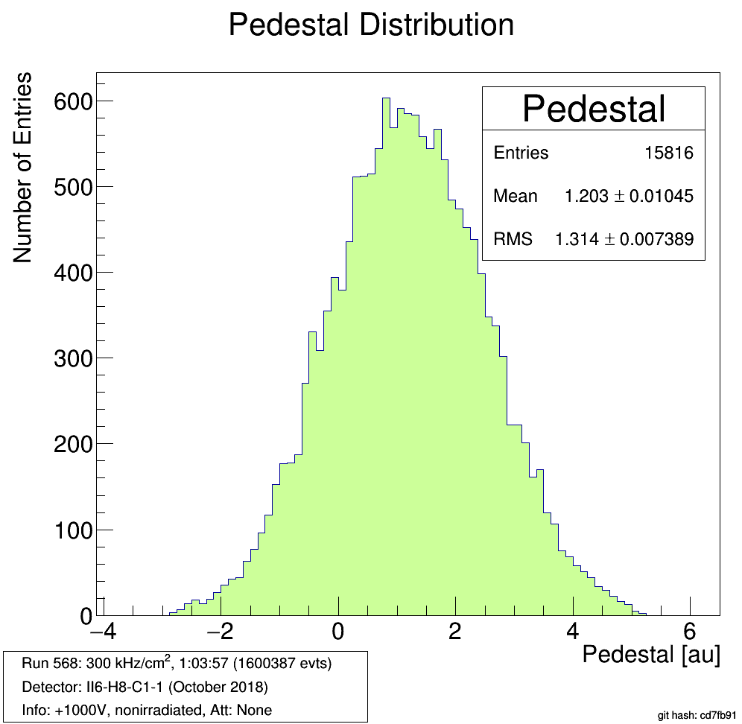
Signal spectra at 1000 V
+ 1000 V
MPV 37.2
Mean 45
– 1000 V
MPV 36.7
Mean 45
σ = 1.3
At 1000 V signal spectrum is the same for both polarities
Small pedestal – due to low tracking resolution

Slide 14
Signal spectra at 1000 V
+ 1000 V
MPV 37.2
– 1000 V
MPV 36.7
At 1000 V signal spectrum is the same for both polarities
Small pedestal – due to low tracking resolution

Slide 15
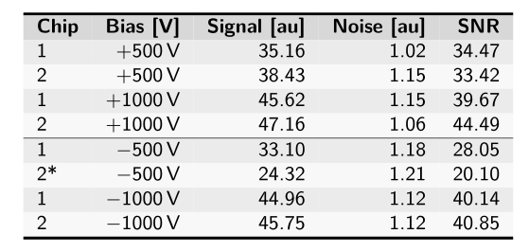
Signal summary
Diamond 1
Diamond 2
Mean
Mean
(Mean)
S/N ratio = mean signal / noise RMS
At highest bias voltages S/N ≈ 40
Timing resolution: t_{rise} / (S/N) = 1.4 ns / 40 = 35 ps ≪ 100 ps → In line with BCM' requirements

Slide 16
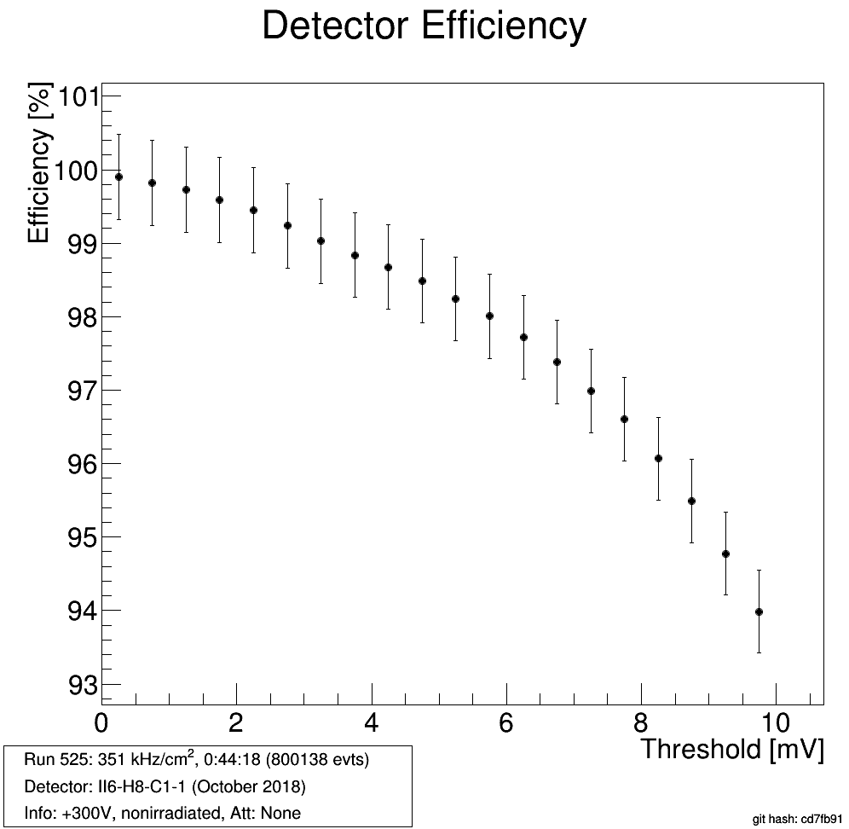
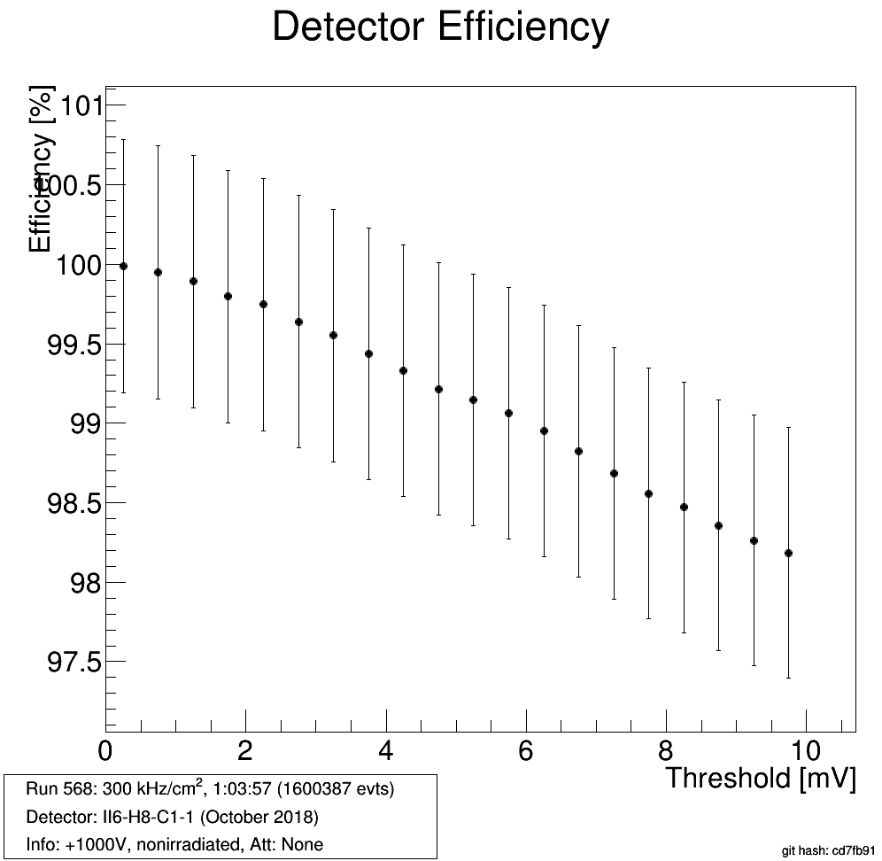
Efficiency vs. threshold
+ 300 V
+ 1000 V
typical threshold
Efficiency at improves from 300 V (0.7 V/μm) → 1000 V (2 V/μm)
Inefficiency in part due to low tracking resolution

Slide 17
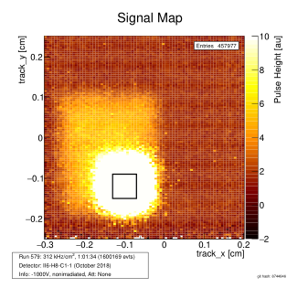
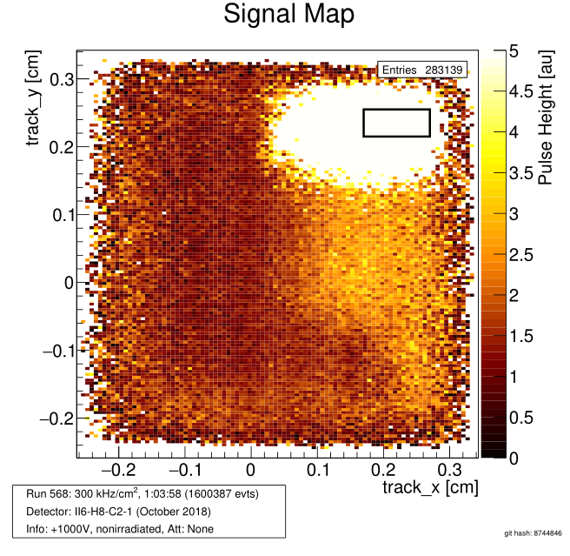
Interchannel coupling
+ 1000 V
Neighbour pad
Couplings to the neighbour pad observed
Similar behaviour observed at SPS
Small signals every time a particle hits the neighbour pad

Slide 18
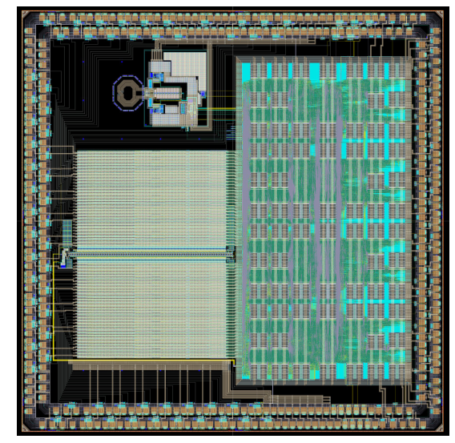
Toward the BCM' module
Module = Sensor + amplification + CFD + digitization + data transmission
Use "existing" components:
PicoTDC: time-to-digital converter (TDC) being developed by CERN
Compatible with lpGBT
65 nm process, radiation hardness 500 MRad
12 ps inherent time resolution
32 channels, selectable between measurement of
Time of arrival
Time over threshold
BCM' requires 16 channels
+
PicoTDC
+
lpGBT

Slide 19
Summary and outlook
Successfully demonstrated functionality of the first BCM' front end prototype
> 99 % efficiency measured in the test beam
S/N (mean) = 40 before irradiation
Good timing performance
Rise time 1.4 ns
Baseline restoration 10 ns
100 ps timing resolution is already achievable
Module production will be simplified by using common components: PicoTDC

Slide 20
BACKUP

Slide 21
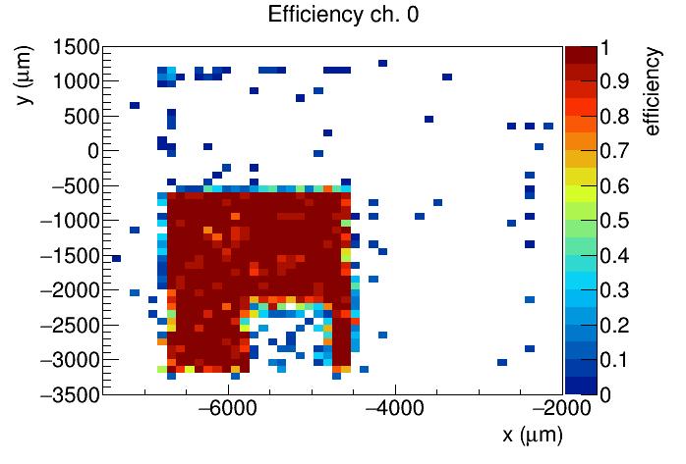
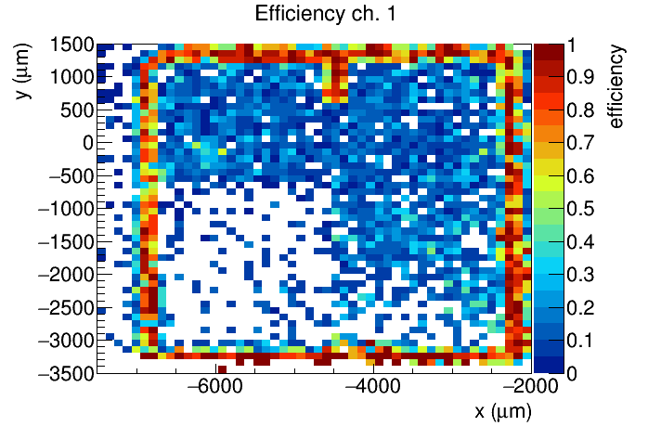
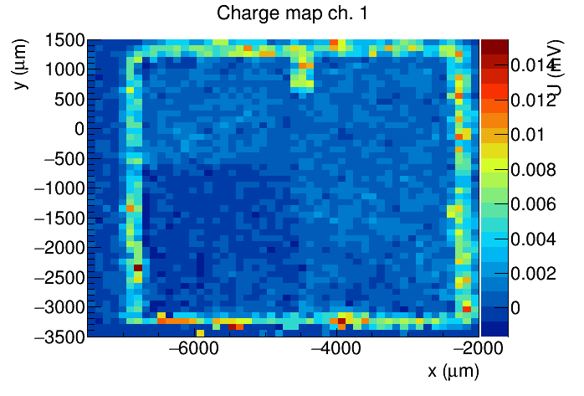
Chip 1 ch. 2 + Chip 2 ch. 2
Efficiency Chip 1 ch. 1
+ 1000 V
Efficiency Chip 2 ch. 2
Signal Size Chip 2 ch. 2
Cross talk ?
Observed cross talk on the sample
Separate readout chips, so cross-talk most likely from the sensor
Noise level larger with larger pads → 2x higher threshold, efficiency slightly lower

Slide 22
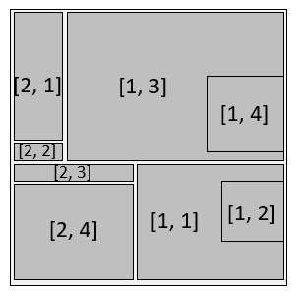
Trigger
Acquisition triggered by the FEI4 module
ROI to trigger only on tracks through the active area
ROI determined in a test run by self triggering on the DUT
HitOR
ROI
FEI4 ROI
DRS4
Telescope
Example ROI:
(chip 1, ch. 4) + (chip 2, ch. 4)
read out FEI4

Slide 23
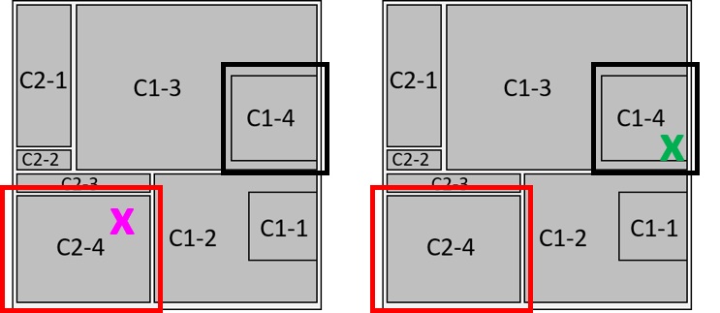
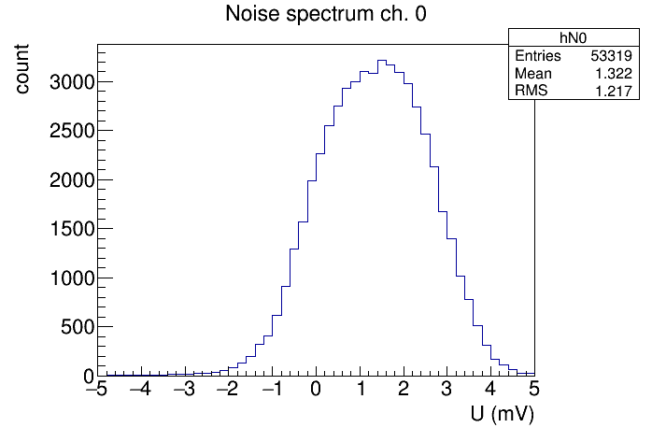
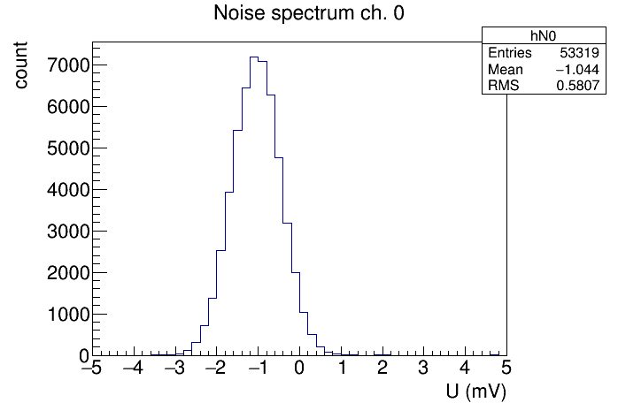
Waveform subtraction
Large pick-up occuring at the CERN test beam
Same shape in all channels → Mitigation by subtracting two waveforms
Subtrahend based on track position:
Noise before subtraction
Noise after subtraction
wf2 – wf1
wf1 – wf2

Slide 24
Waveform subtraction
x
Blue wf = Black – red (+ offset for better visibility)
x
Fine tuning the phase between black and red does not reduce the noise figure
wf2 – wf1
wf1 – wf2
Large pick-up occuring at the CERN test beam
Same shape in all channels → Mitigation by subtracting two waveforms
Subtrahend based on track position:
[2, 1]
[1, 3]
[1, 4]
C2-1
C1-3
C1-4
[2, 2]
[2, 3]
C2-2
[1, 1]
C2-3
[2, 4]
[1, 2]
C1-2
C1-1
C2-4

Slide 25
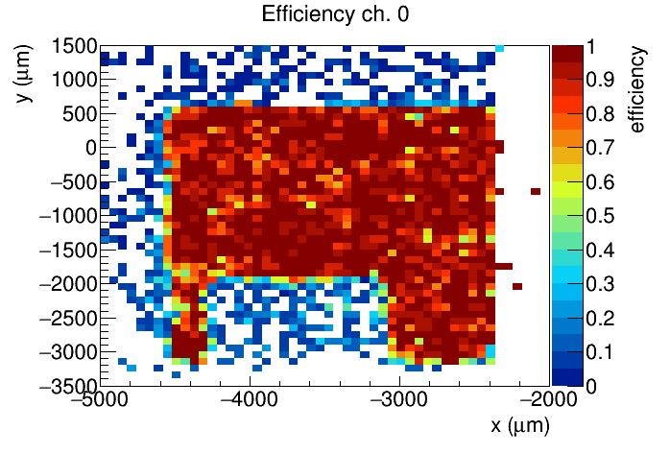
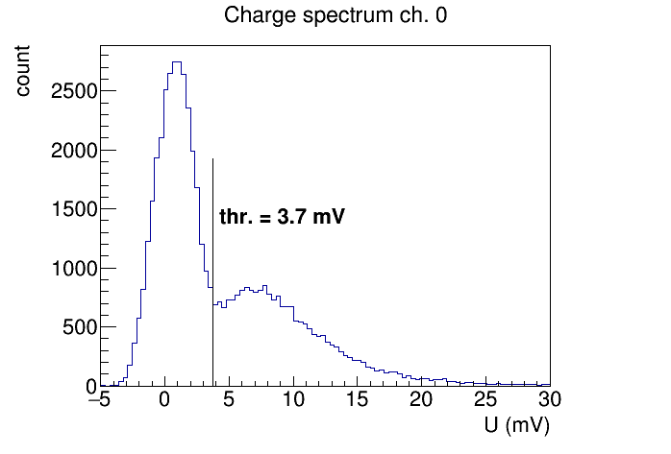
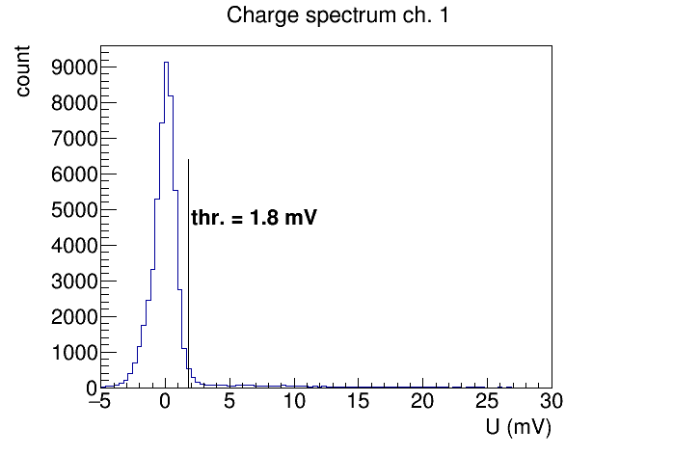
Channel 3
zoom on next slide

