Slide 1
CMOS: DESY test beam with TJ MALTA
F9 Weekly, Ljubljana, 19.04.2019
Bojan Hiti, F9, Jozef Stefan Institute

Slide 2
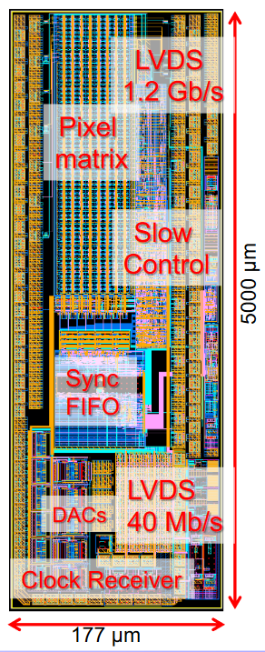
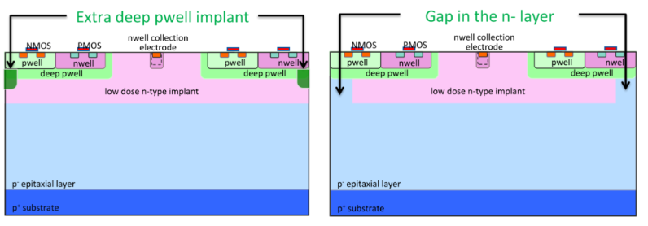
TowerJazz (Mini)MALTA
TowerJazz: Small collecting electrode
Second submission of monolithic CMOS pixel detector
MALTA C – pixels modification to improve charge collection
MiniMALTA – smaller test chip with different pixel modifications and readout changes
64 x 16 pixels
MiniMALTA was DUT in DESY test beam

Slide 3
MiniMALTA
16 x 16 pixels per sector

Slide 4
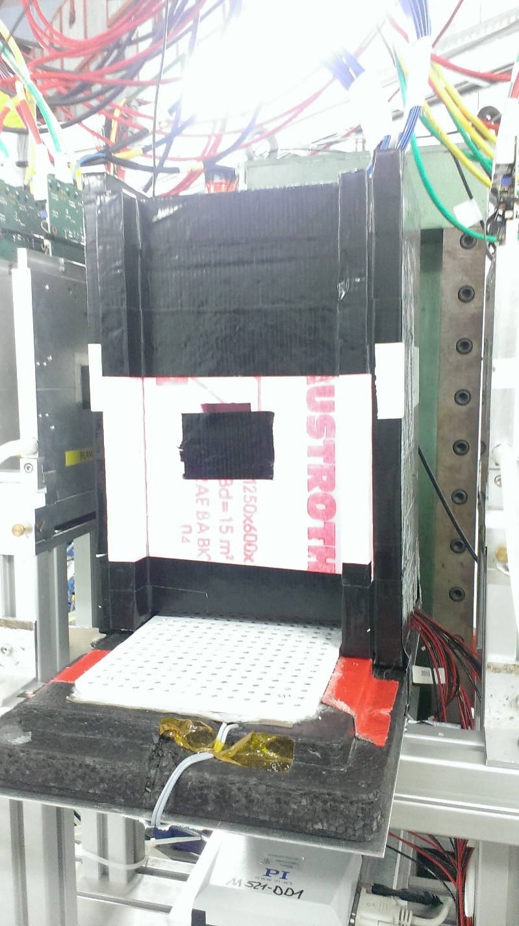
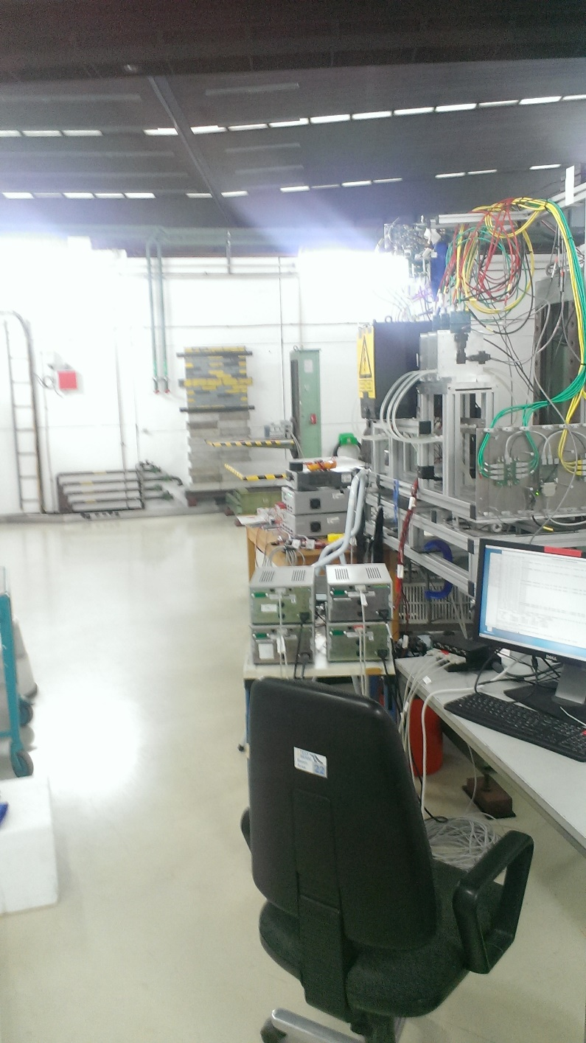
Test beam setup
Beam dump
DRY ICE BRICKS
MALTA C as anchor module
General Broken Line track fitting algorithm

Slide 5
Timing efficiency
very preliminary, to be investigated

Slide 6
Efficiency example 1e15
enlarged transistors
n-gap
Very preliminary, track reconstruction still to be improved
extra deep pwell
standard pixel

Slide 7
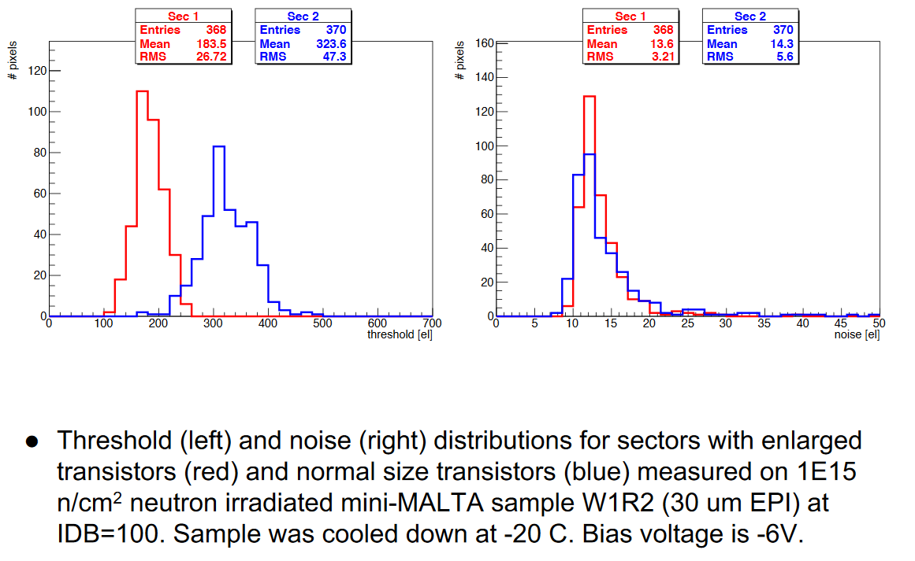
Noise/threshold example 1e15

Slide 8
Efficiency example 2e15

Slide 9
7e14 proton irradiated (ELSA, Bonn)

Slide 10
Conclusion
Changes in pixel architecture improve charge collection after irradiation
n-gap and extra deep pwell implant beneficial
Reduced noise and threshold due to larger transistors
1e15: 95 %
2e15: 85 %
Massive drop in efficeincy after 2e15

