Slide 1

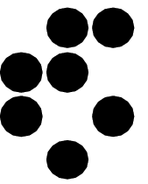
Silicon Sensors at
Extreme
Radiation Fluences
M.Mikuž
G.Kramberger, V.Cindro, I.Mandić, M.Zavrtanik
University of Ljubljana & Jožef Stefan Institute
AIDA2020 Topical Workshop on Tracking at Future Colliders
Oxford, April 2nd, 2019

Slide 2

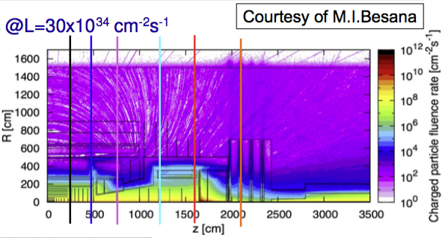
Extreme ?
What is extreme ?
A rather subjective measure
  for LHC 10¹⁵ n_{eq}/cm² was considered extreme
    design was 730/fb @14TeV...
  HL-LHC takes it to nx10¹⁶ (vertex) or even 10¹⁷ (FW calo)
    4000/fb @14TeV
  FCC is dreaming of towards 10¹⁸ for the tracker
    30/ab @100TeV (well, you need x100)
  Ratio 1:20:600 !
What is the limit of tracking sensors ?

Slide 3
Expectations for 10¹⁷ n_{eq}/cm²
Linear extrapolation from low fluence data
  Current: I_{leak} = 4 A/cm³ @20°C
    2 mA/cm² (2W @ 1 kV) for 300 μm thick detector @ -20°C
  Depletion: N_{eff} ≈ 1.5x10¹⁵ cm⁻³
    FDV ≈ 100 kV
  Trapping τ_{eff} ≈ 1/40 ns = 25 ps
    Q ≈ Q₀/d v_{sat}τ_{eff} ≈ 80 e/μm 200 μm/ns 1/40 ns = 400 e in very high electric field (>>1 V/μm)
Looks much like Mission Impossible (part n...)

Slide 4
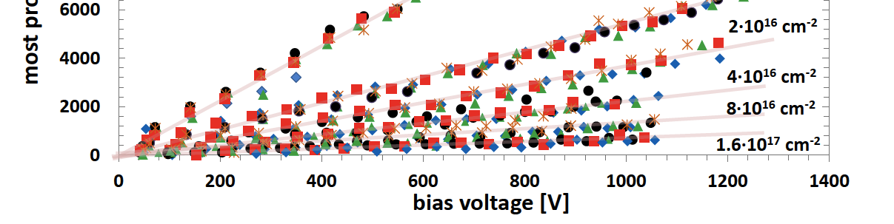
Measurements up to 1.6x10¹⁷ n_{eq}/cm²
Observed signal not at all compatible with expectations
  Above 3x10¹⁵ linear CCE(V_{bias})
  Power law scaling with fluence, b ≈ -⅔
  Leakage current “saturating”
T=-25°C
From:
G. Kramberger et al.,
JINST 8 P08004 (2013).
1000 e

Slide 5
Linear CCE(V) ?
What could be linear
  SCR governed CCE(V) after irradiation (√V), highly resistive ENB (√V), without trapping
  Trapping dominated with non-saturated drift velocity
What is not linear
  velocity saturation
  charge multiplication
  double junction
  field in ENB
  ...
Just a nice coincidence or some physics behind ?
  look into silicon to search for an answer

Slide 6
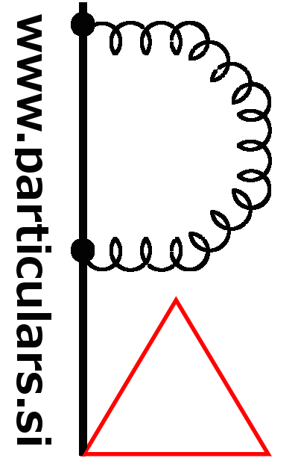
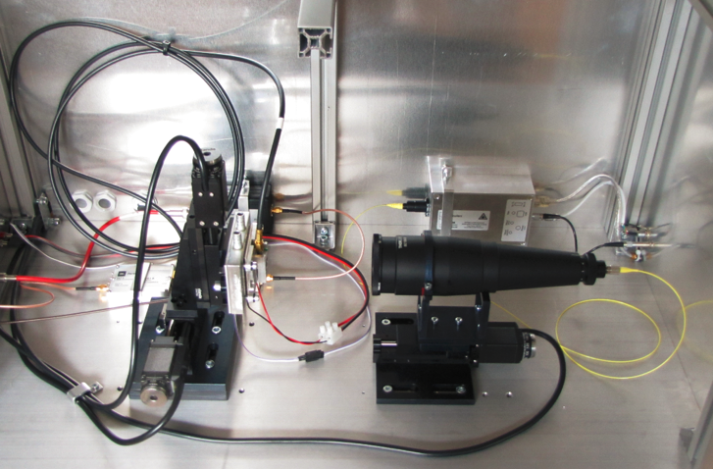
Edge TCT
Edge-TCT
  Generate charges by edge-on IR laser perpendicular to strips, detector edge polished
  Focus laser under the strip to be measured, move detector to scan
  Measure induced signal with fast amplifier with sub-ns rise-time (Transient Current Technique)
  Laser beam width 8 µm FWHM under the chosen strip, fast (40 ps) and powerful laser
    Caveat – injecting charge under all strips effectively results in constant weighting (albeit not electric !) field
Edge TCT

Slide 7
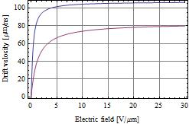
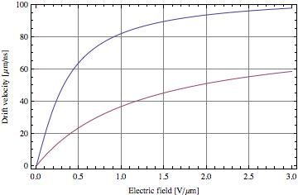
Electric Field Measurement
Initial signal proportional to velocity sum at given detector depth
Caveats for field extraction
  Transfer function of electronics smears out signal, snapshot taken at ~600 ps
    Problematic with heavy trapping
    Electrons with v_{sat} hit electrode in 500 ps
  Mobility depends on E
    v saturates for E >> 1V/μm
Measured signal
non-irradiated
    50 μm from strip
electrons
electrons
holes
holes
90% v_{sat,e} @2.5V/μm

Slide 8
Selected Results from Neutrons
Hamamatsu ATL07 n⁺ mini-strip, FZ p-type, neutron irradiated at JSI TRIGA reactor
  In steps up to 10¹⁶ n_{eq}/cm²
CM !
v saturation
v saturation
Depletion ?
“double
junction”
Depletion
Depletion
E=0
Small E?
Sizeable E??
Very instructive regarding qualitative electric field shape
  Non-irradiated “by the book” for abrupt junction n⁺p diode
    SCR and ENB nicely separated, small double junction near backplane
  Medium fluence (Φ=10¹⁵ neutrons): some surprise
    Smaller space charge than expected in SCR, some field in “ENB”
  Large fluence (Φ=10¹⁶): full of surprises
    Still lower space charge, sizeable field in “ENB”
    Charge multiplication (CM) additional trouble for interpretation at large V
Nice, but let’s try to get quantitative !
Published in :
G. Kramberger et al.,
JINST 9 P10016(2014).

Slide 9
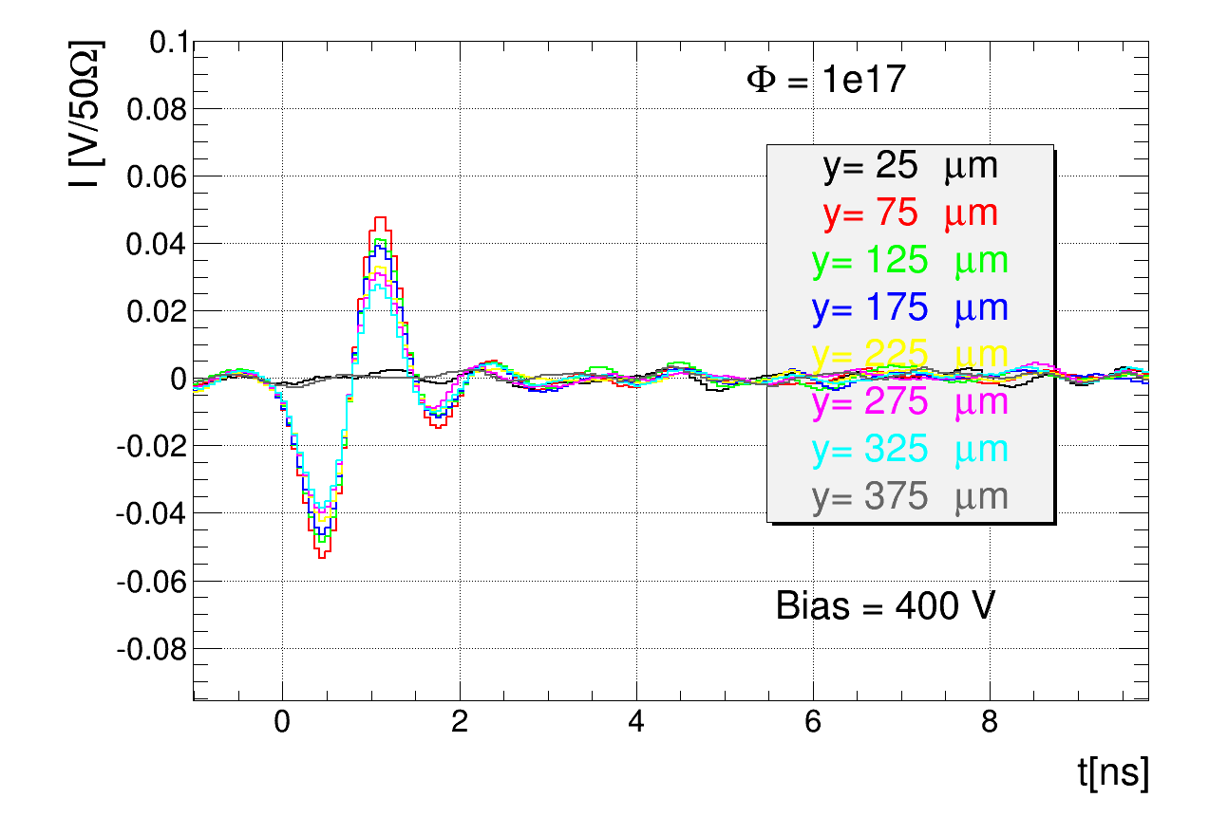
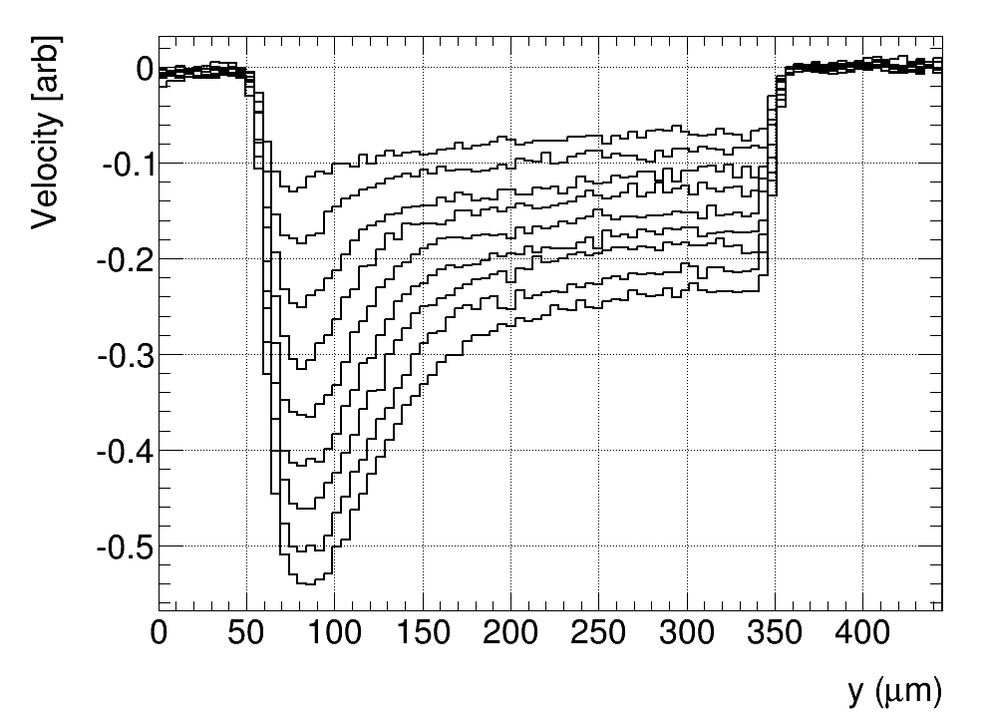
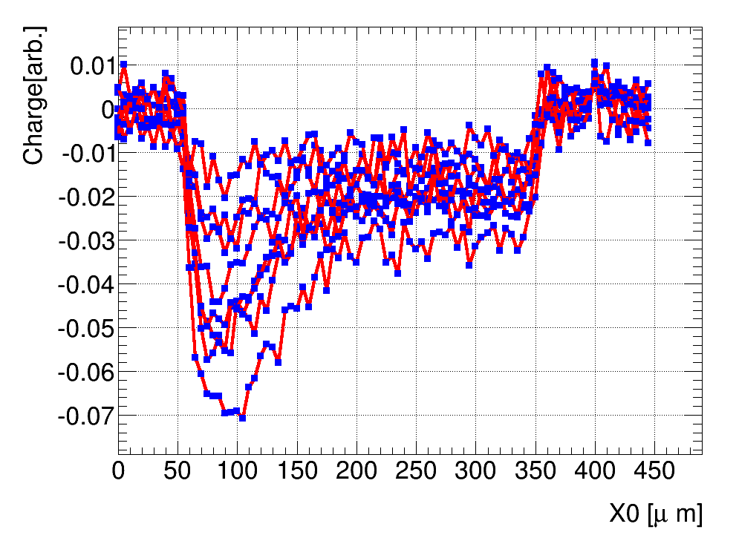
Extending the Reach
In 2014 added 5x10¹⁶ and 10¹⁷ n_{eq}/cm² measurements of the same detector
  10¹⁶ of this fluence fully annealed, the rest 80 min @ 60°C
Intrinsic feature – signal oscillations
  period ~5/4 ns
  LRC (C~2pf => L~20 nH ~ 1cm of wire)
  velocity (slope) and charge (integral) yield consistent results
  should be, as Q ≈ Q₀ v_{sum}τ_{eff} /d
Cannot use I(t) to measure trapping...
... shall take a closer look
Signal I(t)
10¹⁷ velocity
profile
10¹⁷ charge
profile

Slide 10
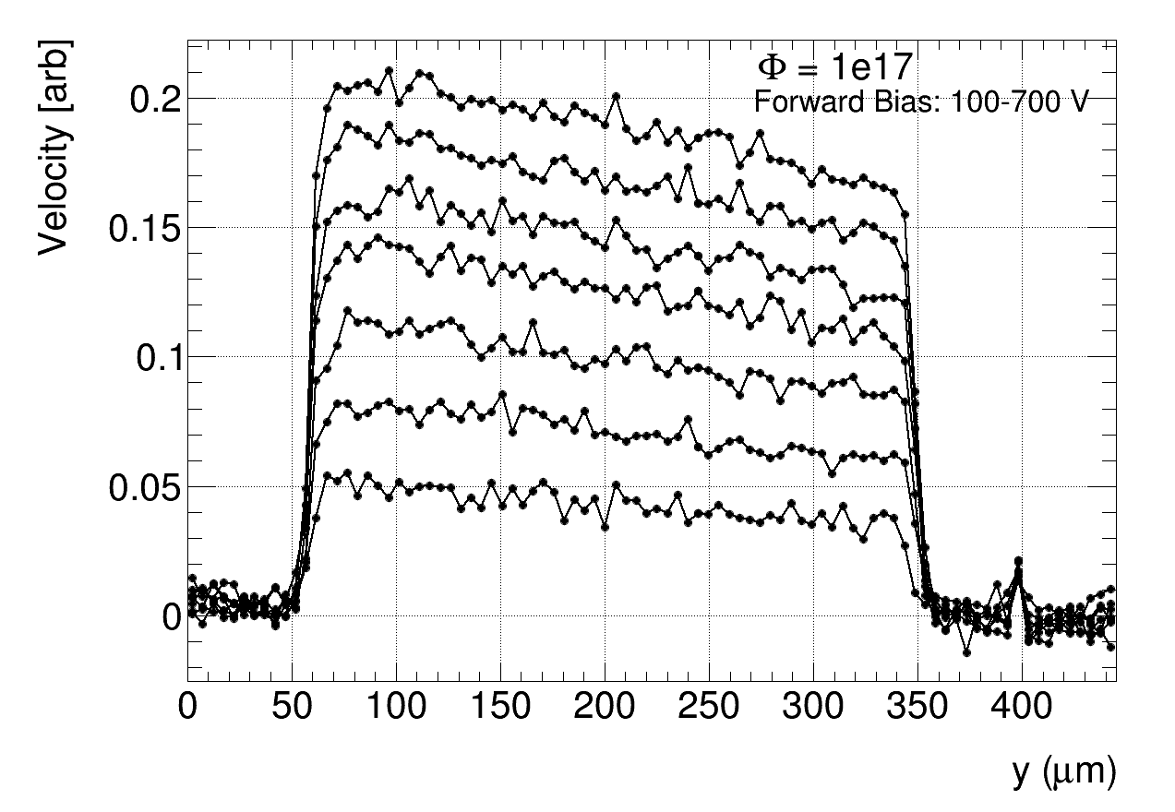
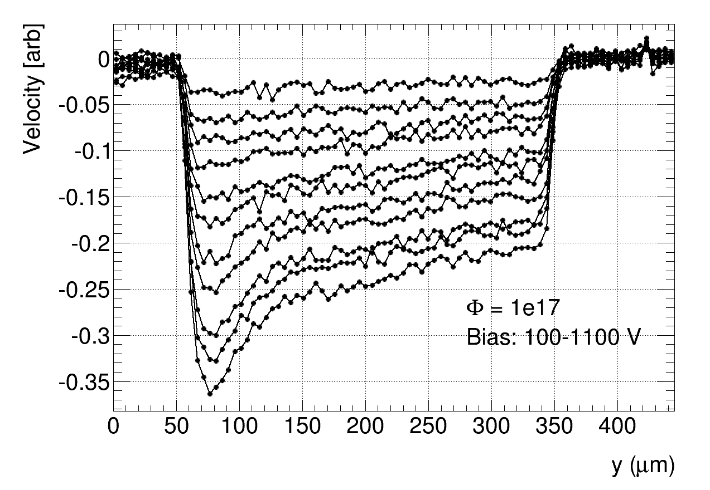
Absolute Field Measurement
Solution: concurrent forward bias v_{sum} measurements
  Ohmic behaviour with some linear (field) dependence
    constant (positive) space charge
  can use to pin down field scale
    corrections from v(E) non-linearity small
Use same scale for reverse bias!
FW measurements up to 700 V
  know E scale up to 2.33 V/μm
  can reveal v(E) dependence
2 V/μm
1 V/μm
Forward
1 V/μm
2 V/μm
Reverse

Slide 11
Proton Irradiations
5 sample pairs of ATL12 mini-strips irradiated at CERN PS during summer 2015
  got 0.5, 1.0, 2.9, 11, 28e15 protons/cm², no scanning
  NIEL hardness factor 0.62
  thanks to CERN IRRAD team
    took 41 PS days to reach the highest fluence
Covers HL-LHC tracker range well
  does really not look practical for 10¹⁷++
2 samples per fluence investigated by E-TCT for all fluences
  concurrent forward and reverse bias measurements

Slide 12
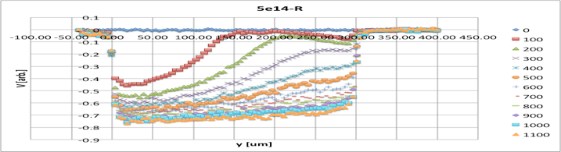
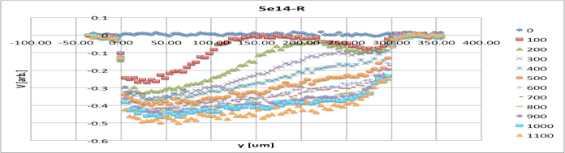
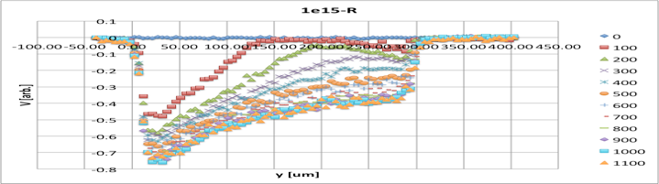
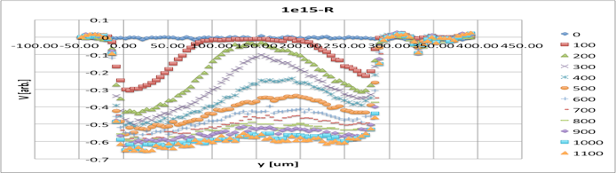
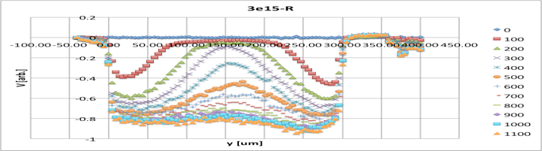
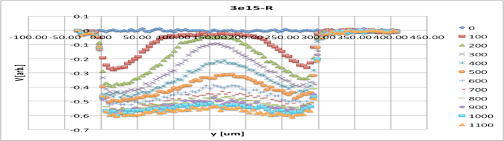
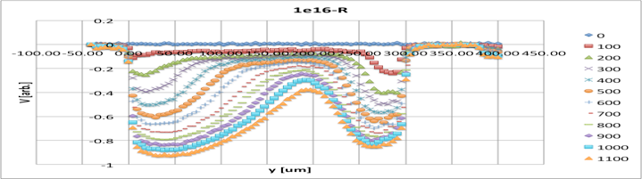
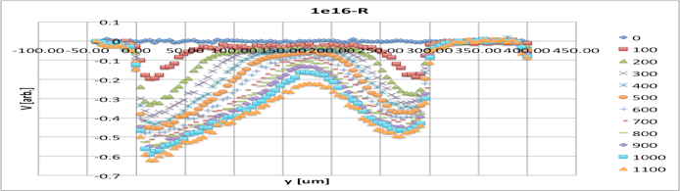
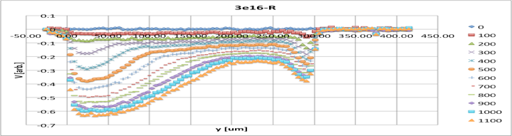
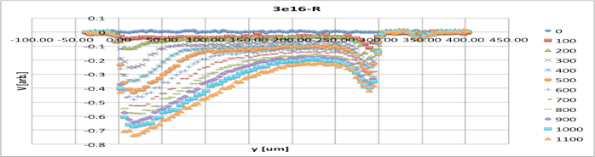
Reverse velocity profiles
samples A
samples B
5e14
1e15
?
3e15
1e16
3e16
Something’s fishy... never repeat experiments ?!

Slide 13
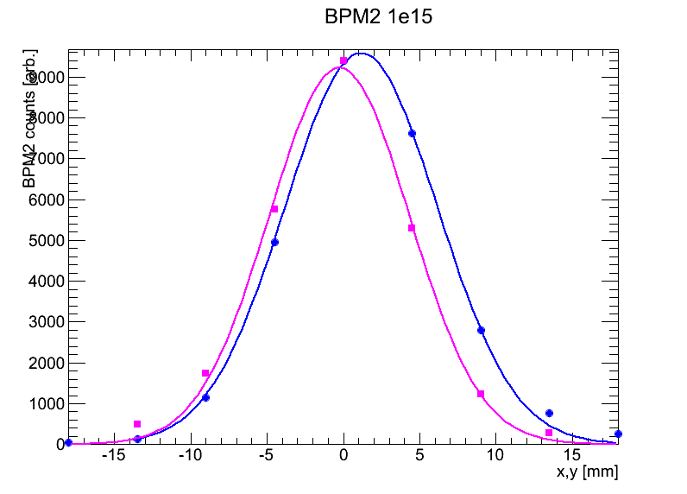
Proton irradiations - details
Samples irradiated in PS in pairs
  in series in same sample holder
Same leakage current in both samples
  same average fluence received
Beam profile asymmetric
  monitored by BPM2
Which side did we pick up ?
?

Slide 14
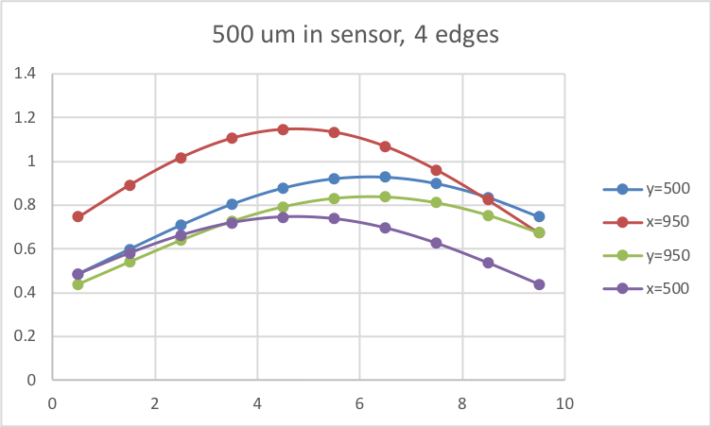
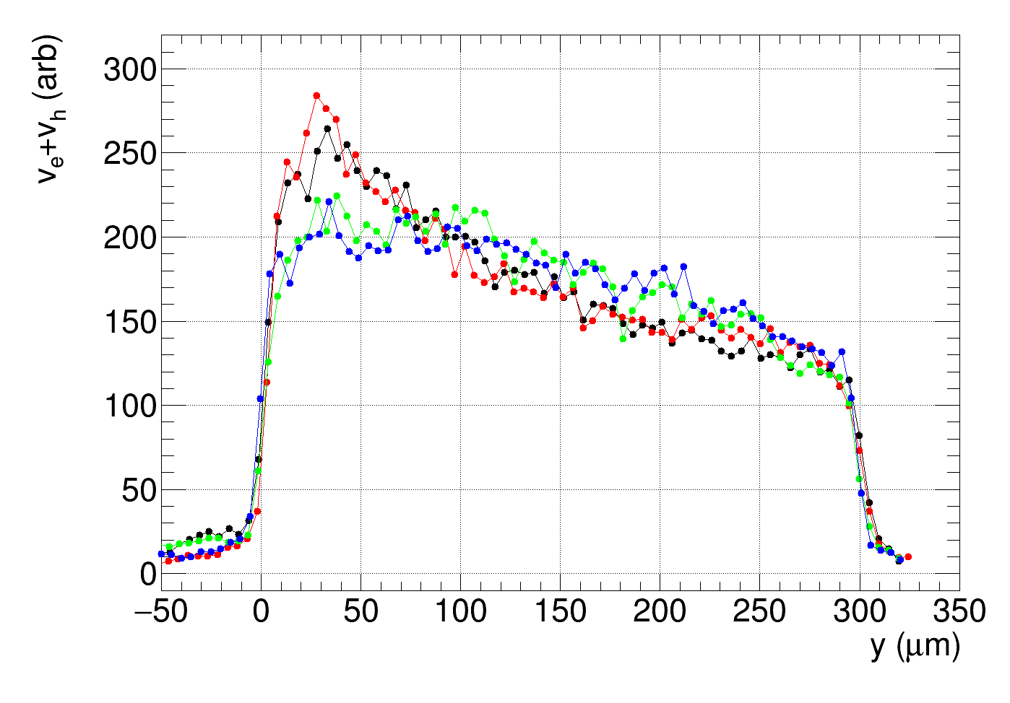
Protons revisited
BPM2 results for the 1e15 sample, 0.5 mm in sensor
10x10 mm² average to peak: 0.7
  Values rescaled
Mid-side to average:
  1.17, 0.88, 0.82, 0.74
    Must be the larger difference
  Correct fluences by -10 %
  Assign 20 % error
Re-measured one sample from both sides, match with BPM2 data – still in progress
  Looks like explaining the issue
1000 V reverse

Slide 15
Additional irradiations
3e17 n_{eq}/cm², JSI reactor neutrons
  A12 mini, 7x8 mm², 75 µm pitch, 300 µm thick
    Also to 3e16, 1e17
  Spaghetti: 4x4 mm2, n-on-p, strip pitch 80 um, 300 um thick, strips connected together at side
    1.6e17 received previously, 4.6e17 total
A12
Spaghetti

Slide 16
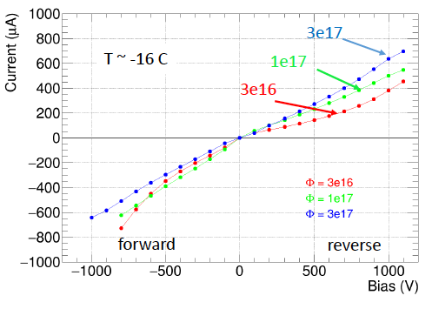
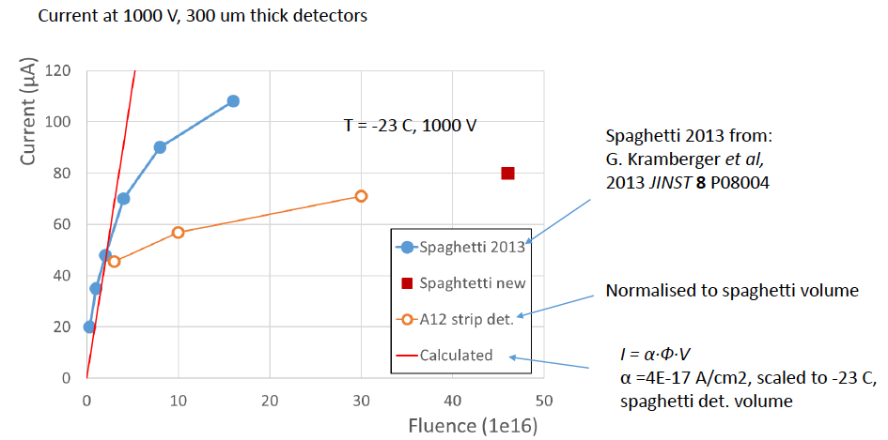
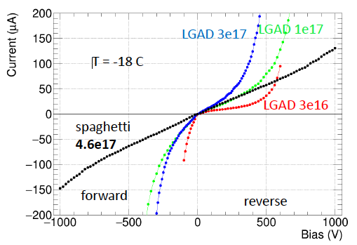
Basic measurements
I-V for 3&4.6e17 looks very linear with little difference between reverse/FW bias
  No breakdown, as observed in LGAD’s
I @1000 V does not scale linearly with fluence !
  Not governed by generation current ?
Tried to measure 4.6e17 spaghetti CCE with ⁹⁰Sr
  No signal above background observed up to 320 V
  Magic formula predicts 120e for 4.6e17 @320 V
𝜌 ≈ 30 MΩcm
Warning: T uncertain
𝜌 ≈ 120 MΩcm

Slide 17
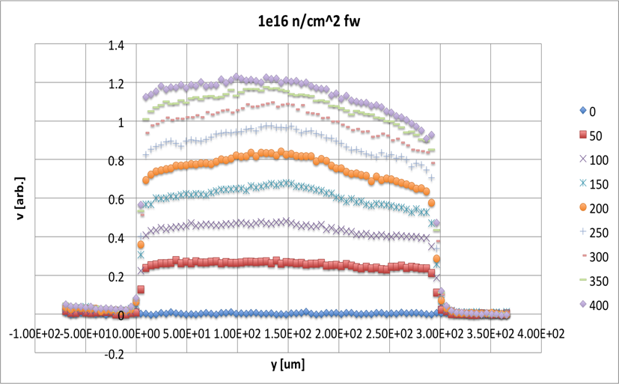
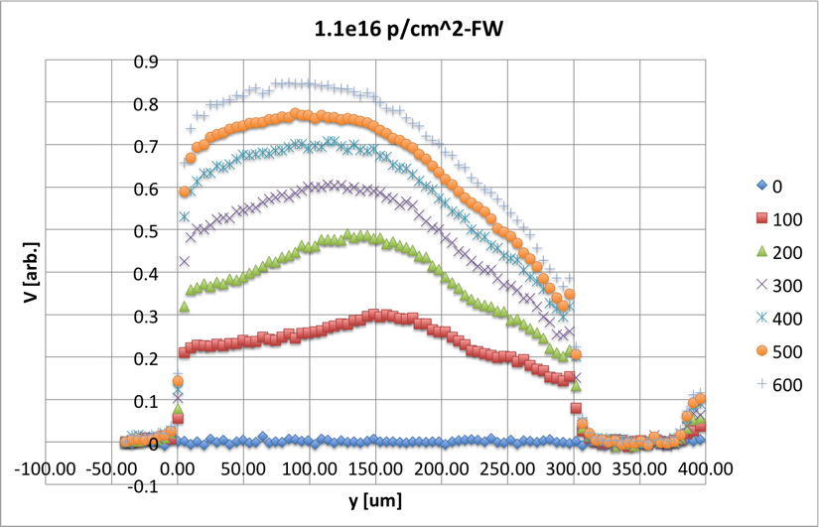
Mobility Considerations FW bias
For forward bias can extract v(E) up to a scale factor
Observe less saturation than predicted
Model with
  keep saturation velocities at nominal values @-20°C (v_{e,sat} = 107 μm/ns; v_{h,sat} = 83 μm/ns)
  float (common) zero field mobility degradation
  fit v(E) for ϕ_{n}≥5x10¹⁵ and ϕ_{p}≥3x10¹⁵
    n.b. FW profiles less uniform for lower fluences & protons; departures from average field still small, corrections O(%)
neutrons
n⁺
- - - - - - - - - -
+ + + + + + + +
p⁺
protons

Slide 18
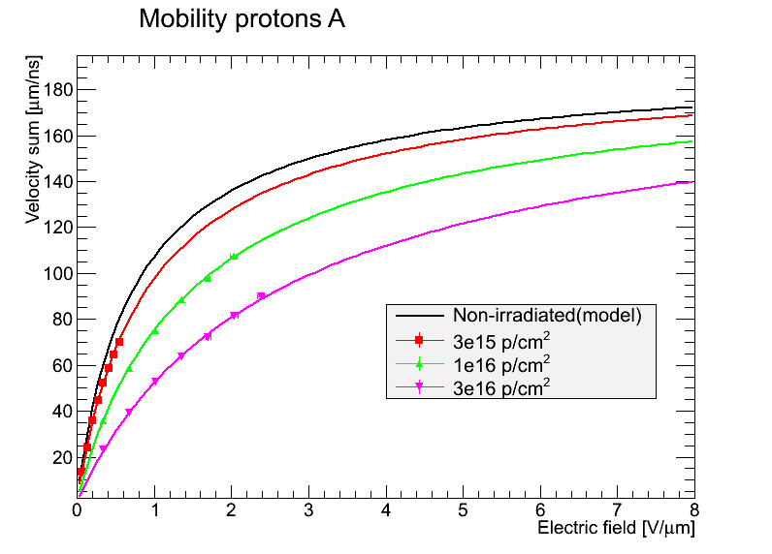
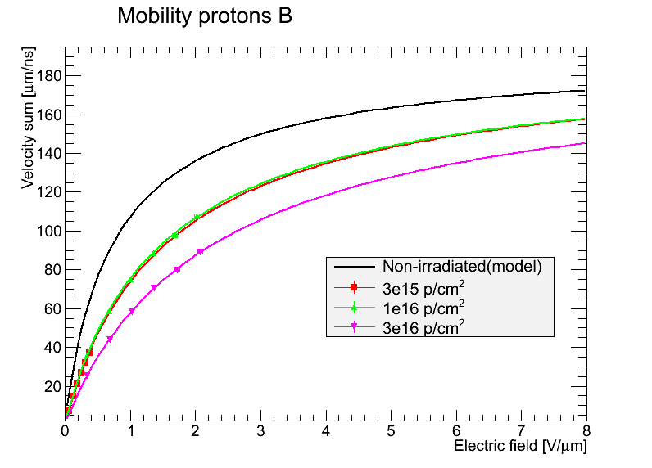
Mobility Fits
Data fits model almost perfectly
  μ₀ degradation the only free parameter, scale fixed by v_{sum,sat}
  At 3e17 E range too limited (v(E) linear), regard result as upper limit

Slide 19
Mobility Results
Fit to v_{e} + v_{h} with common mobility degradation factor
  factor of 2 at 10¹⁶ n_{eq}/cm², 6 at 10¹⁷ n_{eq}/cm², >10 at 3x10¹⁷ n_{eq}/cm²
  need 2x/6x/>10 higher E to saturate v !
  correspondingly higher E for charge multiplication !
Φn | μ_{0,sum} | Φp | μ_{0,sum}
[10¹⁵ n_{eq}/cm²] | [cm²/Vs] | [10¹⁵ n_{eq}/cm²] | [cm²/Vs]
non-irr (model) | 2680
5 | 1661 ± 134 | 1.6 | 2063± 188
10 | 1238 ± 131 | 6.1 | 1337± 47
30 | 560 | 15.4 | 817± 42
50 | 555 ± 32
100 | 407 ± 40
100 | 420
300 | <240
T=-20°C

Slide 20
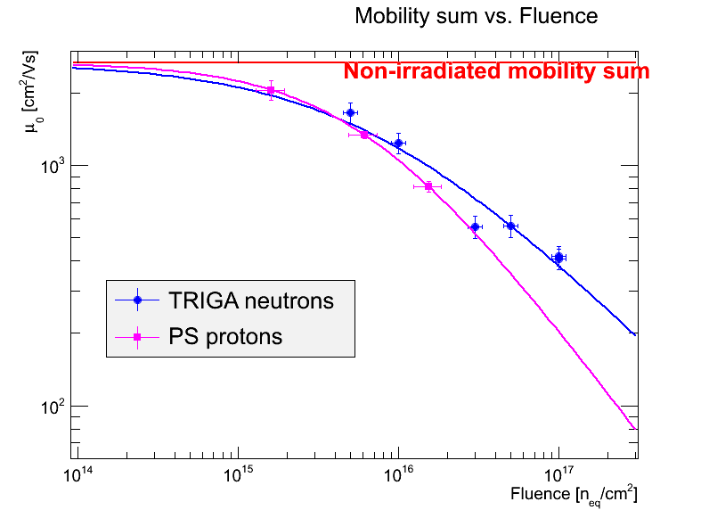
Mobility Analysis
Mobility governed by hard scattering on acoustic phonons and traps
Fit mobility dependence on fluence with a power law
Fits perfectly, value of a close to linear
  10% error assumed for all neutron data
At same NIEL, mobility decrease worse for protons
  NIEL violation ? Large errors ?
Irradiation particle | a | σ_{a} | Φ_{½} /10¹⁵ | σ_{Φ½} /10¹⁵
Reactor neutrons | -0.68 | 0.08 | 6.9 | 1.7
PS protons | -0.90 | 0.19 | 6.1 | 1.0

Slide 21
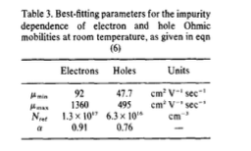
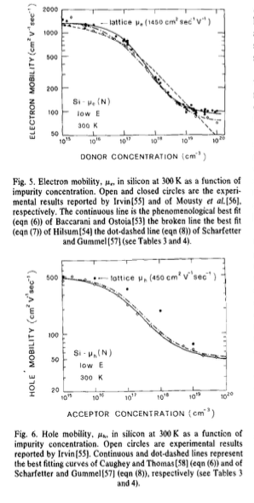
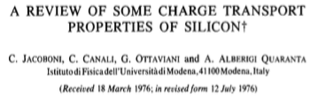
Mobility Comparison
Dependence on shallow dopant concentration
  Measured in the roaring 60’s
Characteristic trap concentration N~10¹⁷ cm⁻³
  looks out of reach for typical g=O(10⁻²)
But g refers to N_{eff} = |N_{a} – N_{d}|
While N is more like N_{a} + N_{d}
  x-sections for deep and shallow ?
Power law looks compatible: a ≤ 1

Slide 22
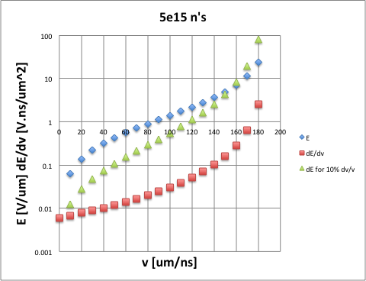
Velocity and Field Profiles
Knowing v(E) can set scale to velocity profiles
  assumption: same scale on FW and reverse bias
    protons: for 5x10¹⁴ and 10¹⁵ use same scale, fixed by average field for 5x10¹⁴ at 1100 V (no good FW data)
Invert E(v) to get electric field profiles
  big errors when approaching v_{sat} i.e. at high E
    exaggerated by CM in high field regions
    v > v_{sat} not physical, but can be faked by CM

Slide 23
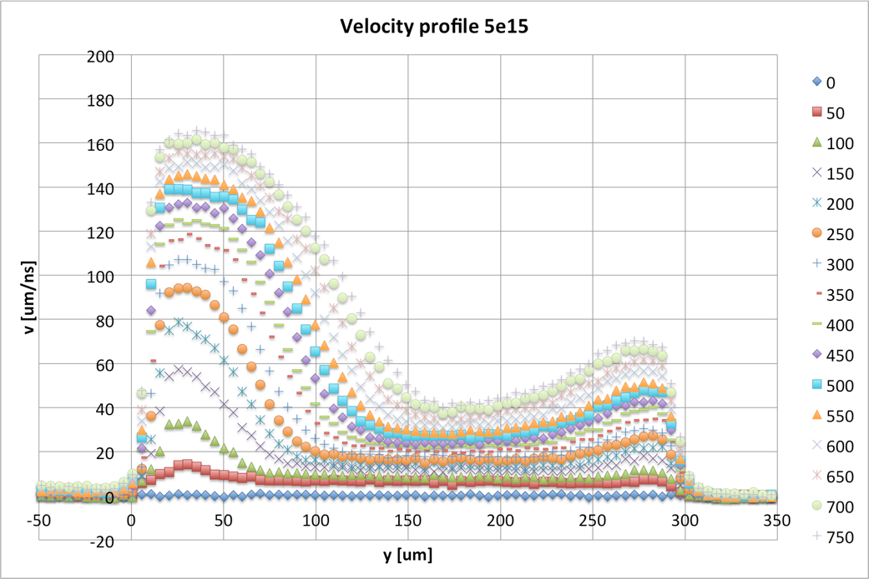
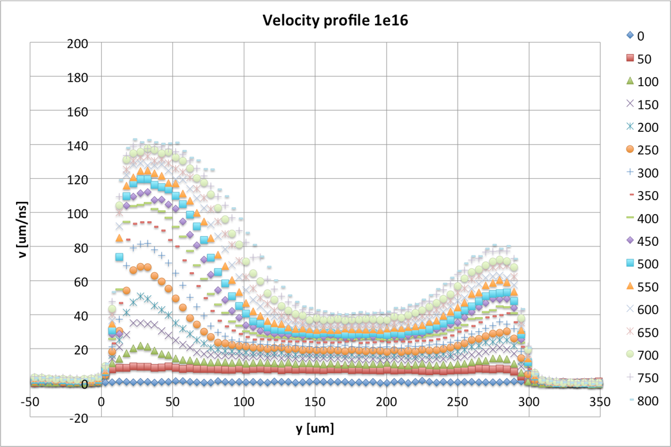
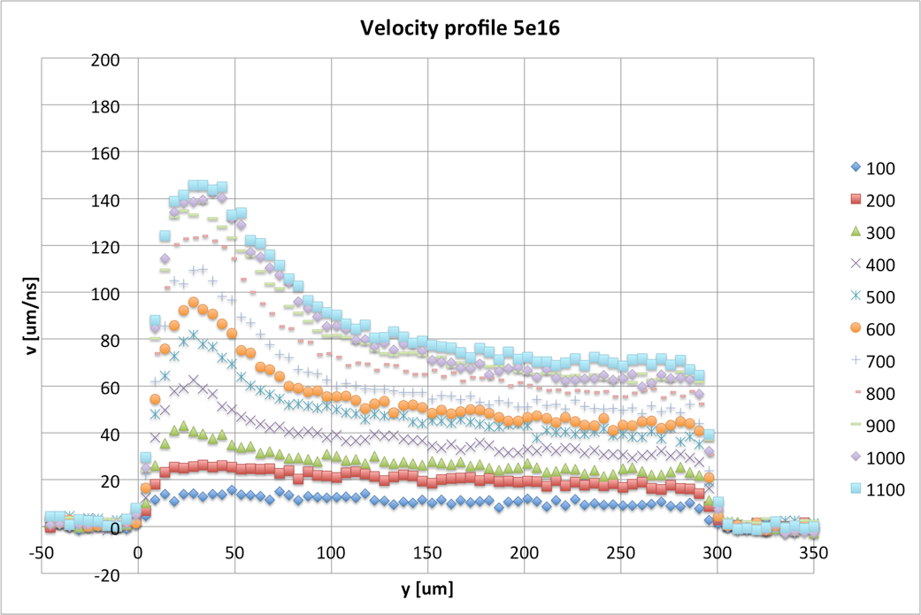
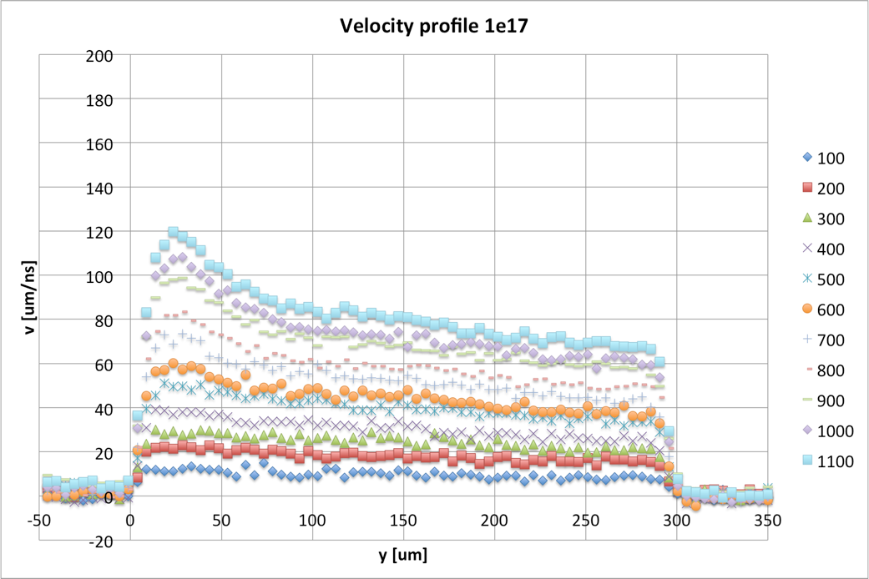
Velocity Profiles Neutrons
v = 190 μm/ns
v = 190 μm/ns

Slide 24
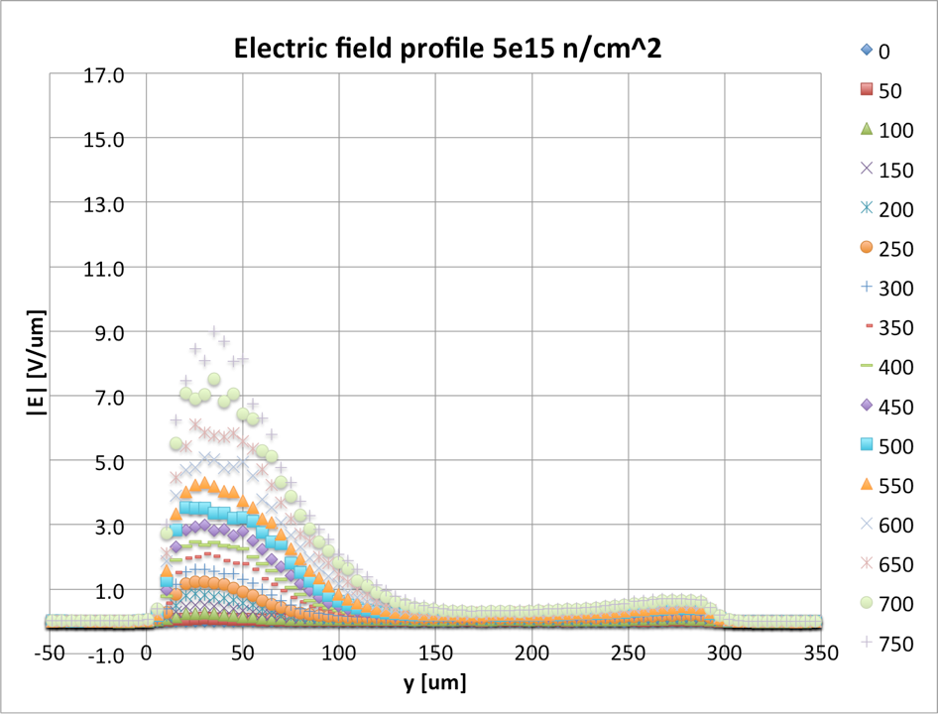
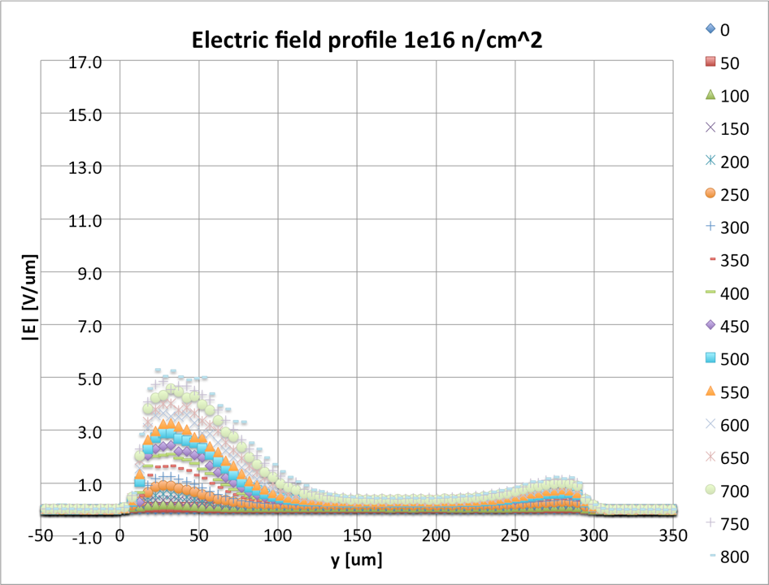
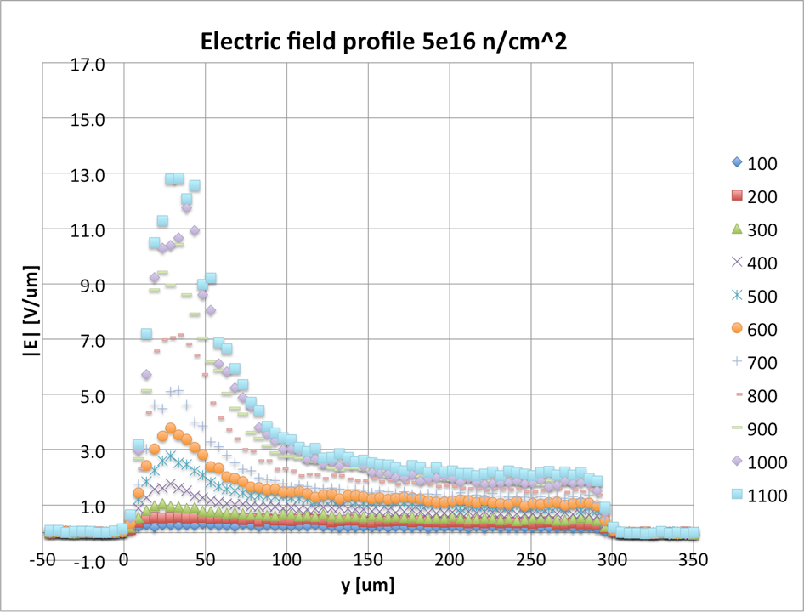
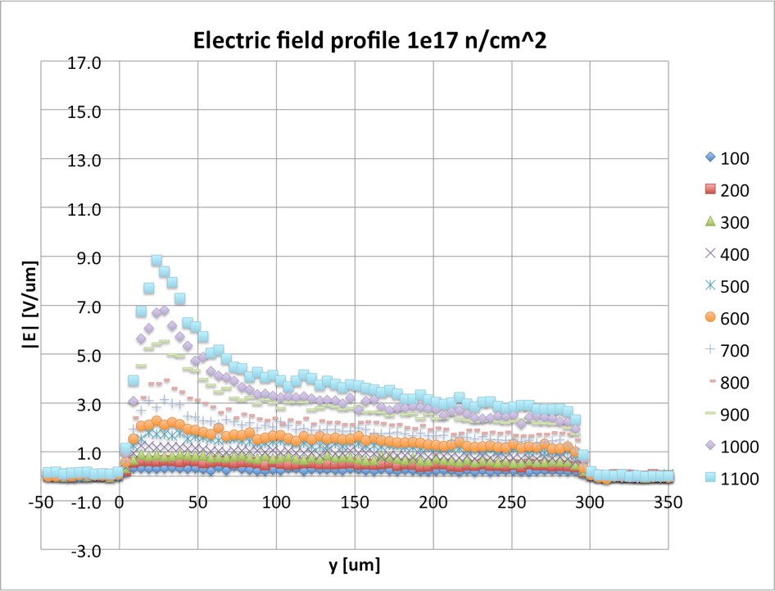
Field Profiles Neutrons

Slide 25
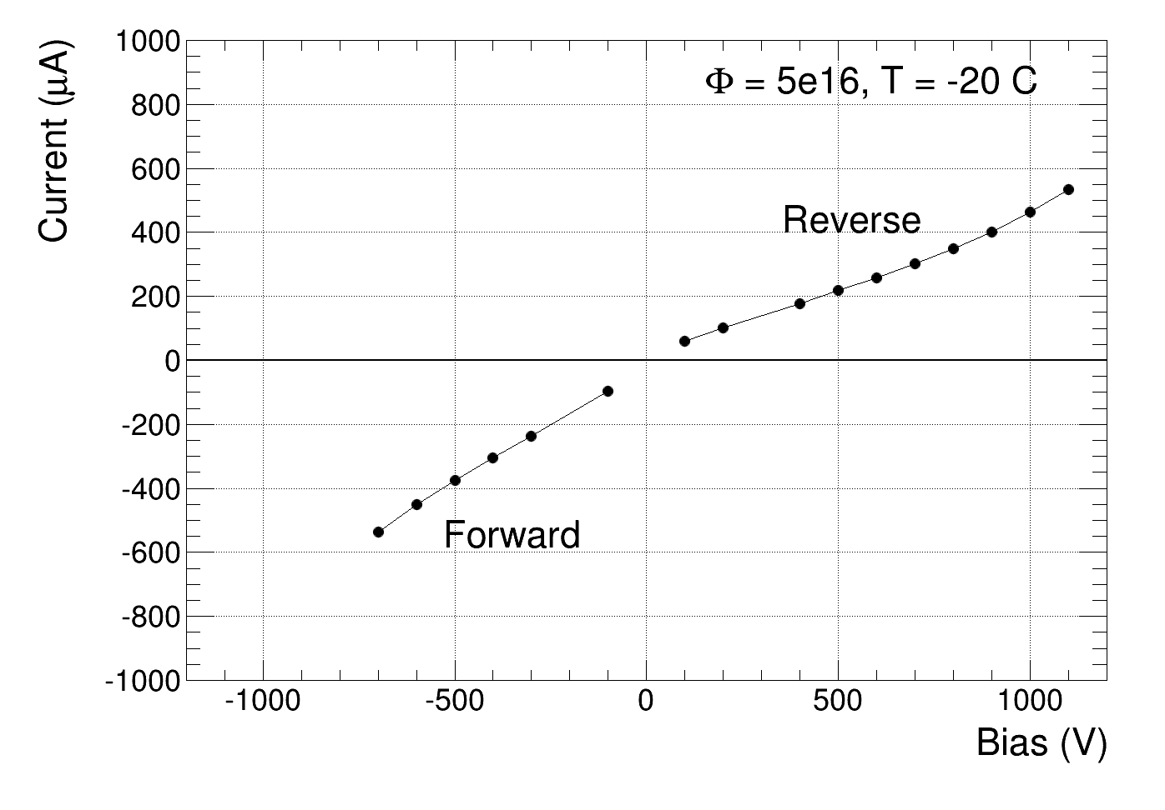
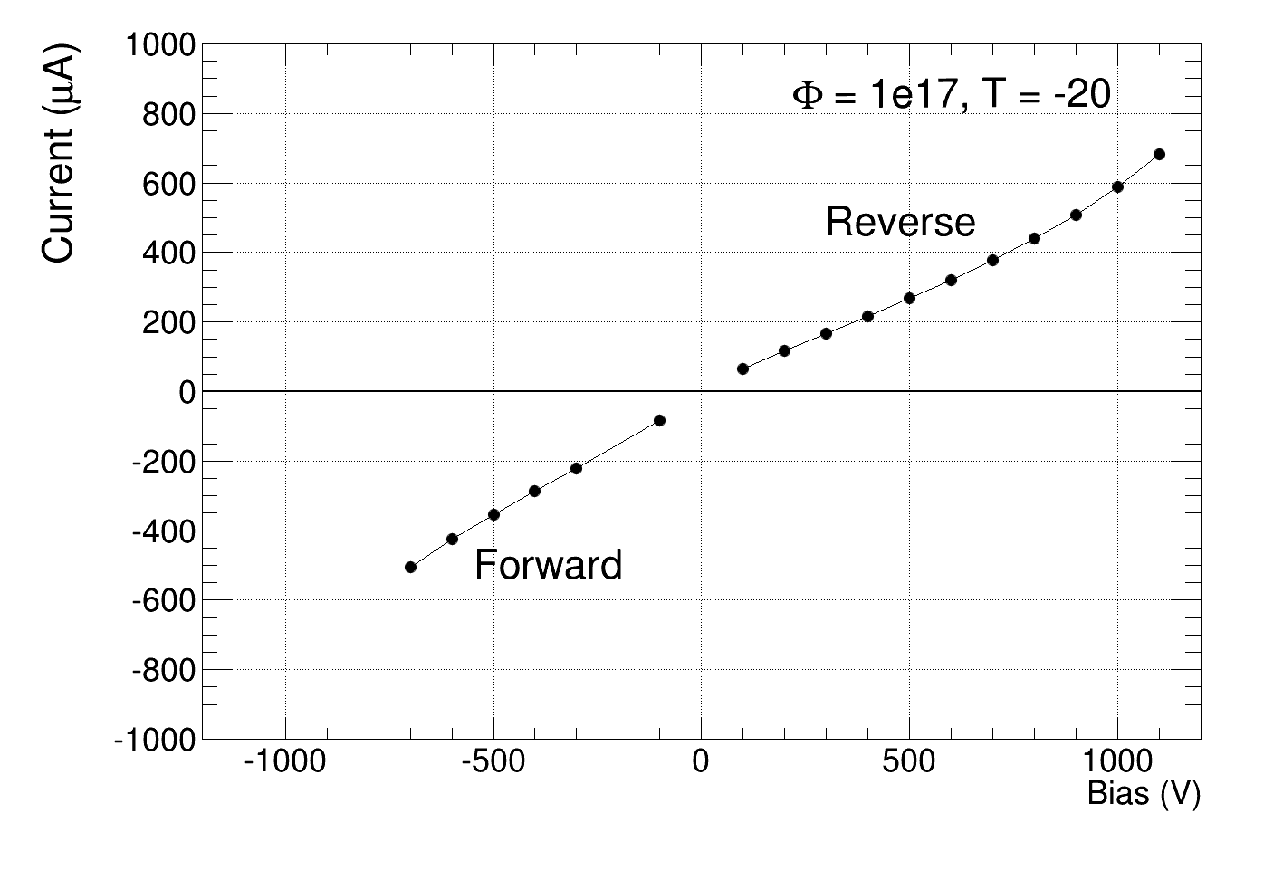
Current Characteristics
Smooth behaviour in both directions
  Highly resistive Si limits FW injection
Reverse current smaller than predicted by an order of magnitude
Both currents rising ~linear with bias
  Slopes FW/reverse more compatible at higher fluences
Consistent with recent measurements at highest fluences

Slide 26
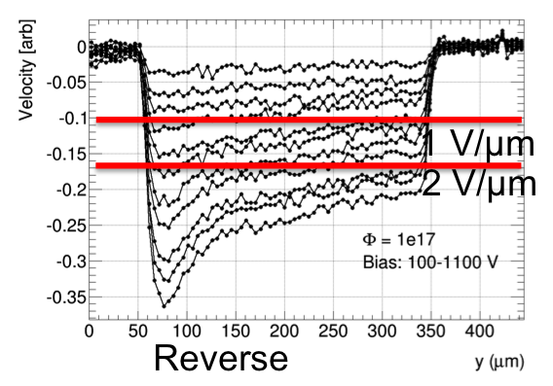
Reverse Bias Field Profile
Depletion ?
Two distinct regions at high biases
  Large region from backplane with (small) slope in the field
    constant (small, negative) space-charge
    E = j.ρ at junction ? like “ENB” ?
    indication of thermal (quasi)equilibrium: np = n_{i}² ?
    thus no current generation ?
  Small region at junction building up with bias
    depleted space-charge region ?
    source of generation current ?
1 V/μm
2 V/μm
Φ = 5e16
Bias: 300-1100 V
Depletion ?

Slide 27
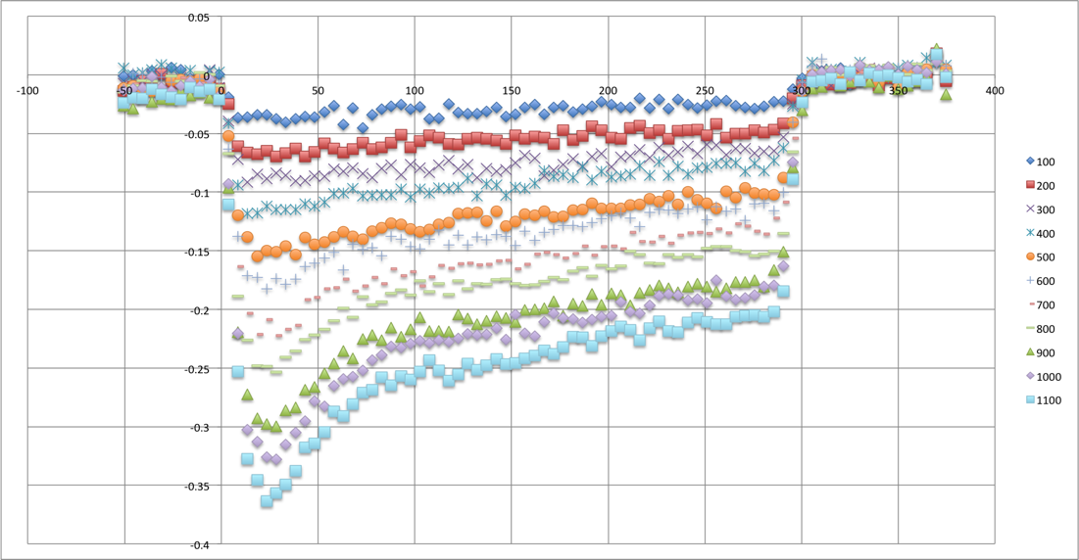
SCR Consistency
Hard to estimate SCR extent, especially at lower bias and highest fluence
A crude estimate
  5x10¹⁶ n_{eq}/cm² :
  ~80 μm @ 600 V; ~120 μm @ 1000 V
  10¹⁷ n_{eq}/cm² :
  ~60 μm @ 600 V; ~80 μm @ 1000 V
60/80 μm
1e17 n_{eq}/cm²
Predicted/measured currents
  5x10¹⁶ n_{eq}/cm²: 300/300 μA @ 600 V; 400/500 μA @ 1000 V
  10¹⁷ n_{eq}/cm²: 400/300 μA @ 600 V; 500/600 μA @ 1000 V
  Not compatible with linear I-V at 3 & 4.6e17 – pure resistor ?
Reasonable agreement with current generated exclusively in SCR
  n.b. - current “saturation” observed @1000V in JINST 8 P08004 (2013)
Acceptor introduction rates: g_{c} ≈ 6/4x10⁻⁴ cm⁻¹
  substantial part (up to 80 %) of voltage drop “spent” in “ENB”
  matches well data in JINST 9 P10016(2014) (up to 10¹⁶)

Slide 28
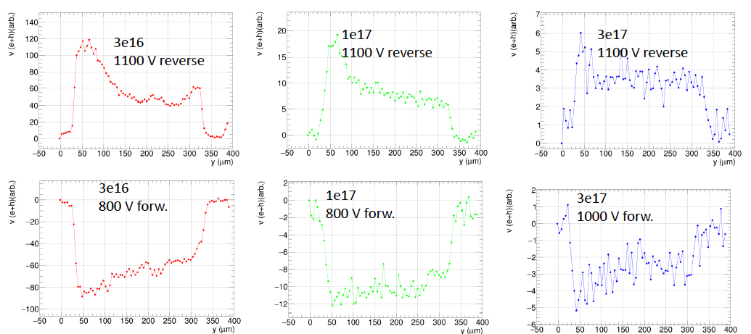
ATL12 up to 3e17
Estimate of SCR width 115 -> 75 -> 40 μm
V_{drop} in SCR only 23 -> 19 -> 6 % of 1100 V
49:165
56:240
7:105
D=115
D=75
D=40

Slide 29

Acceptor introduction in SCR
Stable acceptor introduction rate g_{c} drops by nearly two orders of magnitude from low fluences to 3x10¹⁷
  Observed up to 10¹⁶ in JINST 9 P10016(2014)
  Looks like a power law
    g_{c} in JINST not taking into account voltage drop out of SCR – higher values of g_{c}

Slide 30


“ENB” Consistency
Space charge in “ENB” rising with bias, e.g. for 10¹⁷ n_{eq}/cm²
  1.6x10¹¹@ 100 V, 9.2x10¹¹cm⁻³ @ 500V
  c.f. ~4x10¹³cm⁻³ in SCR
  negative space charge, like in SCR
Resistivity from ρ = j/E @ 100 V
  maximum ρ(p) ≈ 2.8x10⁷ Ωcm using nominal mobilities @ p ~ 2x10⁸ cm⁻³
    all measured values exceed this limit
  compatible with measured mobility sum and p~O (10⁹) cm⁻³
  Compatible also with ρ from I-V for 3 & 4.6e17
50 μm
250 μm
1e17
ρ(p)
Φ | ρ | p
[n_{eq}/cm²] | [10⁷ Ωcm] | [10⁹ cm⁻³]
1e16 | 3.3 | 0.5
5e16 | 3.0 | 1.5
1e17 | 2.8 | 2.1

Slide 31
Trapping Considerations
Extrapolation from low fluence data with 𝛽_{e,h}(-20°C)=4.4,5.8x10⁻¹⁶ cm²/ns; 1/τ= 𝛽 Φ
Measured data exceeds (by far) linear extrapolation of trapping
  n.b.1: E~3 V/μm by far not enough to saturate velocity
  n.b.2: little sign of CM at highest fluences
Φ [1e15] | 5 | 10 | 50 | 100
τ [ps] | 400 | 200 | 40 | 20
mfp@v_{sat} [μm] | 95 | 48 | 9.5 | 4.8
MPV [e₀] | 7600 | 3800 | 760 | 380
MPV@1000 V | 8900 | 5500 | 1800 | 1150
CCD_{1000 V} [μm] | 110 | 70 | 23 | 14
From “magic formula”
JINST 9 P10016(2014)

Slide 32

More Considerations
More realistic: take v_{sum} at average E = 3.3 V/μm
Implies factor of 6-9 less trapping at highest fluences
  lowest fluence still x2 from extrapolation
  weak dependence on fluence as anticipated
  CM would effectively shorten trapping times
  not good when large E variations (v(E) saturates)
  not good when CCD ≈ thickness (less signal at same τ )
Φ [1e15] | 5 | 10 | 50 | 100
v_{sum}(3.3 V/μm) | 137 | 126 | 90 | 77
CCD_{1000 V} [μm] | 110 | 70 | 23 | 14
τ ≈ CCD/v [ps] | 800 | 560 | 260 | 180
τ_{ext} [ps] | 400 | 200 | 40 | 20

Slide 33


Exploiting TCT Waveforms
Waveforms at y=100 μm, 800 V, 5x10¹⁶ and 10¹⁷
  E ≈ 3 V/μm, CCD/2 implies signal within ~10 μm or <0.2 ns
    the rest you see is the transfer function of the system
Still distinct signals from the two fluences
  treat 10¹⁷ waveform as transfer function of the system
    convolute with e^{-t/τ} to match 5x10¹⁶ response
    τ = 0.2 ns provides a good match
In fact, measure ~Δτ, as “transfer” already convoluted with e^{-t/τ(1e17)} !
τ = 0.2 ns
FWHM
525 ps
500 ps

Slide 34


Waveforms: How sensitive ?
Δτ = 0.2 ns certainly best fit, 0.1 too narrow, 0.3 too broad
precision ~50 ps

Slide 35






Trapping – position dependence ?
Waveforms plotted every 50 um in detector depth for reverse bias at 1000 V
Forward bias in middle of detector added at 600 V
Very little, if any, wf dependence on position observed
Trapping not position (even not bias) dependent !?
reverse
bias
FW bias

Slide 36


Trapping @3e17
Moved to another setup – different waveforms
  Widths of reverse and FW similar
  With decreases 1->3e17
  Irregular waveforms with small signal @3e17
  Hard to state something more quantitative
1e17
800 V
3e17
1000 V
Blue
Reverse
Black
FW
FWHM
830 ps
FWHM
750 ps

Slide 37
Summary
Measurements performed on Si detectors irradiated to extreme fluences
  Neutrons from 10¹⁵ to 3x10¹⁷ n_{eq}/cm² , PS protons from 5x10¹⁴ to 3x10¹⁶ p/cm²
  Velocity vs. electric field impact observed and interpreted as reduction of zero field mobility
    Zero field mobility follows power law with |a| ≤ 1, Φ_{½} ≈ 10¹⁶ n/cm²
    Protons degrade mobility more than neutrons
    Induces resistivity increase in-line with measured I-V
    Must have adverse effect on charge multiplication !
  Simple field profile for very high neutron fluences
    SCR and highly resistive ENB
    Effective acceptor introduction rates reduced by factor ~100 wrt low fluences
    Current much lower than anticipated. Generated in SCR only ? Ohmic at highest fluences…
  Trapping estimates for very high neutron fluences
      from charge collection
      from waveforms
    All estimates point to severe non-linearity of trapping with fluence
    Trapping appears independent of electric field
Conclusion: Low fluence extrapolations do not work at all !
… go out and measure to get anything working at extreme fluences !!!

Slide 38
Backup Slides

Slide 39

Charge Multiplication
Multiplication is textbook physics
  e.g. S.M. Sze, Physics of Semiconductor Devices, Wiley, New York, 1981
    Ch 1.6.4 High-Field Property
      Velocity saturation, impact ionization
    Ch 2.5.3 Avalanche Multiplication
      Junction break-down
Measured impact ionization
  Electrons create 1 pair in 10 µm at E~20 V/µm (100 µm at 14 V/µm), holes need E~40 V/µm
  Holes need ~1 mm for pair creation at E~20 V/µm
    Neglect hole multiplication in signal creation altogether
    Need to invoke hole multiplication for junction breakdown
α_{e} >> α_{h} - Nature gentle to us (in silicon)
  Large range in E where electrons multiply without inducing breakdown
  But beware of (too) high electric fields !
A. G. Chynoweth, Phys. Rev. 109, 1537(1958).
R.VAN OVERSTRAETEN and H.DE MAN,
Solid-State Electronics 13(1970),583-608.
W.MAES, K.DE MEYER, R.VAN OVERSTRAETEN,
Solid-State Electronics 33(1990),705-718.
Breakdown condition, can swap α_{e} with α_{h}

Slide 40





Velocity Profiles Protons
a
v = 190 μm/ns
Same scale as
for neutrons

Slide 41





Field Profiles Protons
a
Smaller peak fields
than for neutrons
Scale 0-7 V/μm

