Slide 1
HVCMOS
RD50 CMOS project – nov čip RD50-MPW2 pride ven julija, 4 upornosti
mi bomo merili E-TCT s pasivnimi pixli (diode)
dobro bi bilo, če bi lahko brali in merili E-TCT tudi z aktivnimi detektorji
(to bi se dalo z RD50-MPW2, ker je čip majhen in je PCB narejen tako, da je čip ob robu)
Za branje aktivnih pixlov na RD50-MPW2 bi rabili
CaRIBOu – dobimo pri UNI Geneva ~1400 CHF
Xilinx ZC706 evaluation board ~ 2500 USD
➔ A tole nabavimo?

Slide 2
Status RADMON za ITk

Slide 3
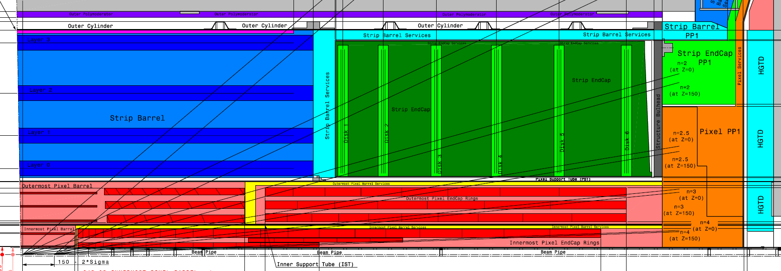
Lokacije radmonov (28)
Approximate locations confirmed, to early to specify exact locations:
1) strip barrel outer cylinder, z ~ 0, r ~ 1100 mm, one in each quadrant → confirmed
2) strip EC volume (r ~ 600 mm, z ~ 1600 mm in each quadrant, on side A and C)
fixed on the blades of disk 1 or disk 2 → confirmed
3) endcap side A and C (z > 3000 mm, r ~ 400 mm and r ~ 800 mm, one in each quadrant)
at r ~ 800 mm strip PP1 volume, fixed on the outer side of the structural bulkhead → confirmed
at lower r (~ 400 mm ) → on the outer side of PP1 (see figure) → confirmed

Slide 4
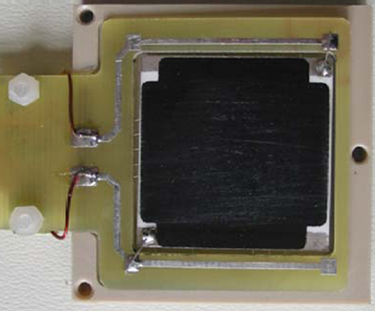
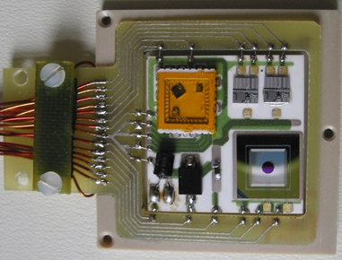
Radiation Monitor Sensor Board (RMSB)
example from ATLAS ID shown on photos
➔ make something very similar for the ITk
connector
or
pigtail
3 cm x 3 cm, 0.8 cm thick
ceramic (Al₂O₃) hybrid, connected to PCB frame with soldered wires
back side covered with resistive layer to heat the ceramics → stabilize temperature at 20°C
fixed in PEEK support for mechanical protection and air gap for insulation
Sensors on ITk RMSB:
3 RadFETs (TID) ➔ need to qualify NurFET
3 diodes (NIEL)
1 temperature sensor (10 kOhm NTC)

Slide 5
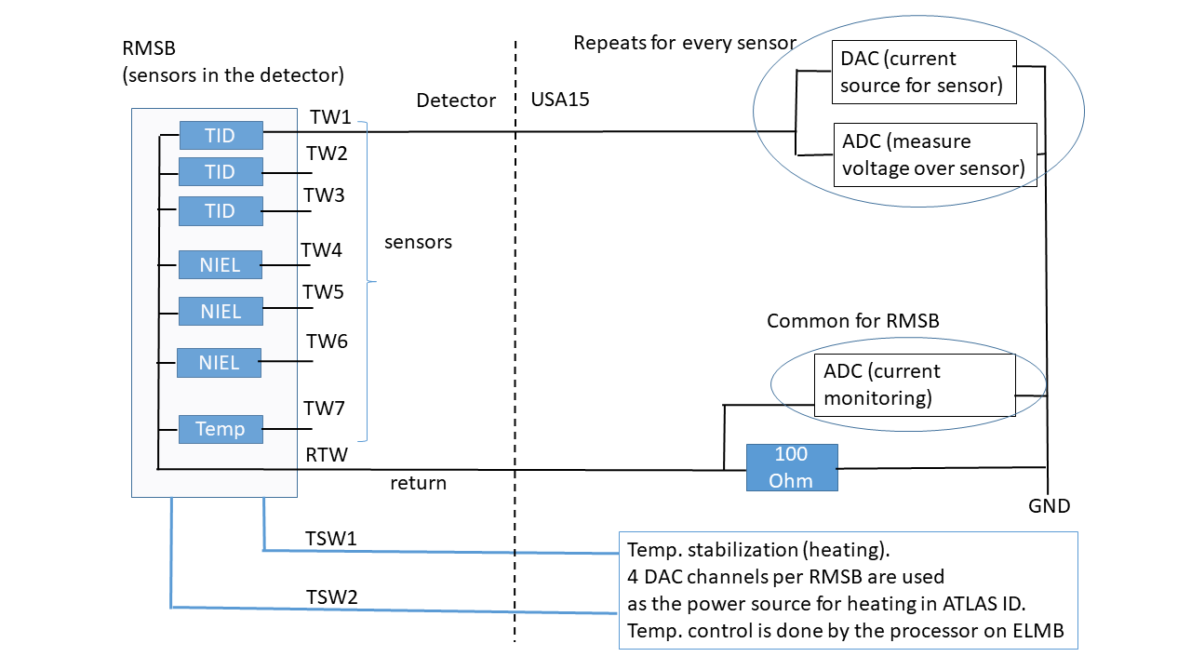
Readout
Current source:
0.1 and 1 mA current pulses
up to 100 V
0.1 s – 1 s long
ELMB, DAC ➔ current sources, temp. stabilization, communication with DCS as in ATLAS ID
➔ ELMB DAC goes only up to 30 V
➔ 30 V je premalo, da bi šli do zadosti visokih doz (1e15 in 100 kGy)
partly custom made: combination of ELMB (for ADC, communication with DCS) and
fully custom made

Slide 6
1
Switching
matrix
ADC (ELMB?)
2
ATLAS DCS
Current source
3
Tele kose naj bi mi naredili
Narejeno mora biti nekje do 2026
Pri ATLAS je vse delal ELMB
Za upgrade je problem, da bi rabili
Višje napetosti kot cca 30 V kar
Lahko dobimo iz DAC
4
28 channel
Temperature
Control unit
28
in USA15

