Slide 1
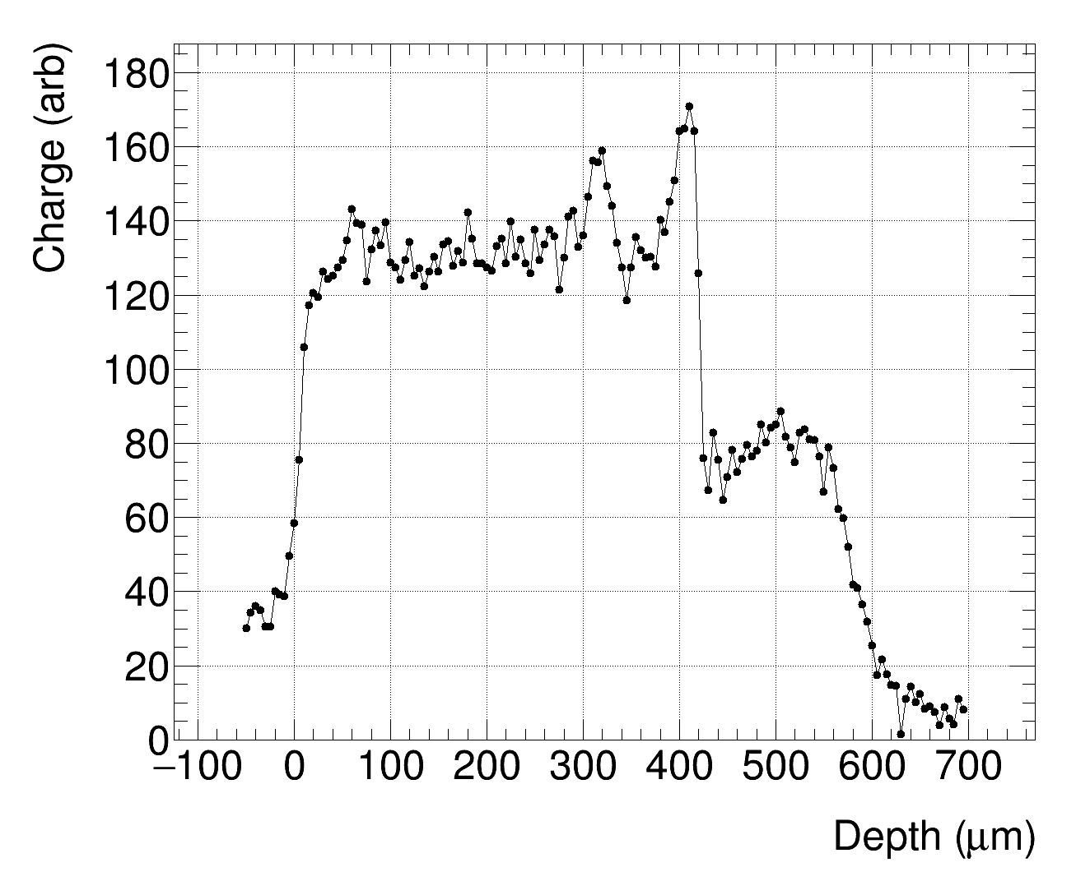
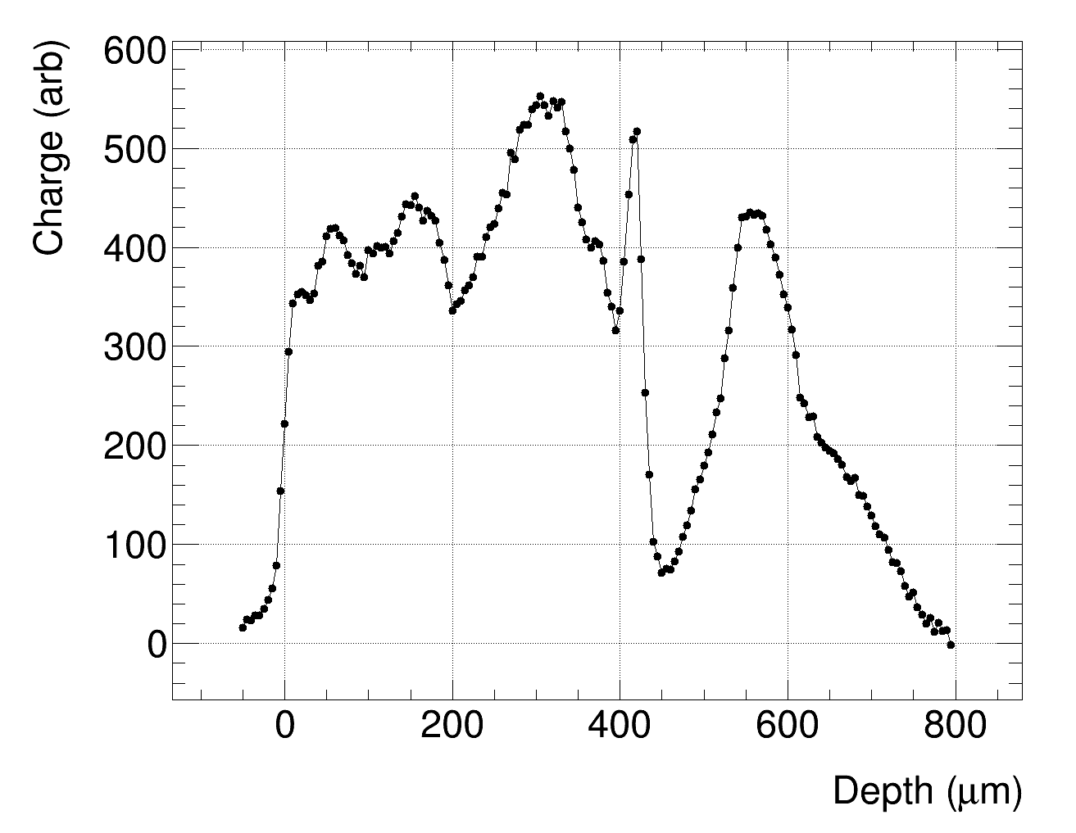
300 um špageti (1100 V)
600 um LGAD, 600 V

Slide 2
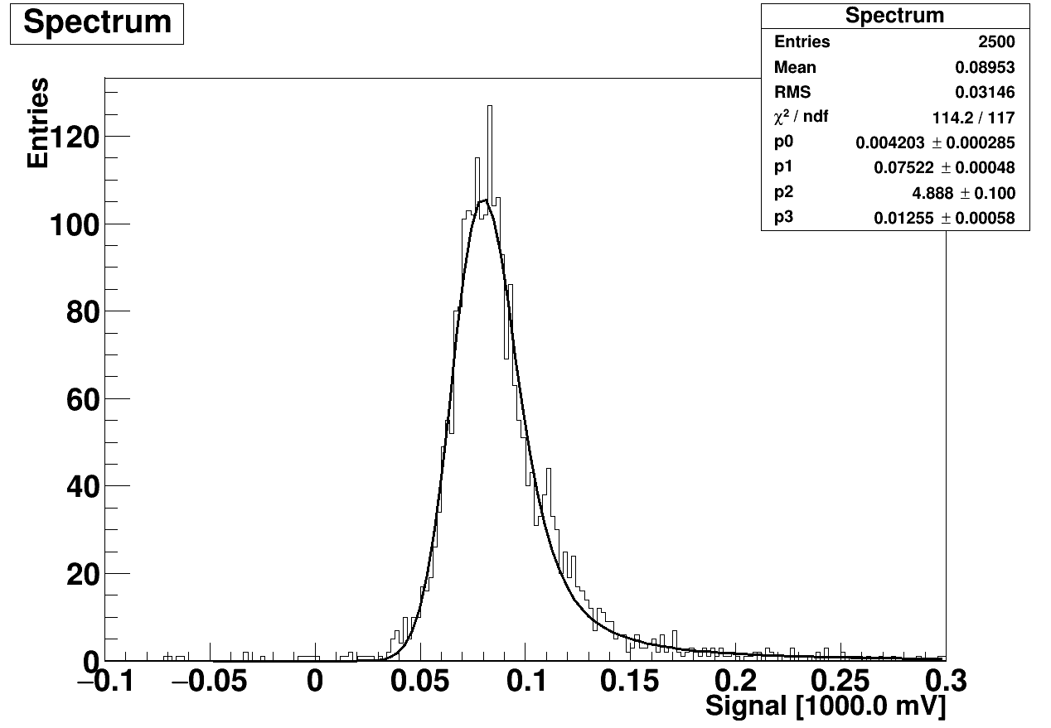
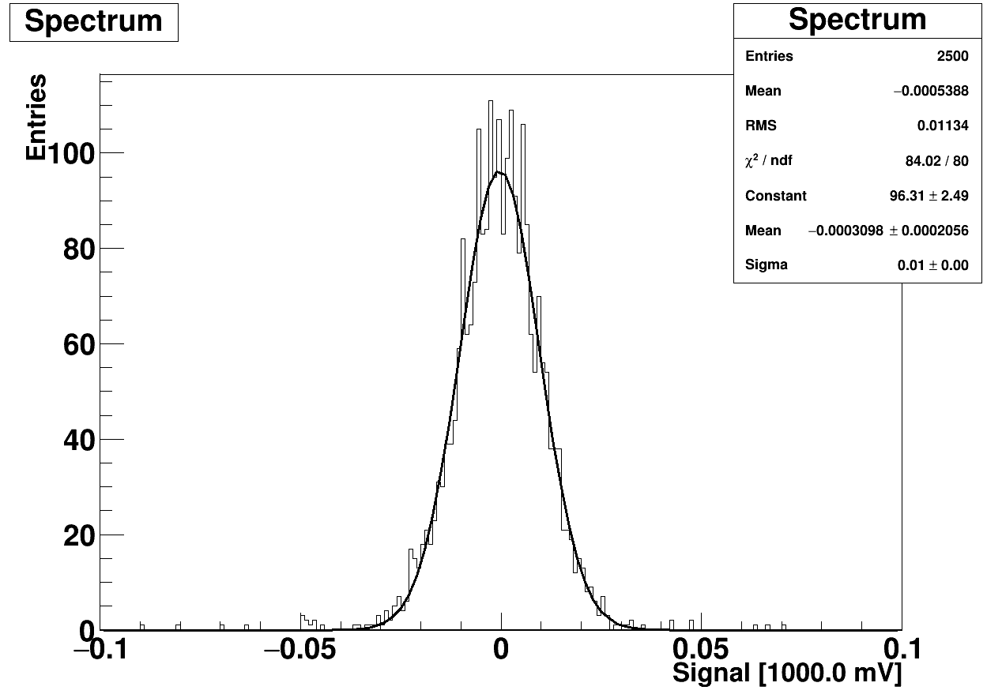
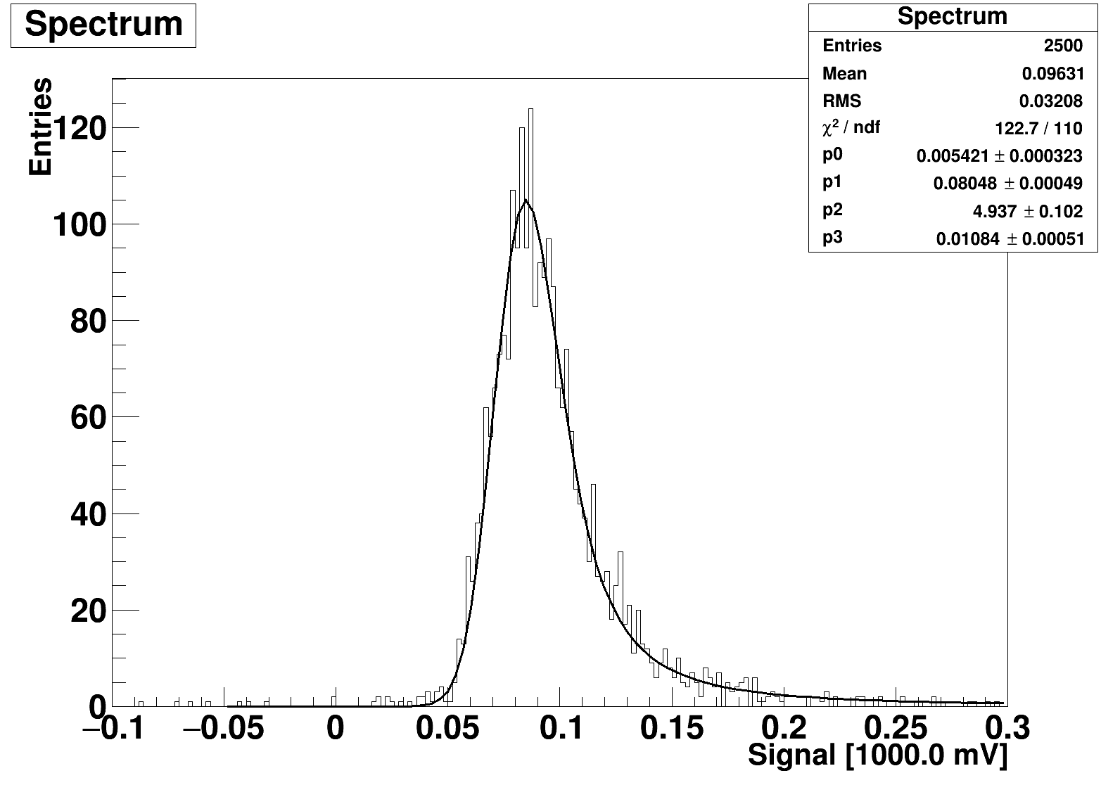
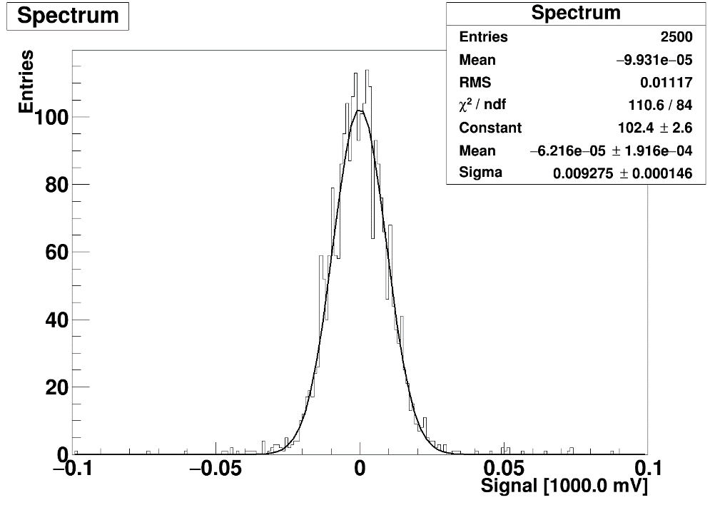
Micorn, p-type, 300 um, unirrad, RT. Bias = 100 V
1 MOhm
1 MOhm
Noise
10 MOhm
Noise
10 MOhm

Slide 3
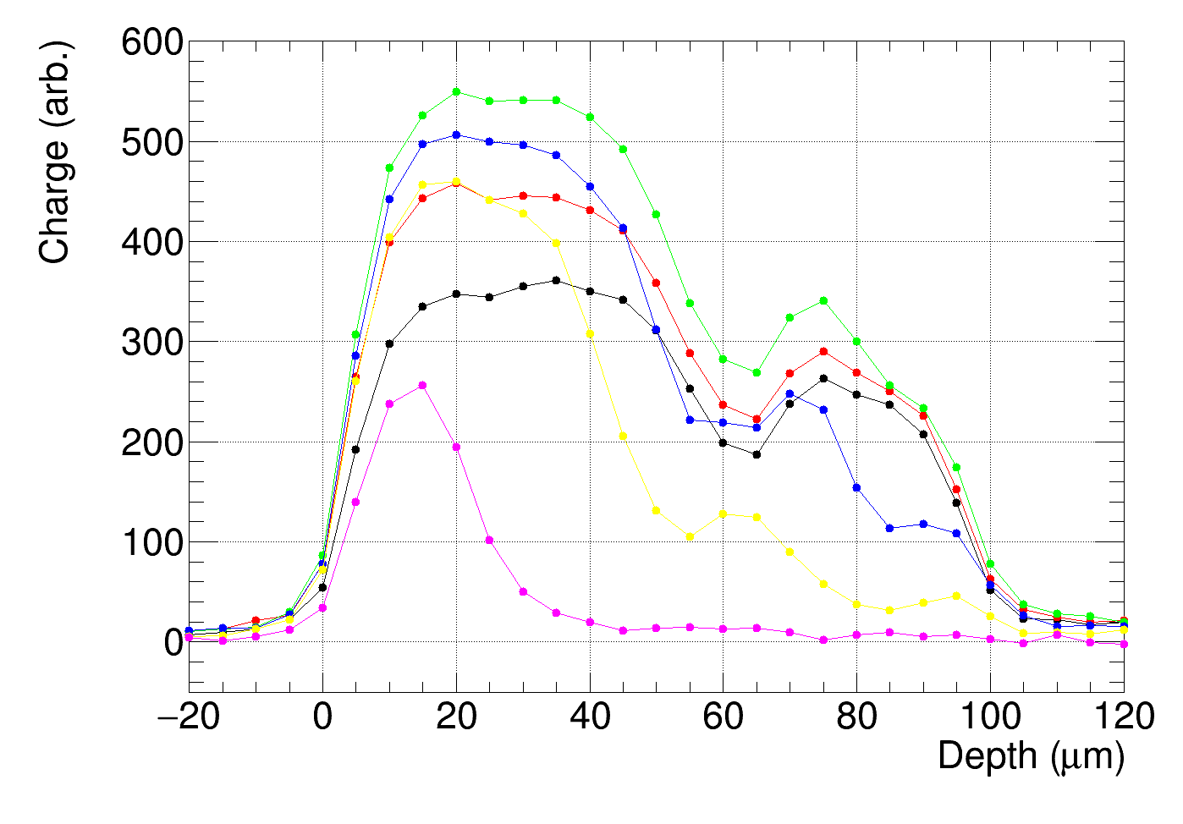
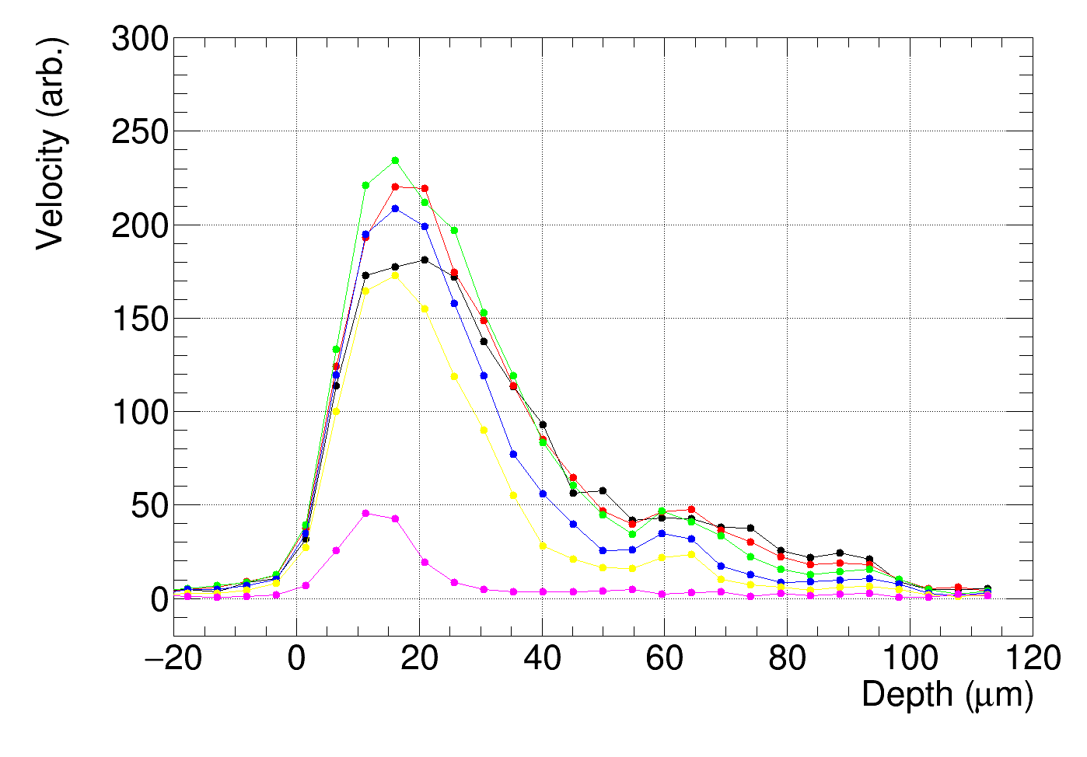
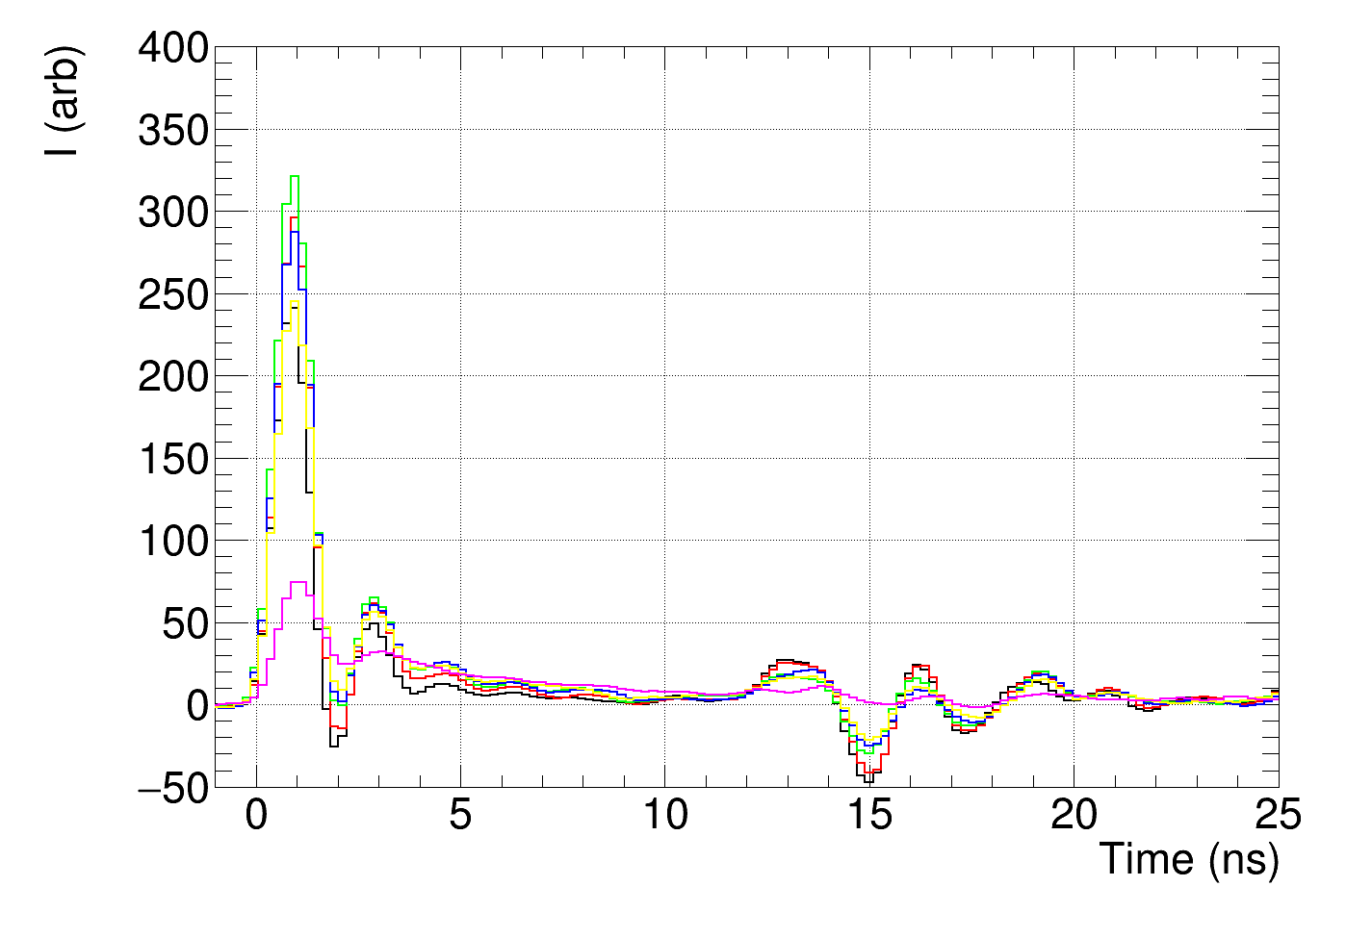
Charge and velocity profiles and induced currents
colours from root numbering:
1 (black) 50 V
2 (red) 40 V
3 (green) 30 V
4 (blue) 20 V
5 (yellow) 10 V
6 (pink) 0 V

