Slide 1
Update on measurements with Si detectors irradiated to 3e17
50 um LGAD (CNM)
New:
1 Mohm bias resistor in Q-TCT amp (Ortec) → possible to measure at higher bias current
Improved cooling → T = - 30 C

Slide 2
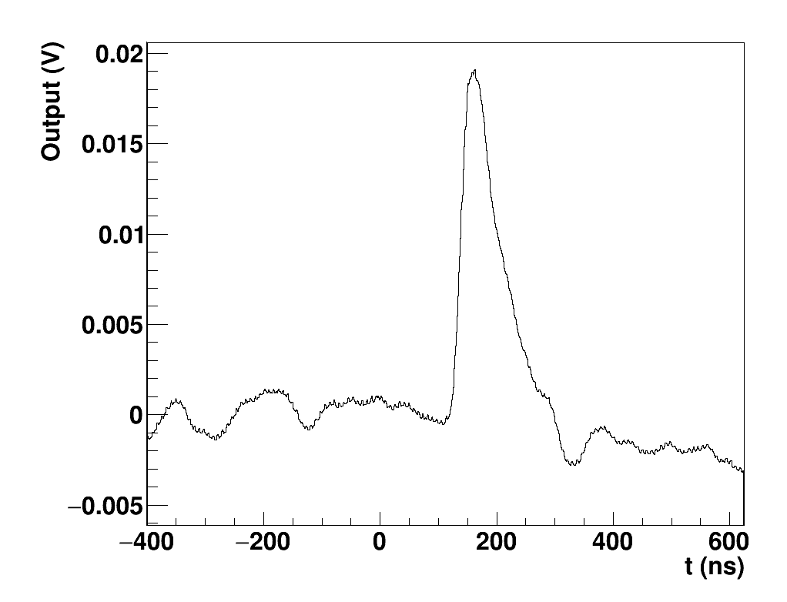
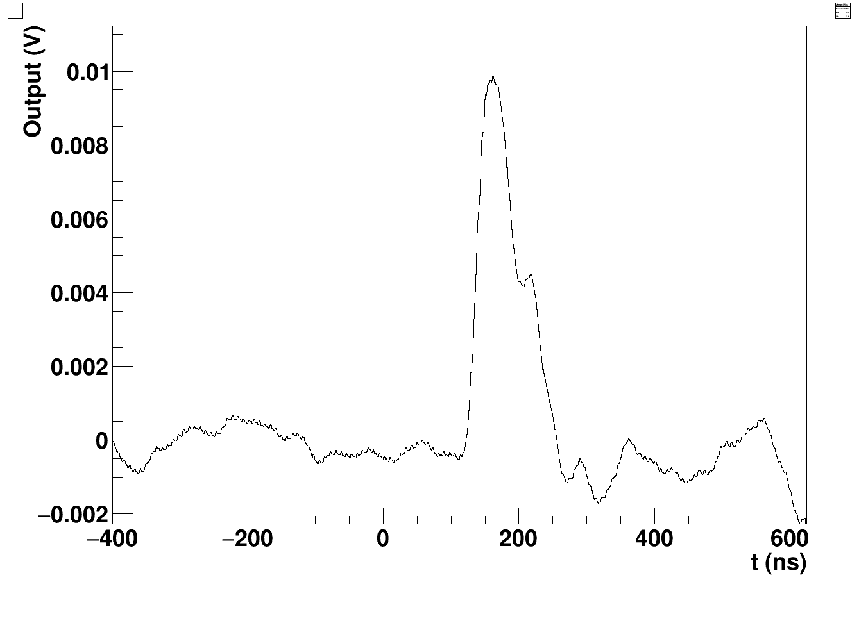
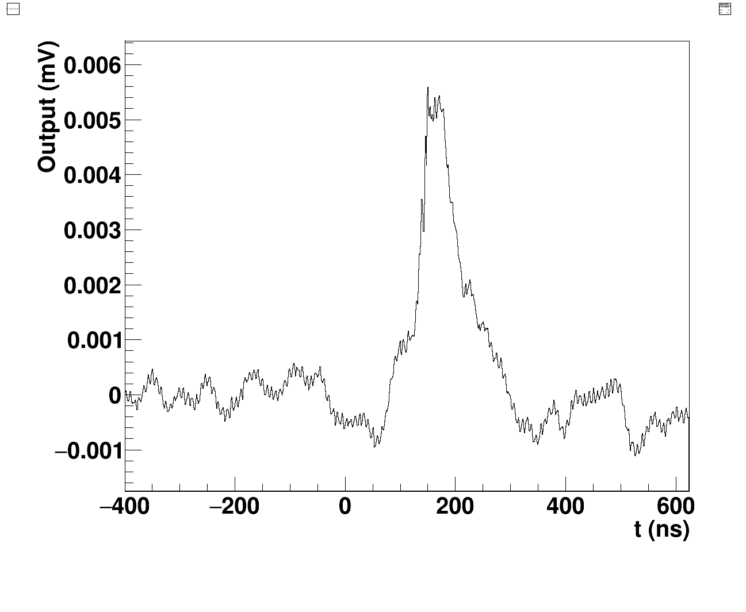
Average waveforms
3e16, 650 V
1e17, 1100 V
3e17, 1100 V

Slide 3
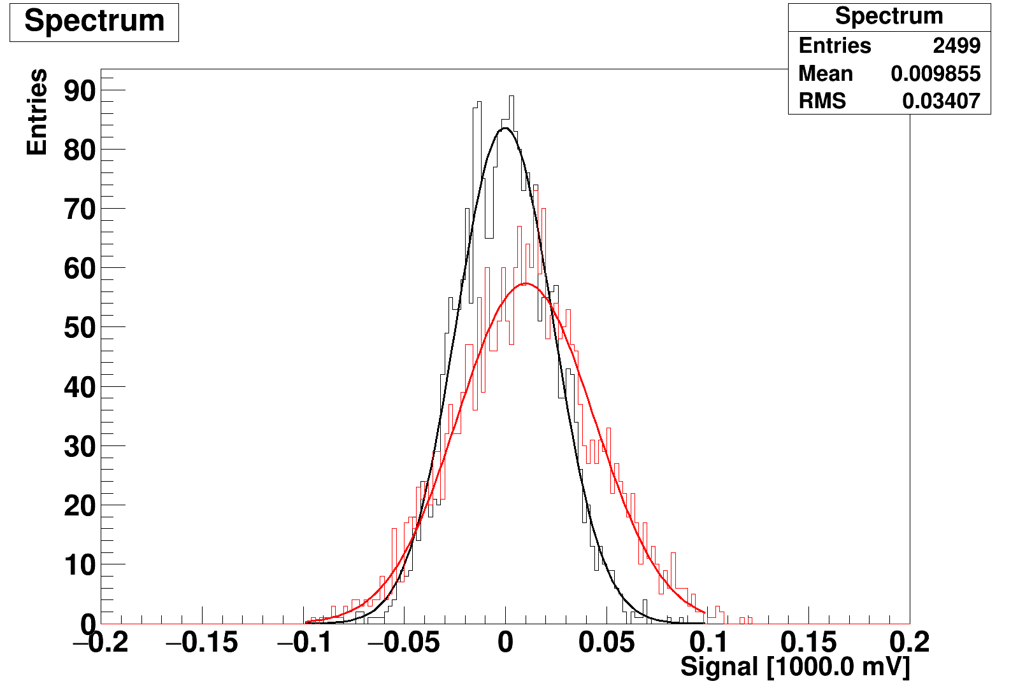
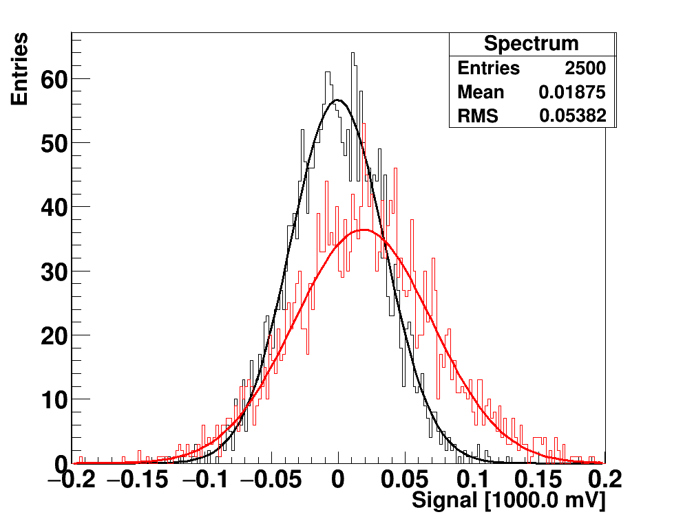
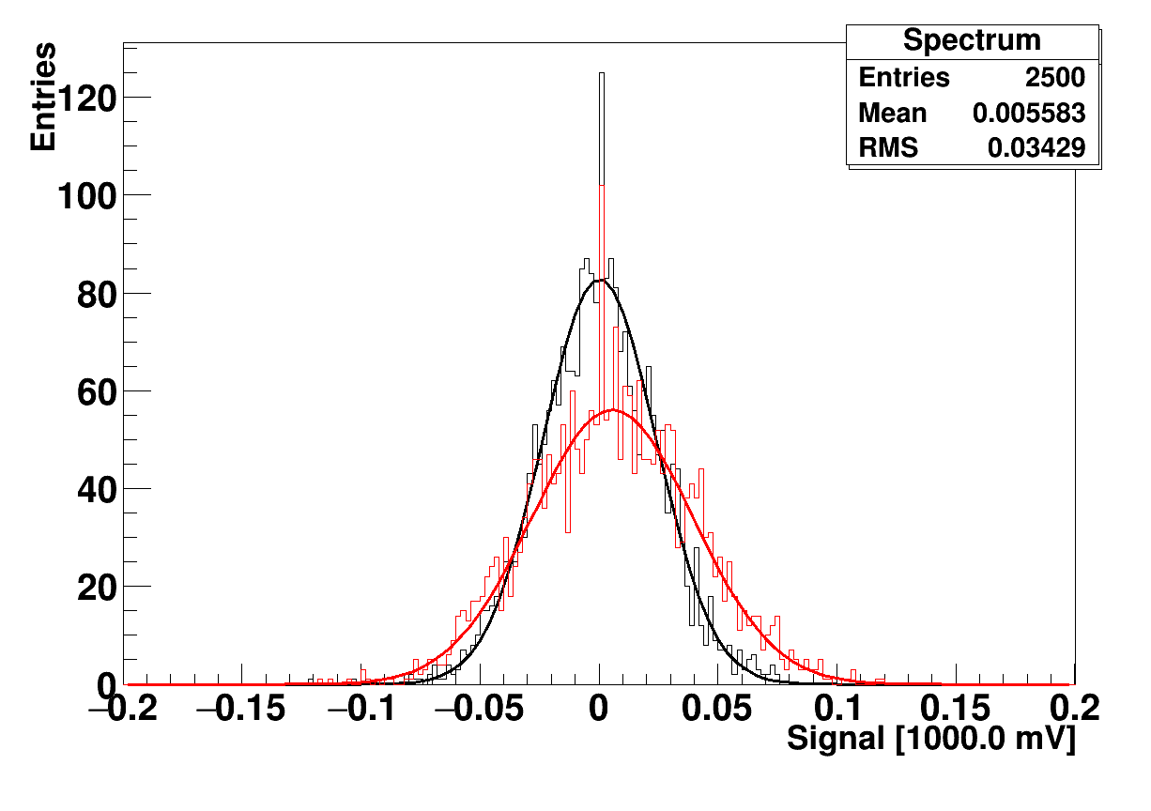
3e16,
650 V
1e17,
1100 V
3e17
1100 V

Slide 4
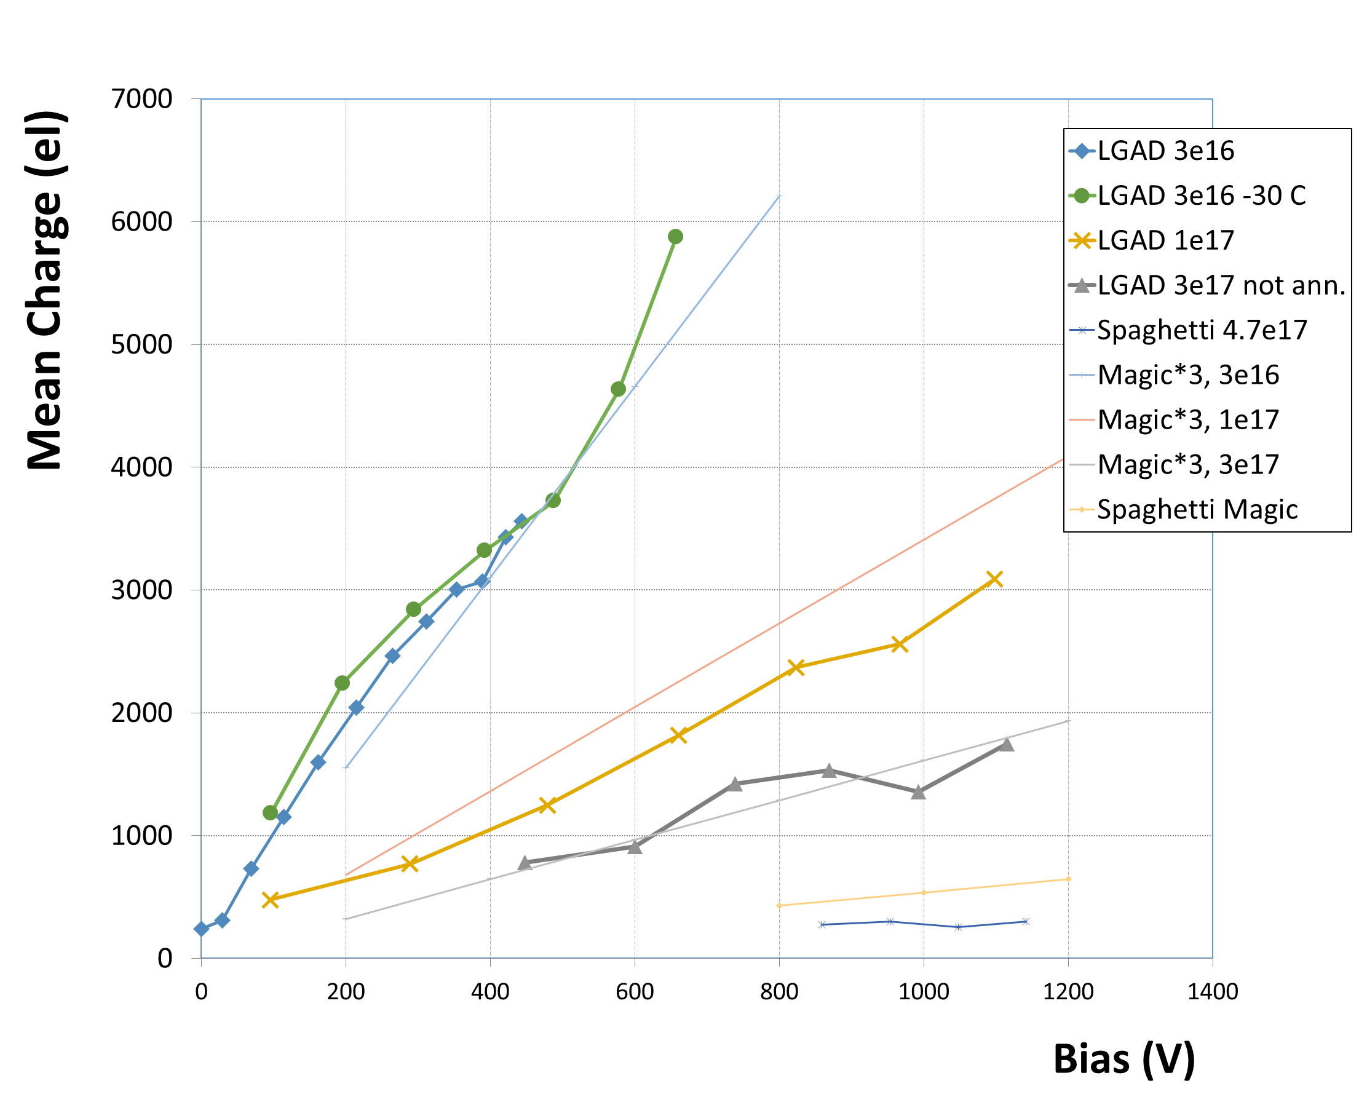
Magic formula (300 um spaghetti Ф > 1e15):
Q_{MPV} = k∙Ф^{b}∙V ,
k = 26.4 el/V, b = -0.683
Ф in 1e15 n/cm2, V in volts
Q ~ (dq/dx∙D)∙(1/D)∙L,
L = v∙τ, charge collection distance
v increases with E (until saturation)
At high Ф, saturation at higher V
LGAD (50 um): Q_{mean} (V)= ~ 3 x Q_{MPV_spaghetti} (V)
➔ More charge than in spaghetti because of higher E-field and/or charge multiplication

Slide 5
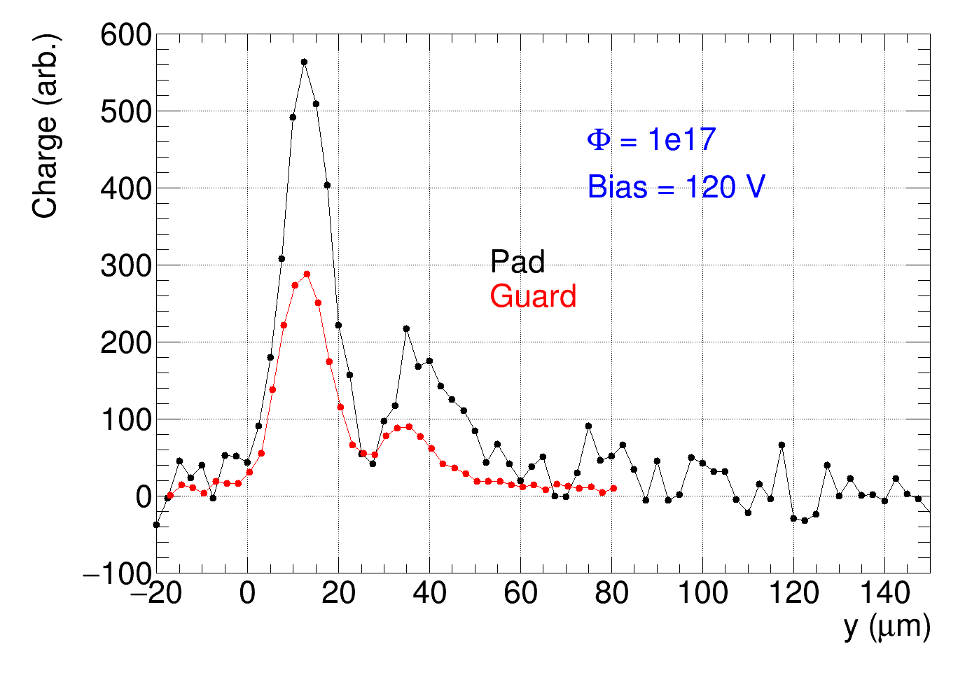
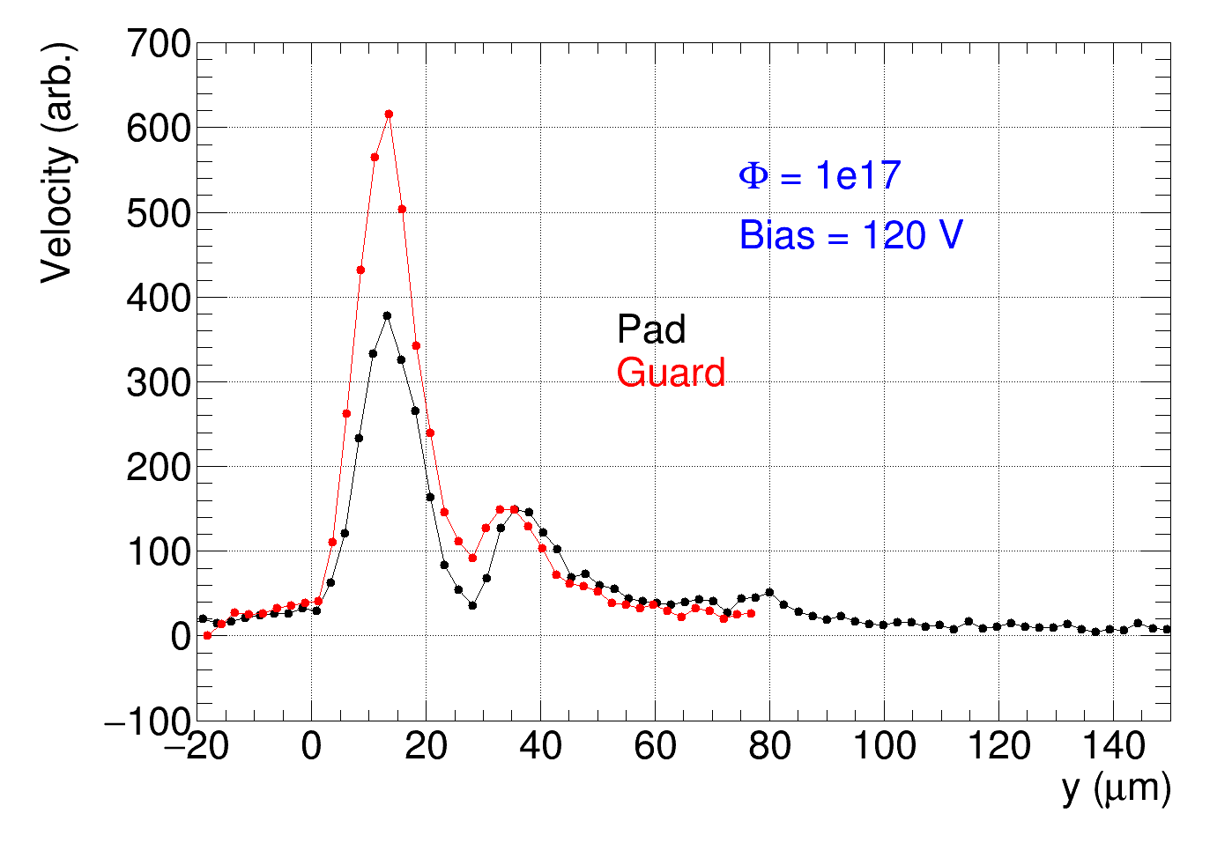
Edge-TCT with pad detectors– try to measure effective thickness
LGAD – pad detector
difficult to focus on pad detector
➔ signal from guard ring
Double junction
DAC = 57
DAC = 57
~ 50 um active
➔ large signal near top electrode ➔ multiplication

Slide 6
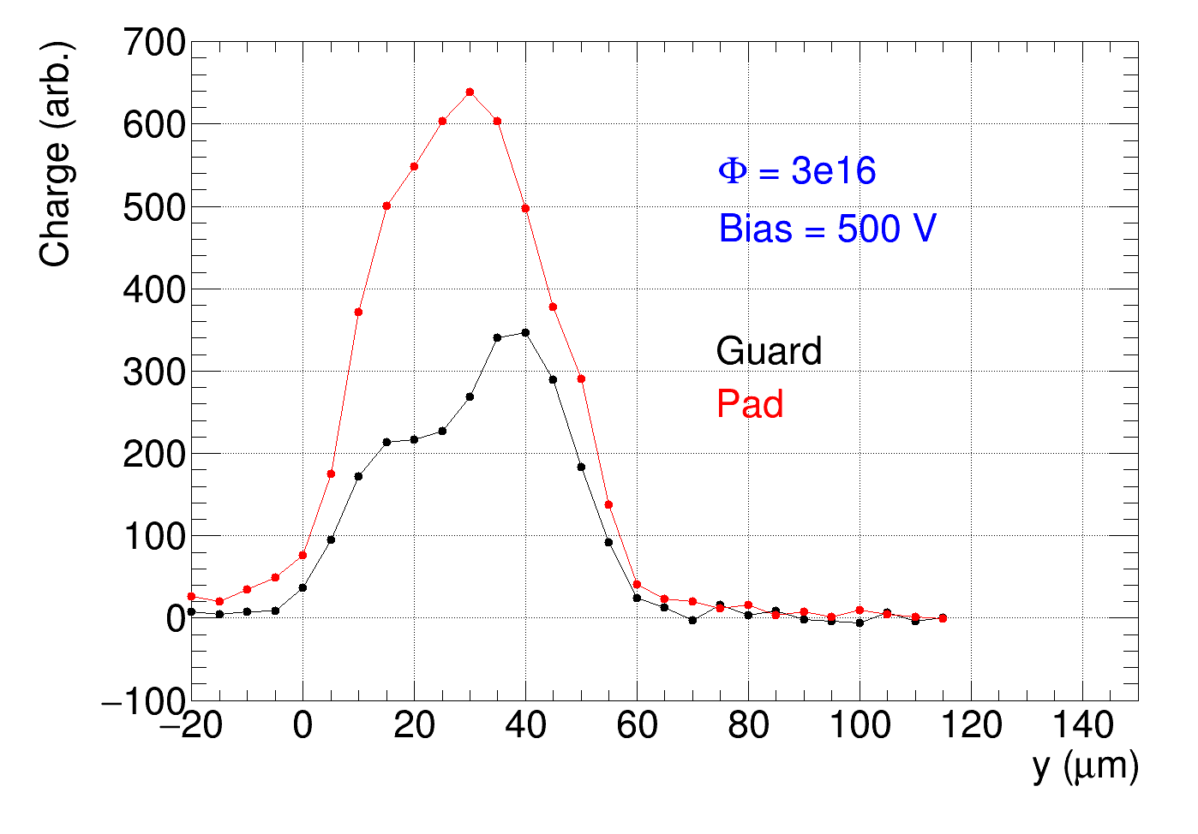
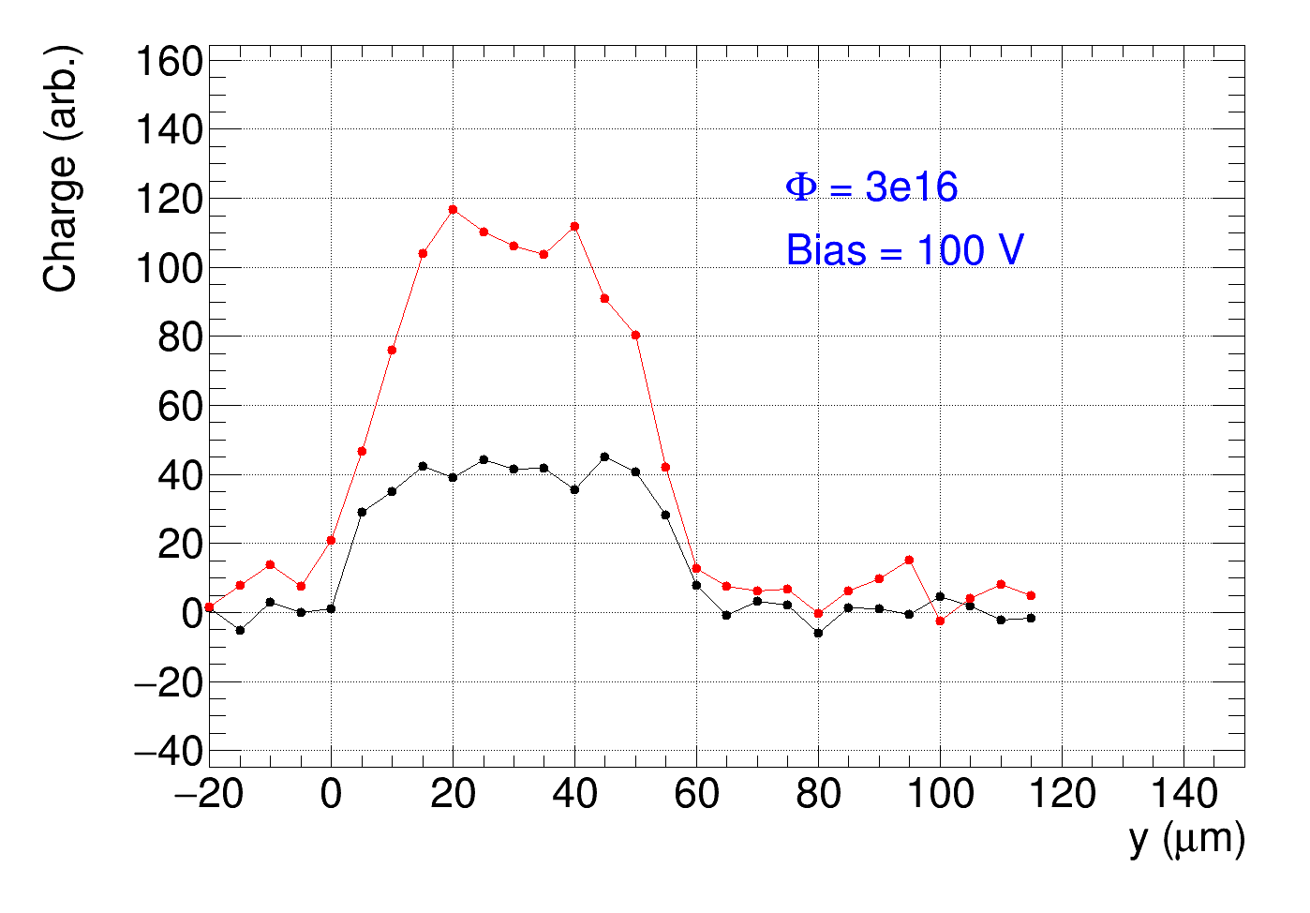
DAC = 57

Slide 7
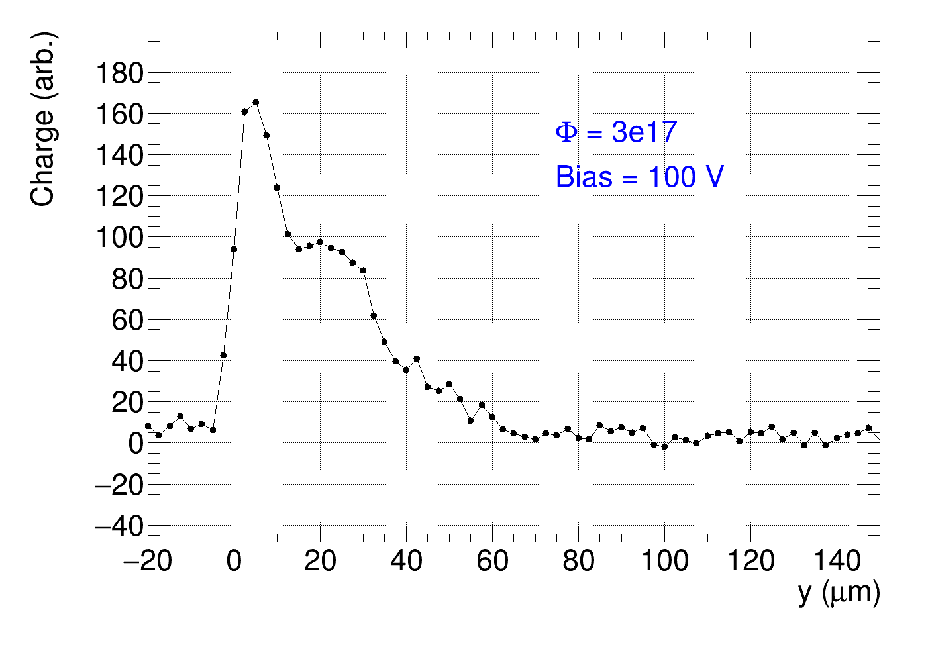
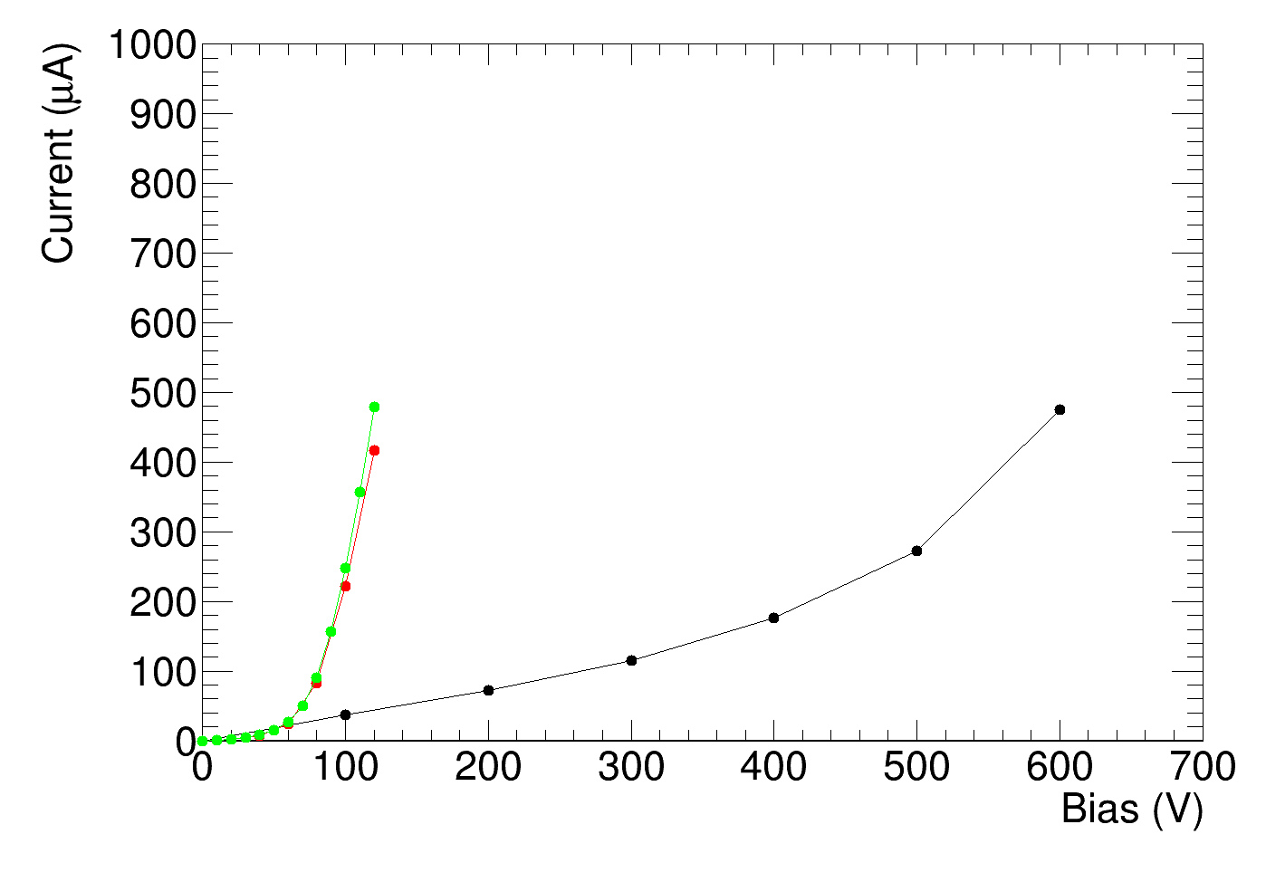
DAC = 30
1e17
Ponovitve – veliko višji tok?

Slide 8
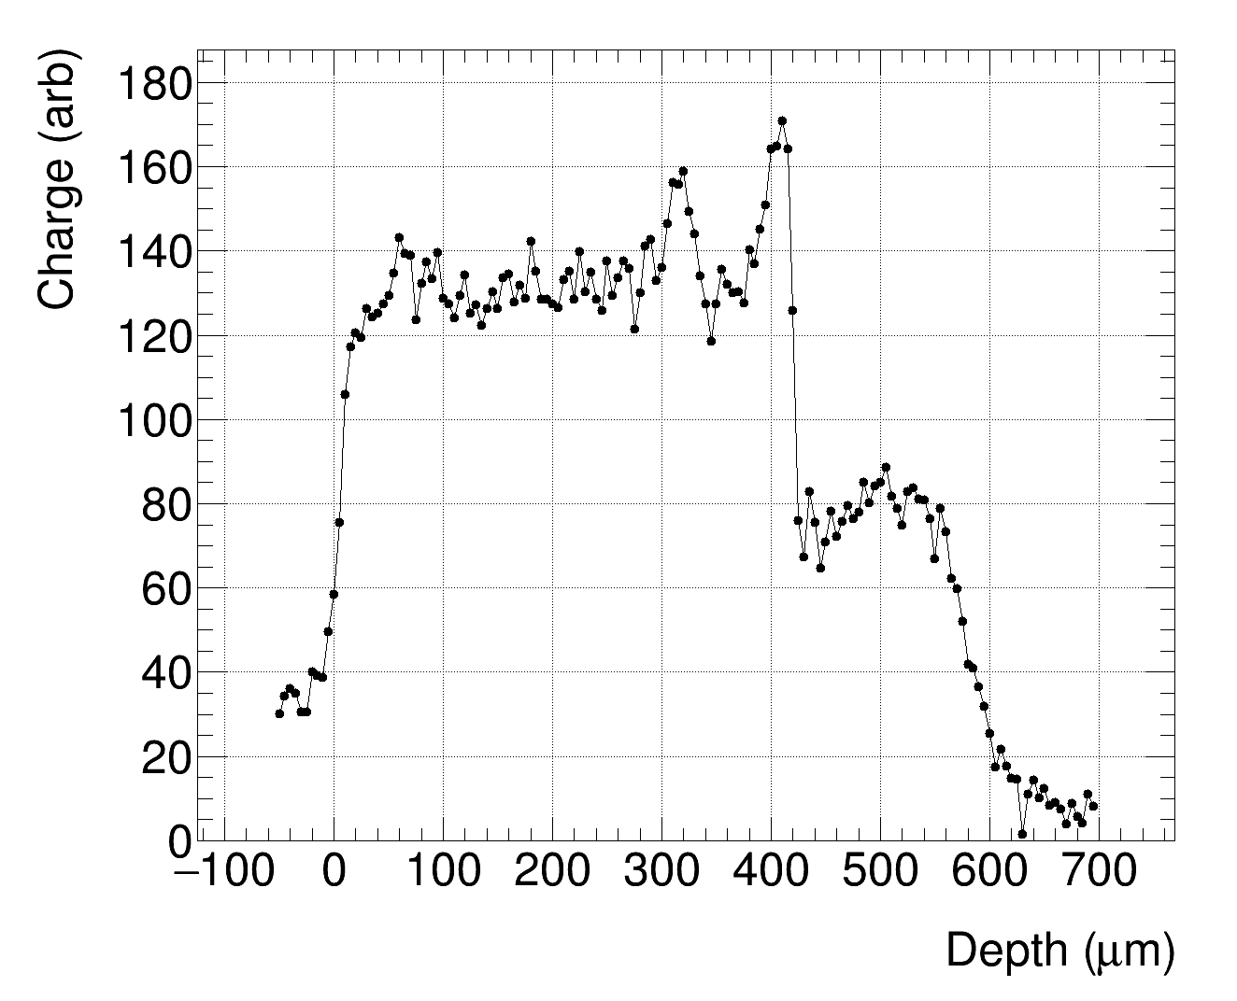
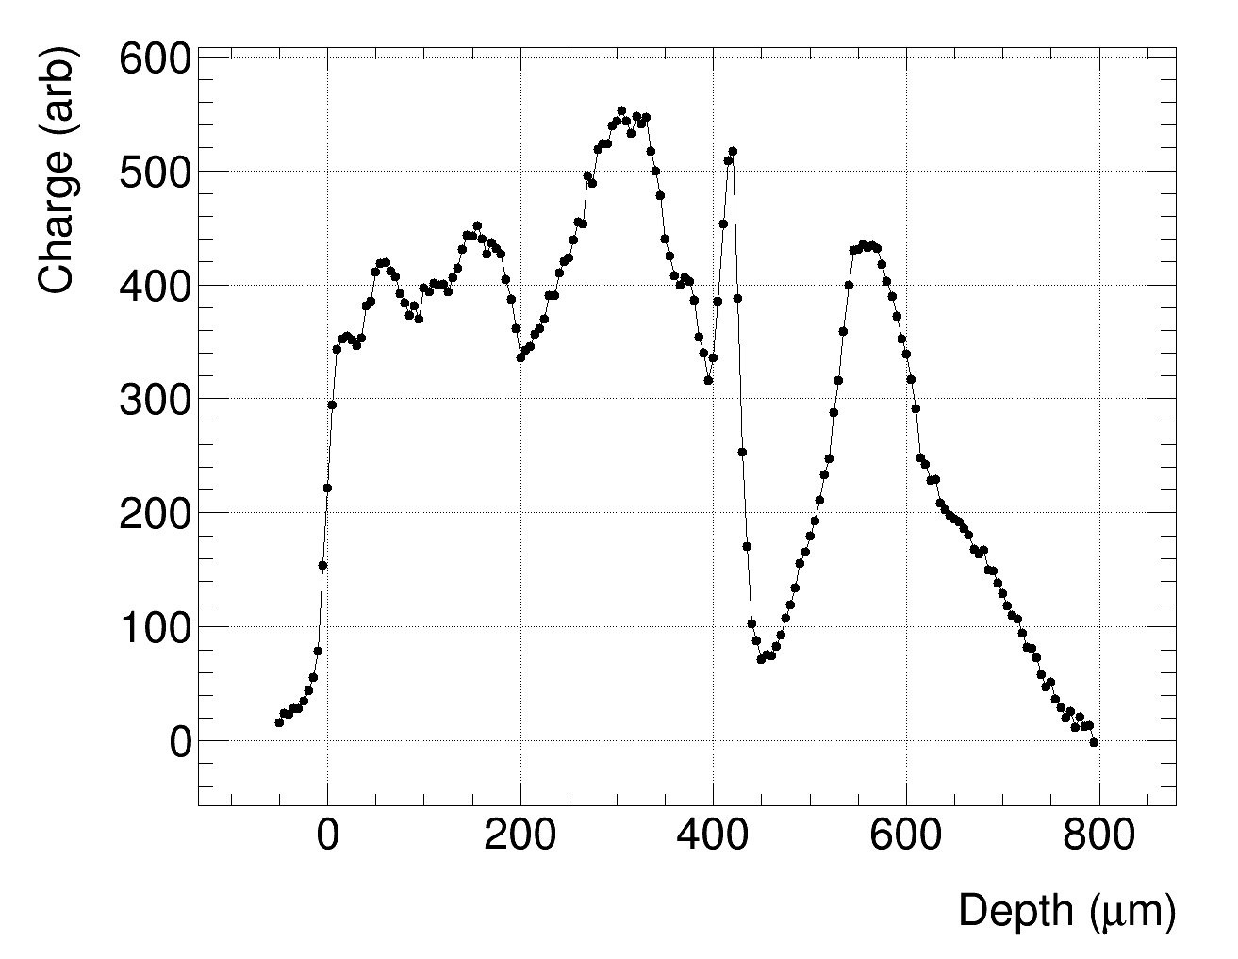
300 um špageti (1100 V)
600 um LGAD, 600 V
Strange charge collection profiles if no good focus???

Slide 9
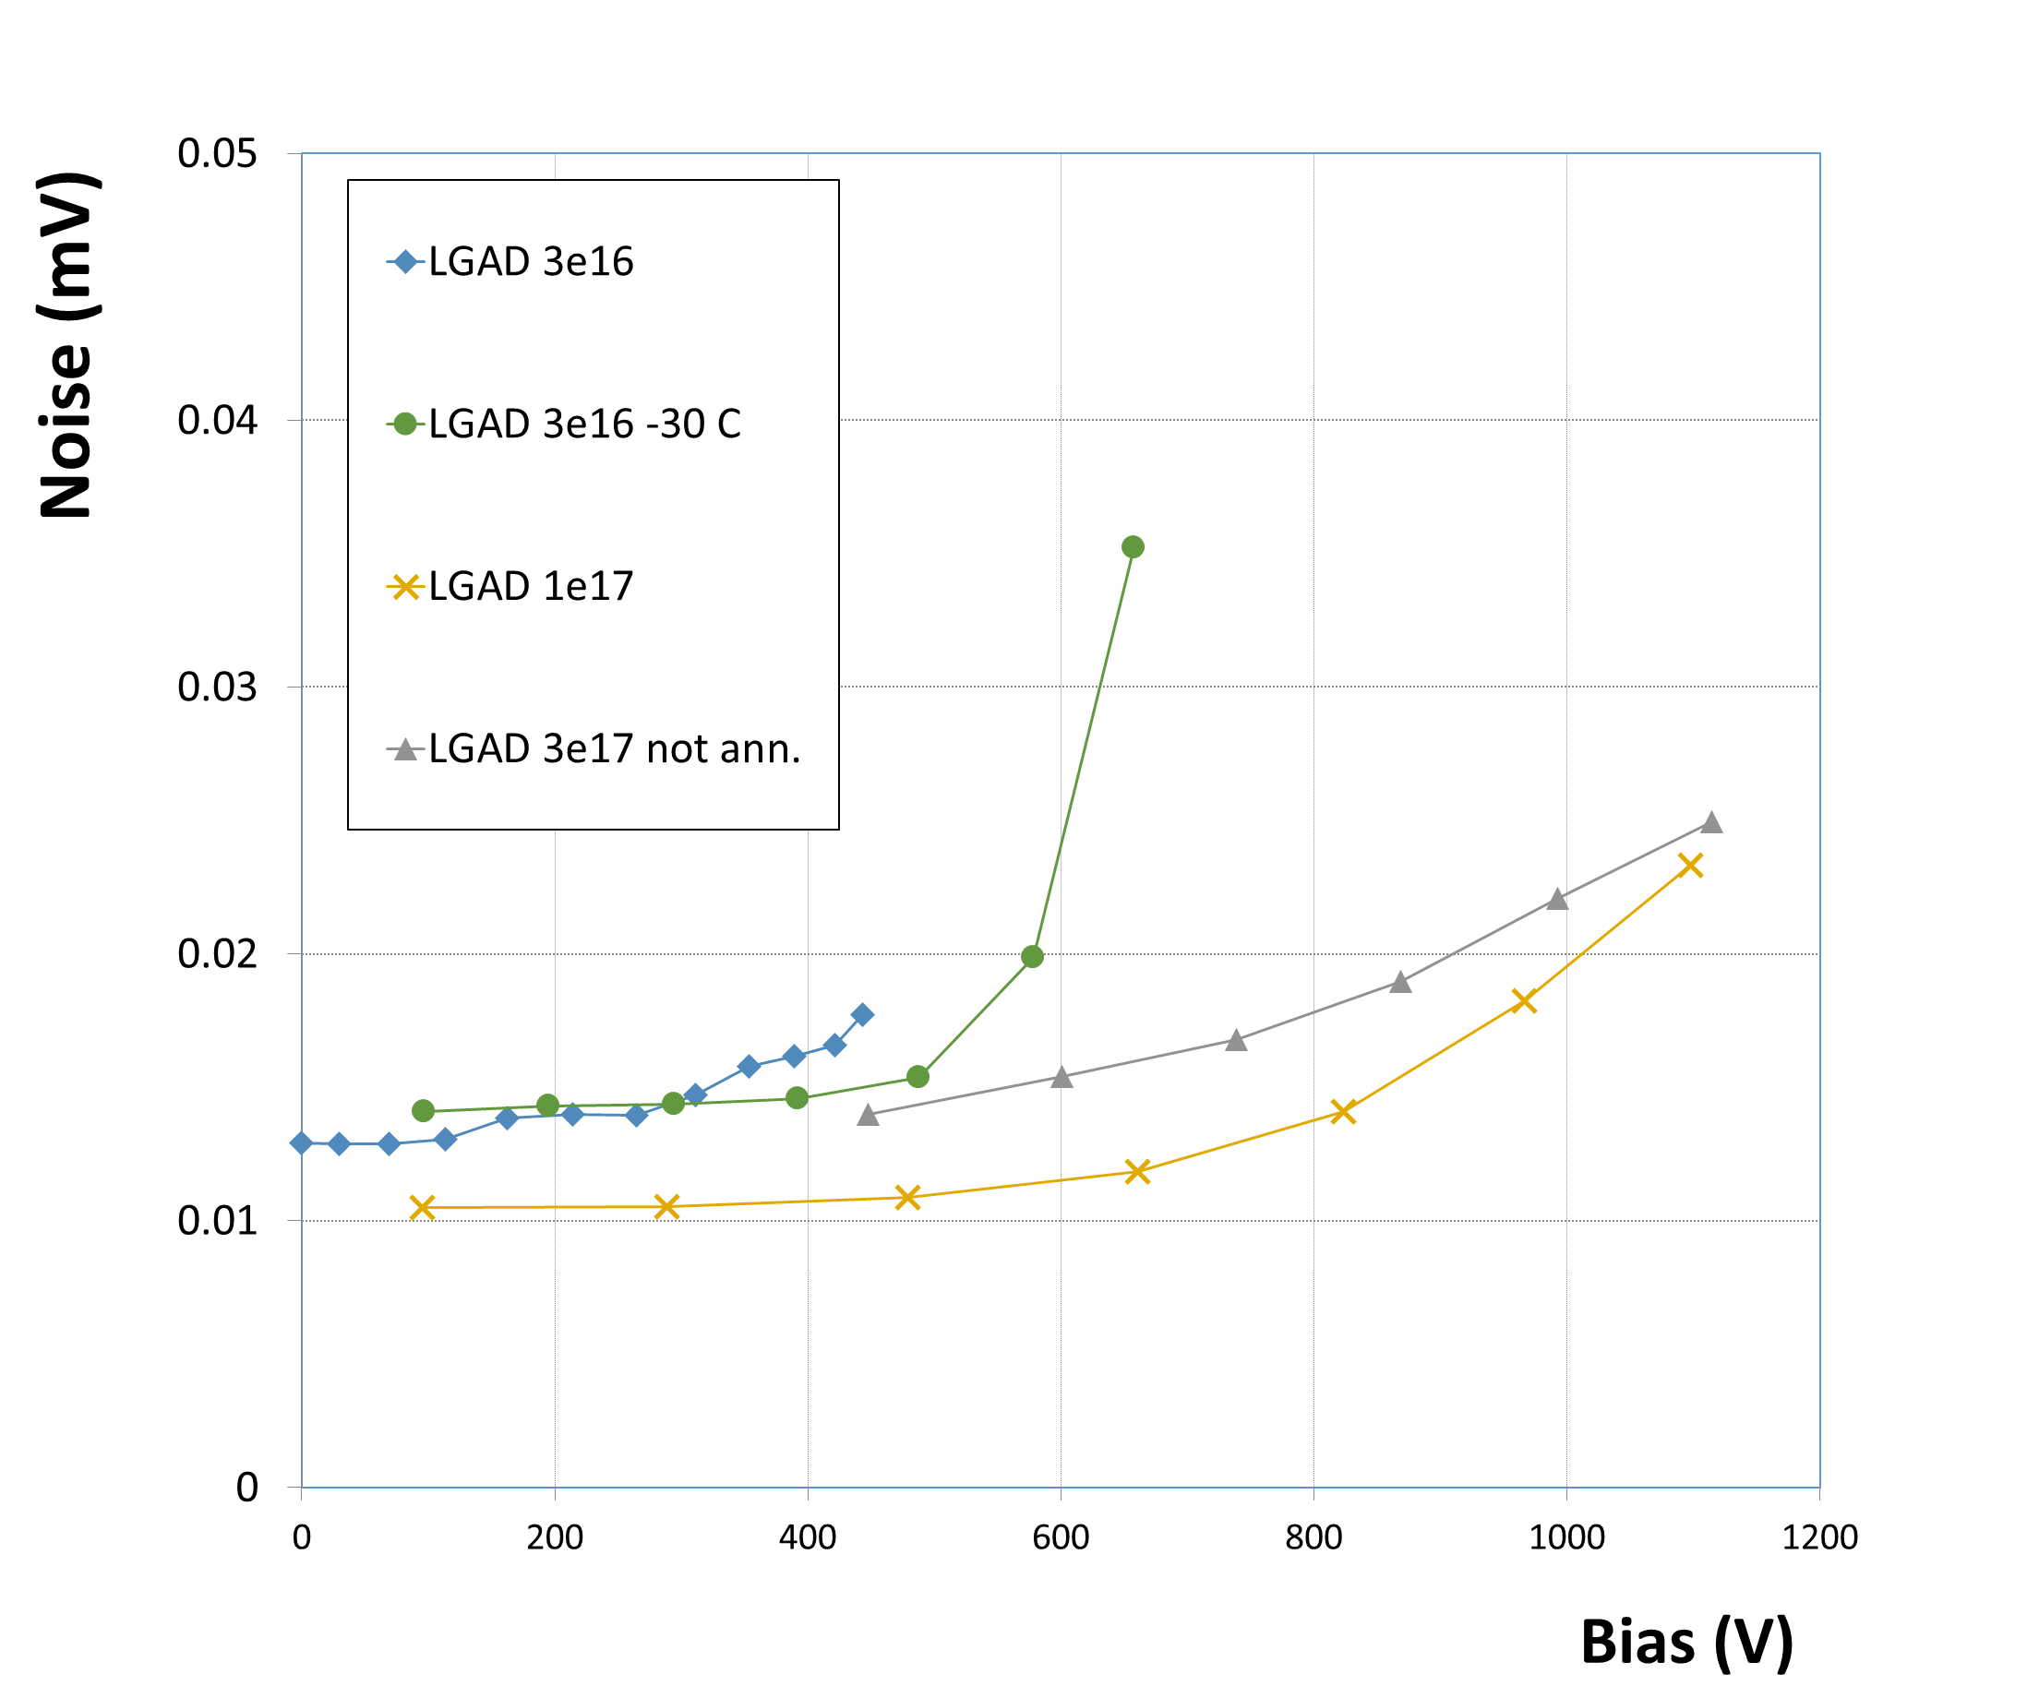
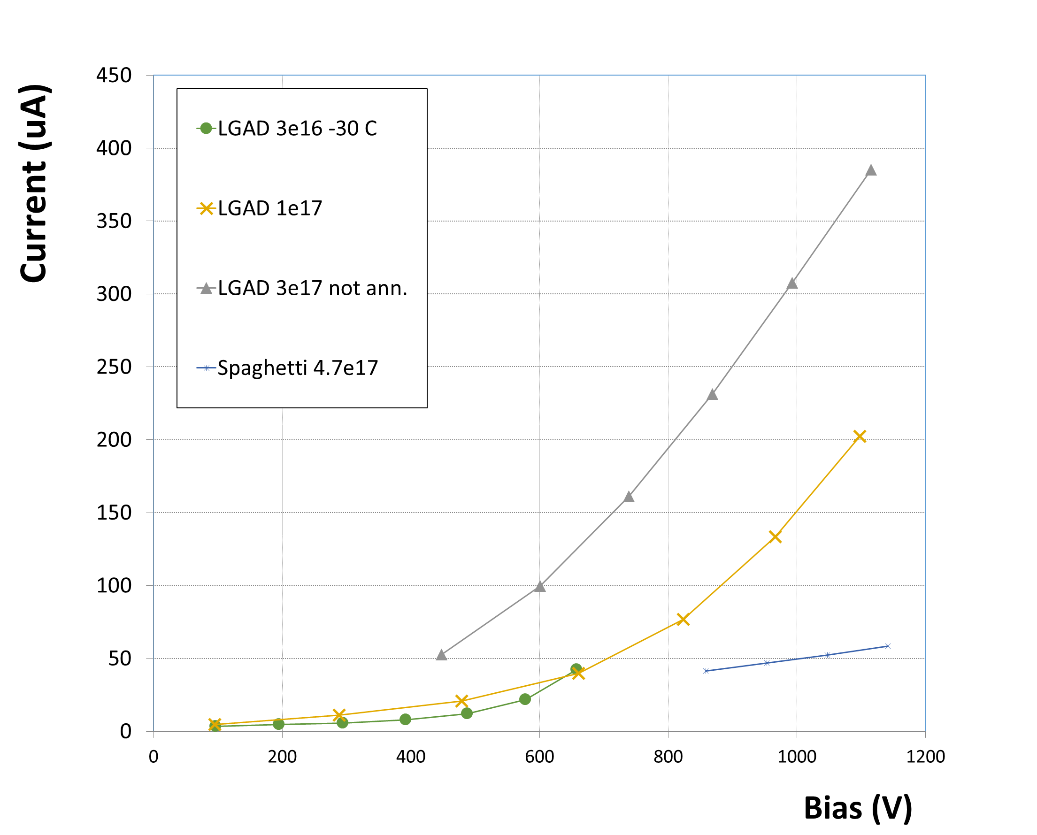

Slide 10
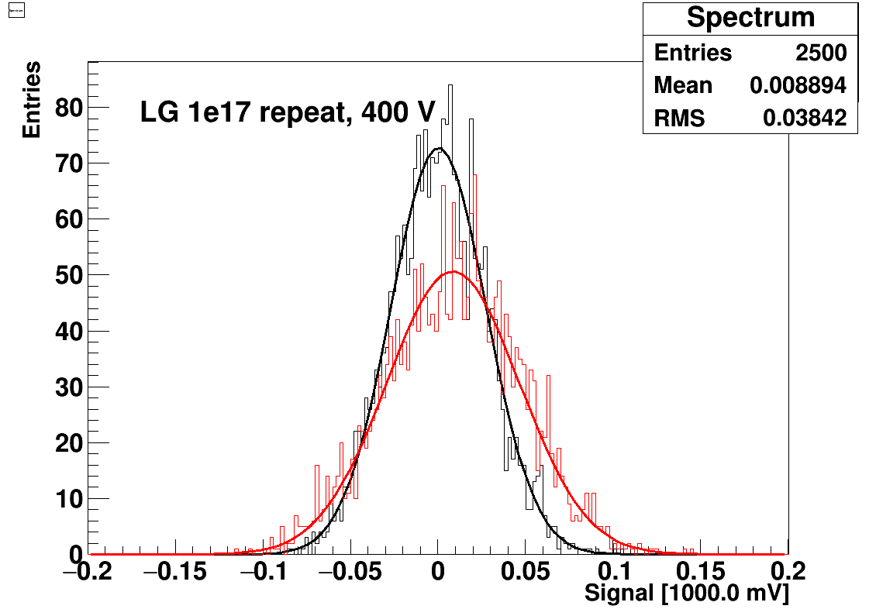
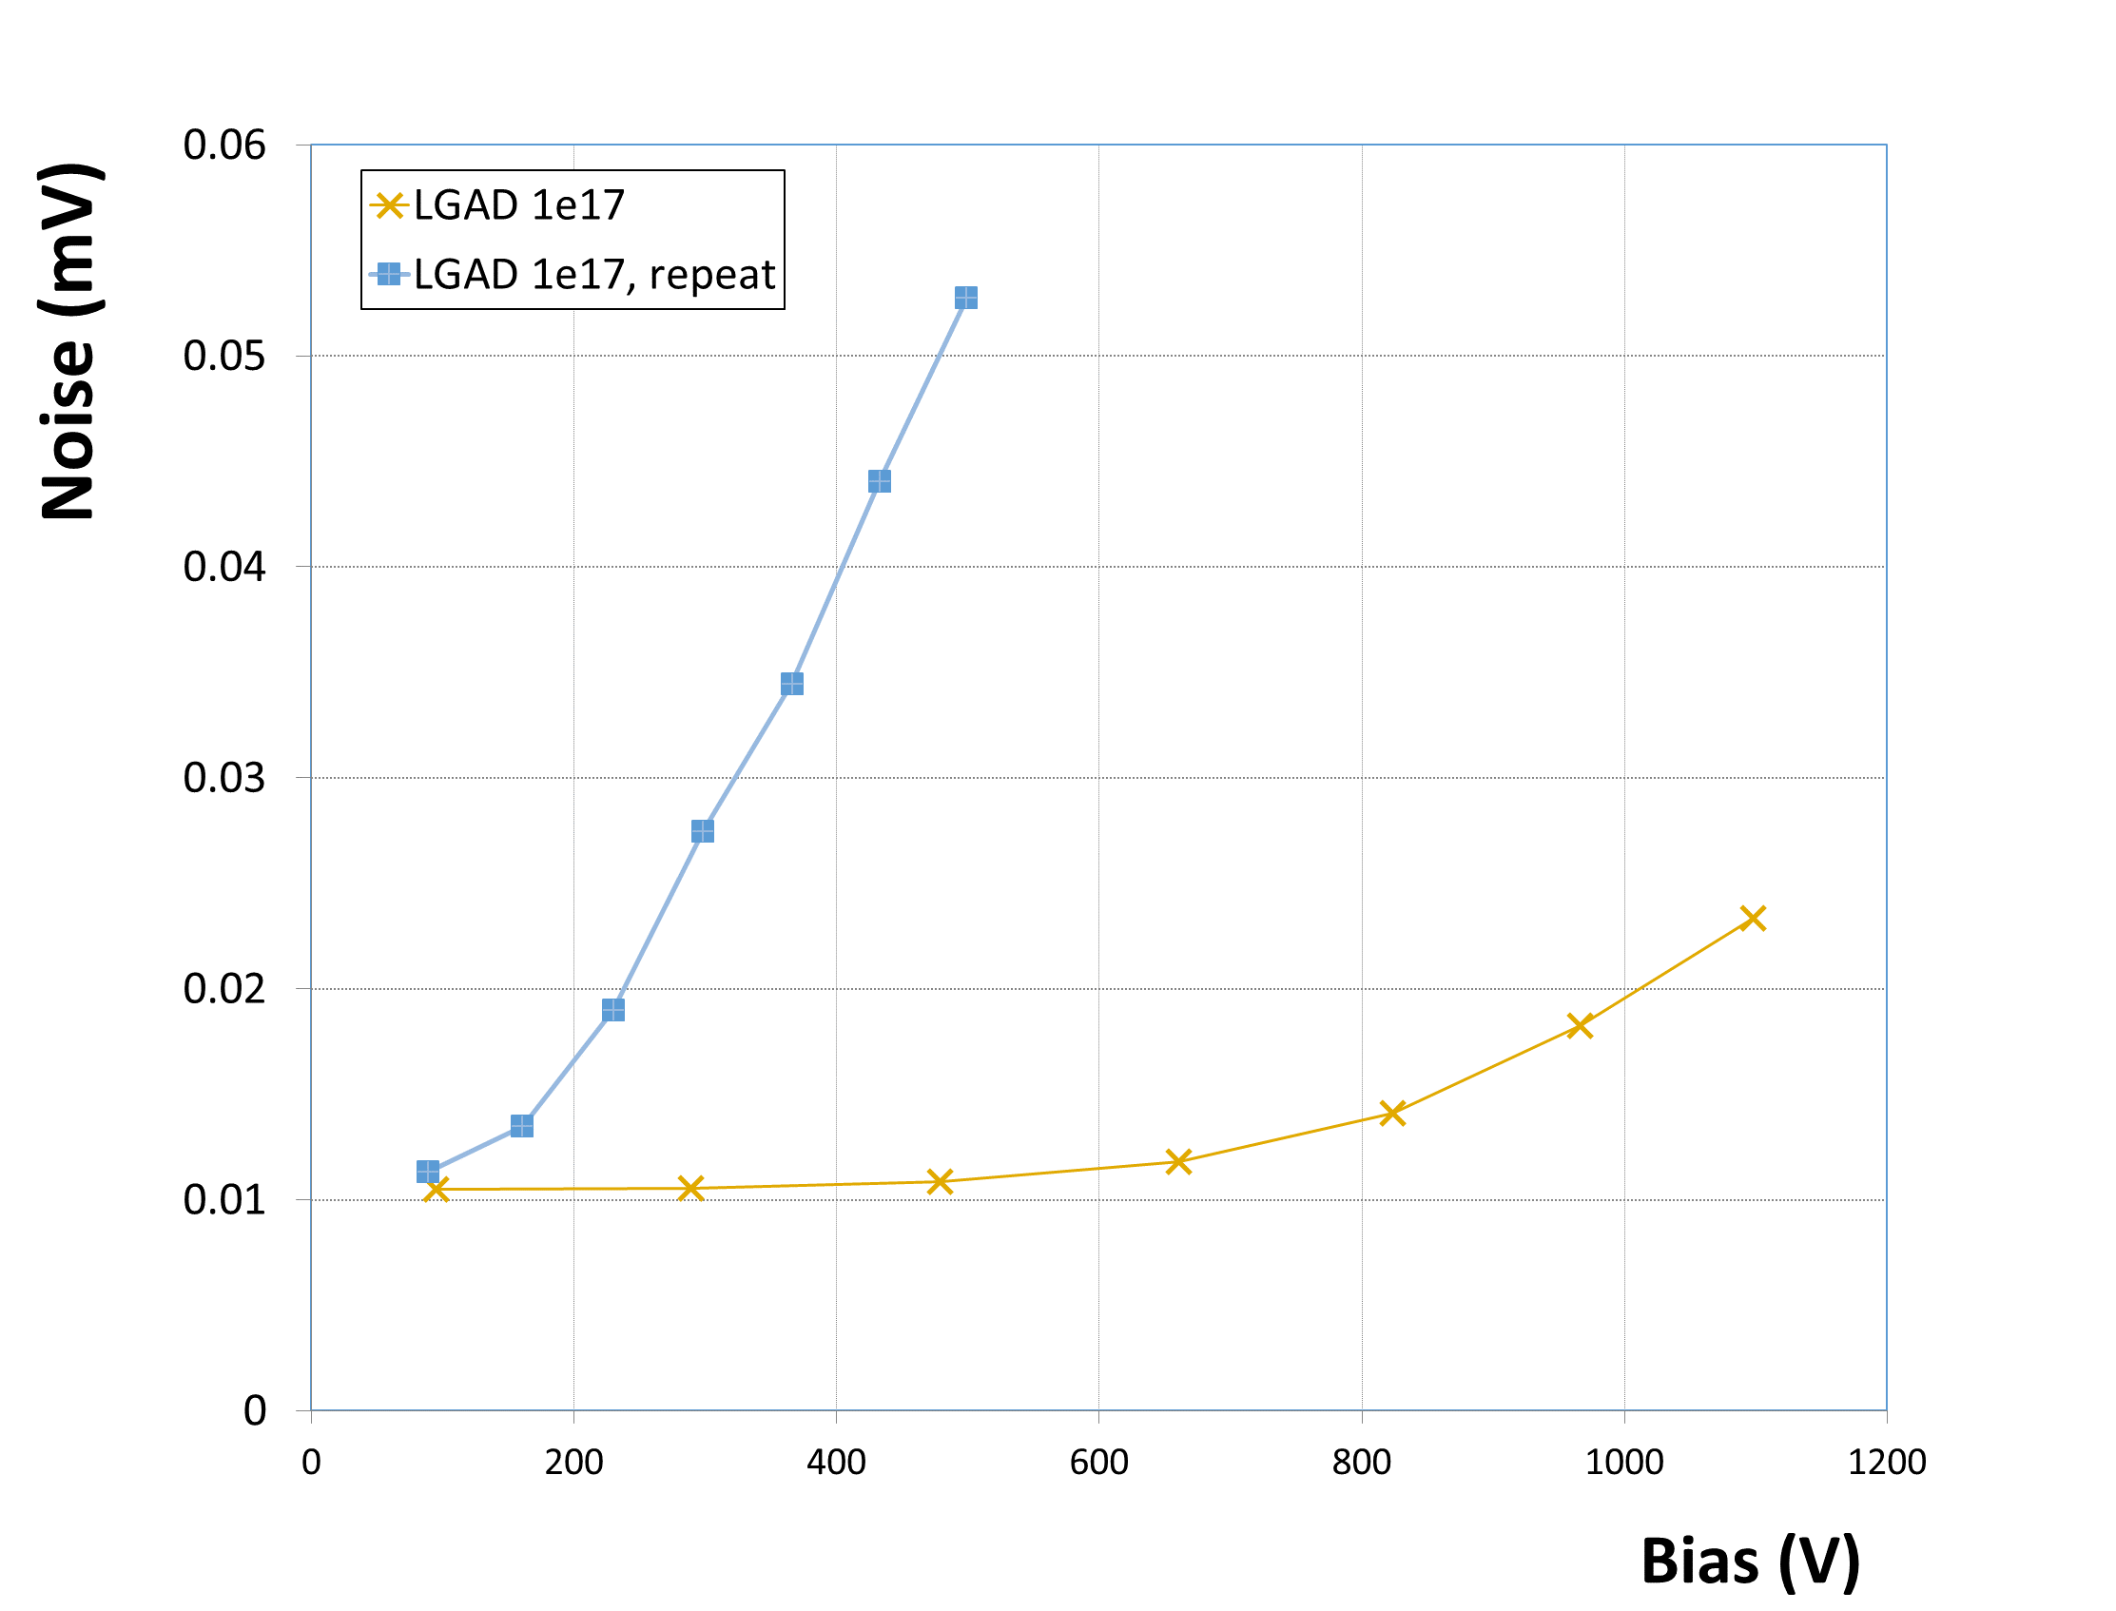
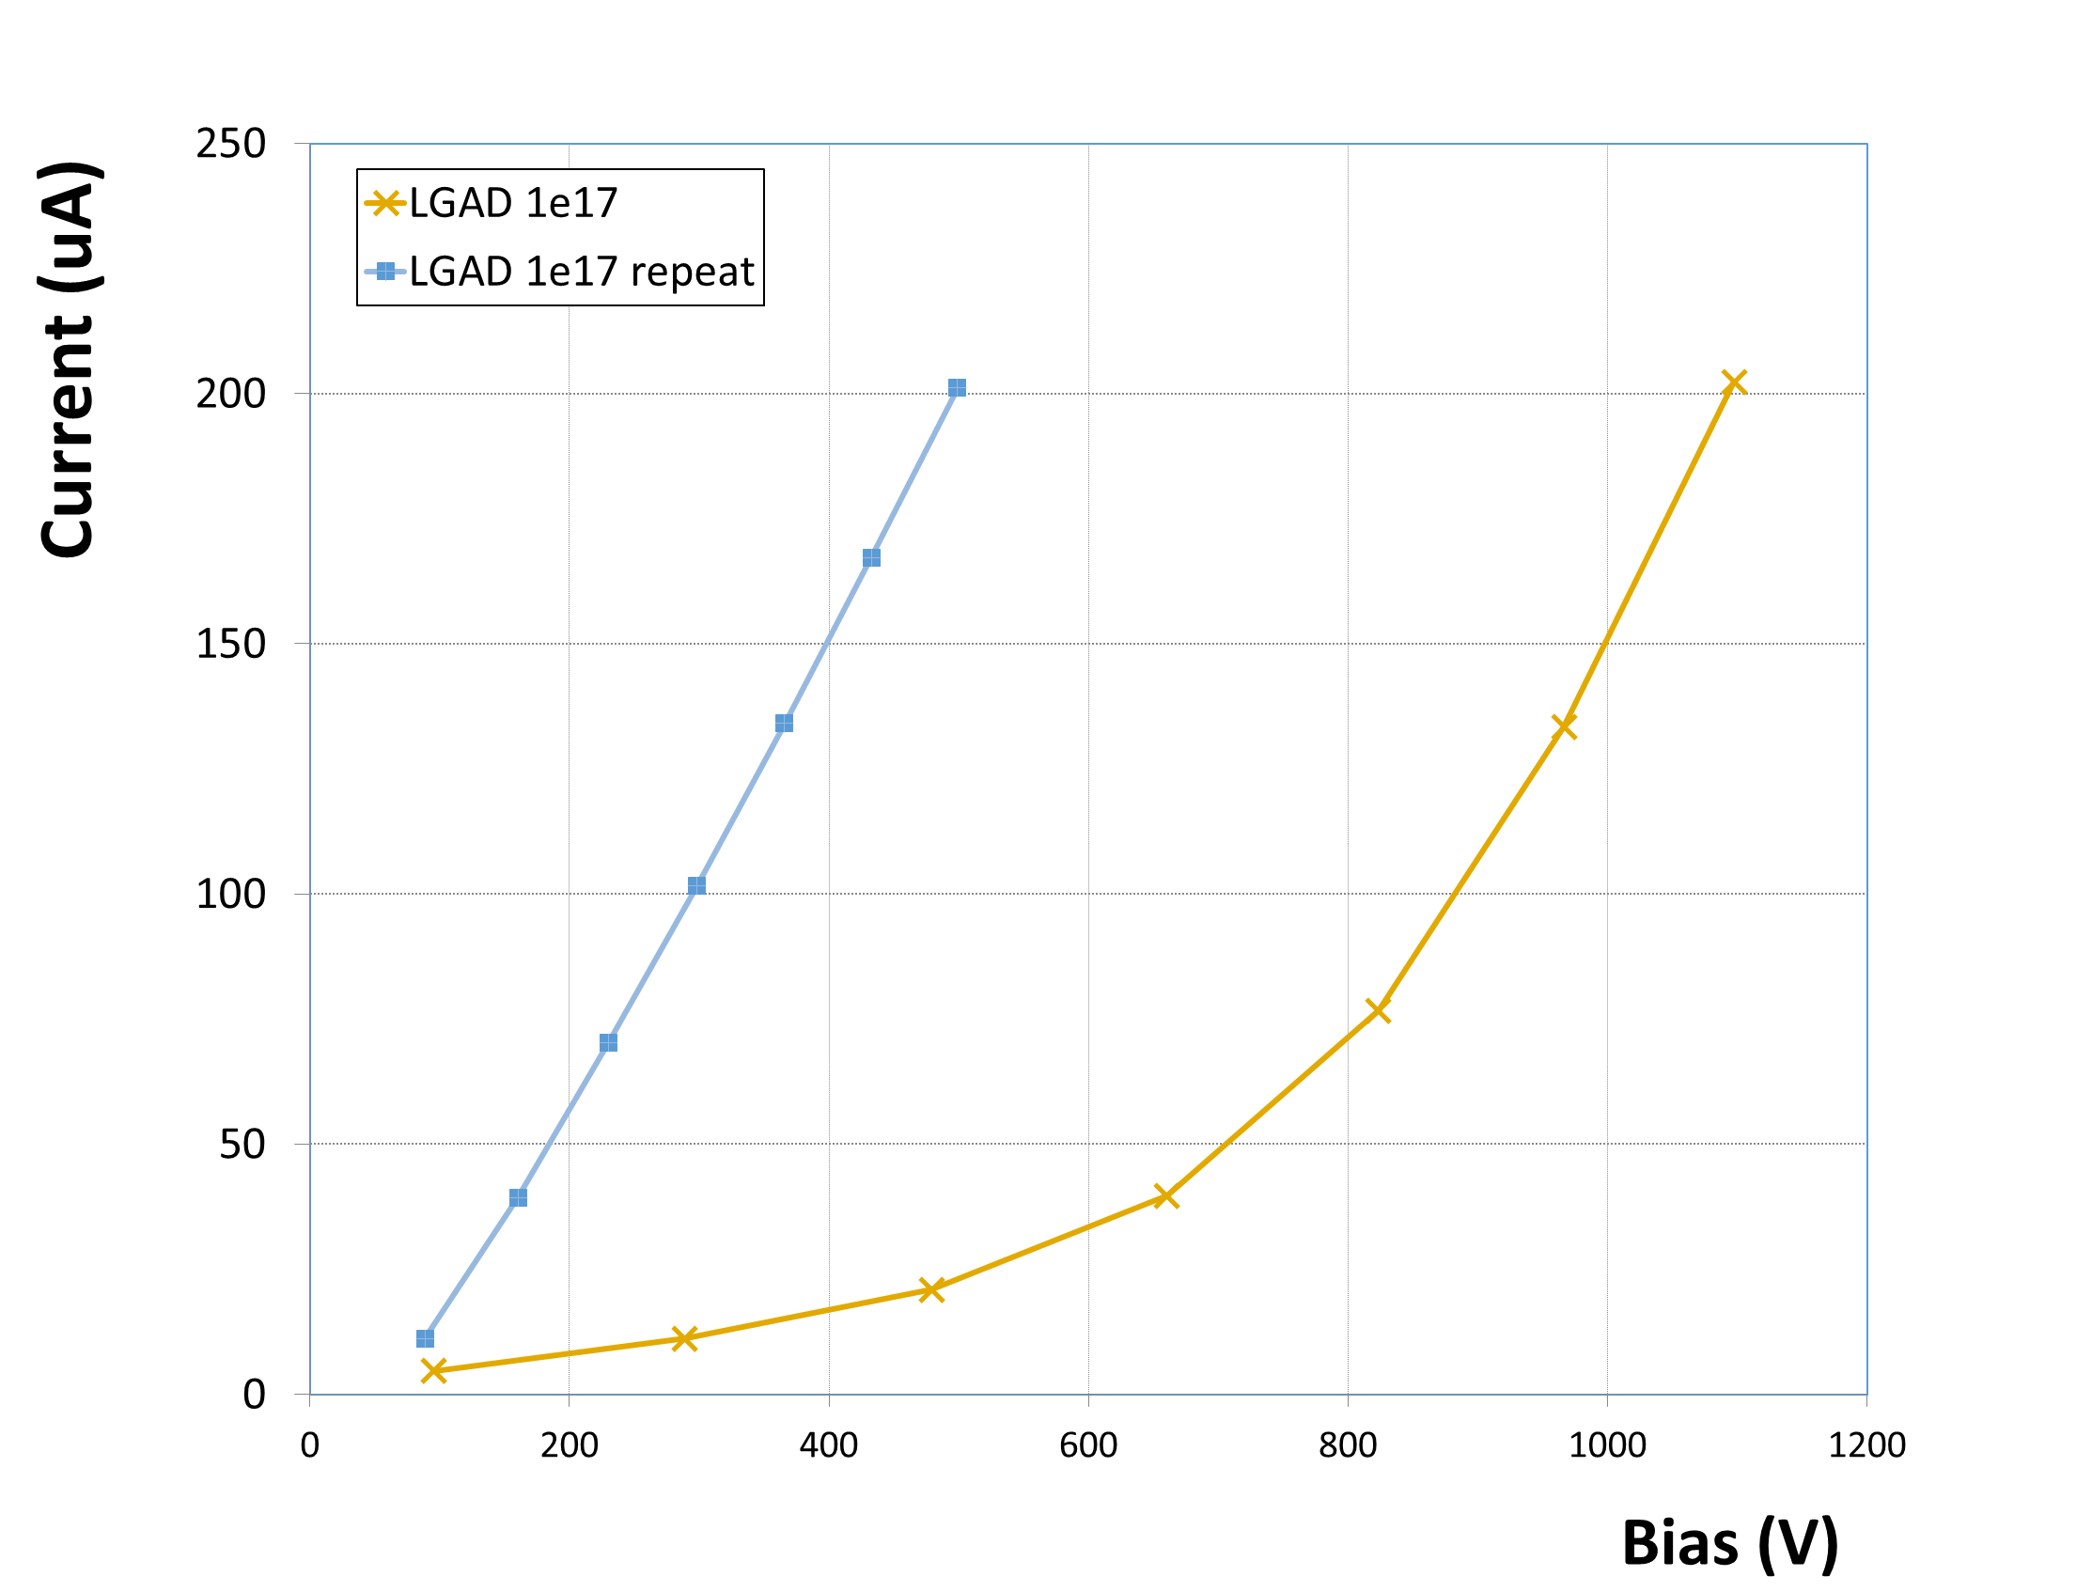
Lazarus++
Same detector, ~ 10 days at RT kater
LGAD 1e17
Bias = 1100 V
~3000 el
~3000 el
Multiplication?
Breakdown?

Slide 11
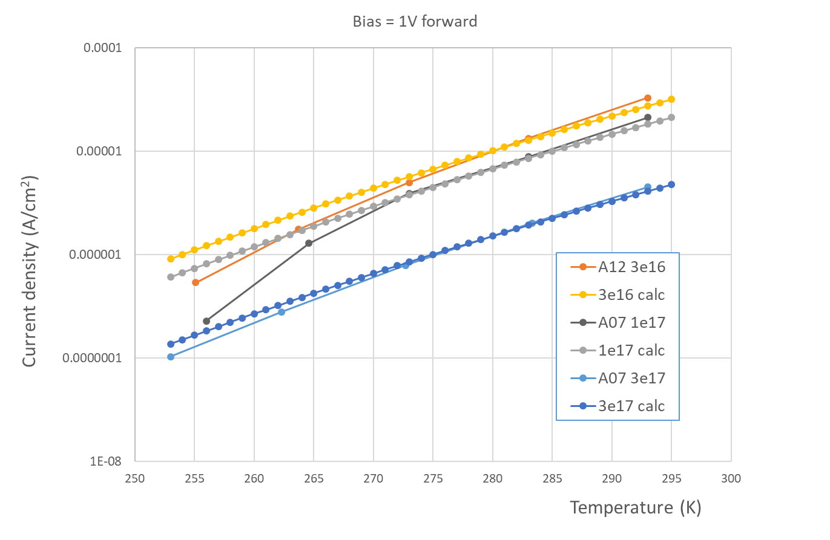
j vs T at 1 V forward bias
Calculation:
j = n_{i} ∙E∙(µ_{e}+µ_{h})
E_{g} = 1.12 eV,
m_{e} = 1.08 m₀
m_{h} = 0.6 m₀
Mobility temp scaling:
µ(T) = µ(T₀) (T/T₀)^{2.2}
Phi = 3e16
µ_{e}+µ_{h} = 1200 cm²/Vs
(TCT ~ 600)
Phi = 1e17
µ_{e}+µ_{h} = 800 cm²/Vs
(TCT ~ 400)
Phi = 3e17
µ_{e}+µ_{h} = 180 cm²/Vs

Slide 12
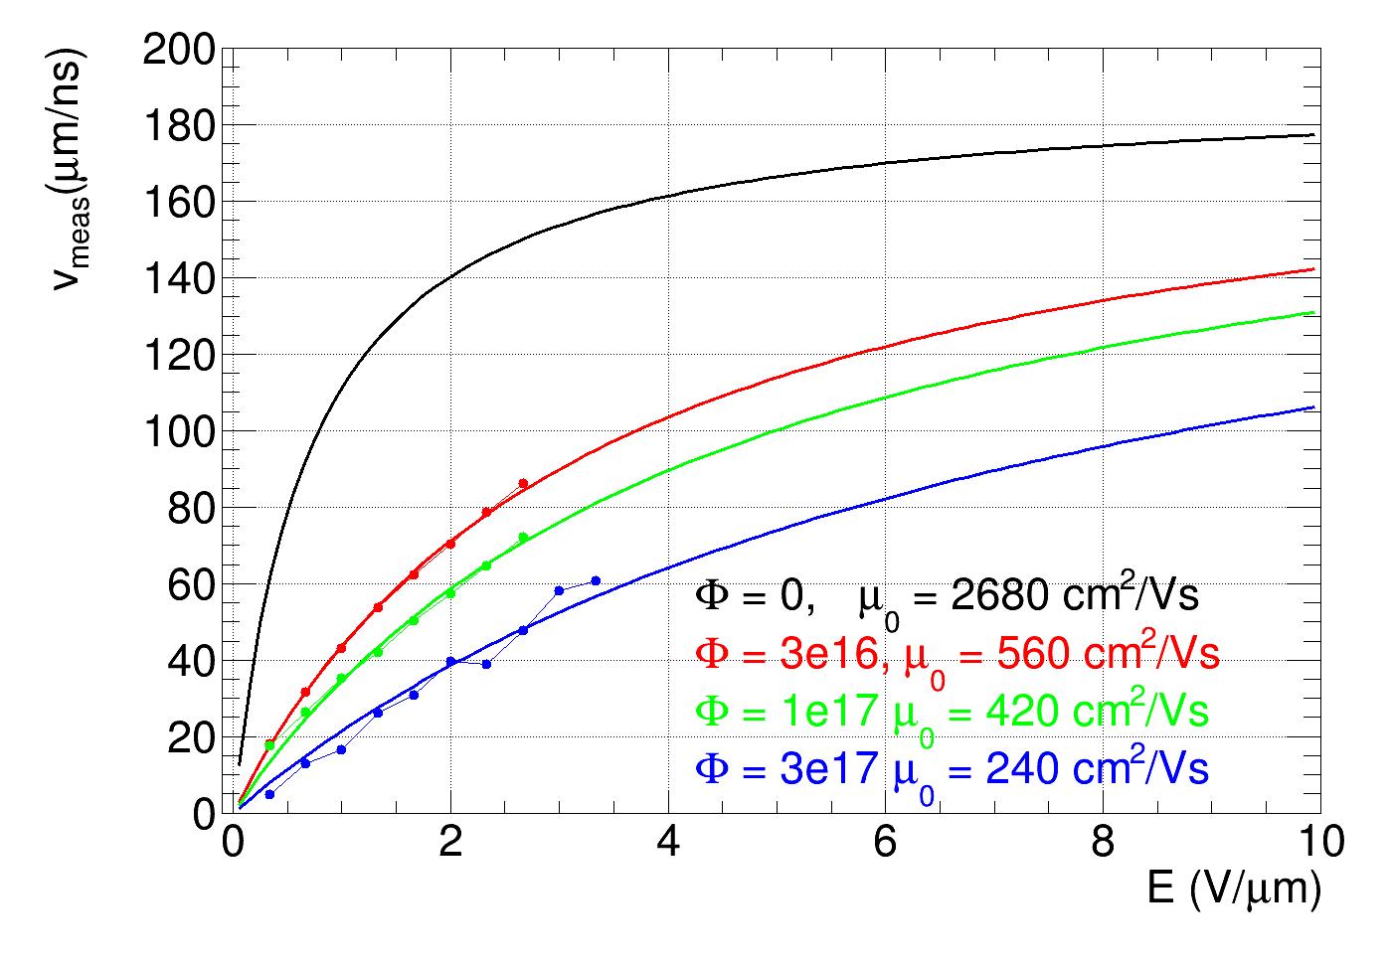
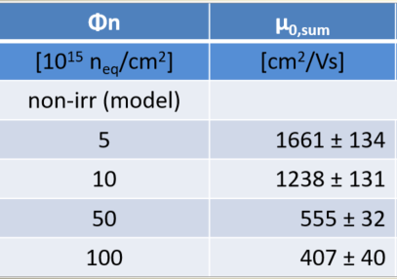
Mobility
Method from M. Mikuž et al.: mobility estimated from velocity profiles in forward bias
Assumptions: 1) electric field in forward bias: E = V/D, (V bias voltage, D detector thickness)
2) saturation velocity v_{sat} = 190 um/ns does not change with fluence,
3) fit with: v = µ₀∙E/(1+µ₀∙E/ v_{sat})
Good agreement with previous measurements!
Table from M. Mikuž et al.:
Preliminary!
Value at 3e17 uncertain → should be interpreted as upper limit
zero field mobility decreases with fluence!
velocity increases linearly with field up to high E

