Slide 1
ITk Common Environmental Monitoring System:
Radiation Monitoring
I. Mandić et al.
Jožef Stefan Institute, Ljubljana, Slovenia

Slide 2
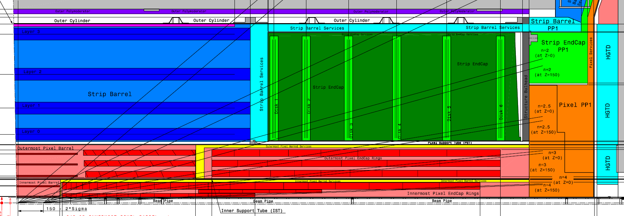
Locations
position/detector volume | Number of sensors
Strip barrel outer cylinder, z ~ 0, r = 1100 mm, one in each quadrant | 4
Strip EC volume (r ~ 600 mm, z ~ 1600 mm in each quadrant, on side A and C) | 8
Strip EC PP1 volume, fixed on the outer side of structural bulkhead: r ~ 800 mm, z ~ 3000 mm, side A and C, one in each quadrat | 8
Pixel service volume, fixed on outer side of the enclosure r ~ 500 mm, z ~ 3200 mm, side A and C, one in each quadrant | 8
Total | 28
fixed on outer side of Outer Cylinder
fixed on the blades of disk 1 or disk 2
inside tracking volume, connection goes
through the enclosure
strip EC service volume, outer side of
the bulkhead
Pixel PP1 external volume

Slide 3
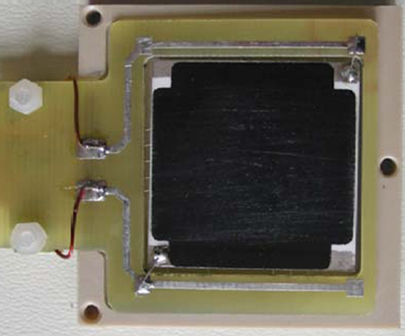
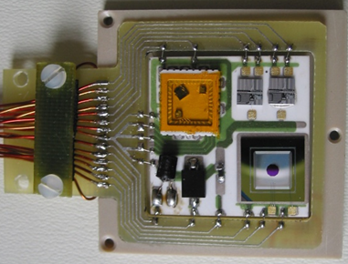
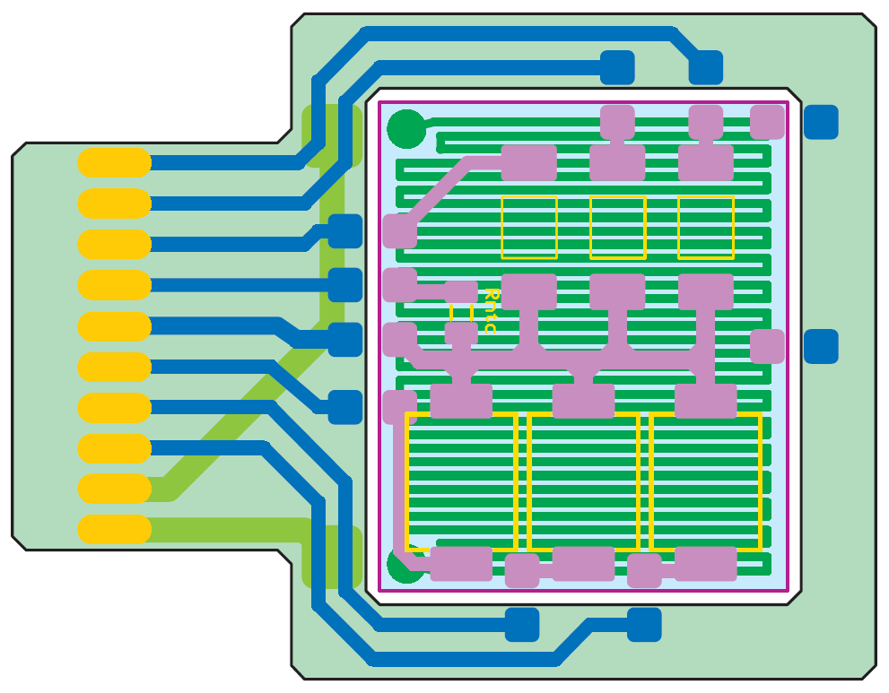
Radiation Monitor Sensor Board (RMSB)
example from ATLAS ID shown on photos
Back side
( heater for temp stabilization)
Sensor side
Pigtail cable
Very similar design for ITk:
3 RadFETs (TID)
temperature sensor (10 kOhm NTC)
3 BPW34 diodes (NIEL)
Ceramic (Al₂O₃)
front side: sensors
back side: resistive layer
PCB
~ 2.2 cm

Slide 4
Radiation Monitor Sensor Board (RMSB)
hybrid fixed inside PEEK box, 3 cm x 3 cm, 0.8 cm thick,
cable soldered and clamped to the PCB
→ can be standard flat cable or e.g. copper clad aluminium wires as used in the ID
Sensor box
3 cm x 3 cm
8 mm thick
Photo of the connector on the mockup :
ERNI, 1.27 mm pitch, flat cable, 30 AWG wires
this is an example of a possible cable
and connector
Mockup with ~ 1 m pigtail
RMSB with pigtail, mount to support and connect via connector?
for locations in the tracking volume: solder to prepared cables at assembly site (e.g. NIKHEF)?

Slide 5
Grounding and shielding requirements (Alex Grillo)
PP1
PP2
USA15
Floating power supply
(DAC)
sensor
Type 0 (flat cable)
Type II DCS
Type III DCS
Cable shield
Ground
RMSB shield
Return wire
Not known:
flat cable shield?
→ wrap the cable with foil?
RMSB shield (25 um Al sufficient)?
→ wrap PEEK box? metalize PEEK box?
make box from Al not PEEK?
RMSB outside of the tracking volume:
Connect to faraday cage ground at RMSB mounting location
RMSB inside tracking volume:
Connect to ground at PP1 through shield around Type 0 cable

Slide 6
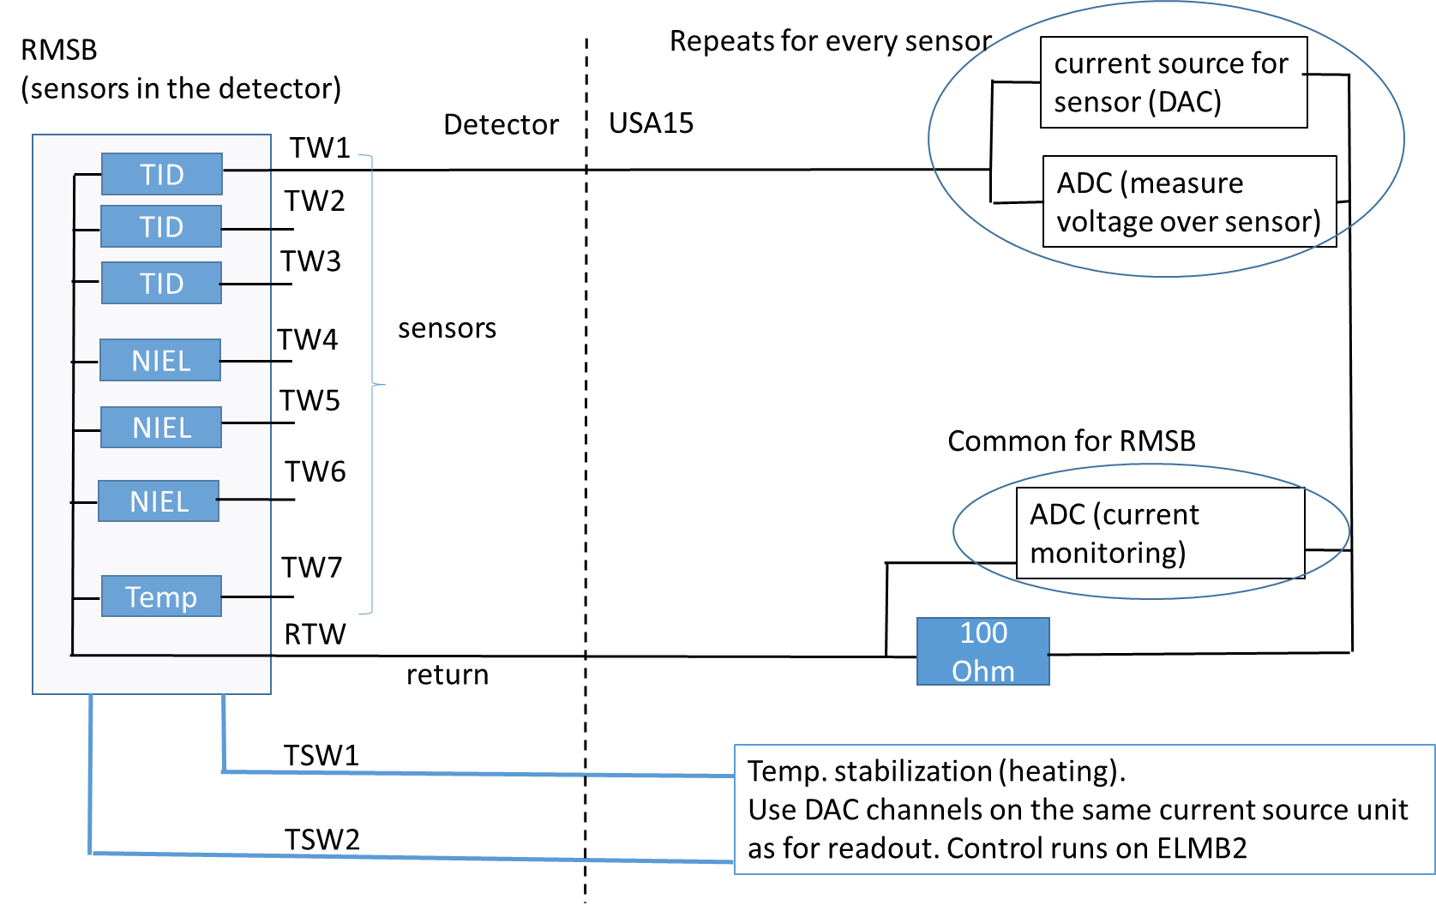
Readout
Read sensors one by one,
few times per hour
Connected to F.C.
Would current
monitoring still
work?
readout based on ELMB2 → same functionality as ELMB, communication with DCS via ELMB2
radiation monitor readout system running on ELMB in the ID → adapt ID radmon firmware for ELMB2
➔ build new current source unit controlled by ELMB2:
a) chose DAC compatible with ELMB2 firmware
b) output up to 100 V
➔ readout system must meet grounding and shielding requirements
→ floating power supply referenced at the Faraday cage
→ design of current sources and monitoring circuits will follow the solutions described in:
ATL-IP-ES-0106 The Supply and Control system for the Opto Link of the ATLAS pixel detector

