Slide 1
Measurements with Si detectors irradiated to extreme fluences
V. Cindro, A. Gorišek, B. Hiti, G. Kramberger, I. Mandić, M. Mikuž, P. Skomina, M. Zavrtanik et al.
Jožef Stefan Institute, Ljubljana, Slovenia
University of Ljubljana, Slovenia

Slide 2
Introduction
presentation at 34th RD50 Workshop in Lancaster, June 2019
  https://indico.cern.ch/event/719814/contributions/3022499
Charge collection and TCT measurements with 50 µm LGAD irradiated to extreme fluences
→ unusual behavior observed in device irradiated to 1e17 n/cm²
→ transition from “normal” to “LGAD” kind of behavior (charge multiplication at low bias voltages) after
few weeks at room temperature
this contribution: 75 µm (epitaxial) LGAD irradiated up to 1e17 n/cm²
→ CC and TCT measurements
→ annealing at 60°C up to 1200 minutes

Slide 3
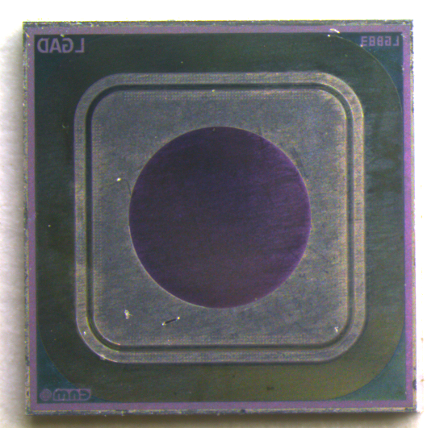
Samples
CNM LGAD run 9256
75 µm epitaxial on low resistivity Cz substrate
chip thickness ~ 600 µm
Irradiated with reactor neutrons to 2.5e16, 5.7e16 and 1e17 n/cm²
3.3 mm
Measurements
Edge-TCT: depletion depth, active thicknes
Q-TCT: charge collection, I-V
Plan
systematically measure the effect of annealing time on these diodes
annealing times: 0, 80, 240, 560 and 1200 minutes
measure in reverse and forward bias

Slide 4

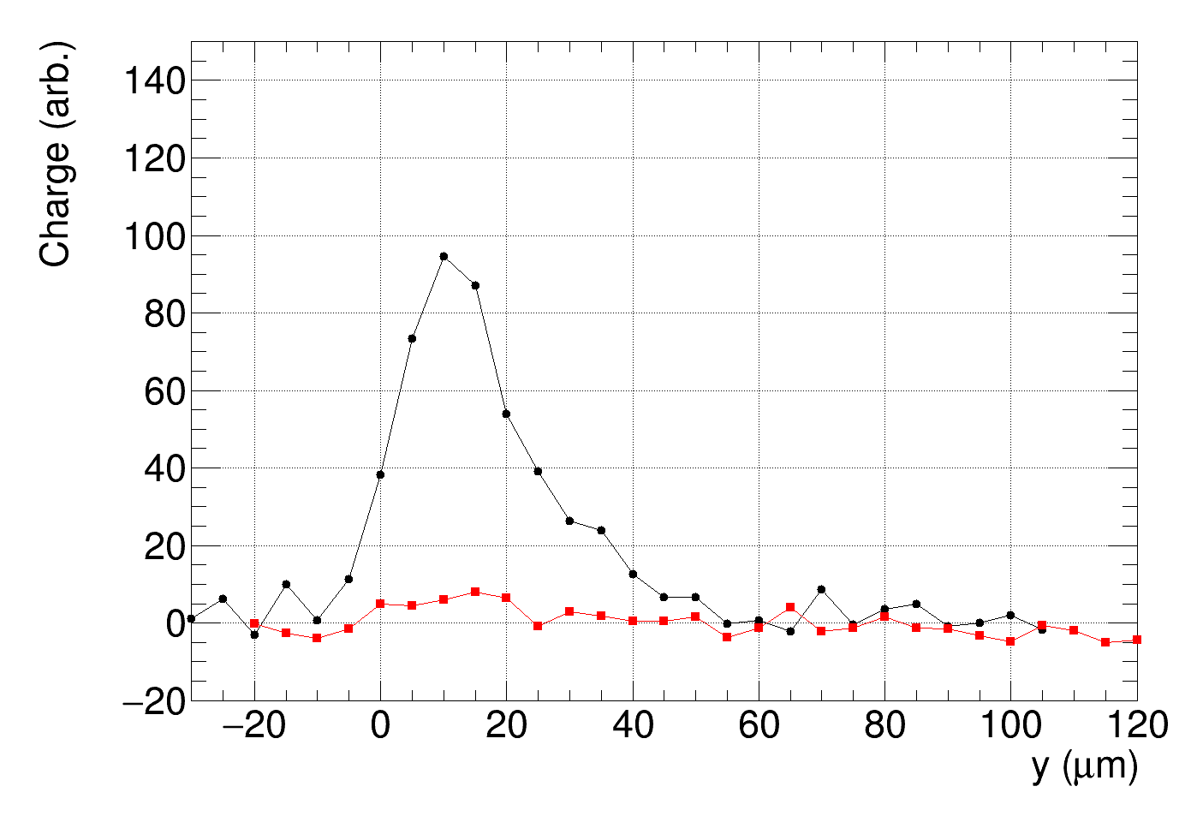
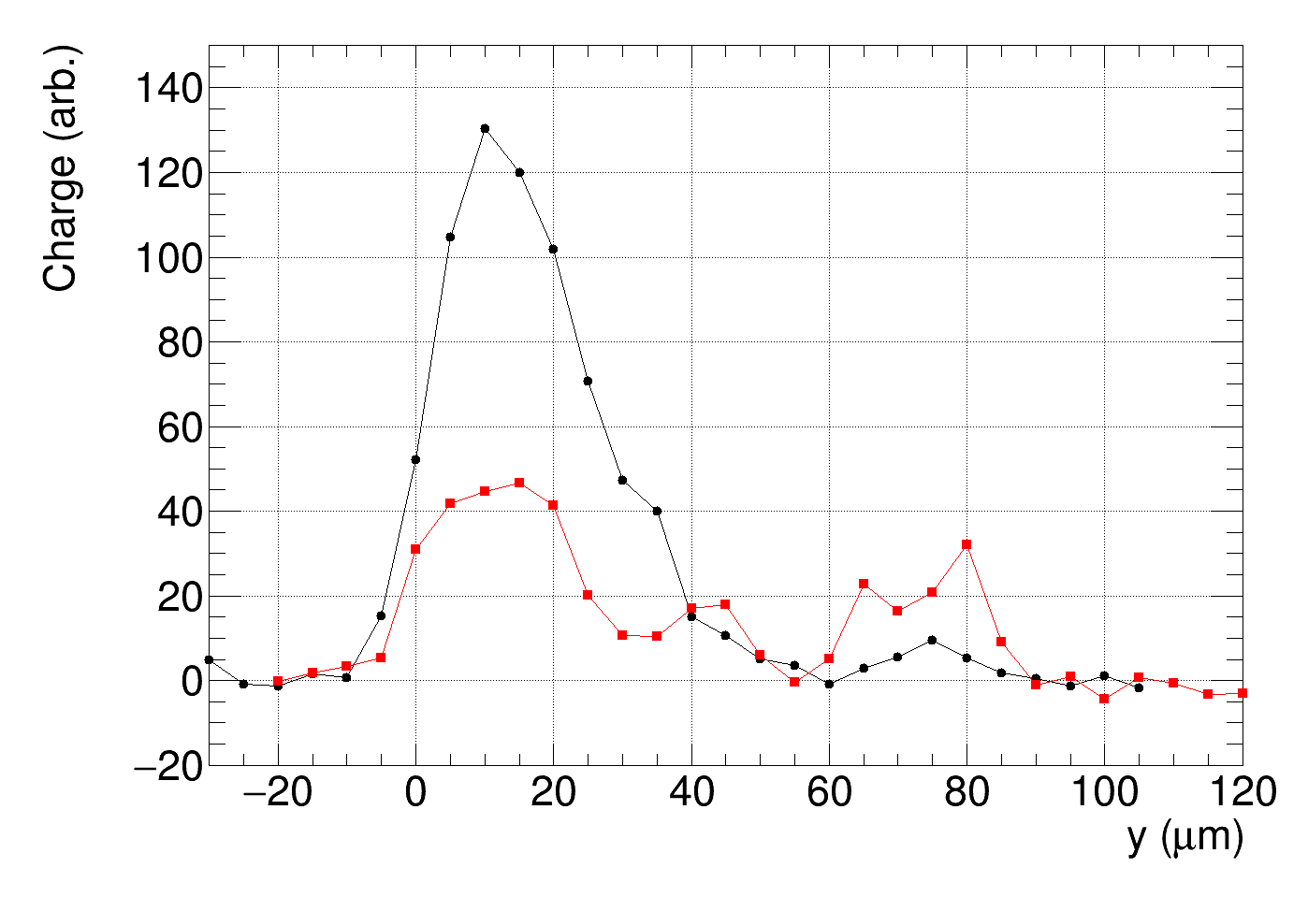
Edge - TCT
No signal on pad electrode
before depletion of multiplication layer
IR laser direction
Pin diode
1/C²
M. Carulla, TREDI 2017, Trento
LGAD
Signal from guard ring or pad electrode
Bias (V)
Not irradiated
Not irradiated
Guard ring
Pad electrode
Guard ring
Pad electrode
10 V
20 V
Diode Surface
depth

Slide 5
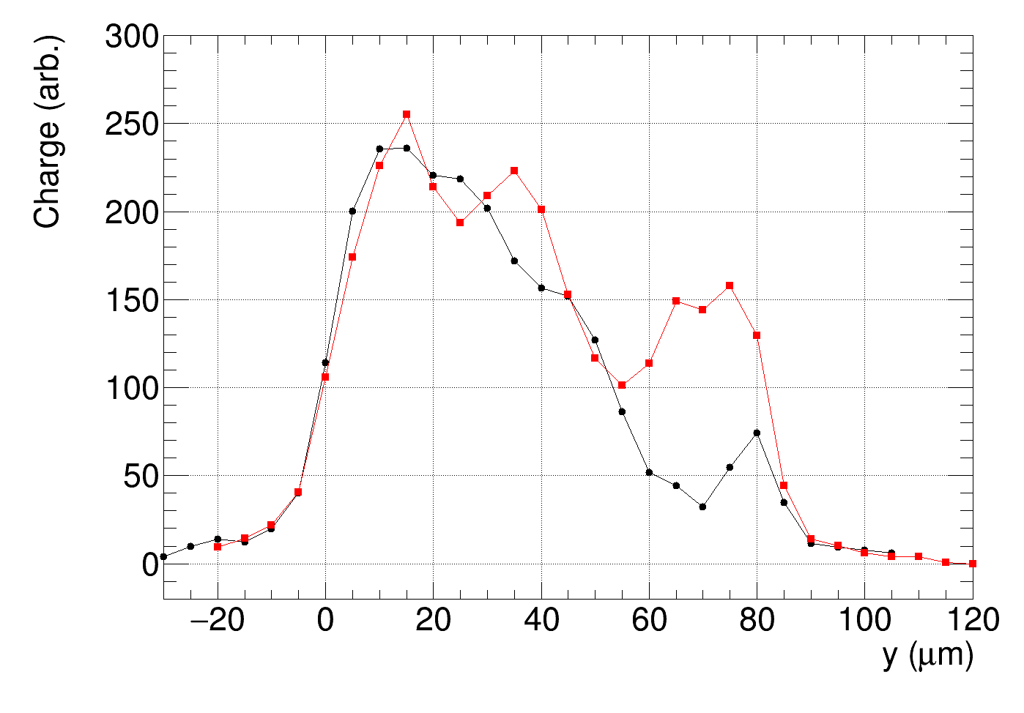
Edge- TCT
Ф = 0
Bias = 200 V
Guard ring
Pad electrode
Field at the back,
effect enhanced because of large pad
electrode.
➔ Measure depletion depth on guard ring
Depletion
depth

Slide 6
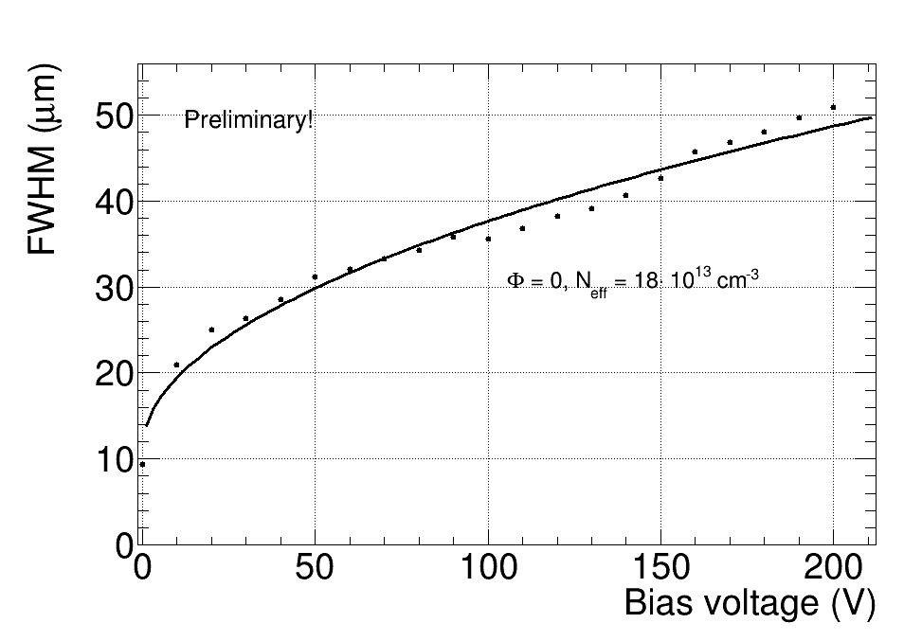
Edge TCT, before irradiation
Signal from guard ring
N_{eff} = 1.8e14 cm⁻³ → Resistivity ~ 70 Ωcm, Expected V_{fd} (75 µm) ~ 750 V
Nominal: 100 Ωcm → N_{eff} = 1.3e14 cm⁻³ → V_{fd} ~ 550 V

Slide 7
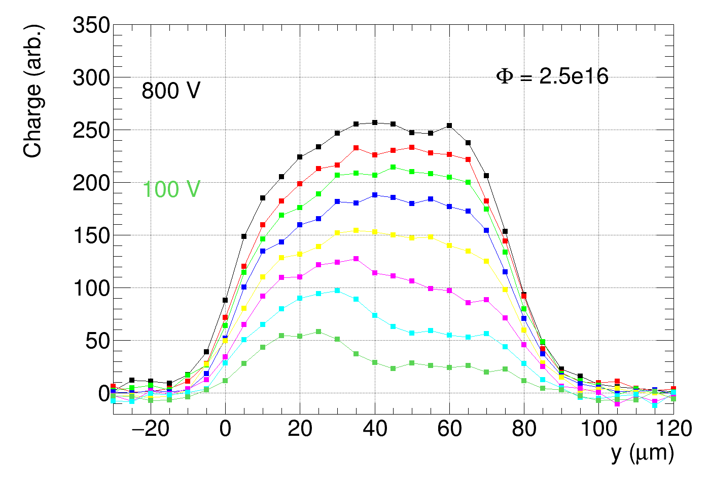
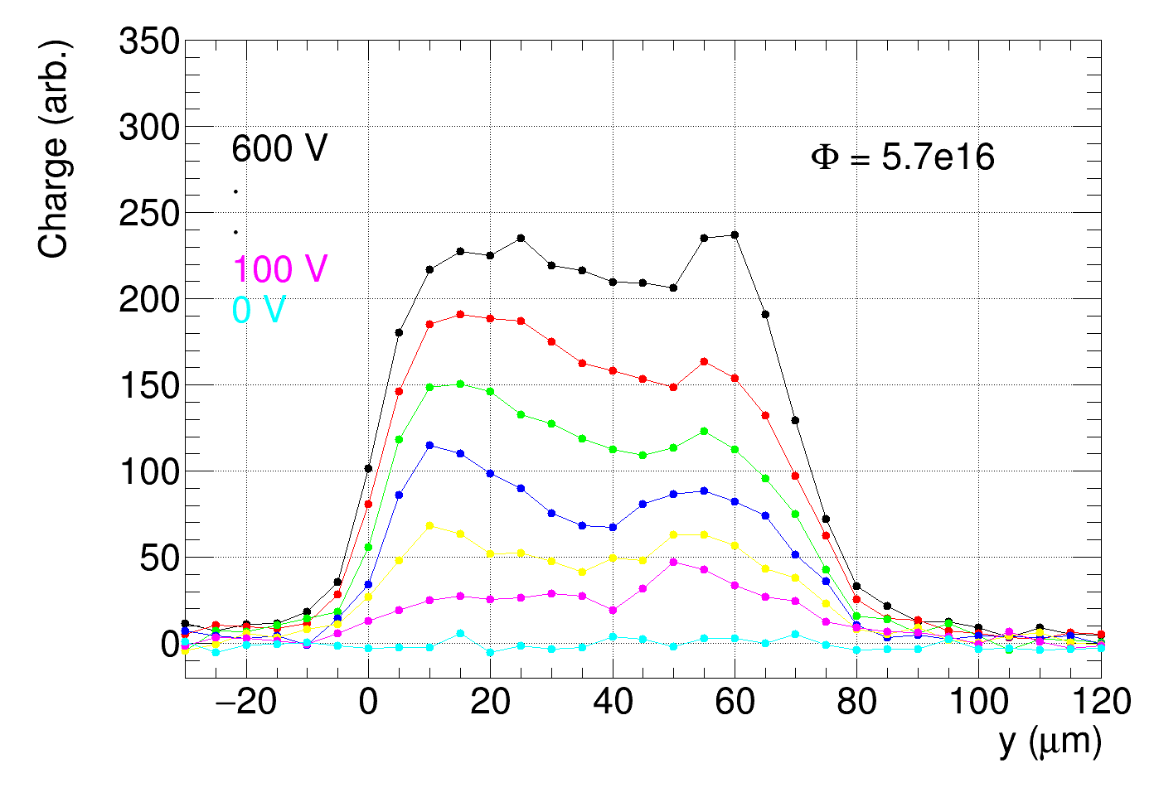
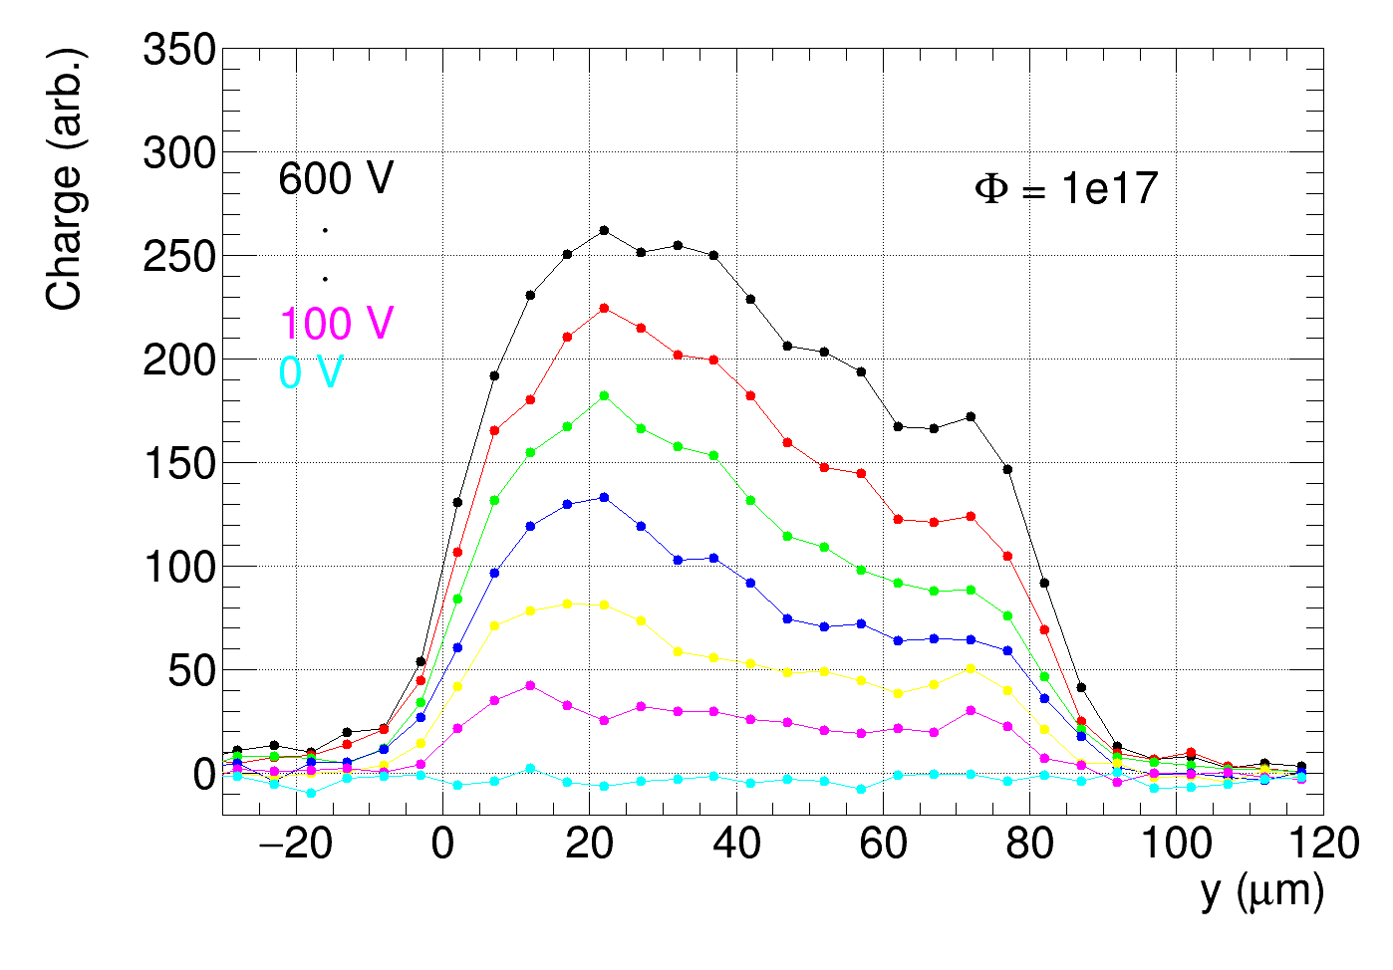
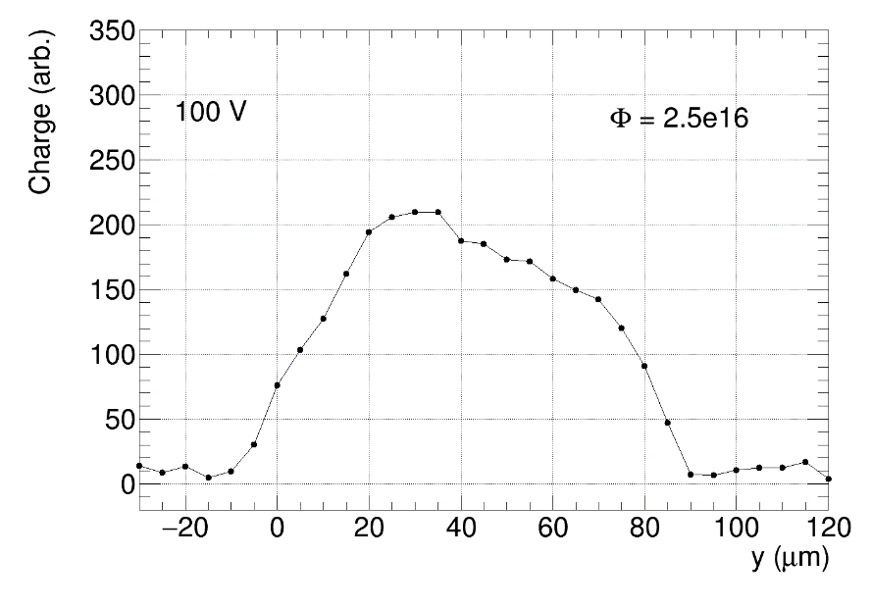
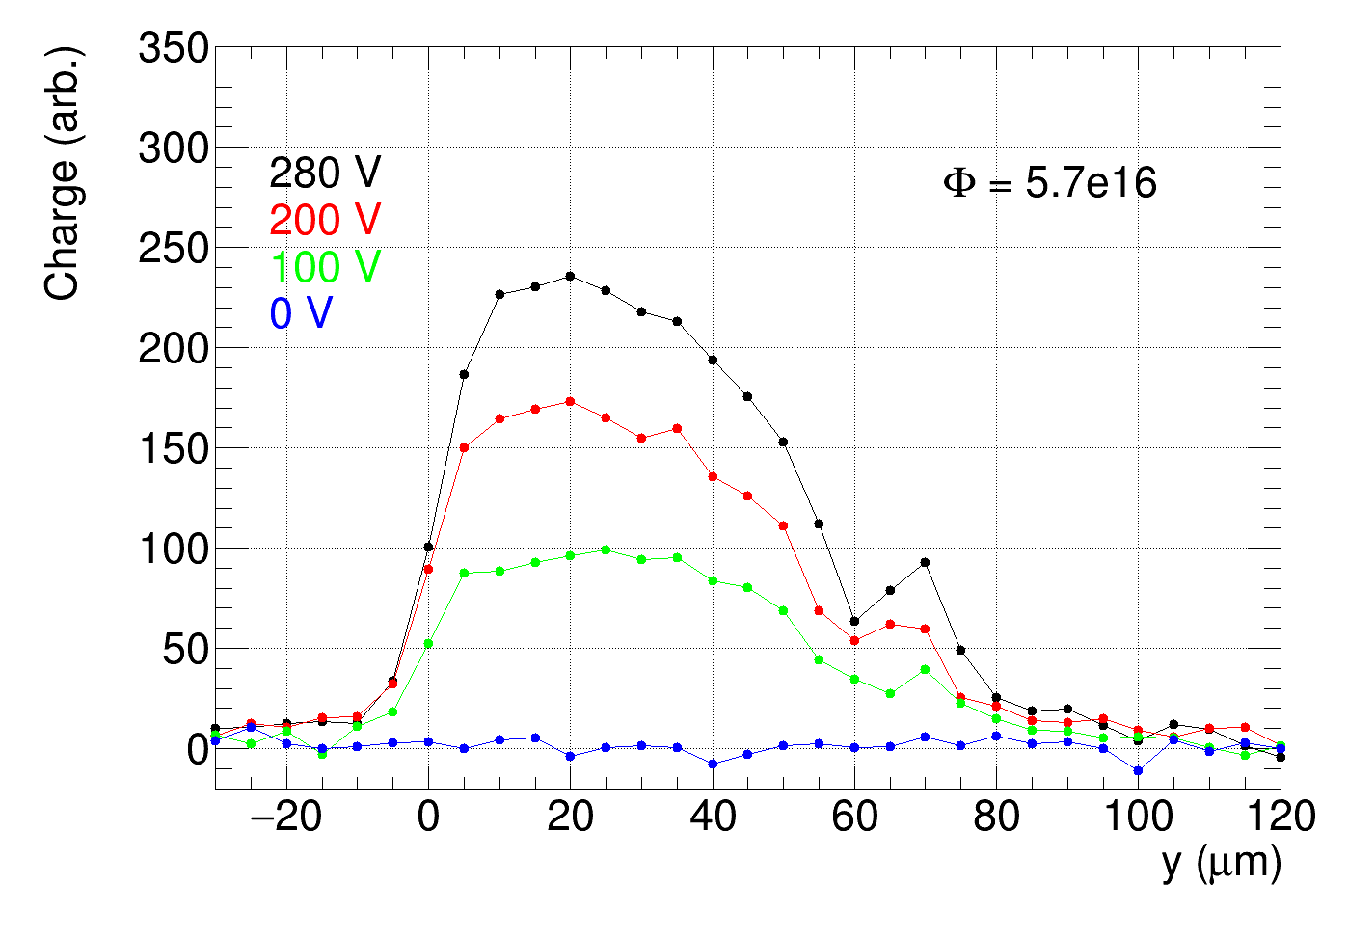
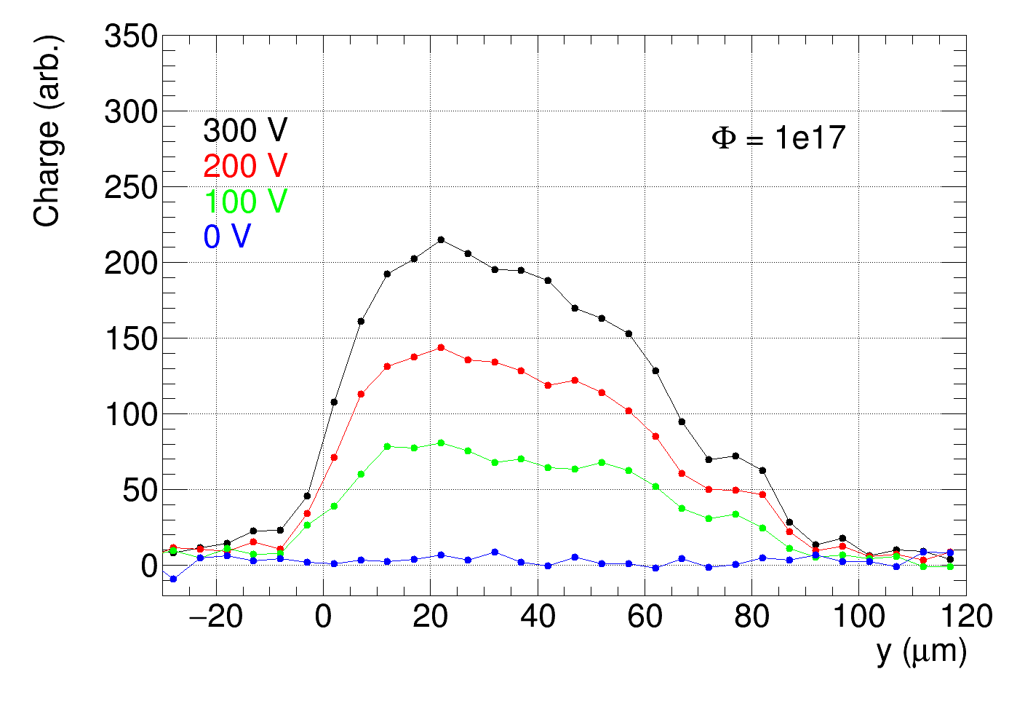
E-TCT, irradiated detectors
charge from the 75 um epitaxial layer, no charge from low resistivity substrate
electric field across whole detector thickness already at 100 V in reverse or forward bias
Forward bias
Forward bias
Forward bias

Slide 8
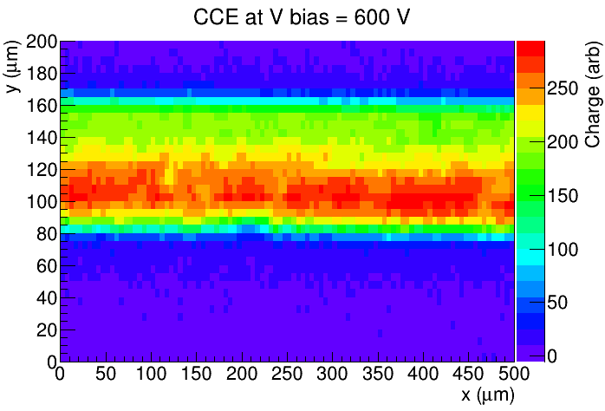
E-TCT
Uniform response across x coordinate
Ф = 1e17 n/cm², Bias = 600 V, signal from guardring
Depth
x
Detector surface
IR laser direction

Slide 9
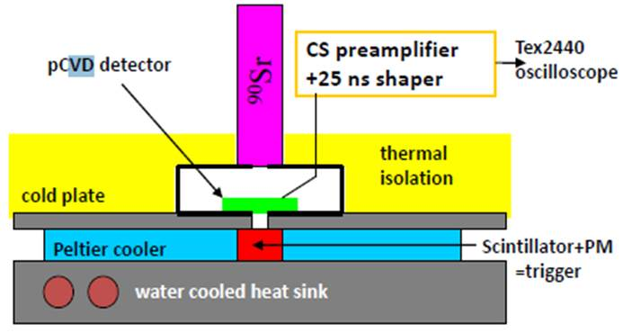
Charge Collection measurement with Sr-90
ORTEC 142 charge sensitive amplifier + custom made shaper with 25 ns shaping time
digital oscilloscope
detector
Large (3x3 mm) pad detector and small collimator holes enable recording of a clean sample of waveforms
➔ no “empty triggers” → can measure average charge collected after passage of a (almost) MIP
also at small signal/noise
New since last year: a) replaced bias resistor in ORTEC 142 ➔ 1 MΩ instead of 10 MΩ
b) improved cooling (measure at -30 C)
Can measure up to higher
bias voltages

Slide 10
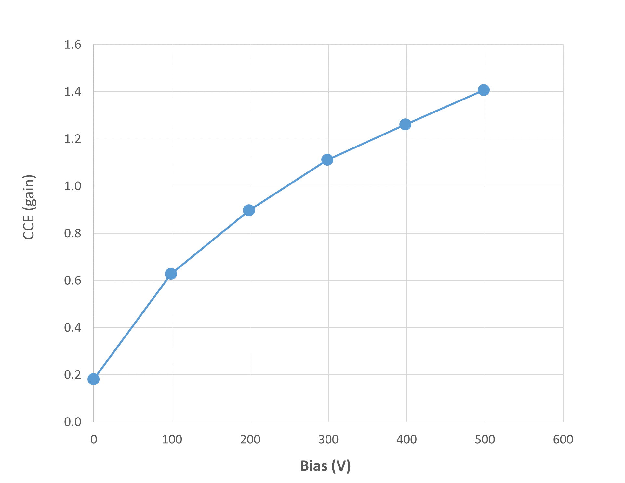
LGAD 75 um, relatively low gain
Measured with Sr90,
CCE = measured_mean/7500 el
Measured with alpha source:
75 μm epitaxial LGAD
M. Carulla, TREDI 2017, Trento

Slide 11
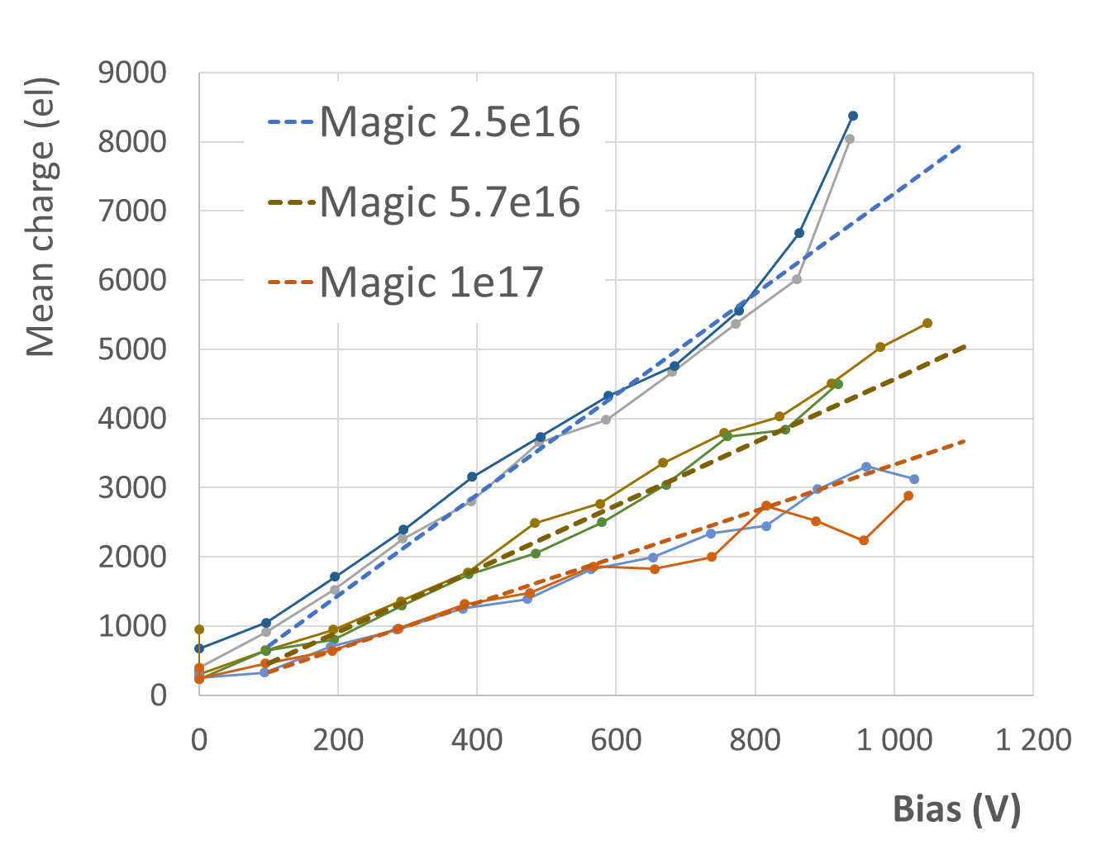
Charge collection
G. Kramberger et al, 2013 JINST 8 P08004
“Magic formula” (300 µm spaghetti Ф > 1e15):
Q_{MPV} = k∙Ф^{b}∙V,
k = 26.4 el/V, b = -0.683
(Ф in 1e15 n/cm², V in volts)
More charge at same bias voltage for thinner detectors
➔magic formula slightly modified for
75 µm detectors:
Q_{mean_75um} = k∙Ф^{b}∙V
k = 44 el/V, b = -0.56
(Ф in 1e15 n/cm², V in volts)
Annealed 80 minutes
Dots: measurements

Slide 12
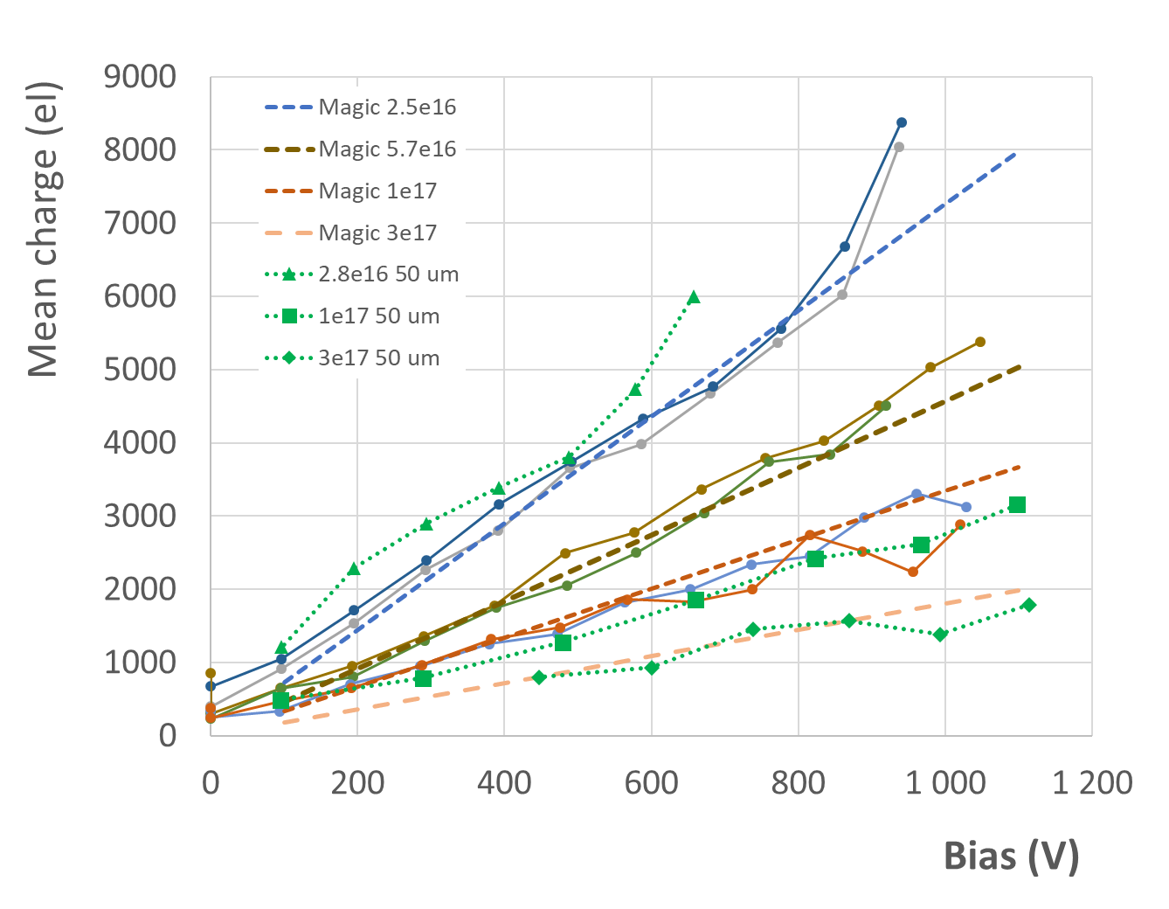
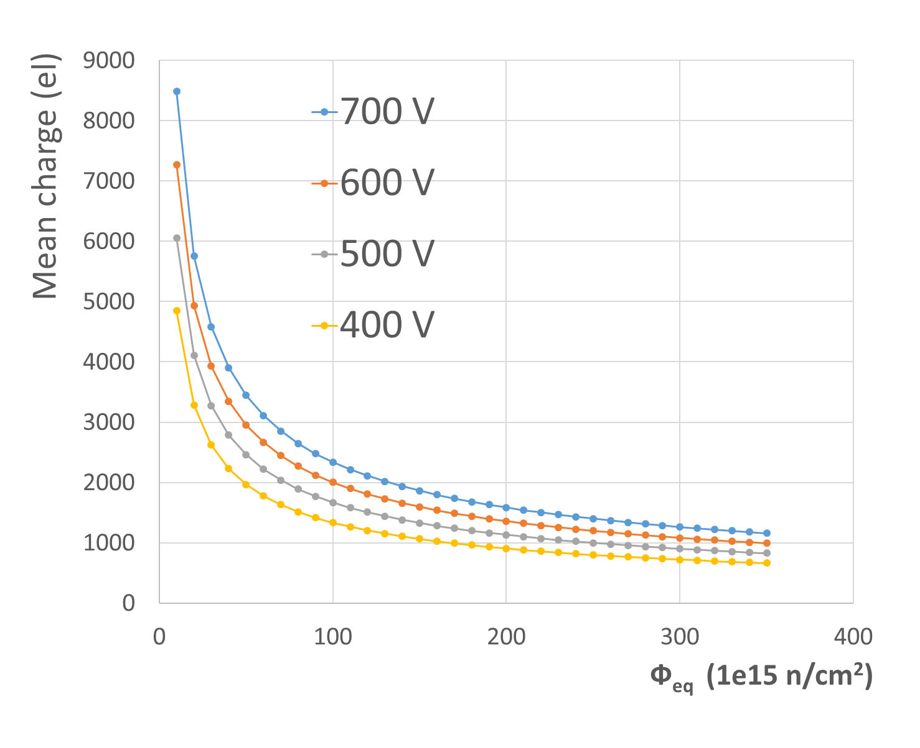
Compare with 50 µm LGAD
50 µm epitaxial LGAD (see https://indico.cern.ch/event/719814/contributions/3022499 )
no significant differences:
  50 µm at 2.8e16 slightly more charge than 75 µm at 2.5 e16
  not much difference at 1e17
  ➔ can be approximated with the same magic formula
Dots: measurements 75 µm

Slide 13
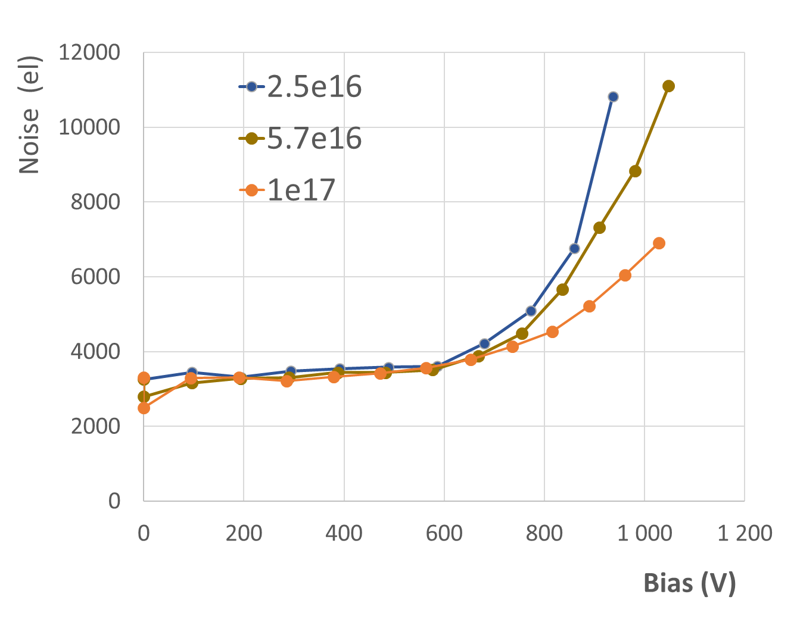
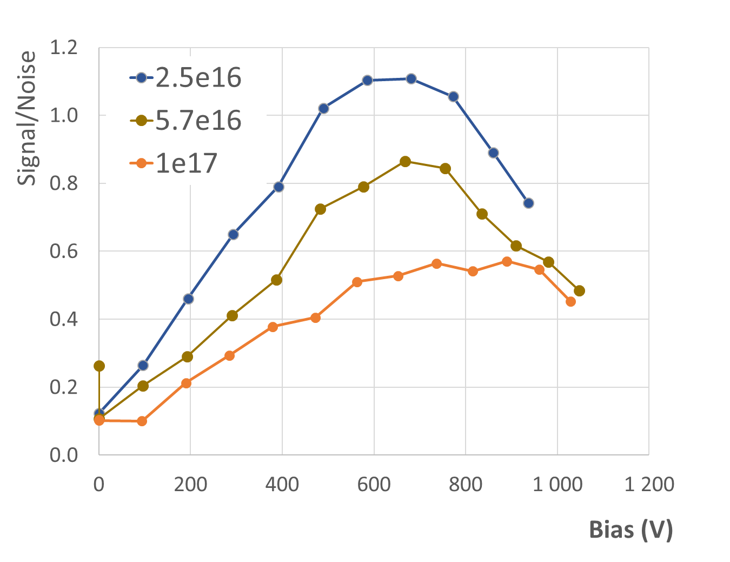
Charge collection – compare with noise
not useful to bias far above 700 V
  start of breakdown: current increase, breakdown noise

Slide 14
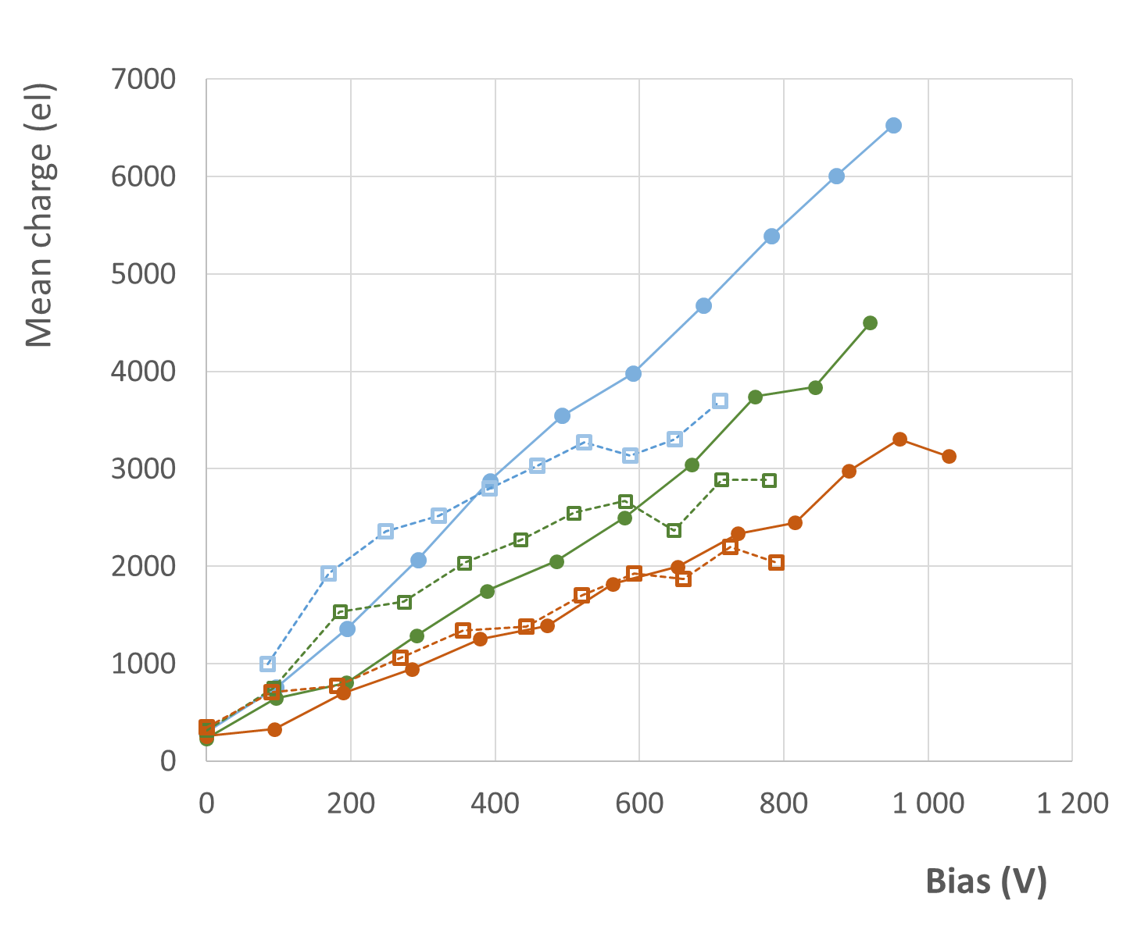
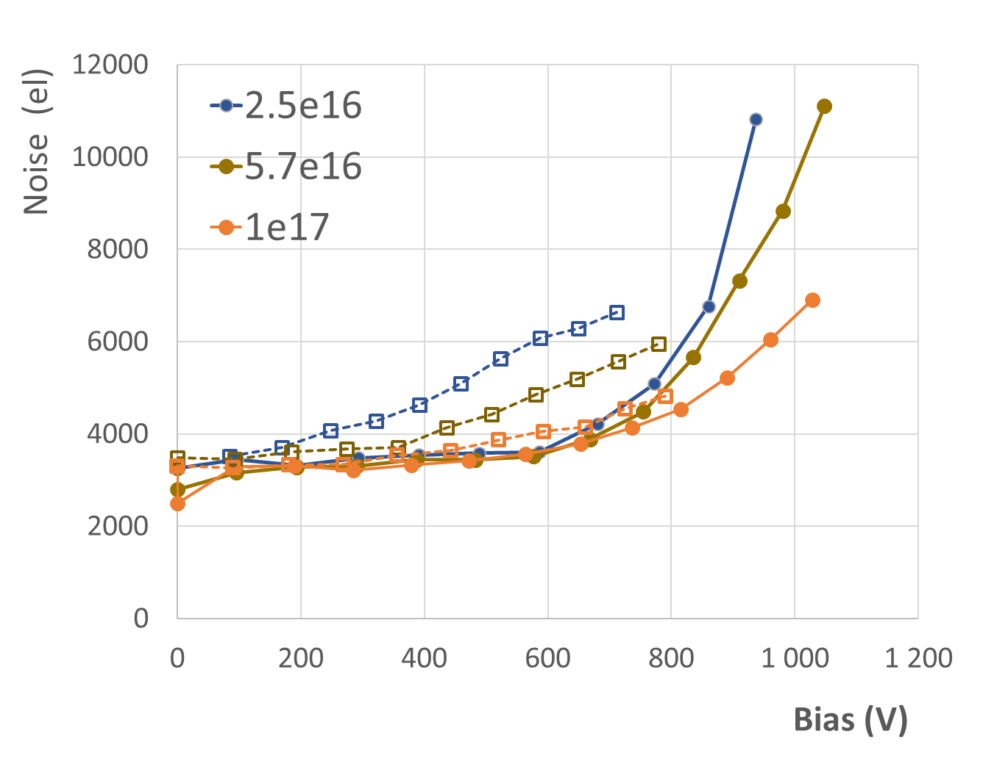
Forward bias
Dots – reverse bias
Squares – forward bias
Dots – reverse bias
Squares – forward bias
For lower fluence at lower forward bias voltages somewhat more charge than in reverse bias
at 1e17 not much difference
lower current in reverse bias → can go to higher bias voltages
➔ better performance under reverse bias
➔ difference smaller at higher fluence

Slide 15
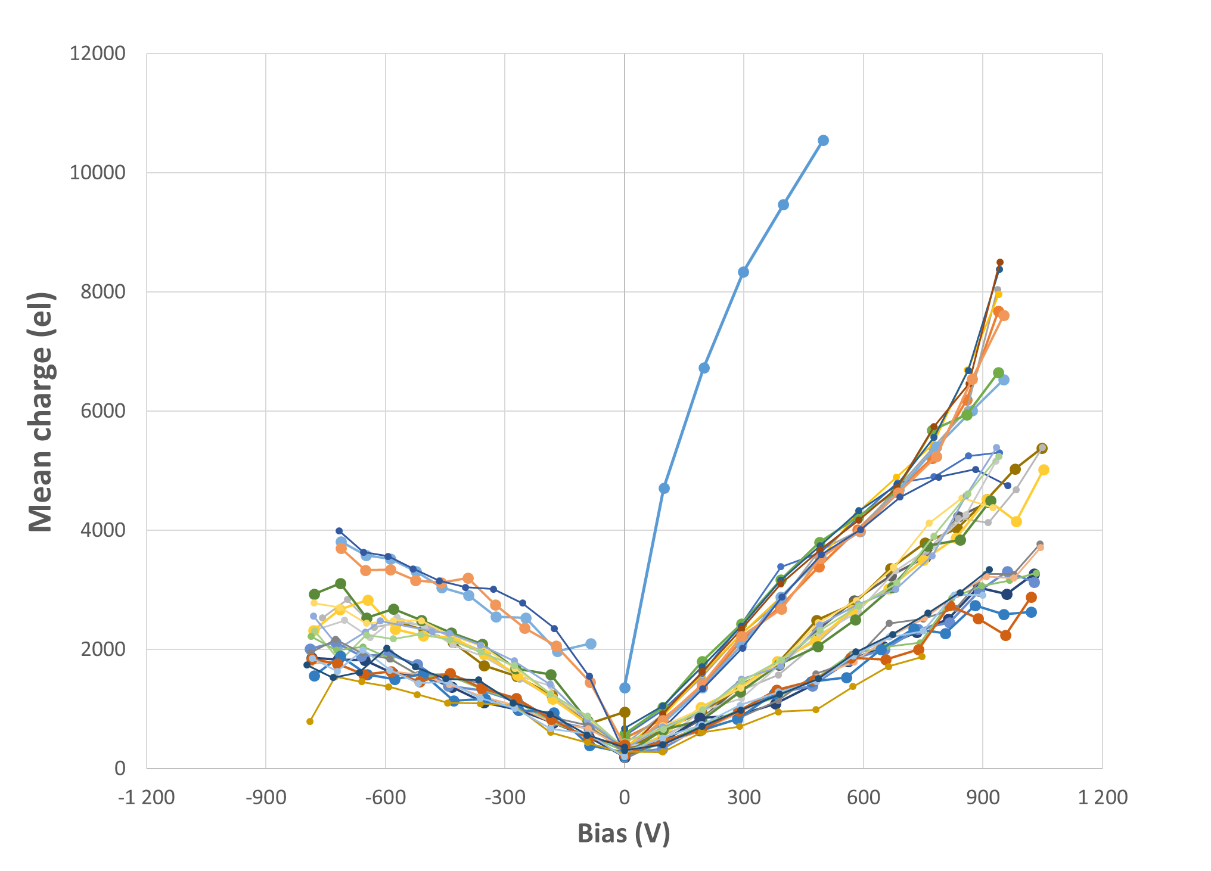
Charge collection - annealing
All measurements, different annealing times
forward bias
reverse bias
Not irradiated
2.5e16
5.7e16
1e17

Slide 16
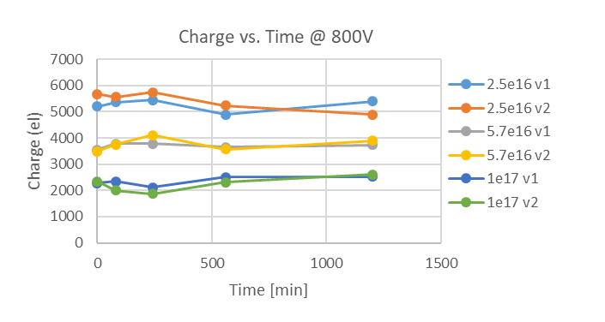
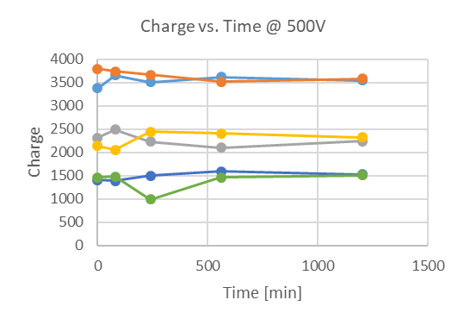
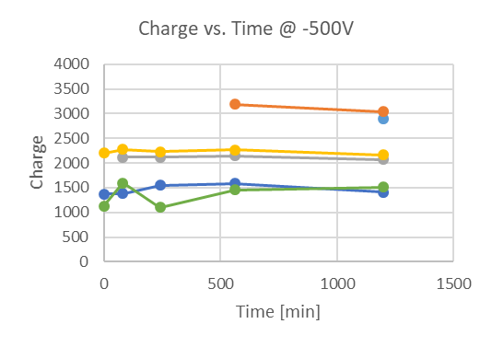
Annealing: collected charge
➔ not much annealing
Forward bias

Slide 17
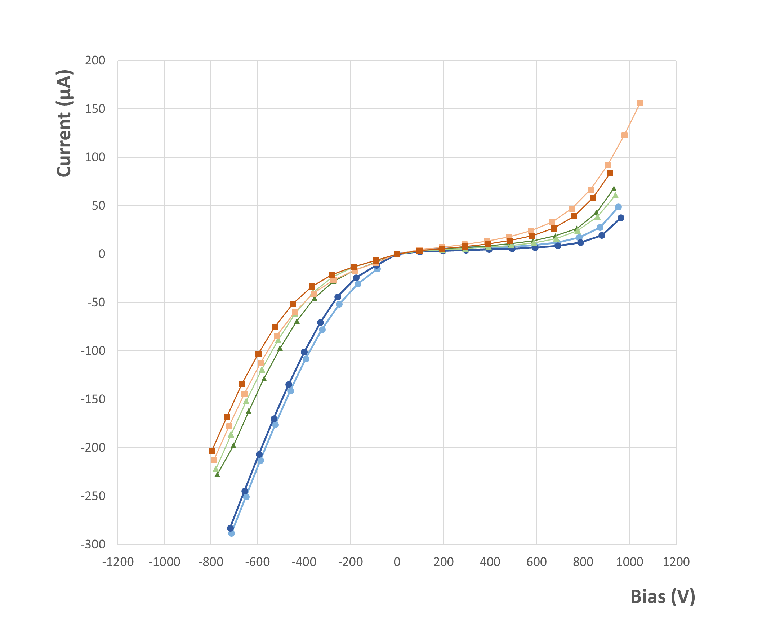
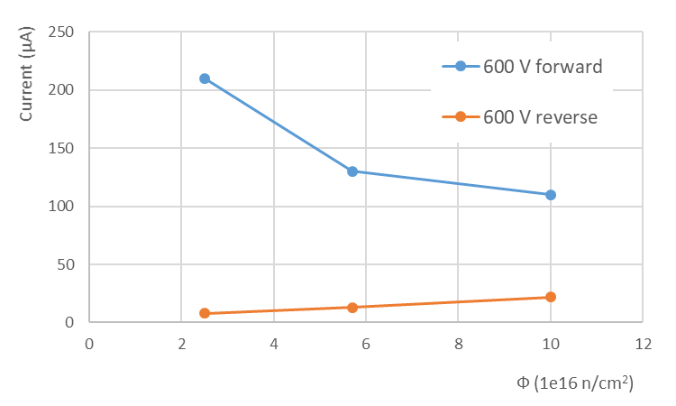
Current
reverse bias:
current increases with increasing fluence
→ increase of generation current
forward bias:
current decreases with increasing fluence
→ increase of resistance because of
less free carriers, decrease of mobility
Diode like IV also after 1e17, breakdown above 700 V
Forward bias
Reverse bias
T = - 30° C
1e17
Annealed 1200 min
5.7e16
2.5e16

Slide 18
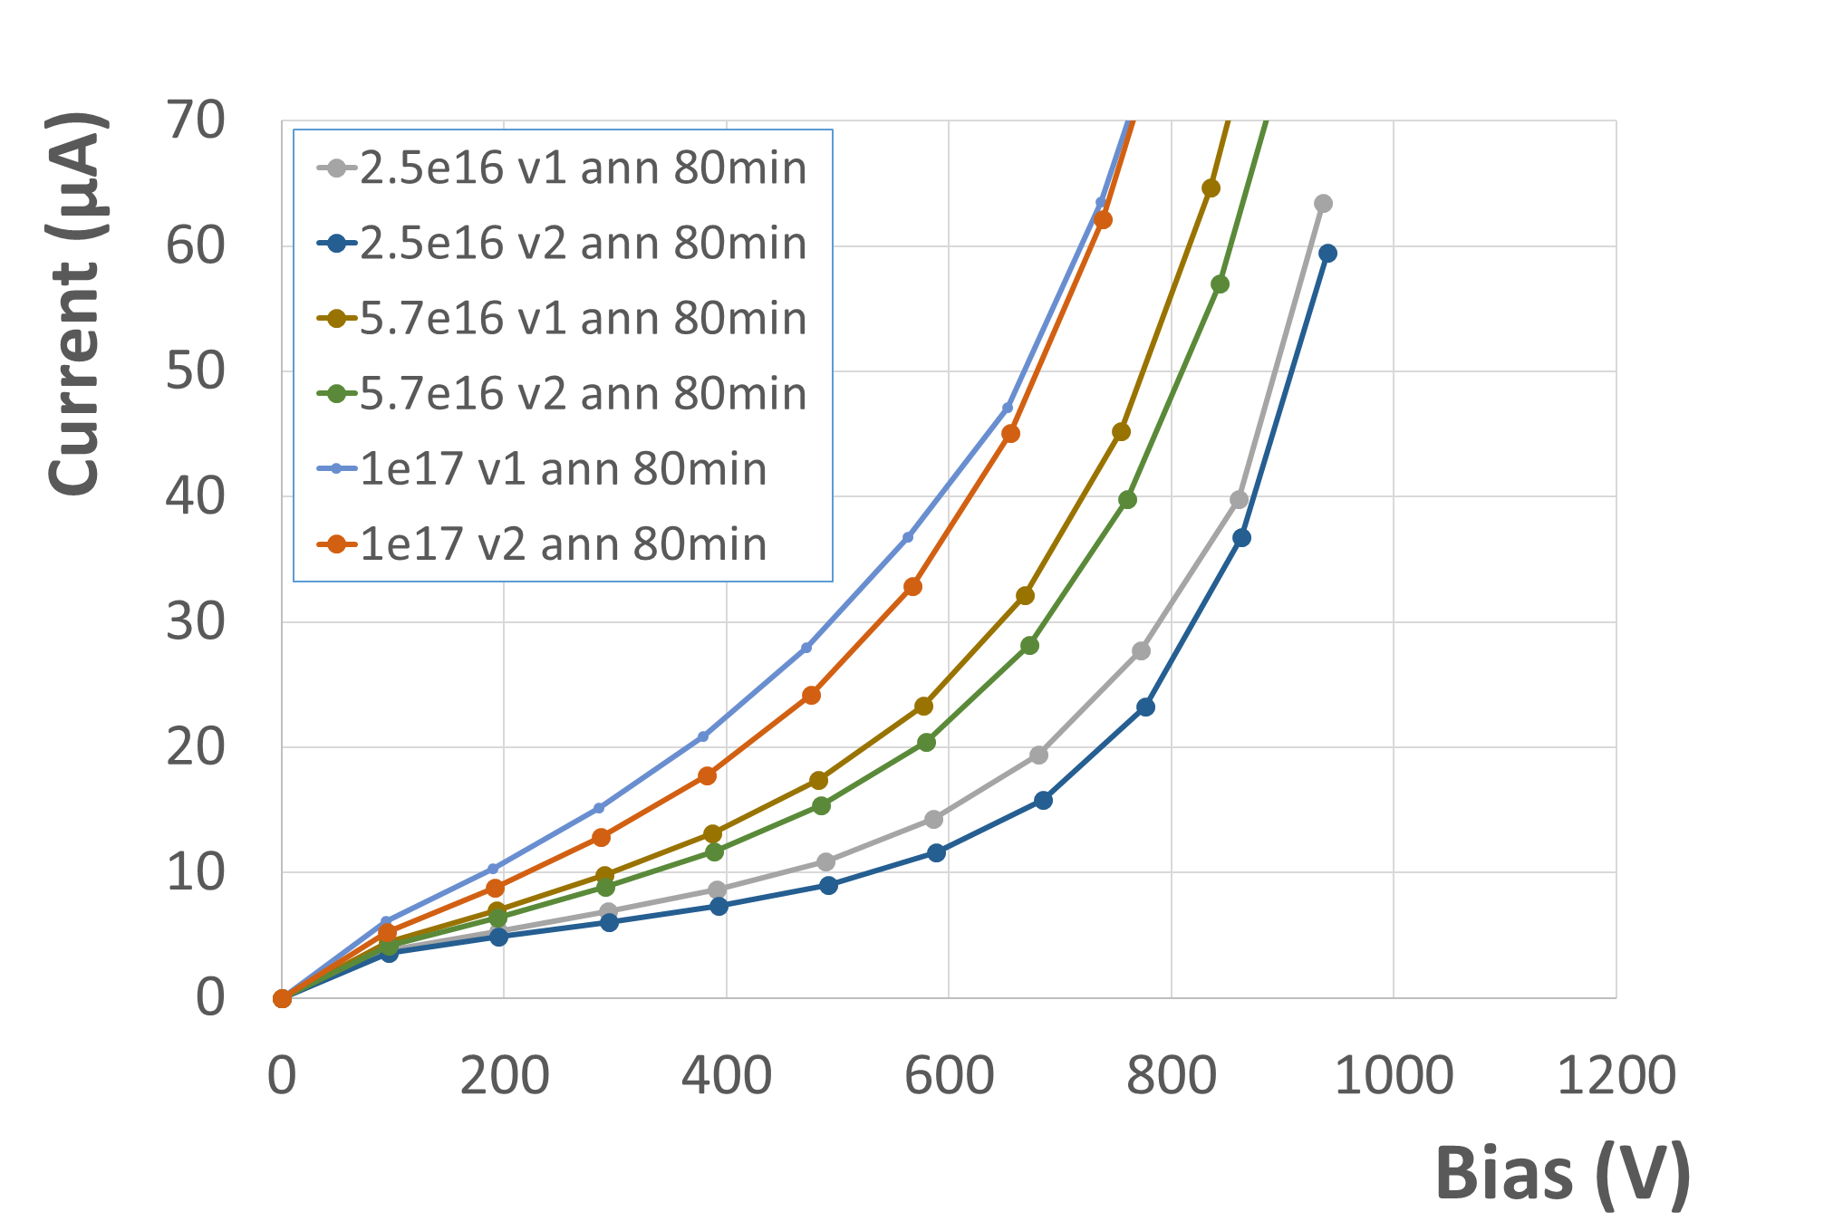
Current
T = - 30° C
Ф = 1e17, I = αФV = 49 µA
Ф = 5.7e16, I = αФV = 28 µA
Ф = 2.5e16, I = αФV = 12 µA
E-TCT: field in the whole detector volume at V > 100 V → is current generated in the whole detector volume?
current increases with bias
above ~600 V current higher than calculated from α = 4e-17 Acm⁻¹ → charge multiplication
→ noise in CC measurement starts to increase sharply above ~ 600 V → micro-discharges
→ contribution of surface or edge currents?

Slide 19
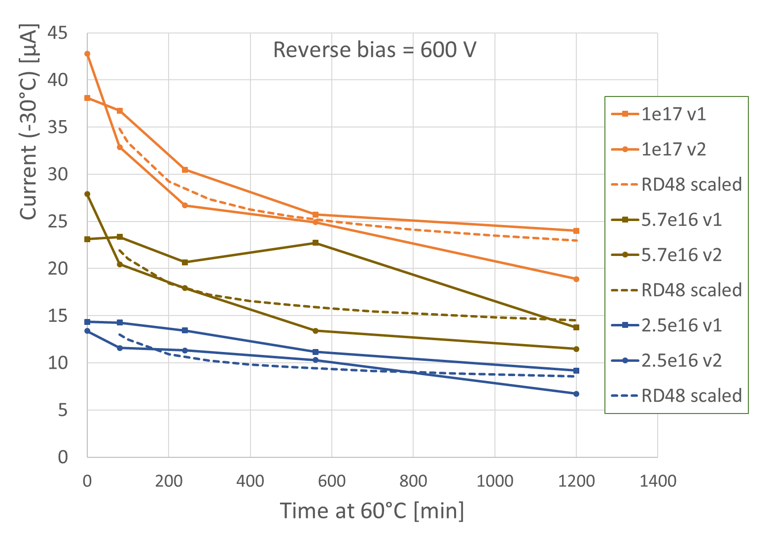
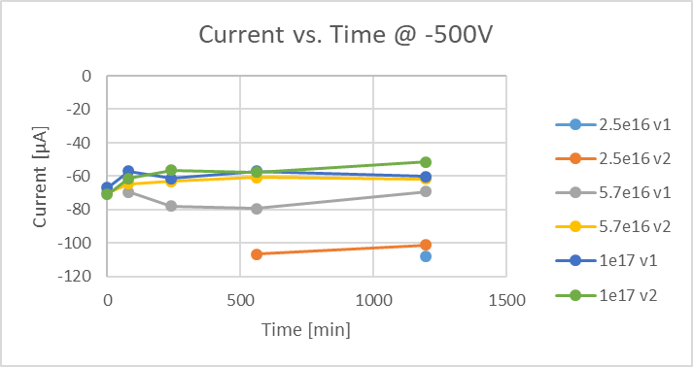
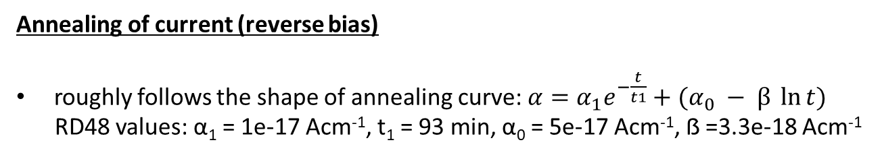
Annealing of current (reverse bias)
roughly follows the shape of annealing curve: $α=α_{1}e^{−\frac{t}{t1}}+(α_{0} − β \ln{t)}$
RD48 values: α₁ = 1e-17 Acm⁻¹, t₁ = 93 min, α₀ = 5e-17 Acm⁻¹, ẞ =3.3e-18 Acm⁻¹
Points at t = 80 min set by hand to match data
→ annealing during irradiation
(irradiation time 4 h, T > 40° C,
temp. probably higher for higher fluences)
Forward bias
→ annealing effects small

Slide 20
Summary
measurements with 75 um thick epitaxial LGAD irradiated 2.5e16, 5.7 e16 and 1e17
E-TCT:
  before irradiation: as expected, observed LGAD depletion behavior observed
  after irradiation response across whole detector thickness already at 100 V in reverse or forward bias
  no signal from low resistivity substrate
Charge collection measurements with Sr-90:
  charge scales with fluence and voltage according to Q_{mean_75um} = k∙Ф^{b}∙V (k = 44 el/V, b = -0.56, Ф in 1e15 n/cm², V in volts)
  at high bias voltage sharp increase of noise because of micro-discharges
  → detector can be operated up to ~ 600 V reverse bias, ~ 2000 el (mean) collected at 1e17
  better charge collection in reverse bias than in forward bias
  → differences get smaller at higher fluences
  change of collected charge by annealing at 60°C up to 1200 minutes not very significant in these measurements
Current
  reverse current increases with fluence, forward current drops
  reverse bias: linear increase with bias voltage up to ~ 600 V, sharp increase after that
  higher forward than reverse current, differences get smaller with increasing fluence

