Slide 1
QA – site verification for CCE tests
on behalf of groups from Birmingham, Ljubljana,
Tsukuba, Toronto, Valencia

Slide 2
QA Irradiation & Test Sites
Mini&MD8 (CCE tests)
1 irradiation/6 mo
KEK/Tsukuba
4 batches/mo
KEK/Tsukuba: p
HPK
KEK
4 pieces/mo
6 sensors /mo
Birmingham
Birmingham: p
4 pieces/mo + 6 IV-CV/mo
Toronto
9 batches/mo
6 sensors/mo
CERN
Ljubljana: n
4 pieces/mo
Ljubljana
QA
2 pieces/mo
Valencia
Irradiations to 1.6 10¹⁵ n_{eq}cm⁻²

Slide 3
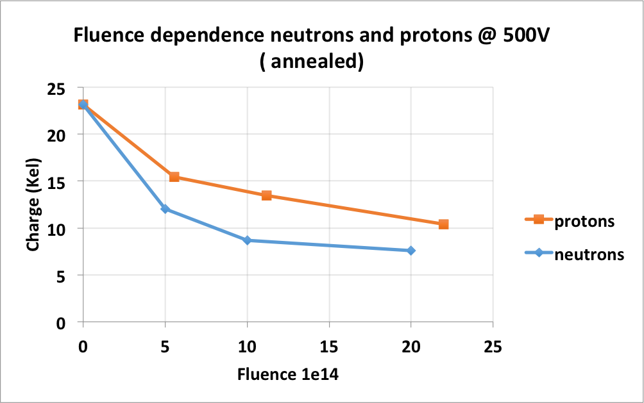
QA procedure
CCE measured with Alibava setup, irradiated and annealed sensor (80 min at 60 C)
measurements scans in 100 V steps up to 700 V
measurement at -20 C or lower
cluster finding procedure defined (3. 5 σ seed, 1.5 σ) in QA document
at least 7500 e⁻ signal expected above 500 V
careful verification of measurements should be done!
R0 results

Slide 4
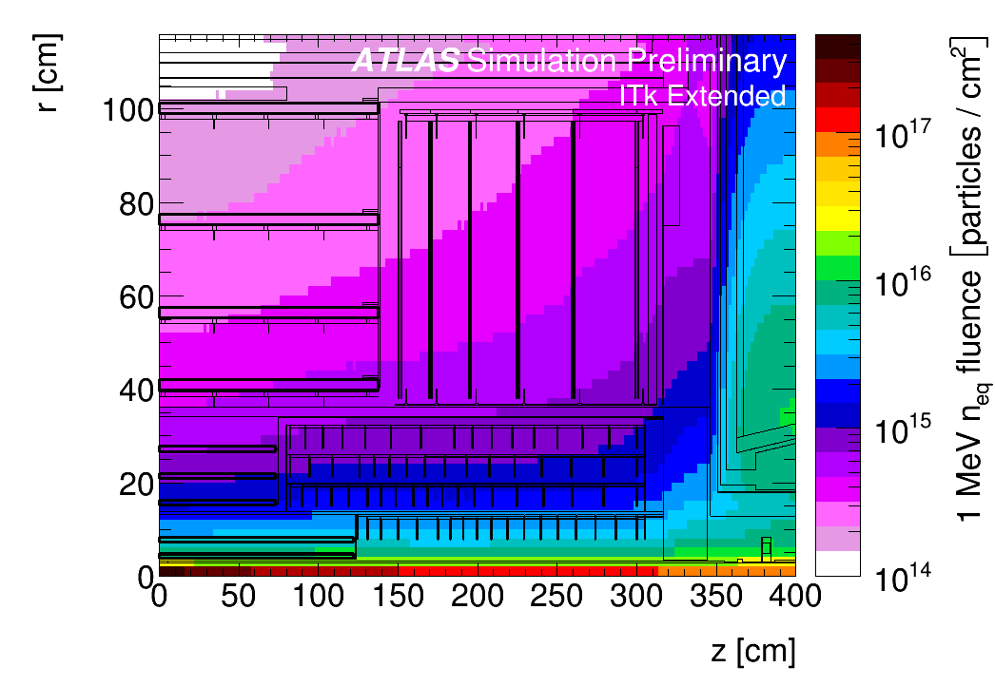
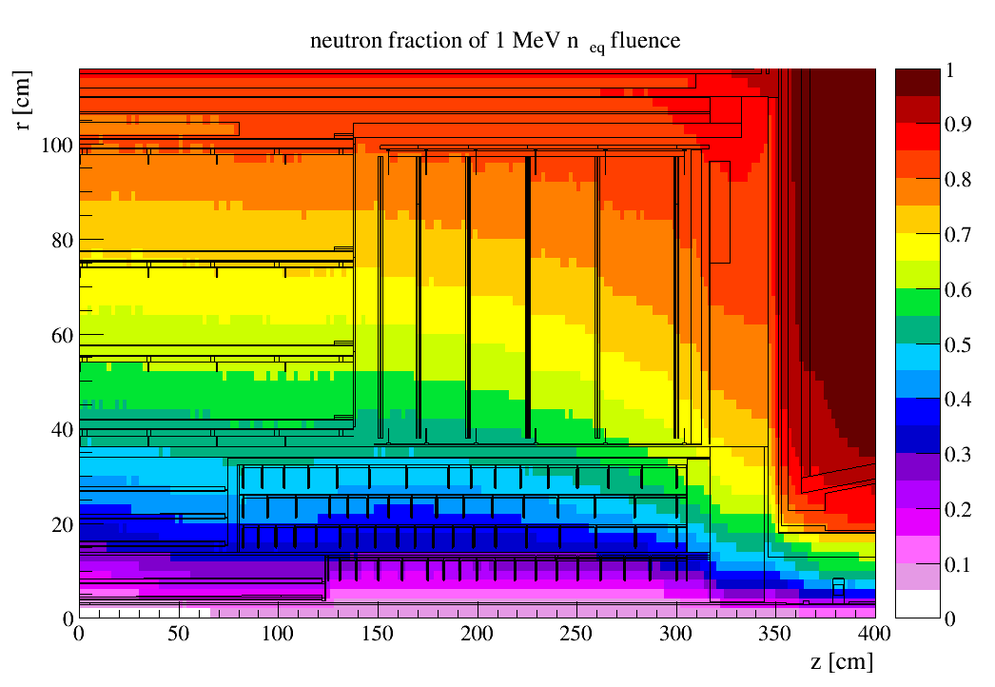
1 MeV fluence
Neutron fraction of 1 MeV fluence
Step 1.5 extended layout and no HGT
Neutron fraction in the region with the highest fluence is about 65 %
Thanks to Paul Miyagawa

Slide 5
Site verification
all sites should measure the signal of nonirradiated and irradiated sensors from the same batch
20 ATLAS17 LS minisensors from March 2019
10 sensors irradiated with neutrons to 1.6 10¹⁵ n_{eq}
common annealing 80 min at 60 C before measurements
distributed to QA labs together with nonirradiated sensors

Slide 6
Site verification
setups were built in the past more than 10 years ago
they have different cooling (Peltier, gas) , collimation, trigger , Alibava boards
agreement on normalization procedure of setups
calibration with capacitors is not precise
measure signal of nonirradiated sensor and normalize it to 23050 e⁻ above FDV for 295 microns of the active thickness
correct chip gain due to the temperature dependence if needed
use this gain for irradiated sensor

Slide 7
labs share on CERNBOX
voltage scans of CCE, I/V
spectra with fit
cluster widths
noise
geometry
We started with the exchange of data a week ago, some data are not complete yet or need small corrections (Birmingham, Toronto).
We are still discussing details of analysis….

Slide 8
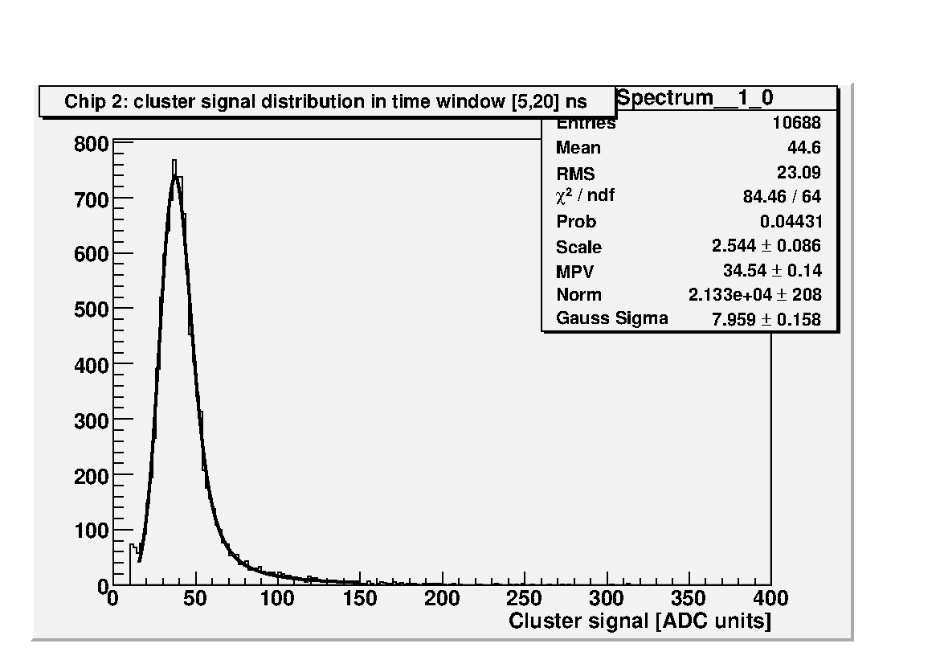
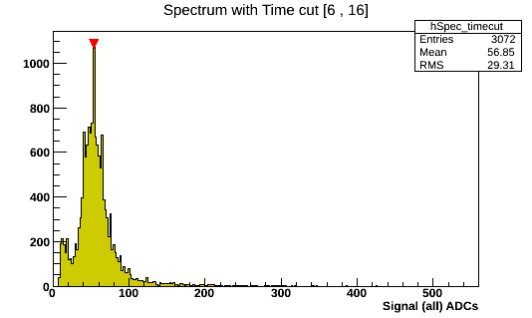
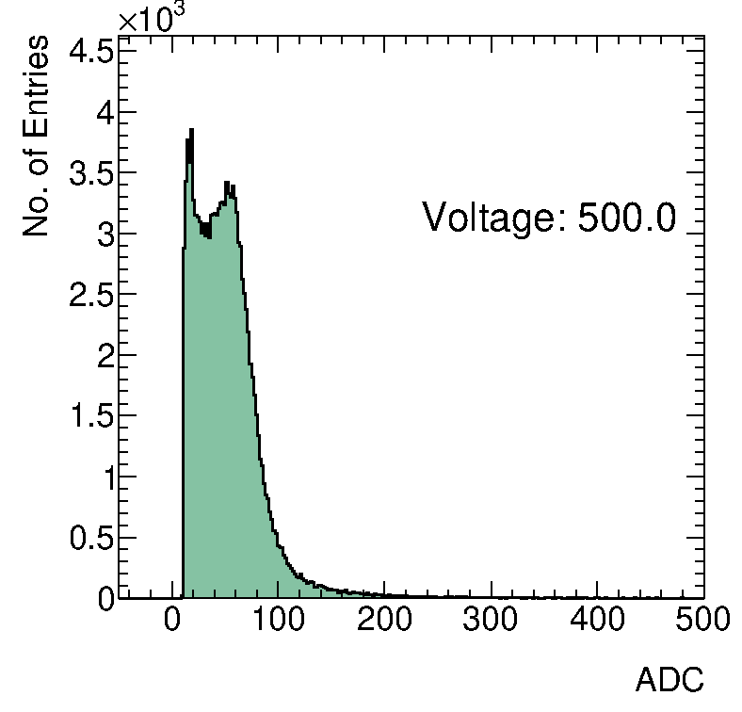
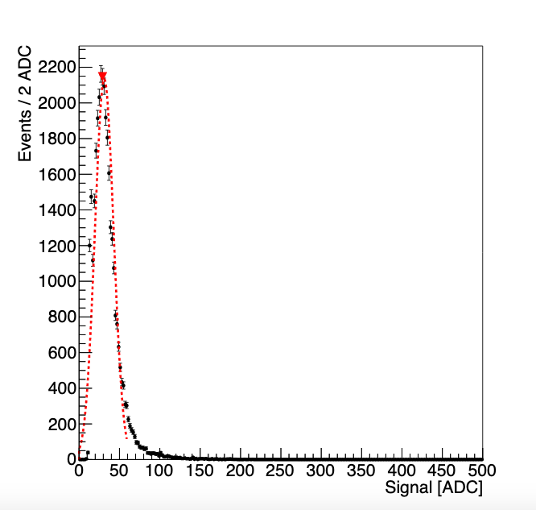
Spectra irradiated sensor 500V
Ljubljana
Valencia
Toronto
Birmingham

Slide 9
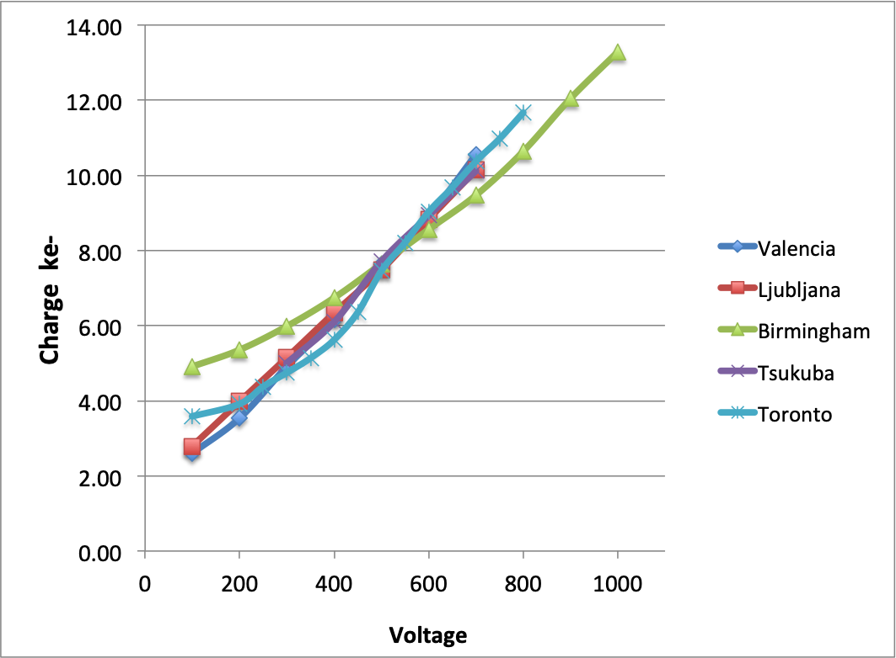
Voltage scan of CCE

Slide 10
Summary
excellent agreement of CCE values at 500 V

Slide 11
Conclusion
although setups are different there is excellent agreement (few %) of measured CCE at 500 V
fluence variation (10 %) will add uncertainty
will learn more (=improve statistic) during the preproduction
mixed p/n irradiations (not for QA)?

