Slide 1
Preparations for LFoundry 150 nm RD50-MPW2 testing in Ljubljana
F9 weekly, 21.02.2020
Bojan Hiti, F9, Jozef Stefan Institute

Slide 2
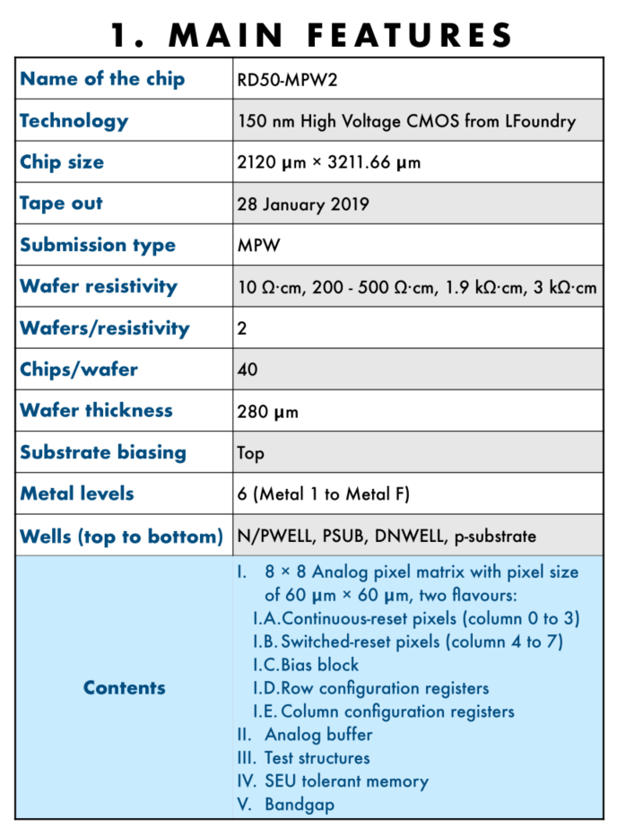
RD50 – MPW2
CMOS chip developed in the scope of RD50
Chief designer E. Vilella (Liverpool)
Not yet advanced to the level of ATLAS CMOS
Collaborating institutes
Liverpool
HEPHY Vienna
University of Barcelona + IFAE
CPPM
FBK
Sevilla
Valencia
Lancaster
IJS starting to get involved in testing
We have tested MPW1 in Summer 2018 with Edge-TCT (Petja and Jernej)
Irradiation campaign
Early breakdown at cca 50 V
MPW2 breaks down at 130 V (unirr.)

Slide 3
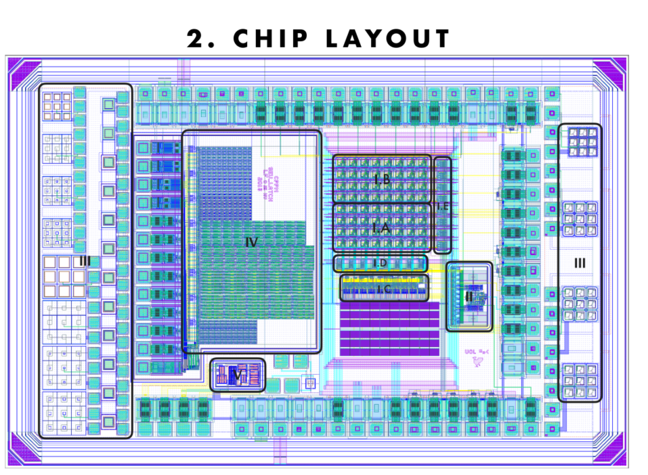
RD50 – MPW2
I
III
Structures III – Edge-TCT diode (3x3)
Measure acceptor removal
Structure I – active analog pixel matrix
Interesting for Edge-TCT?

Slide 4
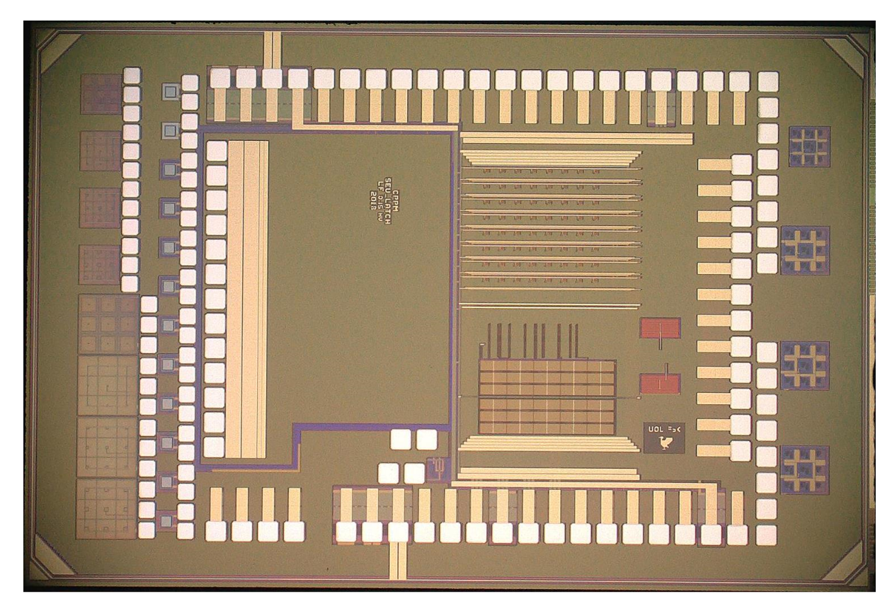
RD50 MPW2 chip
I
I
III
III
Everything except Structures III is metalized on top
We will receive some chips already fully wire bonded and some bare chips (for Edge-TCT)
In next two weeks

Slide 5
Pixel structure

Slide 6
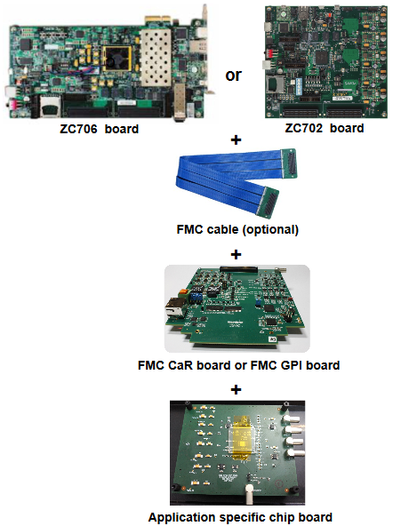
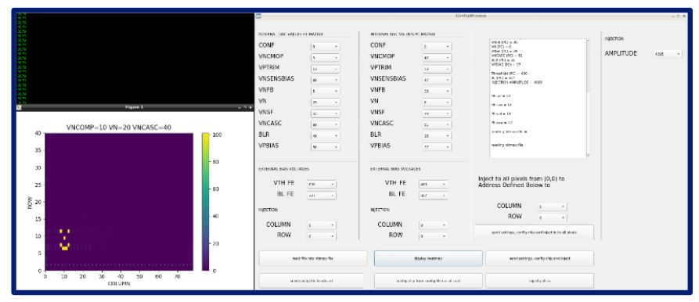
Readout system
Readout system for readout of active devices (f.e. analog pixel matrix)
Xilinx ZC 706 commercial SoC developmnet board
CaRibou general purpose test board developed by Uni Geneva + BNL
Firmware developed by Vienna (engineer) – plug and play (SD card)
DAQ Software developed by Liverpool (PhD student) – GUI
Runs on a Linux PC
Common code repository in CERN Gitlab being established

Slide 7
Edge-TCT setup – active pixel matrix
ZC706
Caribou

Slide 8
Sr90 setup
Sr90 setup is also available
Could be used for tests with analog matrix?

Slide 9
Active pixels
Analog CSA output
Comparator output
To us not yet clear whether data can be recorded with Caribou directly to PC or an oscilloscope is required

Slide 10
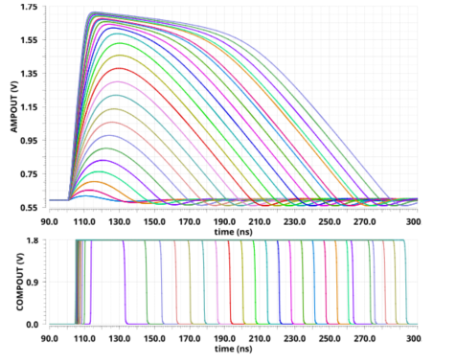
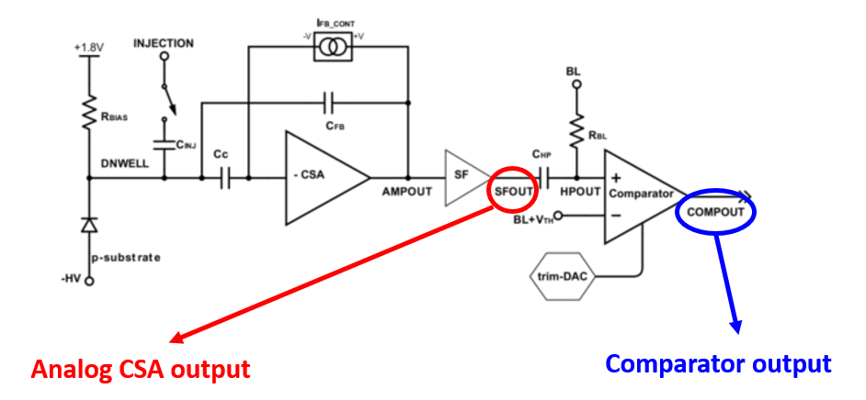
Active pixels
To us not yet clear whether data can be recorded with Caribou directly to PC or an oscilloscope is required

Slide 11
Brainstorming
What are potential things to measure with the active matrix?
Edge-TCT and Sr90 are possible
Running the DAQ requires Linux PC
Option 1: install Virtual Machine on Windows PCs in the lab
Option 2: use Intel NUC with Ubuntu and transfer it between setups

