Slide 1
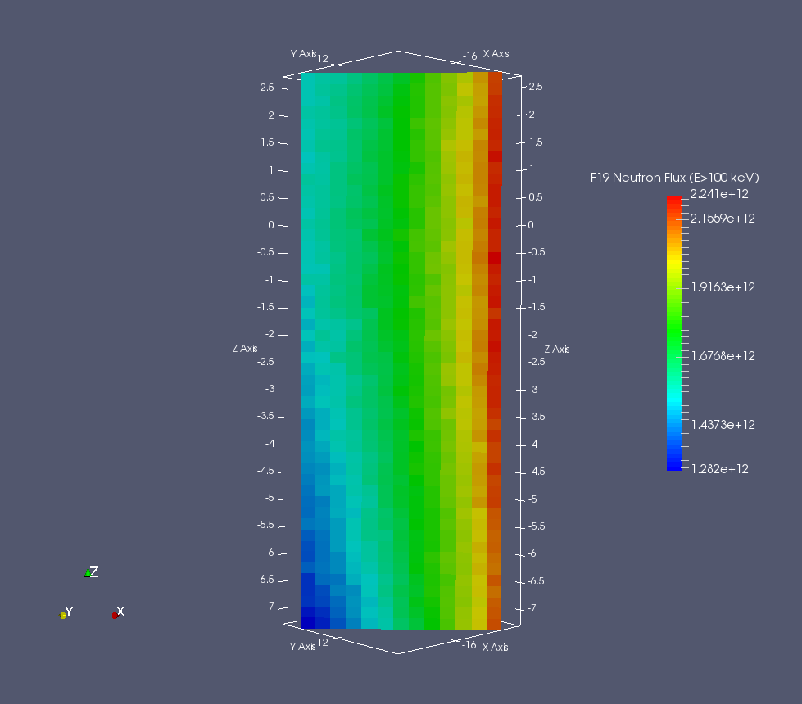
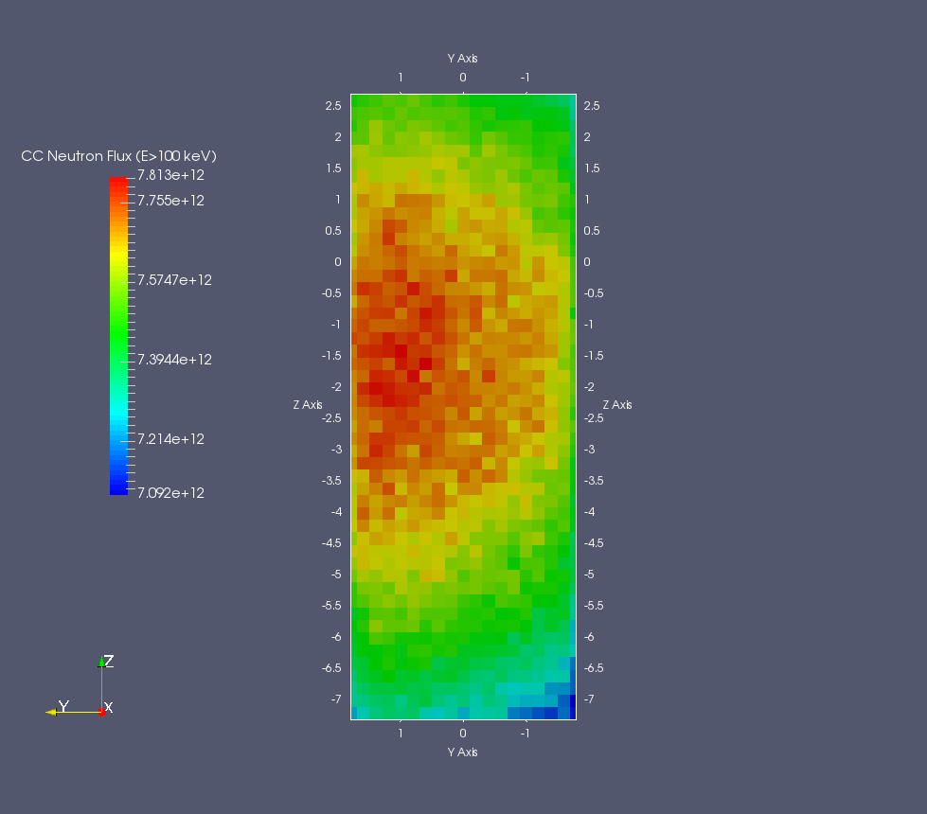
Calculated flux of fast neutrons (E > 100 keV) in F19 and CC. Calculations were made with resolution 2x2x2 mm³
horizontal direction is towards the centre of the core.
large gradients in F19: factor 2 variations peak to peak
Central channel more uniform
Central Channel
F19

Slide 2
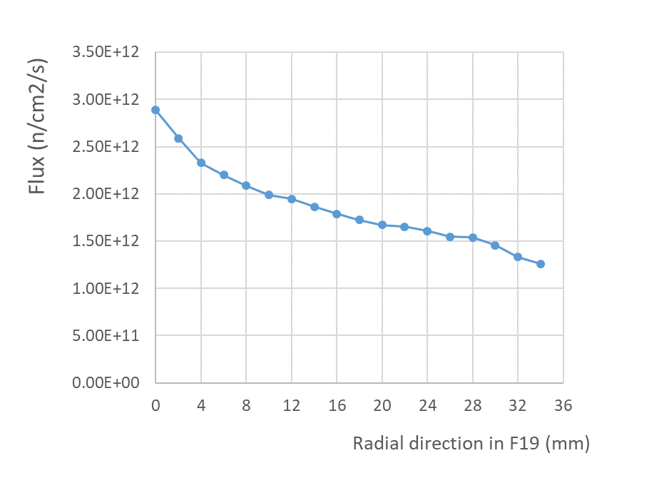
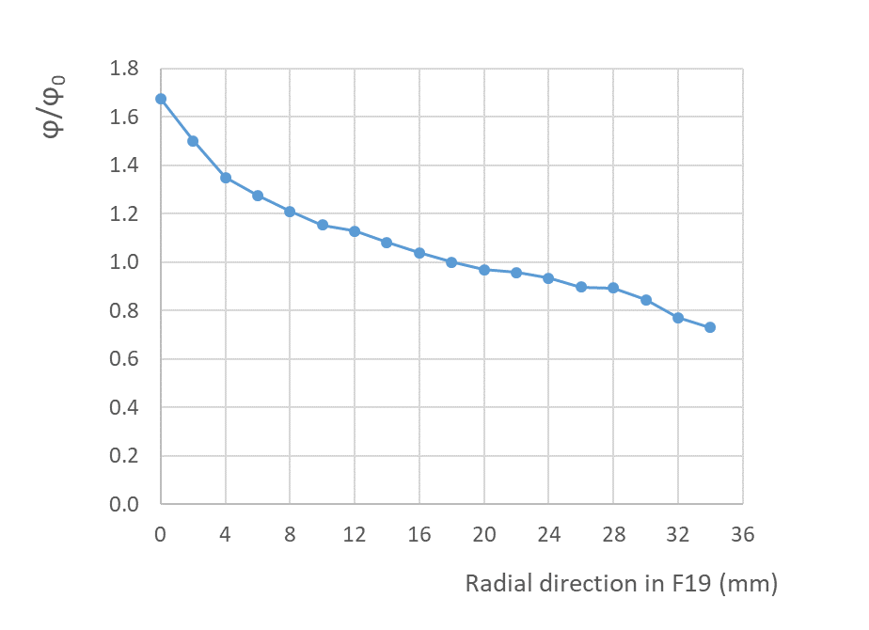
We quote 1 MeV equivalent flux: 1.54e12 n/cm2 → ϕ(E > 100 keV) = 1.71e12 n/cm2/s
Irrad. Container (2 cm)
± 20%

Slide 3
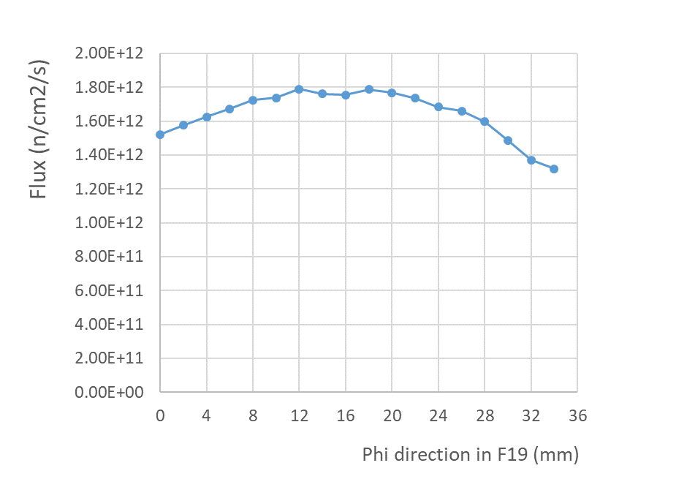
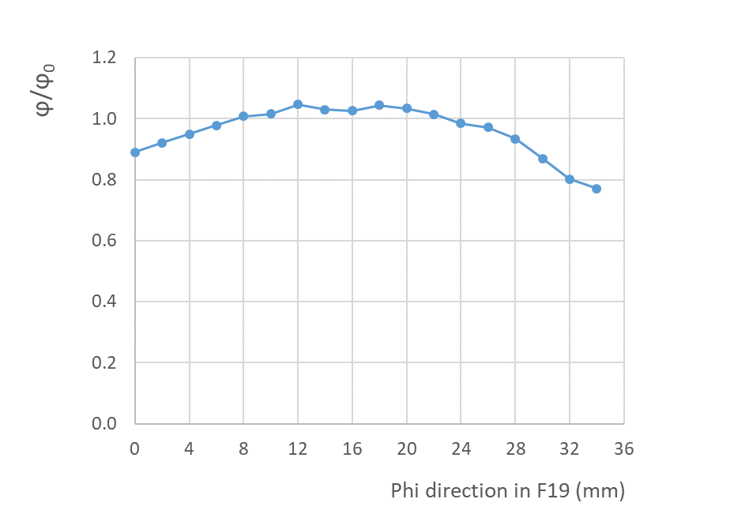
Gradient smaller in perpendicular (phi) direction
< ± 10%

