Slide 1
Dva članka:
moblitiy vs fluence za nevtrone in protone iz E-TCT meritev (velocity profile) s strip detektorji v forward biasu
➔ M. Mikuž, TREDI, Paris 2016
2) CCE meritrve z LGADi do 3e17 in ocene za trapping za visoke fluence
➔ I. Mandić, TREDI, Vienna 2020

Slide 2
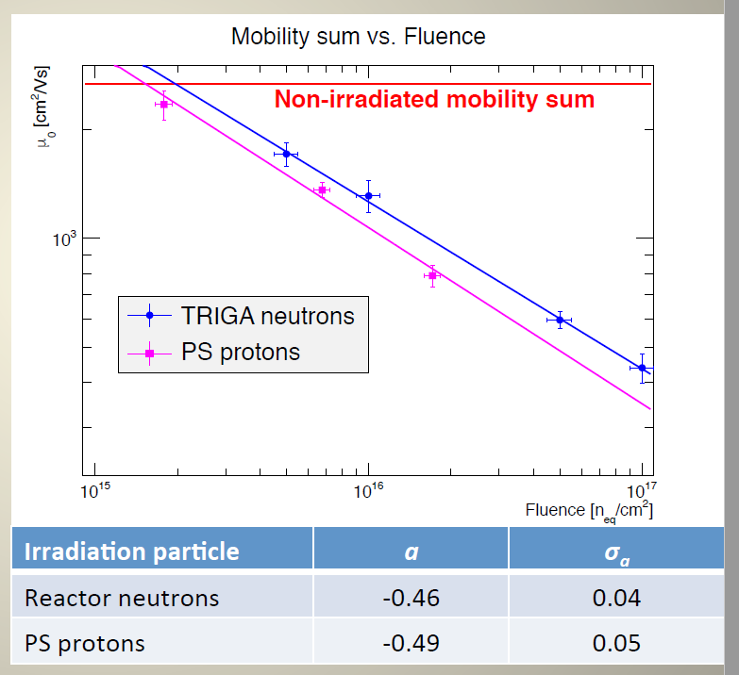
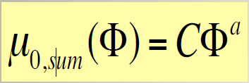
Mobility:
M. Mikuž, TREDI 2016
dodati še točko za 3e17 za nevtrone
imamo tudi 2e15 za nevtrone do 300 V

Slide 3
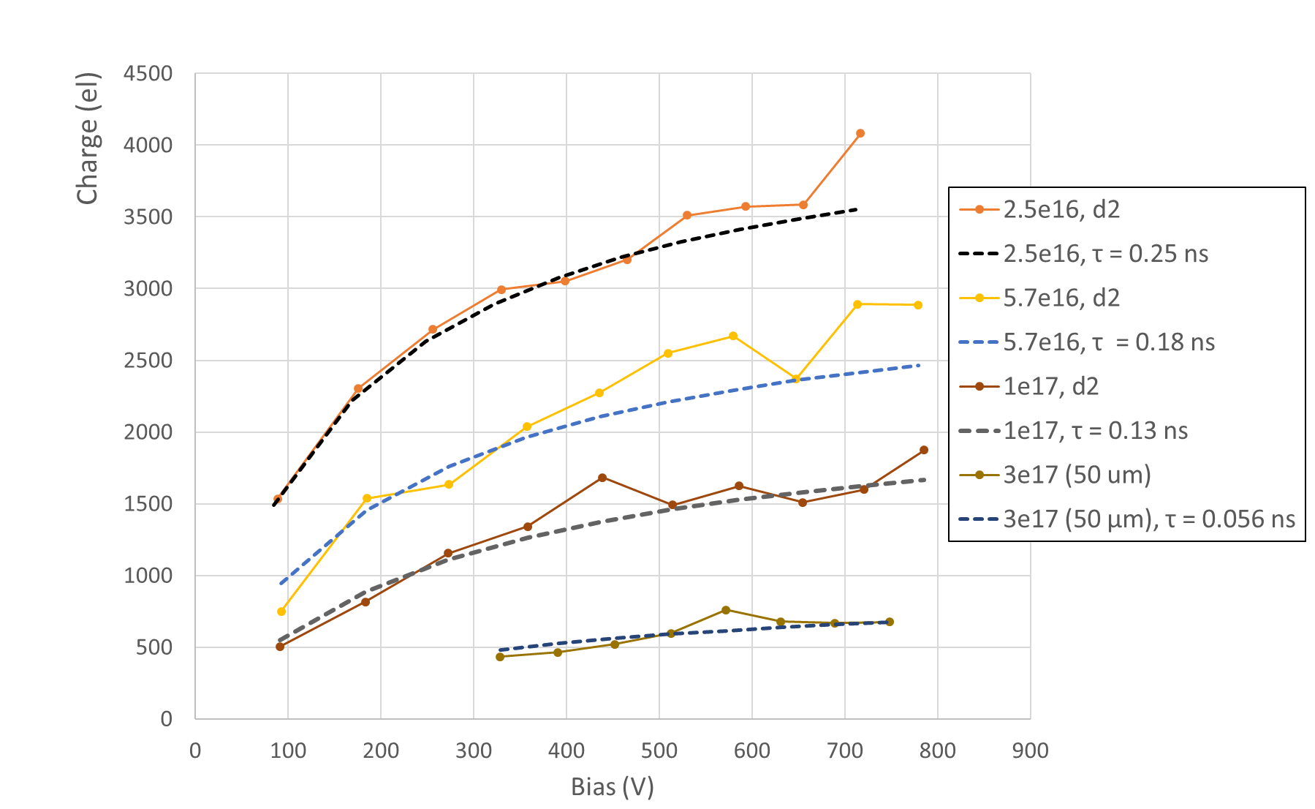
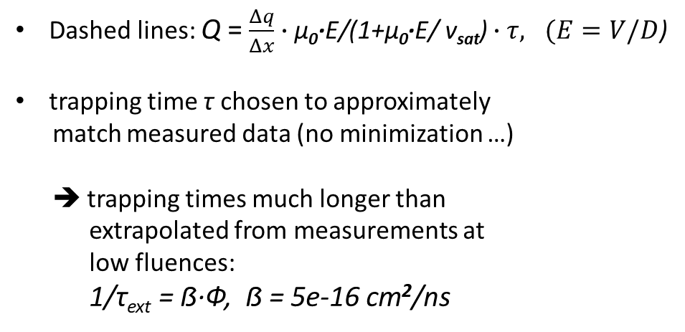
CCE in trapping
Dashed lines: Q = $\frac{Δq}{Δx}∙\text{µ}\text{0}\text{∙}\text{E}\text{/(1+µ}\text{0}\text{∙}\text{E}\text{/ }\text{v}\text{sat}\text{)}∙τ, (E=V/D$)
trapping time τ chosen to approximately
match measured data (no minimization …)
➔ trapping times much longer than
extrapolated from measurements at
low fluences:
1/τ_{ext} = ẞ∙Ф, ẞ = 5e-16 cm²/ns
Forward bias
Fluence (1e16 n/cm²) | τ measured (ns) | τ extrapolated (ns)
2.5 | 0.25 | 0.080
5.7 | 0.18 | 0.035
10 | 0.13 | 0.020
30 | 0.06 | 0.007

Slide 4
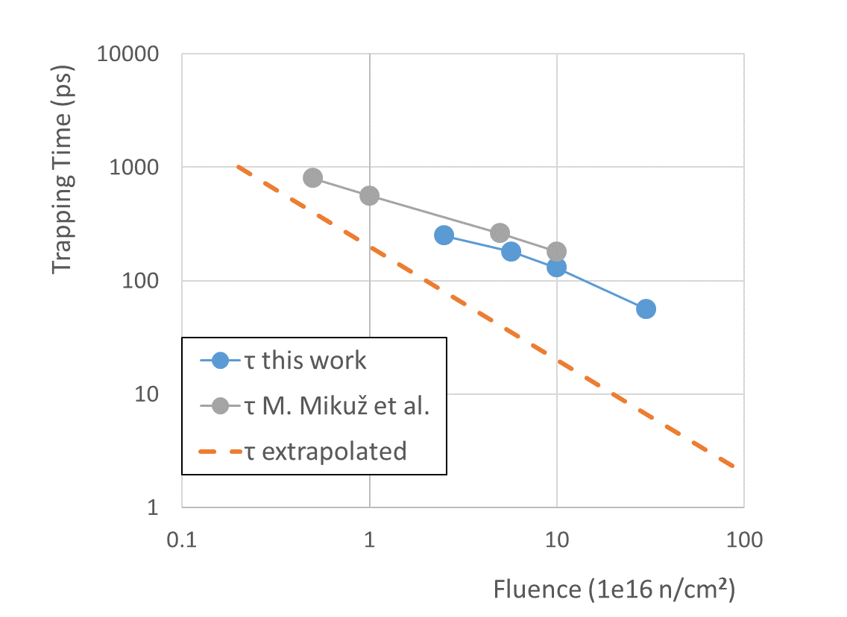
Trapping time
Compare with:
M. Mikuž, TREDI2016:
same approximation as used here, charge measured with reverse biased 300 um spaghetti detectors at 1000 V from G. Kramberger et al., 2013 JINST 8 P08004
➔ good agreement with measurements with
75 um LGAD
➔ much larger than extrapolated
with ẞ = 5e-16 cm²/ns

