Slide 1
The SEEIIST project from the CERN perspective
Herwig Schopper CERN and University Hamburg

Slide 2
Why talk about CERN perspectives?
SEEIIST was proposed as International Institute in the spirit of CERN:
double objective - promote science and technology in the region - bring countries together (‘science for peace’)
It is more than a national laboratory with international cooperation (there are many, but only one ‘CERN’)
Some Conditions for success?
No dominating country, each has one vote scientists have influence depending on their competence and experience, independent of nationality, race, religion, gender
The second issue can be achieved only if the science and technology are first-class according to international standards

Slide 3
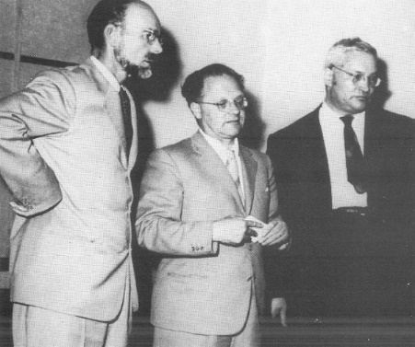
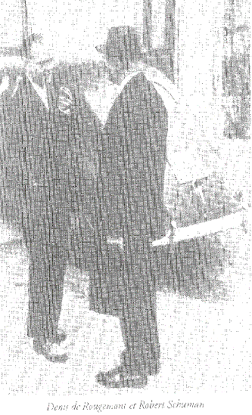
CERN in Geneva
Foundation in 1954 under UNESCO, first European organisation
Two parallel initiatives :
Physicists: to strengthen European science
European Politicians: European Cultural Conference, Lausanne 8-12 December 1949 (Swiss de Rougemnont) Use science to bring nations together
Auger, Amaldi,Kowarski
In CERN Council: each country has two delegates: 1 Government official, 1 Scientist
Assures day-to-day cooperation
Denis de Rougemont, Robert Schumann

Slide 4
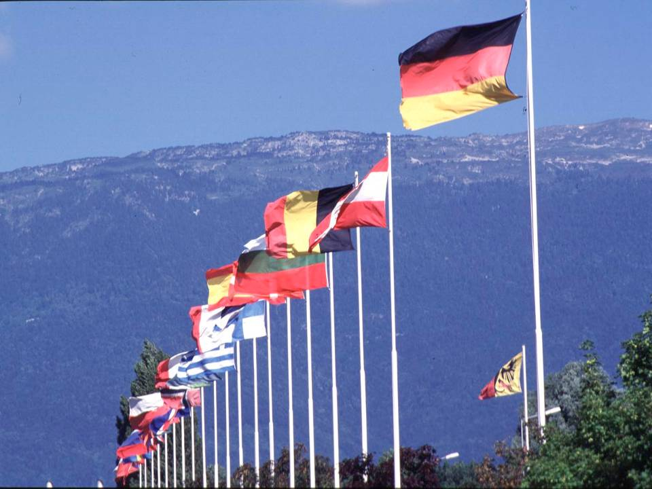
CERN was founded 1954: 12 European States
“Science for Peace”
Today: 24 Member States
~ 2300 staff
~ 1050 other paid personnel
~ 13000 users
Budget (2012) ~1000 MCHF
Member States: Austria, Belgium, Bulgaria, the Czech Republic, Denmark, Finland, France, Germany, Greece, Hungary, : Israel,Italy, the Netherlands, Norway, Poland, Portugal, Romania, Slovakia, Slovenia, Spain, Sweden, Switzerland and the United Kingdom
Candidate for Accession: Associate Members in the Pre-Stage to Membership, Applicant States
Observers to Council: India, Japan, the Russian Federation, the United States of America, Turkey, the European Commission and UNESCO,SESAME
4
Notes:
4

Slide 5
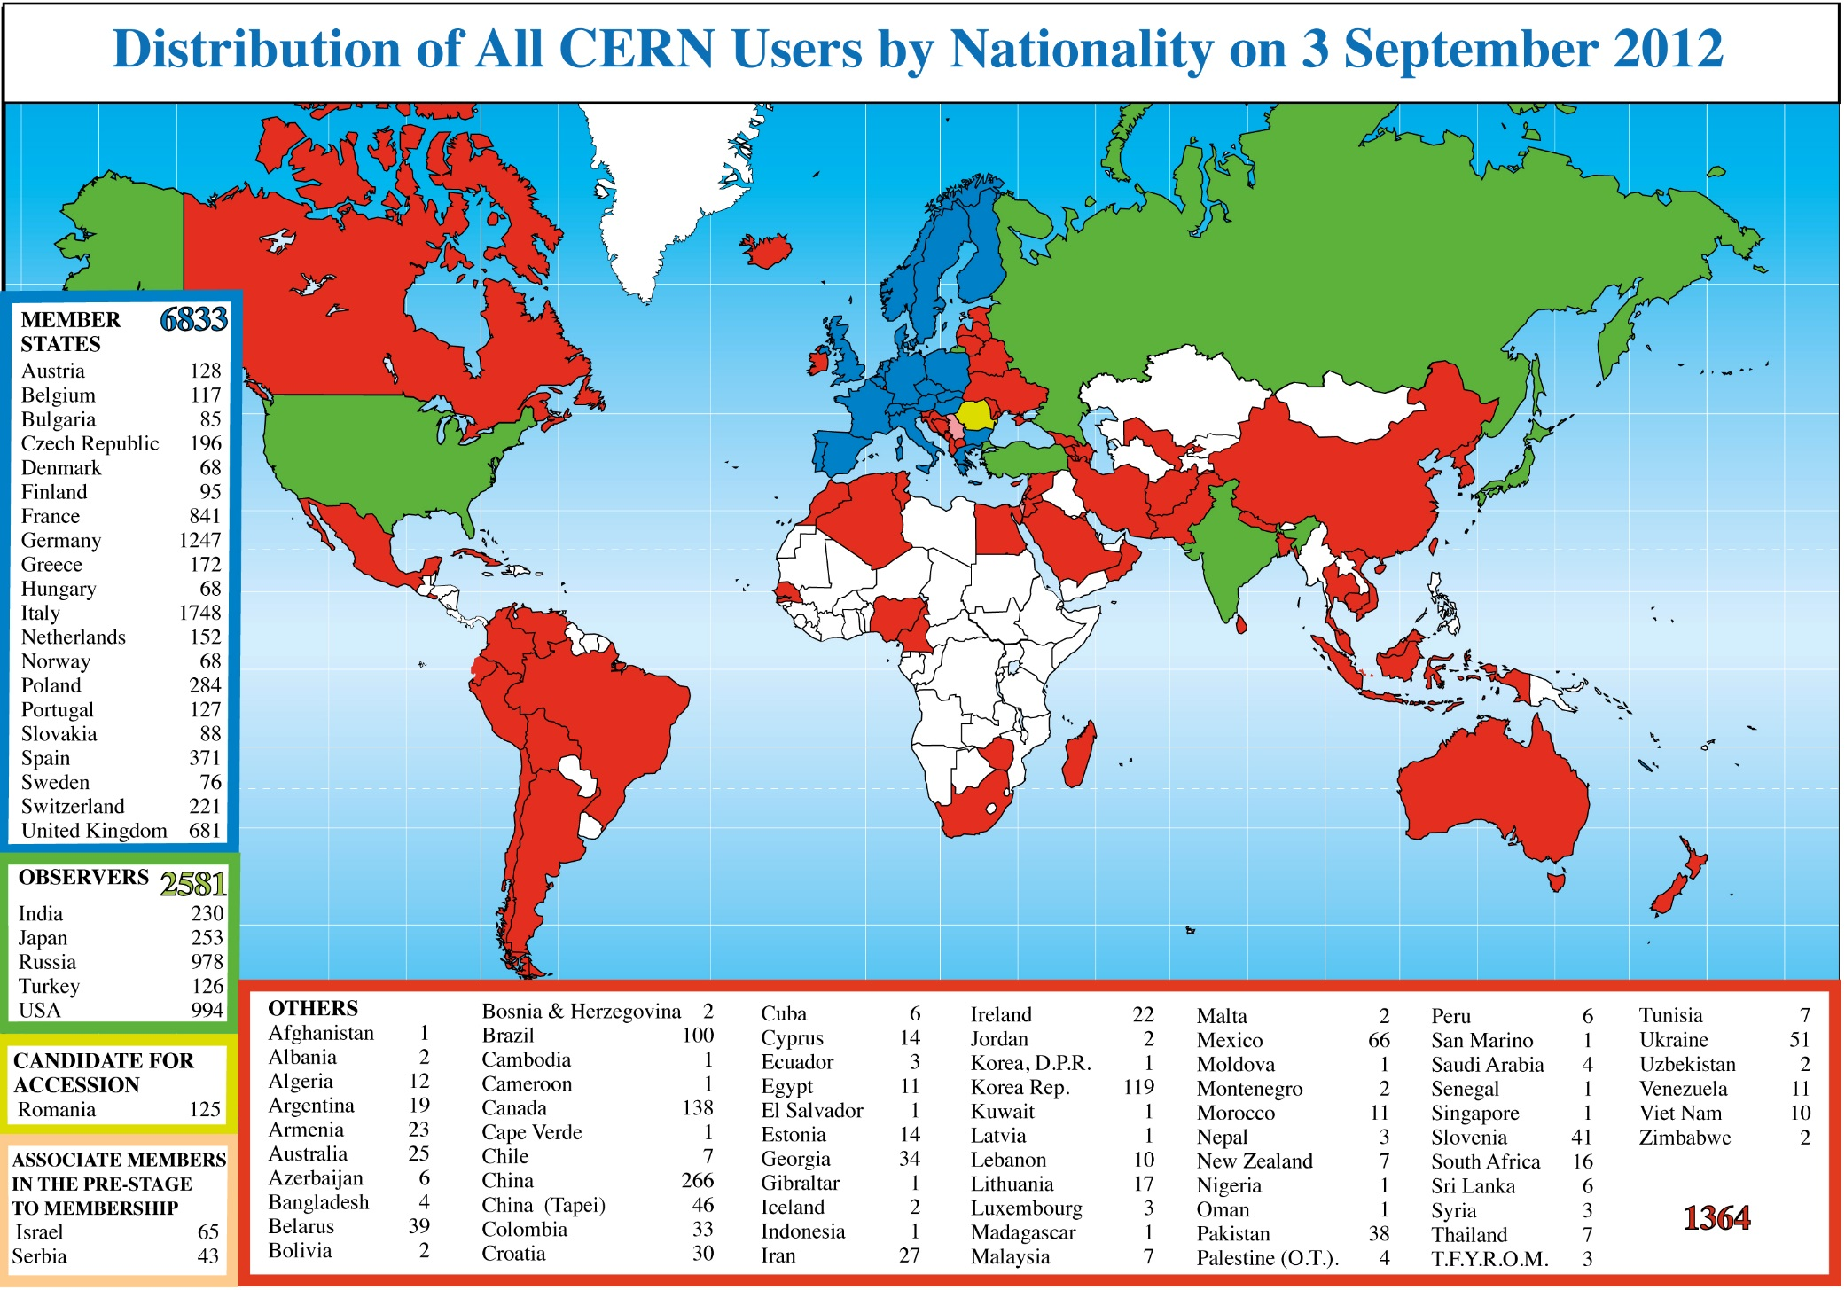
CERN is becoming a World Laboratory
More than 13000 users

Slide 6
CERN helped to transfer its success and spirit
to Europe and other regions in need of developping science and technology and with political frictions
Not as its own projects, but as ‘widwife’ (providing help in infrastructure, management, administration, technology ,…
In the past EMBL, ESO
recently SESAME (middle East)
and now SEEIIST
All organisations used CERN convention with some adaptation
What are the lessons from history of those organisations?

Slide 7
Formal establishment of SESAME by UNESCO as autonomous international laboratory
UNESCO General Assembly (about190 countries) October 2001 -recommendation by Executive Committee (about 50 countries) strong support by Director General, K.Matsuura, Executive Unanimous decision in Mai 2002: (after 2 years, normally more than 4 years !!)
“SESAME is ….. A Quintessential UNESCO project combining capacity building with vital peace-building through science ….model project for other regions....”
Very useful in region with great political stress,
But very long procedure (several years)

Slide 8
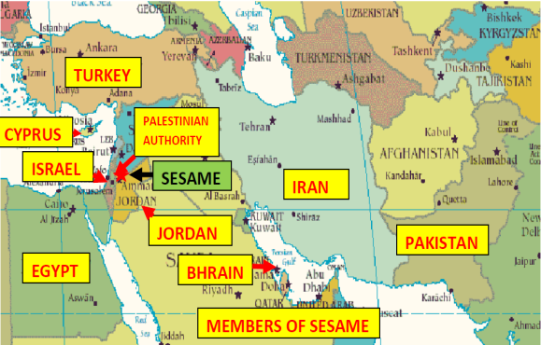
SESAME’s Members
Not ‘countries’
Observers: Brazil, Canada, China, EU, France, Germany, Greece, Italy, Japan, Kuwait, Portugal, Russian Federation, Spain, Sweden, Switzerland, UK, USA
CERN
Experience:
Council works (in spite of Palestine and Iran)
Important help from Obseervers (in kind and cash)
Decentralisation possible (strong users’ community, power station)

Slide 9
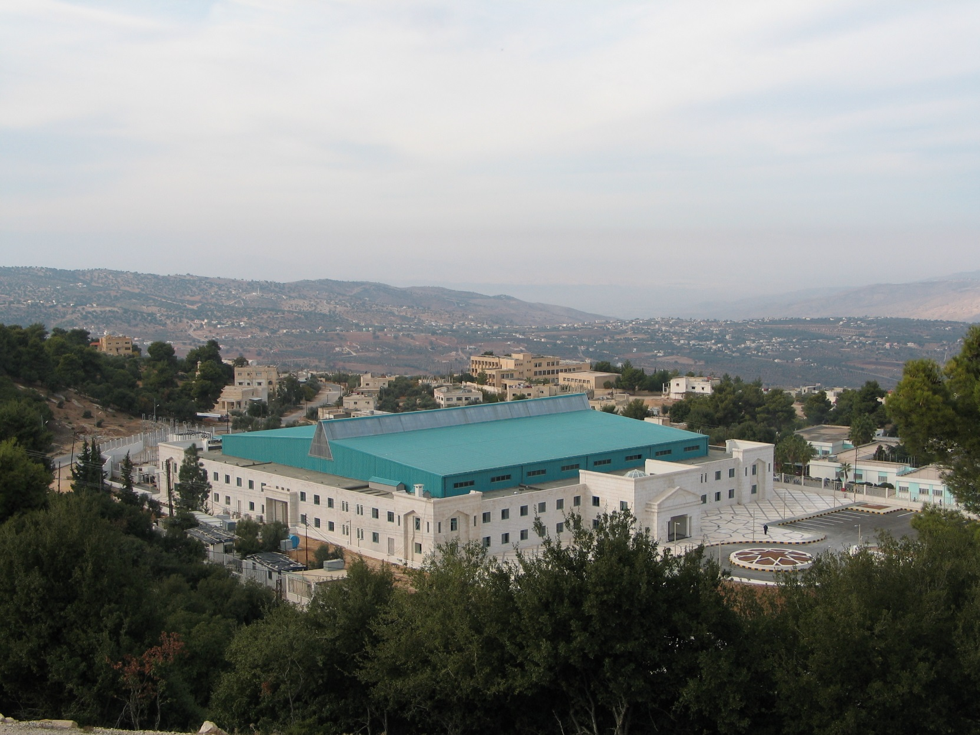
Completion of building 2008, faciity is fully working since 2018
Considerable contributions from Observers in kind, in cash and advice
Users’ community has been created with help of IAEA

Slide 10
Solar Power Plant Project
1st Carbon Free Light Source Facility in the World P0wer plant Inaugurated on February 26th 2019, financed by EU
Reduces considerably operation budget
Example: distributing installations to various sites should be followed for SEEIIST

Slide 11
Advantages of SEEIIST as interregional organisation
Political issues
Only way to create a symbol (light house) to demonstrierte the determination and spirit of upturn and cooperation
Chance to get substantial support from EC, IAEA not just for an individual research project but for infrastructure
Create a neutral, objective platform for governmental discussions to agree on convention, procedure for site selection, rule for contributions Swiss government has formally offered help to support such a platform

Slide 12
- buy a machine ‘clef-a-main’ from a firm (main contractor) (only way for a national project), expensive (cover risks of firm), restricted choices according to experience of firm - build most advanced and flexible upgradable project (which needs some developing work), including training during the construction of the future staff and involving local industry (CERN model) Needs international cooperation
Two principal options for construction of the facility
This choice is a highly Political decision !

Slide 13
Treatment options:Which kind of beam qualities (energy definition, cross-section) Beam steering possibilities Gantry (superconducting) Imaging techniques during radiation treatment (PET, others)
Some Questions to be answered:
Technical – medical issues
- which kind of accelerator, linear or round or combination - highest possible beam intensities (fast treatments)- - possibility of fast change of particle and energy - Time schedule: of course, as quick as possible, but should be coordinated with political and financial time schedules

Slide 14
Mailly Medical and scientific issues:
Treatment of tumours is quickly expanding and field in full development (kind of tumour, protons or carbon ions, pharmaceutical treatment, combination)
Needs group of oncologists for consultation, digital network
Needs a large database for decision taking (digital data base)
Both difficult for a national hospital
A large radiobiology comunity in Europe is waiting for a facility to carry out such research (ENLIGHT community). Requiers an international facility. Would stabilise the laboratory by having a second focal point
All these issues can best be solved in international collaboration

Slide 15
The chances for SEEIIST are good
EU is prepared to support the region, (phase 1)
A lot of preparation has been made by contribution from outside e.g. U.Amaldi, M.Vretenar, M.Dohanji, (free volonteers!)
So far most of push came from Montenegro in particular minister Sanja Damjanovic
Now clear interest must be shown by countries on political level
Scientists, technical experts, administratord and others must get involved actively in the project contributions to project

Slide 16
Thank you

