Slide 1
Expert Meeting: From Vision To Reality January 23rd 2020, Ljubljana
Challenges And Opportunities For Industry In SIPTC And SEEIIST Projects
Mark, Pleško, Engineering Academy of Slovenia, Cosylab
Notes:
<številka>

Slide 2
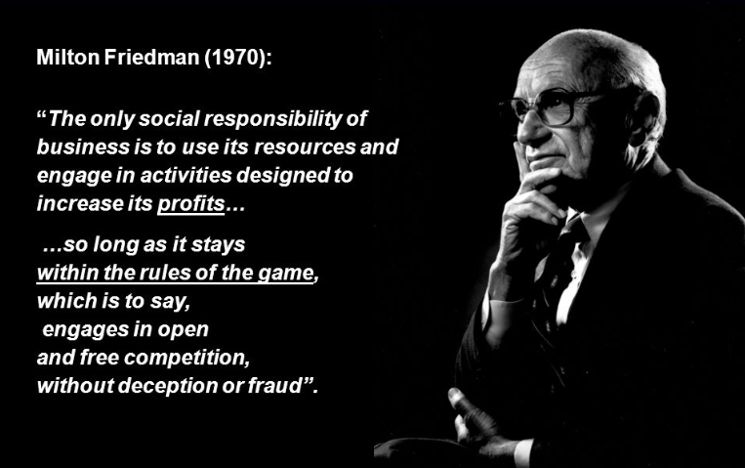
What is the role of business?
<številka>/19
The traditional view:
The sole purpose of a business is to make money for its stakeholders…
(Any business executives who pursued a goal other than making money were, unwitting puppets of the intellectual forces that have been undermining the basis of a free society these past decades).
Notes:
<številka>

Slide 3
What is the role of business when work with Big Science?
<številka>/19
AND MUCH MORE
Tech transfer
Getting references
Collaboration
Partnerships
New domains
Spill-Over Effect
…

Slide 4
How Should Science View Business: in-house versus outsourcing
<številka>
For in-house: maintenance, upgrades
Wrong!
In-house people are smart: but get N different solutions
Nobody is writing documentation unless forced
“Outsourcer” is forced, because of payment
In-house person will just tell you, until she/he is gone
In-house knowhow rests with people, not the lab
Outsourced knowhow from competent suppliers is like an escrow vault:
You pay, but it is well kept for you
Over the whole lifetime of the

Slide 5
The 3 Phases of Non-outsourcing
<številka>
We will outsource, but we don’t know yet what
We have some specs, but we can handle them ourselves
We should have outsourced to you, but now we have already invested so much of our work that we can not justify throwing it all

Slide 6
The Right Way to Outsourcing: Rightsourcing (you name it!)
<številka>
start with smaller projects to get to know each other
regular visits or work on-site
Get benefits from both “in-sourcing” and “out-sourcing”:
A few engineers on-site (gather requirements, communicate with customers, organize, support, service…)
expert team at home, professionally organized and managed
Benefits for the lab:
pay only for the work done, get an expert in every area
scientists retain the established work practice: (almost) no specs, creative academic environment, ask and get (almost) next day
value for money (efficiently managed, optimized procedures, no cure no pay!)
Lifetime support (no need to call in retirees like CERN had to)
Notes:
<številka>

Slide 7
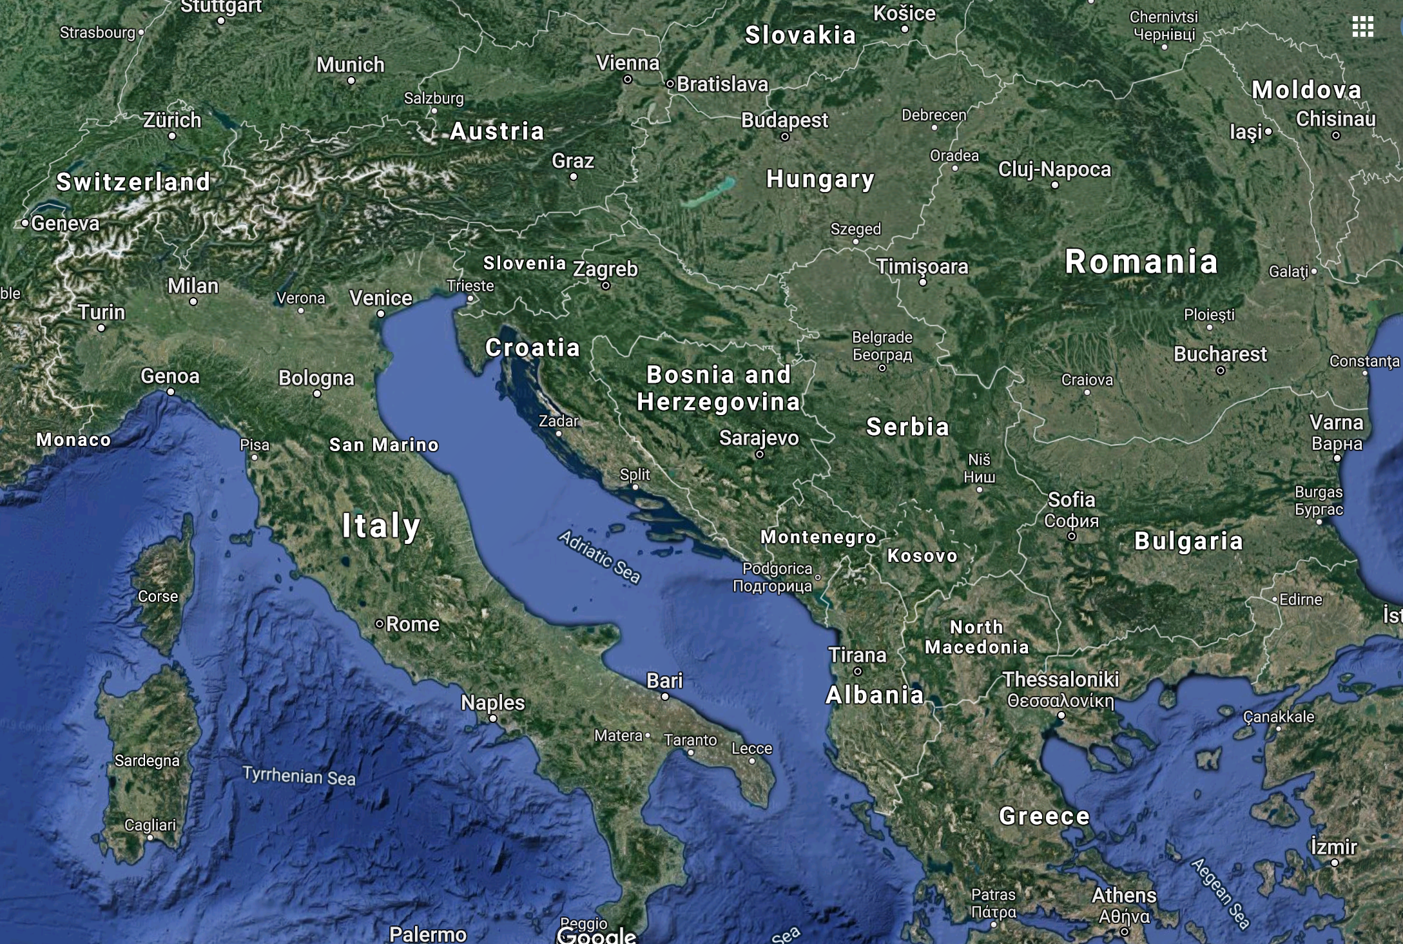
Does The Region Have Relevant Industry?

Slide 8
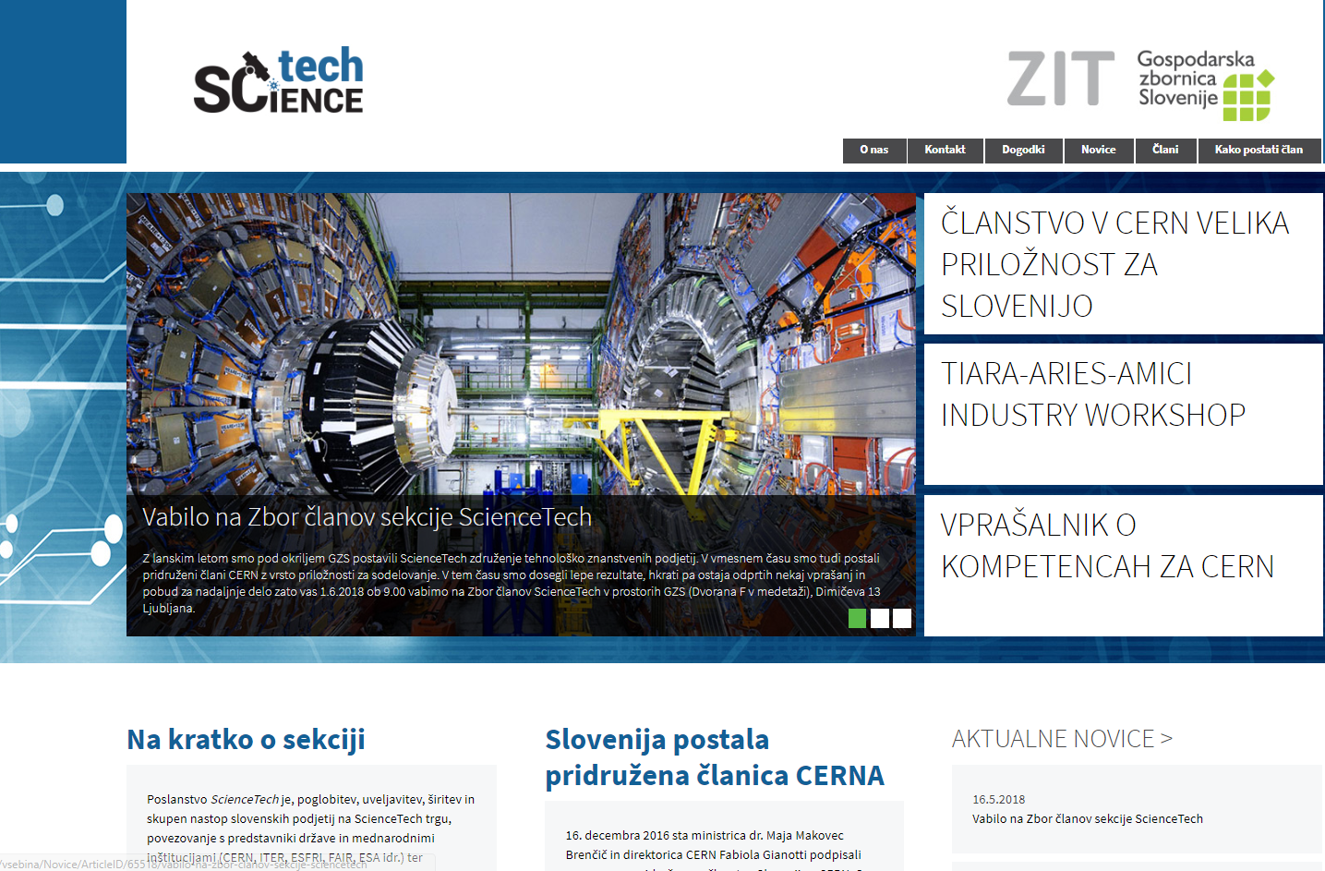
https://www.gzs.si/sciencetech/
Notes:
<številka>

Slide 9
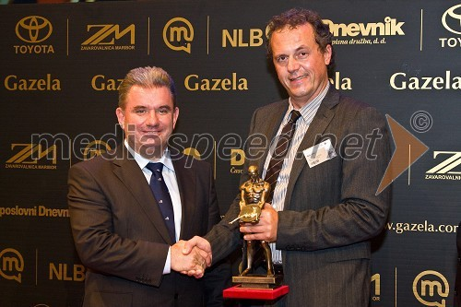
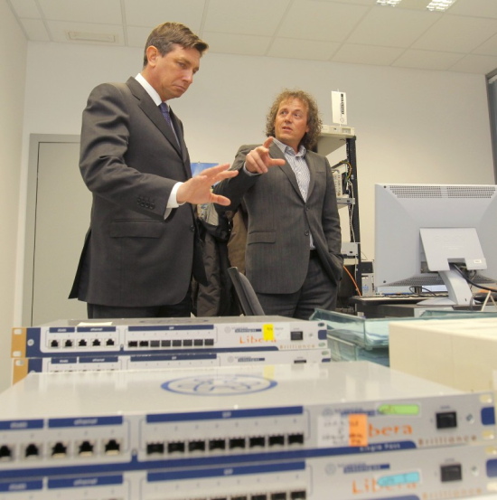
<številka>
Golden gazelle – best fast growth co. Visit of Prime Minister
Co-Innovated Digital BPM For PSI, Then Developed New Model From Scratch
With two launch customers, Soleil of France and Diamond of the United Kingdom, Libera began its „winning march“ in 2004

Slide 10
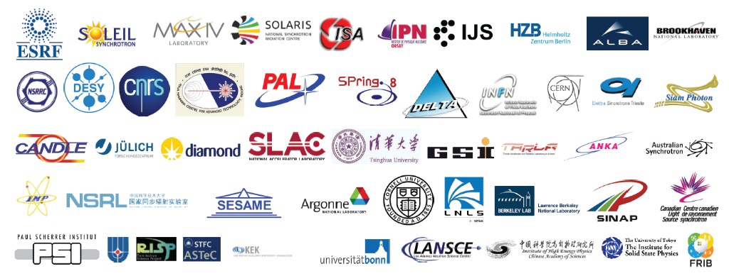
is the provider of instruments
Established in 1998
Located in Slovenia (EU)
Thousands of units deployed and working reliably for 15+ years
Tens of scientific publications use I-Tech instruments as the reference benchmark
Notes:
<številka>

Slide 11
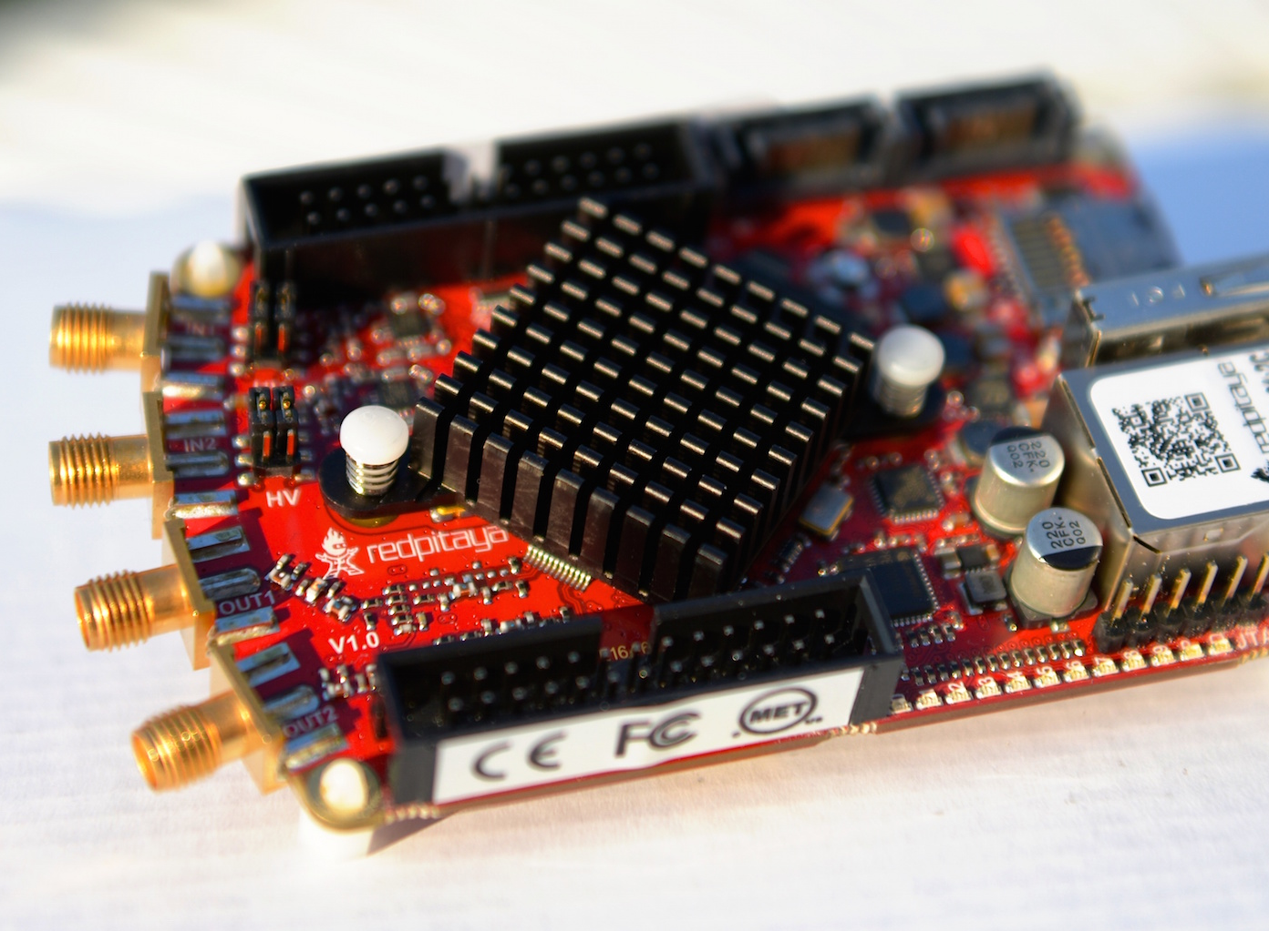
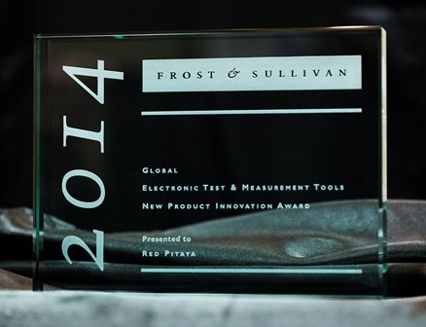
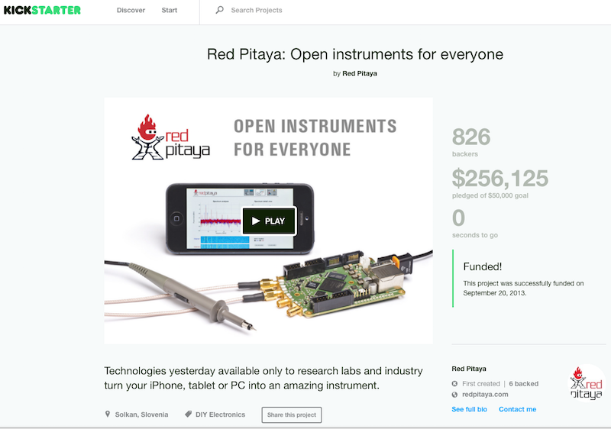
Instrumentation Technologies’
spin-off
“Where do you find a team that can dream up something like a Red Pitaya?
Working on particle accelerators in Slovenia, of course.”
Steve Leibson
Director of Strategic Marketing and Business Planning
Xilinx Inc., San Jose, USA

Slide 12
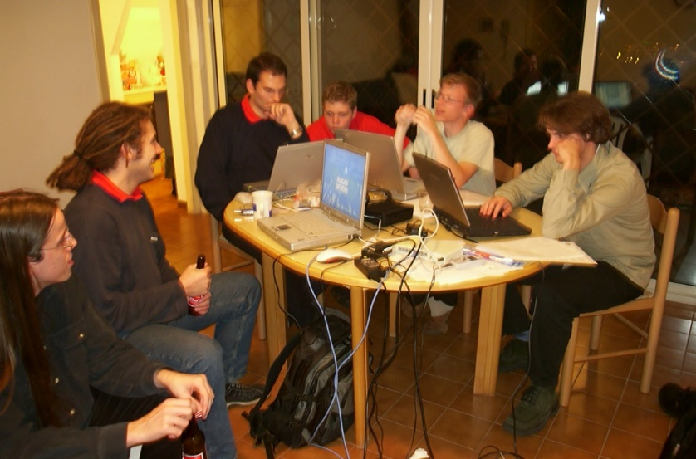
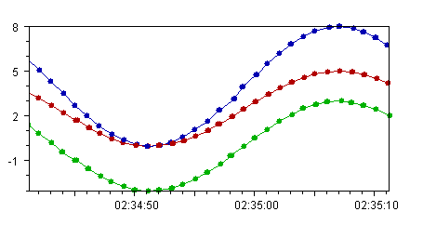
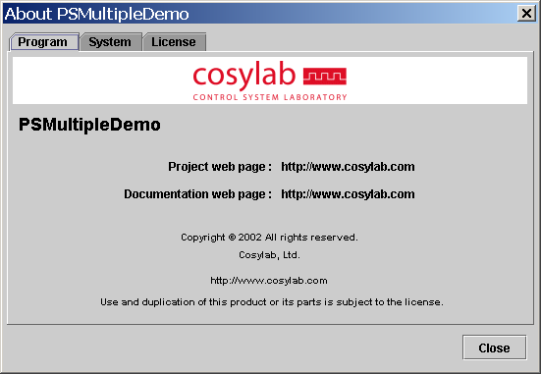
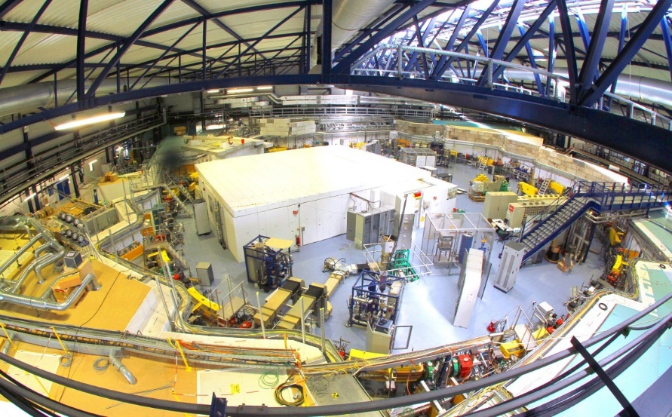
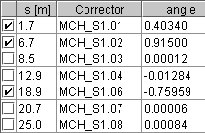
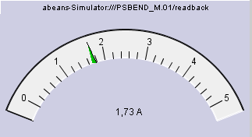
<številka>
J. Stefan Institute: Students Did ANKA Control System In 1997-01
spin-off as Cosylab:
Software for Any Large Experiments Facilities

Slide 13
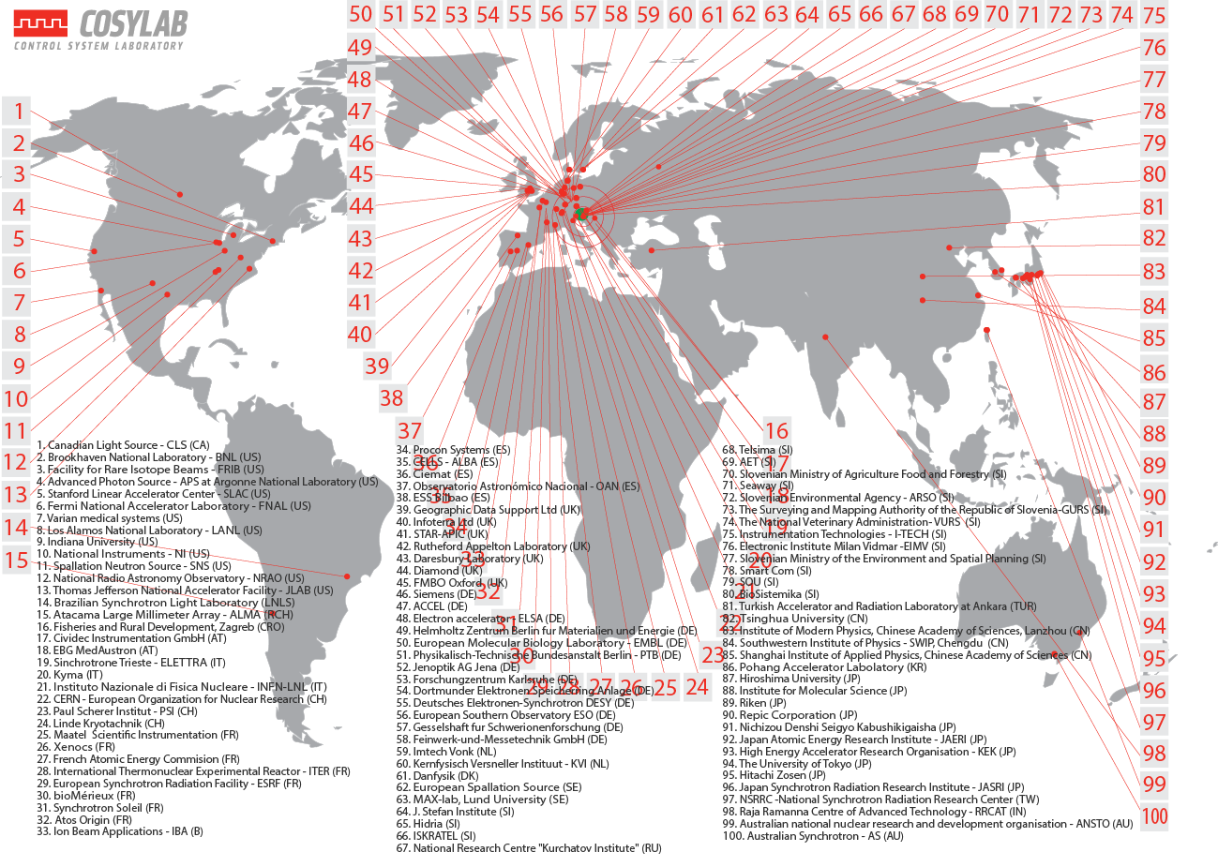
2020: >200 People: Acc, Astronomy, Fusion, Lasers, Space
<številka>

Slide 14
Clients: 70% Of All PT Manufacturers
<številka>
Our biggest customers AND research partners:
and many others, even iBNCT…

Slide 15
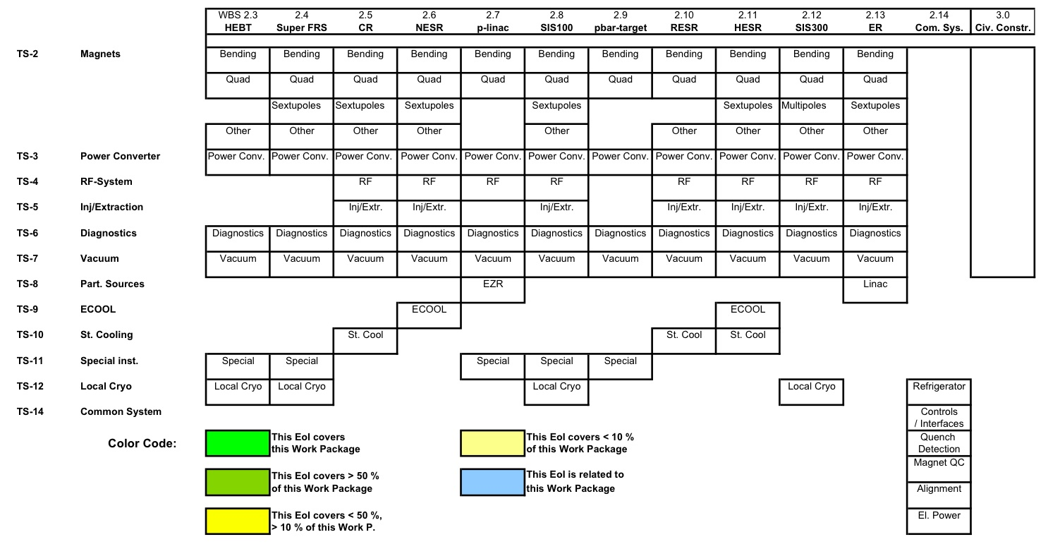
<številka>
Darmstadt -14/03/2008 - <številka> of 11
In-Kind Contribution Driven by FAIR Requirements: New Products
FAIR Contribution from TWELVE Slovenian Companies
Notes:
<številka>
Different levels of involvement.
Specific work packages to be defined within the context of the Slovenian contribution. Phase specific.

Slide 16
Thank you!
COSYLAB
Tel.: +386 1 477 66 76
Web: www.cosylab.com

