Slide 1
Synergies of
SEEIIST and SIPTC
Od vizij k stvarnosti, 23.1.2020
Andrej Studen

Slide 2
Layout
Comparison of projects
Particles
Time component
Number of patients
Research
biomedical
medical physics
Non-medical use of beams
Summary

Slide 3
Comparison of projects
Promote collaboration between science technology and industry
Platform for improved education
Slow down/revert brain drain
Recover the great tradition
Foster cooperation in region
Dedicated to clinical work
Ready to go project
The most effective way to introduce PT in Slovenia and region
OIL becomes a competence center in proton therapy
Complementary goals
Notes:
We see the projects not in competition, but as complementary efforts. The complementarity itself offers an opportunity. And this is a rare occasion where diverse goals can be exploited to build an infrastructure that exceeds goals of each project in isolation. In the next slides I will try and show how this complementarity can be used best to
improve health care
promote science
assist in technological development of the region

Slide 4
Particle component
Protons only
Sufficient evidence that proton therapy is beneficial in cancer treatment
Protons initially
Operation of heavy ions (Carbon Helium) essential part of the roadmap
SEEIIST has a much broader scope of treatment options to be used for treatment scenarios.

Slide 5
Time component
First patient in 3 years
Build up on previous experience within OIL:
sustainable RT
model center
training center
Fastest PT in the region
First patient in 2028
Site selection by 2021
Multistage approach (gantry planned for
stage 2)
SIPTC fast implementation -> ideal reference for SEEIIST development, providing training, experience and operation model.

Slide 6
Number of patients
>500 patients/year in Slovenia eligible for PT
10 -15 % of patients from neighbouring countries
500/patients per regional, 20M population
50 % of the beam dedicated to biomedical research with heavy ion sources
To treat all patients eligible for PT, dedicated clinical treatment centers are required.

Slide 7
Biomedical research
Possible, but not integrated into proposal.
50 % of the beam dedicated to biomedical research with heavy ion sources.
For biomedical research, a dedicated SEEIIST like treatment facility is required.

Slide 8
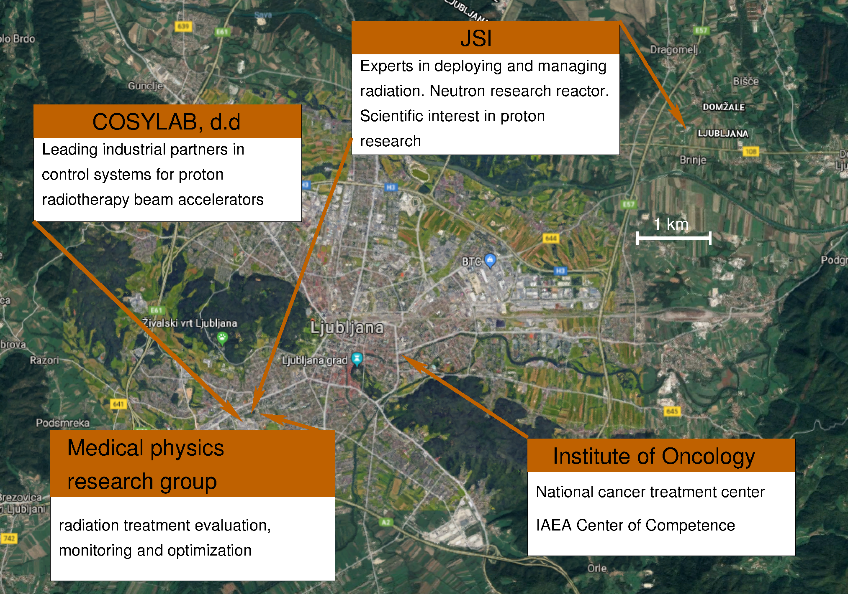
Medical physics research

Slide 9
Medical physics research
Unique arrangement of key players (Health: OIL, Industry: COSYLAB, Science: JSI)
The only organized medical physics research group in region
Requires dedicated scientists in design, implementation and running of the facility
Slovenian medical physics group can contribute through experience, knowledge and organization.

Slide 10
Medical physics research
Medical physics research group already involved in particle therapy research
Collaboration with leading centres (CNAO, PSI, GSI, OncoRay), industry (COSYLAB, RaySearch) and academy (LMU, UMCG) in adaptive proton therapy (RAPTOR)
Involved in proposals on imaging and novel dose and treatment reports (robust optimization)
Slovenian medical physics group can contribute through experience, knowledge and organization.

Slide 11
Non-medical research
Unique possibility of combining particle acceleration with top-level research of elementary physics
Limited potential

Slide 12
Non-medical research

Slide 13
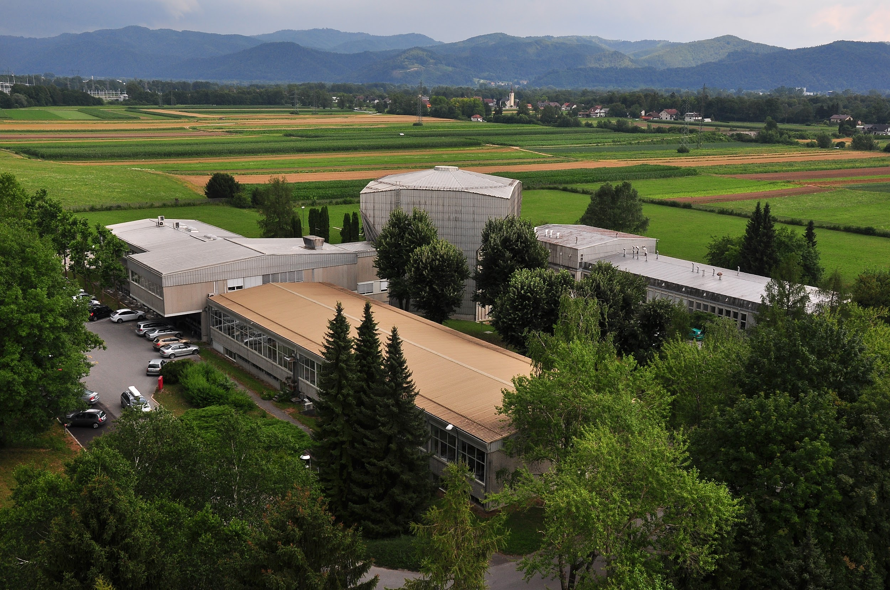
Non-medical research
Potential location of particle accelerator at the JSI Reactor Centre
Synergy with existing infrastructure
4 MeV ion accelerator
TRIGA Mark II 250 kW nuclear reactor

Slide 14
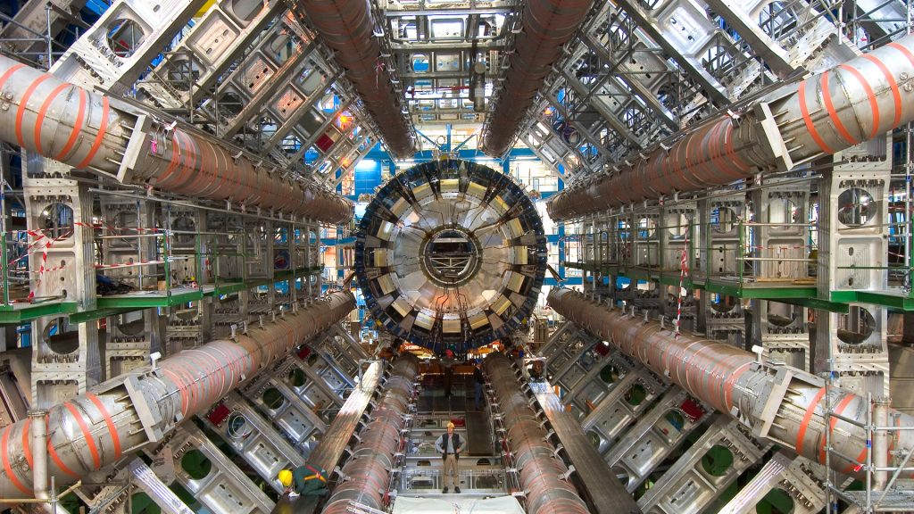
Key projects: Radiation hardness
Detector radiation hardness studies, currently performed at TRIGA
Detector damage by neutrons not identical to protons
Both species at CERN
Large currents (uA) required
Development accelerator such as planned by SEEIIST significantly simplifies adoption of medical beam for radiation hardness studies

Slide 15
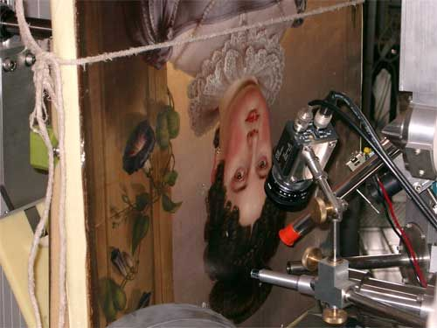
Key projects: Cultural herritage
Herritage studies performed with TANDEM and similar tools
Adoption of medical beam can reveal complementary information
Beam tunning and optics required
Development accelerator such as planned by SEEIIST significantly simplifies adoption of medical beam for radiation hardness studies

Slide 16
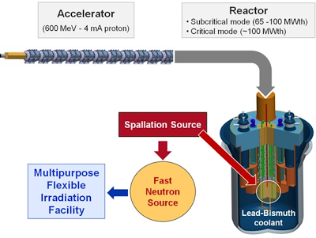
Key projects: Radioactive waste
Accelerator driven systems for spent fuel transmutation
Lowering environmental burden of purified uranium
Energy feasible, but large currents required
Development accelerator such as planned by SEEIIST significantly simplifies adoption of medical beam for radiation hardness studies

Slide 17
Summary
The two projects are not in competition
Complementary goals are being pursued by similar technology
Significant advantage in early PT technology adoption through SIPTC center, building on competences accumulated by the OIL
SEEIIST would profit by
incorporating SIPTC as an early technology adoption stage
exploiting training, operation and management study possibilites

Slide 18
Summary
Integrating SIPTC/SEEIIST at a single location provides:
the whole radiation treatment vertical:
photons -> protons -> particles
builds on competences earned previously
exploits unique concentration of health/industry/science competences
provides unique SEEIIST appoach to particle therapy
reducing brain drain
fostering cooperation
platform for education
first green particle threapy

Slide 19
Summary
Such a collaboration would boost SIPTC/SEEIIST project to
global relevance
competing with leading centers in the vicinity (MEDAUSTRON, CNAO, HIT) , providing
unprecedented opportunity for combining
research
and better health care.

