Slide 1
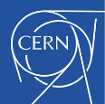
The future accelerator design for SEEIIST
From Vision to Reality
Maurizio Vretenar (CERN)

Slide 2
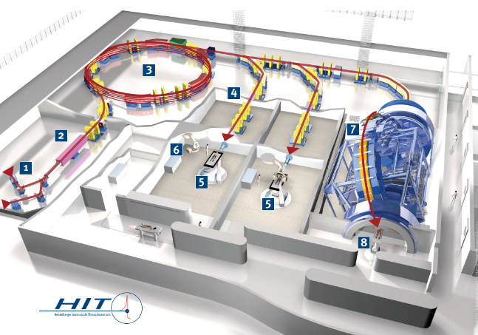
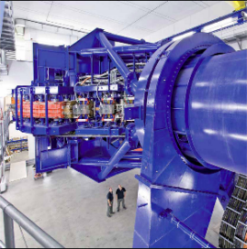
The key element: the accelerator
The new facility will place science and therapy at its focal point - but the particle accelerator remains the key component in terms of cost and performance.
The accelerator system (ion source¹, injector², particle accelerator³, beam lines⁴ , gantry⁷) represents more than 75% of the construction and operation costs of the facility.
View of the accelerator system of the Heidelberg Ion Therapy center (left) and of its gantry (right)

Slide 3
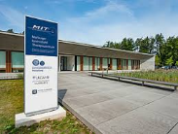
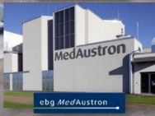
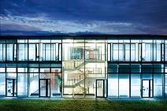
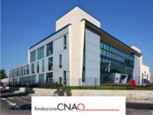
Present and the future of ion therapy accelerators
Europe has played a major role in the development of hadron therapy facilities
4 ion therapy facilities operating in Europe (but 3 in China and 6 in Japan!)
2 based on a design started at CERN in 1996. 1st patient at CNAO in 2011.
2 based on a design started at GSI (Germany) in 1998 . 1st patient at HIT in 2009.
The new SEEIIST
Particle accelerator technology has made a huge progress in the last 20 years, and Japan is progressing fast in the development of new more compact and less expensive ion therapy accelerator designs.
Building on the combined experience accumulated over the last 20 years by the European facilities and on the technologies recently developed at CERN and GSI, we can today revise our standard accelerator designs to profit of the last advances in accelerator technologies.
Notes:
Following the successful development of HIMAC in Japan (started in 1988, 1st patient 1994)

Slide 4
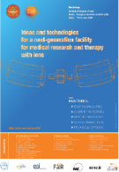
Requirements for a new accelerator design
Requirements of the ion therapy community, expressed at the Archamps Workshop, June 2018
1. Concentrate on heavy ions (Carbon but also Helium, Oxygen, etc.) because proton therapy is now commercial (4 companies offer turn-key facilities) while ions have higher potential for treatment but lower diffusion.
2. A next generation ion research and therapy accelerator must have:
Lower cost, compared to present;
Reduced footprint;
Lower running costs;
Faster dose delivery with higher beam intensity or pulse rate;
A rotating ion gantry;
Operation with multiple ions (for therapy and research).
A new innovative design:
Can attract a wide support from the scientific community;
Can increase the exchange SEE-WE and inside SEE thanks to stronger collaboration on scientific and technical issues;
Can bring modern high technology to the region, with new opportunities for local industry and scientific institutions.
+ Specific requirements for SEEIIST:
Easy Industrialization
Reliability
Simple operation
Reduced risk
Acceptable time to development

Slide 5
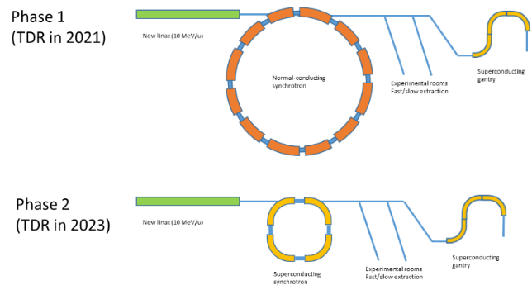
A Strategy for SEEIIST
A two-stage approach: develop an innovative synchrotron design employing standard magnets, and develop superconducting magnets that could replace the standard ones
Innovations
2 x 10¹⁰ carbon ions per pulse
Fast / slow extraction
New linac at 10 MeV/u
Superconducting gantry
Multiple ion operation
Additional features:
Upgradability
Flexibility
Industrialization
Ring circumference ~ 75 m
As above, plus
Superconducting magnets for the synchrotron
Ring circumference ~ 27 m
With 2 x 10¹⁰ carbon ions per pulse, aim for the world record in beam current for a therapy facility

Slide 6
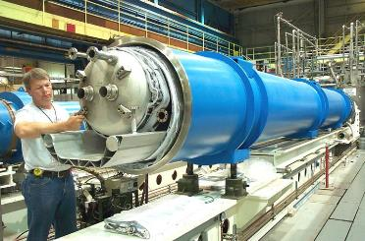
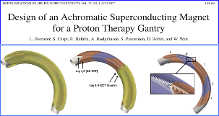
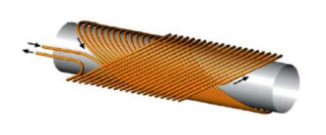
Superconducting magnets for accelerators
Superconductivity is the key to the progress of accelerators
Eliminates power loss and allows reaching higher fields and smaller dimensions.
Since the first tests 50 years ago is now a standard industrial technology with decreasing costs and low risk (1’400 superconducting magnets are operating in the CERN LHC accelerator!).
Canted Cosine Theta (CCT) type magnets, similar to those used in many laboratories, with nested quadrupoles.
The CERN LHC superconducting magnet

Slide 7
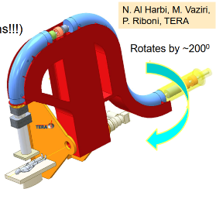
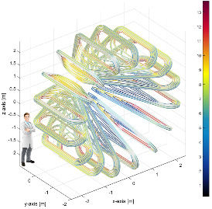
Alternative superconducting designs for the gantry
The medical community requires a gantry system to precisely align the beam on the patient
Rotational superconducting gantry
Equipped with CCT magnets similar to SC synchrotron, rotation by 200⁰.
Radius 5 m, weight ~ 40 tons
Toroidal superconducting gantry
Fixed superconducting toroidal magnet, no rotating parts (GaToroid, L. Bottura)
Radius 5 m, weight 50 tons

Slide 8
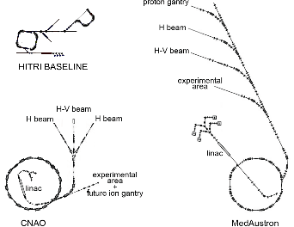
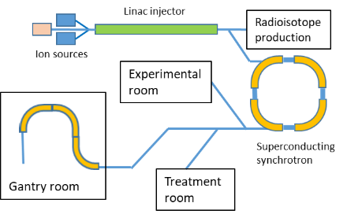
The SEEIIST Accelerator Design
50% research, 50% treatment: clinical and pre-clinical research on particle therapy, treatment to respond to the needs of SEE and to cover operational costs.
2 x 10¹⁰ ppp, 20 x higher intensity than other facilities, for faster treatment.
Different ions, for experiment and combined diagnostics and treatment.
Slow and fast beam extraction, for flexible operation for treatment and experiments.
Reduced footprint and cost thanks to a new superconducting design of synchrotron and gantry.
Production of radioisotopes for imaging and treatment in parallel with beam production.
SEEIIST design on the same scale as CNAO and MedAustron

Slide 9
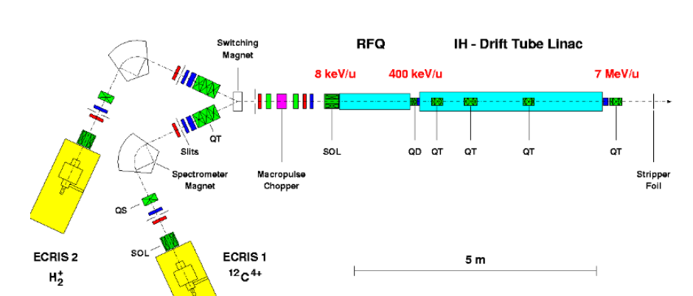
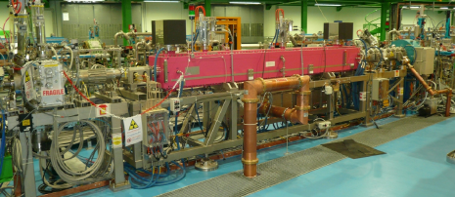
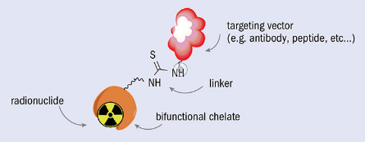
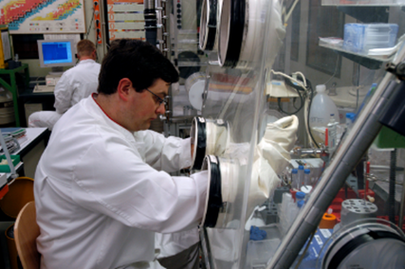
Production of medical radioisotopes at SEEIIST
The SEEIIST facility will have a new injector linear accelerator (linac) designed for higher energy (10 MeV/u), with lower cost, higher efficiency and higher intensity.
With a minor additional investment, the linac could have 2 modes of operation: for injection in the synchrotron, and for sending the beam to a target for production of medical radioisotopes.
An example: Targeted Alpha Therapy
Alpha-emitting therapeutic isotopes: charged atomic nuclei emitting α particles (2 protons+2 neutrons), produced by bombardment of nuclei with an α beam.
Attached to antibodies and injected to the patient: accumulate in cancer tissues and selectively deliver their dose.
Advanced experimentation going on in several medical centres, very promising for solid or diffused cancers (leukaemia). Potential to become a powerful and selective tool for personalised cancer treatment.
If the radioisotope is also a gamma or beta emitter, can be coupled to diagnostics tools to optimise the dose (theragnostics)
to synchrotron
to radioisotope production target

Slide 10
SEEIIST as a distributed facility
Isotope Research Hub
Accelerator Development Facility
7 ancillary facilities, all connected to the main site, can be placed in different countries
Scientific Hub (instrument development)
Sustainability Hub (photovoltaic or wind farm)
Central SEEIIST Facility
Animal Research Hub
Training Hub
Clinical Hub
Oncology Hospitals

Slide 11
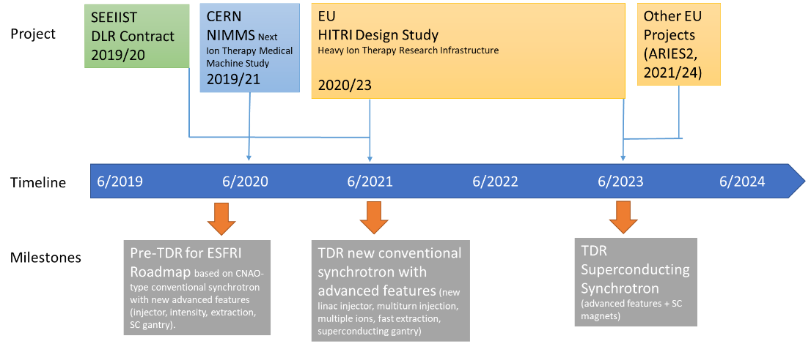
Accelerator Design Strategy – timeline
A flexible strategy, to adapt to the political, technical and financial environment

Slide 12
The HITRI Design Study proposal
HITRI = Heavy Ion Therapy and Research Infrastructure
INFRADEV-01-2019-2020 call for Design Studies (new Research Infrastructures), budget request €3m, duration 3 years
Nº | Name | WP Coordinator | Partners
WP1 | Project Management and Technical Coordination | N. Sammut (UMalta) | UMalta, CERN, GSI, SEEIIST
WP2 | Networking & SEE user community, collaborative platform, dissemination and outreach | M. Dosanjh (CERN) | CERN, SEEIIST (UKIM, CCM), CNAO
WP3 | Accelerator Design | M. Vretenar (CERN) | CERN, SEEIIST (USarajevo), Bevatech, CNAO, INFN, UMelbourne, MedAustron,
WP4 | Magnet Design | L. Rossi (INFN) | INFN, SEEIIST (SEN), CEA, CERN, CIEMAT, PSI, UUppsala, WRPC
WP5 | Gantry Design | S. Rossi (CNAO) | CNAO, SEEIIST (UTirana, UPrishtina, UKIMe, UTetova), CERN, INFN, MedAustron, PSI, UMelbourne
WP6 | Medical Biophysics and Imaging | C. Graeff (GSI) | GSI, CNAO, ANSTO
WP7 | Multiple Energy Extraction System | T. Haberer (HIT) | HIT, GSI, SEEIIST
WP8 | Controls and Safety | M. Plesko (Cosylab) | Cosylab, MedAustron, SEEIIST
WP9 | Facility Integration and Sustainability | N. Sammut (UMalta) | UMalta, ESADE, SEEIIST (USofia, EIZ), CERN, INFN, CNAO, GSI, HIT, Cosylab, MedAustron
Coordinating institute CERN: management, administrative and financial aspects
Scientific coordinator N. Sammut (U. Malta)
Chair of Governing Board: S. Damjanovic (SEEIIST).
20 participants from Central-West Europe (including Cosylab for Slovenia)
10 participants from SEE linked to SEEIIST (including JSI for Slovenia)
Focus on technical aspects and on building community and capacity in SEE.

Slide 13
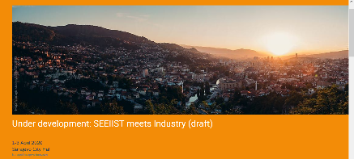
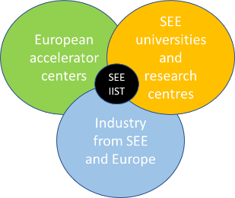
Conclusions and Outlook
Our goal is to create a community around/for SEEIIST, not only to design an accelerator: develop an ecosystem that will support SEEIIST construction and build in the SEE region the competencies required to construct and operate the facility, involving local industry at the earliest possible stage.
Priority:
define a flexible and innovative accelerator design strategy, to support the SEEIIST objectives
1-3 April 2020: SEEIIST meets industry Workshop in Sarajevo City Hall.
Co-organised by CERN and Cosylab for SEEIIST, supported by Central European Initiative.
SEEIIST at the centre of the a cooperation network between European accelerator centers, universities and industry.

