Slide 1
Studies of annealing in Itk Si sensors

Slide 2
Annealing scenario:
Aim: to simulate “real” annealing and irradiation and measure CCE
2-year fluence, then annealing corresponding to combined 1 year at 7 C and 1 year at -3 C
3-year fluence, then annealing corresponding to 3 years at -13 C
4-year fluence, then annealing corresponding to 4 years at -20 C
5-year fluence, then annealing corresponding to 5 years at -25 C.
Annealing calculated with the activation energy 1.07 eV (Freiburg and Ljubljana measurements)
Procedure: irradiate, anneal, measure, irradiate, anneal, measure etc

Slide 4
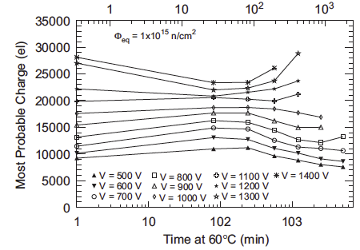
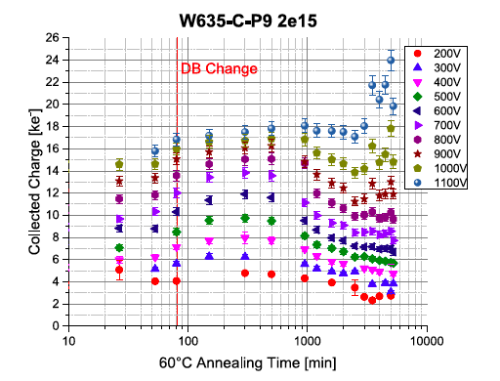
Annealing at 60°C
I. Mandić et.al. NIM A629 (2011) 101-105
l.Wiik-Fuchs et al. NIM A924 (2019) 128-132
“optimal” annealing at 500V is about 200 -300 minutes, position of maximum
slightly depends on fluence

Slide 5
Corresponding fluences and annealing times at 60C - 4000fb^{-1,} safety factor 1.5
“warm start” scenario
 | Fluence step (10¹⁴ n_{eq}cm⁻²) | Fluence (10¹⁴ n_{eq}cm⁻²) | Annealing time after irradiation (minutes) | Total annealing time (minutes)
2 years | 1.3 | 1.3 | 542 | 614
3 years | 2.18 | 3.48 | 45 | 73
4 years | 4.35 | 7.83 | 16 | 27
5 years | 8.17 | 16 | 11 | 11
More annealing
than “optimal”

Slide 6
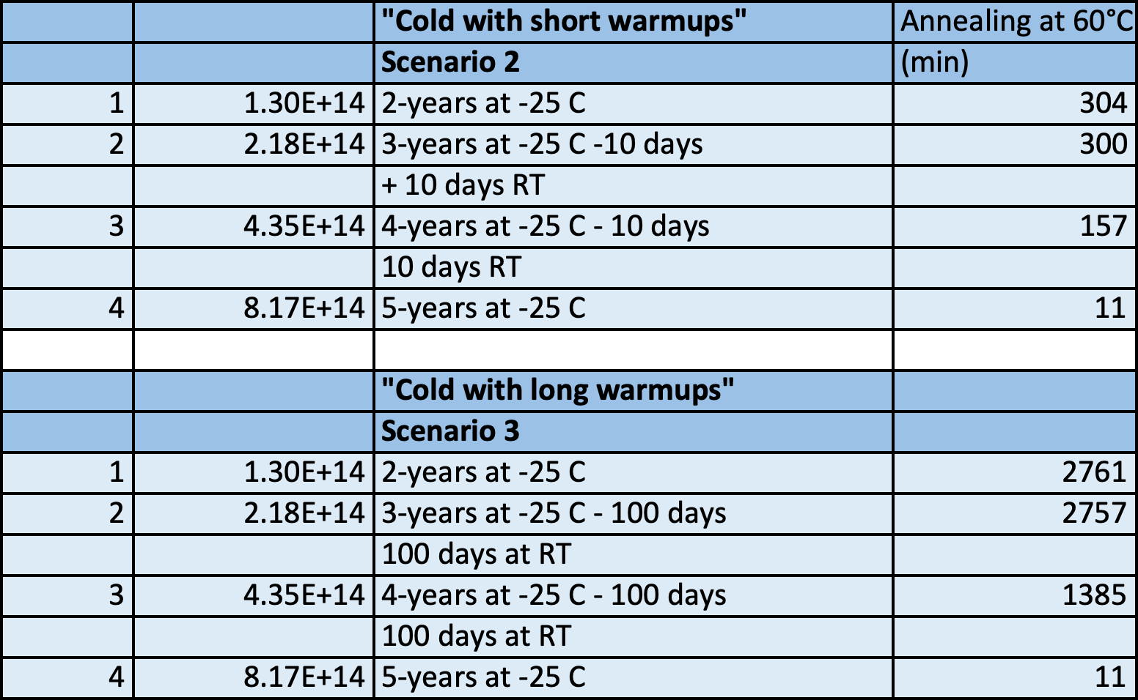
 |  | "Cold with short warmups" | Annealing at 60°C
 |  | Scenario 2 | (min)
1 | 1.30E+14 | 2-years at -25 C | 304
2 | 2.18E+14 | 3-years at -25 C -10 days | 300
 |  | + 10 days RT
3 | 4.35E+14 | 4-years at -25 C - 10 days | 157
 |  | 10 days RT
4 | 8.17E+14 | 5-years at -25 C | 11
 |  | "Cold with long warmups"
 |  | Scenario 3
1 | 1.30E+14 | 2-years at -25 C | 2761
2 | 2.18E+14 | 3-years at -25 C - 100 days | 2757
 |  | 100 days at RT
3 | 4.35E+14 | 4-years at -25 C - 100 days | 1385
 |  | 100 days at RT
4 | 8.17E+14 | 5-years at -25 C | 11
More annealing than “optimal”

Slide 7
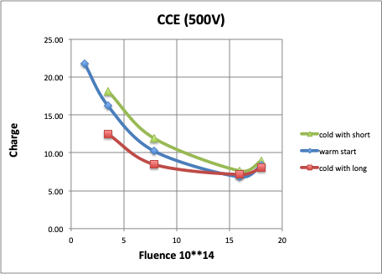
In all scenarios expected charge above 7000 e⁻
Additional annealing to 80 min
Improves CCE

Slide 9
https://atlas-itk-scripts.web.cern.ch/atlas-itk-scripts/scripts/schedule

