Slide 1
QA meritve
V Ljubljani obsevali 21 senzorjev
4 smo pomerili, preostanejo če 4
Birmingham obseval 3 od 20
težave z random rezultati
KEK obseval 23, pomeril 9
PRR Februarja ?

Slide 2
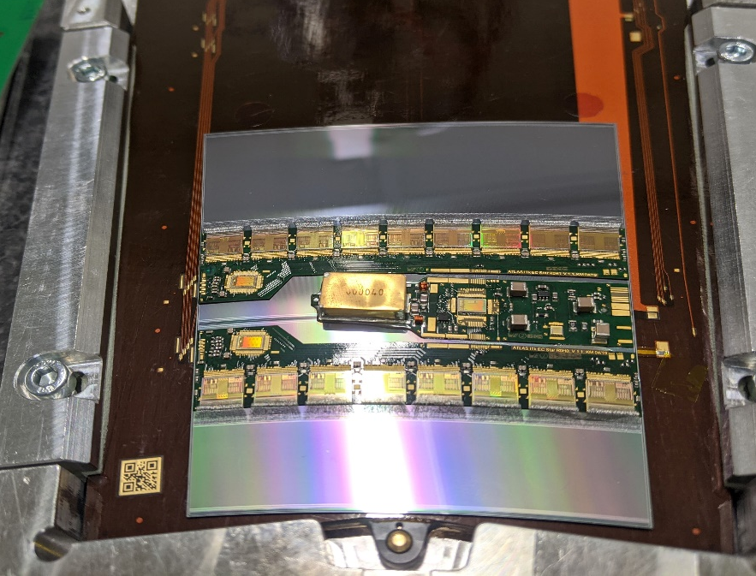
The issue
During the dry loading of the R0Star on the electrical petal, a module placement issue was discovered:
R0Star appeared to be slightly displaced to the left side of the image, too close to the data wire bond pads
Identical on both front and back sides of petal
Displacement increasing with R, resulting in some bond pads covered by the sensors at R2-R5 positions
R5Star S1

Slide 3
Petal bus tapes
Next steps:
Based on electrical petal results, propose possible bus tape modifications to optimise noise behaviour
Implement bus tape modifications
In addition, modifications already detected:
Correct sensor rotation
Better alignment R0H0 and R0H1 pads to latest hybrid version
Move HV_in2 pads 8mm inwards to avoid bonder head clash to the petal frame
Remove FastSignalGround bondpads (to be verified on electrical tests)
Remove extra apertures in the sacrificial part
Increase separation between sacrificial copper layer to petal edge to ease edge cutting

Slide 4
Nova produkcija kablov februarja - marca cca 16+16 kosov
odvisna od rezultatov testov na električnem petalu
Elgoline preveril zalogo
v proizvodnji 4 + 4 kosi serijske številke
A bi dodali tudi tip (back, front)
projekt duoflex 2018
težave pri tab bondiranju

Slide 5
pojavile so se pri letošnjih kablih
Iztekanje lepila - > nov postopek odpiranja coverlayerja , težave pri obeh
vzorce tab bondirajo v Desy-u, Vancouvru, Santa Cruzu

Slide 7
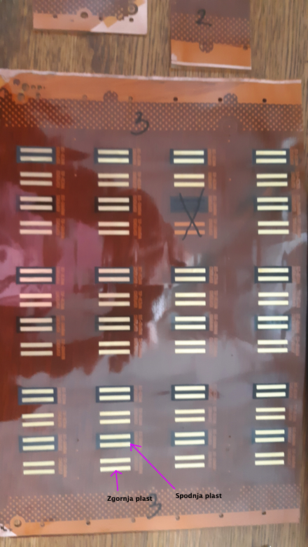
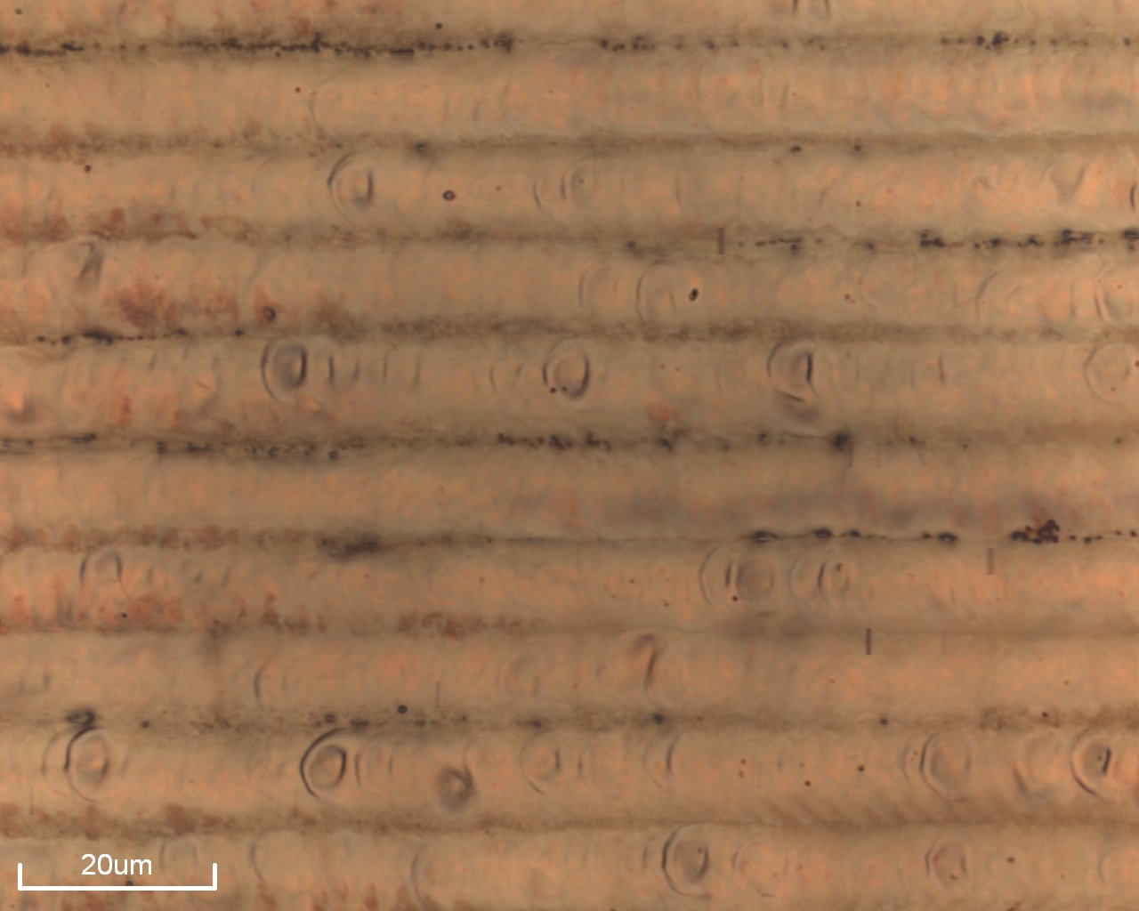
Elgoline izdelal nove vzorce
Čekada pomeril hrapavost, tipično 0.2 mikrona za 40 EUR !!!
INTEC TiV debelino zlata
zadnji rezultati kažejo, da primerna debelina 50 nm – tudi za tab bonding

