Slide 1
ª
^{b}
^{c}
^{d}
^{e}
Development of the monolithic "MALTA" CMOS sensor for the ATLAS ITK outer pixel layer
TWEPP 2018, Antwerp, Belgium, 21.09.2018
B. Hitiª, L. Argemi^{b}, I. Asensi Tortajada^{c}, I. Berdalovic^{c}, I. Caicedo Sierra^{d}, R. Cardella^{c}, F. Dachs^{c}, V. Dao^{c}, N. Egidos Plaja^{c}, T. Hemperek^{d}, H. Krüger^{d}, T. Kugathasan^{c}, C. A. Marin Tobon^{c}, K. Moustakas^{d}, M. Münker^{c,d}, H. Pernegger^{c}, F. Piro^{c}, P. Riedler^{c}, P. Rymaszewski^{d}, C. Riegel^{c}, E. J. Schioppa^{c}, A. Sharma^{c,e}, W. Snoeys^{c}, C. Solans Sanchez^{c}, T. Wang^{d}, N. Wermes^{d}

Slide 2
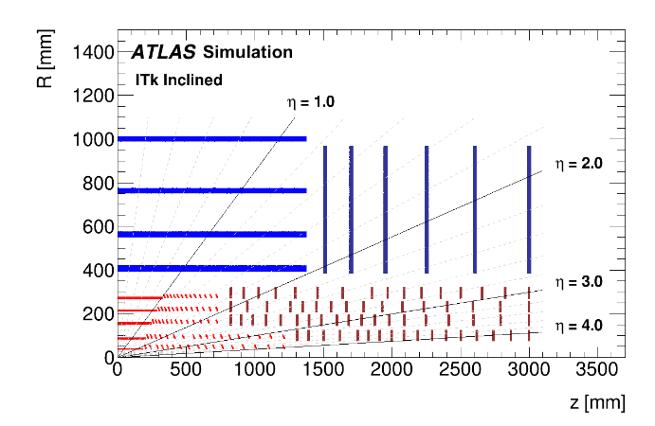
ATLAS Phase II ITk upgrade
HL-LHC Pixel detector upgrade (2024-2026): 5 pixel layers, inclined layout
Option for the outermost Layer 4: Depleted Monolithic CMOS sensors
Requirements for Pixel Layer 4:
Radiation tolerance (without safety factors):
NIEL 1e15 n_{eq}/cm²
TID 60 Mrad
Hit rate 100 – 200 MHz/cm²
Timing resolution 25 ns
ATLAS ITk Pixel TDR

Slide 3
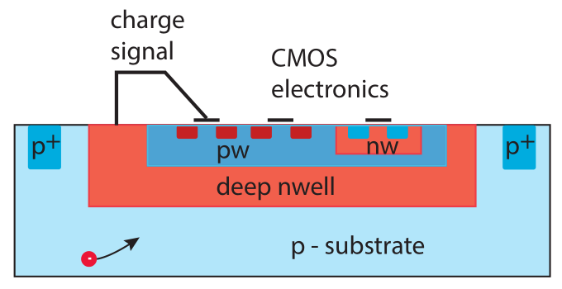
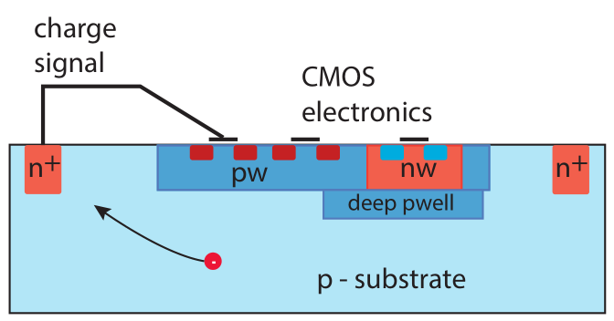
CMOS sensors: Large vs. Small collection electrode
Large collection electrode
Small collection electrode
M. Garcia-Sciveres and N. Wermes, arXiv:1705.10150
Smaller capacitance: C ≈ 3 fF → low power
Less sensitive to crosstalk
Longer drift paths
Full depletion can be achieved by modifying the process → radiation tolerance increases
Larger capacitance: C ≈ 300 – 400 fF
Higher analog power, sensitive to crosstalk
Uniform, strong drift field, high radiation tolerance and detection efficiency
$$τ\text{CSA}= \frac{1}{g\text{m}}\frac{C}{C\text{f}}$$
$${ENC}_{\text{thermal}}^{2}= \frac{4}{3}\frac{kT}{g\text{m}}\frac{C^{2}}{τ\text{f}}$$
$$\frac{S}{N}≈ \frac{Q/C}{\sqrt{g\text{m}}} \sim \frac{Q/C}{\sqrt[m]{P}}$$
$$P \sim {\left(\frac{Q}{C}\right)}^{−m}$$

Slide 4
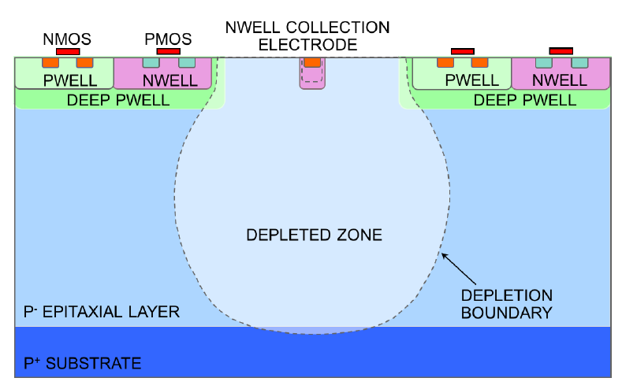
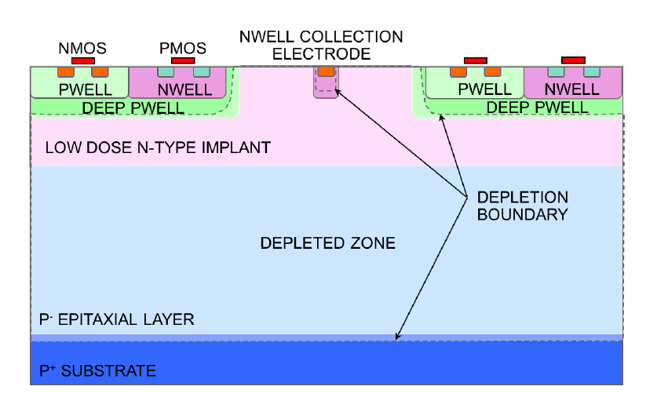
TowerJazz process: Small collection electrode
TowerJazz 180 nm CMOS imaging process, 4 nested wells, 25 μm p epitaxial layer
Typical bias voltages: -20 V (substrate), -6 V (deep PWELL)
25 μm
Standard process
no full depletion on pixel edges
partially charge collection by diffusion, not radiation tolerant
W. Snoeys et al.
DOI 10.1016/j.nima.2017.07.046
Modified process
additional low doped n-layer
full depletion, maintains low capacitance, better radiation tolerance, faster charge collection

Slide 5
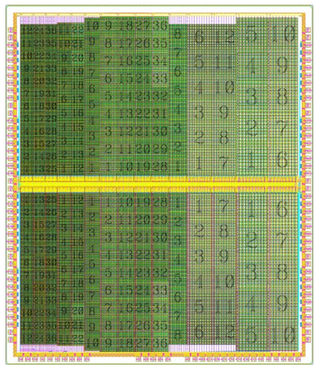
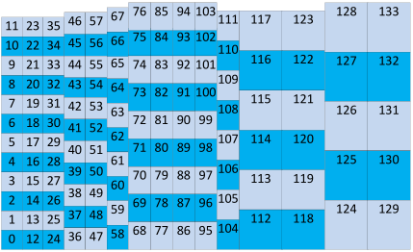
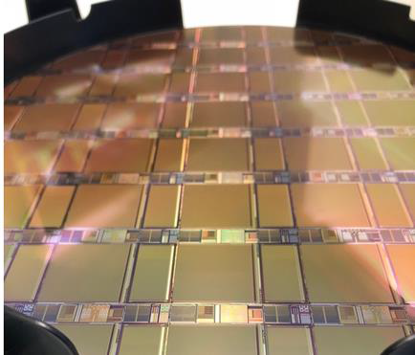
TowerJazz 180 nm development line
radiation hardness,
timing, hit rate
x 100
ALPIDE chip for ALICE ITS upgrade
TJ Investigator (2015)
> 250 different pixel flavors
Analog output after CSA
https://doi.org/10.1016/j.nima.2016.05.016
TJ MALTA (2018)
20 x 22 mm² full size
Asynchronous matrix readout
TJ MonoPix (2018)
20 x 10 mm² half size
Column drain readout
Design team (CERN)
W. Snoeys, T. Kugathasan, C. Marin Tobon, I. Berdalović, R. Cardella, N. Egidos Plaja
Digital readout designed by University of Bonn
T. Wang et al 2018 JINST 13 C03039
Common analog front end design in MALTA and MonoPix

Slide 6
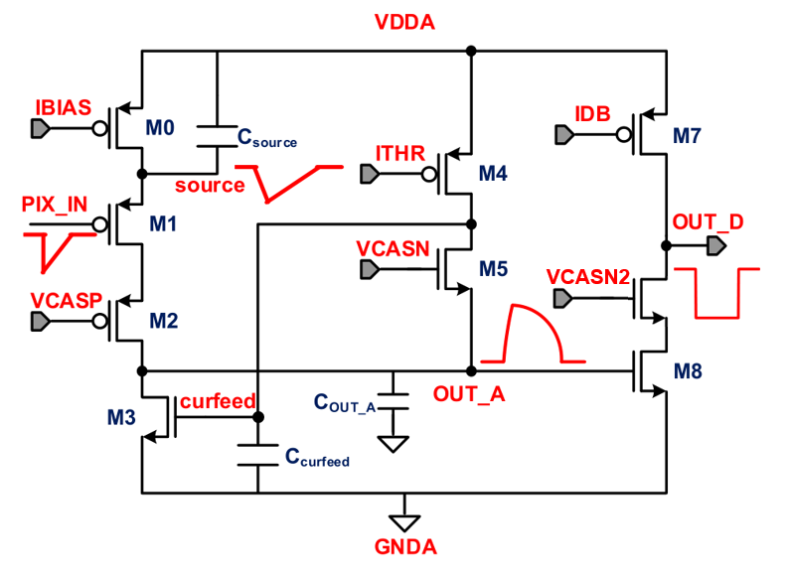
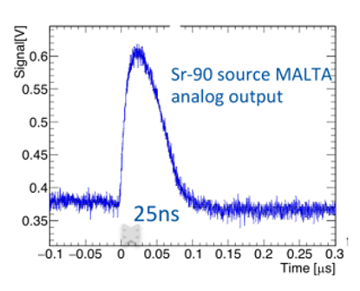
Charge sensitive front end
1
2
Operating principle derived from ALPIDE front end
< 5 fF sensor capacitance → excursion at input of tens of mV
Voltage amplifier can take the place of a standard CSA
Optimization for minimal power consumption and fast timing response
Power 0.9 μW, threshold ≈ 200 e⁻, ENC ≈ 12 e⁻, gain 0.4 mV/ e⁻
D. Kim et al. DOI 10.1088/1748-0221/11/02/C02042
M1 acts as a source follower to avoid loading the input
M2 is a cascode transistor to increase the gain on the output node and eliminate the Miller effect for the input node.
The analog output node is stabilized at low frequencies by active feedback on the transistor M3
Efficient current usage for the input (the same branch current powers the source follower and the amplification stage)
MALTA: optional clipping of the analog pulse is implemented
1 – amplification
2 – discrimination

Slide 7
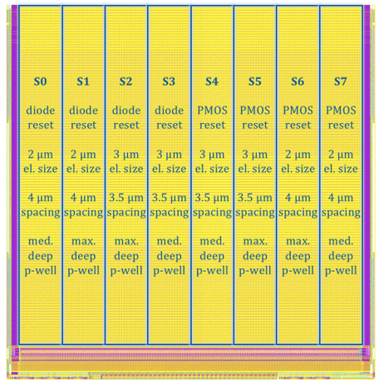
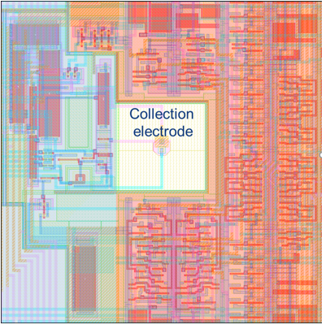
TJ MALTA
Analog
Digital
512 x 512 pixels, 8 flavors
MALTA Pixel
22 mm
36.4 μm
spacing 3.5 – 4 μm
20 mm
36.4 μm
Novel asynchronous readout, no clock distribution over pixel matrix → reduced power
Low threshold spread, no in-pixel threshold tuning
Analog power ≈ 1 μW per pixel (75 mW/cm²)
Digital power (Layer 4) ≈ 10 mW/cm²
Time-walk based charge information
Notes:
large collecting electrode (LF Monopix) has a power consumption of approx. 200 (ana) + 200 (dig) mW/cm2

Slide 8
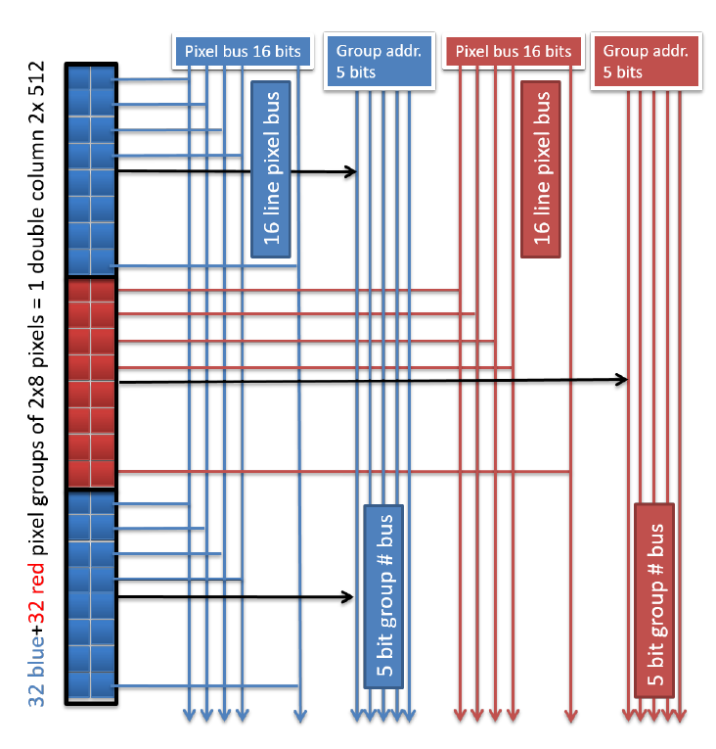
Asynchronous column-drain architecture (MALTA)
Front end discriminator outputs are transmitted asynchronously over high speed bus to chip periphery
2 independent buses serve alternating 2 x 8 pixel groups (one bus for the red groups and another for the blue groups)
Significantly reduced number of lines per pixel
Important to minimize probability for data collisions
Adjustable pulse length 0.5 – 2 ns
22 bits per bus: pixel pattern (16b) + reference (1b) + group address (5b) → 22b
I. Berdalovic et al 2018 JINST 13 C01023

Slide 9
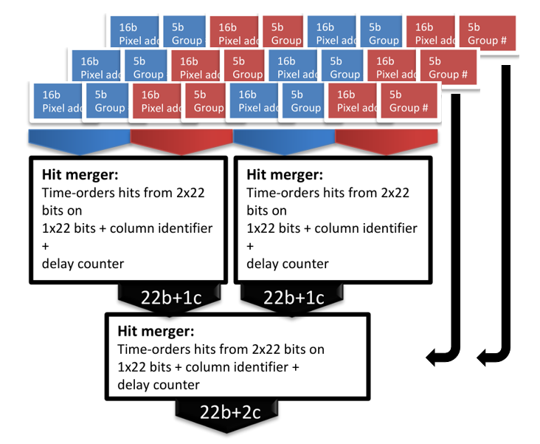
MALTA end of column logic
Asynchronous signals are merged onto a common bus in the periphery
Adjustment for propagation delay in the parallel data bus
Column address, time stamp bits added
Arbitration logic (Hit merger) to process simultaneous signals
One of the signals is delayed to avoid data collisions
Keeping track of the number of delays, additional delay bits
40 bit output word
Asynchronous hit signals transmitted from the chip via LVDS up to 5 Gbps

Slide 10
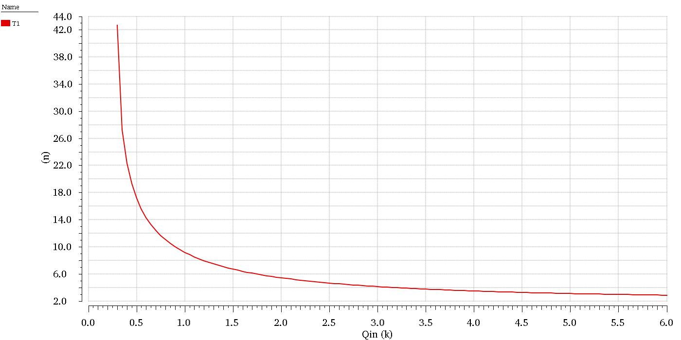
MALTA charge measurement
Charge measurement from time difference between bunch crossing time and leading edge of hit signal
Simulation: Time walk of 25 ns corresponds to 400 e⁻
delay (ns)
Expected time walk 25 ns at 400 e⁻
charge (ke⁻)

Slide 11
MALTA status
First submission – chips received Jan 2018
Pixel readout and pixel pulsing functional
Slow control not fully functional – masking only on double column level, no individual pixels
Hit merger in the periphery disabled due to too high noise activity → can cause data collisions
Second submission (MLVLC) – chips received Jul 2018
Modifications aimed at improving ohmic connections in slow control and powering with minimal number of masks
Chip behavior remained similar to first submission
Future submissions: Mini MALTA – submitted Aug 2018 (MPW)
Smaller 64 x 16 pixel chip with additional functional blocks
Slow control redesigned to achieve correct masking, pixel tuning
Additional synchronization circuit in the periphery to compensate pixel delays at the end of column
Asynchronous readout and slow control with custom readout firmware using Xilinx Virtex-7 VC707 FPGA kit

Slide 12
TESTING

Slide 13
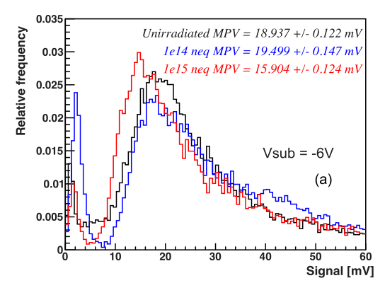
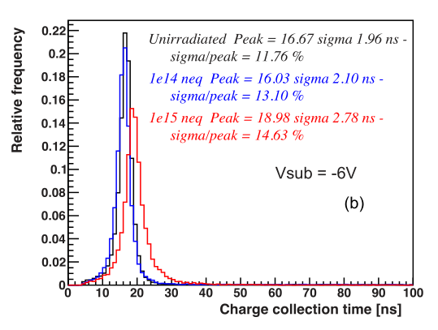
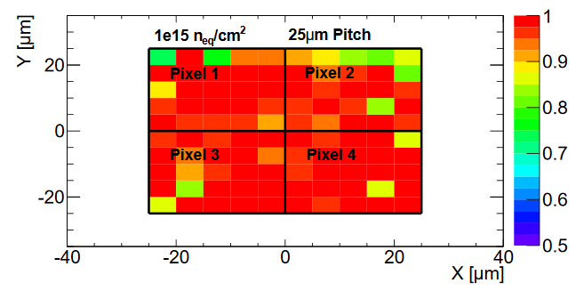
TJ Investigator results summary
150 e⁻ /mV
threshold 50 e⁻
H. Pernegger et al 2017 JINST 12 P06008
Analog output from the front end
Good sensor and front end performance after 1e15 n_{eq}/cm² neutron irradiation*:
⁹⁰Sr measurements:
< 20 % drop in signal MPV: 18.9 mV → 15.9 mV
Charge collection time 19.0 ns ± 2.8 ns
Test beam (SPS 180 GeV/c pions, FEI4 beam telescope, 9 μm pos. resolution):
Uniform 98.5 % efficiency within 25 μm pixel (smaller than MALTA)
*All neutron irradiations made
at Ljubljana TRIGA reactor

Slide 14
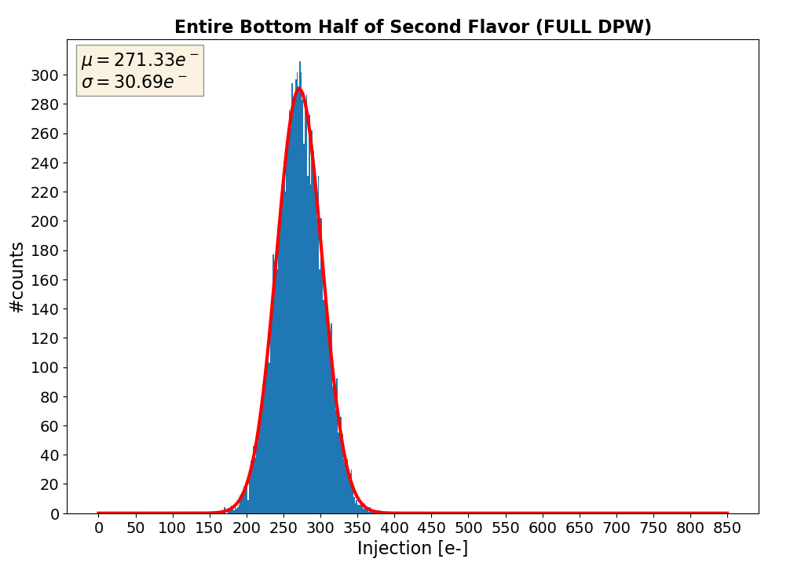
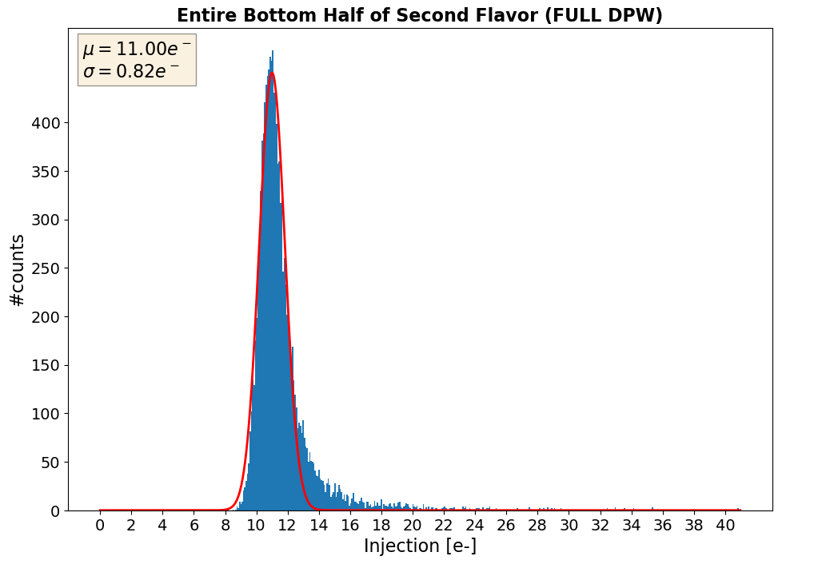
Threshold scan – TJ MonoPix
TJ MonoPix
before irradiation
Threshold distribution
271 e⁻ ± 31 e⁻
ENC 11 e⁻
Tail due to random telegraph signal noise
K. Moustakas et al, arXiv:1809.03434
Measurement of S-curves by injecting test charge into front end
Before irradiation: thr. 271 e⁻ ± 31 e⁻, ENC 11 e⁻
After irradiation: thr. 470 e⁻ ± 50 e⁻, ENC 20 e⁻ (1.5e15 n_{eq}/cm² neutrons, 1 Mrad TID)
Increase in noise may require in-pixel threshold adjustment
Threshold measurement in MALTA not trivial (no masking), extracted distribution compatible with MonoPix
Front end almost identical in TJ Monopix and MALTA – expect same threshold values

Slide 15
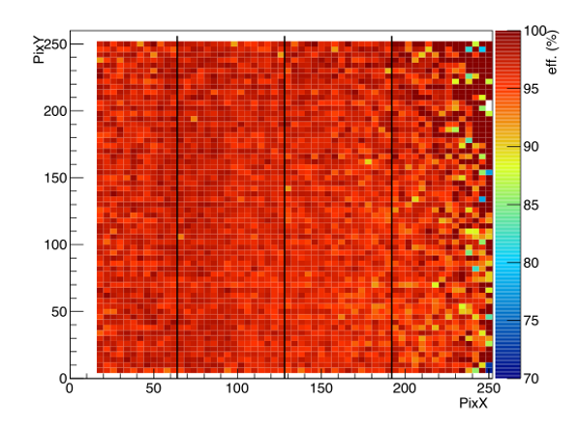
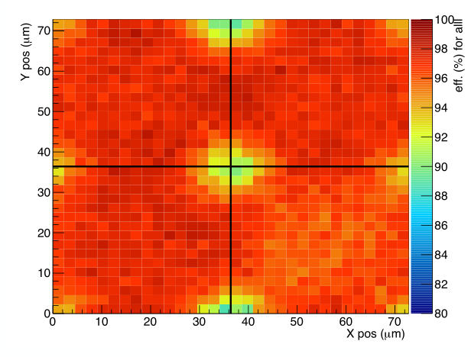
MALTA test beam
SPS test beam, 180 GeV/c pions, Mimosa beam telescope, 5 μm position resolution
Before irradiation: avg. efficiency 96 % (less in corners)
Efficiency loss due to noise
Merger circuit and pixel masking not available
Track hit and a noise hit arrive simultaneously (within 1 ns)
Data is misinterpreted as a hit coming from another pixel → not matched with telescope track
https://doi.org/10.1016/j.nima.2014.05.033.
Efficiency map (unirrad.)
In-pixel efficiency (unirrad.)
IMON2 = 1.36 V
avg. efficiency 96 %
TODO: threshold value
Optimal HV bias configuration SUB -15 V, PWELL -6 V

Slide 16
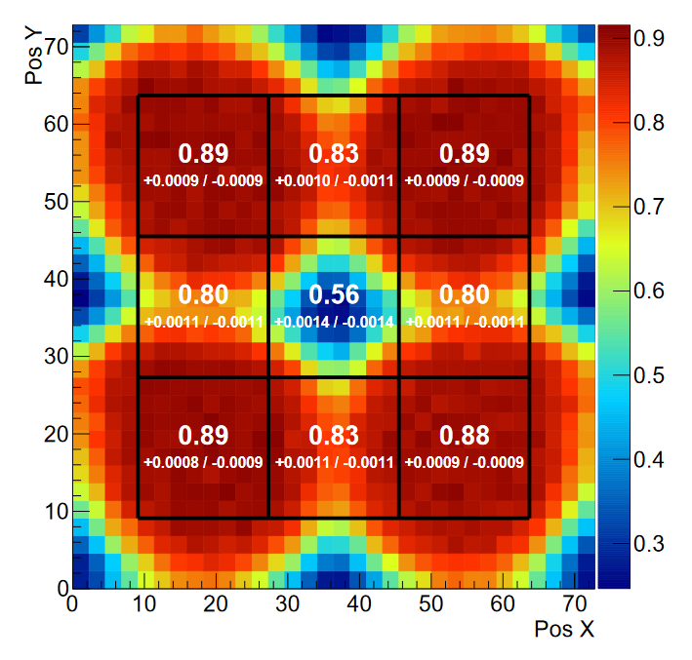
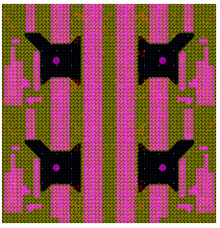
MALTA test beam irradiated
1e15 n_{eq}/cm² neutron irradiated sample
IMON2 = 1.38 V
Deep PWELL distribution
avg eff. 74 %
PosY (μm)
Low threshold
inefficiency due to noise
High threshold
inefficiency for low signals
PosX (μm)
Critical efficiency loss in pixel corners after irradiation
Noise increases in irradiated samples → higher threshold required to suppress noisy pixels (no masking/merging !)
Threshold too high to detect hits on pixel edges (charge sharing)
Efficiency correlated with deep PWELL distribution – inspired modifications discussed with the foundry (next slide)
Inefficiency in the centers due to a high noise level (efficiency in centers increases at a higher threshold !)

Slide 17
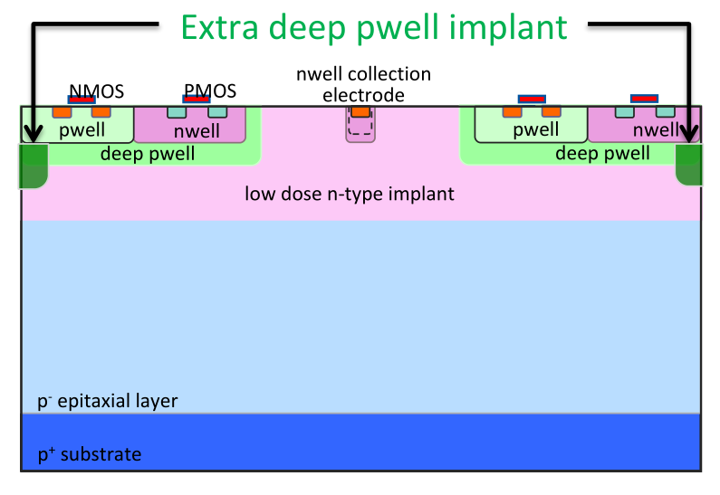
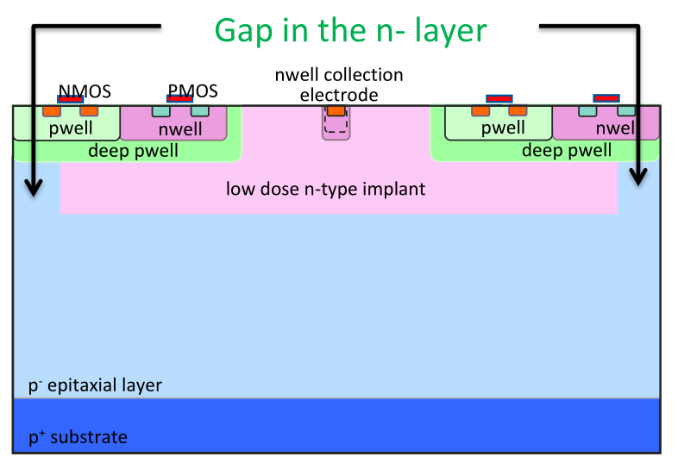
Fixes discussed/planned with the foundry
Additional deep p-type implant
Requires additional mask, but can use 'known' process step
Creating a gap in the deep n-type implant
Mask change, no additional mask required
Both changes target modifying electrical field on pixel edges to improve charge collection – simulation

Slide 18
2D Device simulation
Signal collection from pixel corner
original MALTA/MonoPix
current (A)
pix. size 30 μm
40 μm
40 μm
modified
unirrad.
modified
1e15 n_{eq}/cm²
original
original
pix. size 40 μm
time (s)
Large penalty for increased pixel pitch
Simulation by M. Münker, Bonn & CERN
Both Additional PWELL Implant and Gap in n- Implant expected to significantly improve charge collection

Slide 19
Summary
After encouraging results on first prototypes, designed two monolithic CMOS sensors for the ATLAS ITk upgrade with a small low capacitance collection electrode layout for low analog power consumption
Monopix: more conservative synchronous column-drain readout
Malta: novel asynchronous readout without clock distribution over the matrix to minimize power consumption (< 100 mW/cm²)
Degraded detection efficiency, especially in the pixel corners, due to:
Higher threshold spread than expected from simulations,
further degraded after irradiation
Non-gaussian tail in the noise due to random telegraph noise
The increased pixel pitch, effect confirmed also by TCAD simulations
Slow control issue on Malta
(unability to correctly mask and therefore large number of noise hits and constraint to stay at higher threshold)
Degraded efficiency correlated with deep PWELL layout
This initiated:
Development of threshold tuning and front end study (not yet completed)
Collaboration with the foundry and extensive TCAD simulations to improve charge collection by mask or process modification and submission of a MiniMalta test chip in an MPW including a first version of these fixes in August
Malta efficiency
Test beam | Average eff. | Eff. in corners
unirradiated | 96 % | 90 %
1e15 n_{eq}/cm² | 75 % | < 40 %

Slide 20
Acknowledgements
We thank TowerJazz for their constructive collaboration

Slide 21
BACKUP

Slide 22
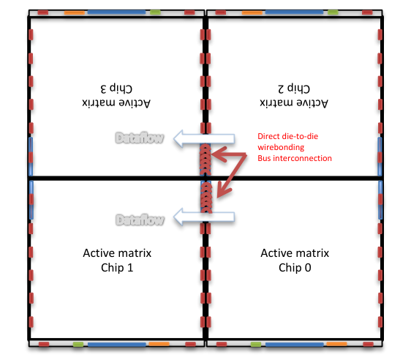
MALTA chip
power pads
allow chip-to-chip bonding

Slide 23
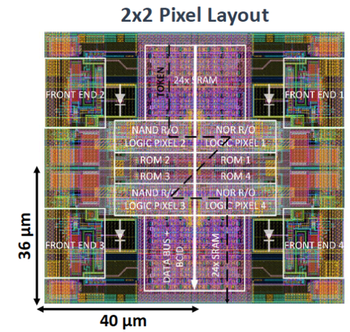
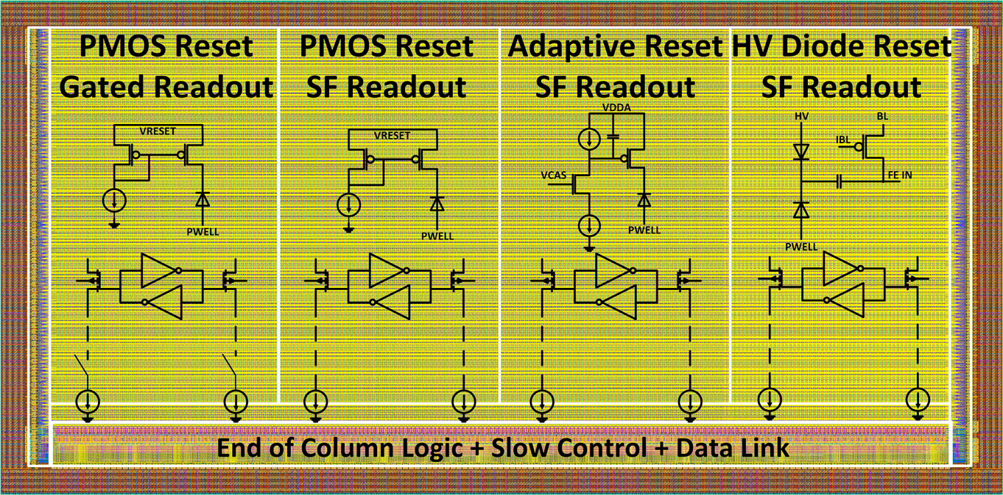
TJ MonoPix
1 x 2 cm² chip (224 x 224 pixels)
Column drain readout
4 sectors with different pixel flavors
Improved low power column bus readout
Standard PMOS input reset
Adaptive input reset (leakage compensation)
Frontside HV biased, AC coupled pixels
T. Wang et al 2018 JINST 13 C03039
Pixel size 36 μm x 40 μm
Low threshold dispersion, no in-pixel tuning
ToT charge information
Analog power < 1 μW per pixel (65 mW/cm²)
Digital power (Layer 4) ≈ 100 mW/cm²

Slide 24
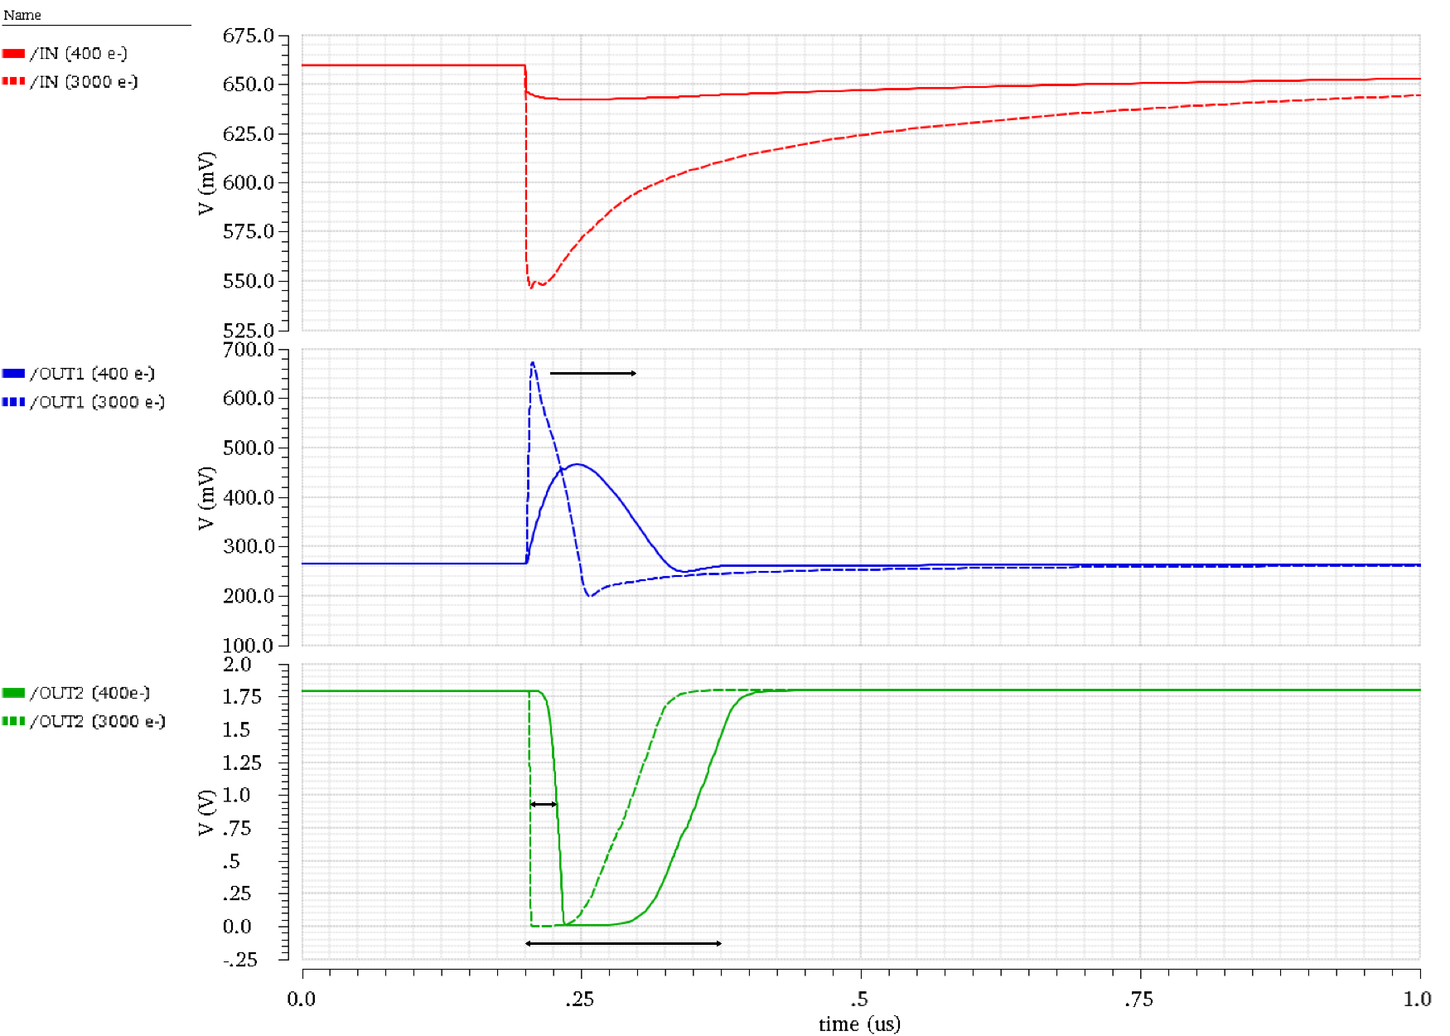
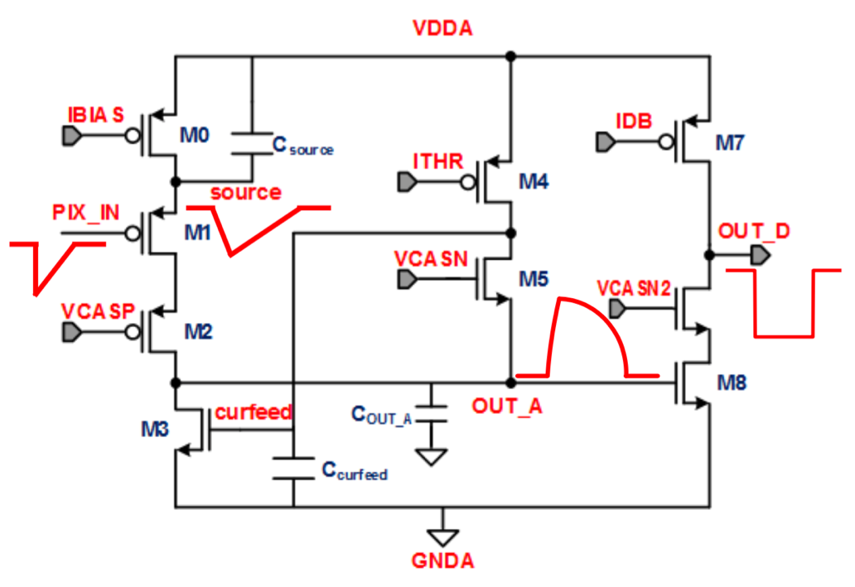
Front end optimization (simulation)
sensing node
pulse duration clipping (MALTA)
amplifier output
time walk
discriminator output
dead time
I. Berdalovic et al 2018 JINST 13 C01023

Slide 25
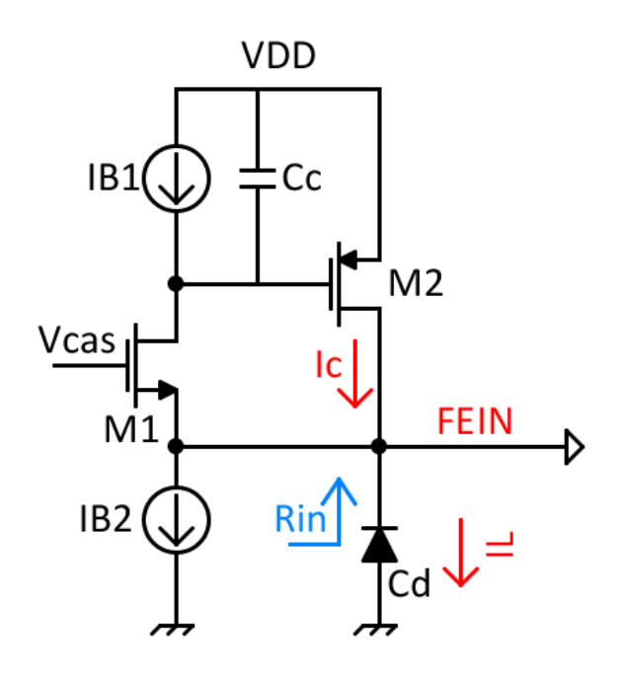
Adaptive PMOS reset
Circuit for reseting input in some pixel flavors
At high frequencies (hit)
fast input Reset
adjustable
At low frequencies (leakage)
Low frequency feedback
Compensate for I_{L}
Stability has to be guaranteed

Slide 26
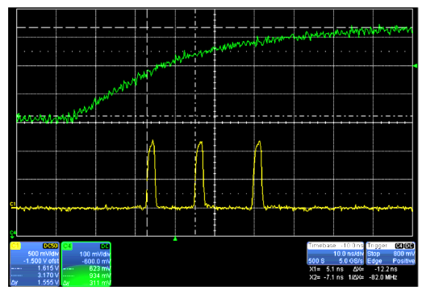
MALTA propagation delay
analog output of one of the pulsed pixels
Reference signals (asynchronous 2 ns pulse for each hit)
Measured delay between first two pulses 12.2 ns
Propagation delay of asynchronous signals through double column bus up to 8 ns

Slide 27
MALTA ⁵⁵Fe spectrum
Analog output from the front end
Separation between K_{α} and K_{β} lines before and after irradiation
Front end configuration not the same → signal size not directly comparable

Slide 28
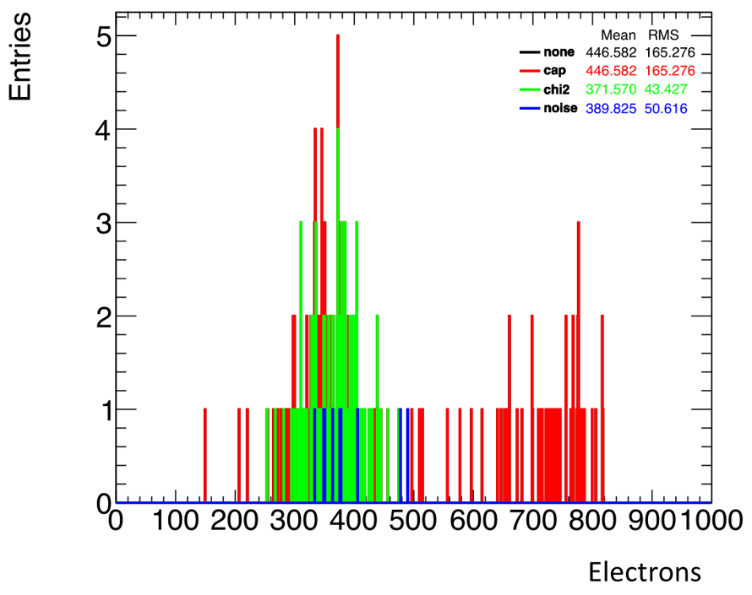
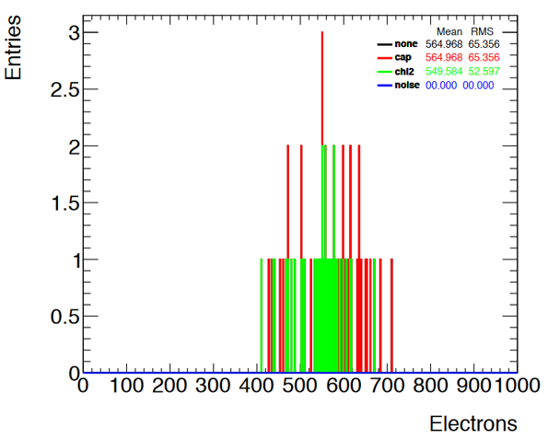
MALTA threshold
Measurement of S-curves by electronically injecting charge in the front end
Charge calibration calculated from injection capacitance
Without fully functional slow control difficult to measure correctly
Fit error function and make a χ² cut on fit quality
Analyzing only S-curves which passed the cut
Samples (unirradiated):
W4R7 – Jan 2018
W6R6 – Jul 2018
Thresholds
371 e⁻ ± 43 e⁻ (W4R7)
550 e⁻ ± 53 e⁻ (W6R6)
10 % threshold spread
calibration verification necessary, f.e. ⁵⁵Fe
After irradiation noise level increases substantially
high pulse amplitude
entries
W4R7
W6R6

Slide 29
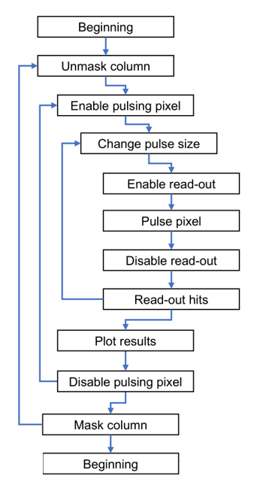
MALTA threshold scan
Chip status
Merger is disabled, therefore high traffic in the output will resolve in incorrect reconstruction
Each slow control command is preceded by lowering VDD to 1.2V and followed by raising VDD to 1.8V
Cannot mask top half pixels
Fixed threshold settings (IMON2=1.3 V)
Algorithm
Mask all the chip
Unmask selected column
Enable pulsing on selected pixel up to row 20
Change pulse size
Enable read-out, pulse, disable read-out
Repeat 500 times
Readout all hits in buffer
Only selected pixel + row 251 and 511 should respond

Slide 30
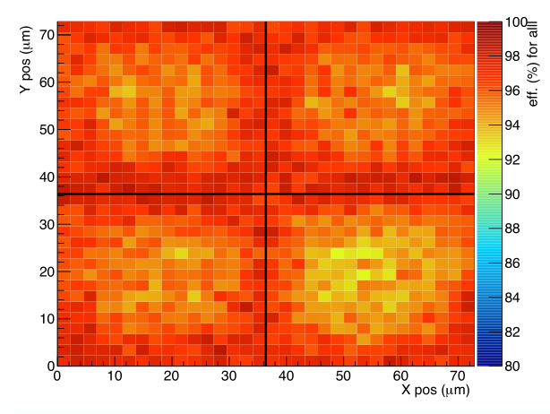
MALTA test beam unirradiated
In-pixel efficiency map (2 x 2 pixels), unirradiated, low threshold
Optimal HV bias configuration SUB -15 V, PWELL -6 V
Sample W6R6 (Jul 2018)
Lower (93 %) efficiency in centers
Threshold is higher
Efficiency loss in center when signal is low
Shared hits on edges – higher probability to detect at least one of two hits
Overall efficiency > 96 %
Sample W4R7 (Jan 2018)
Lower (90 %) efficiency in corners
Overall efficiency > 96 %
Discrepancy between samples likely due to difference in threshold level, since process is unchanged

Slide 31
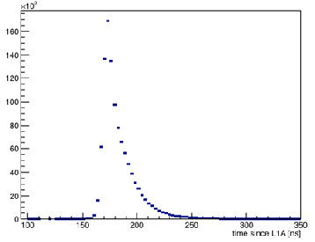
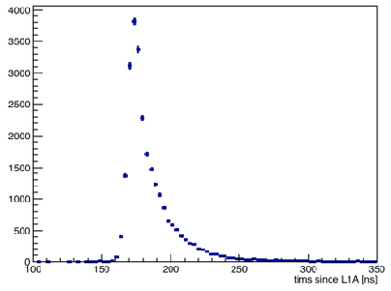
MALTA hit timing
unirradiated sample
Time of arrival for hits matched with a track
Peaked distribution as expected
In-time efficiency ignored for now
Time of arrival for hits not matched with a track
For noise expecting uniform distribution
Indicates false hit reconstruction due to data collisions (merger circuit is disabled !)
Detection efficiency can be increased by improvement of electronical sector
Masking individual pixels → remove noisy pixels
Per pixel threshold tuning ?
Merger circuit

Slide 32
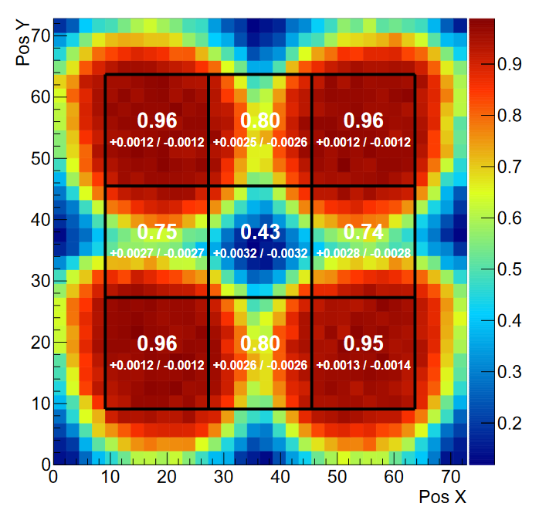
MALTA test beam irradiated
1e15 n_{eq}/cm² neutron irradiated sample (first submission)
IMON2 = 1.30 V
IMON2 = 1.38 V
PosY (μm)
PosY (μm)
(moderately)
high threshold
avg eff. 72 %
low threshold
avg eff. 74 %
2 x 2 pixels
PosX (μm)
PosX (μm)
At a higher threshold:
Efficiency in corners reduces (expected)
Efficiency in centers increases: Lower noise level → smaller probability for data collisions due to disabled merger

Slide 33
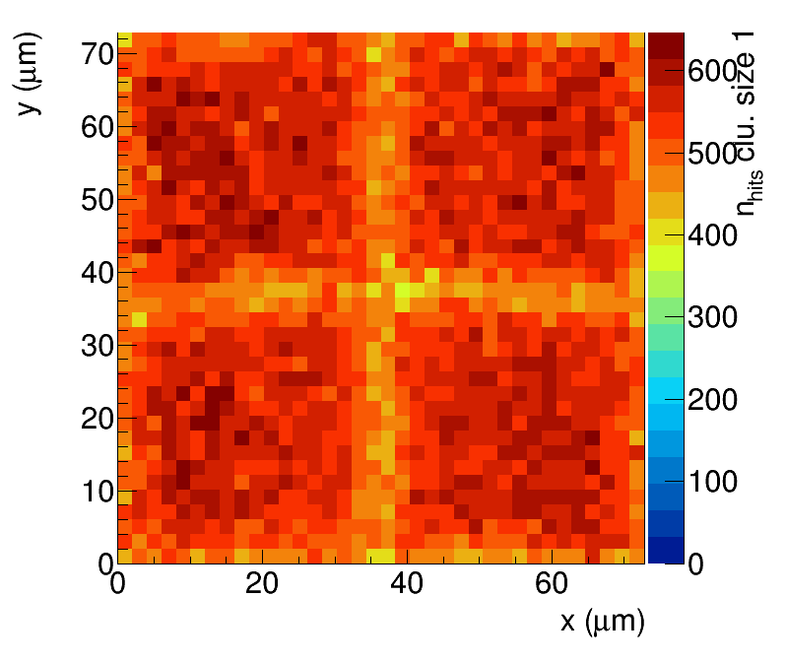
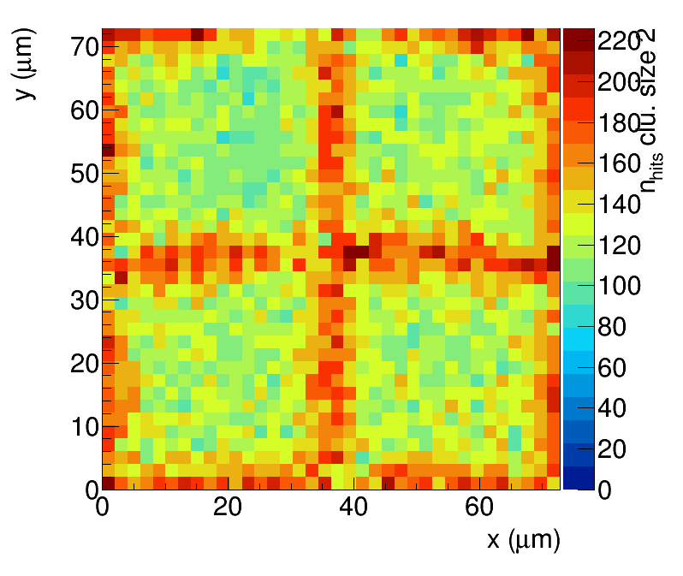
MALTA test beam irradiated
In-pixel cluster size
Cluster size 1
Cluster size 2
Cluster size > 2
1e15 n_{eq}/cm² neutron irradiated sample (first submission)

Slide 34
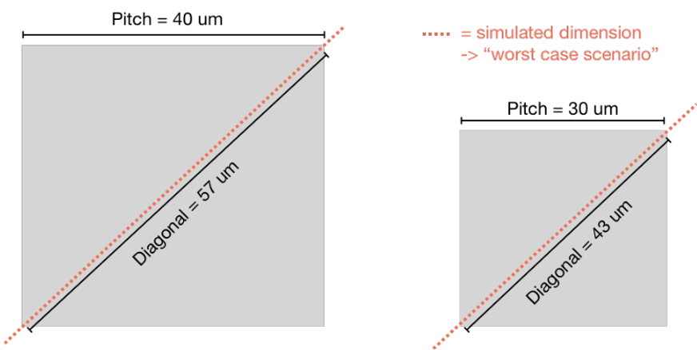
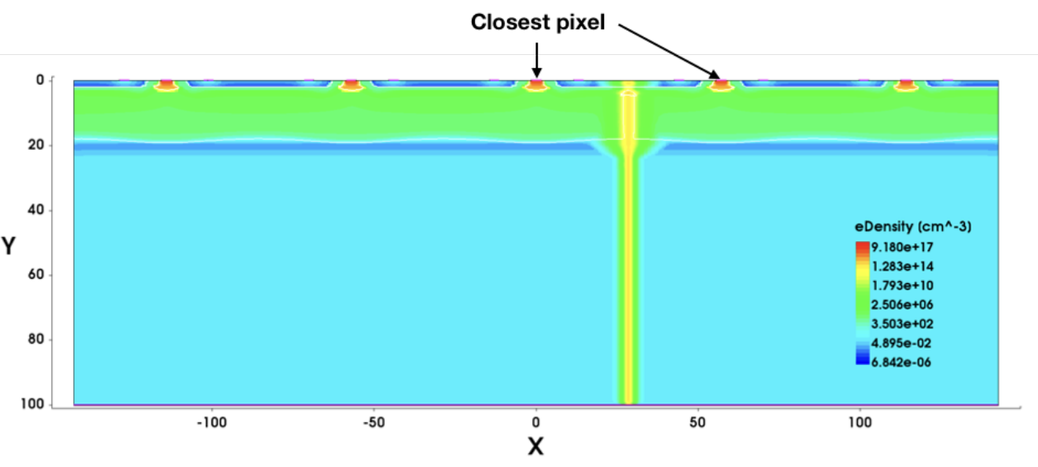
Device simulation
Simulation by M. Münker, Bonn
First TCAD Simulation of charge collection after irradiation
2D simulation for simplicity, 3D in progress
Simulation in the plane on the diagonal between two pixels ("worst case")
Charge injected in the corner between four pixels

Slide 35
Device simulation model
Physics ( material = "Silicon" ) {
Traps (
( Acceptor Level fromCondBand Conc=@<fluence*1.613> @ EnergyMid=0.42 eXsection=1E-15 hXsection=1E-14 )
( Acceptor Level fromCondBand Conc=@<fluence*0.9> @ EnergyMid=0.46 eXsection=5E-15 hXsection=5E-14 )
( Donor Level fromValBand Conc= @<fluence*0.9> @ EnergyMid=0.36 eXsection=3.23E-13 hXsection=3.23E-14 )
# fromCondBand: relative to the conduction band
# Conc: N_0 of radiation level (different energetic distributions of traps, e.g. exponential)
# EnergyMid: defines the energy level with respect to the defined reference level (in this case relative to the conduction band)
# The factors after the fluency are the “introduction rate” -> rate of defect levels produced for a certain dose)
}
Parameters (from: IEEE Trans.Nucl.Sci. 63 (2016) 2716-2723, DOI: 10.1109/TNS.2016.2599560)

