Slide 1
First beam test results with BCM' at CERN
RD42 Workshop 2018, Ljubljana, Slovenia, 13. 11. 2018
Bojan Hiti (Jožef Stefan Institute, Ljubljana, Slovenia)

Slide 2
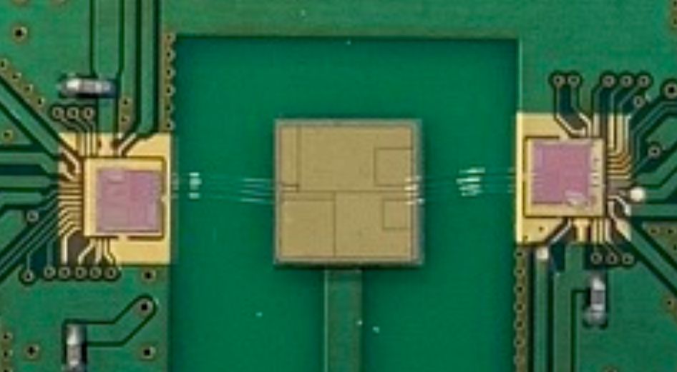
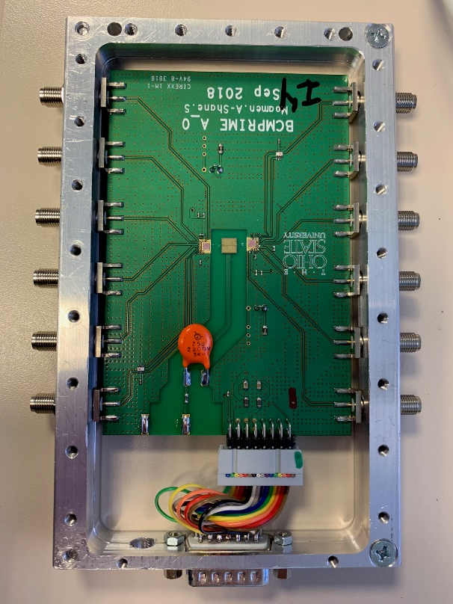
BCM' chip
BCM': Readout ASIC prototype for ATLAS Beam Condition Monitor (BCM) upgrade for HL-LHC
Analog front end with 4 readout channels
Current amplifier, fast pulses (baseline restored after < 25 ns)
Two BCM' wire bonded to a specially segmented diamond sensor
Large pitch bump bonding also considered to reduce capacitance
Chip configuration with external DACs via a Labview interface
[2, 4]
[1, 2]
[1, 1]
Chip 2
[2, 3]
Chip 1
[2, 2]
[1, 3]
[1, 4]
[2, 1]

Slide 3
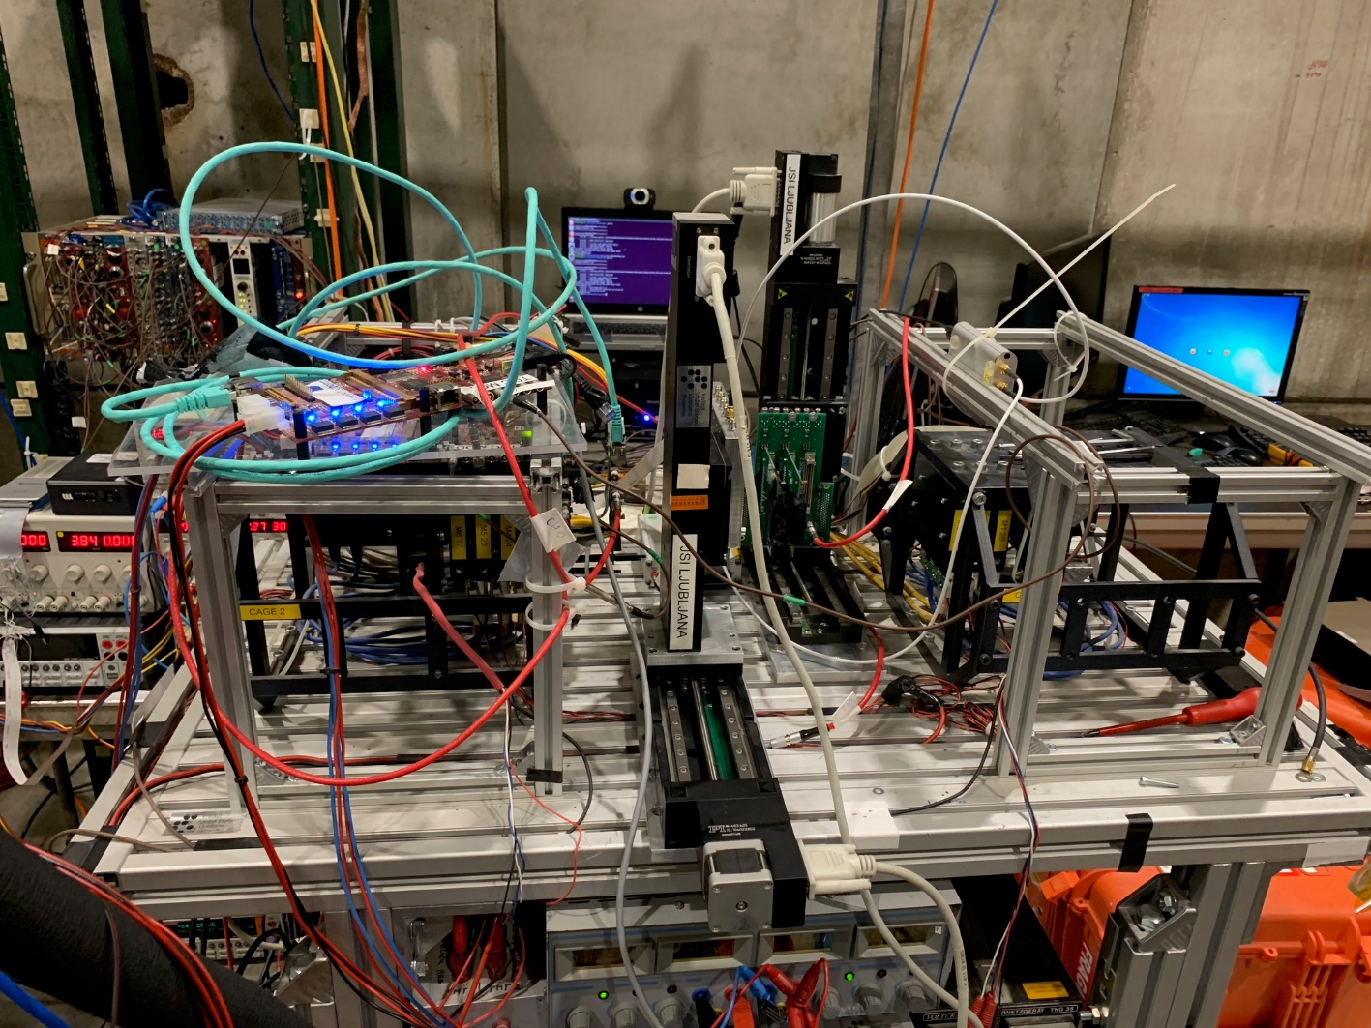
CERN H6 test beam
CERN SPS H6 test beam: 120 GeV hadrons
Mimosa beam telescope
6 mimosa planes for tracking
1 FEI4 module for timing and region of interest (ROI) trigger
Tracking resolution ≈ 3 μm
DRS 4 analog readout
3 GS/s acquisition rate, 700 MHz bandwidth
Recorded one channel per chip per run – two channels per run
Dataset:
All channels measured (separate runs)
All tests done with one version of front end configuration
+ 1000 V bias voltage
200k telescope triggers per channel → 60k tracks
DUT
3 planes + timing + ROI
3 planes

Slide 4
Trigger
Acquisition triggered by the FEI4 module
ROI to trigger only on tracks through the active area
ROI determined in a test run by self triggering on the DUT
[2, 4]
[1, 2]
[1, 1]
[2, 3]
[2, 2]
[1, 3]
[1, 4]
HitOR
ROI
[2, 1]
FEI4 ROI
DRS4
Telescope
Example ROI:
(chip 1, ch. 1) + (chip 2, ch. 1)
read out FEI4

Slide 5
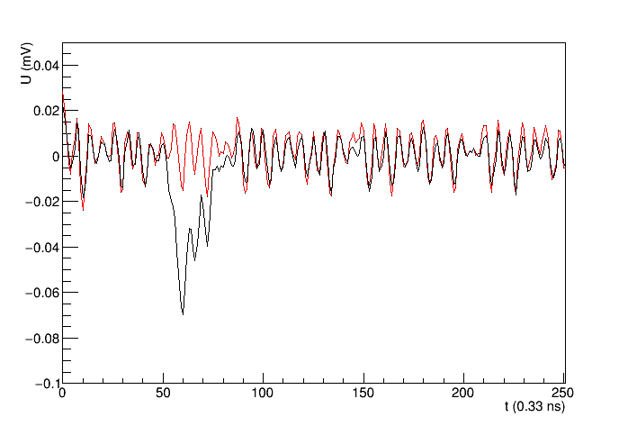
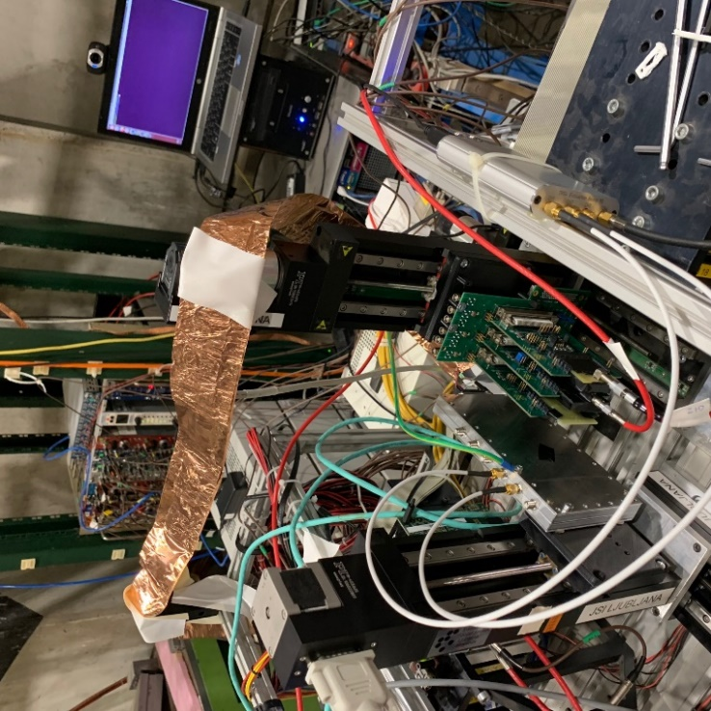
Noise/pick up problems
High electronical pick-up level in the test beam environment
noise RMS ≈ 10 mV
signal MPV ≈ 20 mV
Influenced by the cable connecting the DUT and the NI configuration unit
S/N was improved by running at a lower supply voltage 1.2 V → 1.0 V
Single event waveform
U (V)
charge 20 mV
(Landau tail)

Slide 6
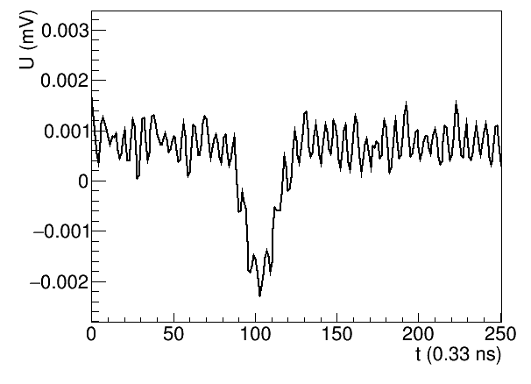
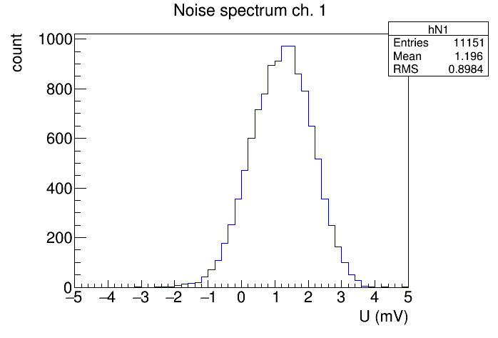
Charge measurement
Average waveform of 1000 acquisitons
Select an integration window around the peak [t_{min}, t_{max}] (typically [– 6 ns, 6 ns])
Signal = Integral around the peak
Hit criterium for efficiency measurement:
signal > 3σ above noise
Average of 1000 waveforms
integration
window – signal
integration
window – noise
$$S=\frac{1}{t_{\max{ }}− t_{min}}\int_{t_{\min{ }}}^{t_{max}}{Udt}$$
Noise spectrum
baseline offset
+3σ

Slide 7
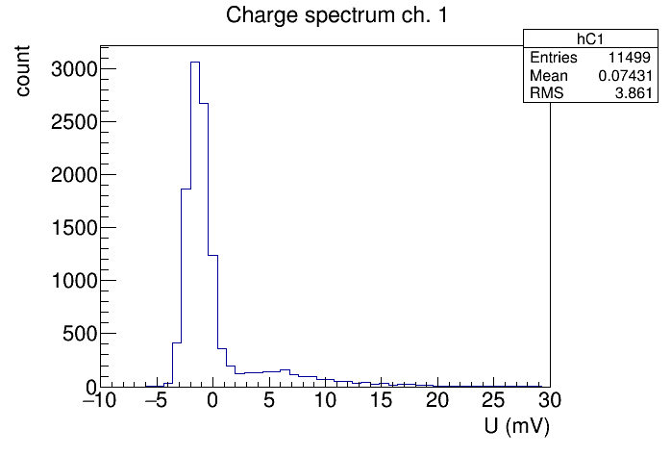
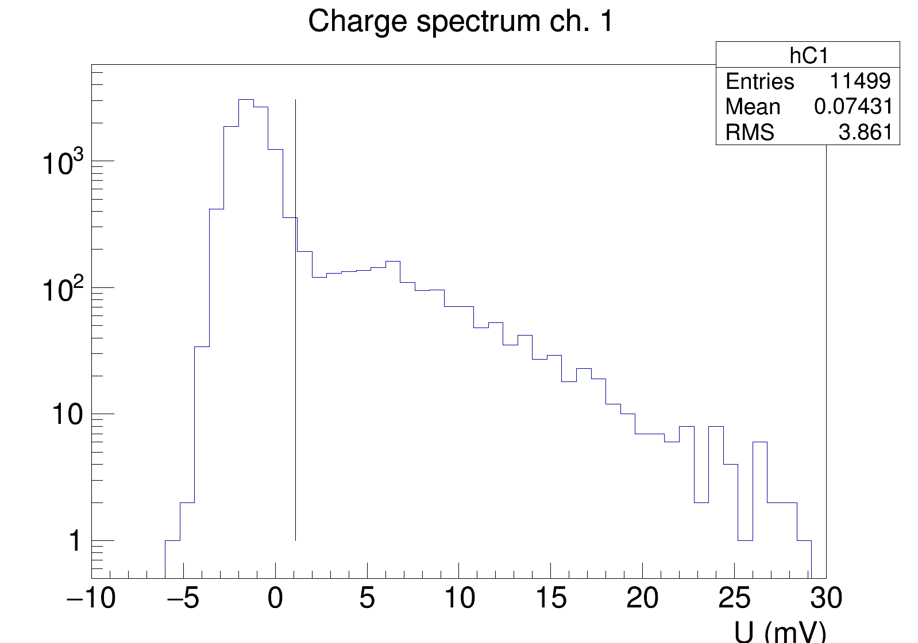
Charge spectra
Chip 1, channel 3 (runs 1154 – 1155)
Very preliminary!
Chip 2, channel 1 (run 1149)
discriminating
threshold
Very preliminary!
Looks like best case of all channels
+1000 V bias voltage

Slide 8
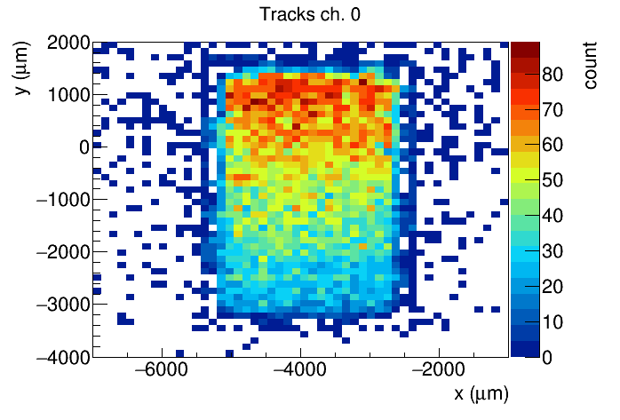
Efficiency maps
Tracks, Chip 1, channel 3
Efficiency, Chip 1, channel 3
Very preliminary!
Very preliminary!

Slide 9
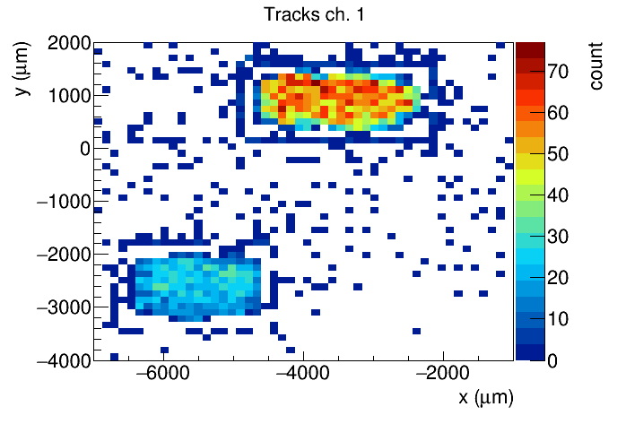
Efficiency maps
Tracks, Chip 2, channel 1
Efficiency, Chip 2, channel 1
Very preliminary!
Very preliminary!
cross talk?
ROI over two structures: chip1, ch. 1 + chip2, ch. 1
Indications of cross talk between the channels

Slide 10
SAMPLE 2

Slide 11
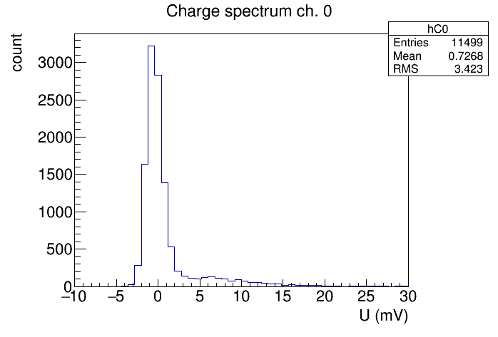
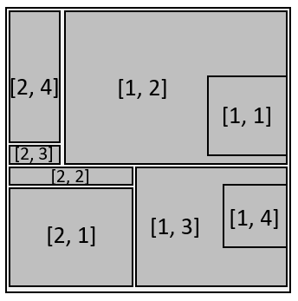
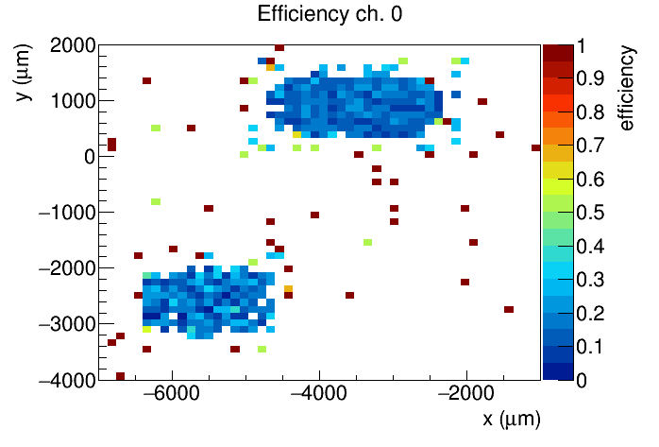
Channel 1
Spectrum chip 1, ch. 1
Spectrum chip 2, ch. 1
Very preliminary!
Very preliminary!
Uniformity chip 1, ch. 1
Uniformity chip 2, ch. 1
Problem with response uniformity: no differentiation of the test structure
Cross-talk ?
Problem with telescope synchronization ?

Slide 12
Channel 2
Spectrum chip 1, ch. 1
Spectrum chip 2, ch. 1
Uniformity chip 1, ch. 1
Uniformity chip 2, ch. 1
Problem with response uniformity: no differentiation of the test structure
Cross-talk ?
Problem with telescope synchronization ?

Slide 13
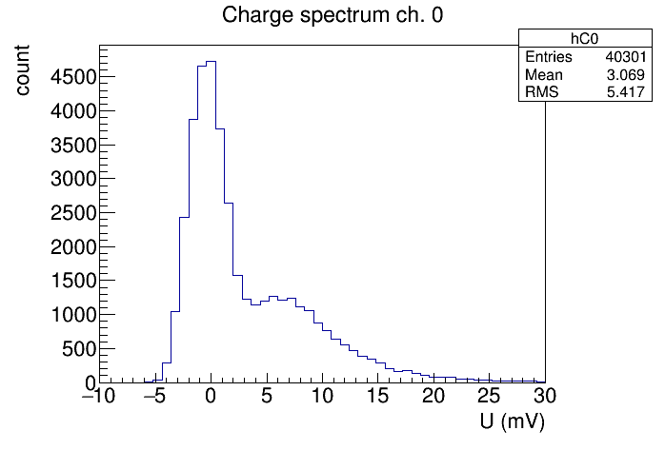
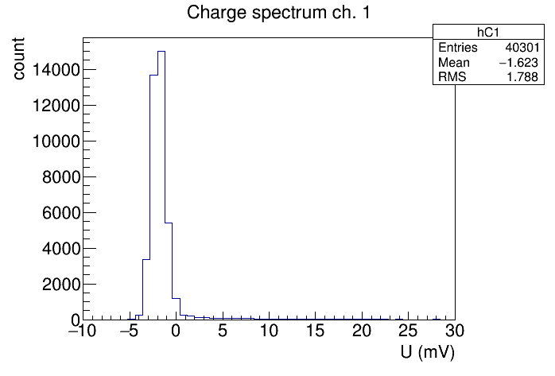
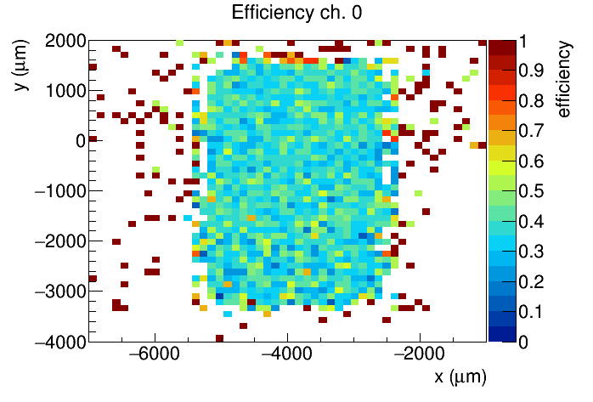
Channel 3
Spectrum chip 1, ch. 3
Spectrum chip 2, ch. 3
Very preliminary!
Very preliminary!
Uniformity chip 1, ch. 3
Uniformity chip 2, ch. 3

Slide 14
Channel 3
Spectrum chip 1, ch. 3
Spectrum chip 2, ch. 3
Uniformity chip 1, ch. 3
Uniformity chip 2, ch. 3

Slide 15
Summary
First test of the BCM' in the beam
Basic functionality established:
Chip is programmable, sometimes oscillations occur if > 1 channel enabled
Signals observed → we see first spectra
High electronical pick-up → Care with cable shielding is required
Lessons learned:
We collected experience with handling the chip in the test beam → see next talk for latest results at PSI
Some effort still required to process and extract all information from the data → in progress

