Slide 1
Results of TCT and Sr-90 measurements with ATLAS17LS detectors
Igor Mandić, Vladimir Cindro et al.,
Jožef Stefan Institute, Ljubljana, Slovenia
ATLAS Upgrade Week, CERN, November 2018

Slide 2
Motivation
results of measurements with A17LS mini detectors irradiated with 28 MeV protons at Birmingham
See presentation at Itk week in Oxord:
https://indico.cern.ch/event/726191/contributions/3151464/attachments/1722835/2782344/ITkStripSensors_MS3-tests_2018-09-26_v4.pdf
Measurements from Birmingham:
after irradiation with 5e14 n/cm² protons at Birmingham:
  ➔ low collected charge
  ➔ large cluster size

Slide 3
Motivation
results of measurements with A17LS mini detectors irradiated with 28 MeV protons at Birmingham
See presentation at Itk week in Oxord:
https://indico.cern.ch/event/726191/contributions/3151464/attachments/1722835/2782344/ITkStripSensors_MS3-tests_2018-09-26_v4.pdf
Results from Santa Cruz (Sean Riedel, Cole Helling et al.)
For proton-irradiated sensors (Birmingham) see a charge deficit for fluences>= 5e14 neq/cm^2
•Gets worse after annealing.
•CYRIC-irradiated sensor after annealing looks ok.

Slide 4
Samples and measurements
Devices irradiated with protons 28 MeV at Birmingham:
ATLAS17LS mini strip detector (W32, mini 8) to 5e14 n/cm² → Edge–TCT and Top-TCT
8 mm x 8 mm diodes
→ I-V (1e14 and 5e14)
→ charge collection measurements with Sr-90: 1e14 (W30, 1-3), 5e14 and 1e15 (W29, 1-2) and
2e15 (W32,1-3)
ATALS17 LS mini strip detectors irradiated to 5e14 at CYRIC (W12, mini8), and CERN PS (W36, mini2)→ TCT

Slide 5
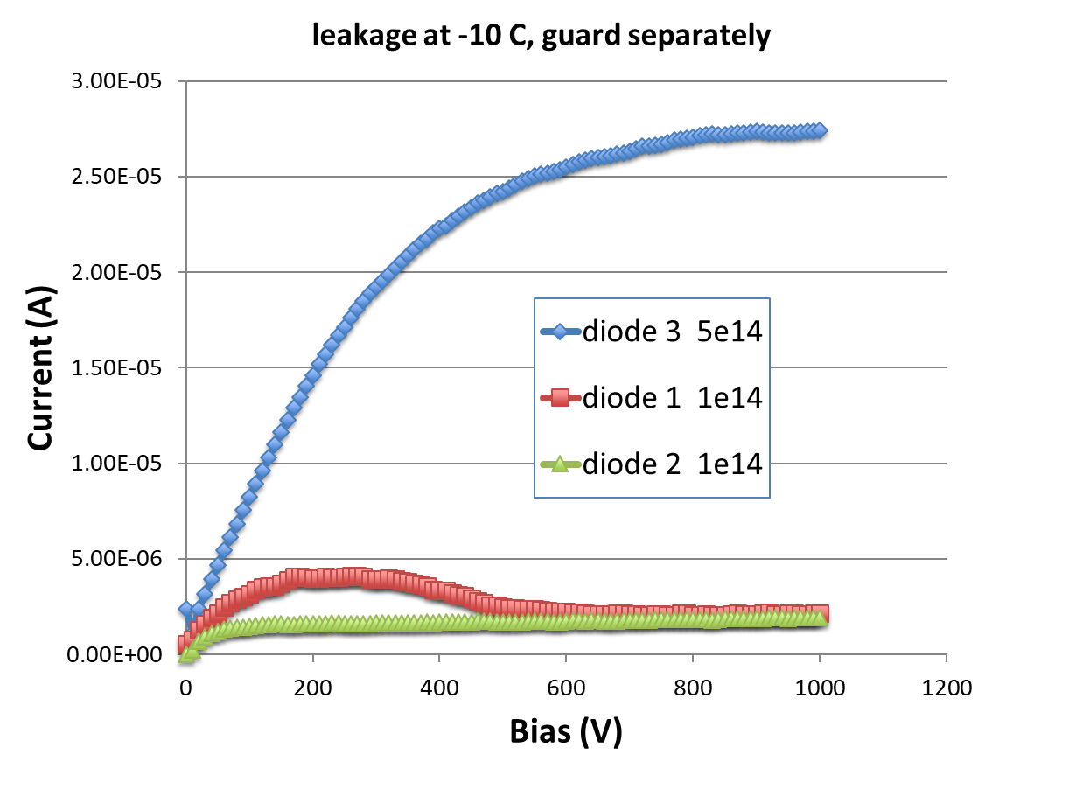
I-V measurements (Vladimir Cindro)
measured with 8 x 8 mm² diodes irradiated in Birmingham
at 700 V extract value of α after annealing for 80 minutes at 60 °C
theoretically expect: 4e-17 A/cm
➔ package was warm when received
➔ detectors annealed for few days at RT during transport
Target fluence 1e14 n/cm²:
Diode 1: α = 2.8e-17 A/cm
Diode 2: α = 2.1e-17 A/cm
Target fluence 5e14 n/cm²:
Diode 3: α = 6.5e-17 A/cm
indicates fluence smaller than target
or too much annealing
or current measurement error
Points to larger than target fluence but:
I-V curve not very nice
current from depleted volume
could be overestimated
➔ fluences ~ OK, may be max. 50% different than target fluences

Slide 6
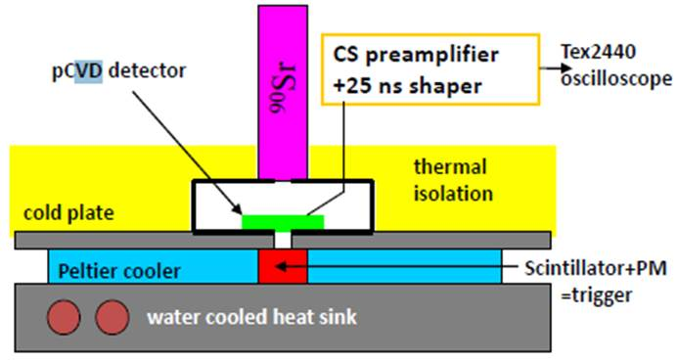
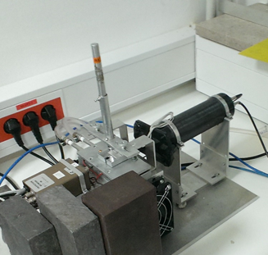
Single channel ⁹⁰Sr setup
ORTEC 142 charge sensitive amplifier + custom made shaper (25 ns)
+ digital oscilloscope
detector
⁹⁰Sr
PMT
ampl.
cooling jig
DUT
ORTEC-142 charge sensitive amplifier + 25 ns shaper
Calibrated with a 300 µm thick Si pad detector
Measured at T = -30°C up to ~ 550 V
➔ measurements of collected charge with diodes

Slide 7
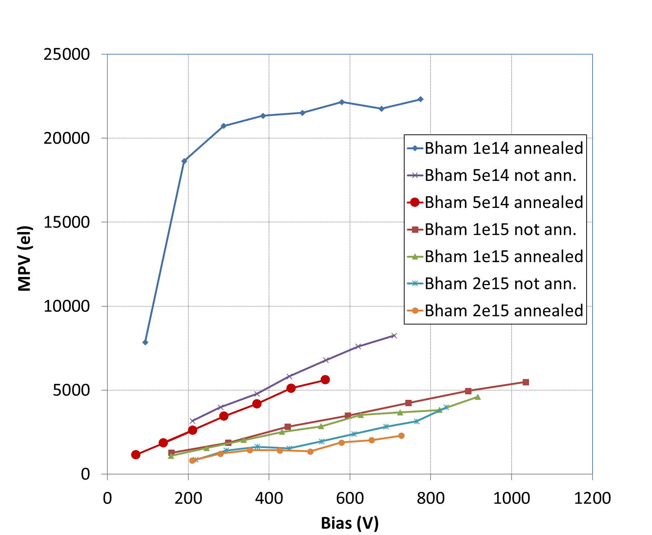
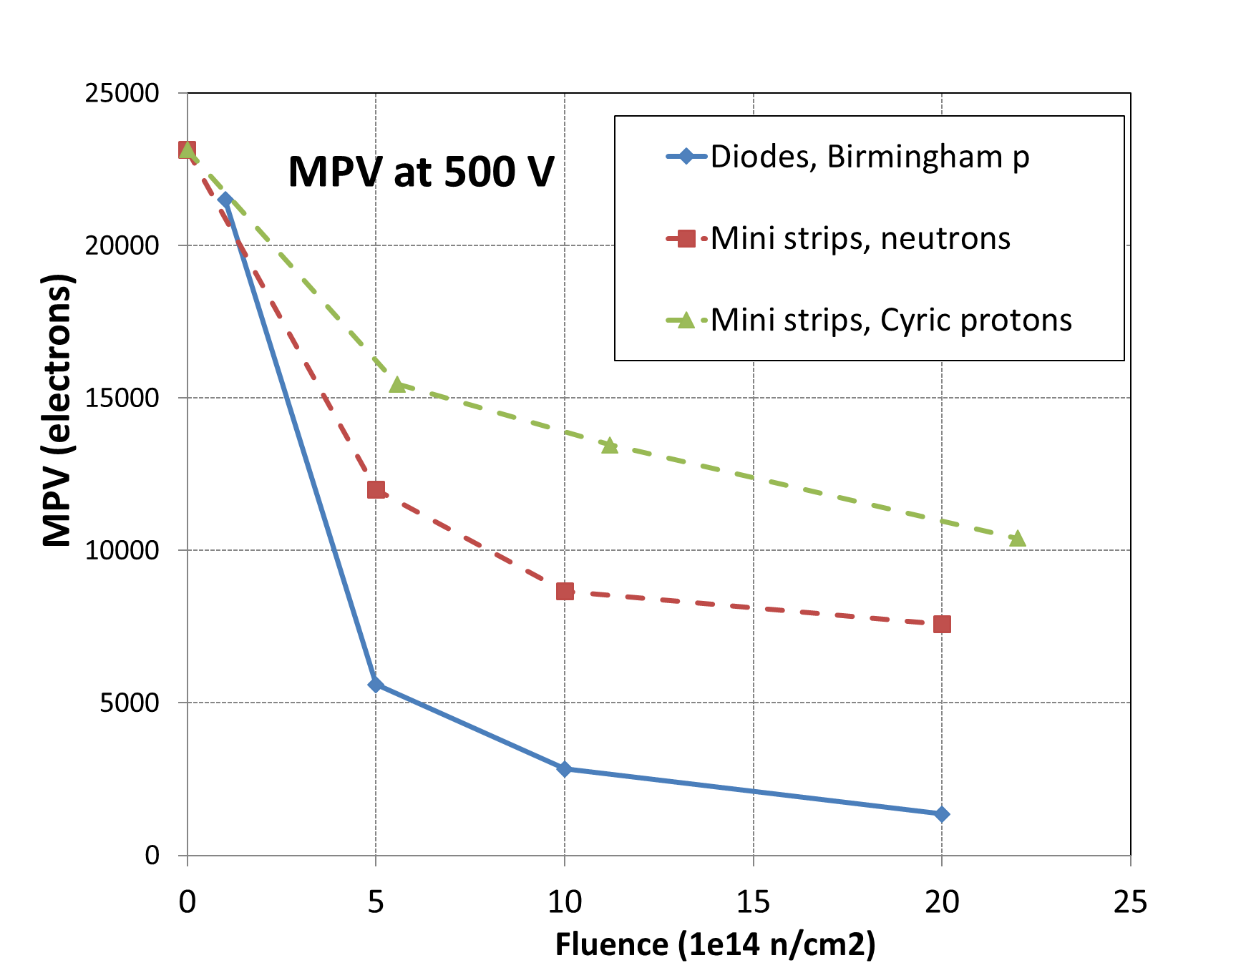
Collected charge, Sr-90, diodes
Results from mini-strips from: V. Cindro, Hiroshima 2017
https://doi.org/10.1016/j.nima.2018.10.007
Diodes (A17LS) irradiated at Birmingham
diode irradiated to 1e14 n/cm² in Birmingham looks OK
diodes irradiated to 5e14, 1e15, 2e15 n/cm² in Birmingham:
  much lower charge than with minis irradiated with neutrons or protons at CYRIC
  (expect somewhat less charge with diodes but the difference should be smaller)
  collected charge drops after annealing for 80 minutes at 60°C
➔ consistent with charge collection measurements with mini strip detectors (Birmingham, Santa Cruz, Toronto)

Slide 8
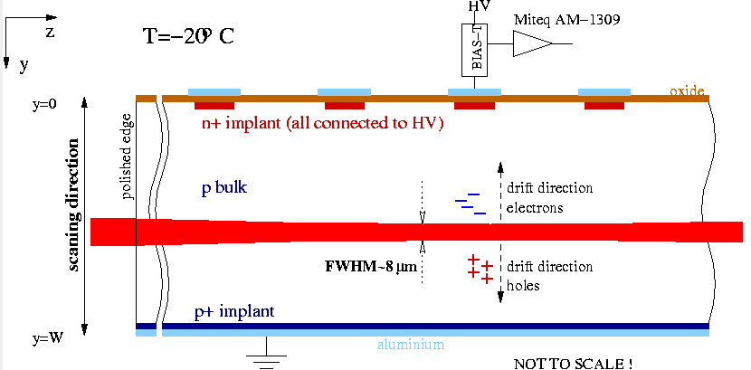
Edge TCT
Velocity profile:
Induced current at t ~ 0 (immediately after the laser pulse) → proportional to carrier velocity at laser spot location
➔ if E not too large, I proportional to E ( E_{w} ~ constant, see: G. Kramberger, et al.,IEEE Trans. Nucl. Sci. NS-57 (2010) 2294.)

Slide 9
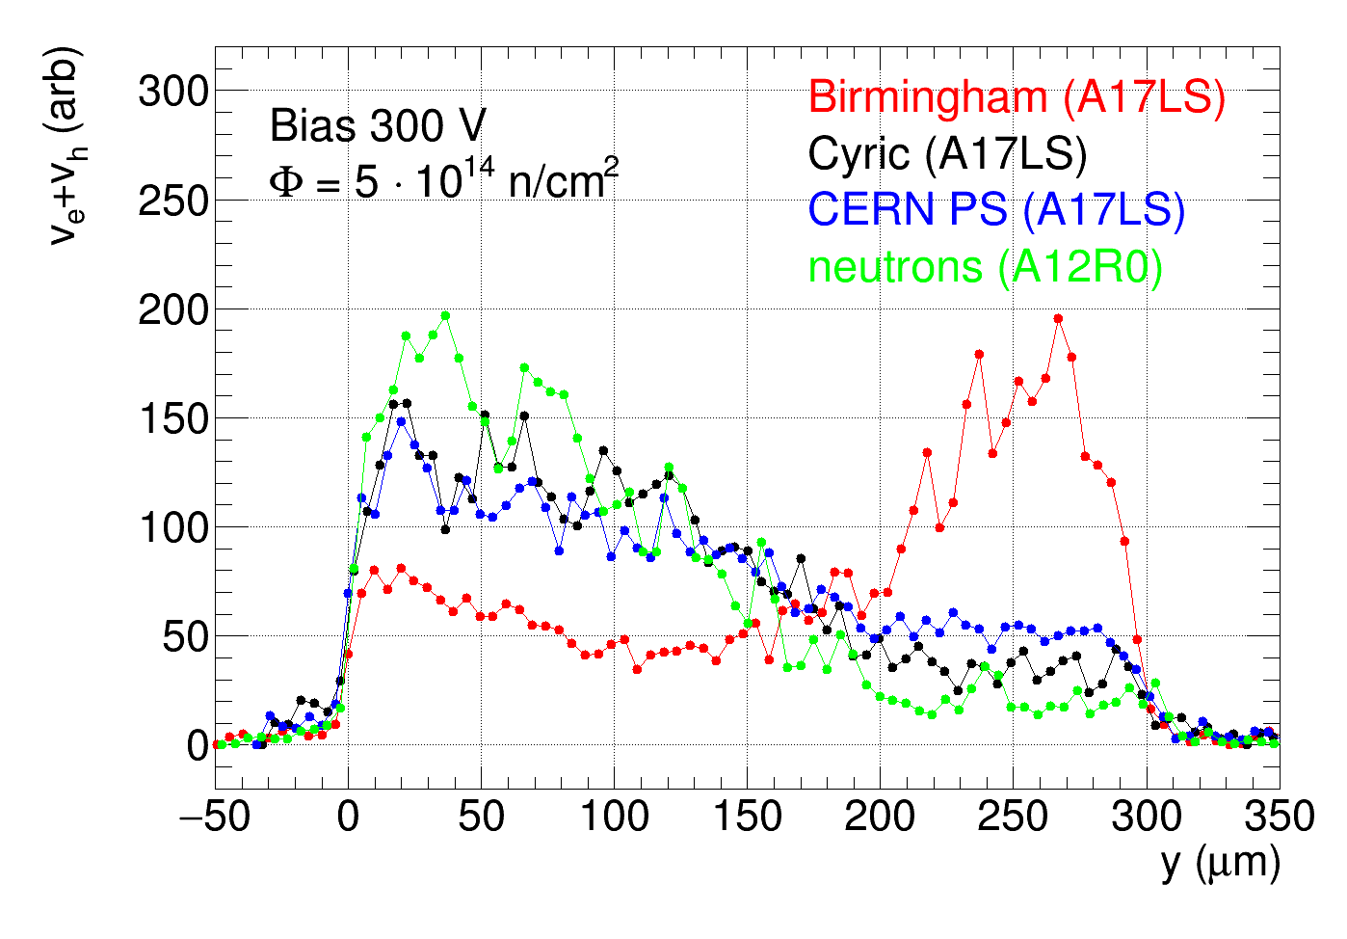
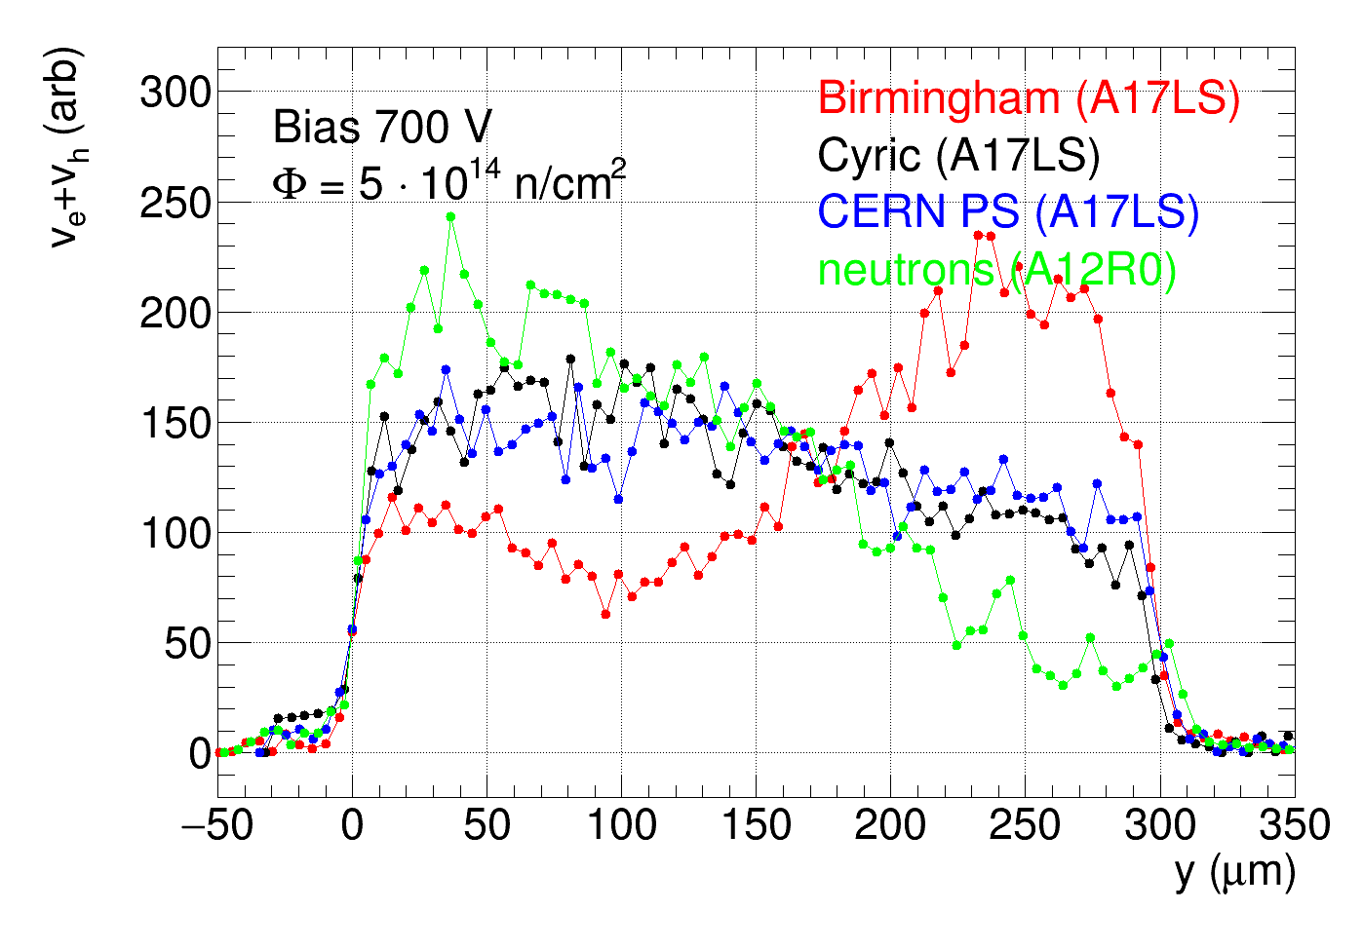
Edge TCT
det. surface
depth
velocity profiles after irradiation at Birmingham very different than after irradiation at CYRIC or CERN-PS or neutrons
➔ high carrier velocity (electric field) near back plane (y = 300 µm)
➔ looks like n-type bulk
CYRIC, CERN-PS and neutron profiles look as expected
➔ differences between protons (CYRIC and CERN-PS) and neutrons can be explained by the oxygen in the substrate material
profile after neutron irradiation measured with ATLAS12EC-R0 mini detectors → same substrate as A17LS

Slide 10
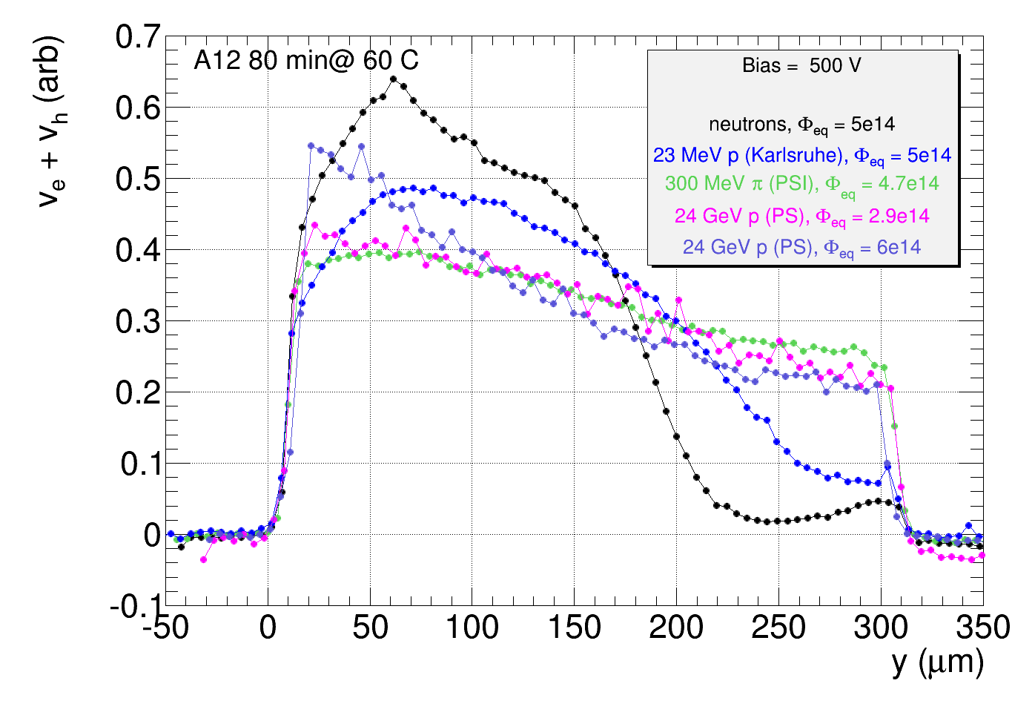
Edge TCT
Measurements with ATLAS12A sensors form 2015
(See e.g.: I. Mandic, ITK strip sensor meeting 20. October 2015, https://indico.cern.ch/event/448475/)
Compare:
neutrons
Karlsruhe protons (23 MeV) ➔ closest to Birmingham protons (28 MeV)
24 GeV protons,
PSI pions (300 MeV)
Effect of Karlsruhe protons most similar to
the effect of neutrons in ATLAS12A sensors
500 V

Slide 11
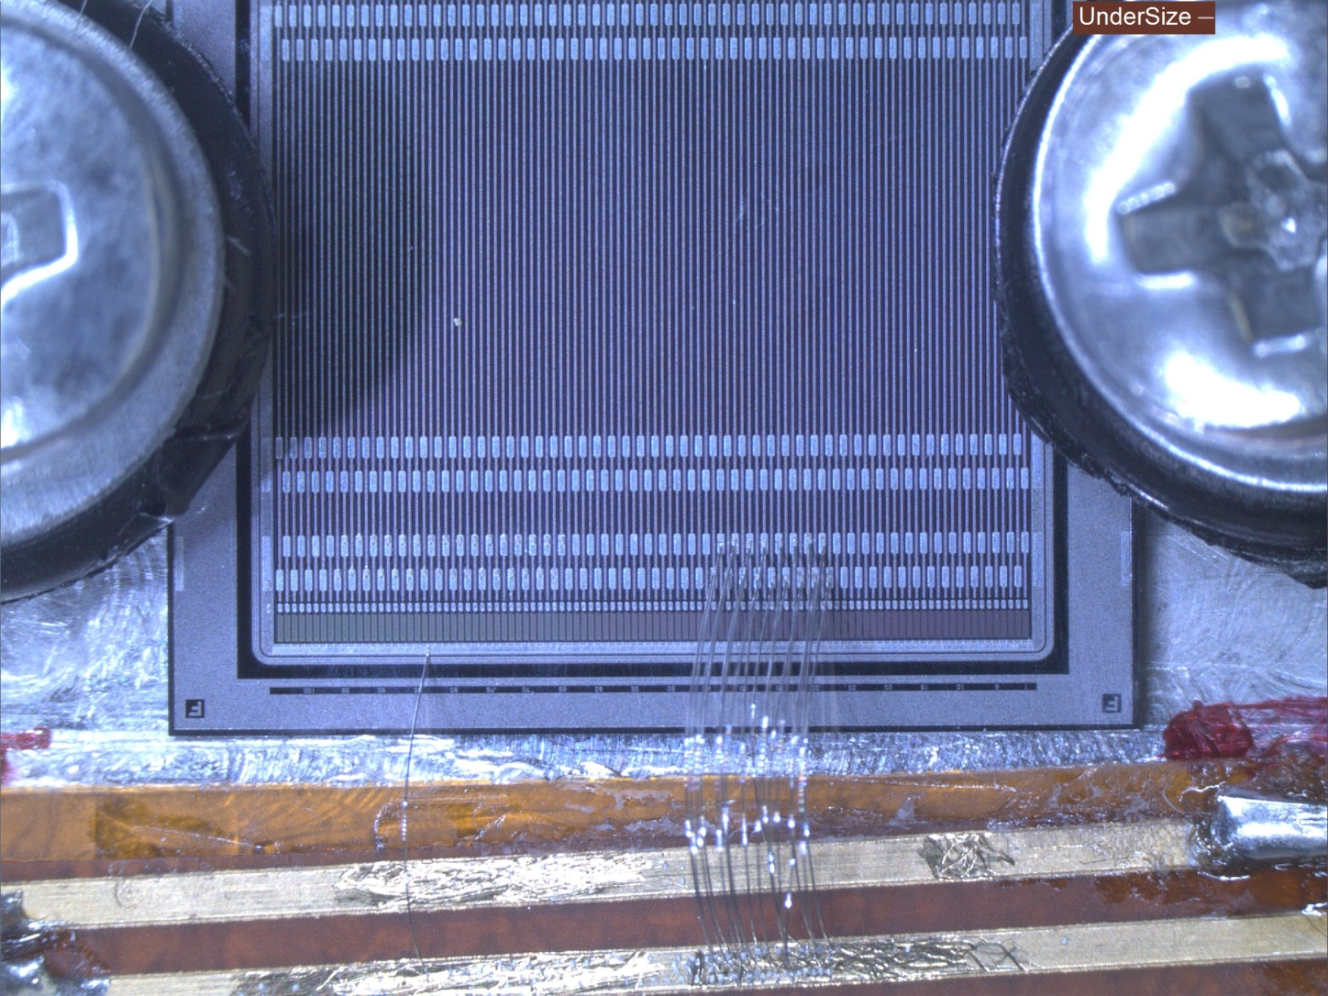
Top TCT
Narrow laser beam directed to the top surface
More detail about Top-TCT in:
Mandić et al., “TCT measurements of
irradiated strip detectors with a focused
laser beam”, 2013 JINST 8 P04016
or slides of RD50 meeting in Bari in2012
https://indico.cern.ch/event/175330/contributions/
283763/attachments/
225128/315042/Mandic_Bari_2012.pdf
Surrounding strips and
bias ring connected to HV supply
One strip connected to amplifier
and to HV via Bias-T
Metal: connected to same potential (HV supply)!
➔ weighting field as when connected to multi-channel readout chip!

Slide 12
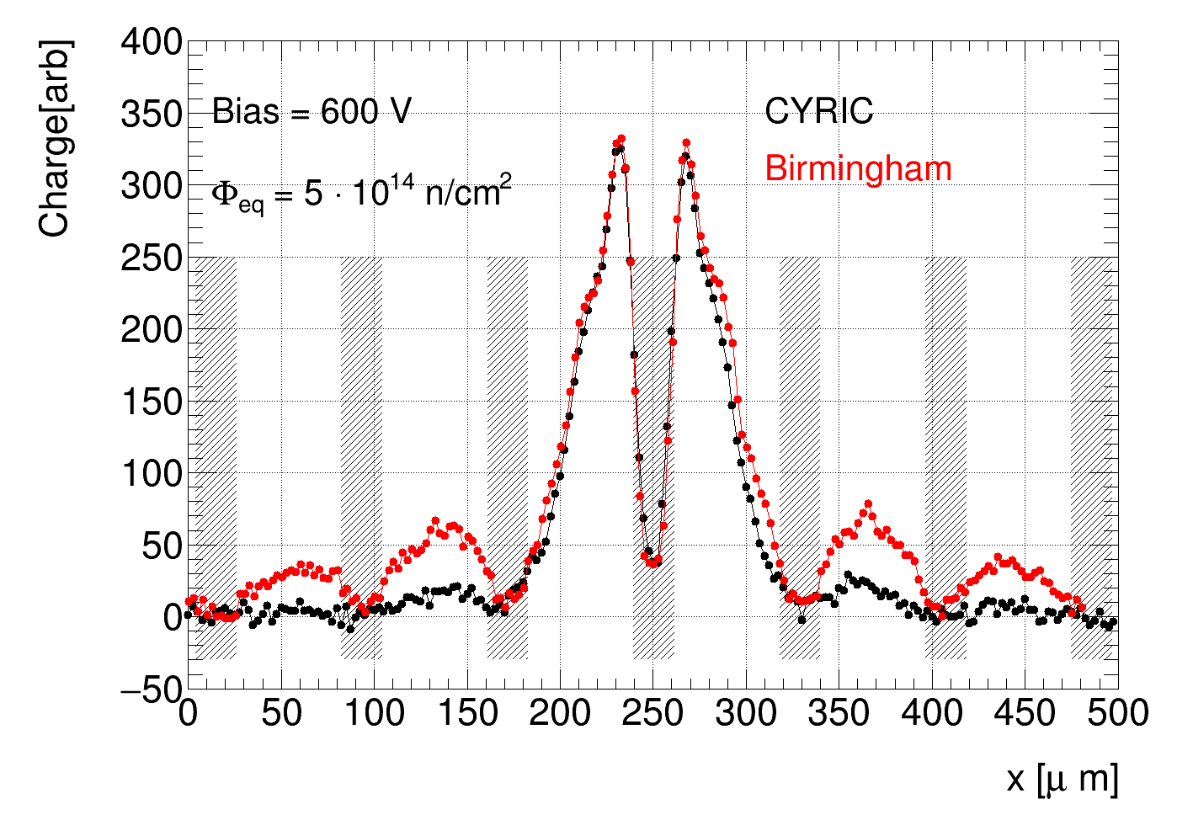
Top TCT
metal on signal strip
connected to the amplifier
Laser beam perpendicular to
detector surface
move the beam in steps across
detector surface perpendicular
to the strips
points show charge collected on signal strip
when laser beam at this point
much larger contribution to the charge on signal strip from carriers drifting far away in detector irradiated in Birmingham
  large charge sharing and therefore large cluster size
  consistent with large field and large charge collection near the back plane seen by Edge -TCT

Slide 13
Conclusions:
unusual behavior of A17LS detectors irradiated with protons in Birmingham → different than after irradiation with neutrons or
protons at CYRIC or CERN-PS
effect of Birmingham protons in this irradiation different than effect of 23 MeV protons in Karlsruhe on ATLAS12A detectors
(measured in2015)
Edge-TCT shows large back side electric field → looks like “type inversion” to n-type bulk
Top-TCT indicates more charge sharing after Birmingham irradiation ➔ consistent with high field at the back seen by E-TCT
Low collected charge measured with Sr-90 with diodes for irradiated in Birmingham to 5e14, 1e15 and 2e15,
drop of charge collection after short term annealing
➔ consistent with charge collection measurements with mini detectors made by other groups
type inversion in p-type material and drop of collected charge after short (beneficial) annealing seen only in epitaxial silicon
irradiated at CERN-PS (e.g. P. Dias de Almeida, RD50 workshop https://indico.cern.ch/event/663851/contributions/2788203/ ,
or Khomenkov et al., 2008 IEEE Nuclear Science Symposium Conference Record, 10.1109/NSSMIC.2008.4774876 )
effects seen in this irradiation not understood ➔ why this behaviour only with Birmingham protons and not with other proton sources?
Outlook:
repeat irradiation of ATLAS17LS minis and diodes in Birmingham

Slide 14
3) Gibljivost nosilcev v visoko obsevanem siliciju

Slide 15
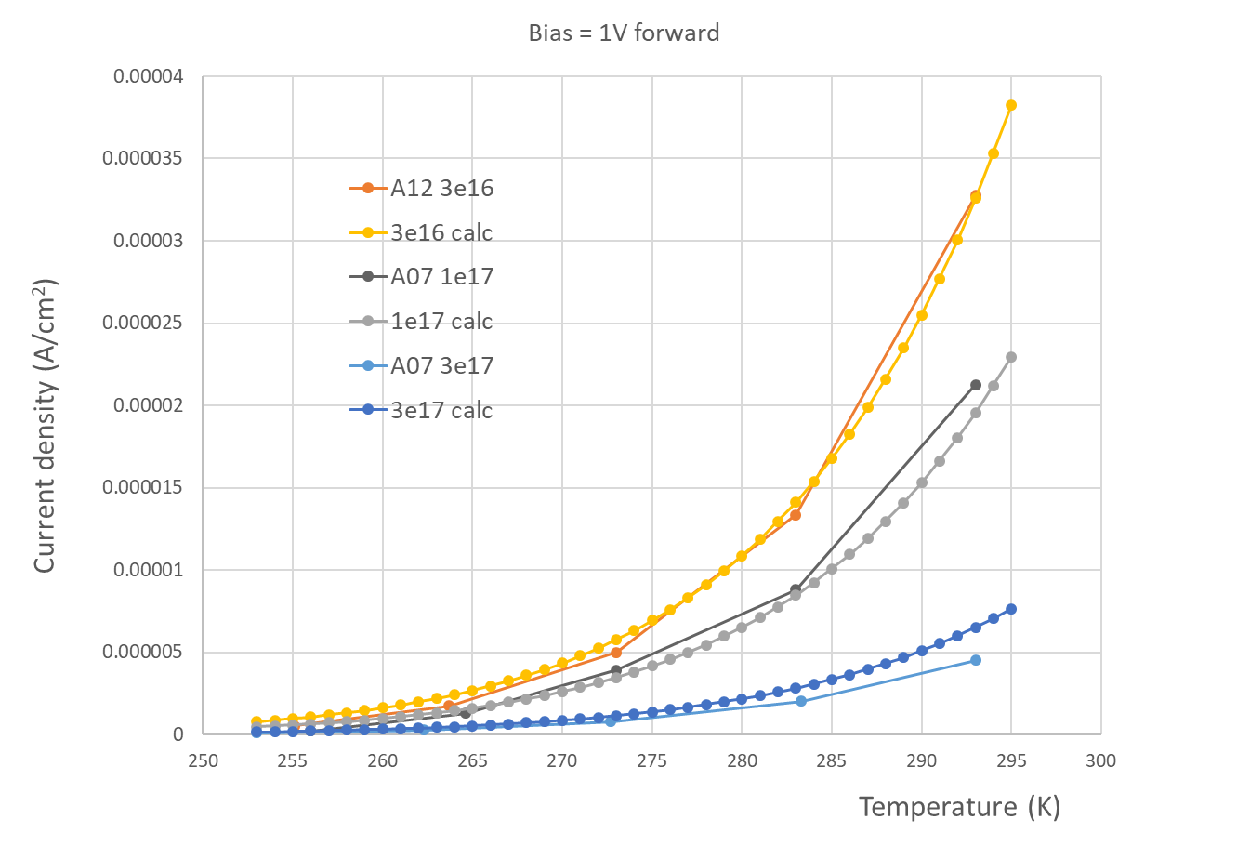
I-V pri 1 V forward
Calculation:
Eg = 1.12 eV
Phi = 3e16
mu_e+mu_h = 1500
Phi = 1e17
mu_e+mu_h = 900
Phi = 3e17
mu_e + mu_h = 300
Gibljivosti večje kot merjeno s TCT

Slide 16
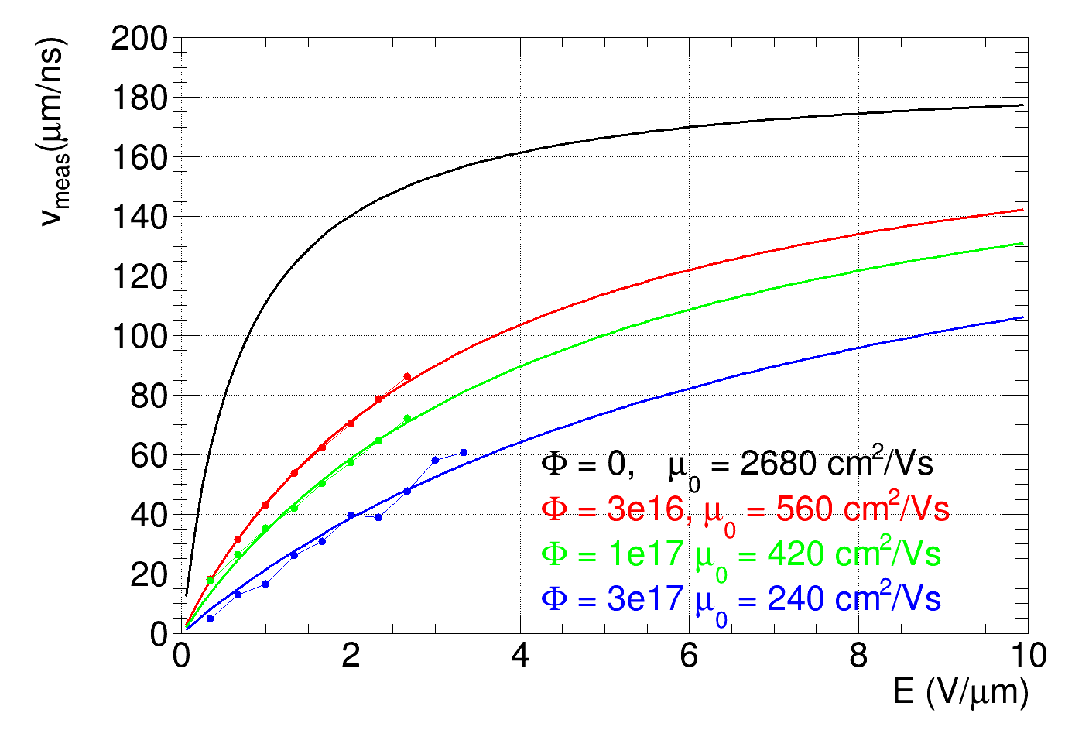
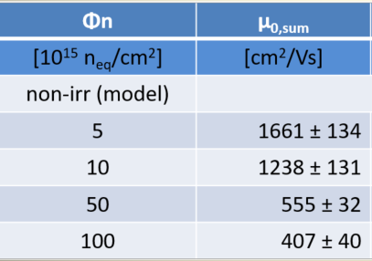
Mobility
Method from M. Mikuž et al.: mobility estimated from velocity profiles in forward bias
Assumptions: 1) electric field in forward bias: E = V/D, (V bias voltage, D detector thickness)
2) saturation velocity v_{sat} = 190 um/ns does not change with fluence,
3) fit with: v = µ₀∙E/(1+µ₀∙E/ v_{sat})
Good agreement with previous measurements!
Table from M. Mikuž et al.:
Preliminary!
Value at 3e17 uncertain → should be interpreted as upper limit
zero field mobility decreases with fluence!
velocity increases linearly with field up to high E

Slide 17
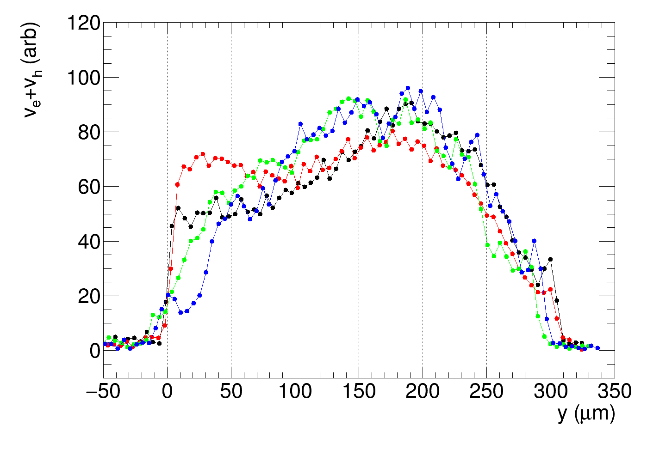
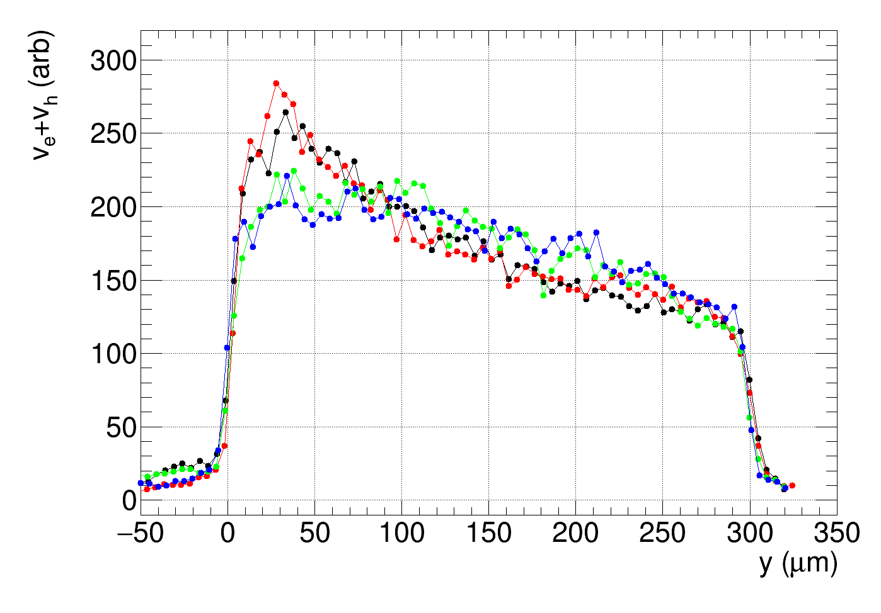
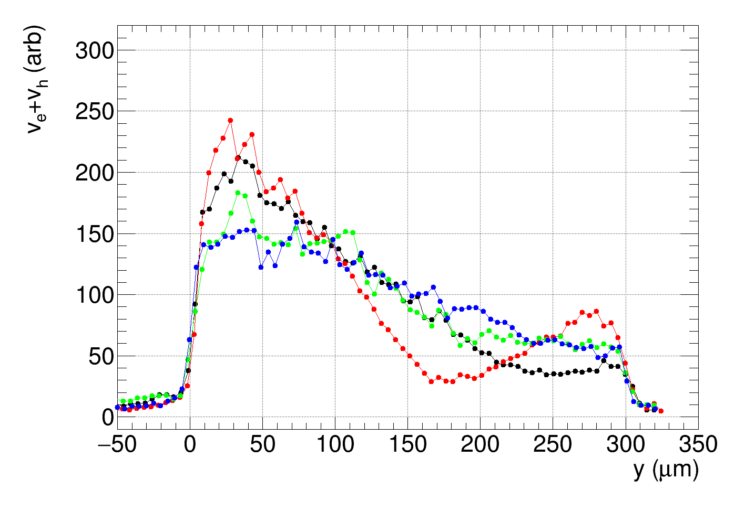
E-TCT, ponovitev meritvev za detector, ki se je čudno obnašal
Merili praktikanti letos poleti
Forward 30 V
1e15, 24 GeV protons
Reverse 1000 V
Revers 300 V

Slide 19
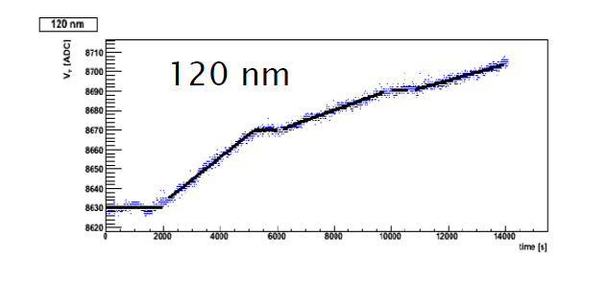
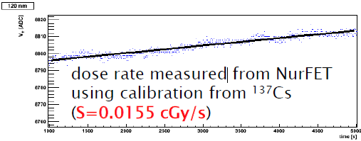
Obsevanje NurFET radfetov v IRRAD v CERNu, oktober 2018
Turški radfeti, 120 nm debelina oksida, test za morebitno uporabo za radiation monitor v Itk
Krambi:
Kalibracija s Cz137
Obsevanje gama v reaktorju
Veliko prenizka dozna hitrost
→ Pričakuješ ~20 cGy/s??

Slide 20
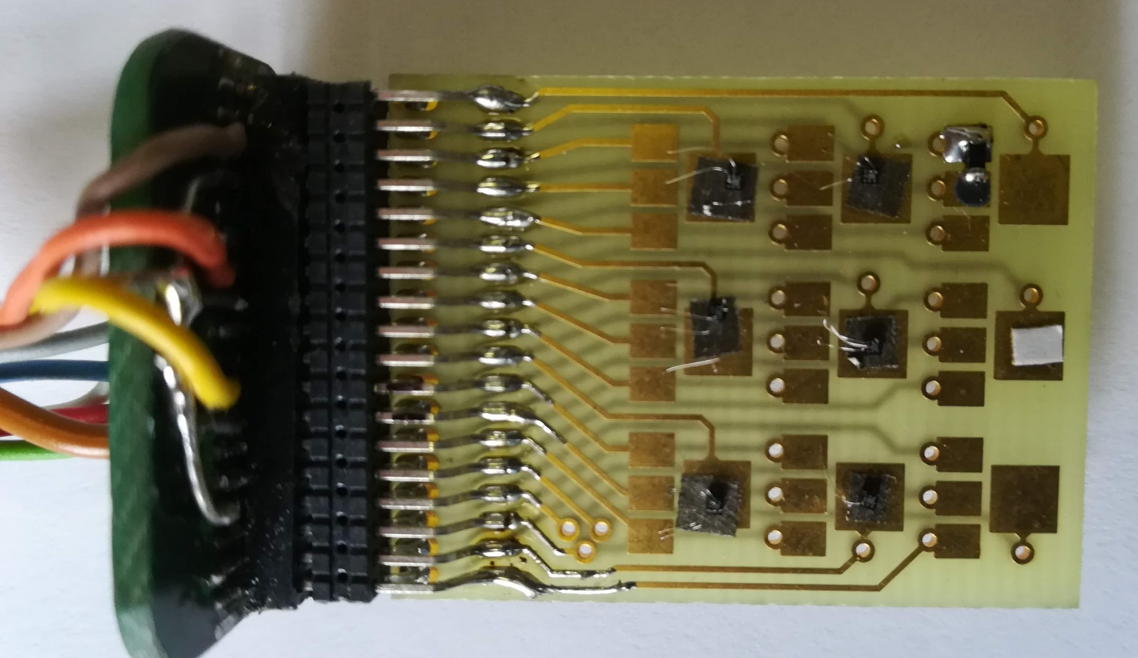
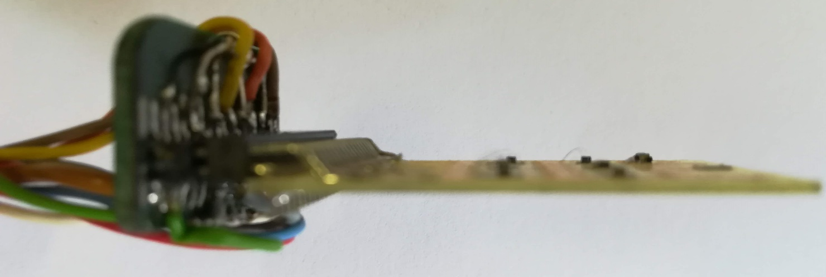
Temp senor
~10 mm
~18 mm
24 mm
Top view
32 mm
40 mm
20 mm
Side view

Slide 21
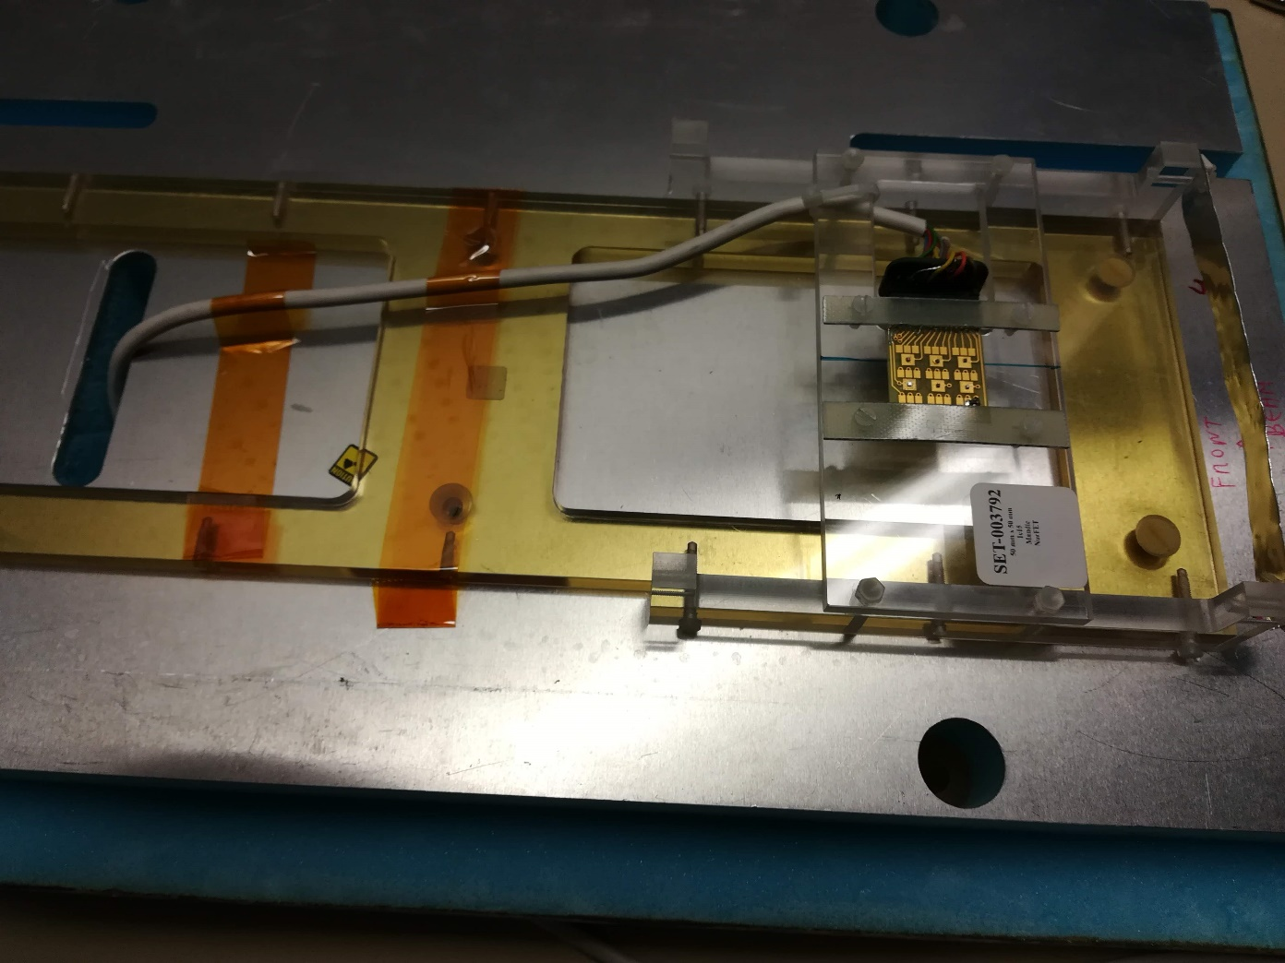
žarek

Slide 22
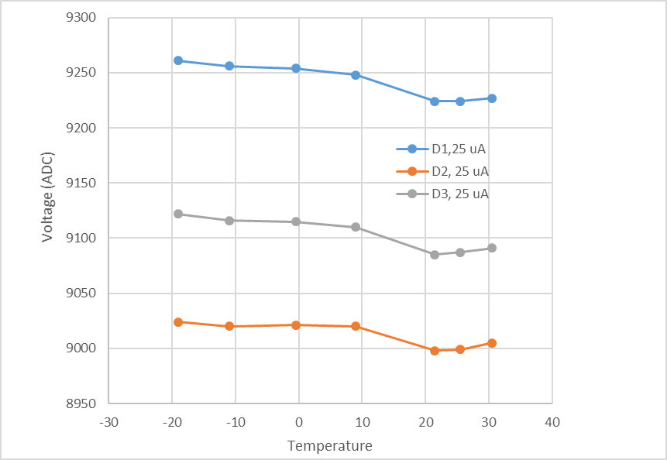
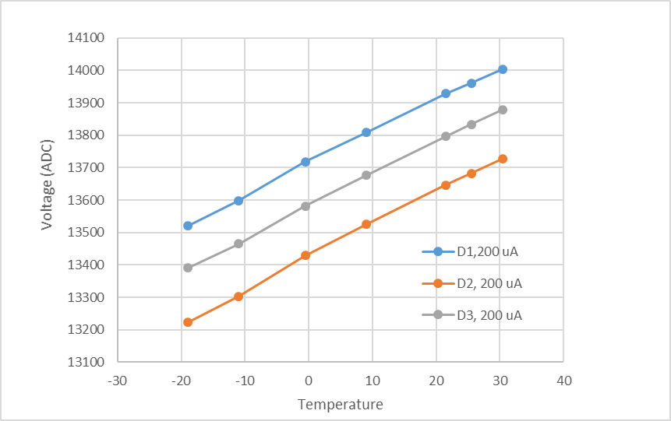
Temperaturna odvisnost pred obsevanjem
25 uA boljše kot 200 uA
nižji tok bolj ugoden, ker rabimo nižjo napetost

Slide 23
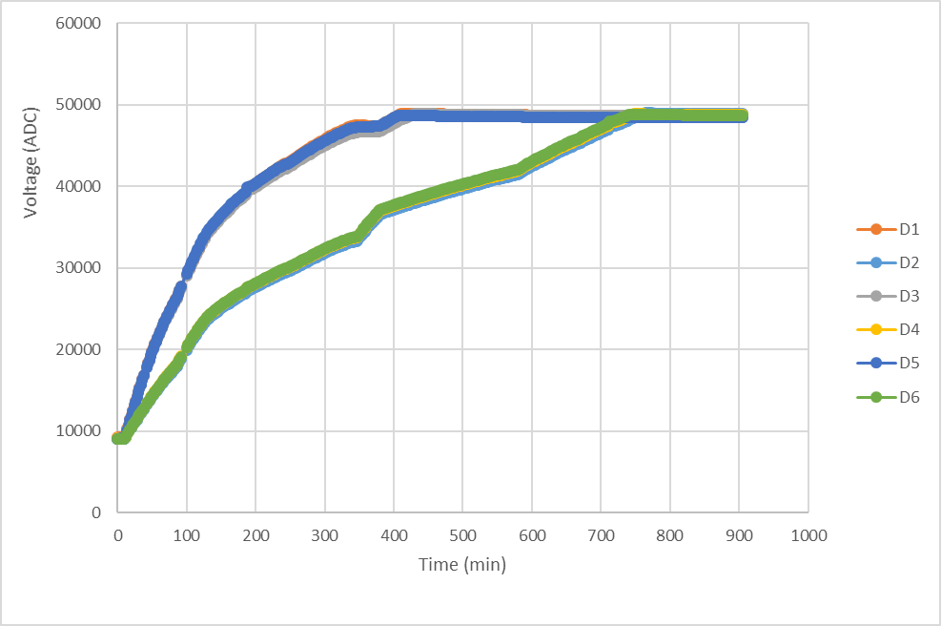
Dozna hitrost cca. 1 Mrad/h (3e13 p/cm2/h)
Saturacija po cca 6 h → to je 6 Mrad (60 kGy) ali 2e14 p/cm2 je 1.2e14 n_eq/cm2
Radfeti v žarku
Radfeti 7 mm izven
žarka
Žarek se je malo odpeljal

Slide 24
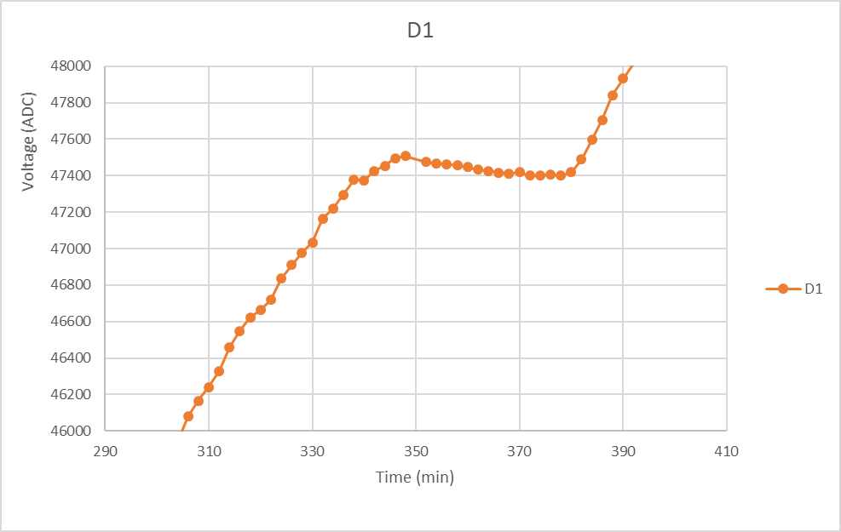
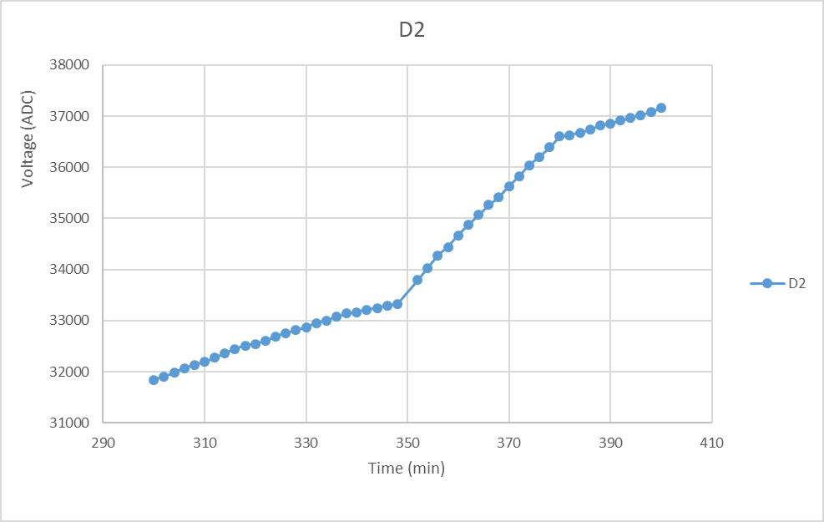
Zoom in the structure at 350 minutes. Fading can be seen.
Vidimo da output pada čeprav se najbrž še vedno nekoliko obseva.
Uporabno dinamično območje je verjetno dosti pod 2e14 p/cm2
Radfet in the central position
Radfet 7 mm off-centre

Slide 25
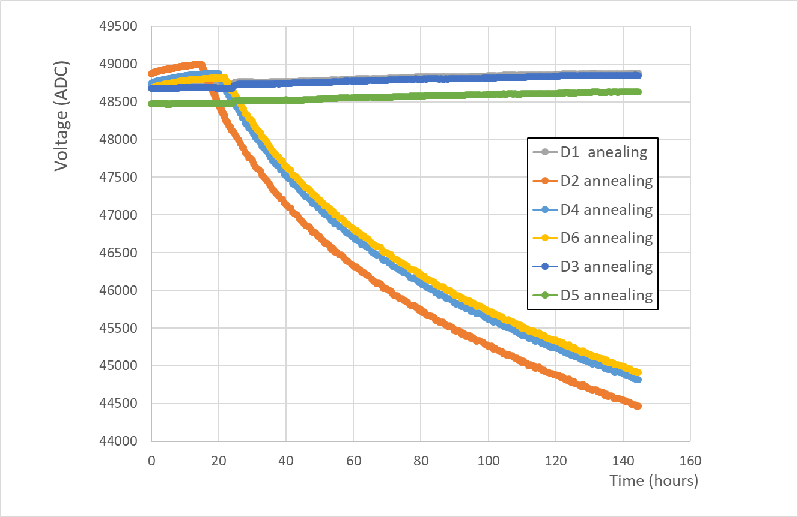
Annealilng:
manj obsevani radfeti so pod saturacijo čitalca (~ 25 V)
bolj obsevani so še vedno nad 25 V
Radfete še vedno beremo, nov plot čez nekaj tednov

Slide 26
Zaključek:
NurFET zazna sevanje
Problem je fading po hadronski dozi
Najbrž ni slabši kot REM radfeti
➔ potrebnih bo še kar nekaj testov
➔ kalibracijo z nabitimi hadroni pri nižji dozni hitrosti

