Slide 1
Beam test results with BCM' and TowerJazz CMOS
F9 weekly, Ljubljana, Slovenia, 07. 12. 2018
Bojan Hiti (Jožef Stefan Institute, Ljubljana, Slovenia)

Slide 2
October 2018 Test beam campaign
Test beam at CERN SPS H6 10 – 24 October, +120 GeV hadrons
Two separate projects:
PART 1: BCM' prototype readout chip
PART 2: TowerJazz CMOS investigator
Kartel beam telescope
6 mimosa planes + 1 FEI4 module
< 5 μm tracking resolution
DRS4 readout of DUTs, few channels

Slide 3
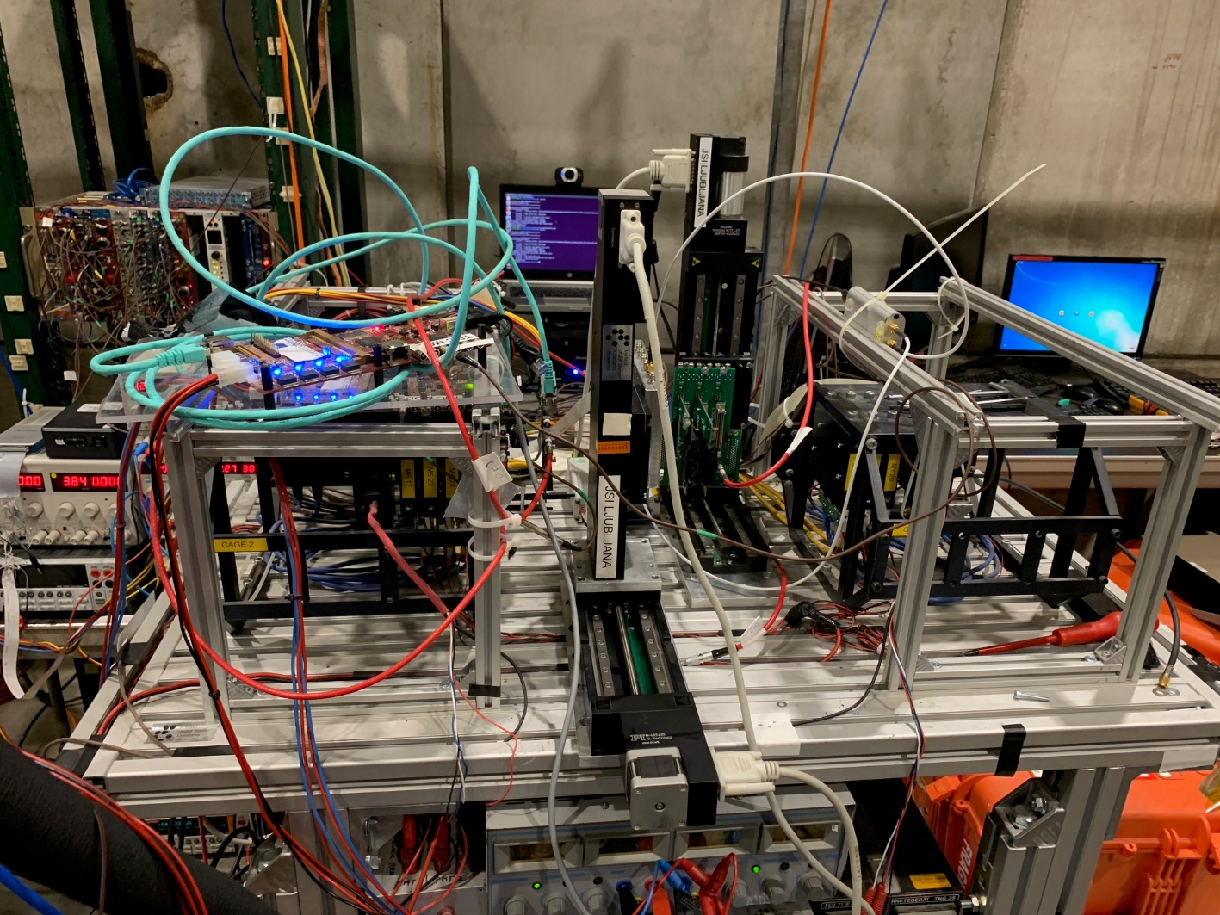
CERN H6 test beam
10 – 17 October, CERN SPS H6 test beam: 120 GeV hadrons
Mimosa beam telescope
6 mimosa planes for tracking
1 FEI4 module for timing and region of interest (ROI) trigger
Tracking resolution ≈ 3 μm
DRS 4 analog readout
3 GS/s acquisition rate, 700 MHz bandwidth
Recorded one channel per chip per run – two channels per run
Dataset:
All channels measured (separate runs)
200k telescope triggers per channel → 60k tracks
All tests done with one version of front end configuration
+ 1000 V bias voltage
DUT
3 planes + timing + ROI
3 planes

Slide 4
PART 1: BCM'

Slide 5
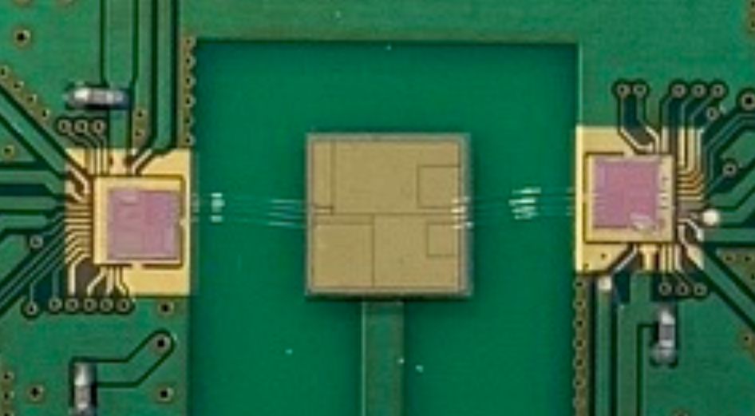
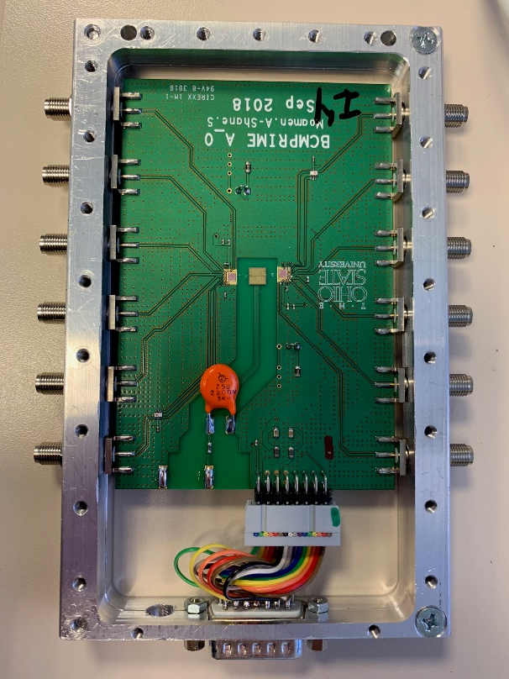
BCM' chip
BCM': Readout ASIC prototype for ATLAS Beam Condition Monitor (BCM) upgrade for HL-LHC
Analog front end with 4 readout channels
Current amplifier, fast pulses (baseline restored after < 25 ns)
Two BCM' wire bonded to a specially segmented diamond sensor
Large pitch bump bonding also considered to reduce capacitance
Chip configuration with external DACs via a Labview interface
[2, 1]
[1, 3]
[1, 4]
Chip 2
[2, 2]
Chip 1
[2, 3]
[1, 2]
[1, 1]
[2, 4]

Slide 6
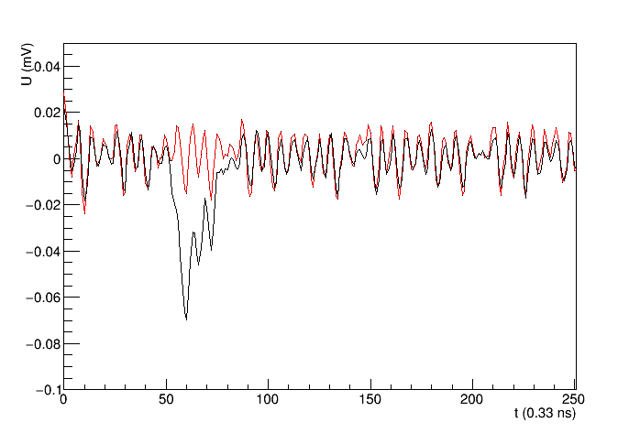
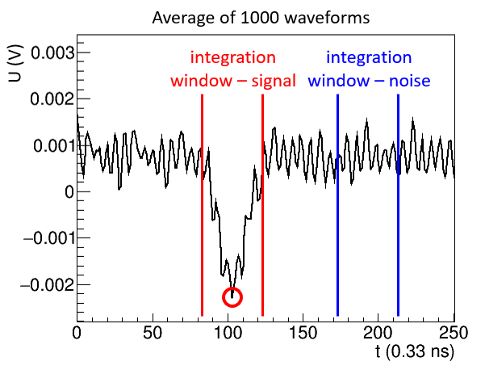
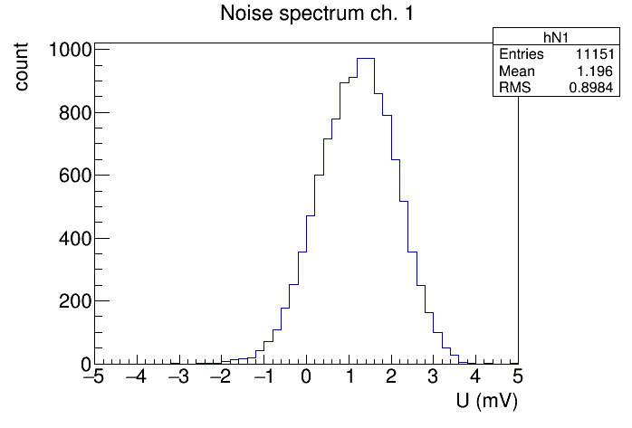
Charge measurement
Single event waveform
U (V)
Average waveform of 1000 acquisitons
Select an integration window around the peak [t_{min}, t_{max}] (typically [– 6 ns, 6 ns])
Waveform subtraction to mitigate pick up – w.r.t. track position
Signal = Integral around the peak
Hit criterium: signal > 4σ above noise
charge 20 mV
(Landau tail)
Noise spectrum
baseline offset
+4σ

Slide 7
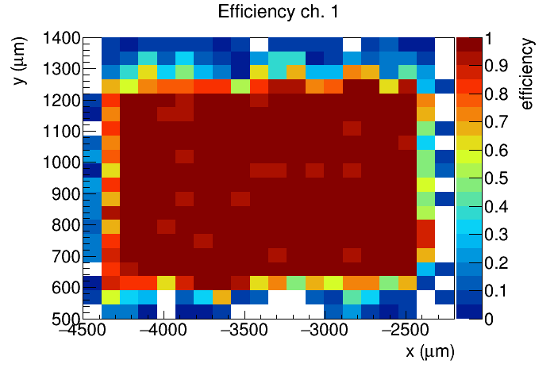
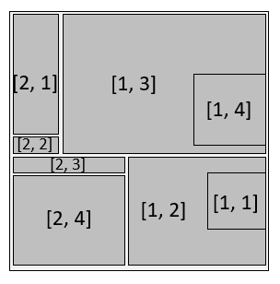
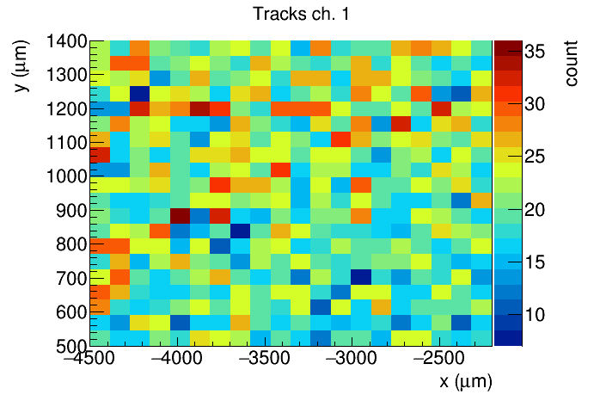
Chip 2, channel 1

Slide 8
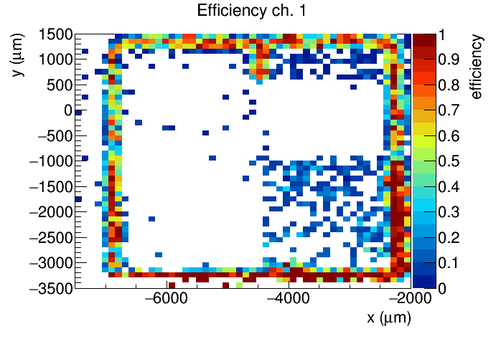
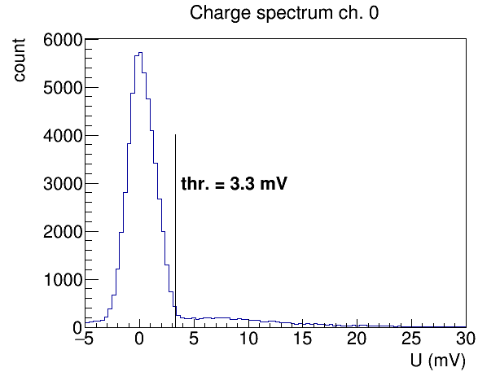
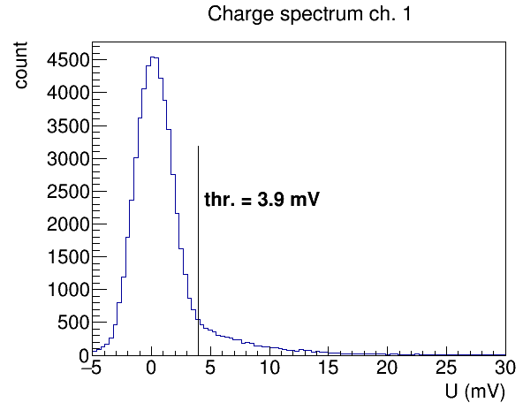
Channel 2

Slide 9
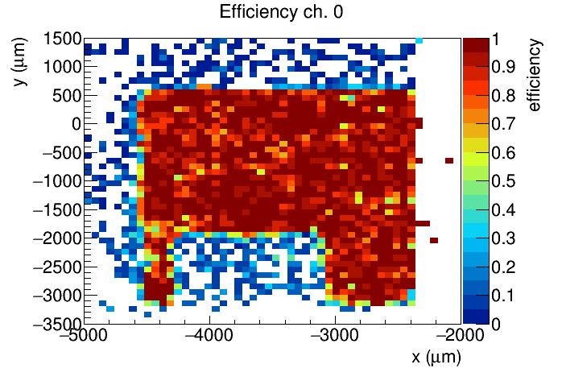
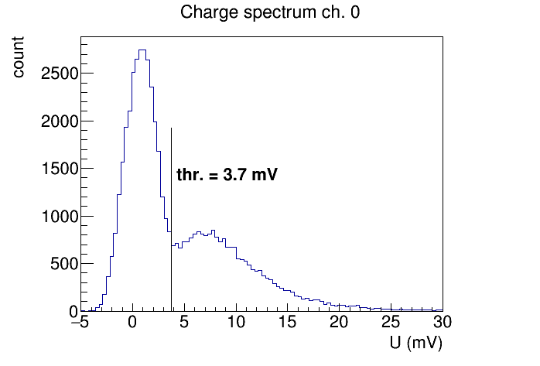
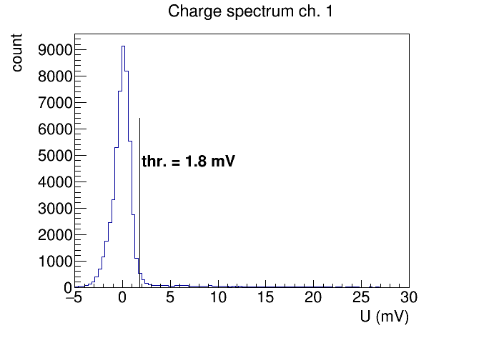
Channel 3
zoom on next slide

Slide 10
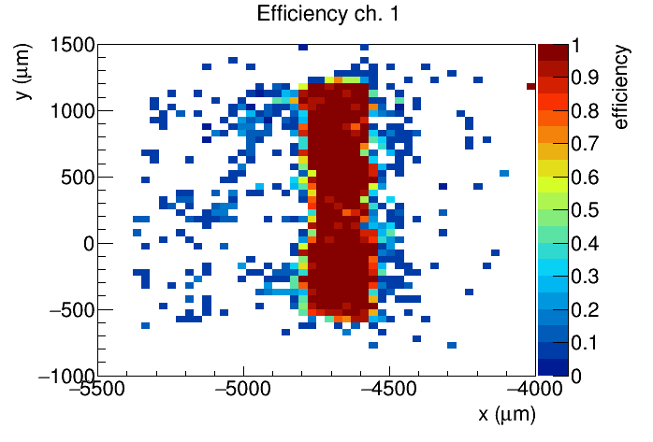
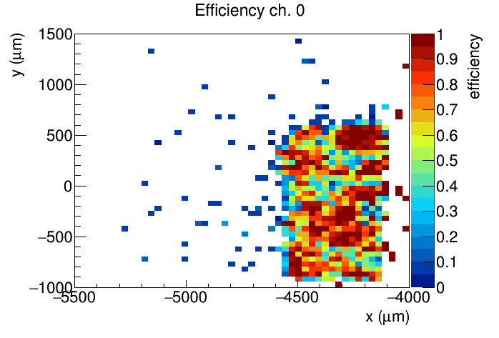
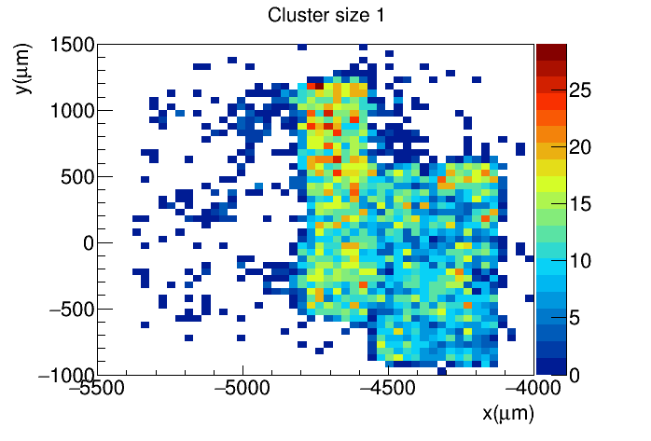
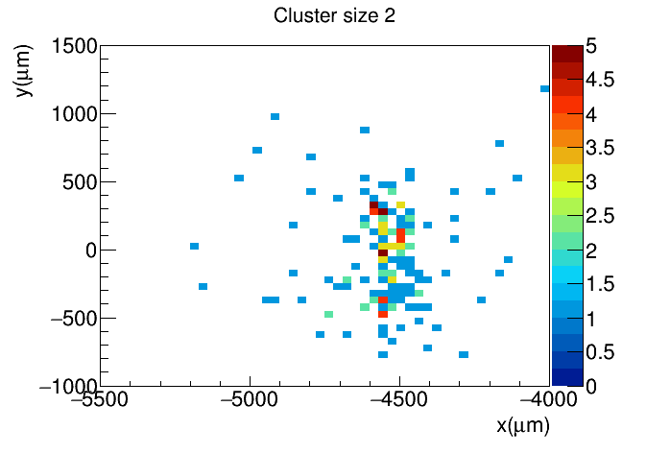
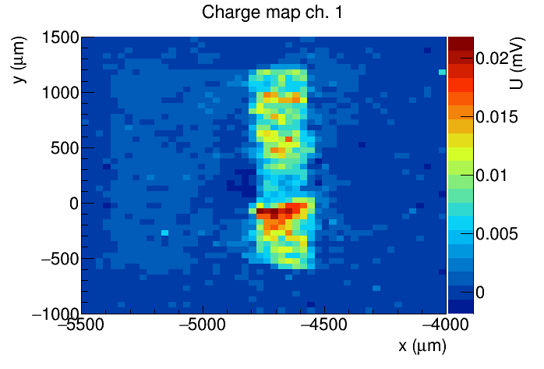
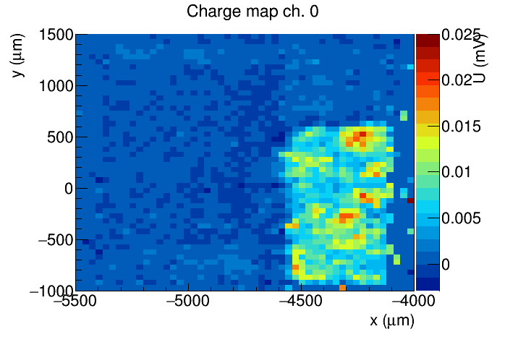
Chip 2 channel 3

Slide 11
Conclusions
Debugged the software, now nice test beam results
Final analysis code uploaded to Git:
https://github.com/bhiti/testbeam_analysis_drs
The plan is to create a Git repository with the "full" test beam software collected in one place
Working on obtaining an eos partition to save the BCM' data

Slide 12
PART 2: TowerJazz Investigator CMOS

Slide 13
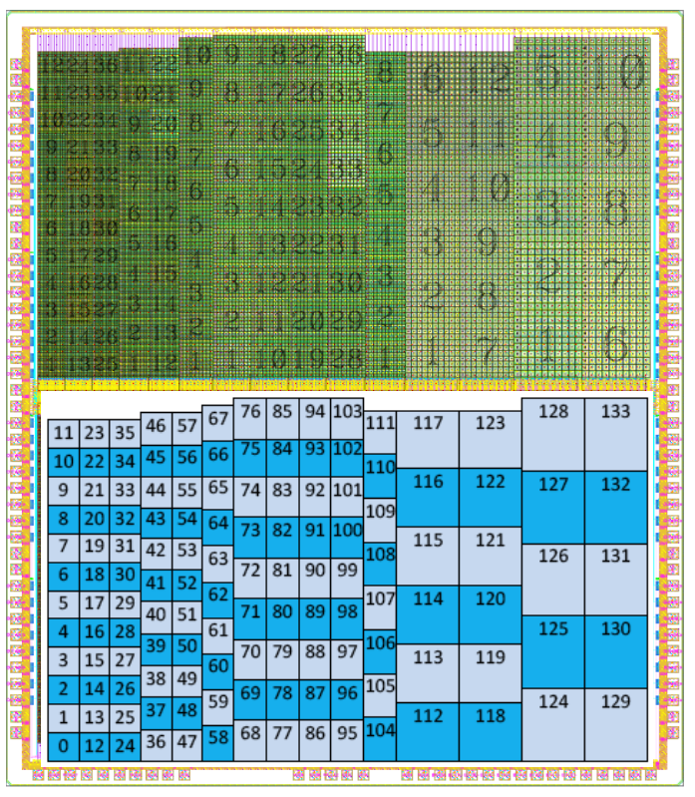
TowerJazz Investigator
CMOS prototype based on small collection electrode architecture
Old (2015) analog only design
Based on this prototype fully monolithic chips TJ MonoPix and TJ MALTA have been produced
Fully monolithic samples have reduced efficiency in pixel corners after irradiation
Agenda: Measure efficiency with Investigator and correlate with E-TCT
Caveat: can read out only one pixel per channel
readout 2 x 2 pixels (50 x 50 um2 pixel size) – low rate!
10 x 10 pixel array
8 x 8 active pixels
dummy pixels

Slide 14
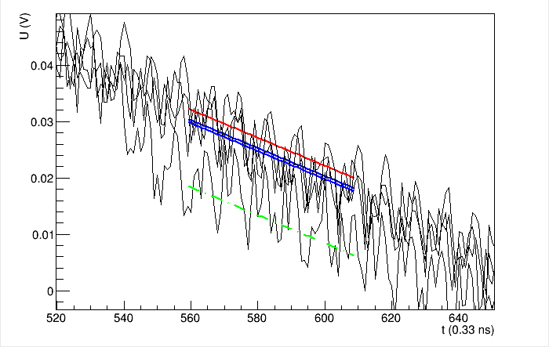
Test beam
Sample:
1e15 neutron irradiated
ROI: 1250 x 400 um2 (DUT 100 x 100 um2 – cca. 0.5 % area)
Charge sensitive amplifier – relatively complicated charge calculation
Pick up was also present
Beam intensity was HUGE. Still working on reconstructing tracks
For now only spectra
Waveforms of 4 channels
Signal wf, 2 references, discarded
Charge = signal – reference

Slide 15
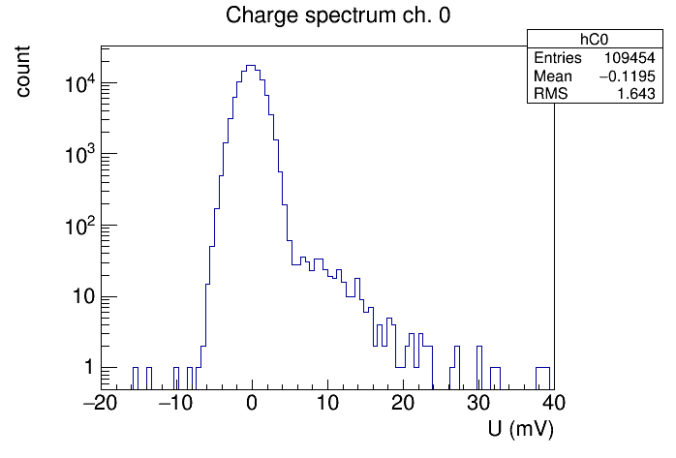
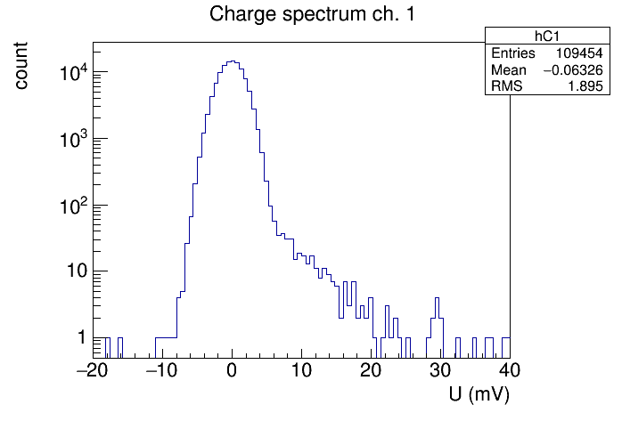
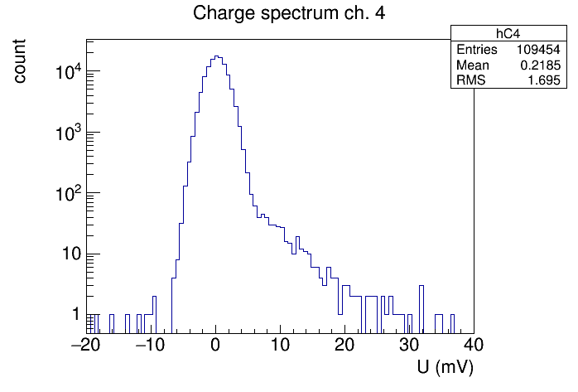
Charge spectra
110k entries
expect 130 full wfs per channel
tracking t.b.d.

Slide 16
BACKUP

Slide 17
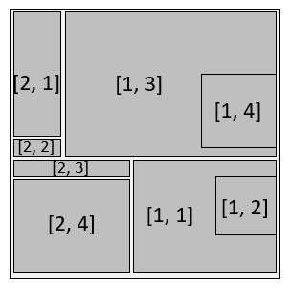
Trigger
Acquisition triggered by the FEI4 module
ROI to trigger only on tracks through the active area
ROI determined in a test run by self triggering on the DUT
HitOR
ROI
FEI4 ROI
DRS4
Telescope
Example ROI:
(chip 1, ch. 4) + (chip 2, ch. 4)
read out FEI4

Slide 18
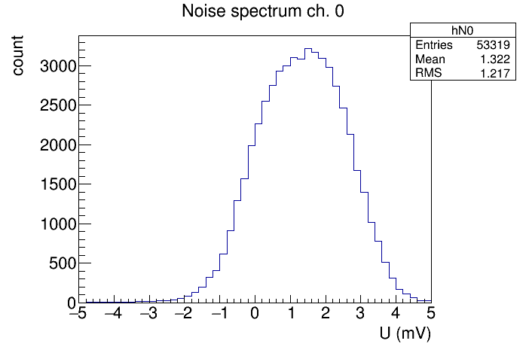
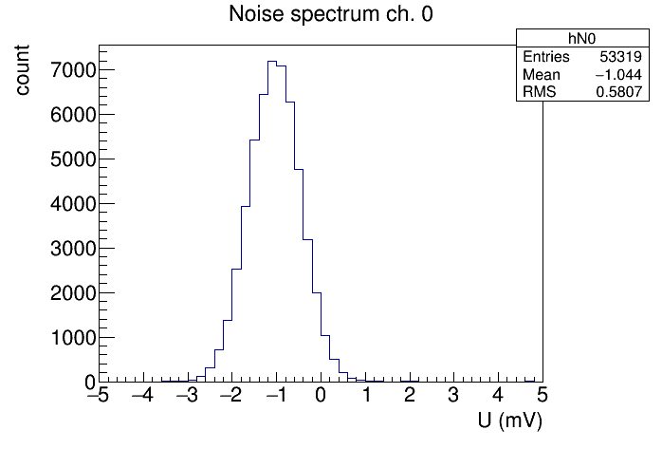
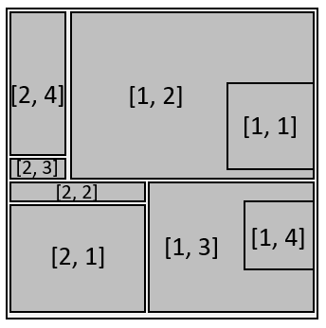
Waveform subtraction
Pick up has the same shape in all the channels
Subtracting Ch. 2 from Ch. 1 reduces "noise" by a factor of ≈ 2
Additional selection has to be introduced for events when signal only in Ch. 2
U (V)
Noise before subtraction
Noise after subtraction

Slide 19
Waveform subtraction
Blue wf = Black - red
Fine tuning of the phase between black and red might reduce the noise

