Slide 1
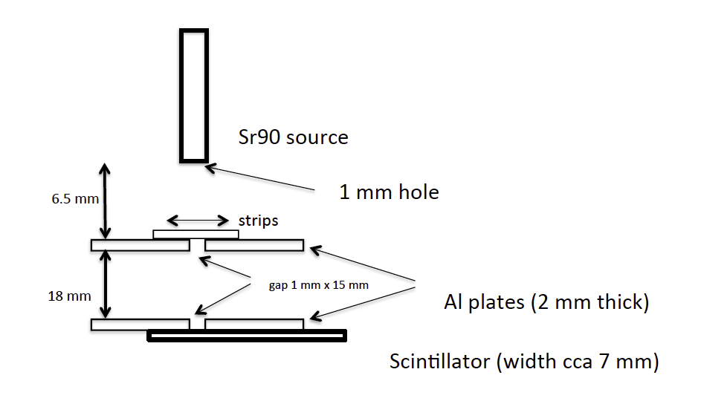
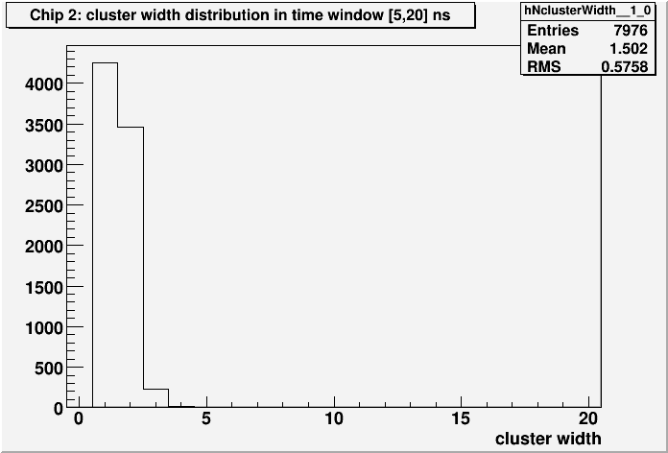
CCE measurements on ATL17LS ministrip sensors in Ljubljana –comparison with R0, thin and thick active regions - preliminary results!!!
Sensors irradiated at TRIGA reactor in Ljubljana, 1 Mev equivalent fluences 10¹⁴, 5 10¹⁴, 10¹⁵, 2 10¹⁵ cm⁻²
measurements at T = -20C
standard cuts – seed 3.5 σ, neighbour 1.5 σ
“narrow” collimation
“narrow “ clusters
thin and thick sensors (nominal active thickness 240 μm and 290 μm) with same fluence measured on the same Alibava board
Cluster width 300 V, neutrons 5 10¹⁴ cm⁻²

Slide 2
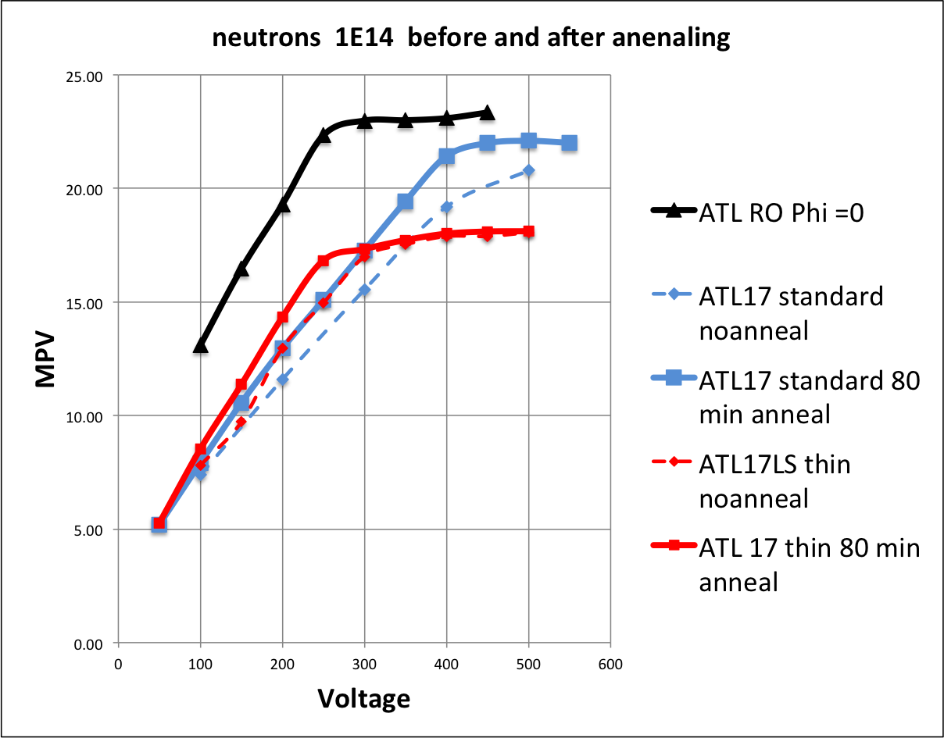
Fluence 10¹⁴ ncm⁻²
R0 fluence = 0

Slide 3
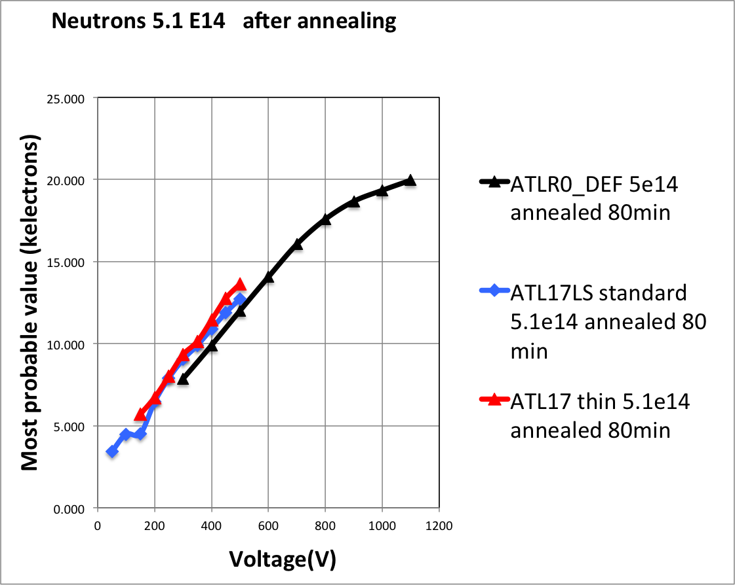
Fluence 5 10¹⁴ cm⁻²
Voltage on ATL17LS limited by breakdown on supporting board

Slide 4
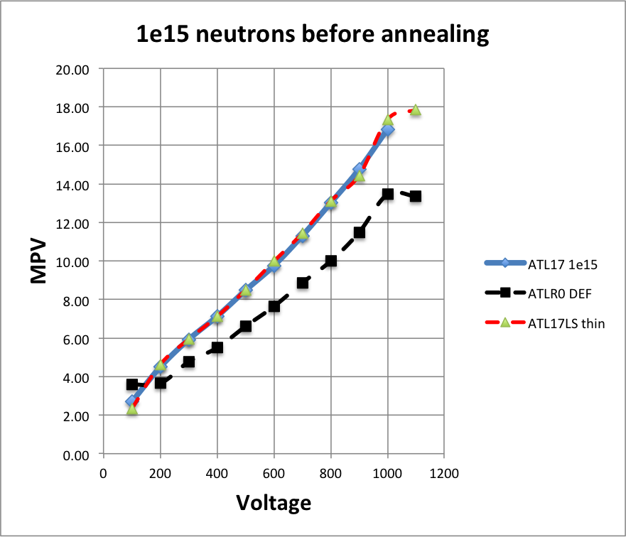
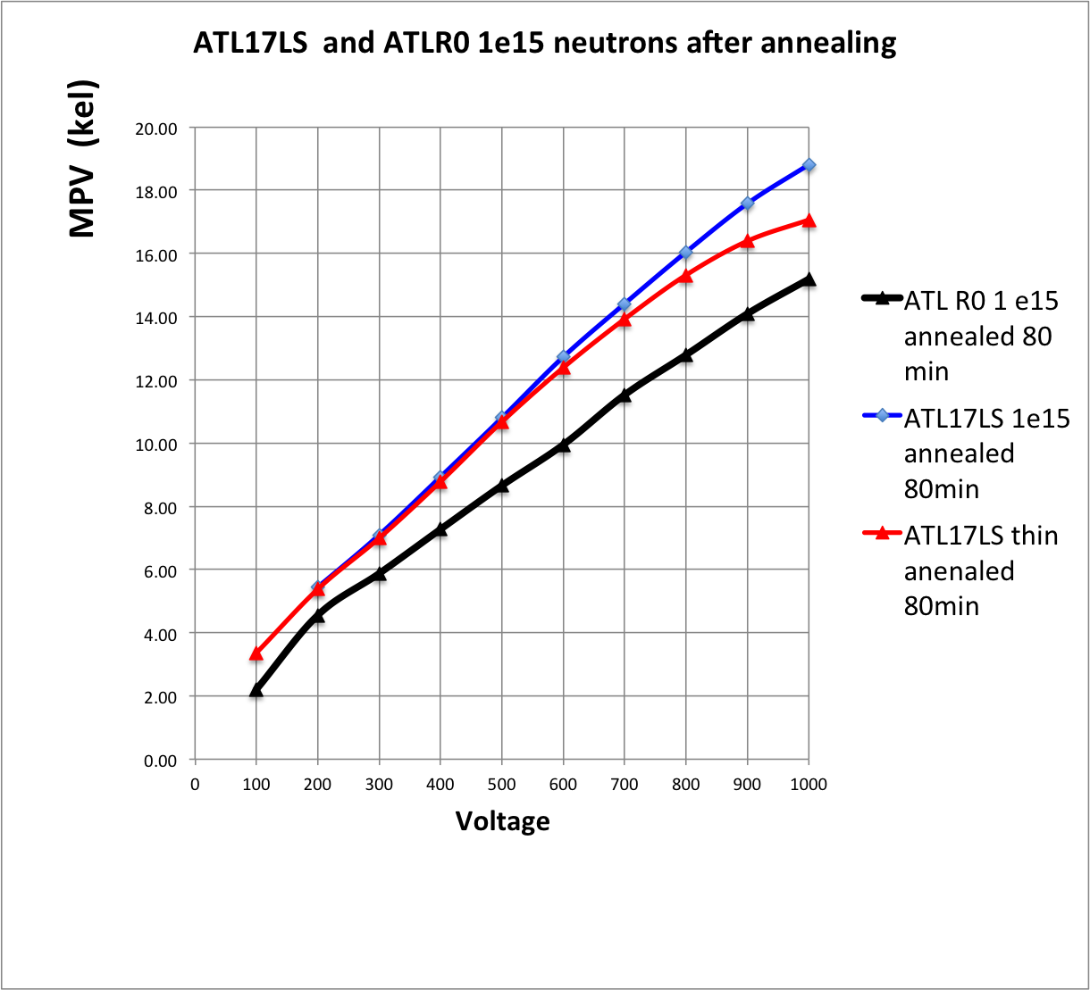
Fluence 10¹⁵ncm⁻²
RO has higher leakage current – higher fluence ?

Slide 5
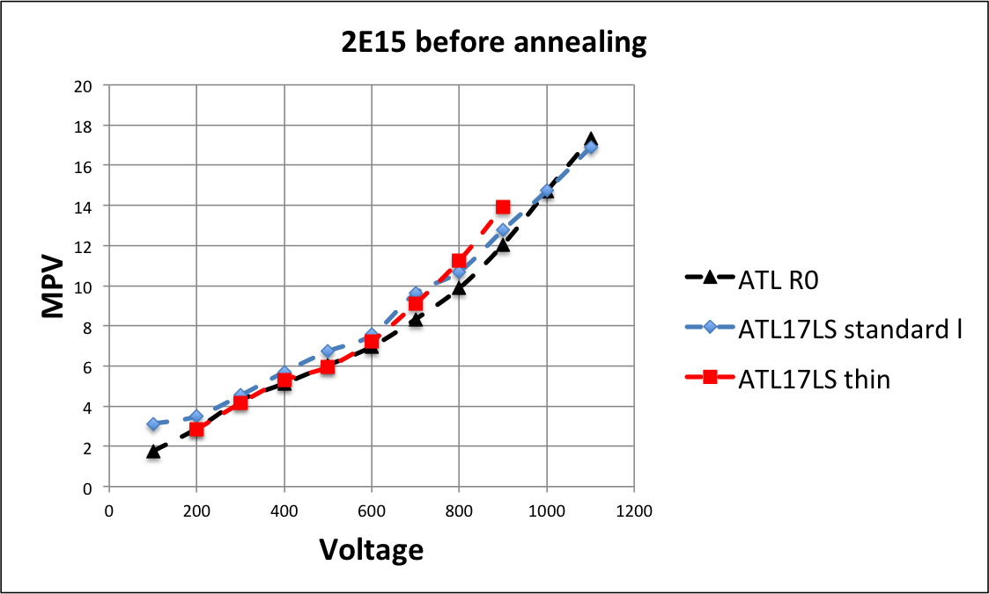
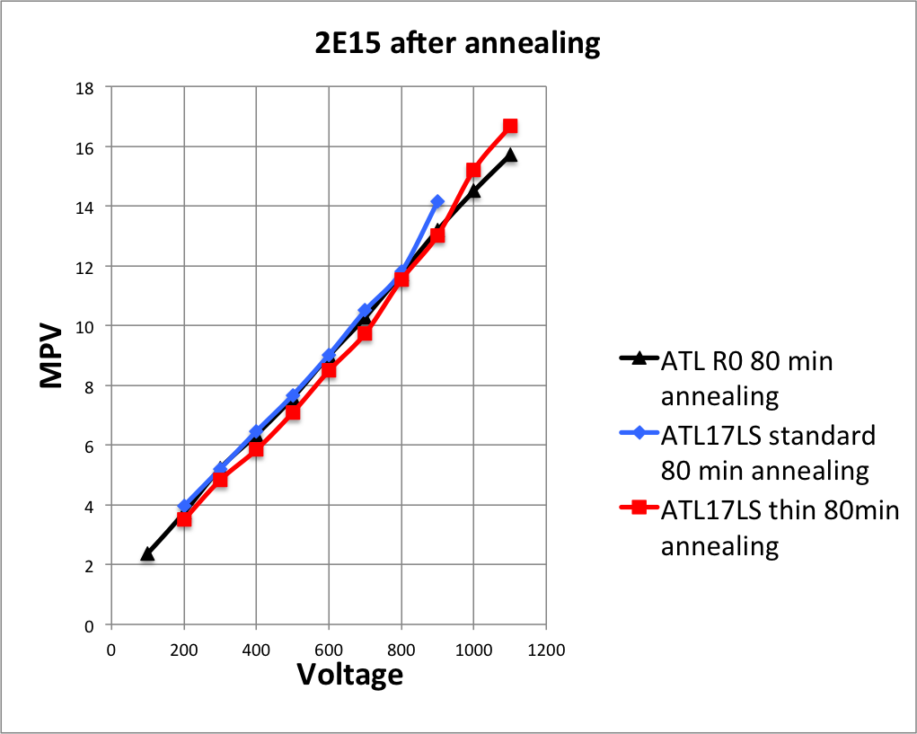
Fluence 2 10¹⁵ ncm⁻²

Slide 6
Conclusions
ATL17LS and R0 have same CCE within the measurement uncertainty
discrepancy at 10¹⁵cm⁻²not clearly understood, different fluences?
thin and thick sensors have very similar CCE after irradiation to 5 10¹⁴ cm⁻² and more
thin sensor has smaller signal at the low fluence compared to standard – as expected for 240 μm thick active region

