Slide 1
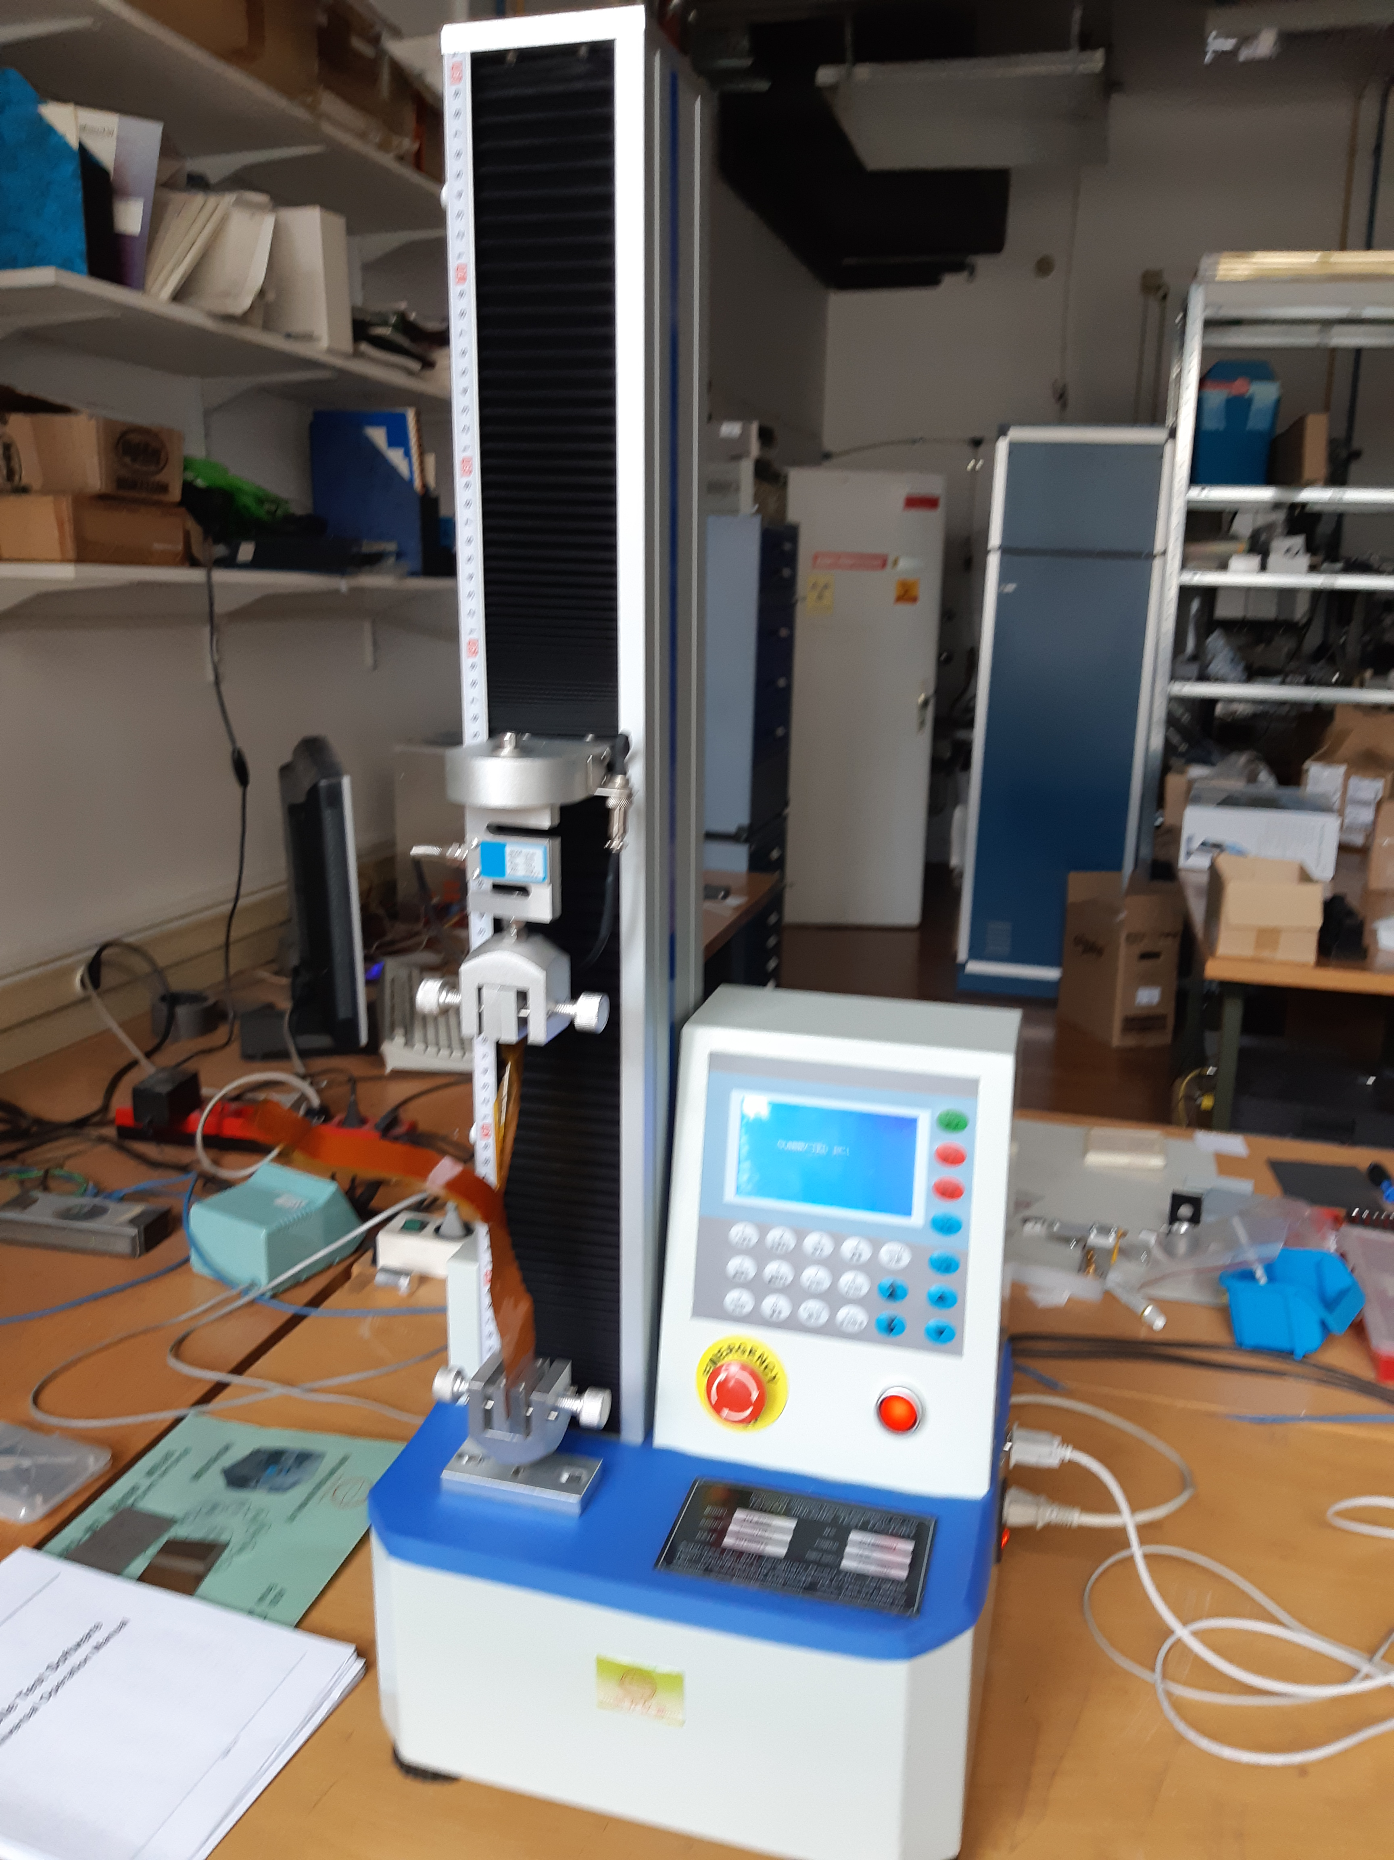
Peel tests - neutron irradiated flexes
samples – coverlayer on copper
Irradiated to 2 10¹⁵ ncm^{-2,} ≈ 20 kGy
Peel tester KJ-1065B Computer type Peeling strength tester
Sample width 50mm
Peel speed 10 mm/min
Force averaged over 30 mmm length

Slide 2
Test reports

Slide 4
Test results
Neutron irradiated
2 10¹⁵ ncm⁻²
TID – 600 kGy

