Slide 1
SIPTC
SLOVENIAN PROTON THERAPY CENTER
Prof. Primož Strojan, Onkološki inštitut Ljubljana
Dr. Božidar Casar, Onkološki inštitut Ljubljana
Mr. Janko Burgar, Cosylab d.d.
Ljubljana, 23.1.2020

Slide 2
Partners
Project
Background facts
Description
Advantages
Conclusions

Slide 3
PARTNERS
SCIENCE
INDUSTRY
MEDICINE
(ONCOLOGY)
2017 →

Slide 4
PARTNERS
6.3.2017: Establishment of a Working Group on Proton Therapy at the Institute of Oncology Ljubljana (IOL)
21.8.2017: Decision of the Expert Council at the IOL: "IOL supports the establishment of proton therapy in Slovenia and will carry out further activities that will enable its realization."
12.10.2017: The OIL Board members support the developmental orientation of the IOL with regard to proton therapy and support the participation of experts in related activities
30.8.2018: At its 186th regular meeting, the Government of the Republic of Slovenia expressed its support to the project of the Slovenian Proton Therapy Center

Slide 5
PROJECT: BACKGROUND
Patient needs and commitment to society:
≈16.000 patients with cancer in 2019 in Slovenia
≈5.000 NEW patients treated annually with radiotherapy
10-20% cancer patients (≈500 per year) would
benefit from proton therapy
Improving the health system and raising the level of health services (≈ new innovative drugs)
No need for sending patients for expensive treatments abroad any longer

Slide 6
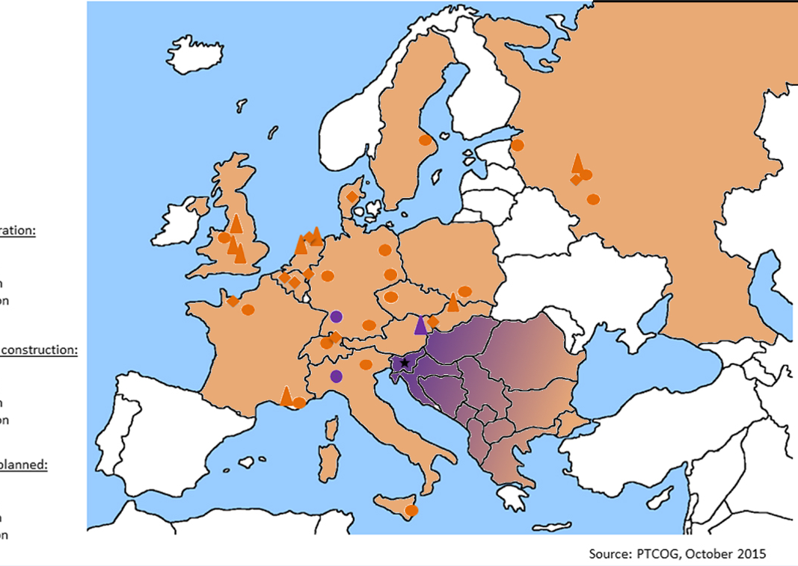
PROJECT: BACKGROUND
No proton therapy center in South- East Europe
WIENER NEUSTADT
PRAGUE
PAVIA
TRENTO

Slide 7
PROJECT: DESCRIPTION
PURPOSE & WORKLOAD
SIPTC is dedicated to clinical work and only partly to research, i.e. improvement of clinical work clinical & preclinical research, dosimetry
Up to 600 patients/year/2 units (when fully operational, two shifts)
Slovenian patients: 85-90%
Foreign patients: 10-15%
self- payers or treatment paid by foreign insurance companies
CONFIGURATION
Two independent compact systems for PT
Configuration with gantry
The building has to be entirely constructed at the beginning of the project.

Slide 8
PROJECT: DESCRIPTION
TRAINING & EDUCATION
ROs – 4 RTTs - 16
MPs – 8 Other staff
Start of clinical work on the 1st PT system, one shift
Second shift activated on the 1st PT system
Commi-ssioning of 2nd PT system
Start of clinical work on the 2st PT system, one shift
FULL OPERATION ON TWO PT SYSTEMS & IN TWO SHIFTS
Construction = building for two PT systems
Installation of 1st PT system
Commissioning of 1st PT system
YEARS →
0 3 4 5 6 7 8

Slide 9
PROJECT: DESCRIPTION
SIPTC = integral part of the IOL:
optimal treatment of patients
state-of-the-art RT equipment
training & work opportunities for top professionals at home (stopping "brain drain")
SIPTC
INSTITUTE OF ONCOLOGY LJUBLJANA
PUBLIC HEALTH SYSTEM

Slide 10
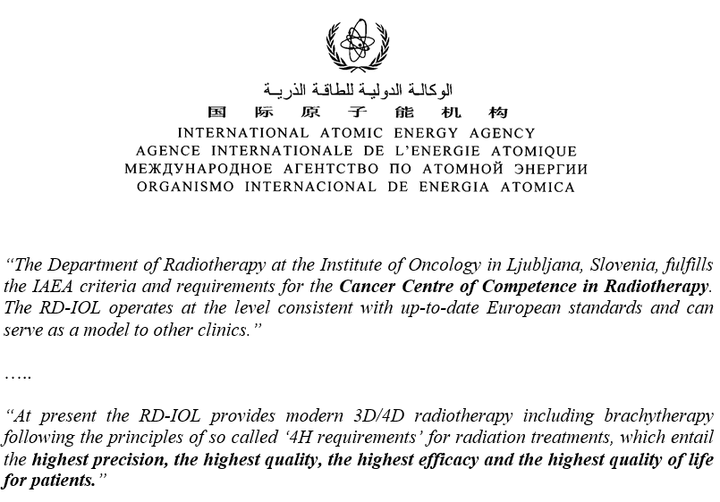
Advantages
RT in SLOVENIA:
tradition
quality
international recognition
IAEA: CENTER OF COMPETENCE
center capable of delivering a sustainable radiotherapy service to international standards;
center that can serve as a model for other radiotherapy centers in the country and the region;
a training center that can offer professional training of staff working in radiotherapy.

Slide 11
Advantages
INSTITUTE OF ONCOLOGY LJUBLJANA:
OIL is the leading cancer treatment institution in this part of Europe
Department of Radiotherapy: Concentration of personnel, equipment, knowledge and experience
Proton therapy: a new developmental breakthrough → to complete RT armamentarium with state-of-the-art technology
Only an institution having both technologies can ensure optimal use of both treatments

Slide 12
Advantages
DEPARTMENT OF RADIOTHERAPY, IOL Statistics 2019
Equipment
8 LAs (→ 9 LAs in 2020)
CT-sim 2, MR-sim 1, access to PET-CT
Staff
ROs – 39
MPs – 15
Dosimetrists – 12
RTTs – 80
Mentainance – 4
RT courses & techniques
Total: 5767
New patients: 4698 (81.5%)
IMRT/RA: 2059 (35.7%)
Stereotactic treatments: 262 (4.5%)

Slide 13
Advantages - summary
SIPTC: READY-TO-GO PROJECT!
First patient in 3 years!
The fastest way to start PT in the region
IOL:
Concentration of personnel, knowledge and experience
In the best position to upgrade competences needed to implement PT in the region
SIPTC: the most effective way to introduce PT in Slovenia and the region (from a time & organizational point of view)
IOL becomes a center of competence in the region (also) for PT

Slide 14
(Conclusions)

