Slide 1
Annealing CCE
“request from the reviewers to look into the dependence of the CCE on the
thermal history of the detector… “

Slide 2
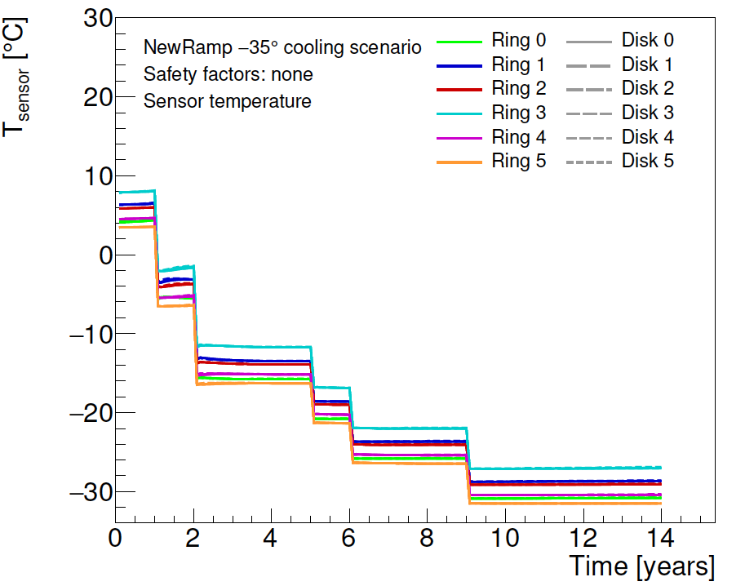
Temperatura v EC

Slide 3
3 scenariji

