Slide 1
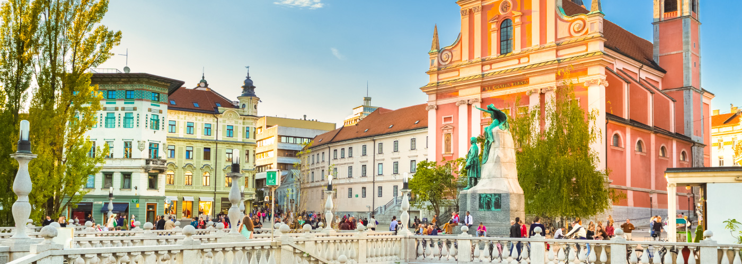
South East European International Institute for Sustainable Technologies (SEEIIST)
https://seeiist.eu
Dr. Sanja Damjanovic
Minister of Science of Montenegro
Chairperson of the SEEIIST Steering Committee
Institute Jožef Štefan, 24 January 2020, Ljubljana, Slovenia

Slide 2
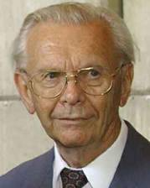
SEEIIST
South East European International Institute for Sustainable Technologies (SEEIIST) in the spirit of ‘Science for Peace’
Initiative for such an institute originally taken by Prof. Herwig Schopper, a former Director General of CERN, at a Meeting of the World Academy of Arts and Sciences in Dubrovnik at the end of 2016
First official support of such an initiative by the Government of Montenegro in March 2017
fast positive reception by a number of organizations and institutions

Slide 3
The Mission of the SEEIIST Project
Create Regional Center of Scientific Excellence with ‘first class research’
To promote collaboration between science, technology and industry (technology transfer)
To provide platform for improved education of young scientists and engineers (knowledge transfer)
To slow down brain drain or even to revert it
Recover the great tradition in technology which SEE had in the past
Foster cooperation between countries in the region
These goals can only be achieved with a Large Scale Facility based on the latest technologies
SCIENCE FOR DIPLOMACY
SCIENCE FOR SOCIETY

Slide 4
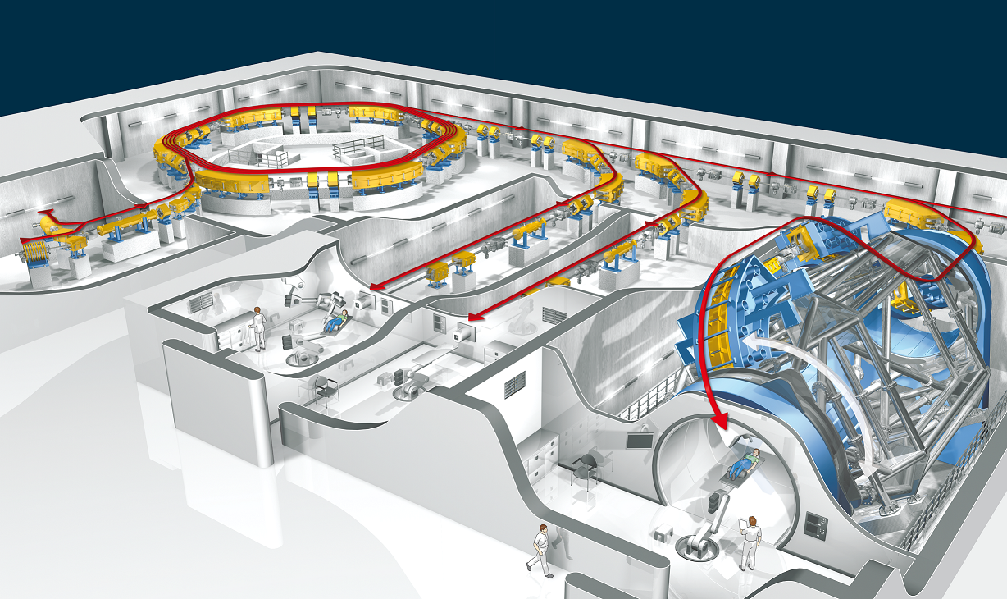
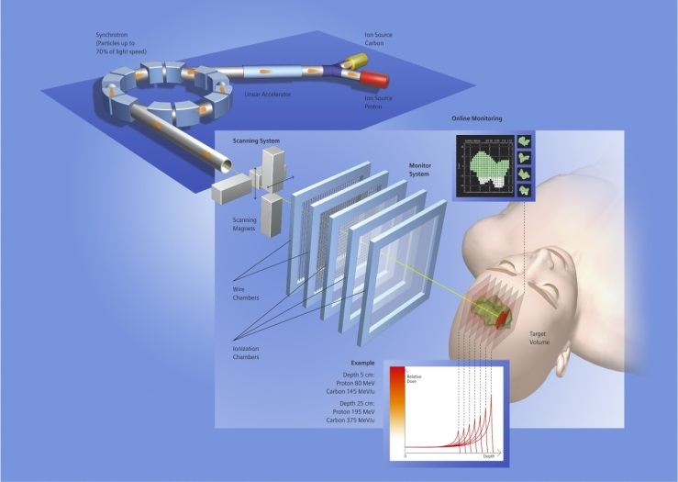
SEEIIST: Facility for Tumour Therapy and Biomedical Research with protons and heavier ions
About 500 patients per year to be treated as needed for a population of 20M. In parallel, 50% of the beam time dedicated to biomedical research with multi-ion sources from H to Ne, making the SEEIIST project unique in the world. Capacity for about 1000 researchers, including a major number from Western Europe.
Example: HIT Heidelberg, first facility in Europe

Slide 5
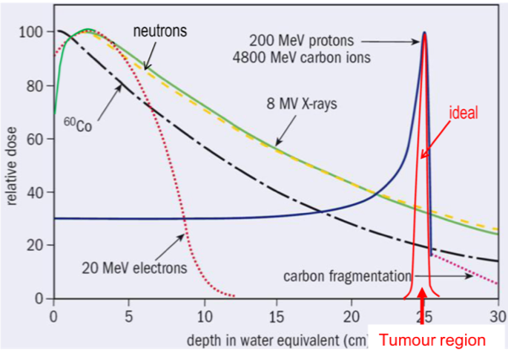
Cancer Therapy with Protons and Heavier Ions
Unique instrument for the treatment of many types of tumours
Deposited dose along the tissue depth
Particle Therapy - Big hole in SEE
source: https://enlight.web.cern.ch
Most important for radioresistant tumours and tumours close to risk organs

Slide 6
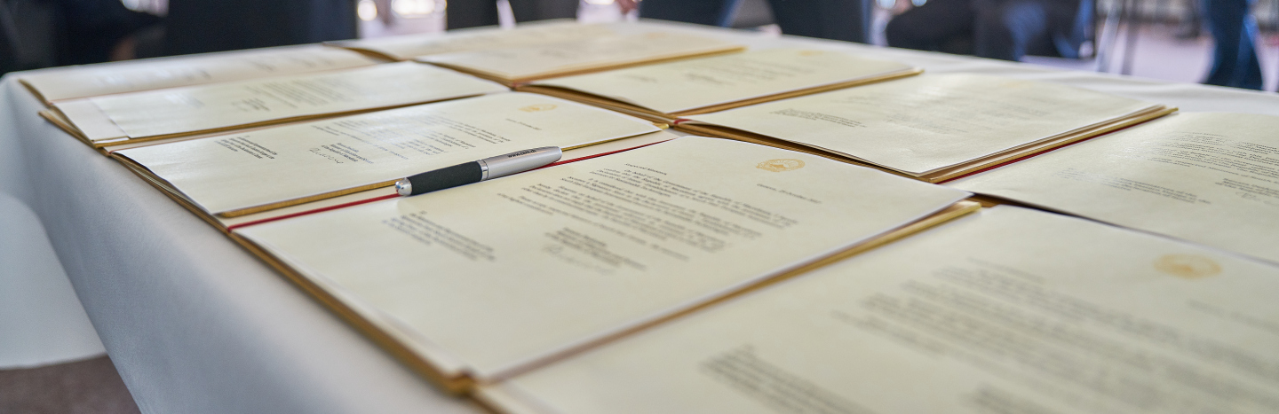
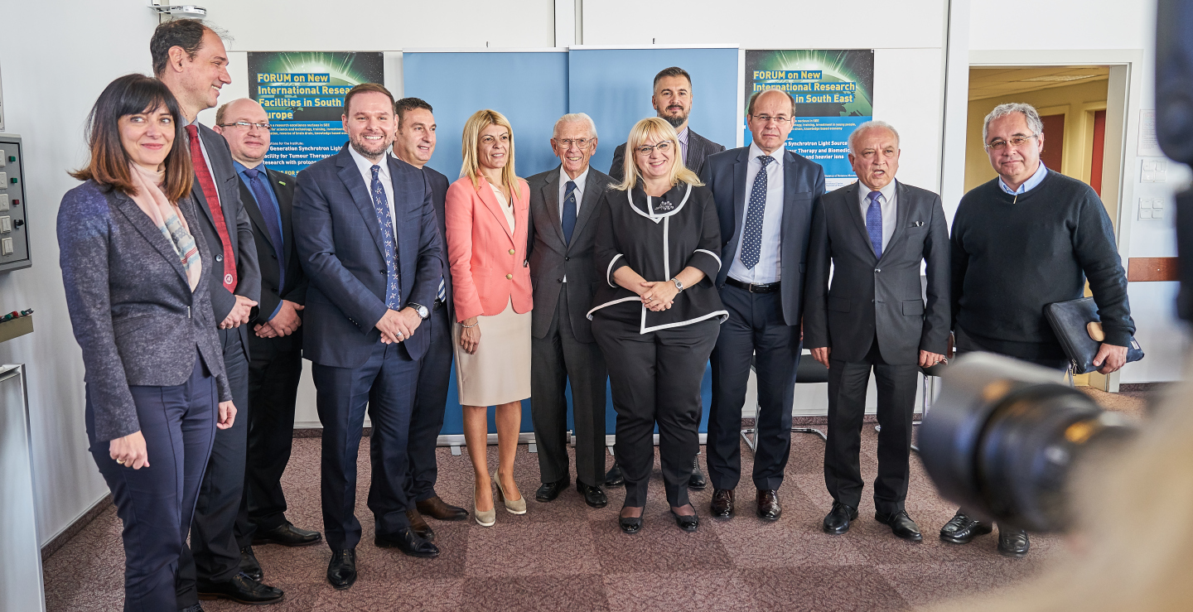
SEEIIST
Political steps taken so far
Declaration of Intent signed at CERN on October 25, 2017
First official support of such an initiative by the Government of Montenegro in March 2017
Signature of Declaration
of Intent by SEE Ministers
of Science/corresponding Ministers or their representatives at CERN
SEEIIST Initiative transformed into a Regional Project

Slide 7
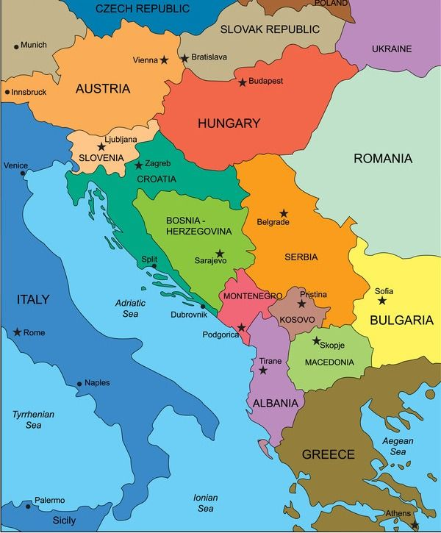
Candidate Members for the South-East European International Institute for Sustainable Technologies
Republic of Albania
Signed a Declaration of Intent
Agreed ‘ad referendum’
Bosnia and Herzegovina
Observer
Republic of Bulgaria
Republic of Croatia
Hellenic Republic
Kosovo*
North Macedonia
Montenegro
Republic of Serbia
Republic of Slovenia

Slide 8
Important support for the SEEIIST Design Phase
European Commission – Directorate General for Research and Innovation (EC DG-RTD)
Strong recognition of the Project by the Commissioner Moedas
First direct financial support of 1 MEUR for the 1st stage of Design Study Phase
CERN – European Organization for Nuclear Research
Hosts the Working Group 1 – Accelerator Design – part of the SEEIIST Design Study Phase
Great benefit from long experience in the design of medical accelerators
GSI-FAIR – Facility for Antiproton and Ion Research
Hosts the Working Group 2 – R&D and Scientific Aspects of the SEEIIST Design Study Phase
Great benefit from long experience in Bio- and Medical Physics
IAEA – International Atomic Energy Agency
Support by the IAEA for the Capacity building program

Slide 9
SEEIIST
Another Political Milestone for SEEIIST
Memorandum of Cooperation signed by six Prime Ministers of the SEE Region
Signature of Memorandum on 5 July 2019 in Poznan, Poland at the occasion of the 6th Summit of the Berlin Process

Slide 10
Concept Study of the SEEIIST worked out over the year 2017
Forum held at the ICTP/Trieste on 25-26 January 2018
Scientific Concept Studies presented for the first time
to the public
More that 100 participants
including 40 Users from the Region
The SEEIIST Concept Study is available in the form of
a CERN Yellow Report
Representatives from the EC, ESFRI, IAEA, EPS, RCC, CERN, FAIR-GSI, HIT, CNAO, DESY, SESAME….

Slide 11
SEEIIST – Actions in Place
SEEIIST Design Phase for the first 18 months (Phase 1) has already started
HITRI – Hadron Ion Therapy Research Infrastructure – Design Study Proposal via EU H2020 INFRADEV-01-2019-2020 call - submitted
As of August 2019 SEEIIST is a legal entity – Swiss Association
Building Innovative Capacity in South East Europe in a cutting edge field such as Hadron Therapy: - IAEA TC RER Project 0.5 MEUR approved; - COST application submitted; - MC-ITN TREASURE project submitted – Leveraging on ENLIGHT and the SEEIIST Project
Planning application for the ESFRI Roadmap – deadline 5 May 2020

Slide 12
HITRI – ‘Heavy Ion Therapy Research Infrastructure’
HITRI – Hadron Ion Therapy Research Infrastructure
Design Study Proposal – EU H2020 INFRADEV-01-2019-2020 call
HITRI Consortium
TIARA give advice
EC budget 3 MEUR – Effective budget 6 MEUR
Several beneficiaries from SEE Region through SEEIIST, Including JSI

Slide 13
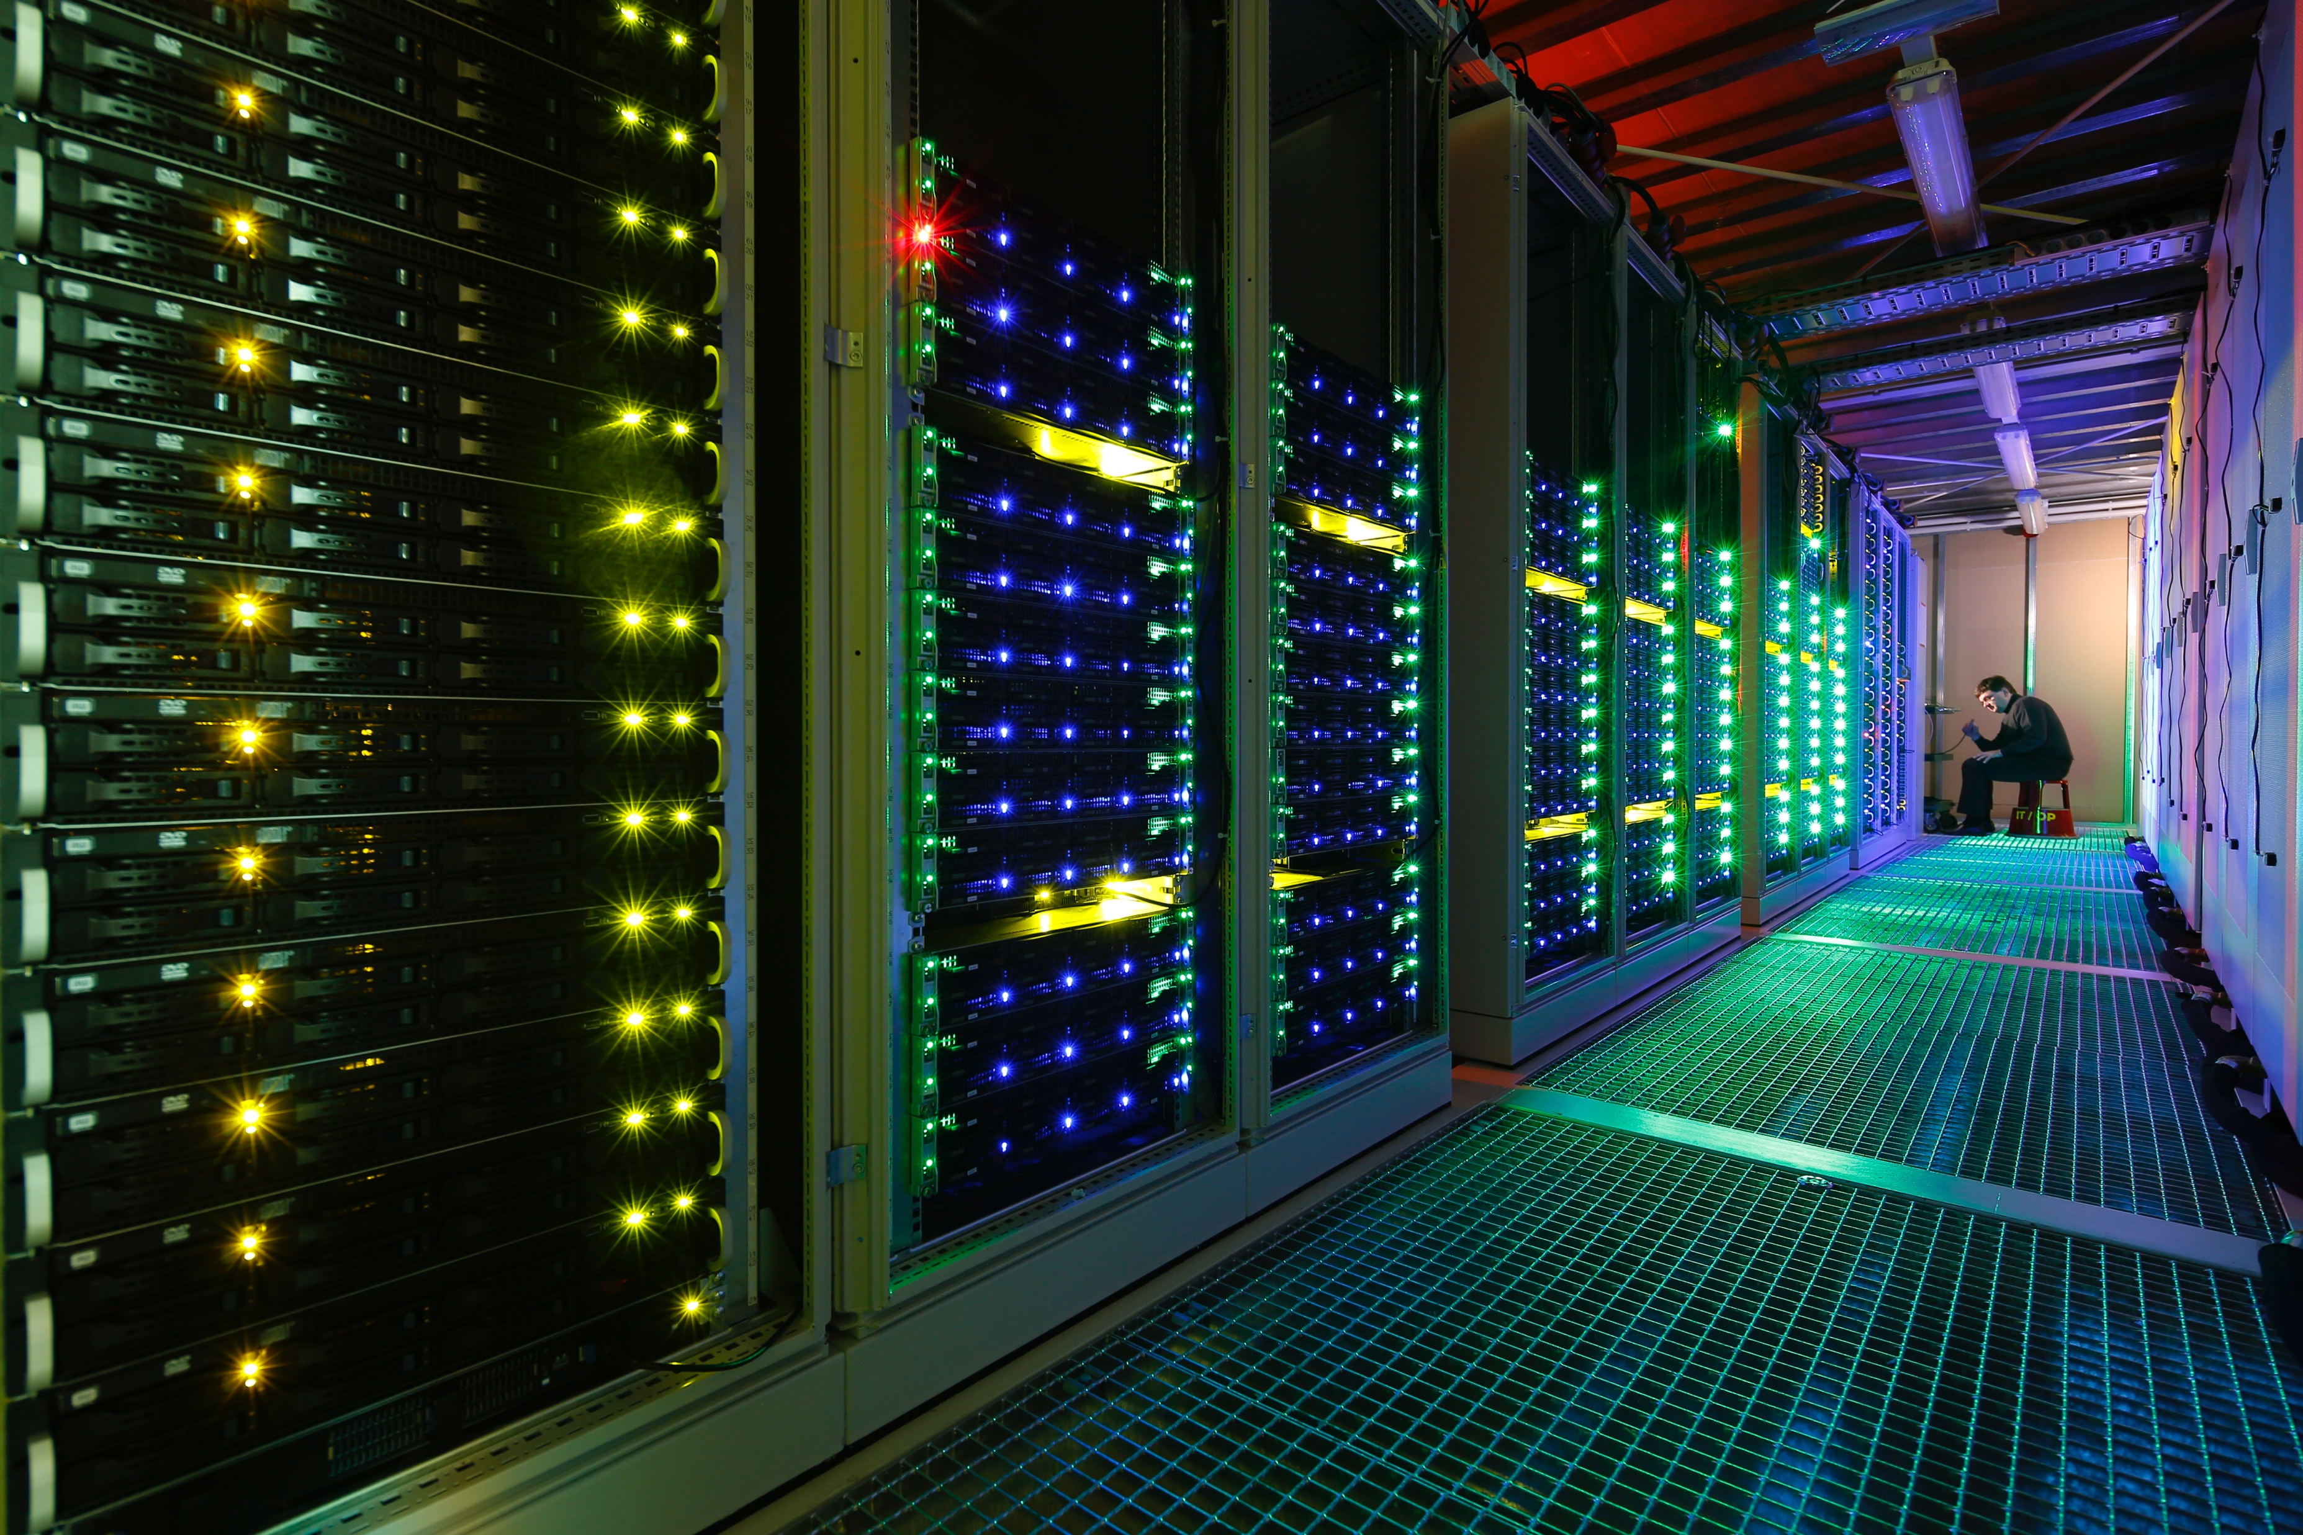
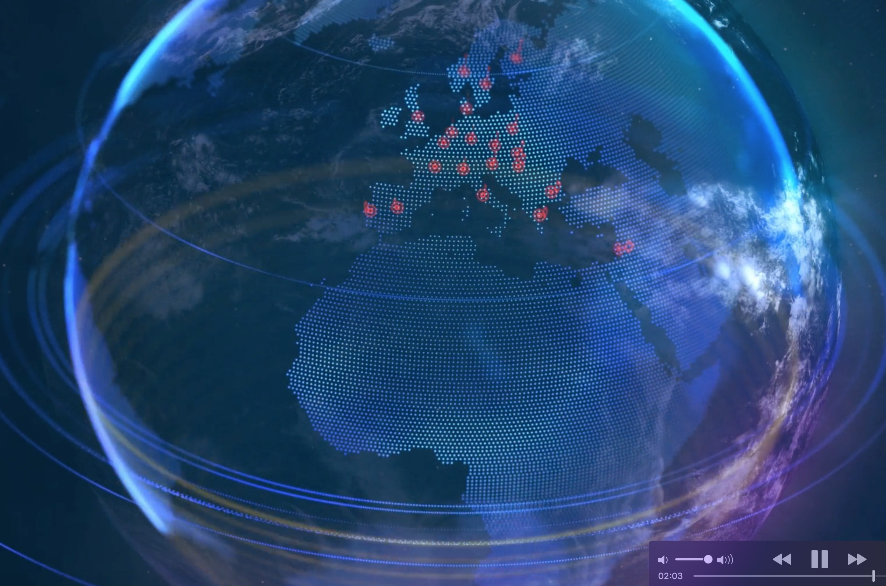
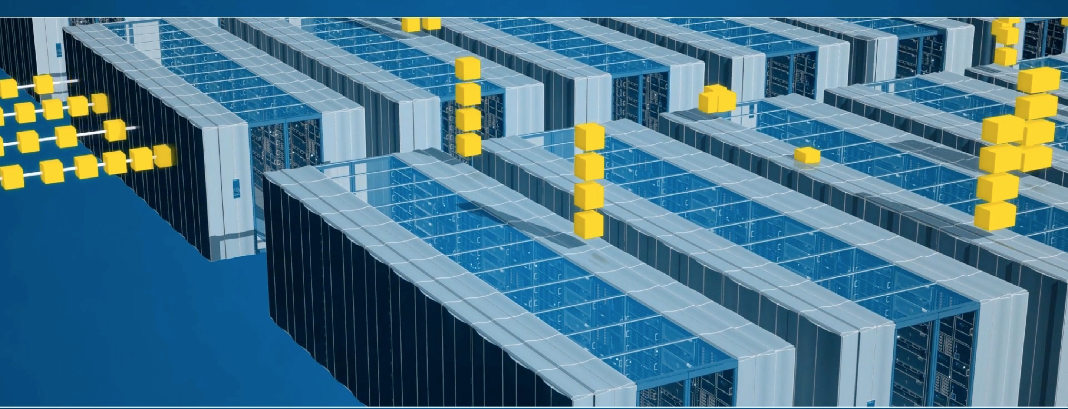
Additional drivers and missions for setting up the SEEIIST
No matter where SEEIIST will be located
– National benefits across the whole Region –
Development of powerful digital network and large data handling
Development of alternative energy production– e.g. Installation of Solar power panels
Treatment of patients: all participating parties will have their share for the treatment of patients
Involving the local industry: the construction of the Facility would require more than 200 companies. The production of many different components can preferentially be assigned to our local industry.
Powerful digital networks and big data handling - to reach the clinical and scientific goals two Networks will be set up, a Clinical- and a Scientific Network, to be located in different parts of the region
for GSI-FAIR
CERN
Training for building innovative capacity in South East Europe – all countries involved - Funding from IAEA, COST, MC ITN,….

Slide 14
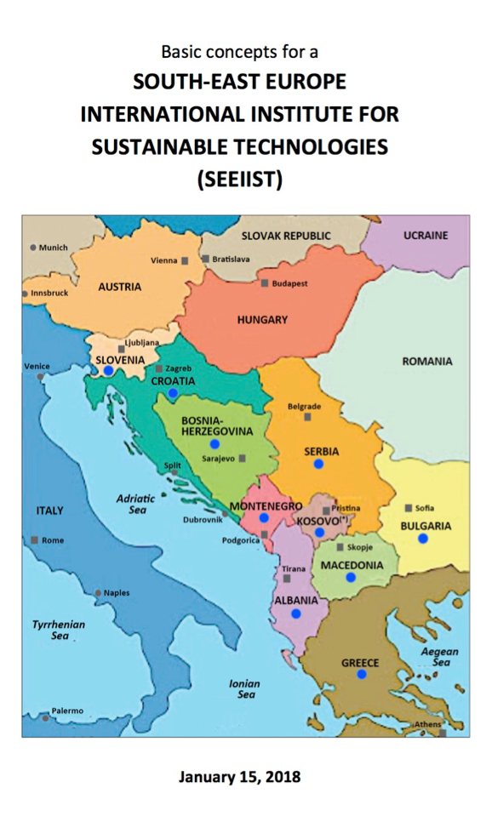
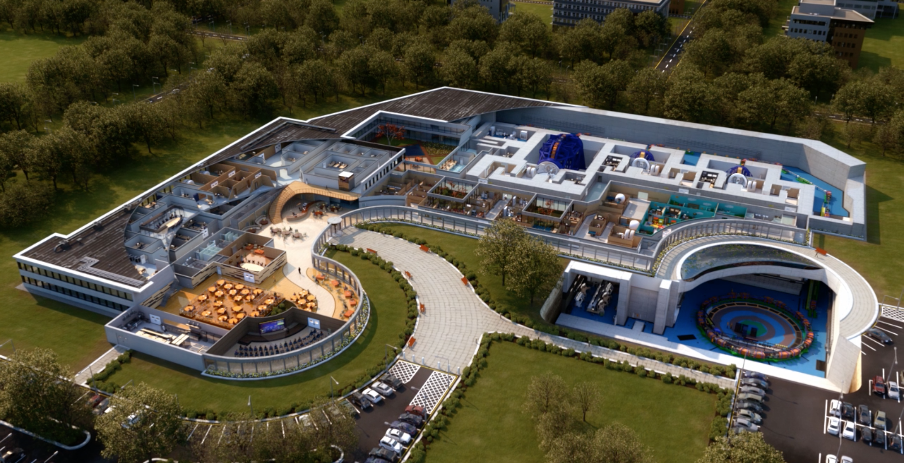
Time line of the SEEIIST Project
2019:
Start of the Design Study Phase
Application for Design-Study-Call INFRADEV-01-2019-2020
2020/21:
Selection of the site
Application for the
ESFRI Road Map
2028:
First patient treatments
2023:
Start construction of the Facility
For SEEIIST up to 200 MEUR required, guaranteeing
competitivity in Europe. Multiple sources of financing
necessary: EU Structural and cohesion funds, IPA funds, some contributions from member-states, other investment funds
2017-2018: Concept Studies

Slide 15
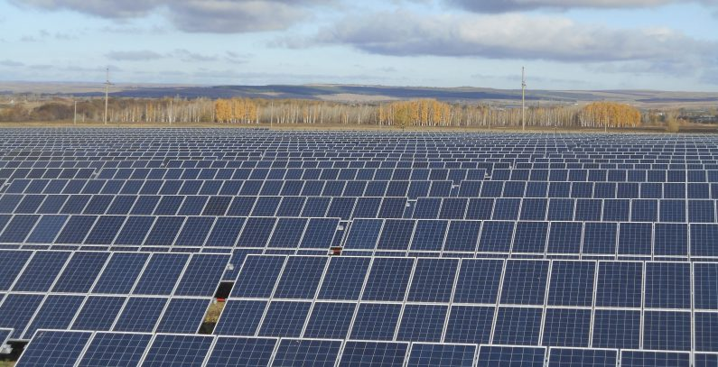
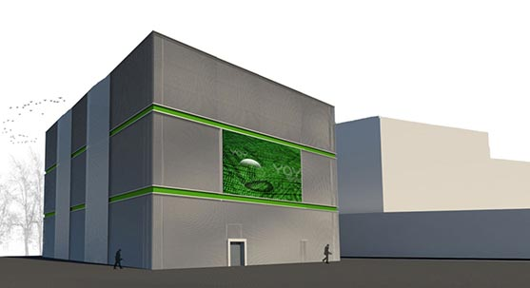
Green Concept for the SEEIIST Project
SEEIIST
will be
First Green Particle Therapy
Action in Place – preparing a concept of SEEIIST as a Green Infrastructure: Green Energy – Green IT ….

