Slide 1
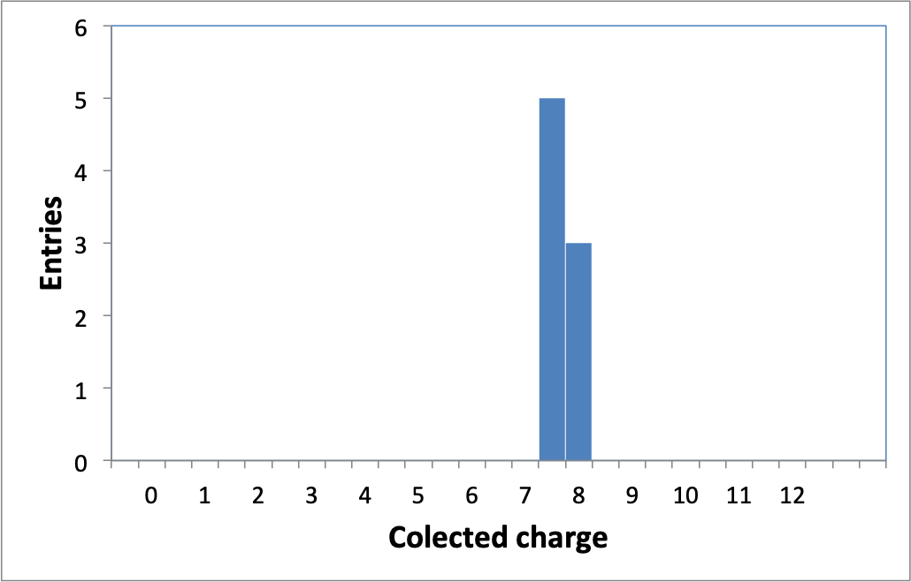
Ljubljana status
CCE of 8 minis measured, all from preproduction
all results above the threshold
threshold

Slide 2
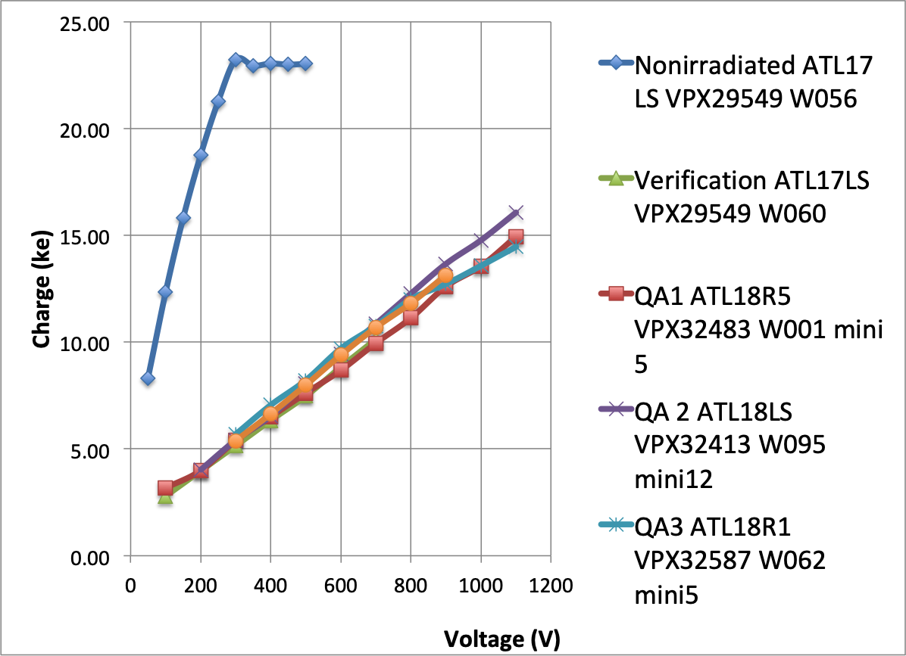

Slide 3
Petal Tapes
Design changes:
  minor changes
  rotate the position of the modules which means rotate the lines along the bustape. This comes from a wrong old petal CAD drawing.
Need final petal CAD drawing, including the module (hybrids, powerboard) description.
Complete design by end February, review and submit mid-March.
Pre-production = 5%, Yield factor=1.256 ➔ 50 Tapes
Production Elgoline 2-3 months (first tapes earlier).
Elgoline dostavil 4+4 flekse, se testirajo
Vnos v databazo!

Slide 4


Slide 5
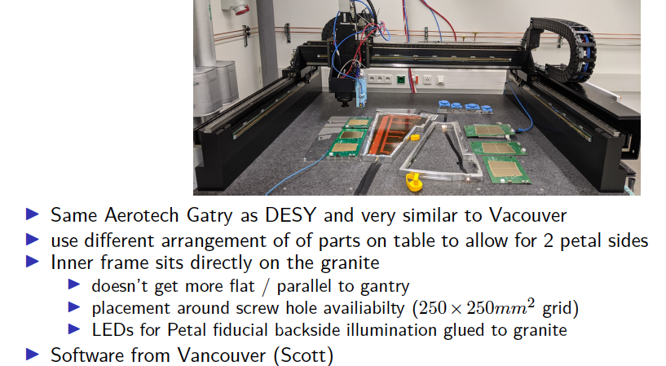

Slide 6
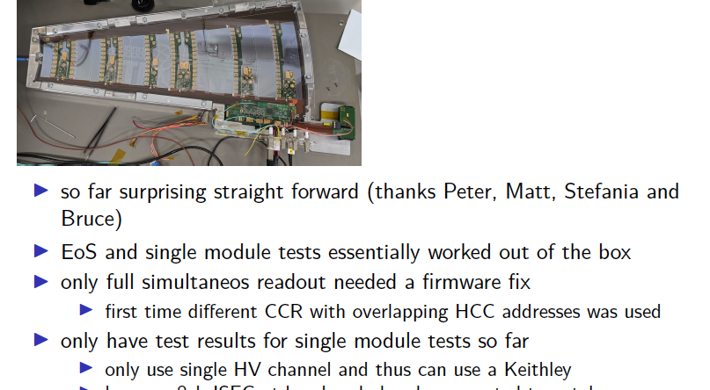

Slide 7


Slide 8


Slide 9
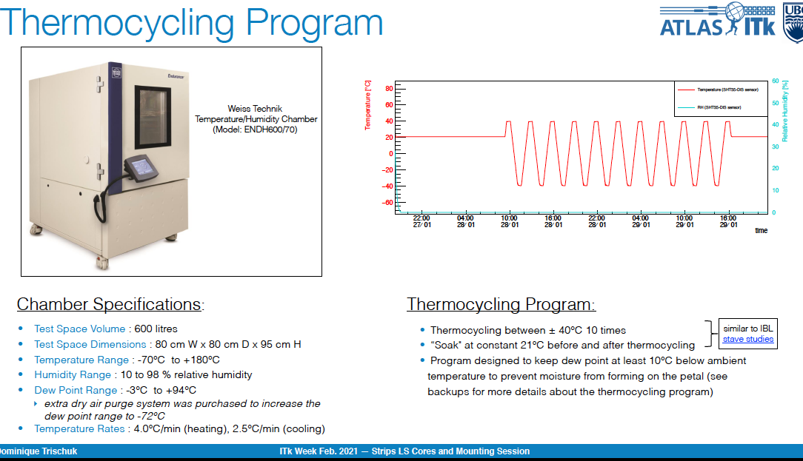

Slide 10
