Slide 1
Active pixels in irradiated RD50-MPW2
F9 Weekly, 26. 03. 2021
Bojan Hiti, F9, Jožef Stefan Institute

Slide 2
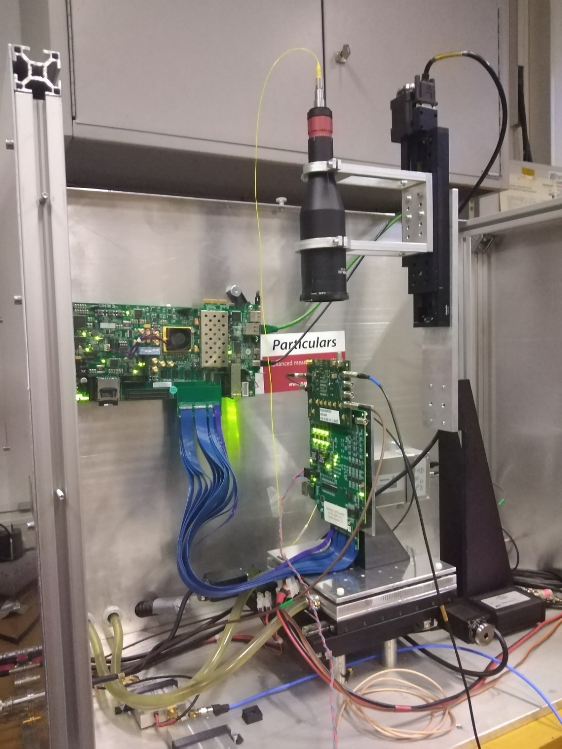
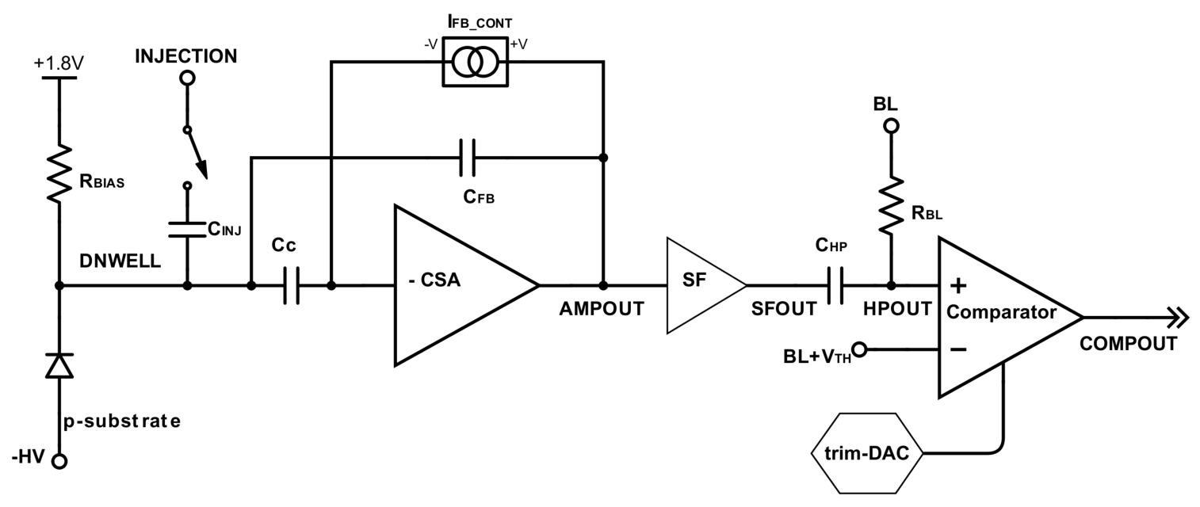
Measurement setup
HV-CMOS with 8x8 active analog pixel matrix (60x60 um)
DAQ: ZC706 FPGA + Caribou + L'pool GUI software
Sample mounted in Particulars Edge-TCT setup
  Neutron irr. sample W11 (1.9 kOhm cm) – 5e14 n_{eq}cm⁻²
    Comparing to an unirradiated W11 sample

Slide 3
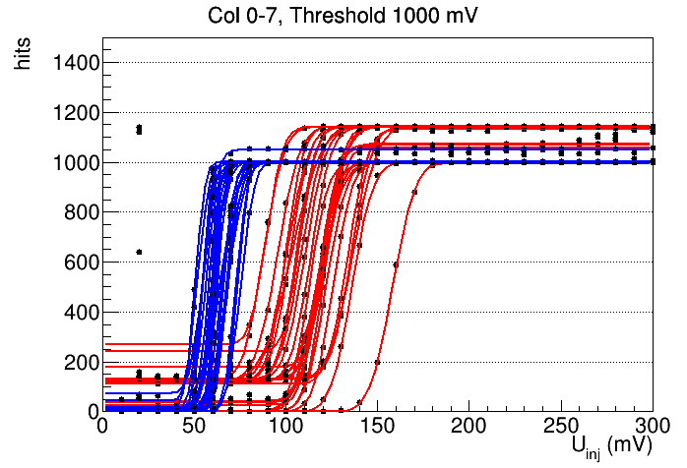
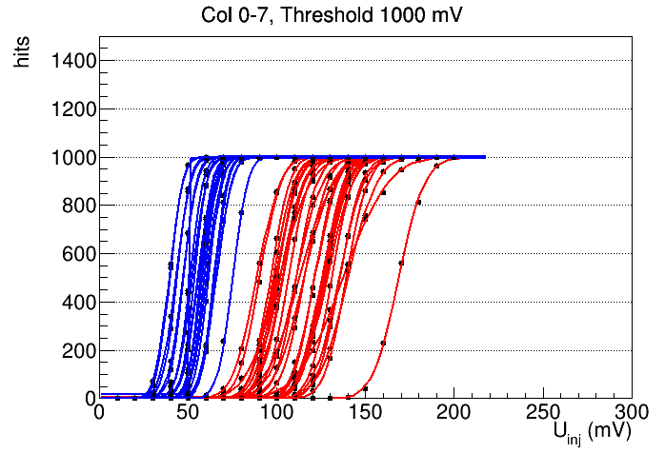
S-curve measurements
BL = 900 mV, different thresholds U_{thr}: 950 – 1100 mV, vary U_{inj} 10 – 300 mV
Fine tuning of pixel threshold possible with TrimDACs (not used here)
Continuous reset pixels (Col 0 – 3), pulsed reset pixels (Col 4 – 7)
No problems with pedestal in irradiated sample
Thresholds similar before and after irradiation similar, significant spread
before irradiation
5e14 neqcm-2

Slide 4
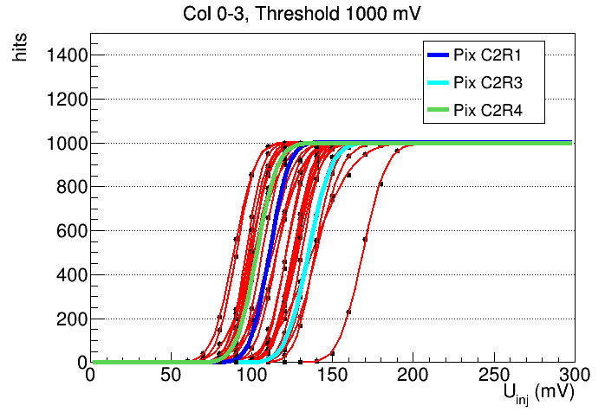
Selected pixels for detailed measurements Edge-TCT
Three continuous reset pixels studed in more detail: ToT→charge calibration, timing with Edge-TCT
Different thresholds: C2R4 < C2R1 < C2R3 (column/row)

Slide 5
ToT Calibration
Calibration via charge injection through injection capacitor (2.8 fF)
  option 1: external pulse via pulse generator
  option 2: injection via CaRibou board
Two thresholds 950 mV and 1000 mV
Measure ToT of COMPOUTBUFF signal on oscilloscope
CaR
Pulse Gen.
(Ext. Inj.)

Slide 6
External injection
Maybe switched 950 and 1000 mV?
S-Curve thresholds: C2R4 < C2R1 < C2R3
Significant difference in calibration of different pixels (up to 50 %)
Probed pixels slightly below simulation values
Approx. 5 % difference within pixel between thresholds 50 mV and 100 mV

Slide 7
CaR vs. external injection
Less cross talk with external injection (can access lower ToT before noise appears)
CaR vs. External Injection are very well compatible (2 – 3 %)

Slide 8
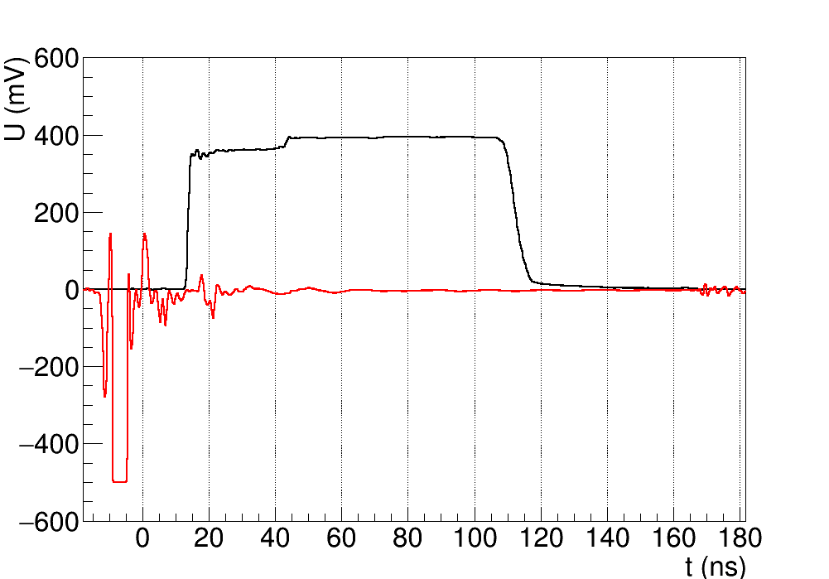
Edge-TCT pulse
Acquisition triggered by laser driver output
Time scale adjusted for cable and fibre length, light hits the sample at t=0
Signal is the comparator output COMPOUTBUF
  Should be 1.8 V logic level, but current driver not powerful enough for 50 Ohm termination
Measure Time of Arrival and Time over Threshold
CabL
ToT
ToA
laser trig

Slide 9
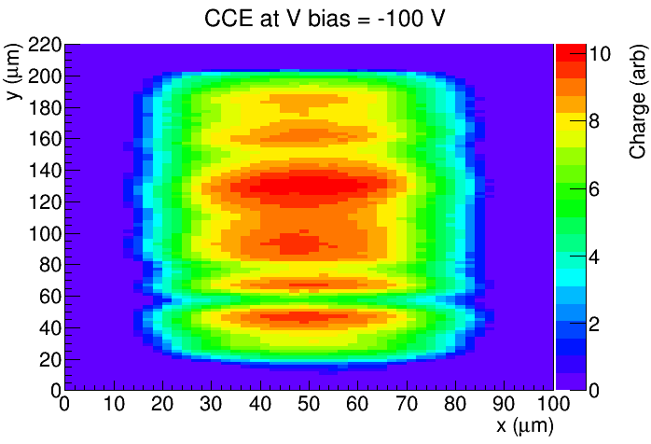
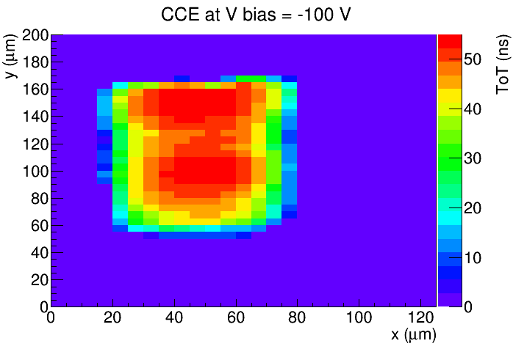
Charge collection before and after irradiation
chip surface
depth
before irradiation
5e14 n
Reduced depletion depth after 5e14: 180 μm → 100 μm (gc in 1.9 kOhmcm)
Some substructure visible in both chips (probably comes from sensor edge – dicing)

Slide 10
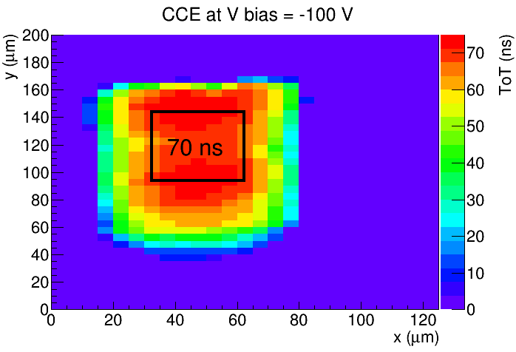
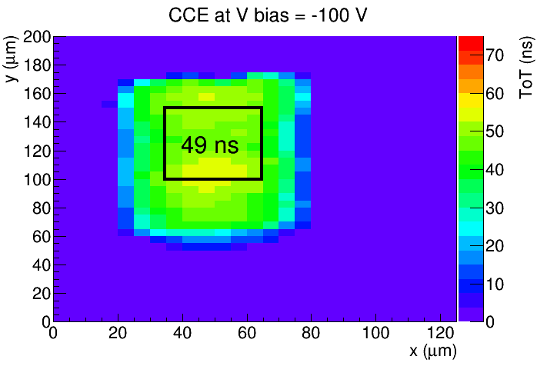
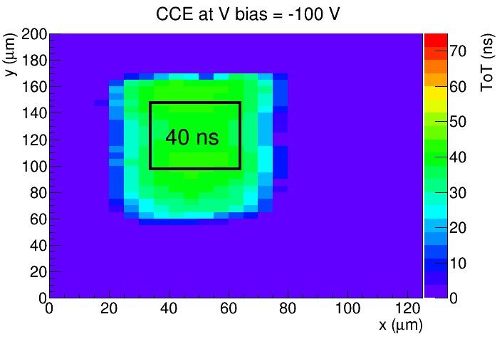
Pixel to pixel variations of signal size (5e14)
ToT 70 ns = 4500 e
ToT 49 ns = 3500 e
ToT 40 ns = 3500 e
S-curve thresholds: C2R4 < C2R1 < C2R3
C2R4
C2R1
C2R3
avg. ToT
Measurements in three different pixels at the same laser intensity
Signal size varies significantly between pixels
  Due to different thresholds (no threshold tuning)
  Not directly problematic for time-walk measurements (expect ToA changing accordingly)

Slide 11
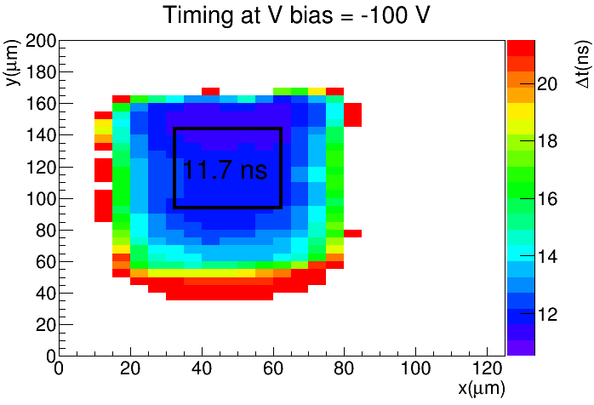
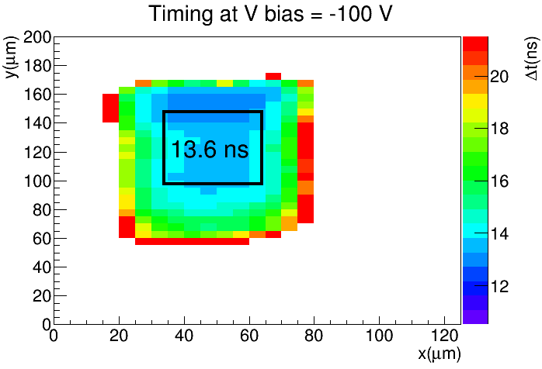
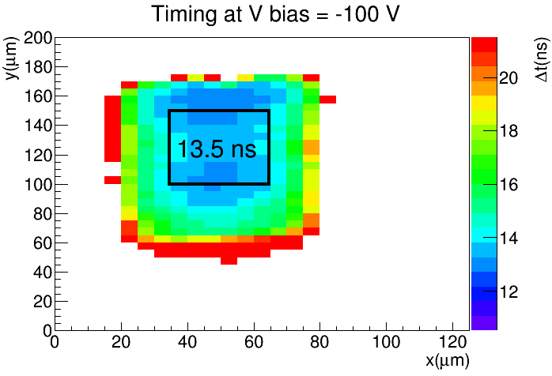
Pixel to pixel timing variations (5e14)
S-curve thresholds: C2R4 < C2R1 < C2R3
C2R4
C2R1
C2R3
avg. ToT
avg. ToA

Slide 12
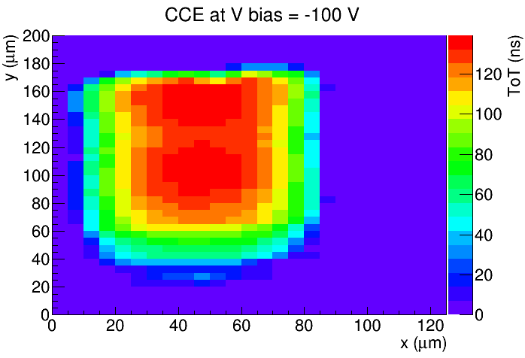
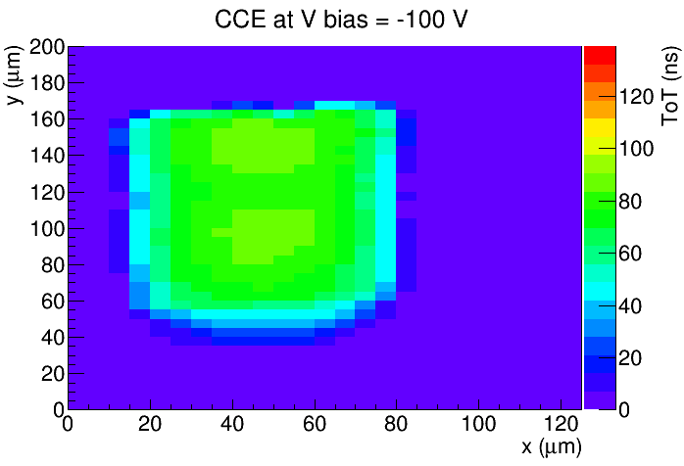
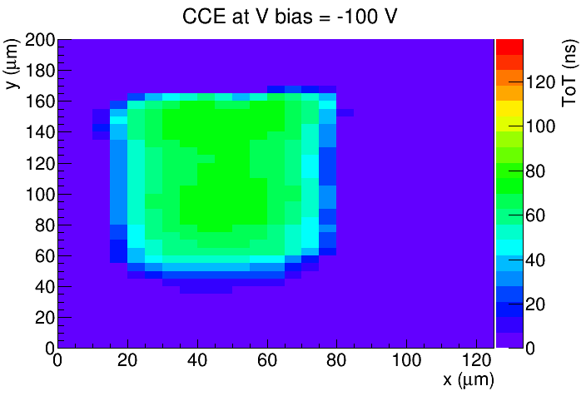
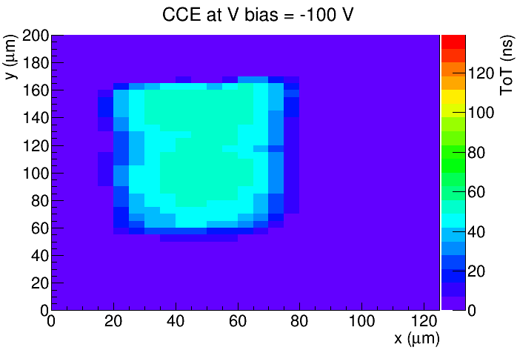
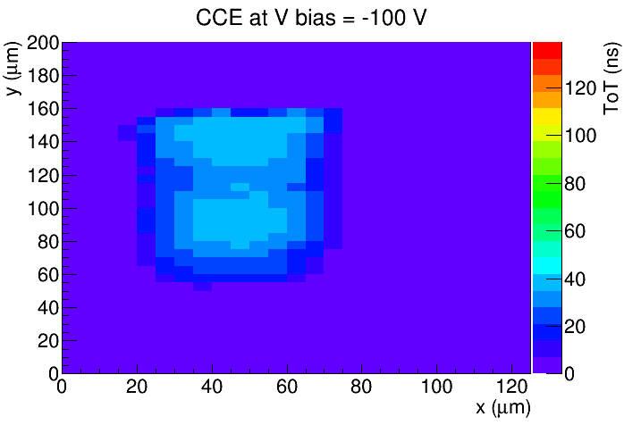
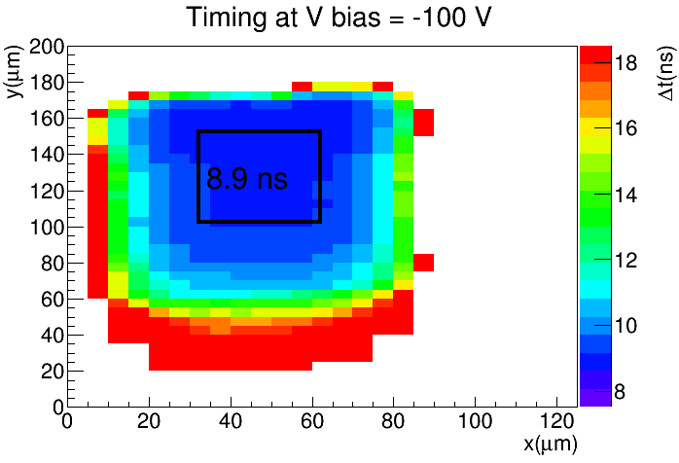
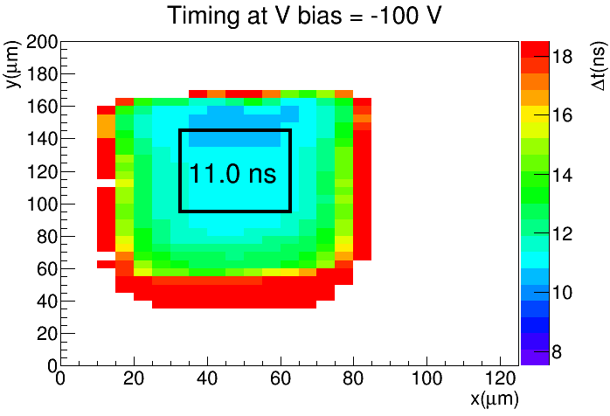
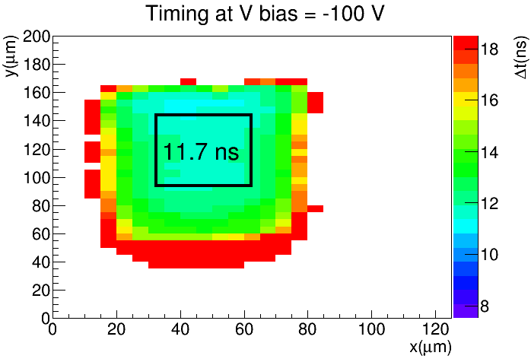
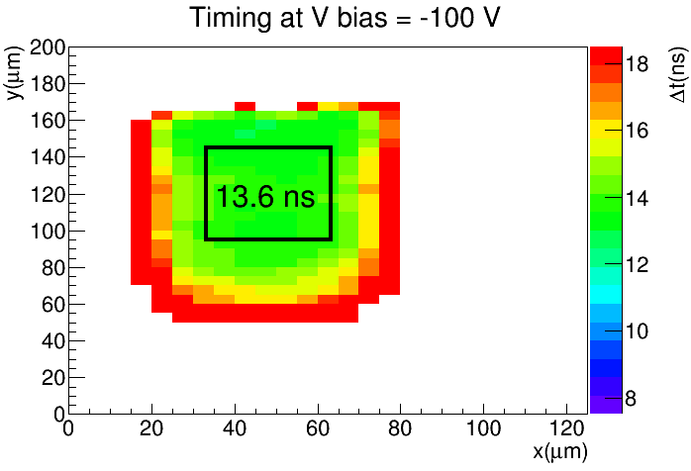
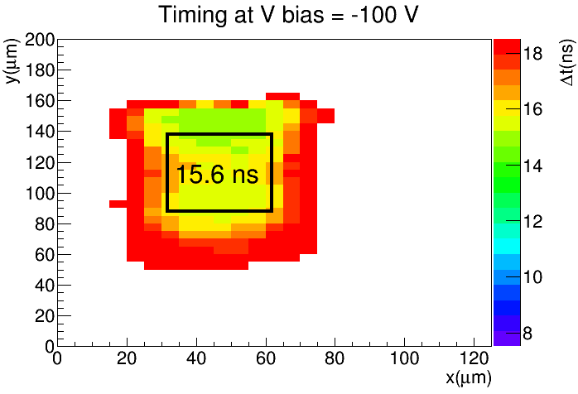
Pixel C2R4
Reducing laser power
(same z-scale for all measurements)
ToT
ToA
Reducing laser power

Slide 13
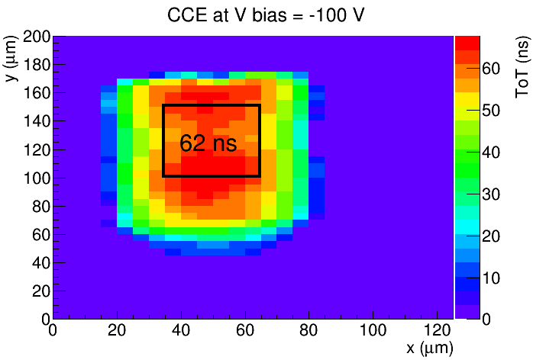
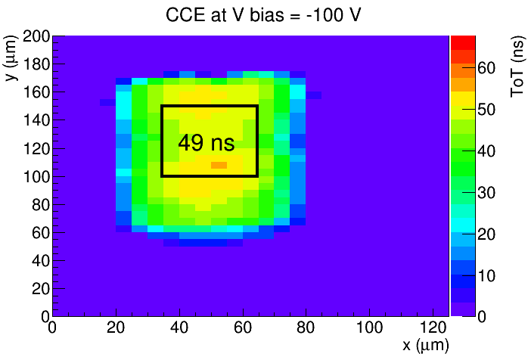
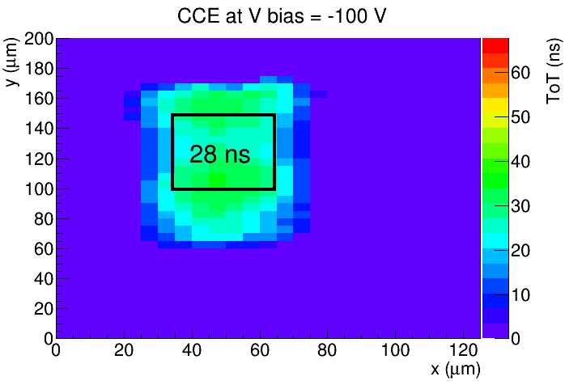
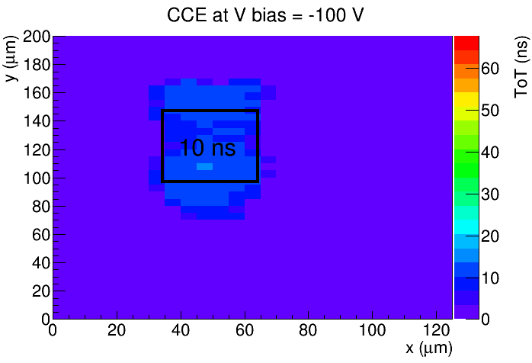
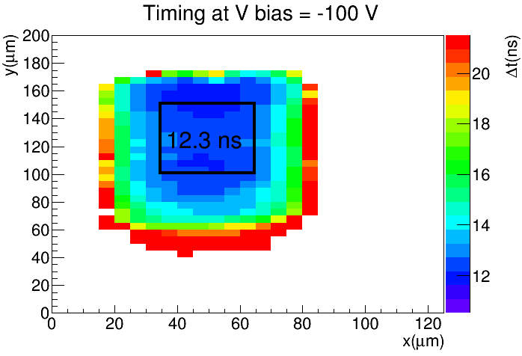
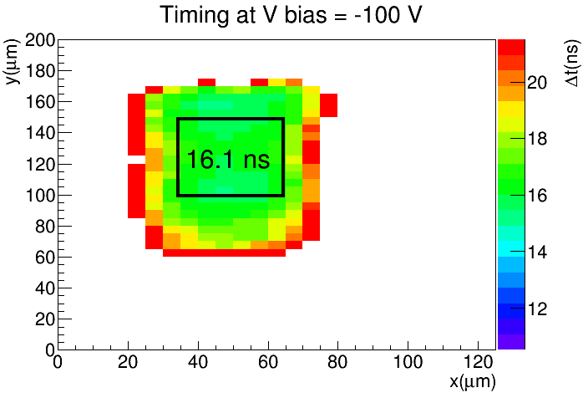
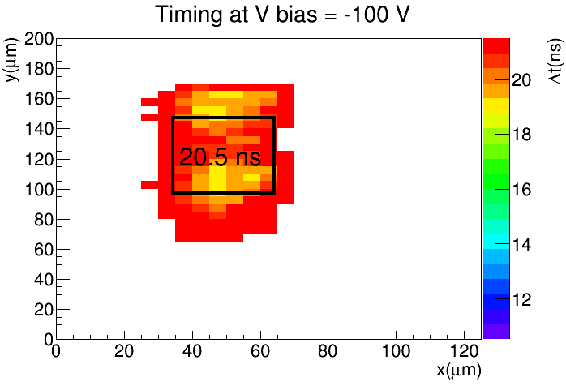
Pixel C2R1
Reducing laser power
(same z-scale for all measurements)
ToT
ToA

Slide 14
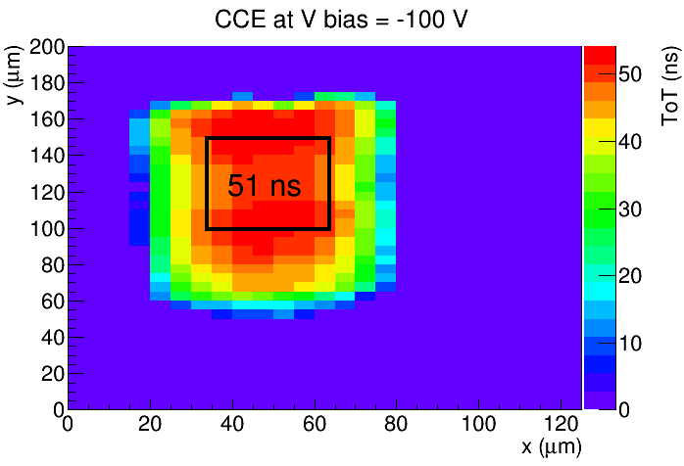
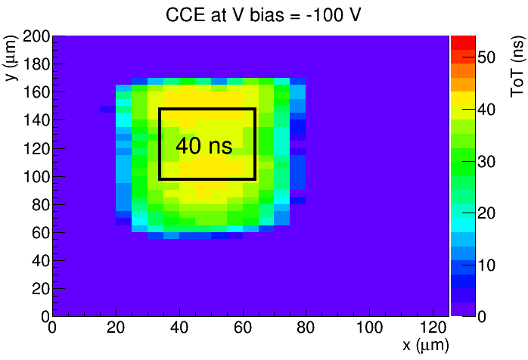
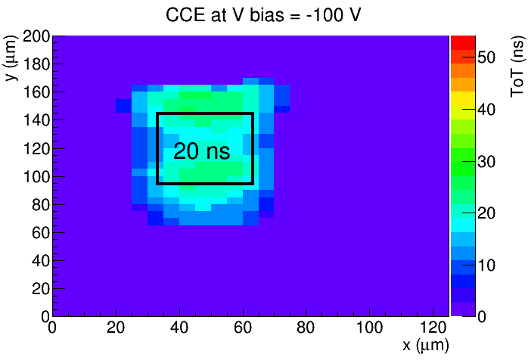
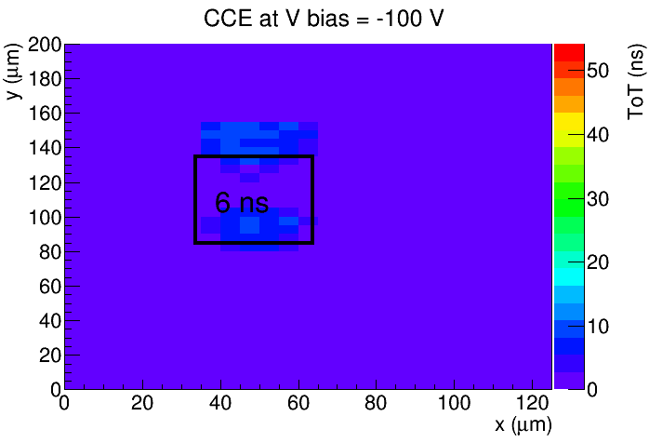
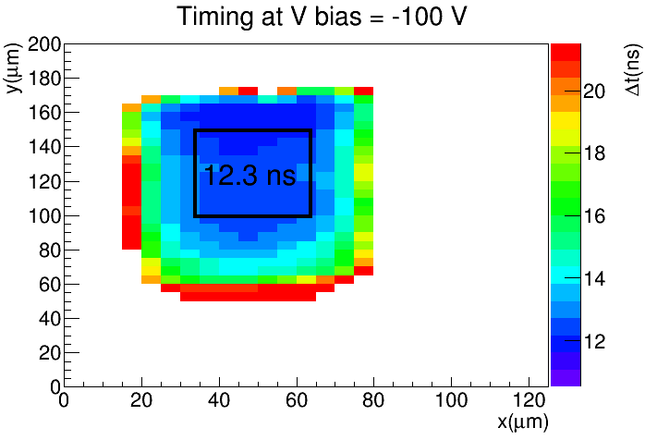
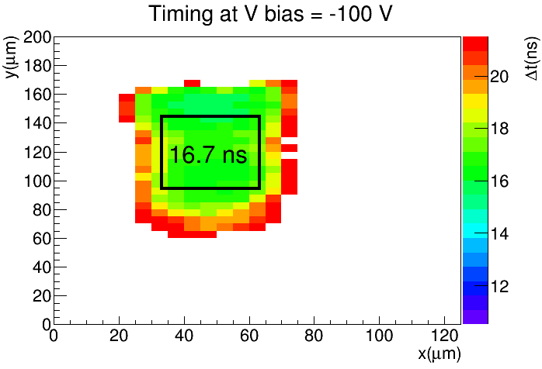
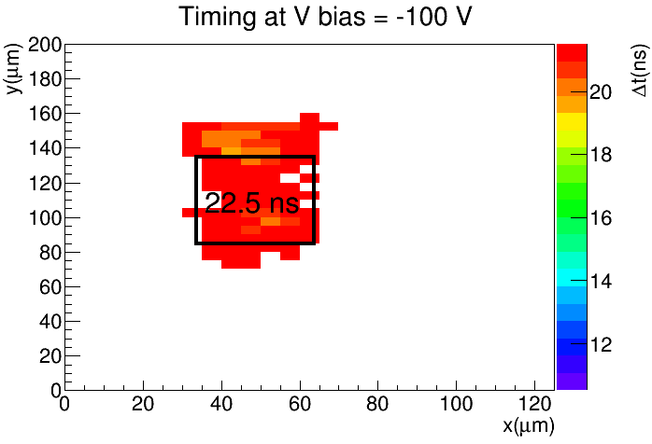
Pixel C2R3
Reducing laser power
(same z-scale for all measurements)
ToT
ToA

Slide 15
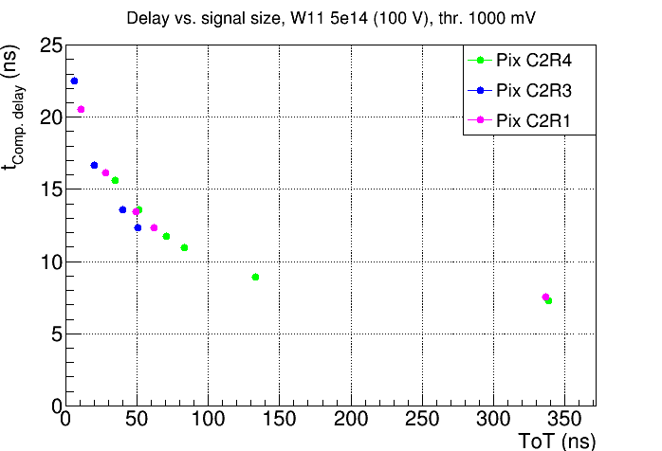
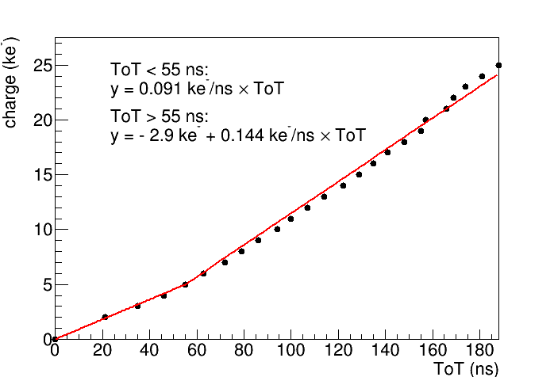
Summary time walk (5e14)
approximate calibration curve from simulation (doc)
ToA in pixel center varies between 7 ns and 25 ns in the selected signal range
Time walk is similar between pixels (signal size variations cancel out)
To do: compare with unirradiated chip, ToT calibration with (external) charge injection

Slide 16
Summary
First measurements at JSI with irradiated (5e14 neutrons) RD50-MPW2
S-curves similar to unirradiated chip
Charge collection efficiency relatively uniform
Time walk measurement: 7 – 25 ns in pixel center

