Slide 1
TPA setup
F9 weekly, 04. 06. 2021
Bojan Hiti, F9, Jožef Stefan Institute

Slide 2
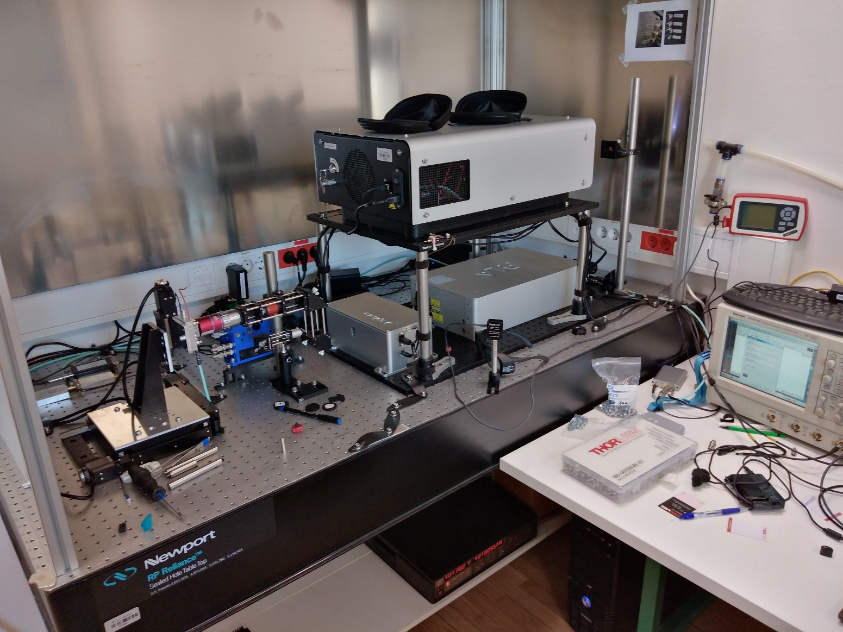
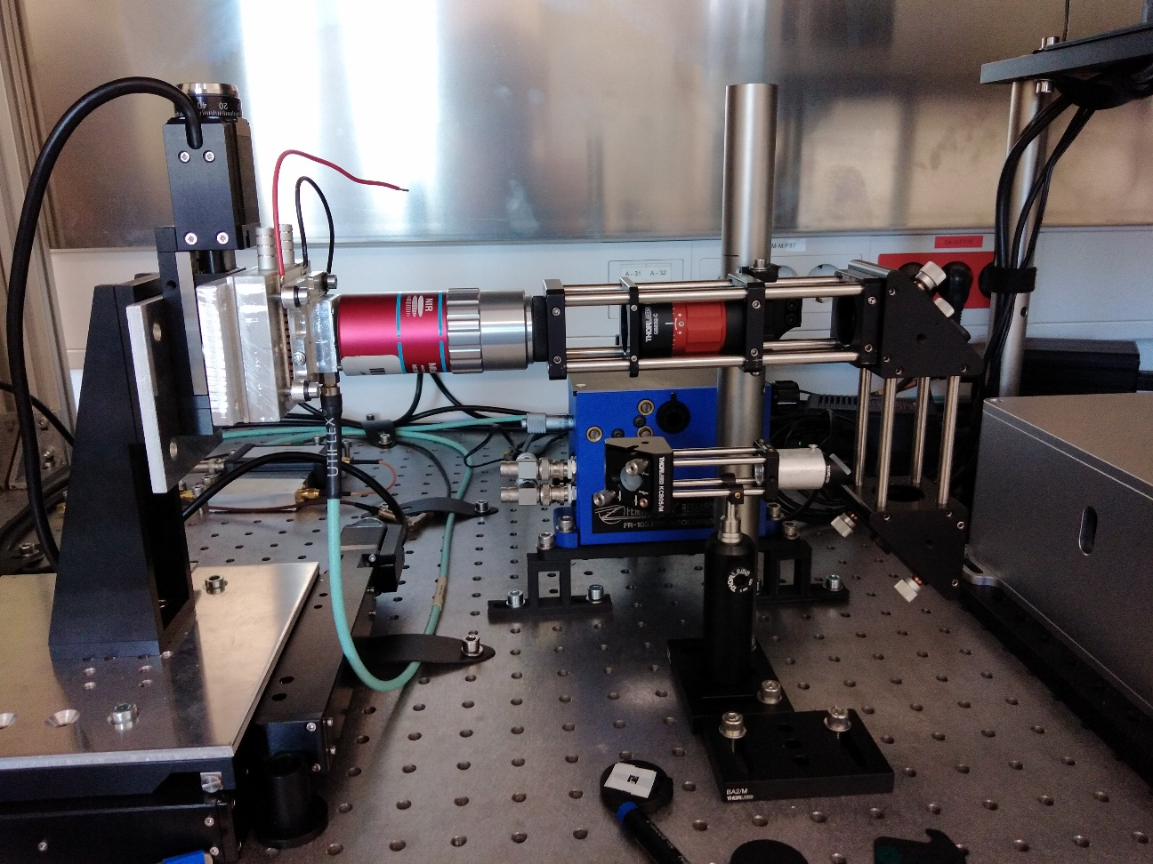
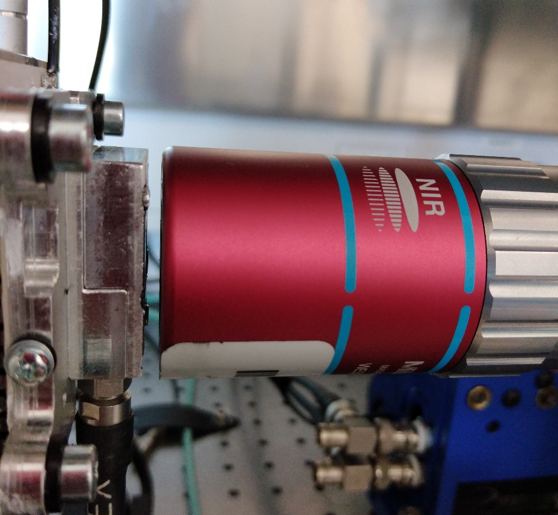
TPA setup
asd

Slide 3
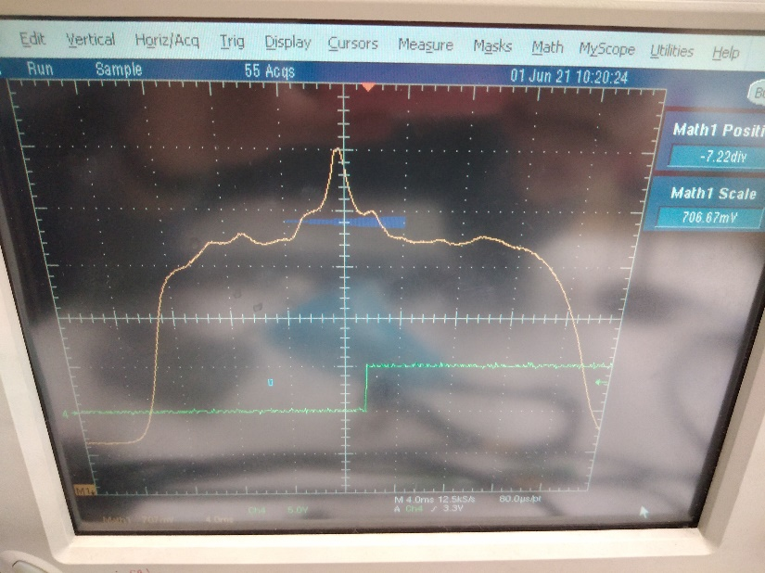
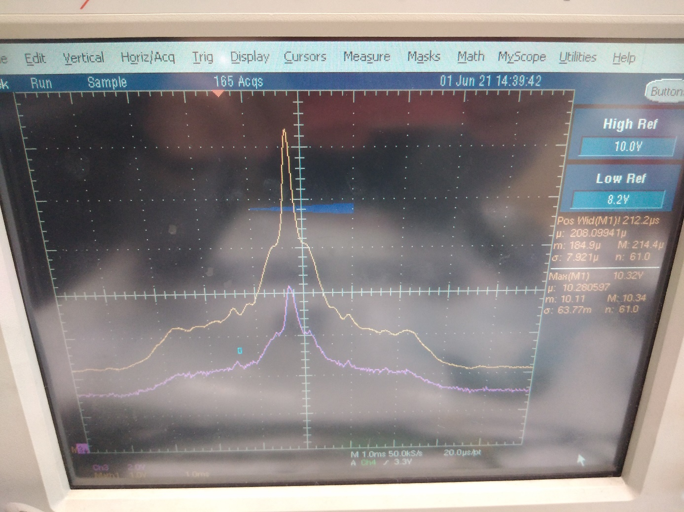
Pulse duration
Autocorrelator output on oscilloscope
Calibration factor 1.6 ms/ps (1 ms on autocorr. function means 1600 fs pulse duration)
4 ms
Pulse duration cca 300 fs
1 ms

Slide 4
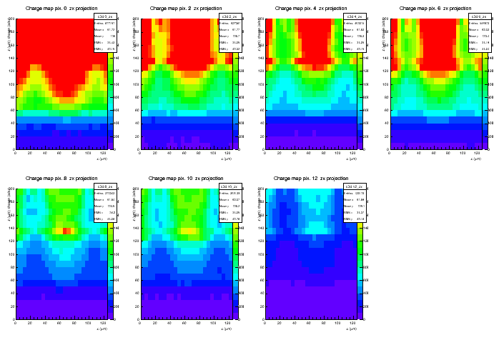
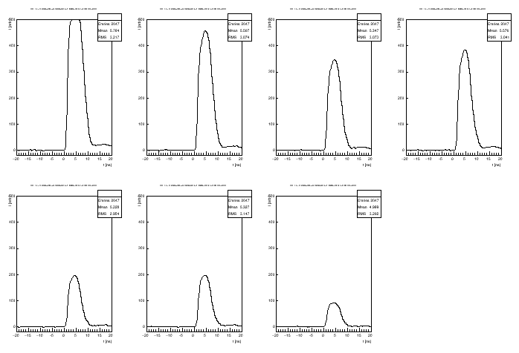
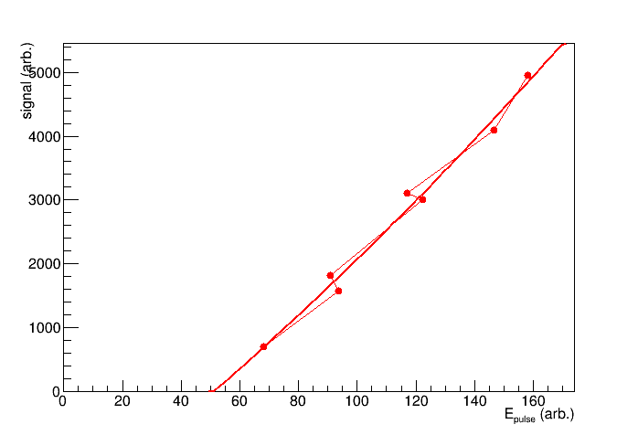
First signals
7 different light intensities
Spaghetti diode cca 60 um pitch

