Slide 1
TPA-TCT measurements status
F9 Weekly, 06. 08. 2021
Bojan Hiti, F9, Jožef Stefan Institute (JSI)

Slide 2
Ljubljana TPA-TCT setup
Based on FYLA LFC 1500X fs laser (λ=1550 nm)
Readout electronics and DAQ based on standard Particulars TCT

Slide 3
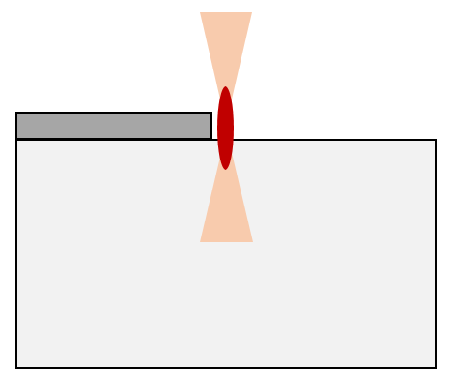
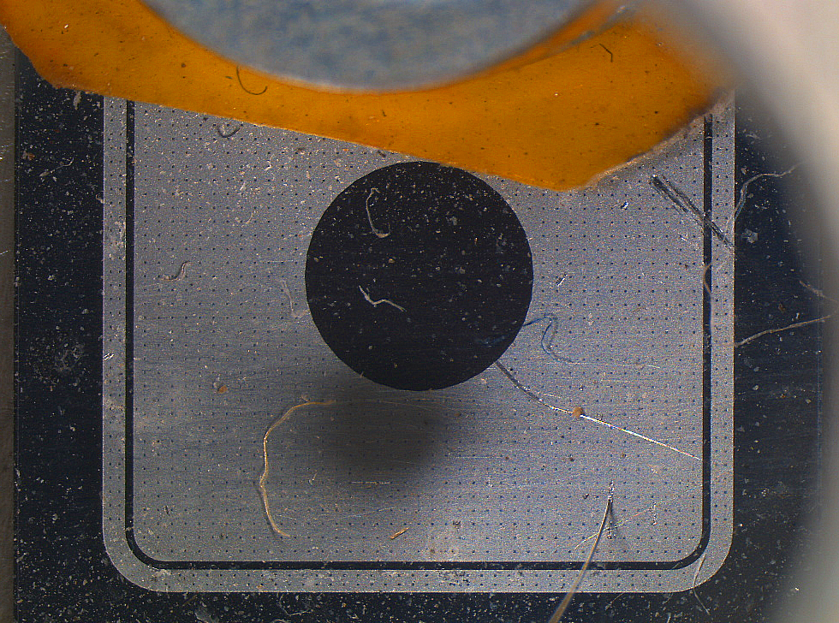
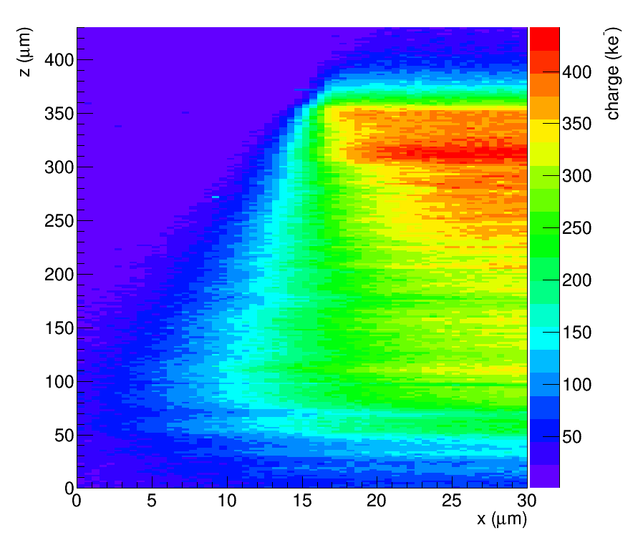
Sample and measurement
Sample:
6 x 6 mm p-in-n pad diode, metalization opening 2 mm
Thickness 300 μm, Vfd=20 V, 10 kΩ·cm, unirradiated
Charge = time integral (25 ns) of TCT-pulse
Amplifier output calibrated with Am²⁴¹ alpha source (5.4 MeV)
x
z
Beam
Direction of view

Slide 4
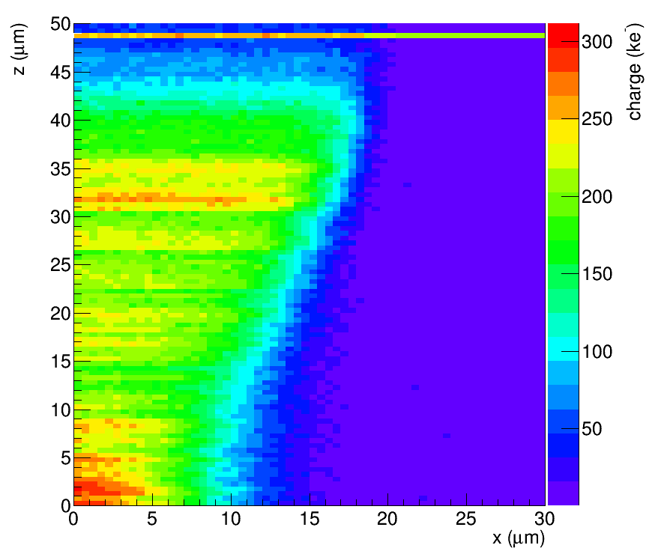
Sample tilt
Sample is tilted by approx. 1°
Ordered a manual tilt stage to compensate

Slide 5
Beam characterization

Slide 6
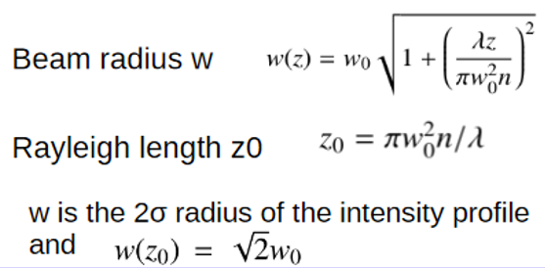
Beam characterization
Fit Error function at different z
extract w(z)
extract w0

Slide 7
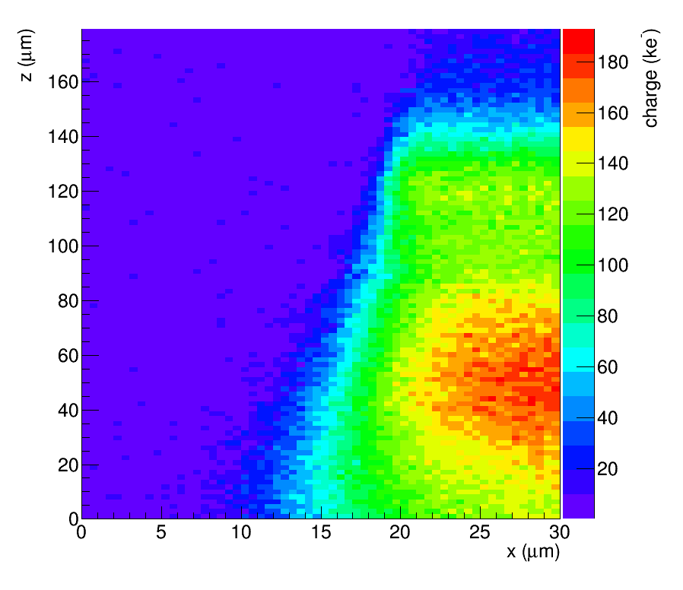
Beam characterization

Slide 8
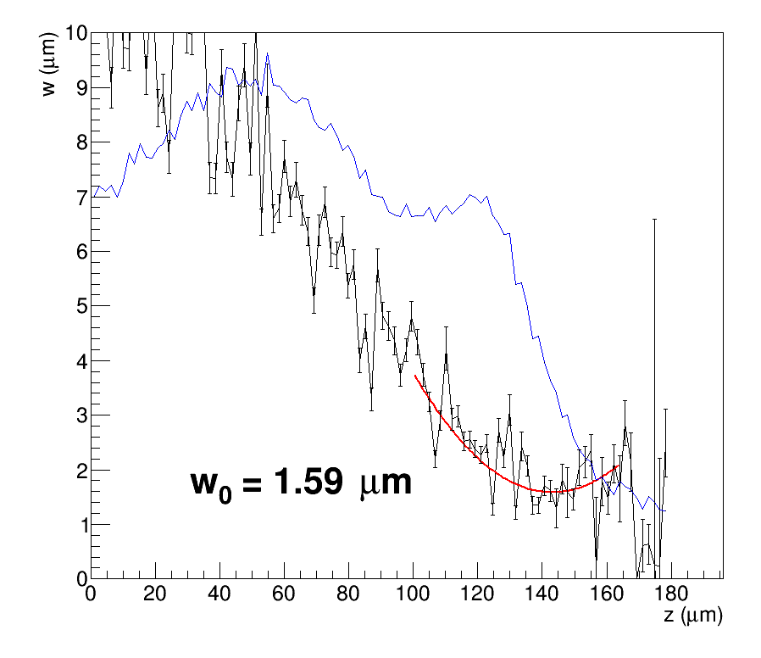
Beam characterization
z0 = 18 um
signal size

Slide 9
Longitudinal spot size
Errata z->x

Slide 10
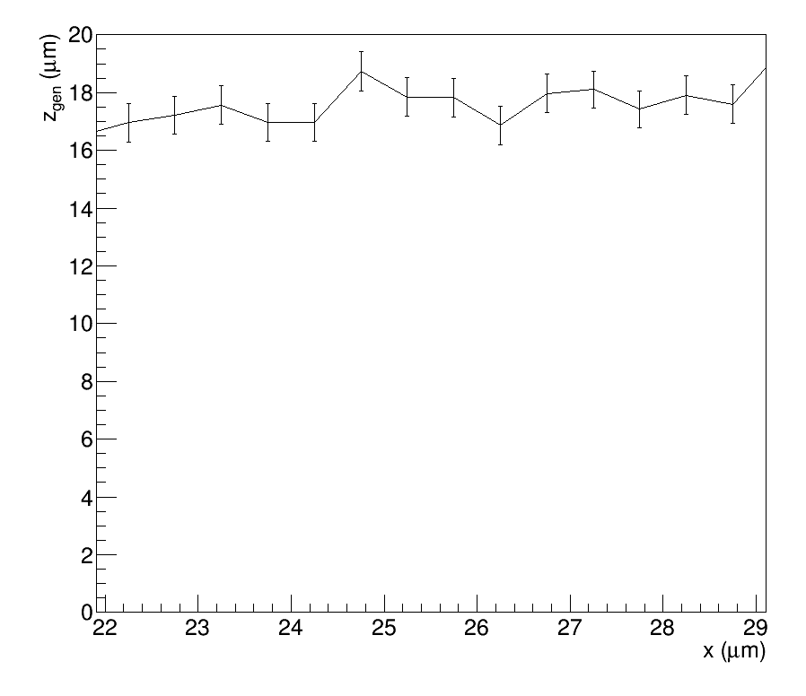
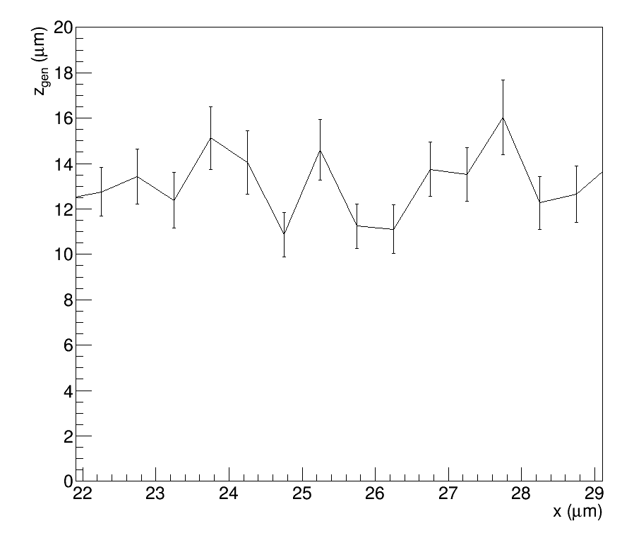
Longitudinal spot size
Reducing beam intensity (approx. factor 2 in charge)
Cigar half-length cca 15 um

Slide 11
SEU potential
LGAD mortality studies require charge of the order of 30M e-h pairs
Can it be done with TPA?
Maximized laser signal
HPK LGAD 2.5e15 biased to 700 V → failed in DESY test beam
No defects observed with TPA
There is still potential to increase pulse energy, but setup overhaul
Reduce losses on optical bench
Pin = 100 mW, Pout = 15 mW

Slide 12
Edge TPA-TCT
Try Edge-TCT configuration using strip detector (CHESS 2)
So far no signals yet observed
 | Strip size 630 x 40 um

Slide 13
BACKUP

Slide 14
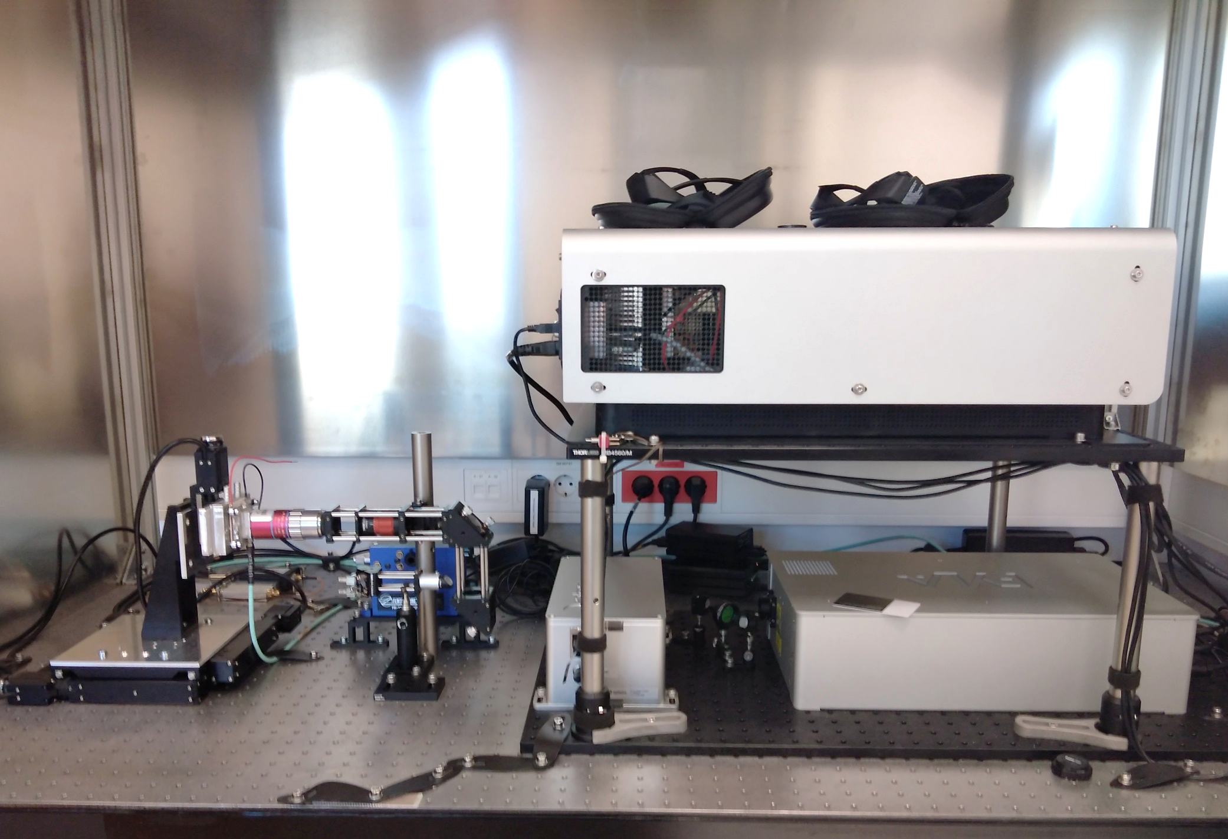
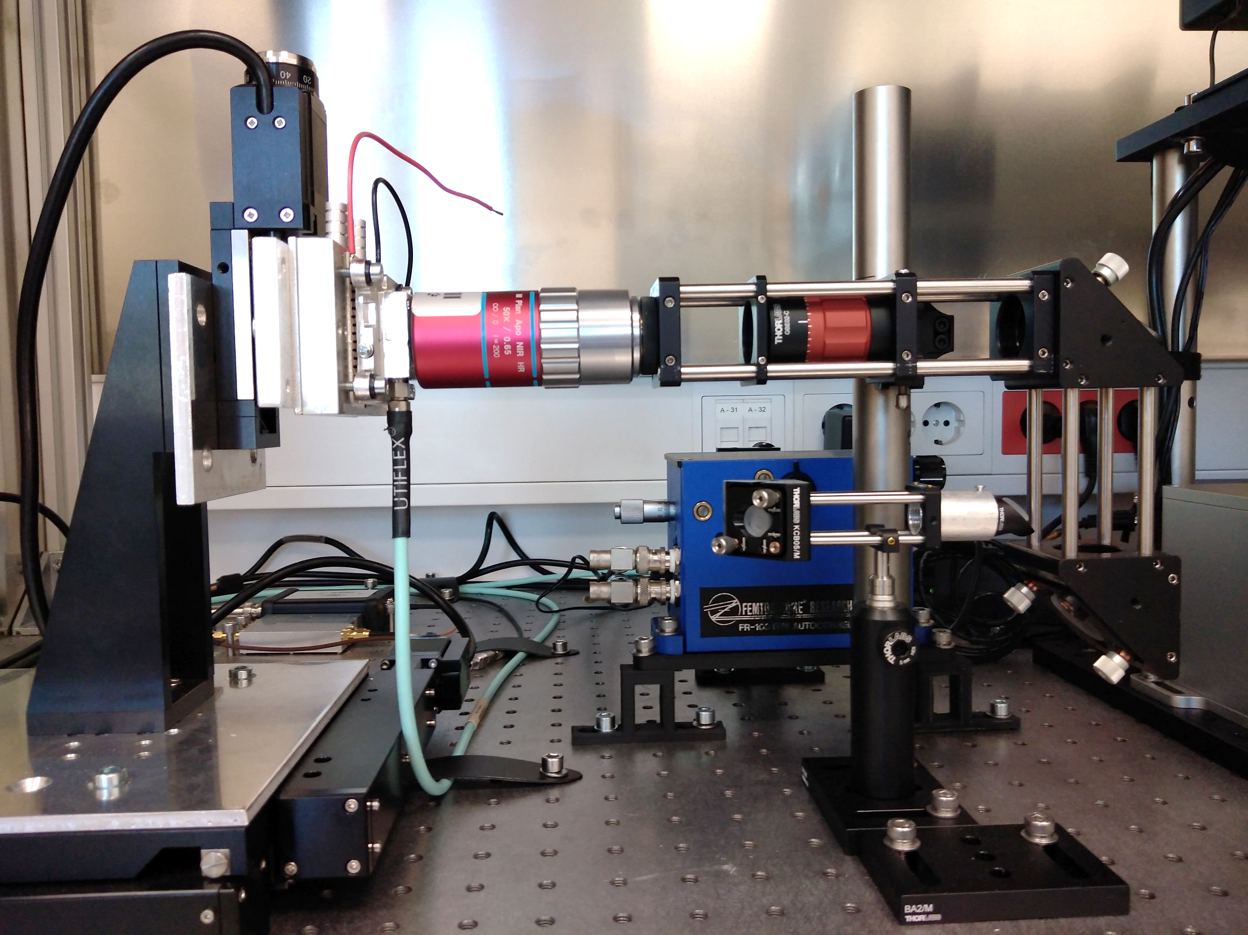
FYLA Laser Unit
Optional cooling
Pulse management module
(trigger & pulse energy)
Pulse compressor
Particulars
readout system
XYZ sample placement
Slide-in autocorrelator
Objective NA=0.65,
Working distance 10 mm
Sample housing

Slide 15
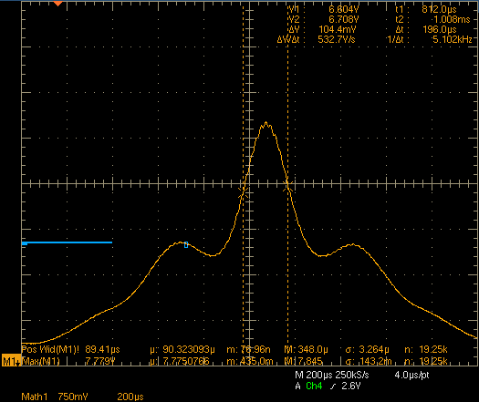
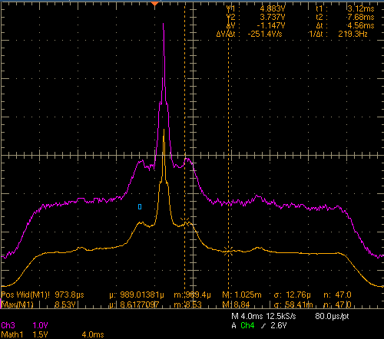
TPA laser pulse: Time domain
Measurement of laser pulse duration with an autocorrelator
Pulse width (FWHM)
0.196 ms x 1600 fs/ms = 310 fs
Autocorrelator output
Pulse duration ≈ 300 fs

