Slide 1
First CERN SPS test beam with BCM' and Calypso 3
F9 Weekly, 27. 08. 2021
Bojan Hiti, F9, Jožef Stefan Institute (JSI)

Slide 2
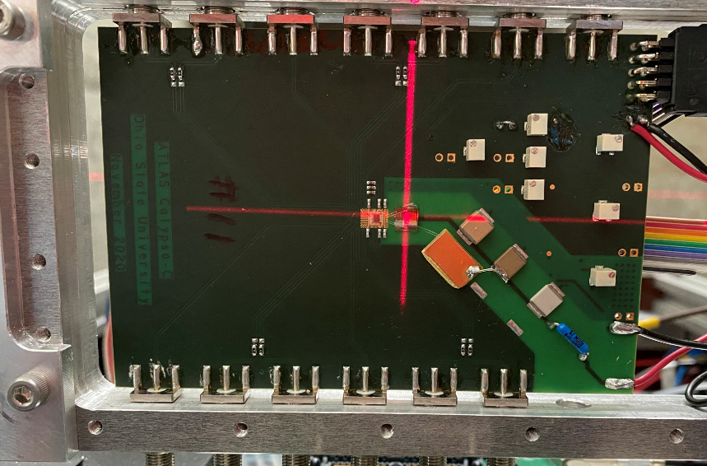
Samples
Calypso 3 chip bonded to segmented diamond samples (2 boards):
Board 1: 3d diamond with 4 test pads (50 V)
400x400 um with bias grid P0
200x200 um with bias grid P1
400x400 um without bias grid P2
200x200 um without bias grid P3
Board 2: Planar single crystal single pad diamond (200 V)
Each channel provides:
Analog output after first stage amplifier
(nominal < 1 ns rise time, ~5 ns fall time)
Two digital comparator outputs (LVDS+, LVDS-)
Read out with DRS4, 3 inputs at a time
Signal → Integration window 20 ns around signal peak (from avg. waveform)

Slide 3
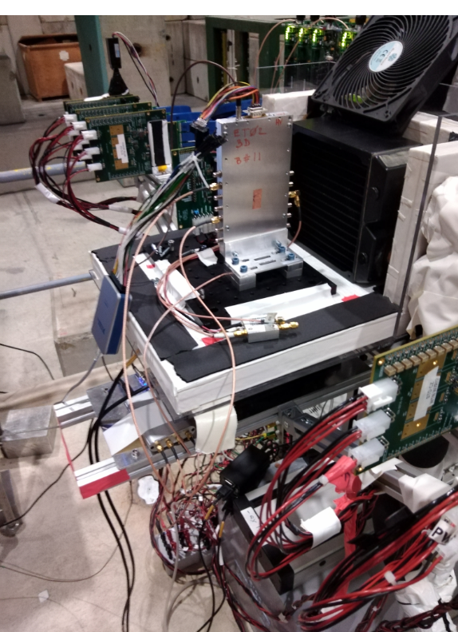
Beam and telescope
SPS 120 Gev pion beam
MALTA CMOS telescope
6 planes (3__0.5m_DUT_0.5m__3)
36x36 um pixels, configurable rectangular Region of Interest
Synchronous trigger signal – jitter 10 ns → not optimal
Scintillator upgrade is ongoing

Slide 4
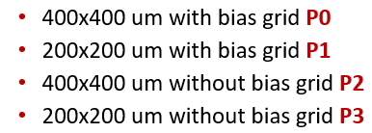
Run log summary
Run number | Run summary | N events | Comment
634 | P0 Analog out | 50k
637 | P1 Analog out | 50k
641 | P2 Analog out | 2M | device not working/connected
651 | P0 comparator thr. 0x70 (high) | 20k
652 | P0 comparator thr. 0x30 (medium) | 20k
653 | P0 comparator thr. 0x10 (low – operation?) | 40k
670 | P0 comparator thr. 0x10 (low), -50 V | 80k
674 | Planar SC 2x2 mm | 500k

Slide 5
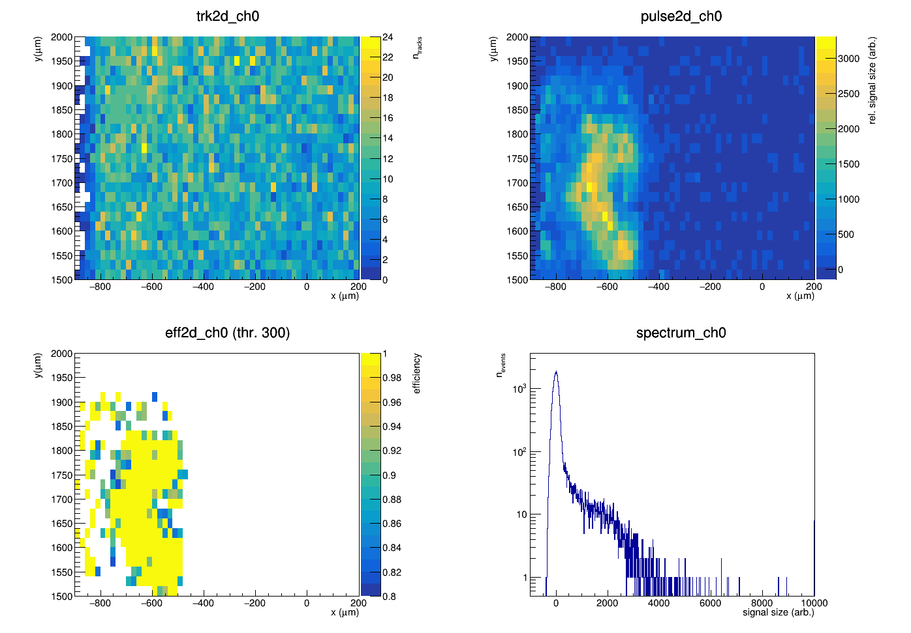
Analog out P0 and P1 (run 637)

Slide 6
Threshold scan (high, medium, low)

Slide 7
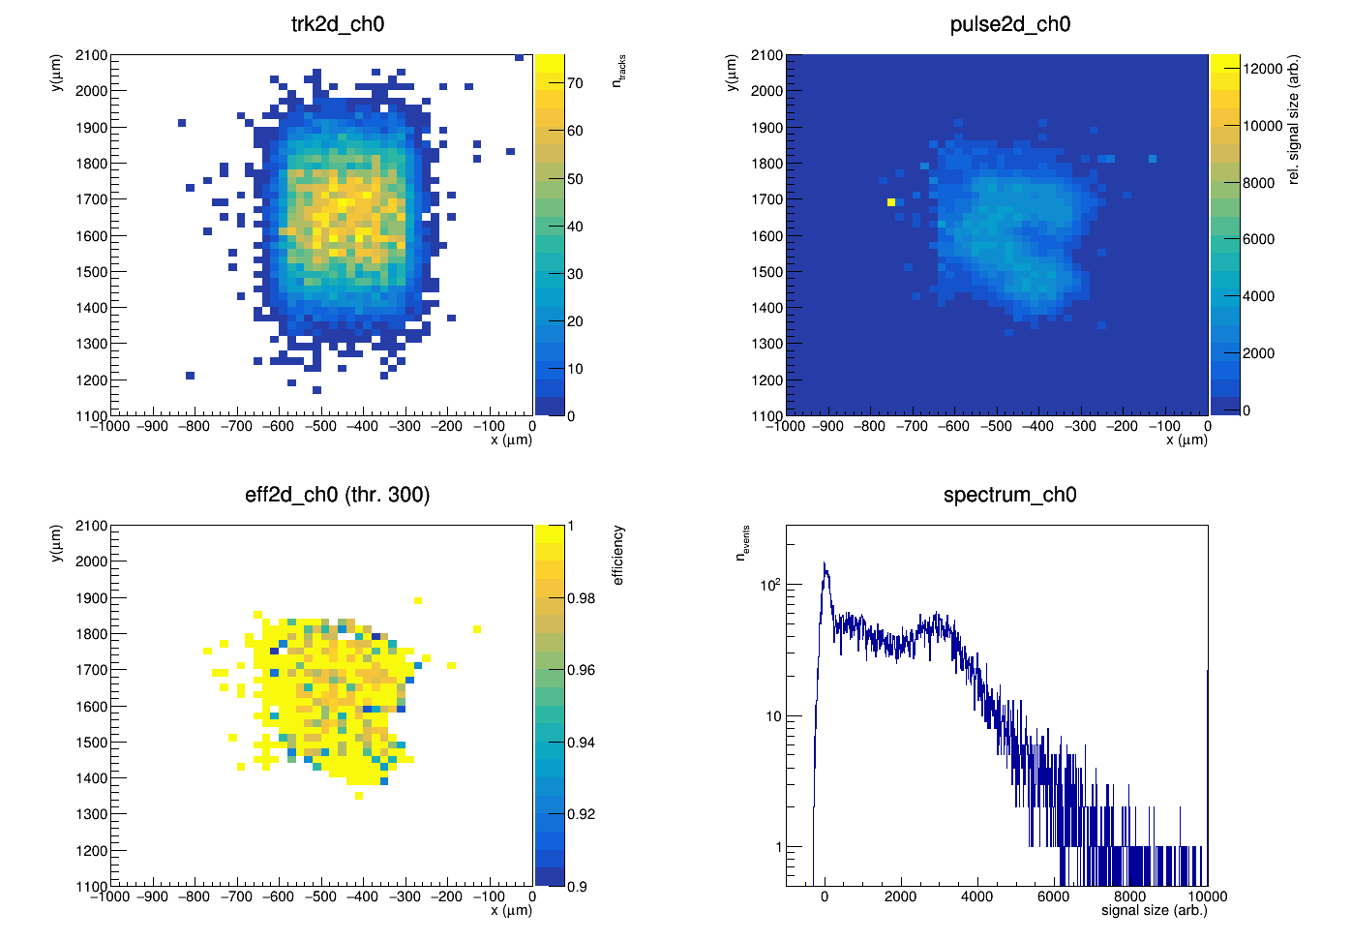
Run 651 (P0 high threshold)
Analog
Discriminator

Slide 8
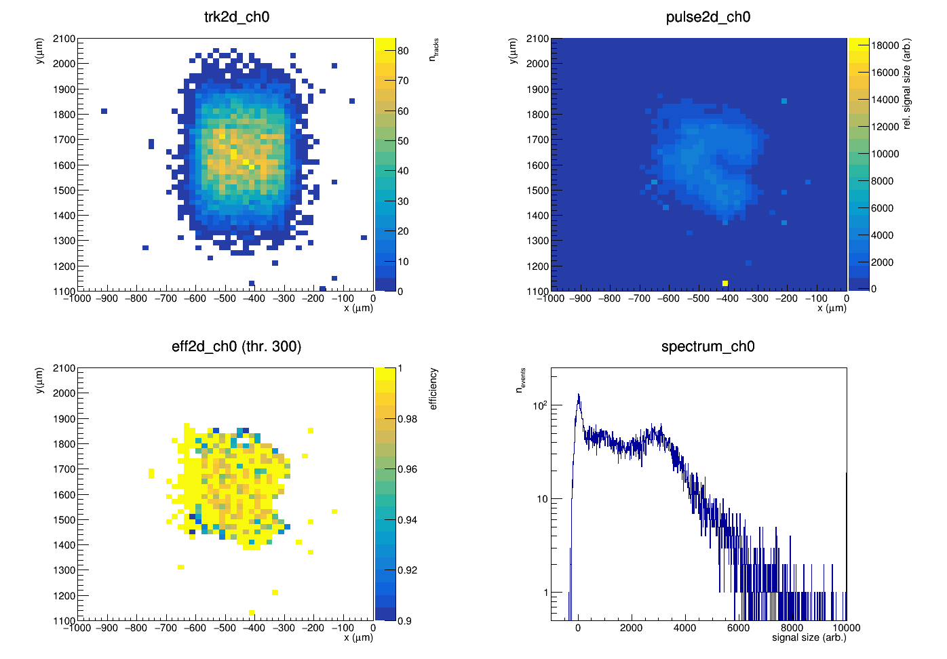
Run 652 (P0 medium threshold)
Analog
Discriminator

Slide 9
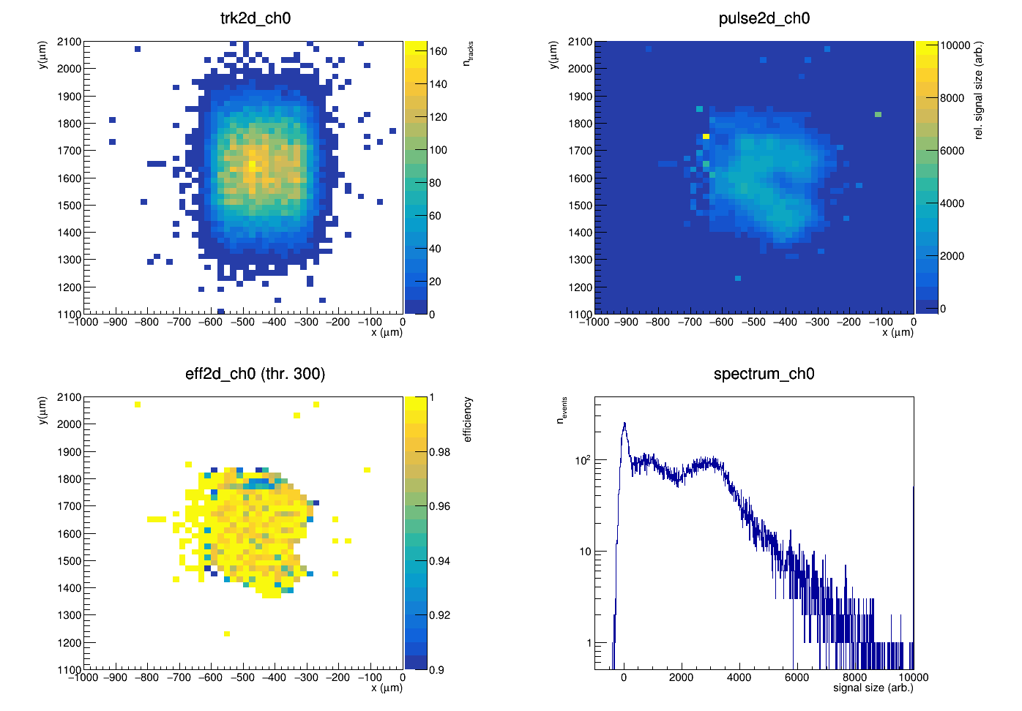
Run 653 (P0 low threshold)
Analog
Discriminator

Slide 10
Negative Vbias = -50 V
taken immediately after changing voltage – no polarization effects

Slide 11
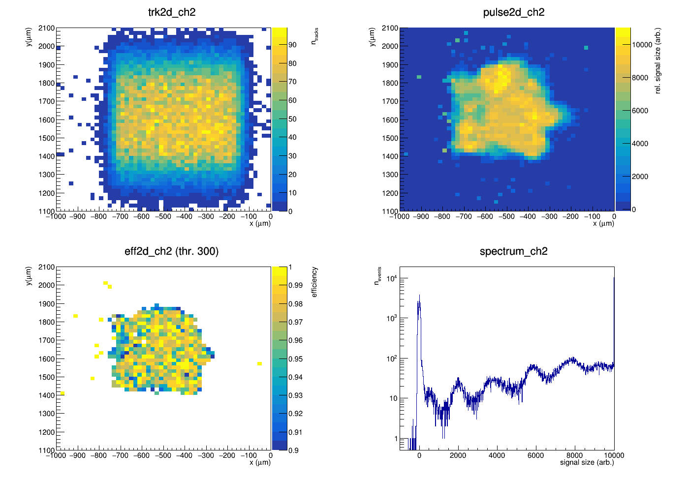
Run 670 (low threshold)
Analog
Discriminator

Slide 12
Run 670 cross check

Slide 13
Single crystal pad diamond
Medium threshold
ROI smaller than sample ...

Slide 14
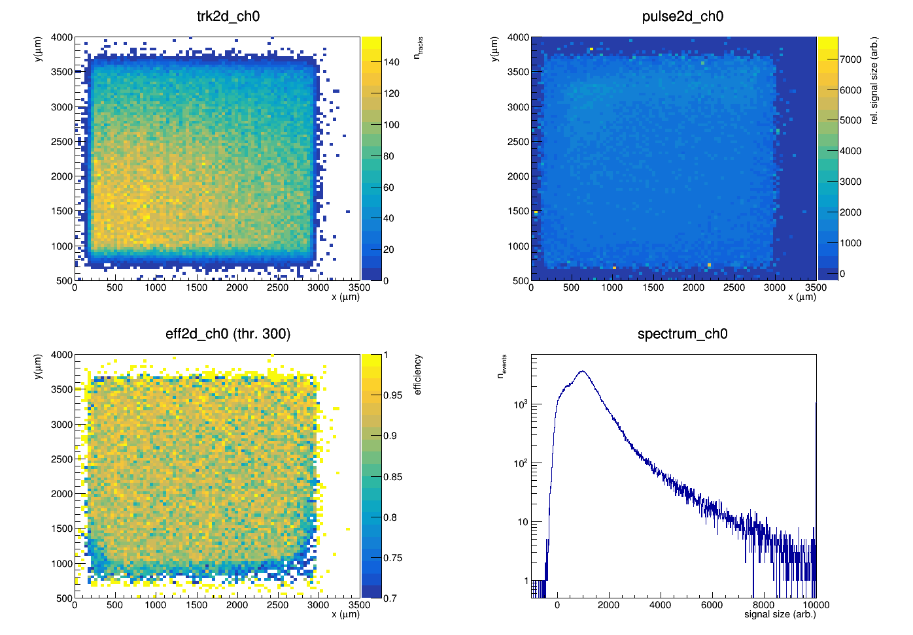
Medium threshold
Analog
Discriminator

