Slide 1
CCE annealing issues
(neutron irradiations)
  8 QA minis from the first and second HPK's production
  - ATLAS18R5 VPX37419 W233 M1 CCE at 500V 6.12 ke Valencia
  - ATLAS18LS_VPX37412_W659 CCE at 500V 5.6 ke Valencia
  - ATLAS18LS_VPX37410 W490 M1 CCE at 500V 8.43 ke L jubljana
  - ATLAS18R3 VPX37416 W198 M1 CCE at 500V 4.594 ke Valencia
  - ATLAS18R1 VPX37415 W171 M1 CCE at 500V 5.62 ke Ljubljana
  - VPX37413-W566 at 500V is 6.56 ke Toronto
  - ATLAS18R4_VPX37424_W284 CCE at 500V 7.0 ke Ljubljana
  - ATLAS18R2 VPA37914 W125 M1 CCE at 500V 6.94 ke Ljubljana
  4 sensors had CCE below specification (6.35 ke at 500 V)
  temperature during annealing was not well controlled
  ➔ repeat irradiations and measurements of problematic batches
  8 minis irradiated to 1.6 10¹⁵ n_{eq}cm⁻²
  8 minis & MD irradiated to 5.1 10¹⁴ n_{eq}cm⁻²
  9 testchips irradiated to 1.6 10¹⁵ n_{eq}cm⁻²
  distributed
  Toronto: 2 minis + 9 testchips
  Valencia 3 minis
  Ljubljana 3 minis
  1 additional mini irradiated and annealed later due to
  breakdowns observed in Toronto

Slide 2
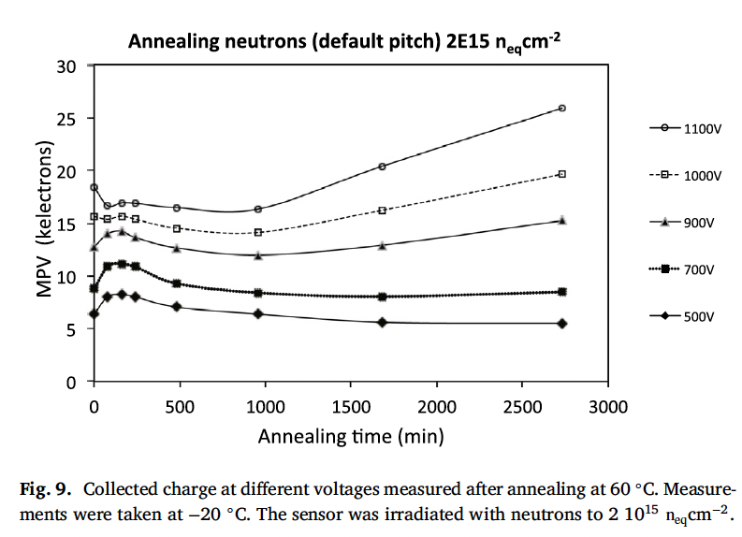
Too much annealing makes CCE just worse (At 500 V)
V. Cindro et al, NIM A 924(2019),
153 – 159
QA point
20 degrees higher T – about 10x faster annealing (L. Wii- Fuchs et al) , NIM A924 (2019) 128 - 132

Slide 3
currents are approx 20-30 percent higher than for overannealed samples
we believe that over annealing is reason for lower CCE
measurements will be completed soon…

Slide 4
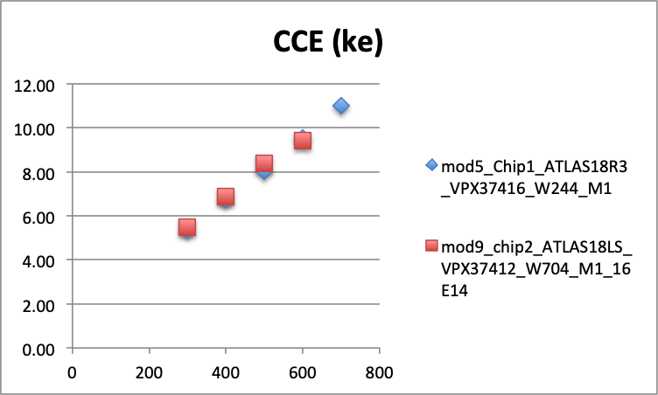
4 samples were received and irradiated last week
three already measured, CCE
  ATLAS18R3_VPX37416_W244 CCE = 8.03 ke (previously 4.59 ke)
  ATLAS18LS_VPX37412_W704 CCE = 8.40 ke (previously 5.6 ke)
  ATLAS18R5_VPX37419_W204 CCE ≈ 7.5 ke (preliminary, previously 6.12 ke)

Slide 5
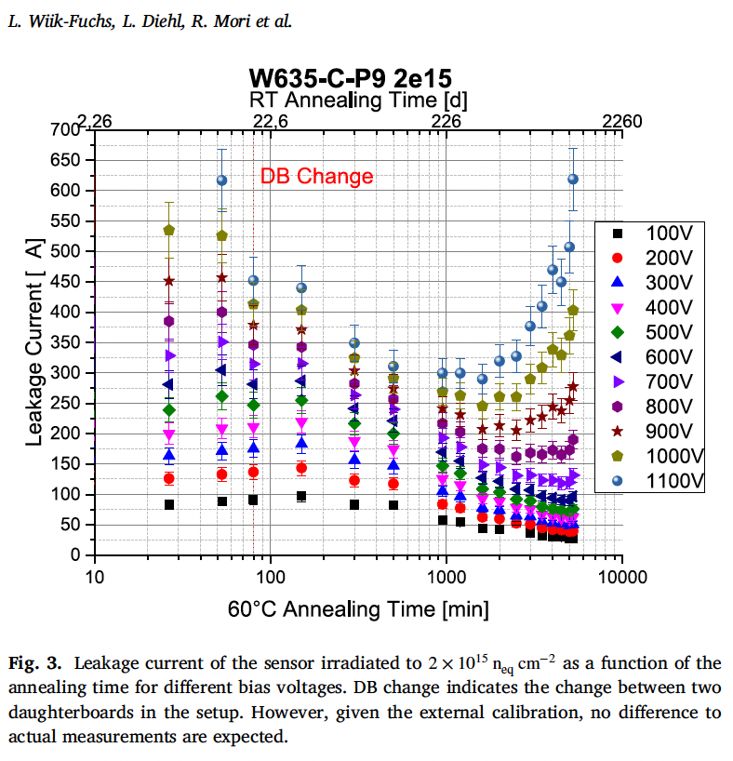
Annealing of current has similar activation energy (1.09 eV) ➔ similar acceleration factor (10) for 20°C higher temperature

Slide 6
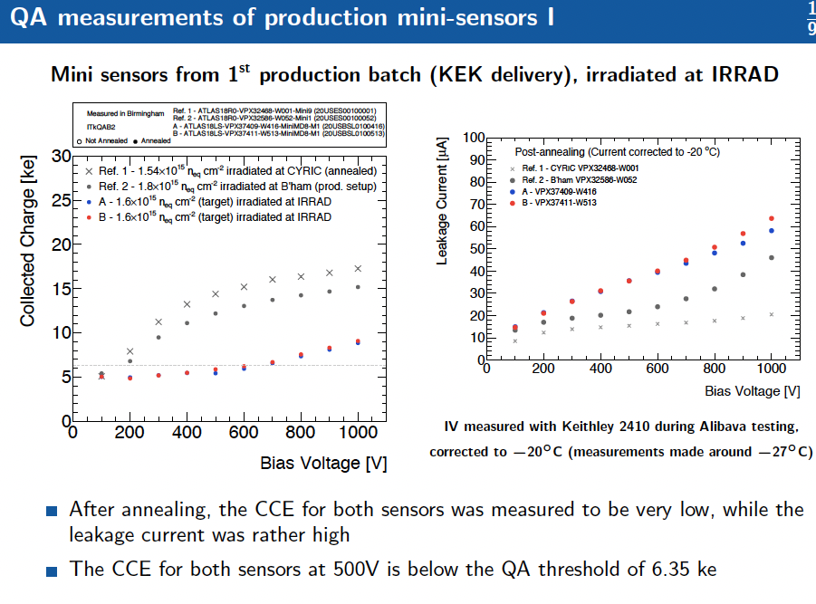

Slide 7
