Slide 1
Fleksibilna vezja
Predprodukcija gotova
25 dobrih front in 25 back
yield cca 90%

Slide 2
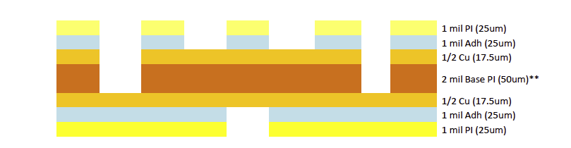
Tape stackup
Bottom copper
Top copper
two conductive layers
DS copper on polymide
150 microns of polymide/glue
requires holes in polymide to access Cu
Holes in polymide opened with laser

Slide 3
Specifications & tests:
wire bonding - an average pull strength of 8 g is to be established on nominal bonds, with a standard deviation of less than 1.5 g and absolute lower threshold of 5 g

Slide 4
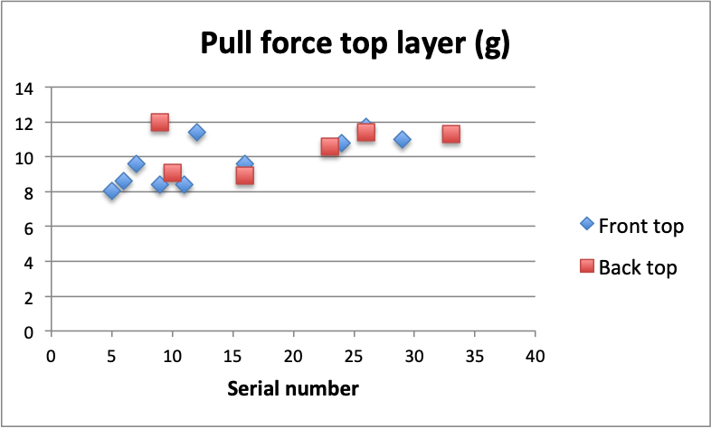
Wire bonding pull test top layer
in principle all flexes meet specifications
pull forces more consistent for higher serial numbers
improvement understood - preparation of copper surface

Slide 5
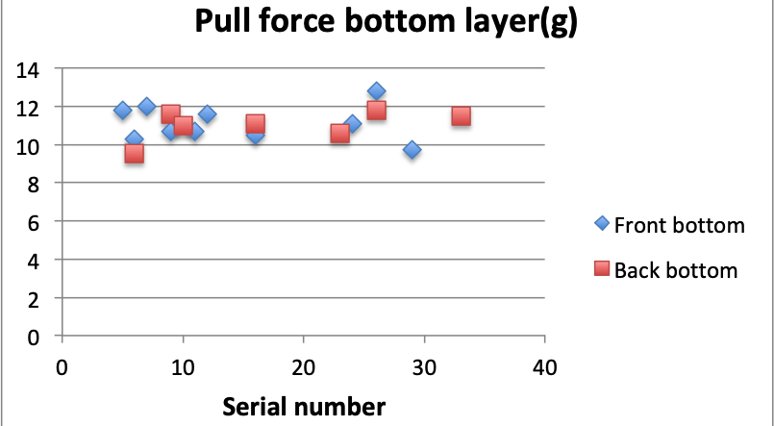
Wire bonding pull test bottom layer
consistent results

Slide 6
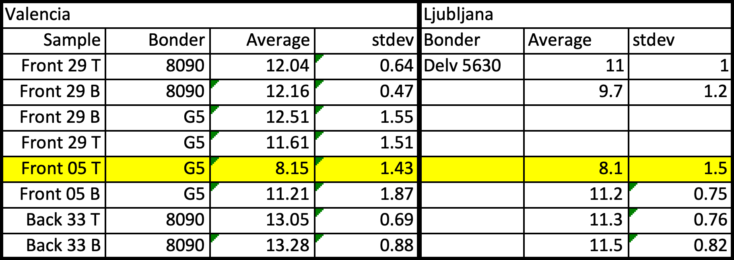
we sent few samples to Valencia
similar results
high pull forces are slightly lower in Ljubljana
not optimized for every sample

Slide 7
Fleksibilna vezja
Bus-tapes PRR (29-Apr-22)
Tape test robots ready at all sites
  Cross-calibration of sites for metrology
  Results in dB for all sites
  SQ for all sites
Pre-Production LS Bus-tapes QC
  Resistance and short circuit measurements
  HVIR
  Metrology
  Results in dB
  Visual inspection
  Signal integrity (Z0 and attenuation)
  Wire bond pull tests.
PO FDRju produkcija, cca 450 + 450 kosov, eno leto

