Slide 1
Testbeam results from BCM' campaign at SPS in Oct2021
F9 meeting, 11.02.2022
Bojan Hiti, F9, Jožef Stefan Institute (JSI)

Slide 2
Overview
pCVD diamond sensor + custom front end (Calypso)
  Pad detector (mm2), 4 channels per FE chip
Test beam with MALTA telescope at SPS in Aug, Oct, Nov 2021
Oct 2021 SPS run log:
  200000 – 200021: 2.5x2.5 mm2 single crystal (SC) diamond sensor diamond thickness 500 um
  200022 – 200039: 10x10 mm2 pCVD diamond (4 pads area 1:4:2:8)
  200040 – 200047: 5x5 mm2 pCVD (board failed)
  200048 – 200070: 3d diamond (positive HV)
  200071 – 200086: 4 mm2 silicon
  200087 – 200094: 3d diamond (negative HV)
  200095 – 200113: another 5x5 mm2 pCVD (rotated 25°)
  200114 – 200119: 3d diamond

Slide 3
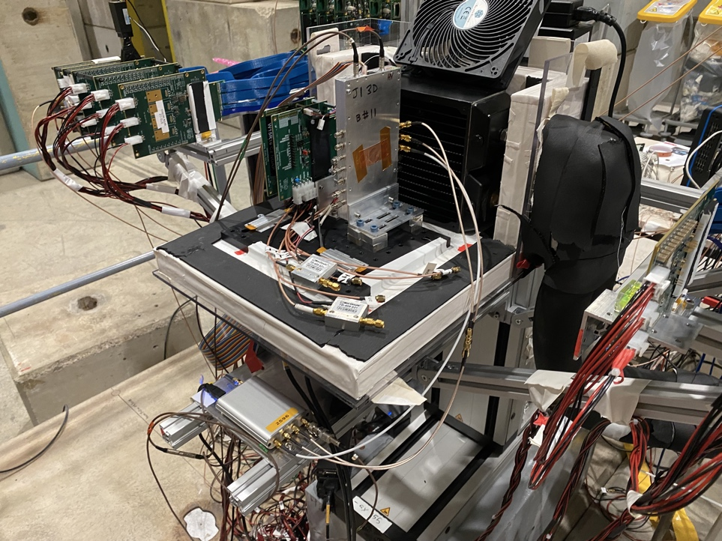
MALTA telescope
DUT
DRS4

Slide 4
Trigger and readout
Trigger:
1.8 V, 200 ns
Needs external 50 Ohm termination on telescope side!
MALTA ROI
Trigger enable window (120 ns)
AND
DRS4
MALTA
trig
out
Delayed PMT
ch4
(trigger on waveform)
  CALYPSO specifications:
  Optimized for C_{det} 2–5 pF
  t_{peak} < 1.5 ns, t_{settling} < 15 ns
  digital LVDS output, analog preamp output for testing
DUT readout:
  Sensors wire bonded to CALYPSO Front End
  Analog and digital signals read out by DRS 4 (3 ch. per run)
    4 GS/s, 700 MHz bandwidth
  In Nov 2021 three DRS4 daisy chained for more channels (9 ch. per run)
analog out
DUT IN
AMP
LVDS+
discr.
thr
LVDS-
Calypso front end

Slide 5
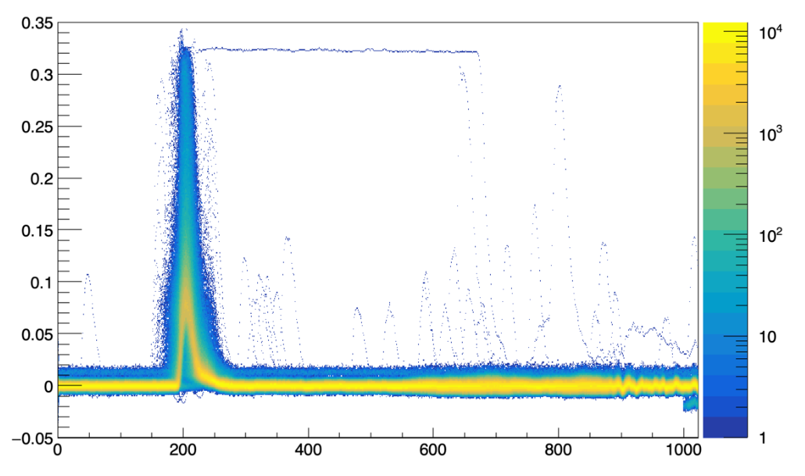
Signal sampling
Signal = integral of waveform over sampling window
  Algorithm will be improved
  Today's results are very preliminary!
In the past Out-of-time signals in 3 % of events
  Efficiency not above 96 %
  Caused by trigger jitter from the telescope
  Remedied by Timing cuts on telescope signals (next slide)
    now spectacular tracking
signal (mV)
t (1 bin = 0.25 ns)

Slide 6
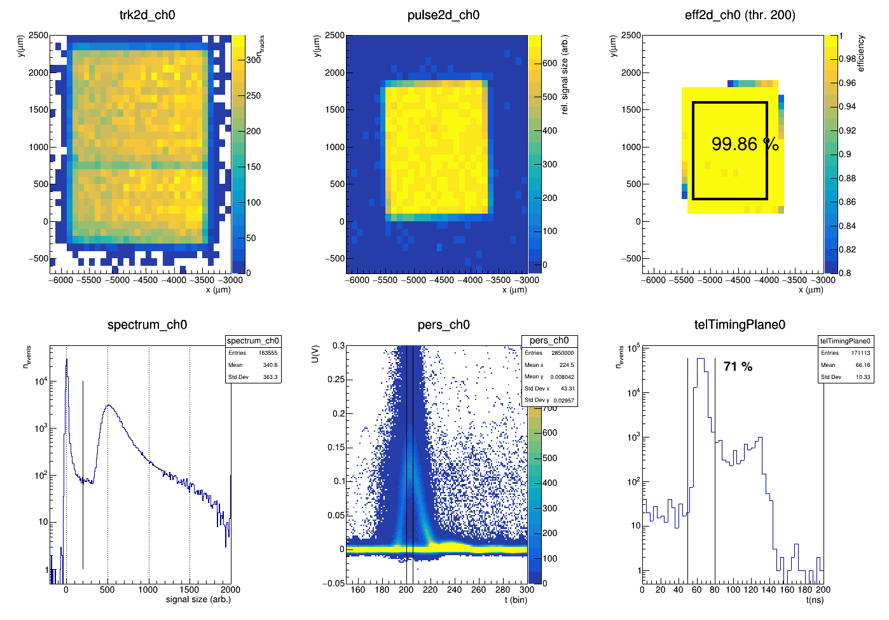
Results – Silicon (200081)
track distribution
pulse height
efficiency
Analog output
Timing cut here

Slide 7
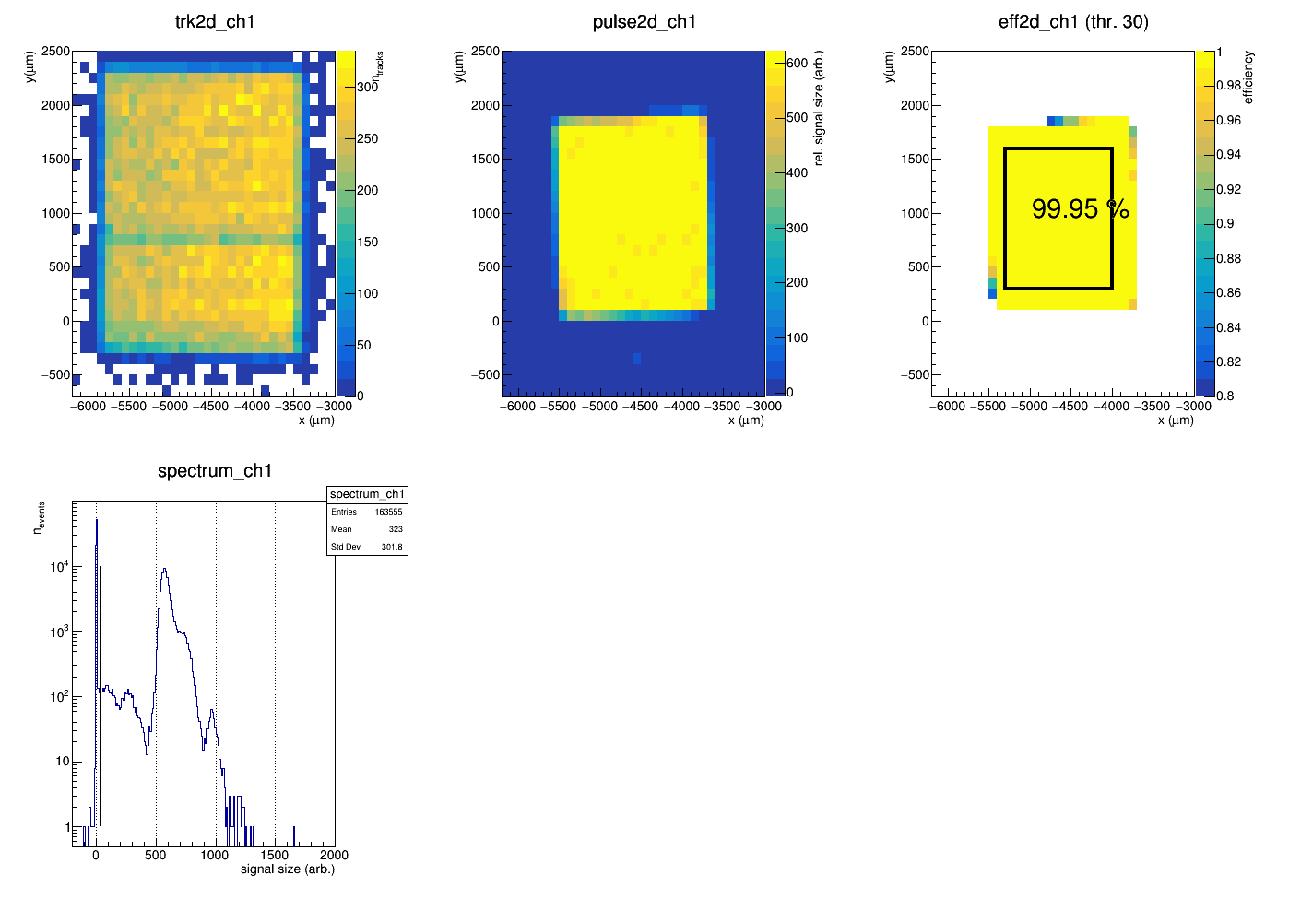
Results – Silicon (200081)
Digital output

Slide 8
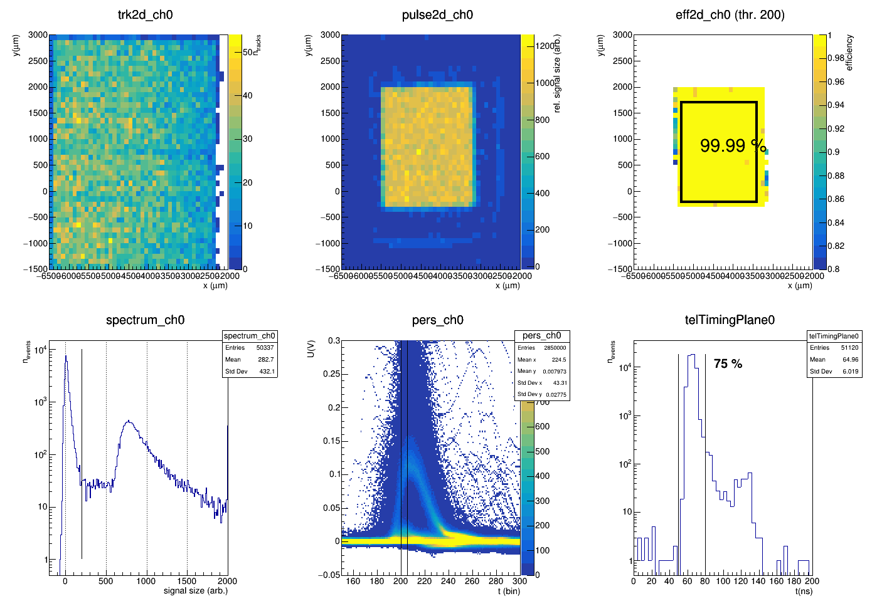
Results – SC diamond (200006)
track distribution
pulse height
efficiency
Analog output

Slide 9
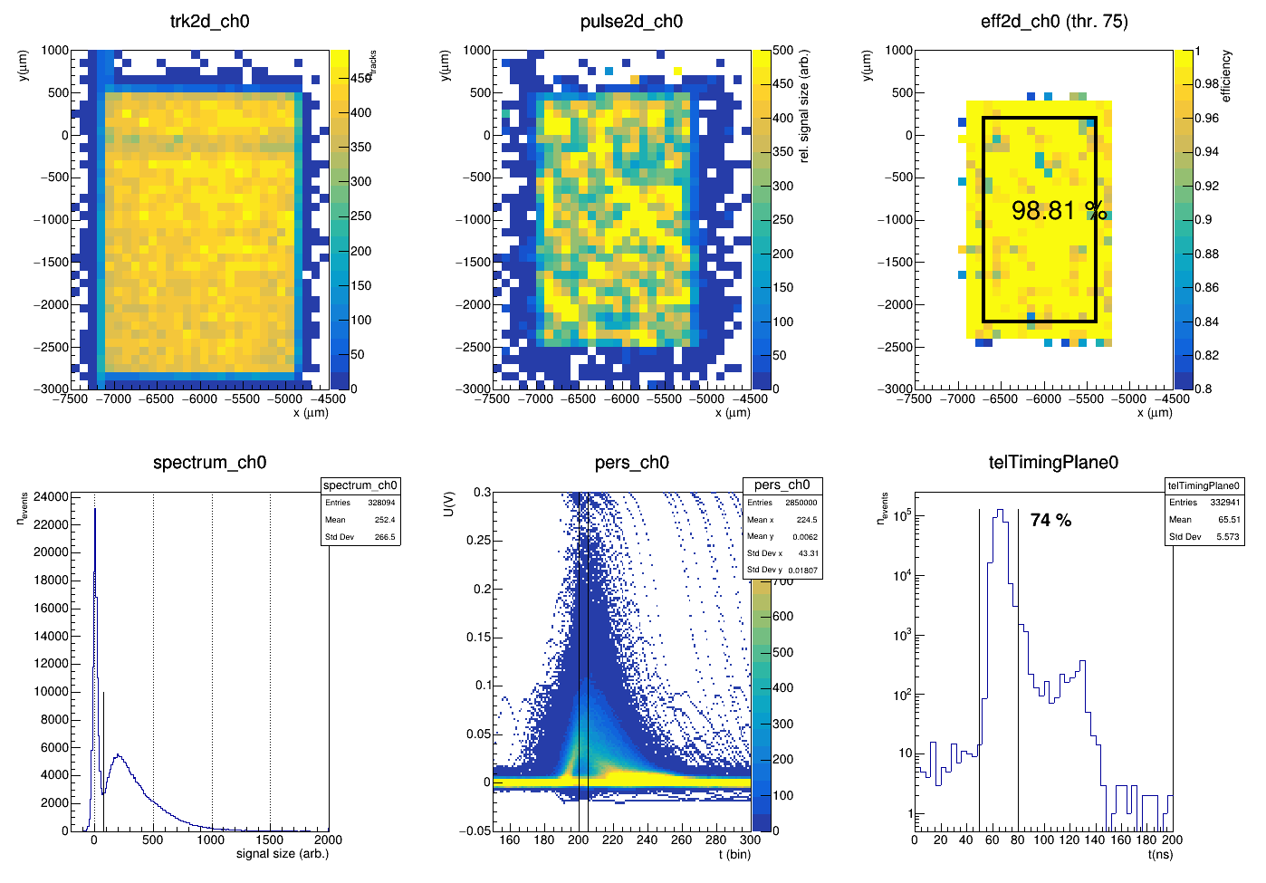
Results – pCVD diamond (200043)
track distribution
pulse height
efficiency
Analog output

Slide 10
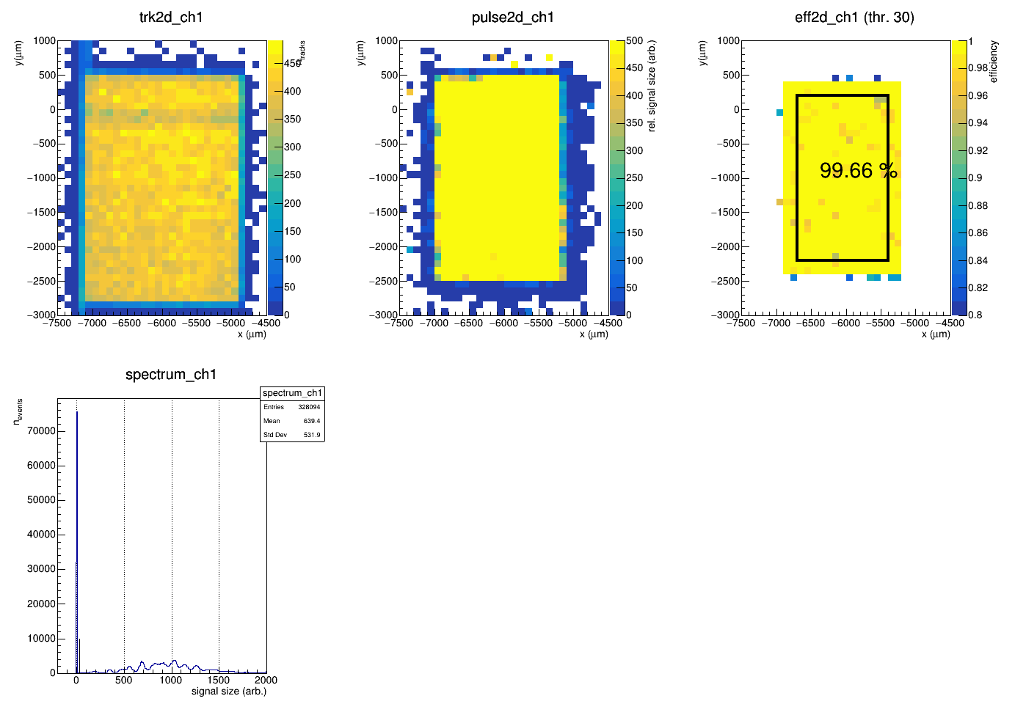
Results – pCVD diamond (200043)
track distribution
pulse height
efficiency
Digital output

Slide 11
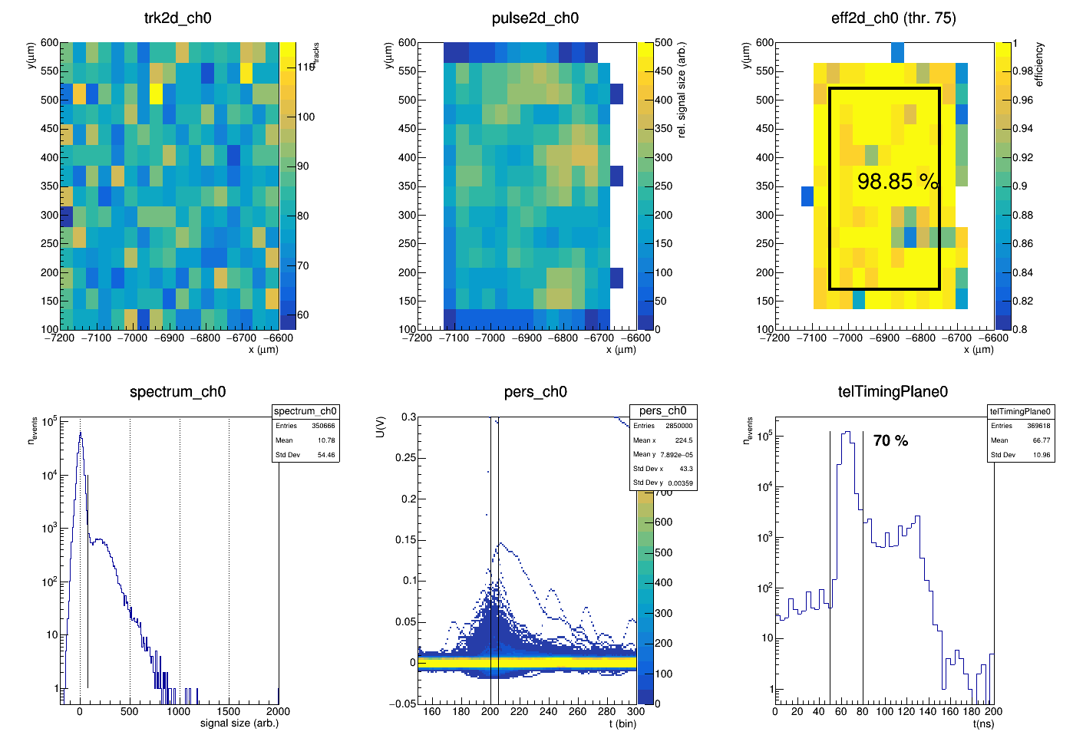
Results – 3d diamond – square (200050)
track distribution
pulse height
efficiency
Analog output

Slide 12
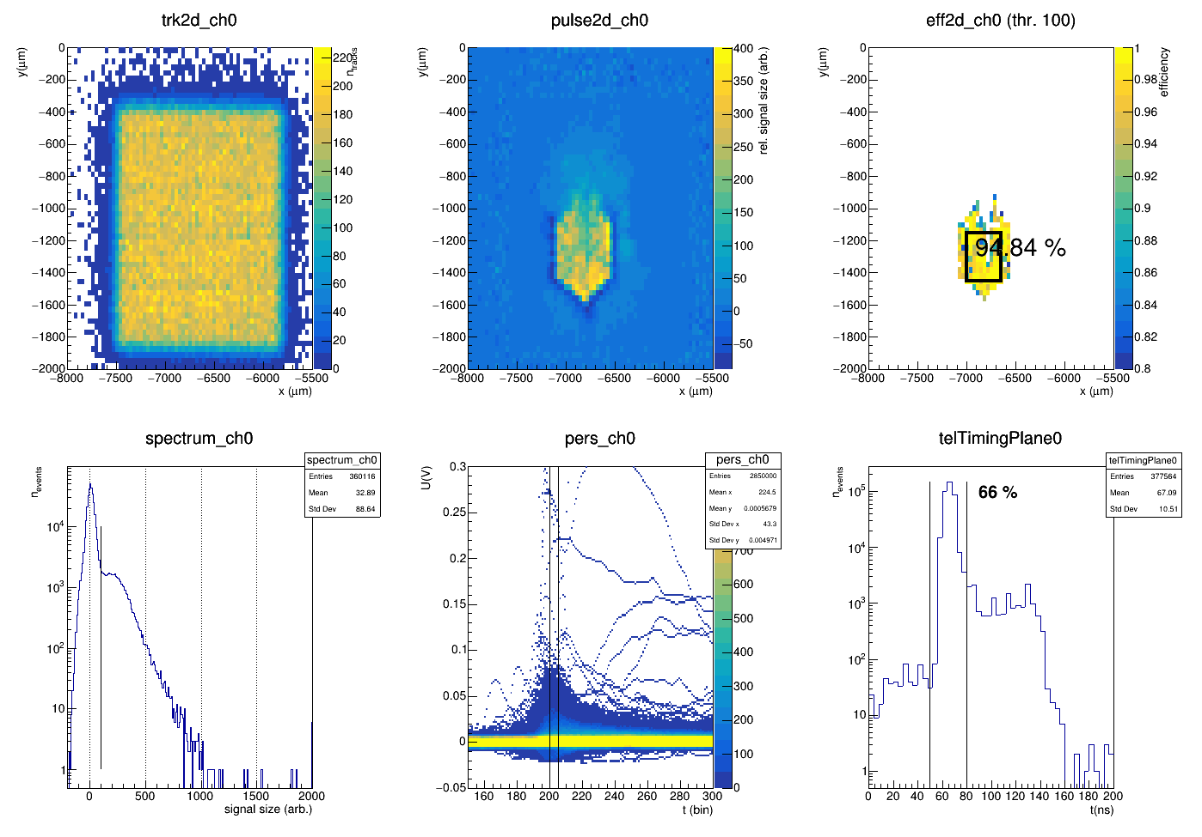
Results – 3d diamond – hex (200069)
track distribution
pulse height
efficiency
Analog output

Slide 13
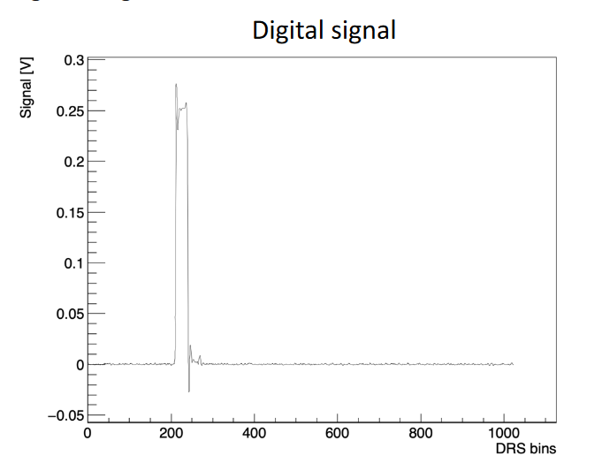
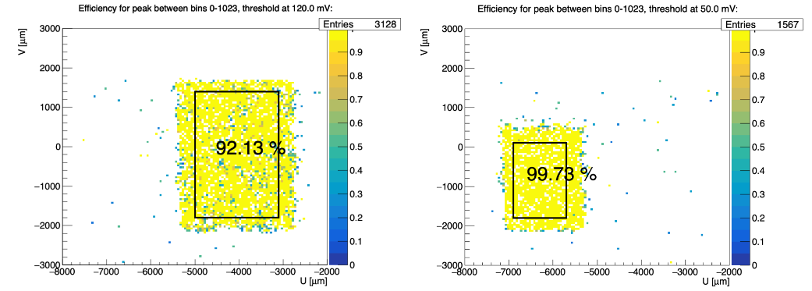
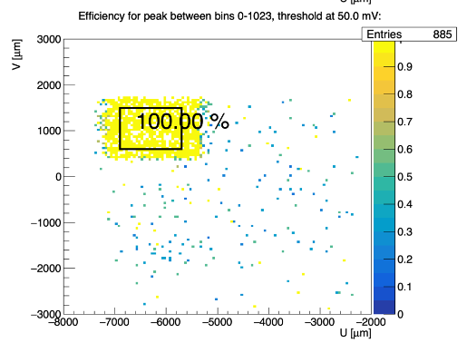
Results – pCVD diamond digital signals
Same analysis, but with digital signals (after on-chip discriminator)
  Limited number of events analyzed up to now
Threshold setting "medium" (no noise figure available)
Three pads with different sizes → capacitance affects efficiency

