Slide 1
ITk strips petal bus tape test site qualification
Ljubljana
Vladimir Cindro, Andrej Gorišek, Miha Mali, Brigita Novak
Jožef Stefan Institute
Ljubljana, Slovenia

Slide 2
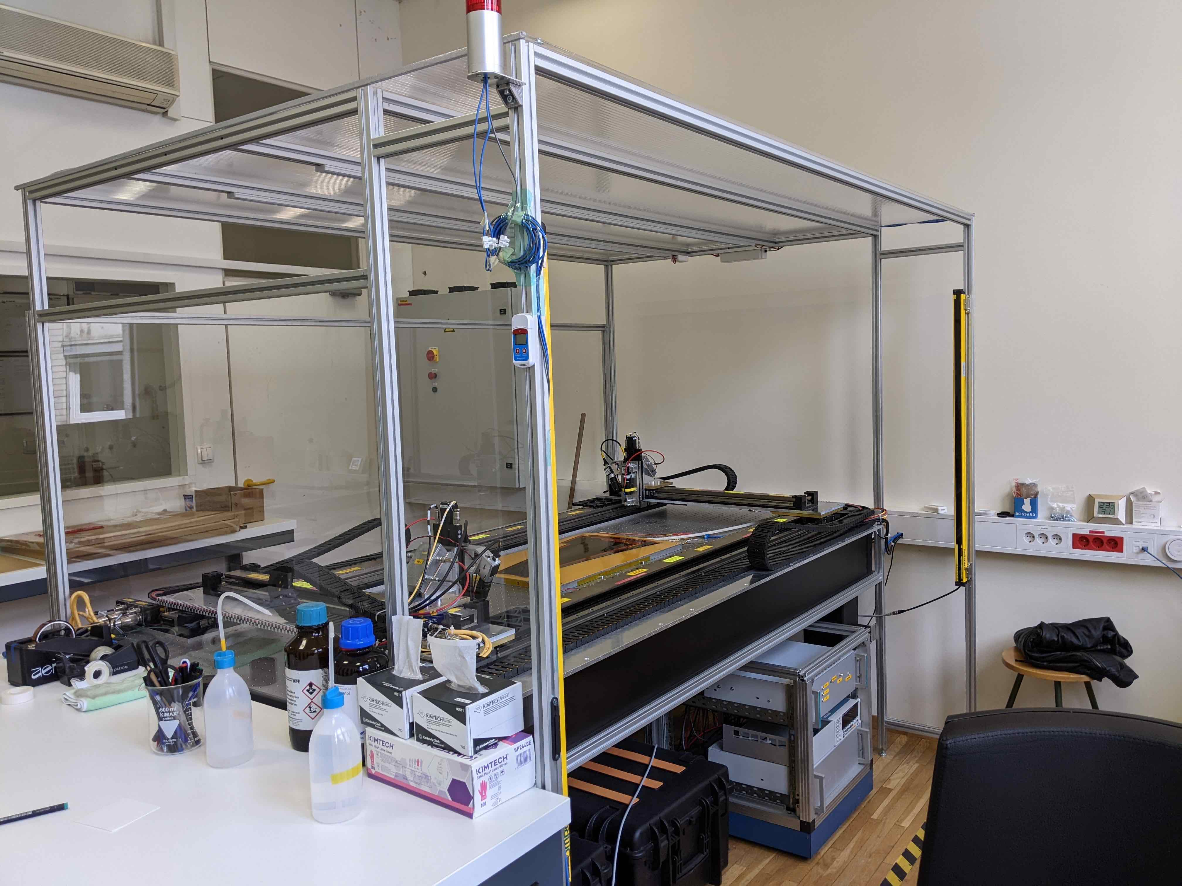
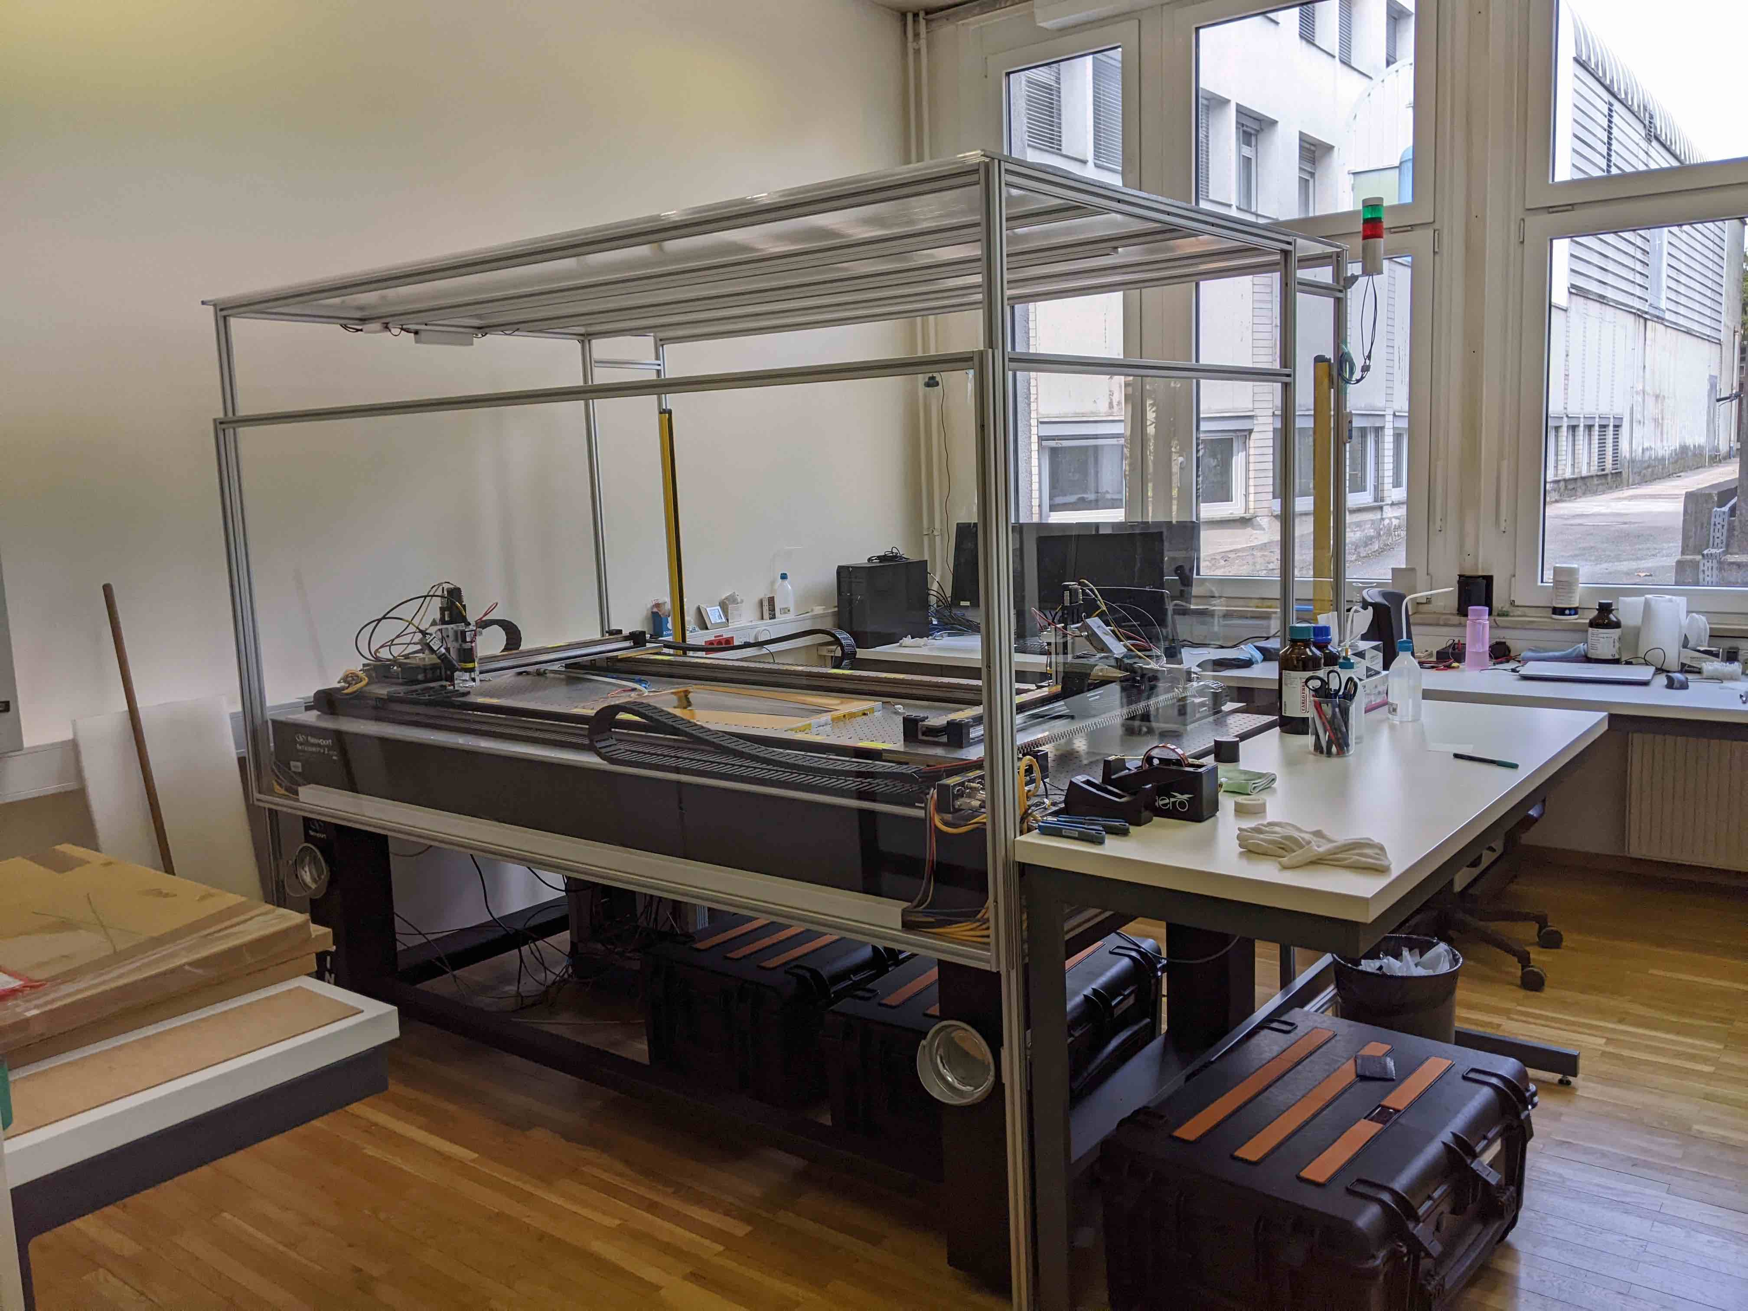
petal tapes will be produced by Elgoline Slovenia
100% of bare tape acceptance tests will be done at JSI
tests on cocured tapes will be done at DESY
tests of tapes on cores QCed at Valencia will be done in Ljubljana
all tests will be done in clean room with controlled temperature and filtered ventilation

Slide 3
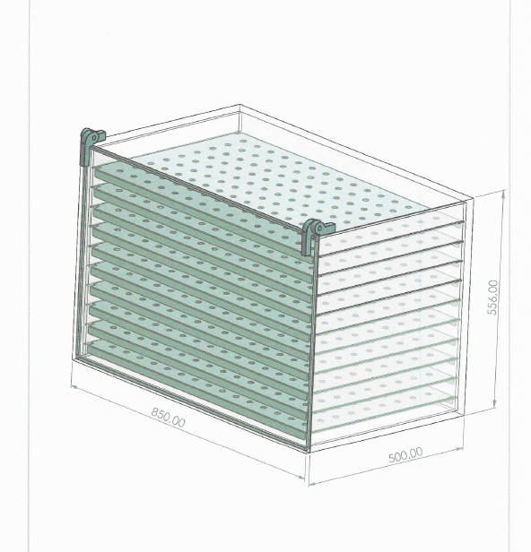
Tape handling:
How are tapes stored before tests?
How are tapes stored after tests?
How are tapes handled?
What kind of cleaning is used if it needed?
tapes will be unpacked and stored in box with dry air ventilation
after tests they will be stored in same box
all handling will be done with gloves
no cleaning will be used before tests. We will use Isopropanol (IPA) if needed

Slide 4
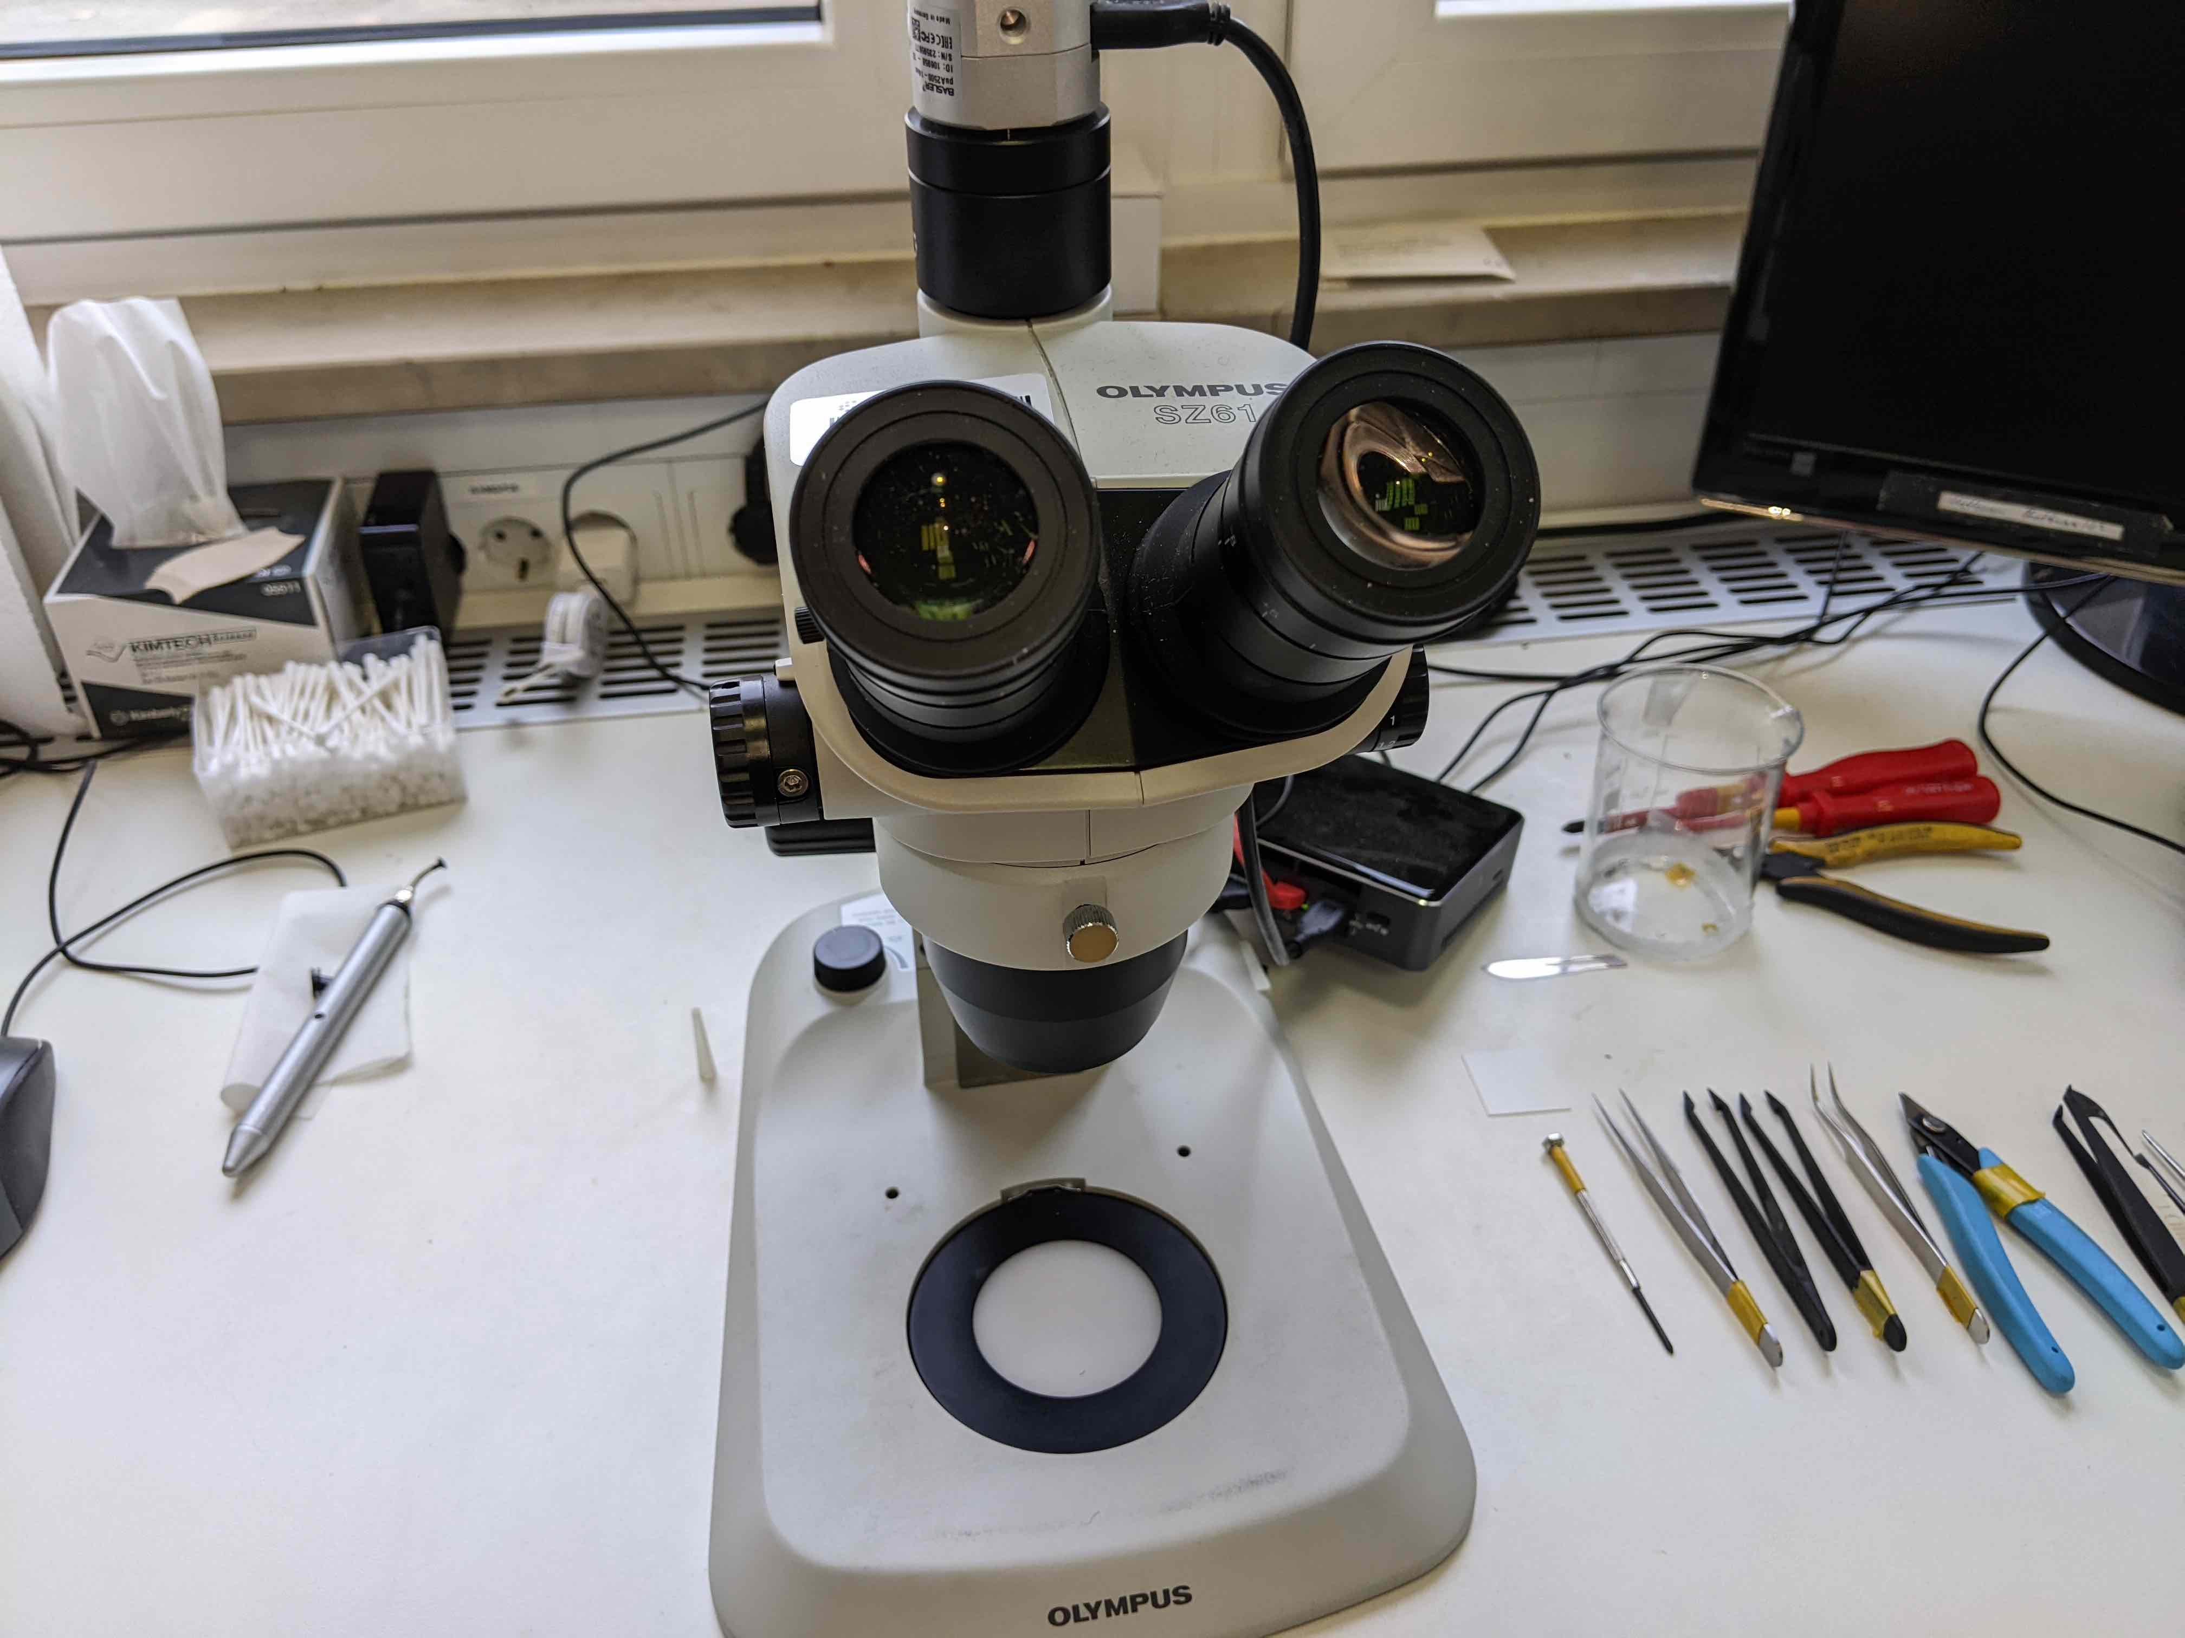
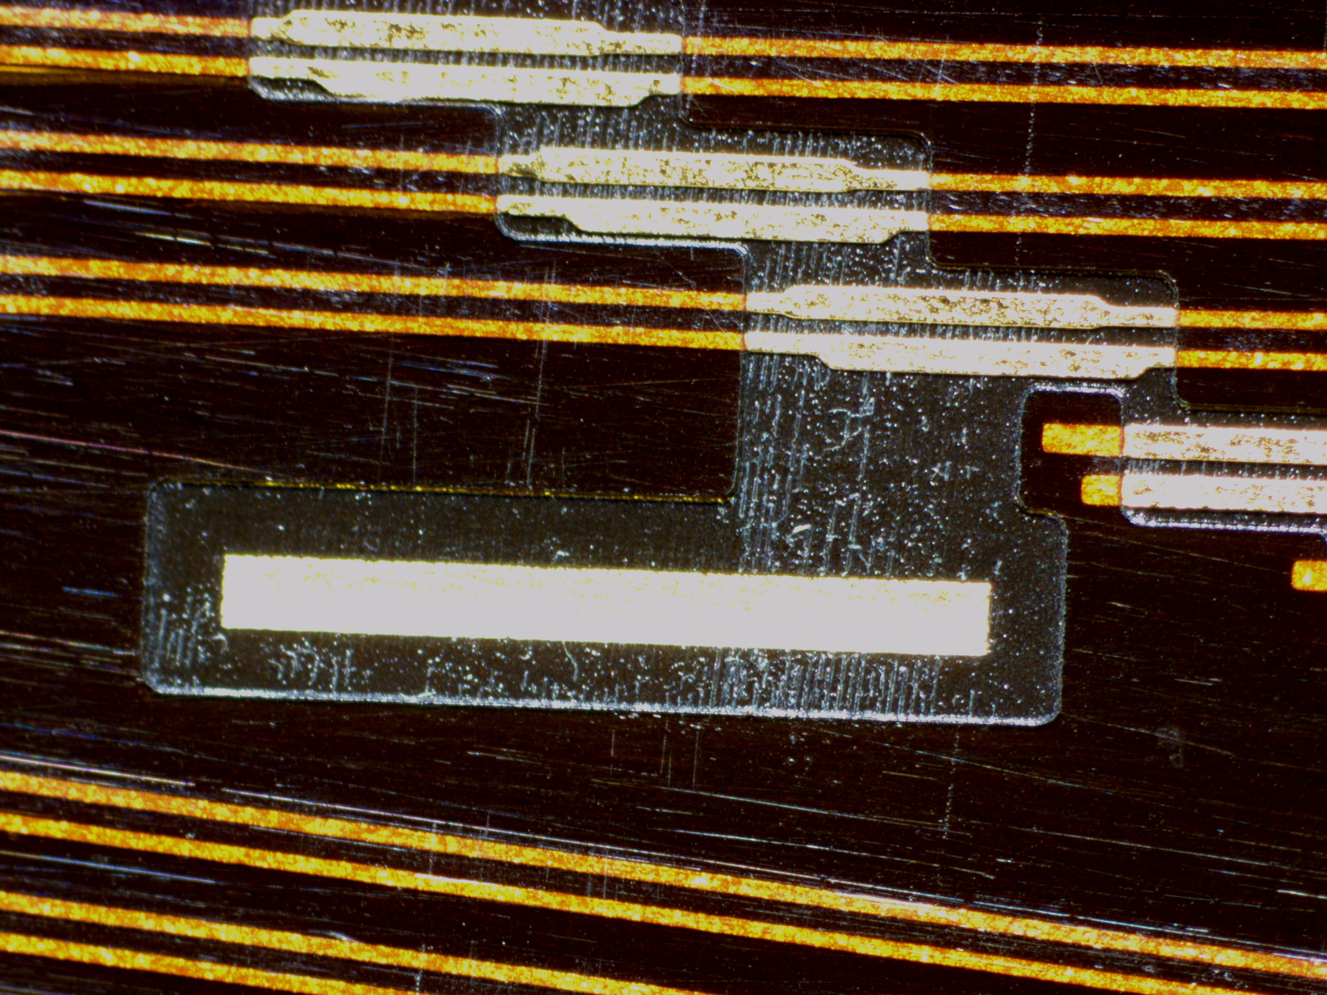
Visual inspection
    visual inspection of all tapes will be done as the first step. Open pads will be checked under microscope
    seepage of adhesive will be checked
    cleanliness of surface will be checked

Slide 5
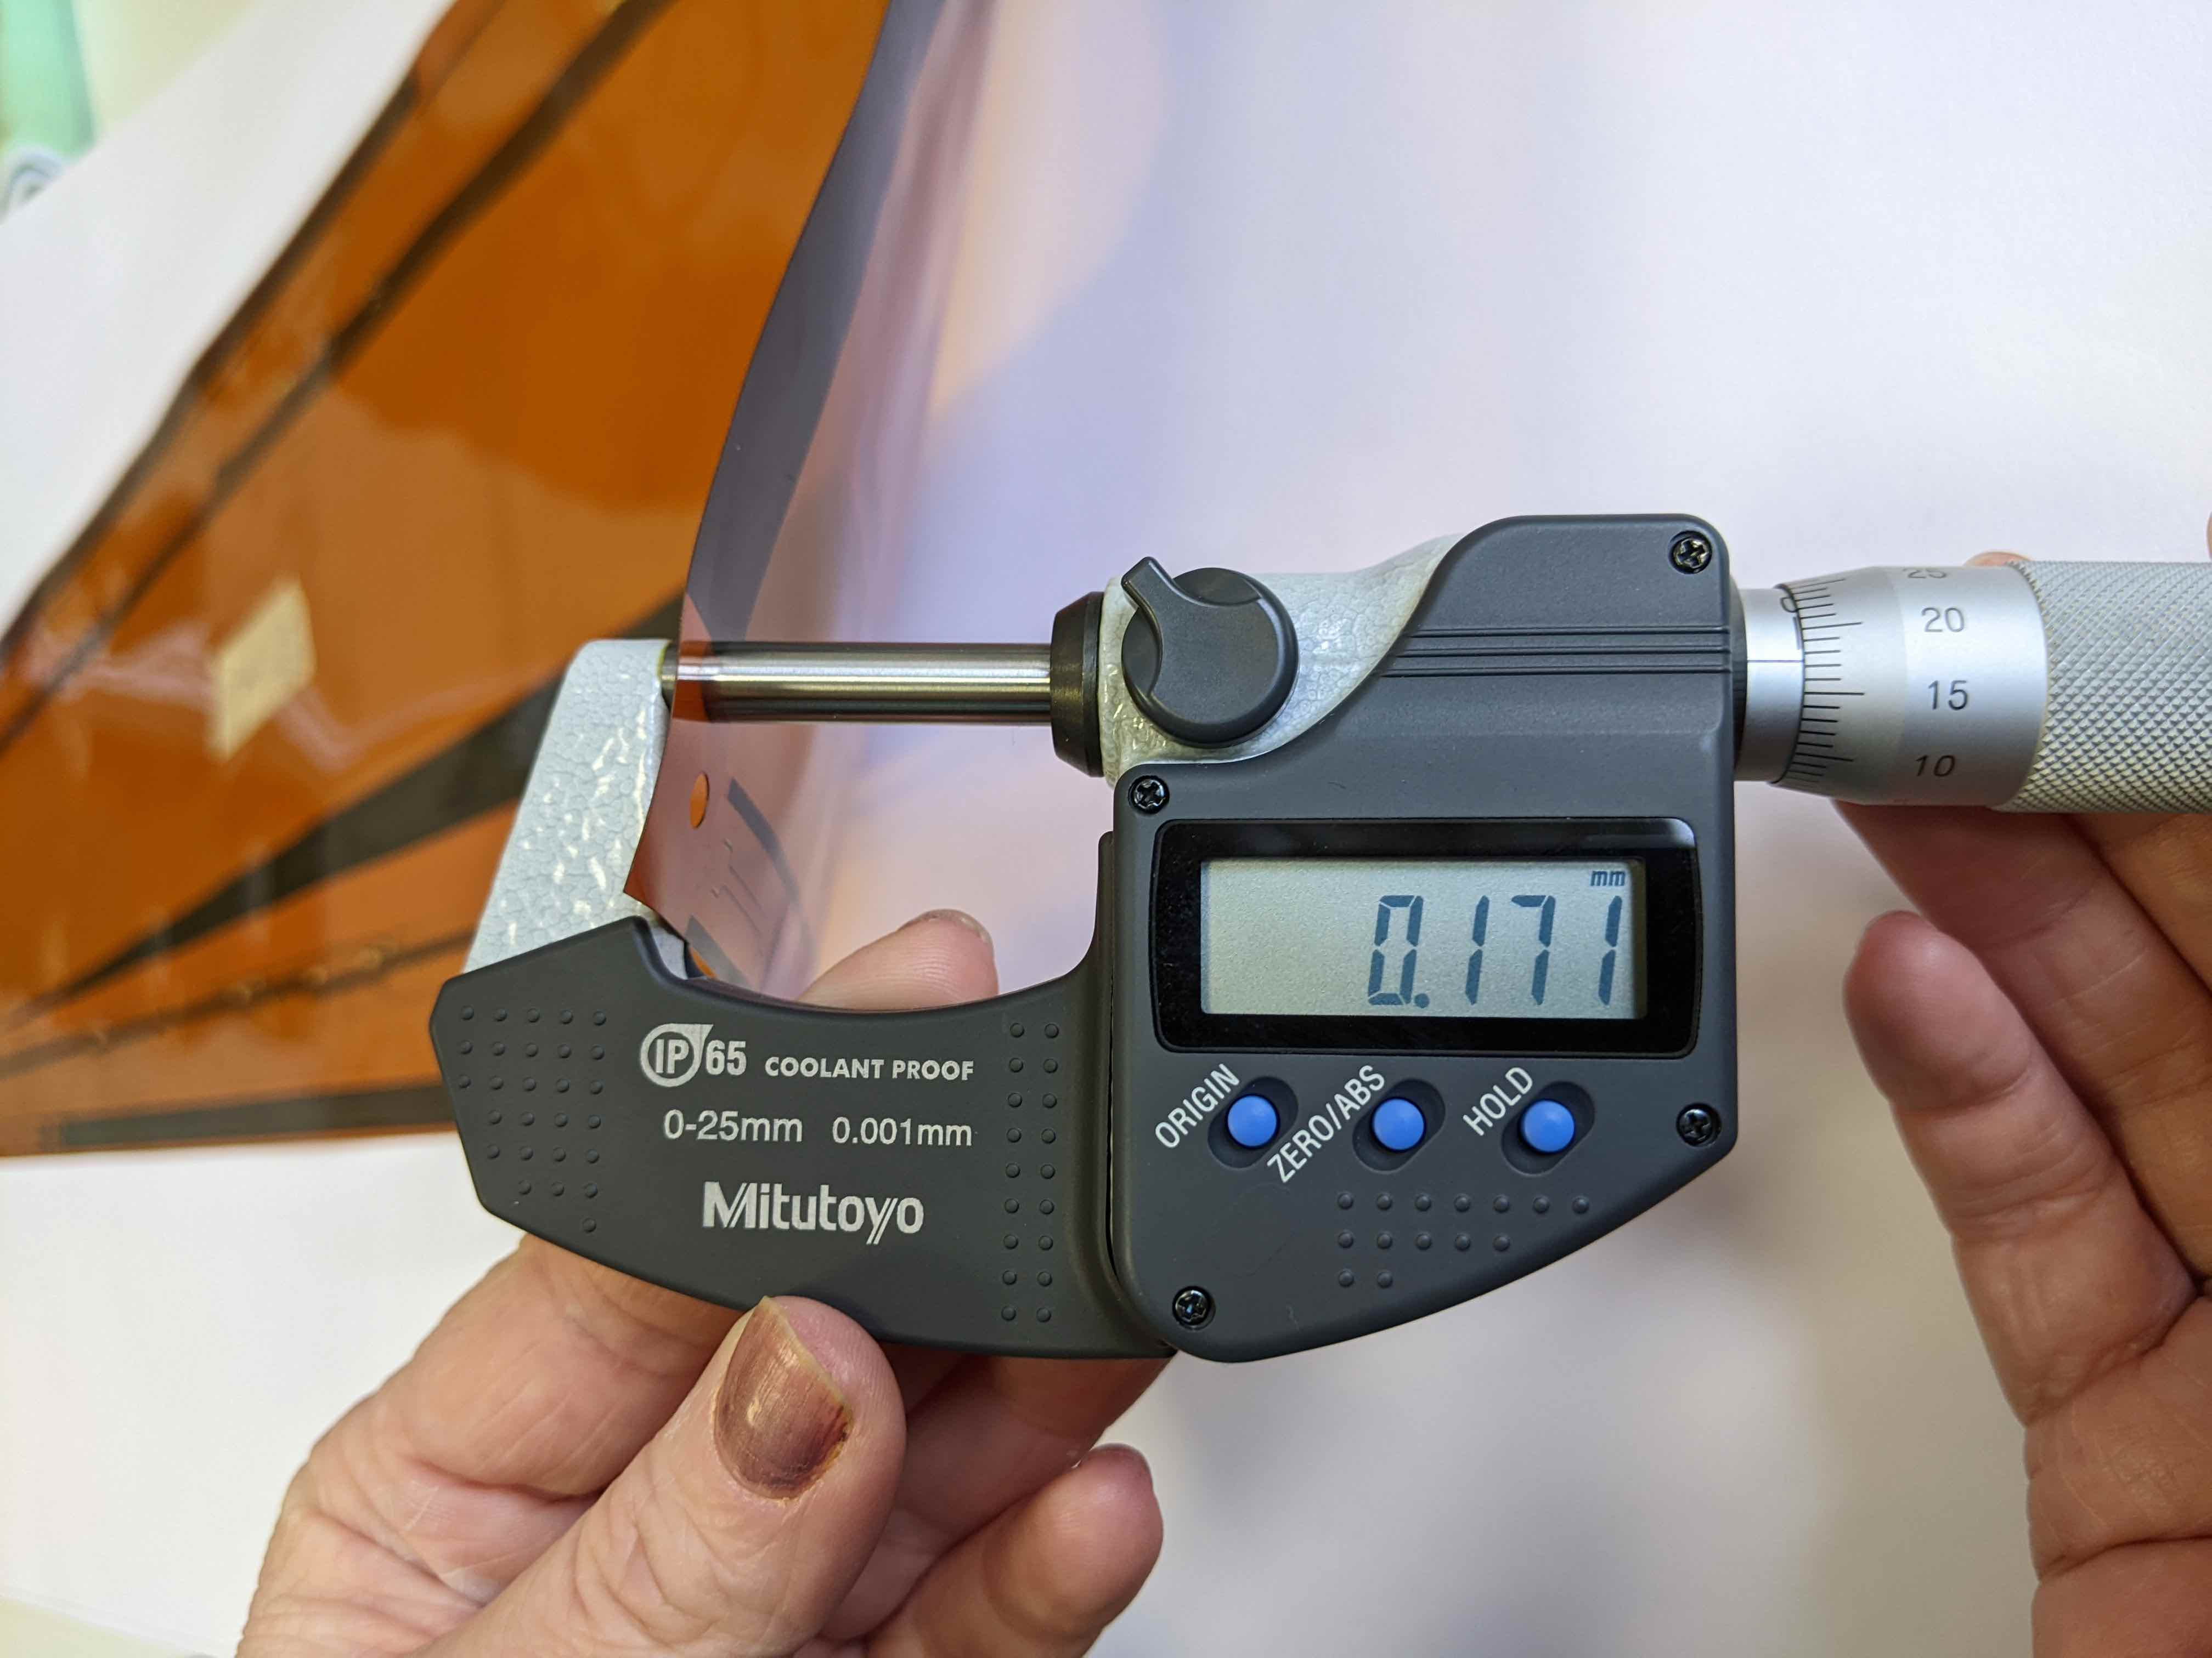
Metrology
    thickness of all tapes will be measured on several places
    weight of tapes will be measured - one of ten or more

Slide 6
Metrology
Length and distortion of all tapes will be measured with robot
Robot calibrated with film, cross checked with DESY

Slide 7
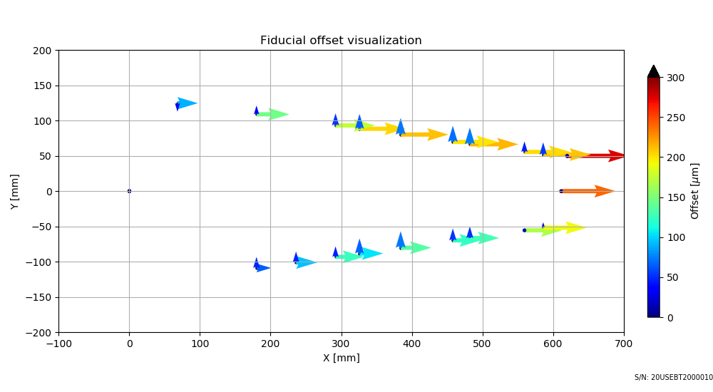
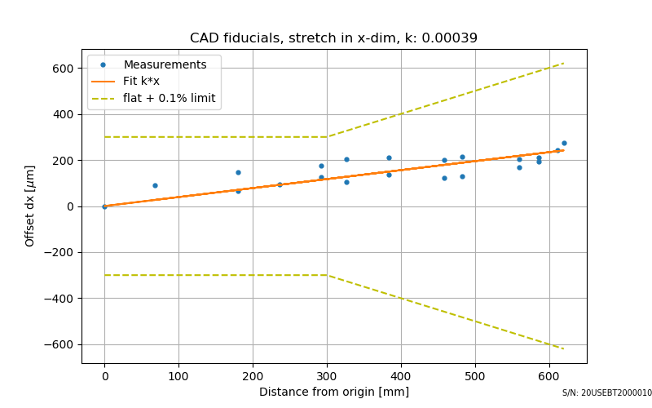
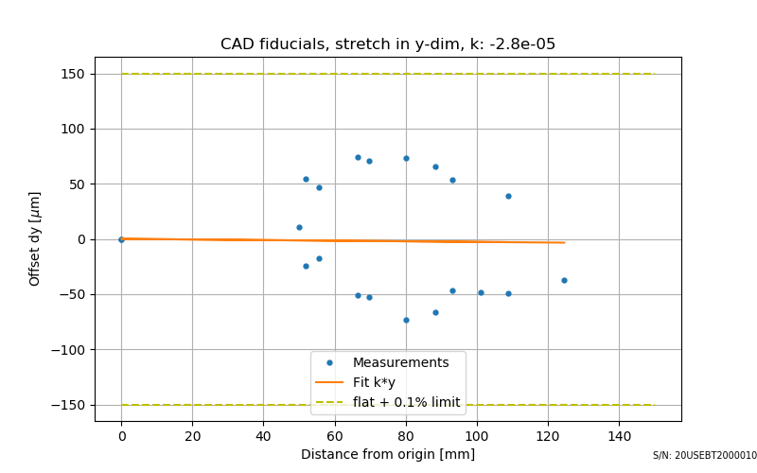
Cocured tape, Ljubljana
Difference between measured and gerber position of fiducials
“banana” deformation
X axis is defined with two fiducials
Stretch in x
Stretch in y

Slide 8
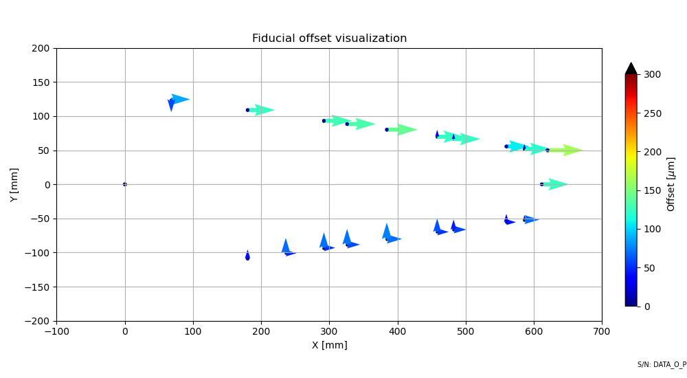
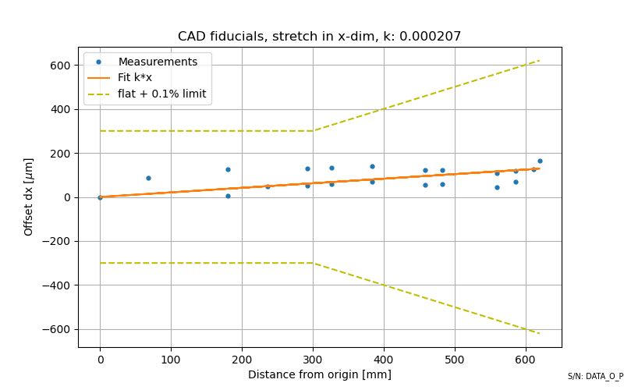
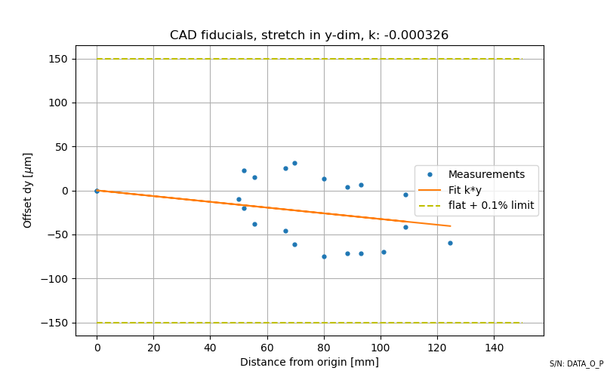
Cocured tape DESY

Slide 9
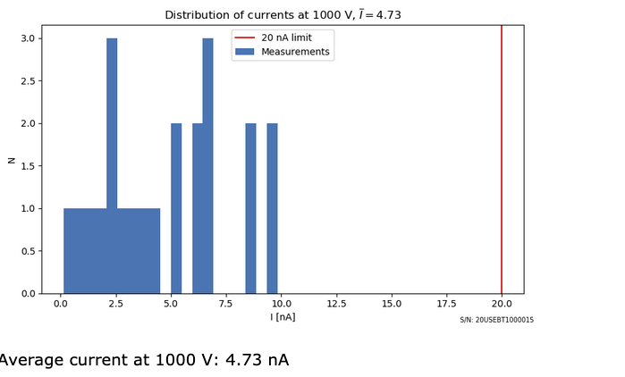
Electrical test – all tapes with robot
  Resistance all lines
  Short circuit test all neighbors
  HVIR all HV pads to all neighbors at 1000V
  (ELGOLINE makes AOI and electrical test during production)

Slide 10
Test on coupons
sacrifitial area coupons: bonding, impedance, attenuation
separate coupons outside tape: bonding, 2x impedance, attenuation, peel test

Slide 11
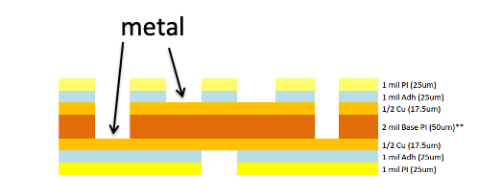
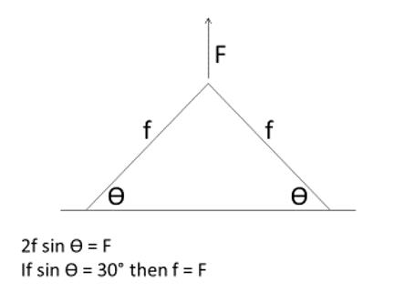
Test coupons
Bond pul tests one in 10 tapes, tests on bottom and top layer, initially more frequently (final tests will be on completed cores)
Procedure defined by ATLAS
wire bonding - an average pull strength of 8 g is to be established on nominal bonds, with a standard deviation of less than 1.5 g and absolute lower threshold of 5 g

Slide 12
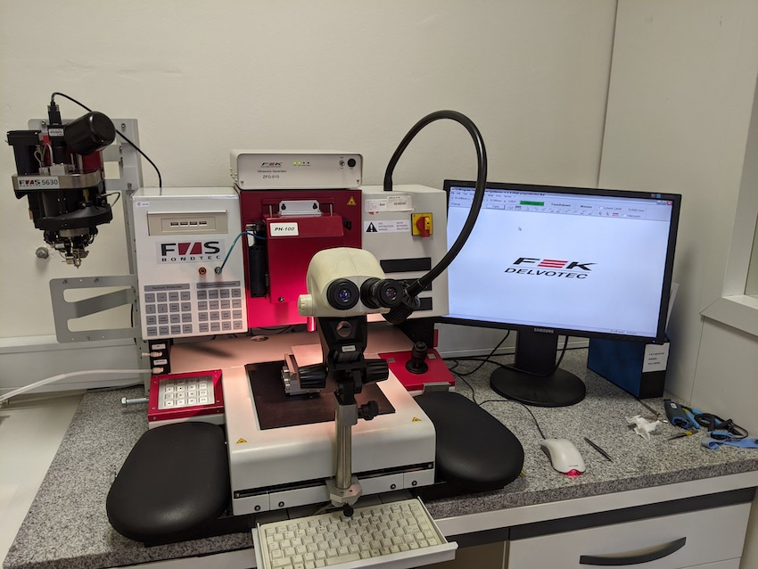
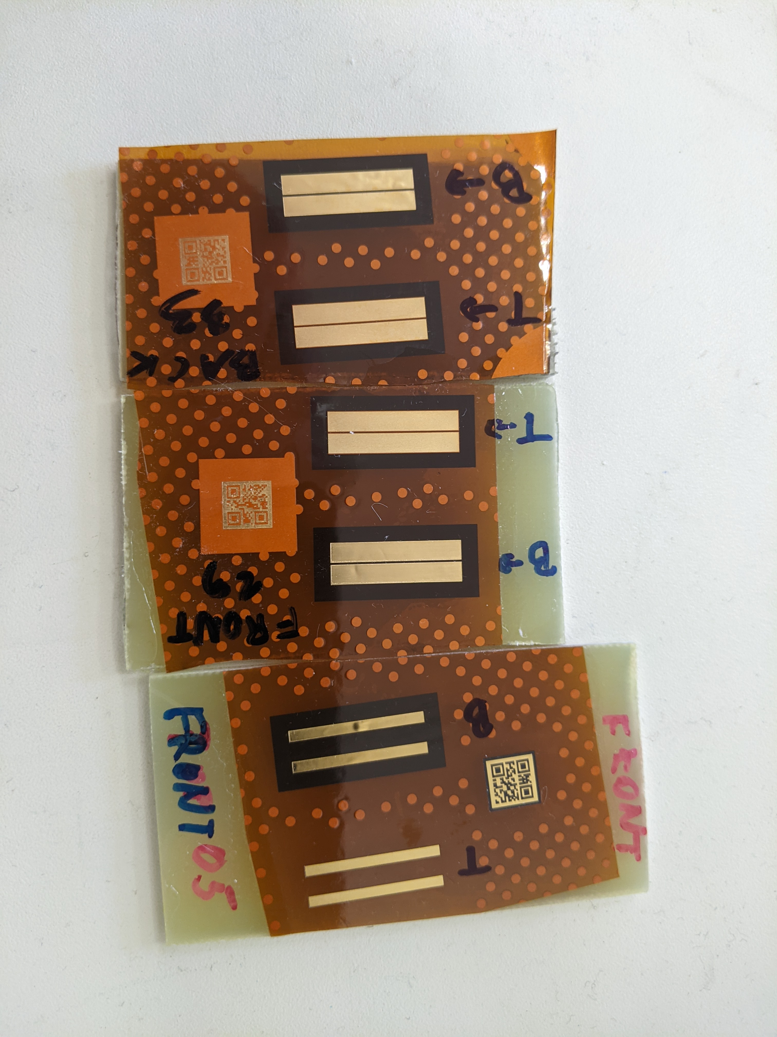
Wire bonder/pull tester Delvotec 5630
wire pull tests performed on both types of gold surfaces
test sample glued on metal plate with epoxy
Test coupons

Slide 13
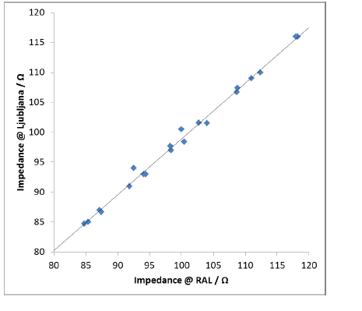
Test on test structure – impedances
Ljubljana Commercial impedance meter Z metrix ST 600 - measured at ELGOLINE
Oxford – TDR osciloscope
Very good agreement!

Slide 14
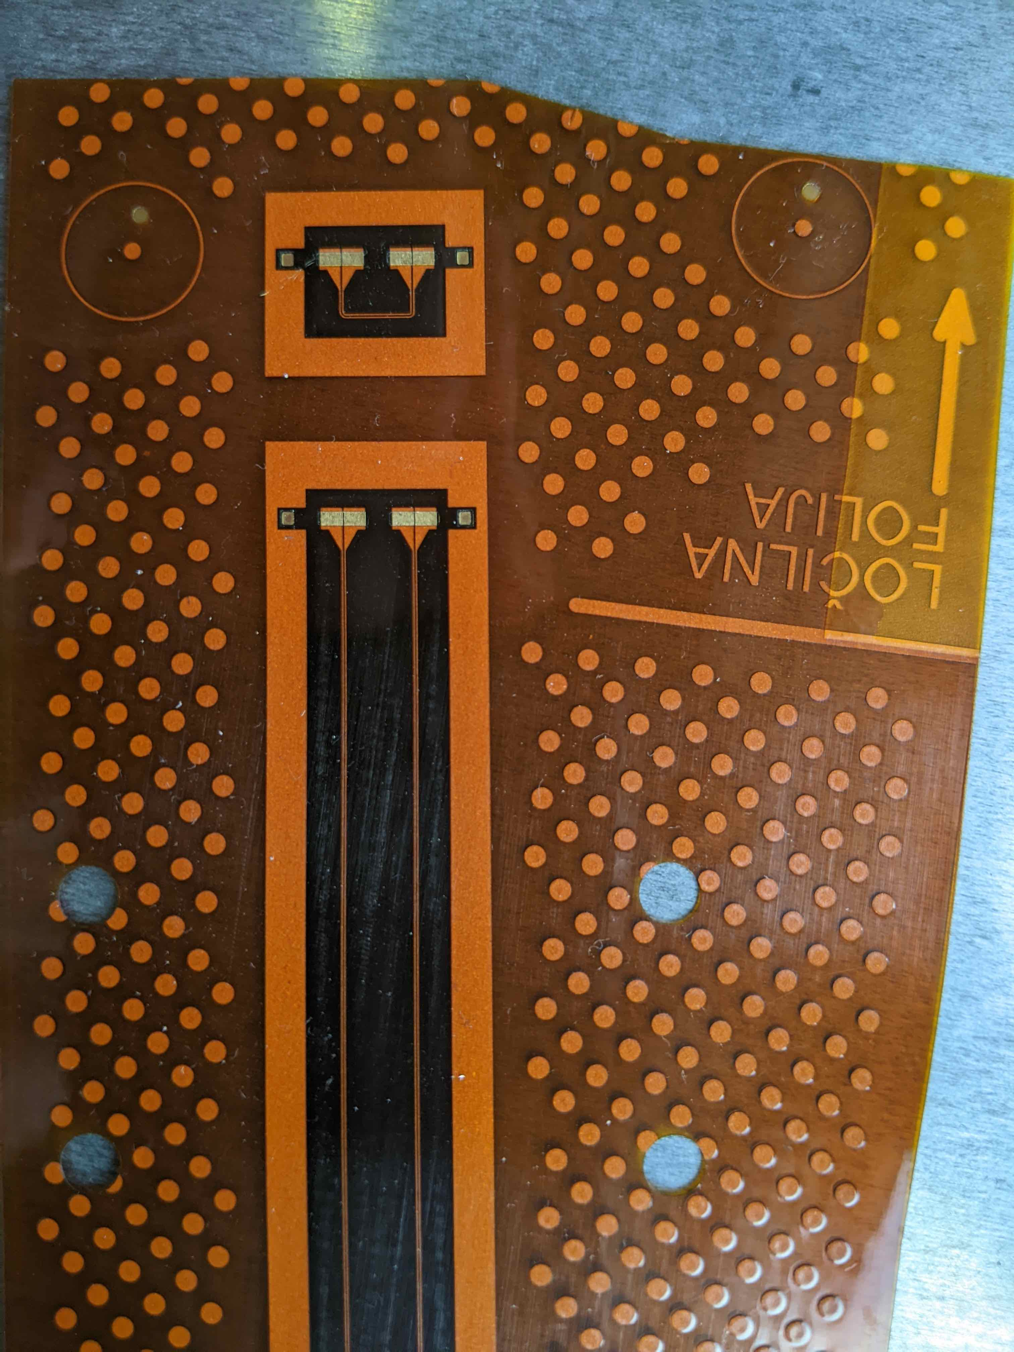
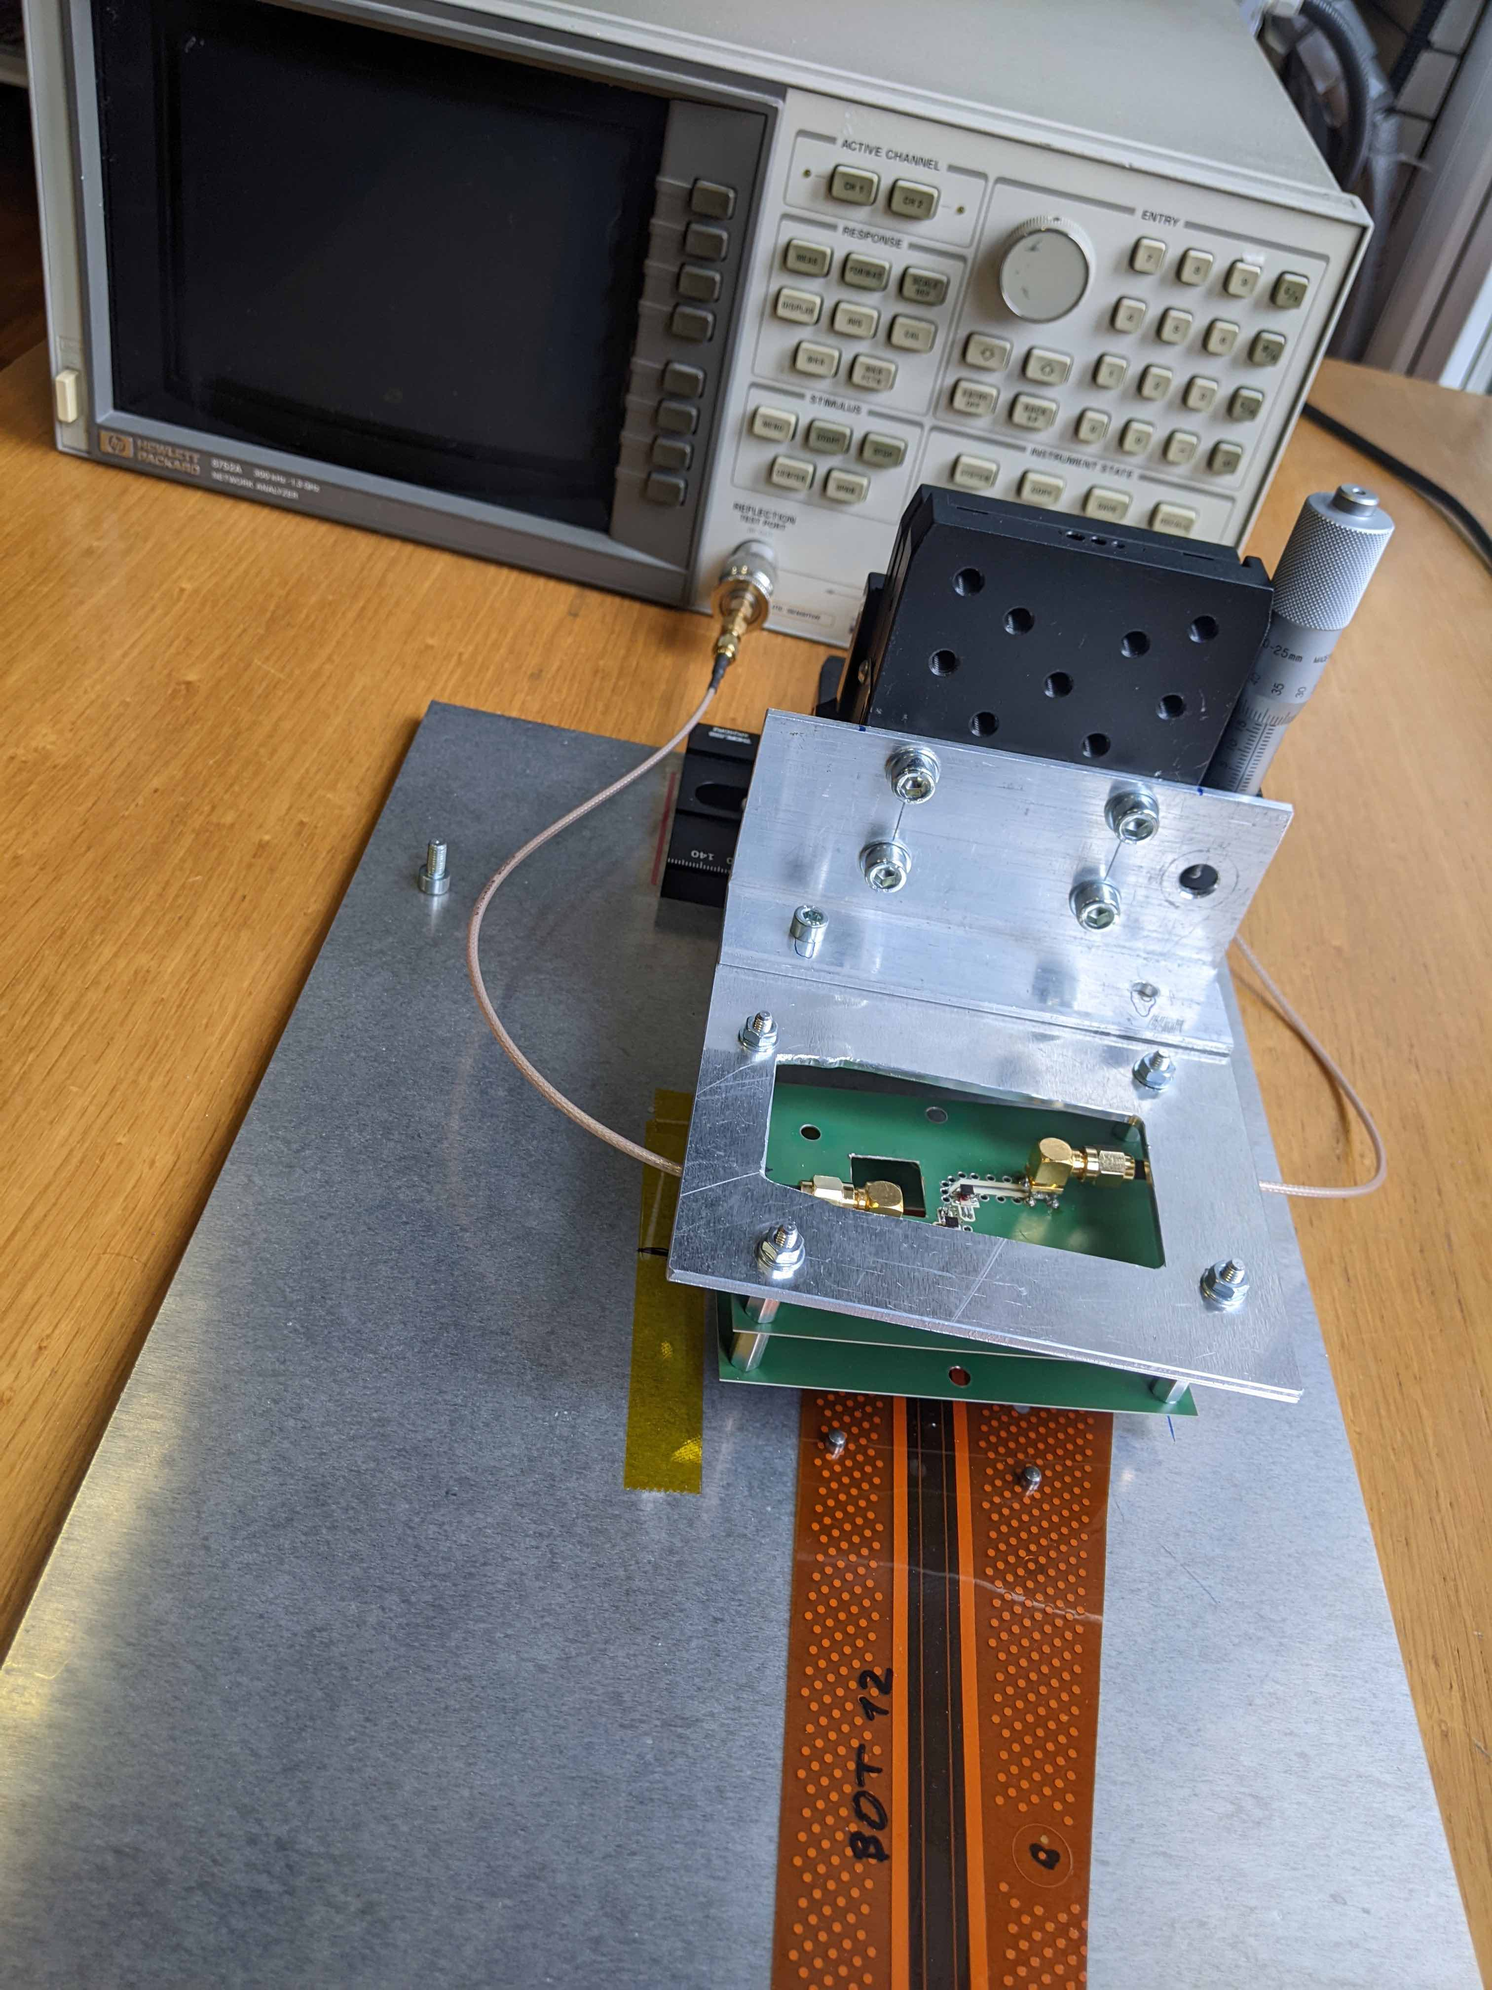
Attenuation measurements
differential measurements on the test structure (60 cm length)
Agilent/HP Network analyser HP 8720C
attenuation 4.2 dB ± 0.1db on 60 cm lines
acceptable attenuation is 15 dB

Slide 15
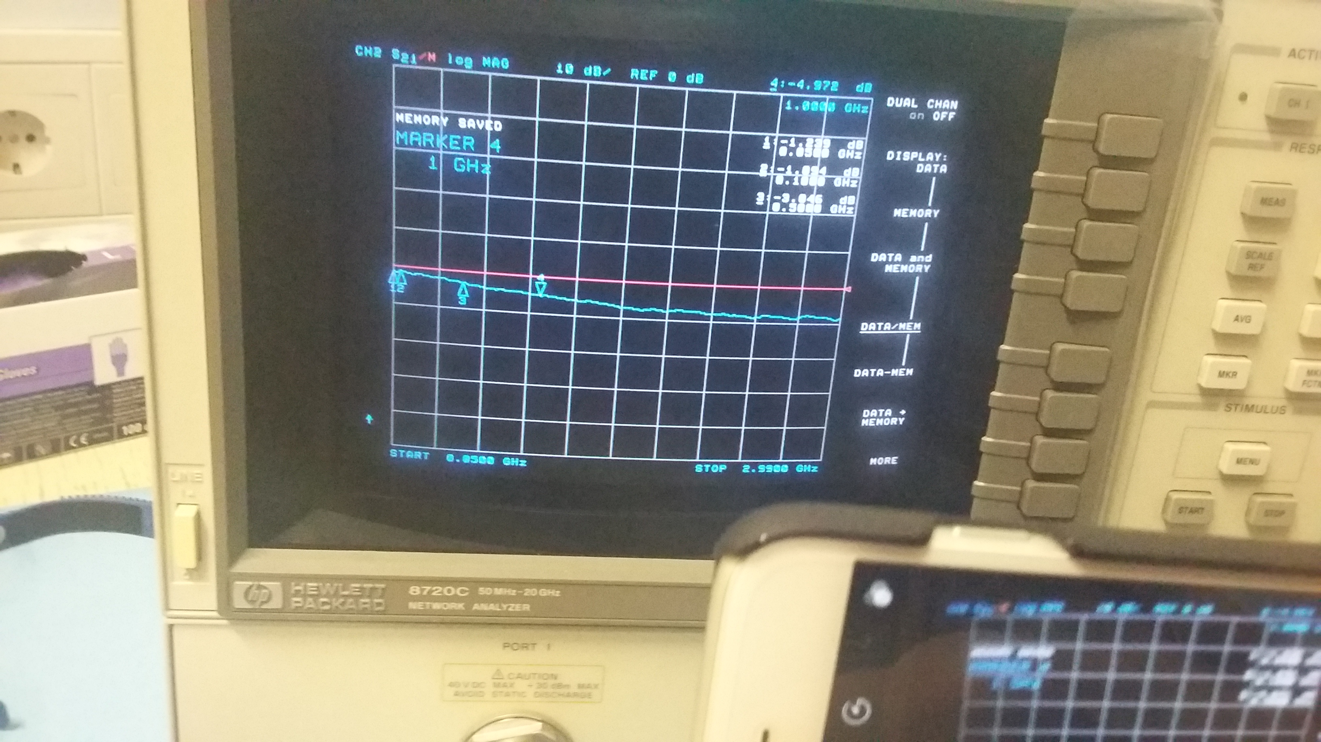
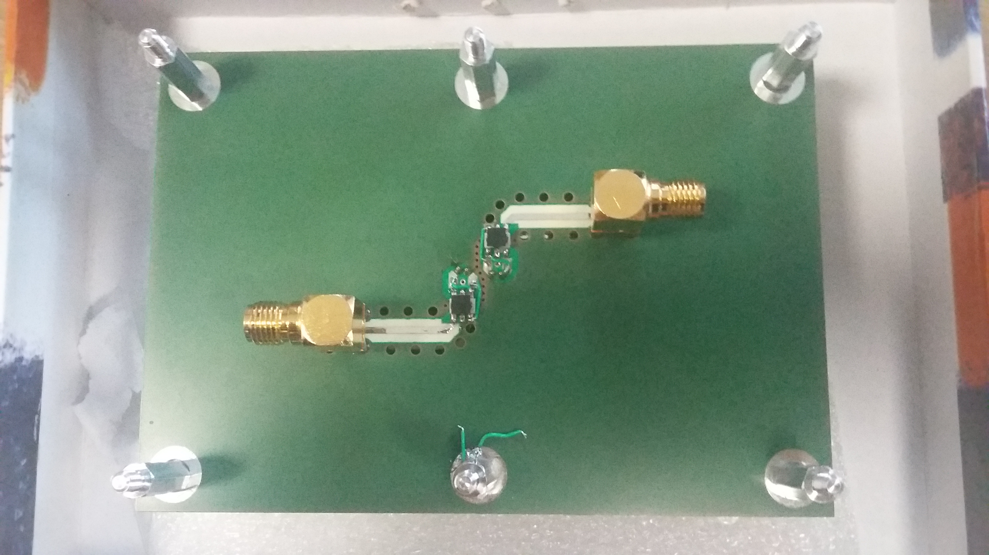
Tests on coupons – attenuation
Setup for measurement of attenuation (Ljubljana):
Equipment:
Agilent/HP Network analyser HP 8720C
Board with balun circuit: transforms single ended signals to differential and vice versa
Jig with contact pins:
Attenuation: 5 db on 60cm differential lines

Slide 16
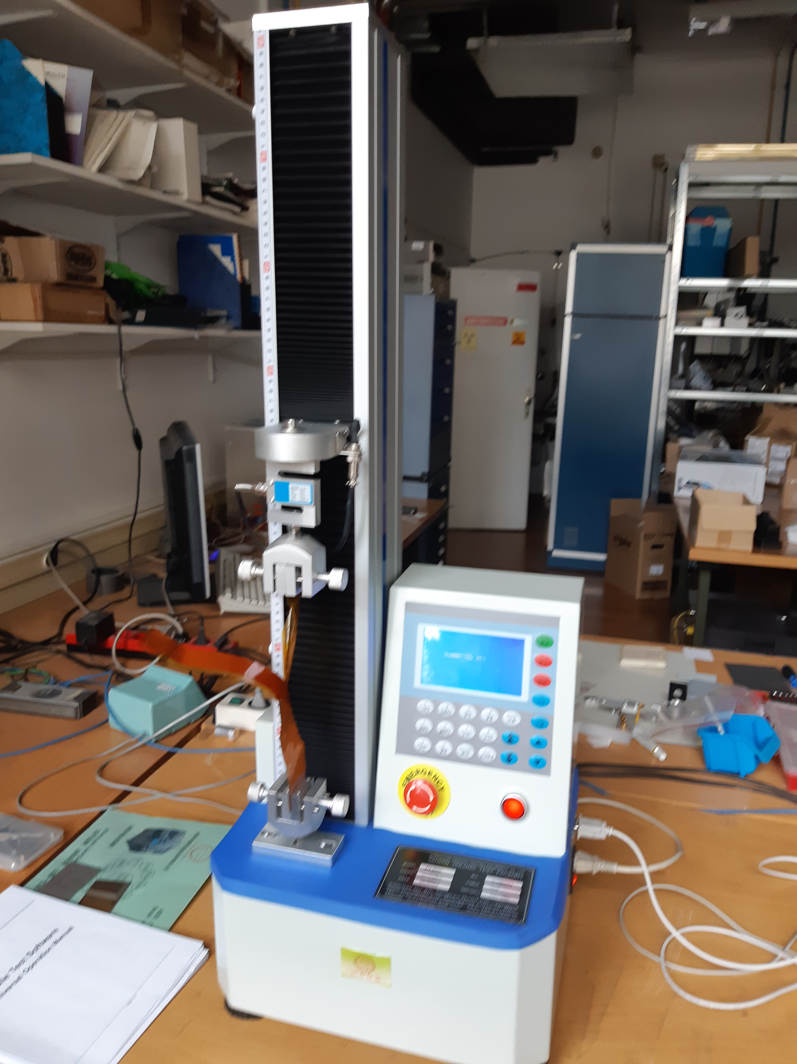
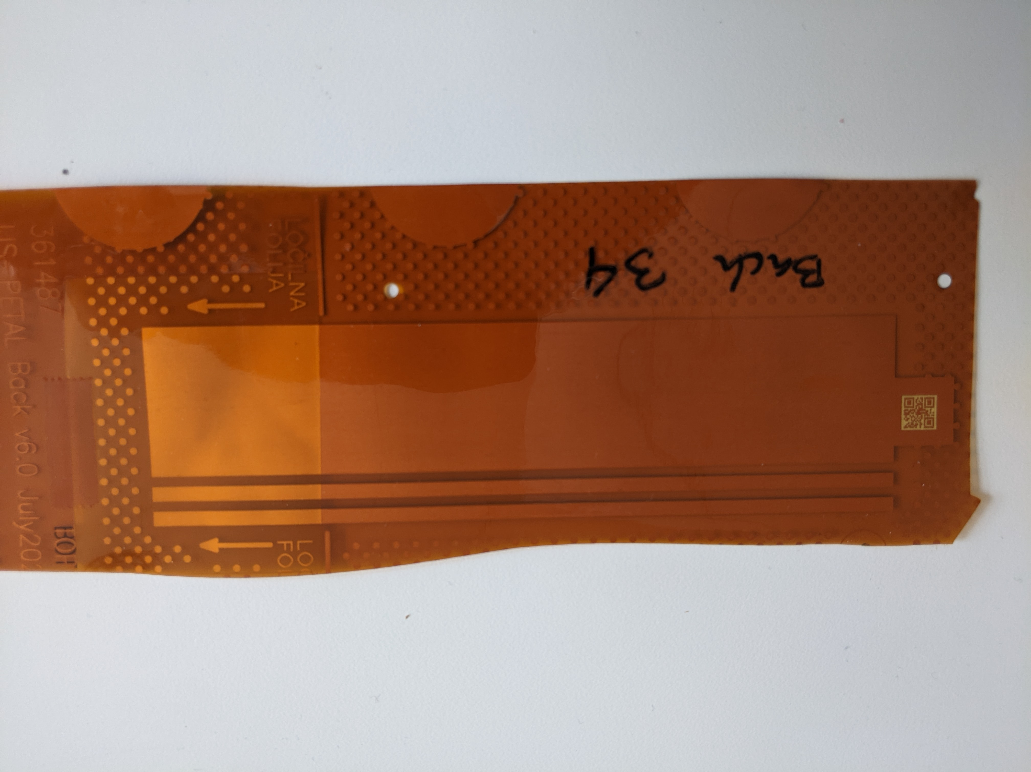
Tests on coupons Peel tests
samples – coverlayer on copper
Peel tester KJ-1065B Computer type Peeling strength tester
Sample width 30mm/3mm
Peel speed 10 mm/min
Force averaged over 20 mmm length
One of 10 tapes will be tested

Slide 17
Irradiation tests
TRIGA nuclear reactor will be used to irradiate peel samples to 660 k Gray

