Slide 1
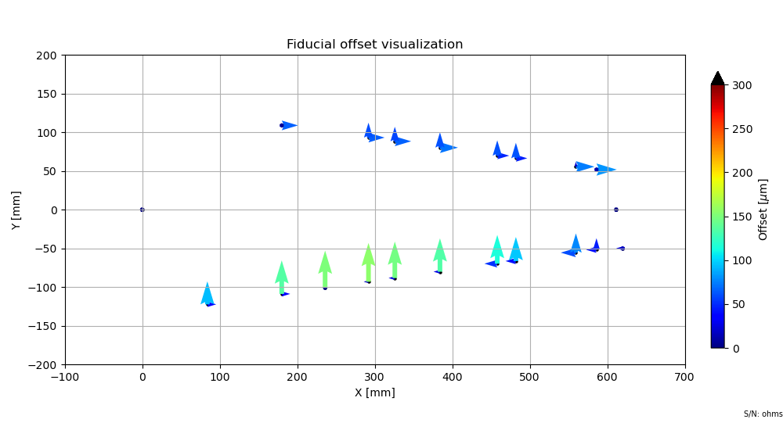
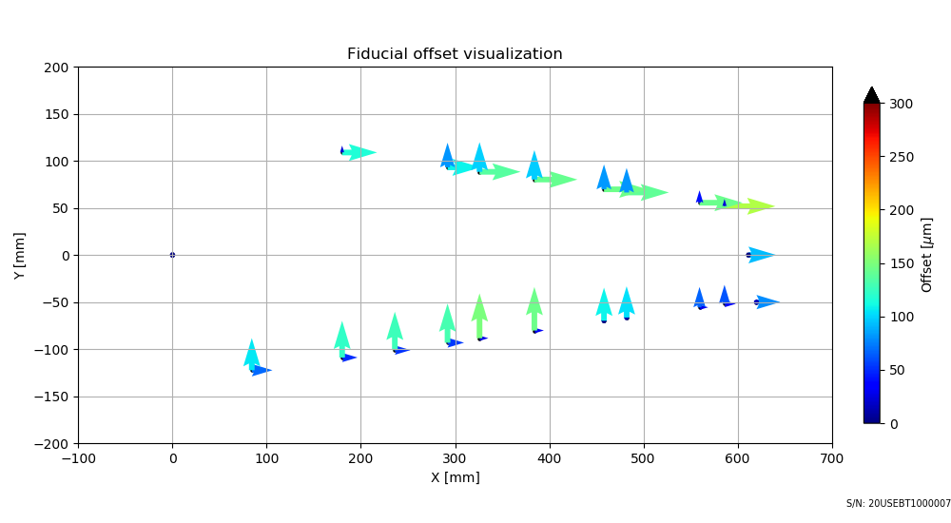
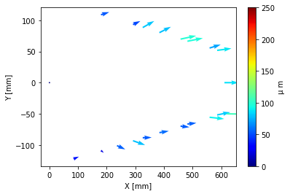
20USEBT1000007
DESY
IJS
IJS - DESY

Slide 2
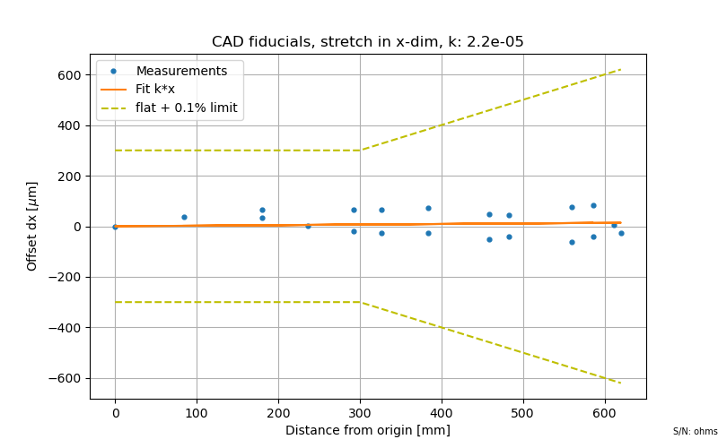
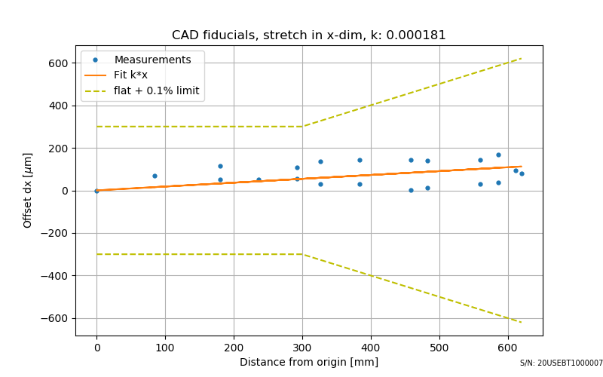
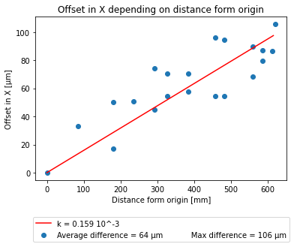
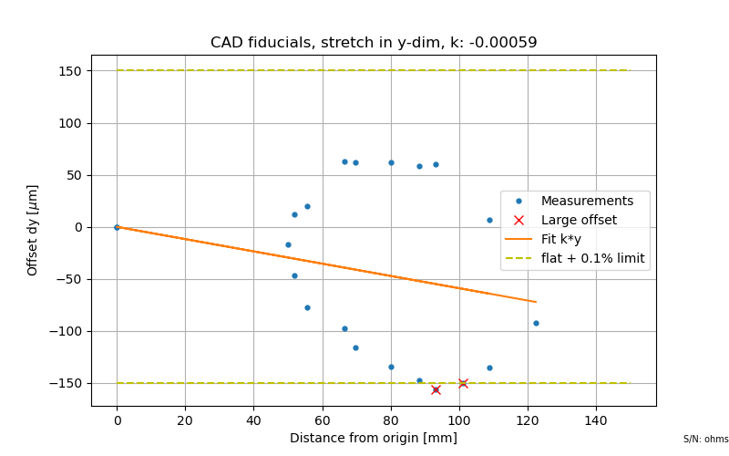
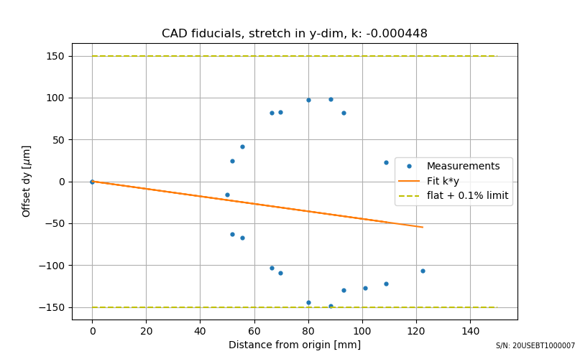
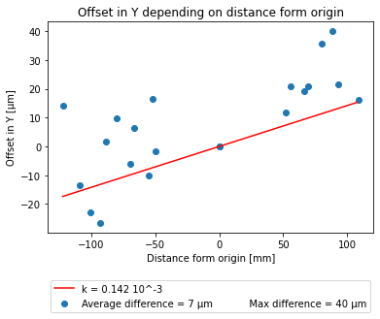
DESY
IJS
IJS – DESY

Slide 3
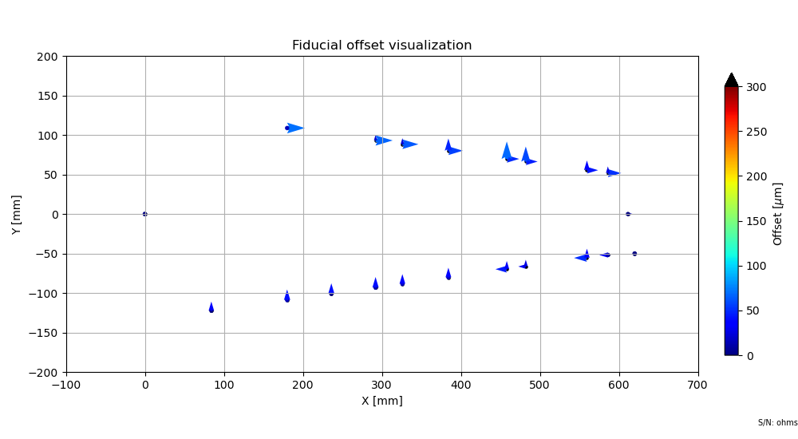
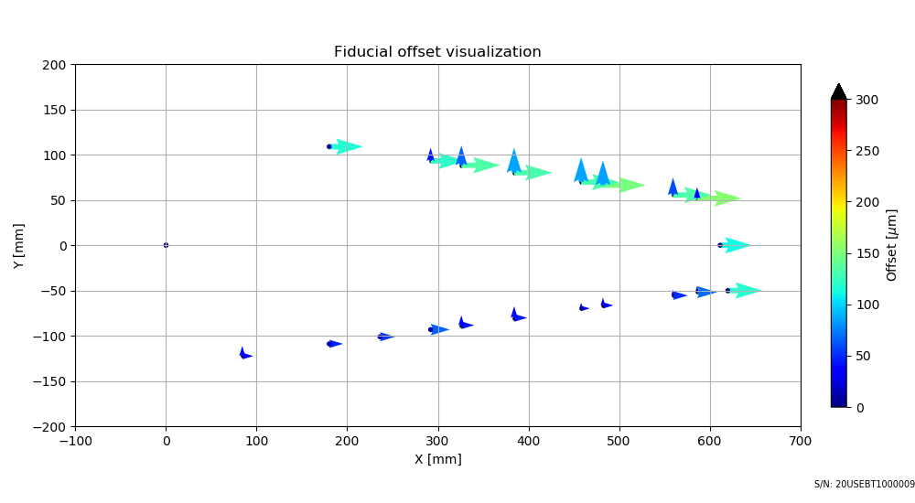
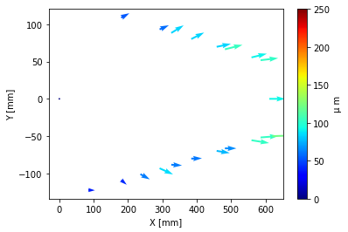
20USEBT1000009
DESY
IJS
IJS - DESY

Slide 4
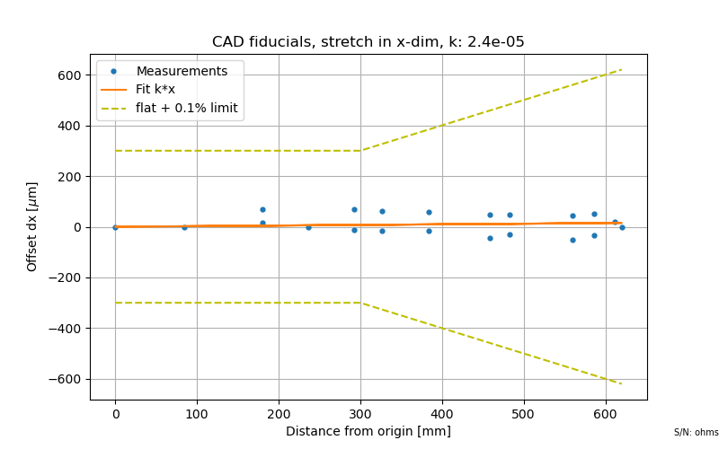

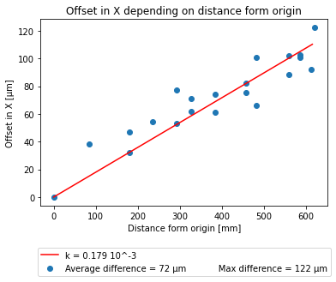
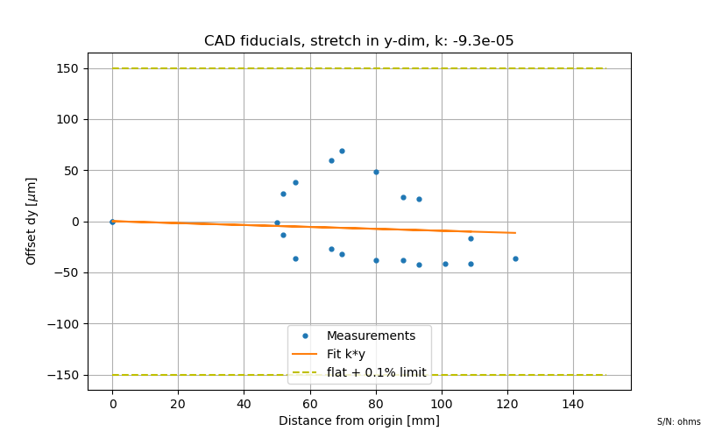
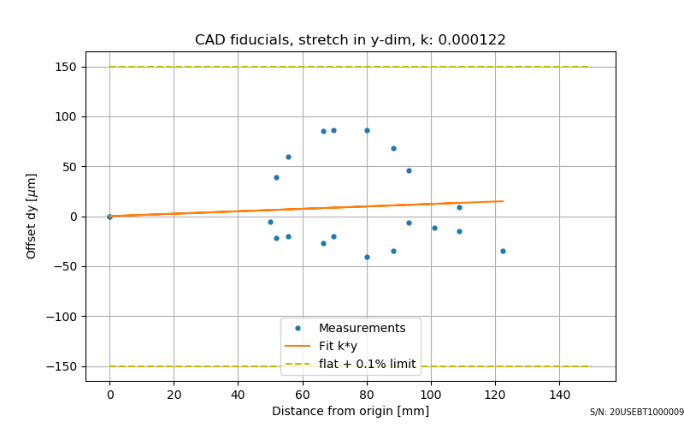
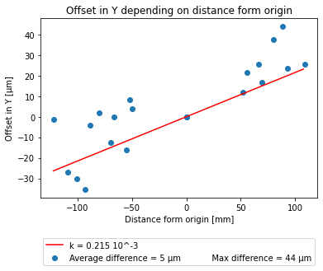
DESY
IJS
IJS – DESY

Slide 5
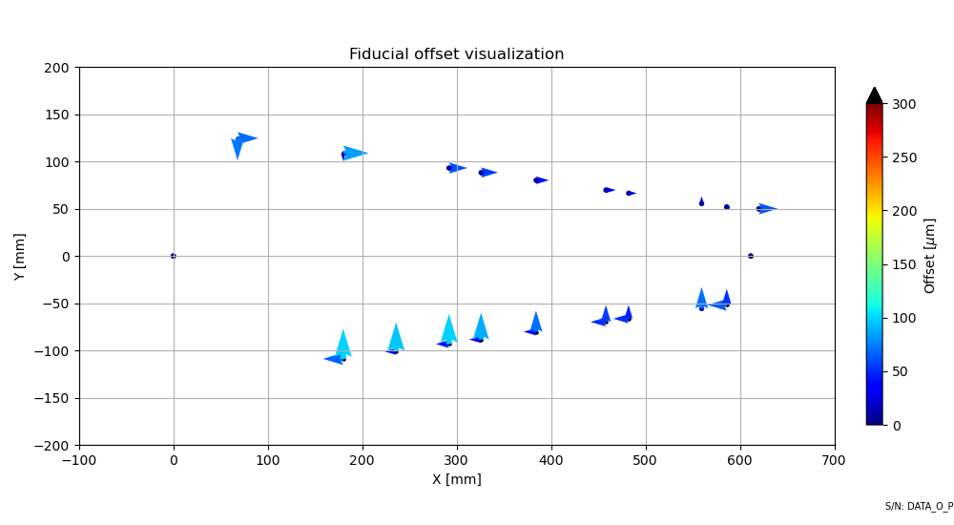
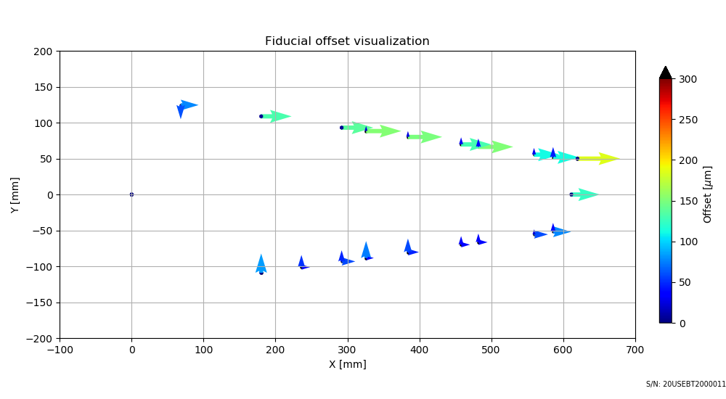
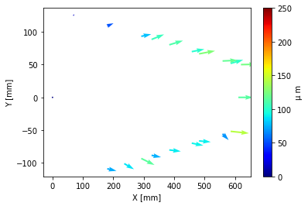
20USEBT2000011
DESY
IJS
IJS - DESY

Slide 6
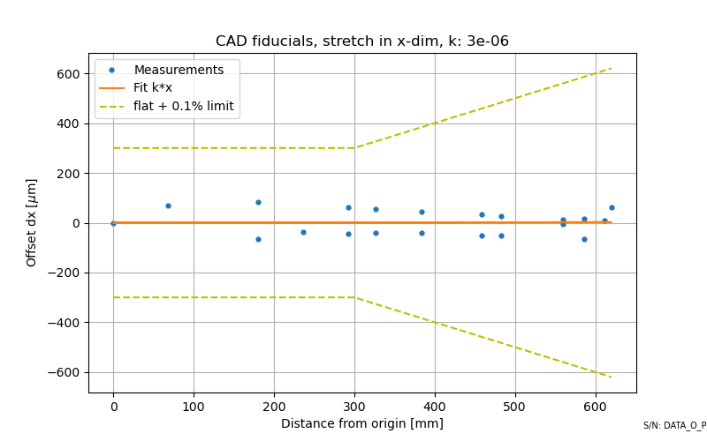

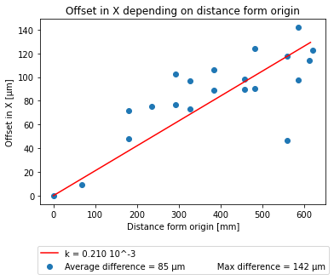
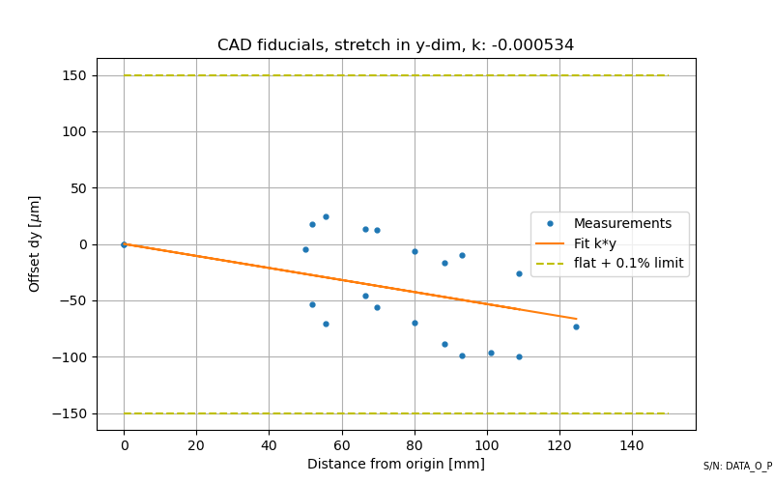
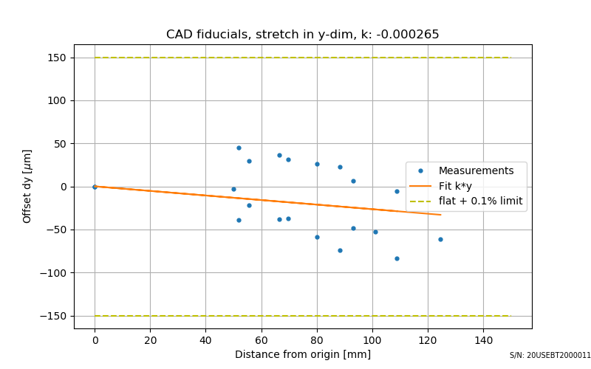
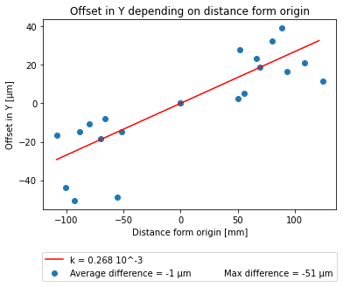
DESY
IJS
IJS – DESY

Slide 7
Tape | kx (DESY) | kx (IJS) | kx (IJS – DESY)
20USEBT1000007 | 2,20E-05 | 1,81E-04 | 1,59E-05
20USEBT1000009 | 2,40E-05 | 2,03E-04 | 1,79E-04
20USEBT2000011 | 3,00E-06 | 2,13E-04 | 2,10E-04
Tape | ky (DESY) | ky (IJS) | ky (IJS – DESY)
20USEBT1000007 | -5,90E-04 | -4,48E-04 | 1,42E-04
20USEBT1000009 | -9,30E-05 | 1,22E-04 | 2,15E-04
20USEBT2000011 | -5,34E-04 | -2,82E-04 | 2,68E-04

Slide 8
Average current at 1000V (nA)
Tape | DESY | IJS
20USEBT1000007 | 4.455 | 3.55
20USEBT1000009 | 4.7452 | 2.945
20USEBT2000011 | 3.535 | 2.845

