Slide 1
Irradiations of ATLAS Itk strips QA samples with protons at CERN PS (IRRAD)

Slide 2
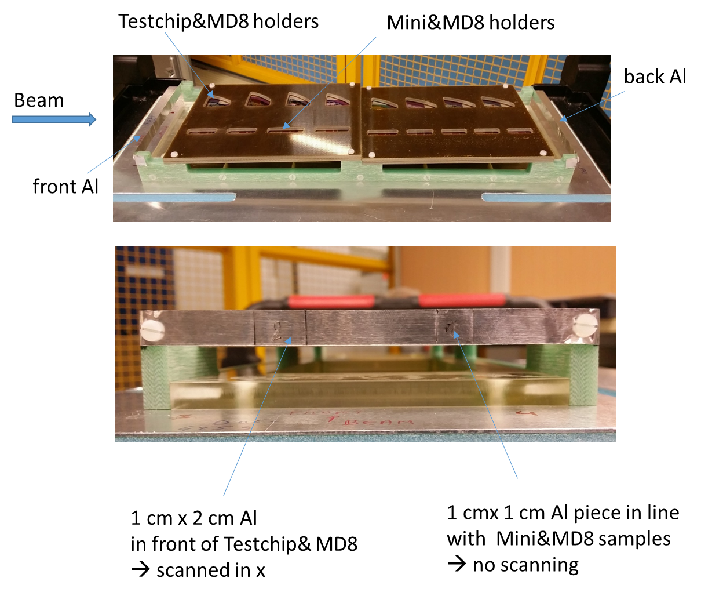
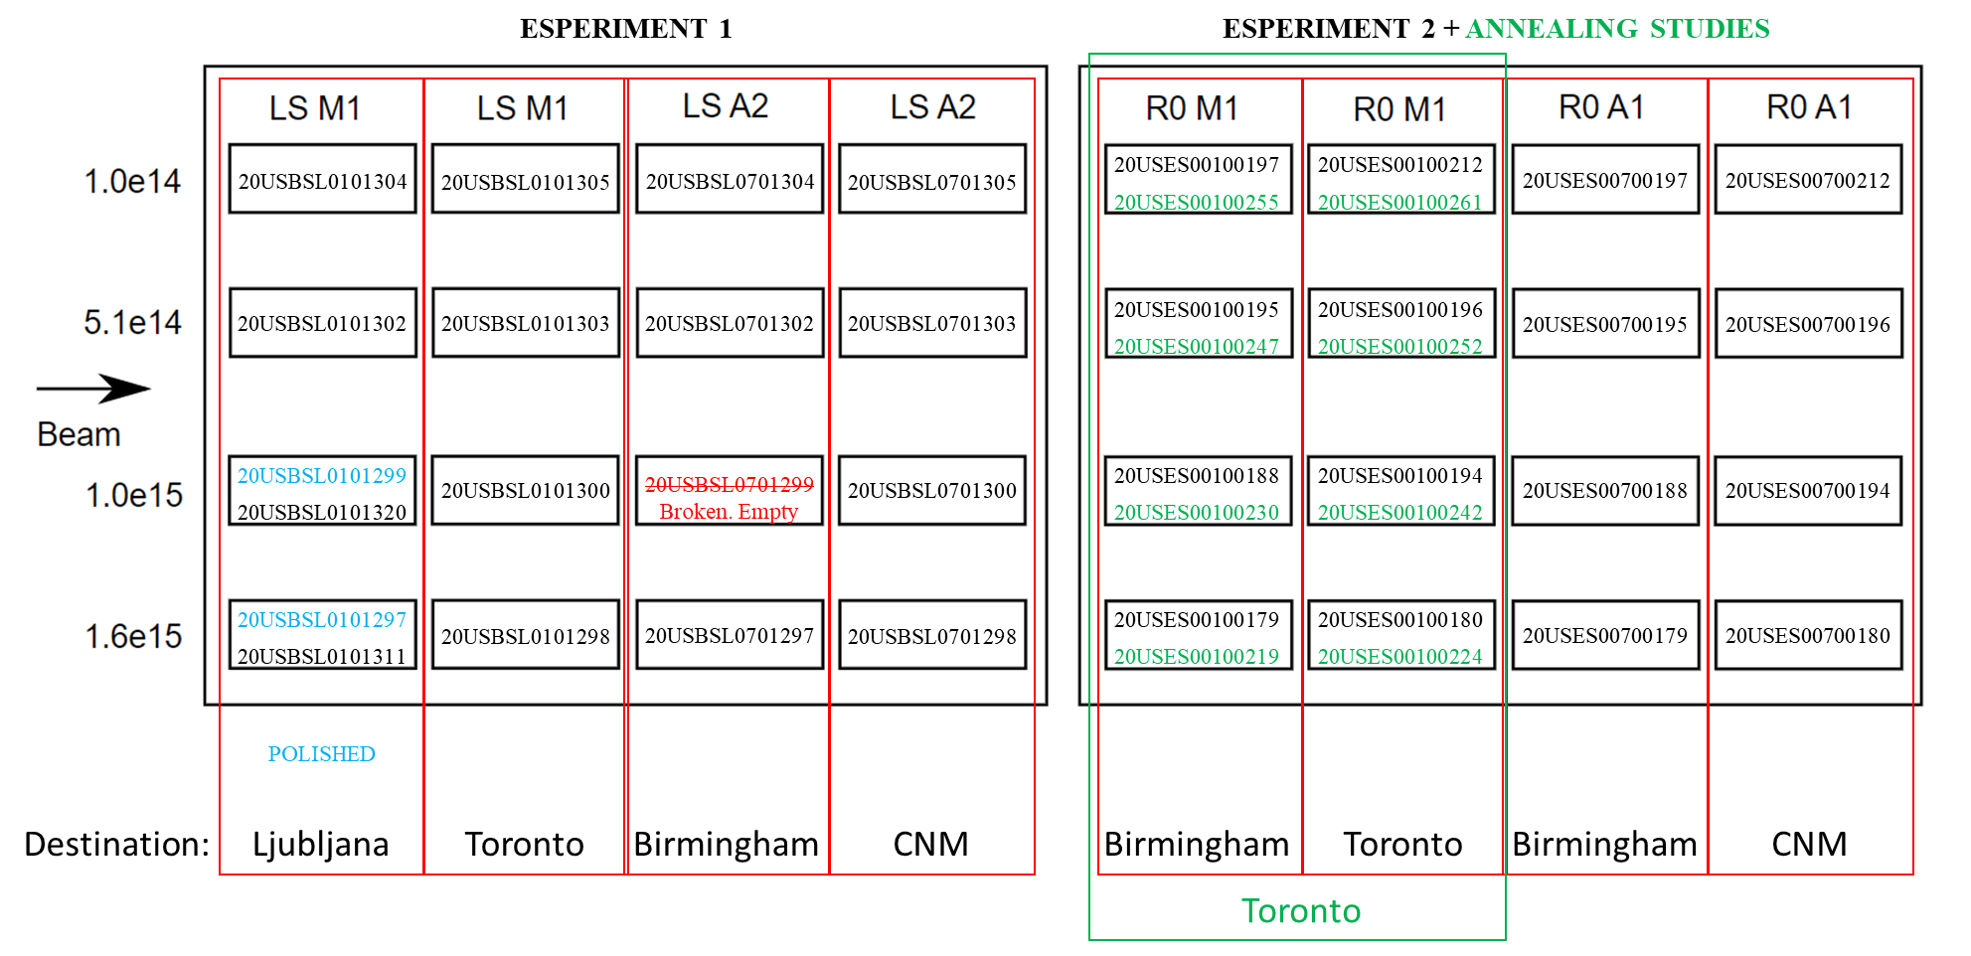
IRRA irradiation 2021
IRRAD irradiation setup 2022
irradiated cold
during shipment ~ 7 days at RT
0 min intentional annealing probably roughly equivalent
to annealing of ~ 80 min at 60 C

Slide 3
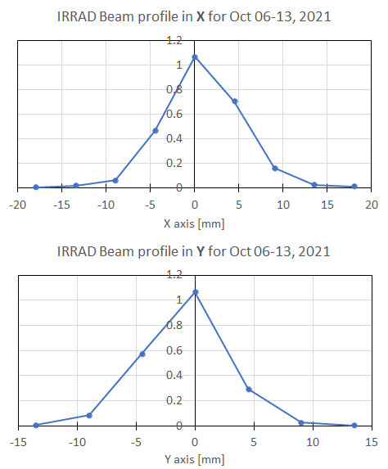
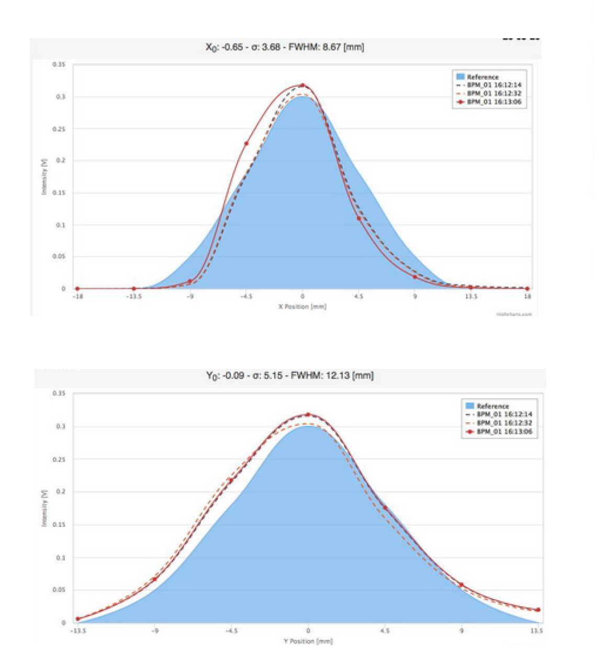
Uniformity of irradiation
This QA irradiation (plot made by Vitaliy):
J. Keller, J Kroll,
https://indico.cern.ch/event/694901/contributions/2849730/
subcontributions/247249/attachments/1588666/2513066/Keller18-01-24.pdf
PS beam profile
x: FWHM = 8.7 mm
➔ scanning possible
y: FWHM = 12.1 mm
position of the device in the beam matters
any misalignment can cause significant effects, especially if there is no scanning

Slide 4
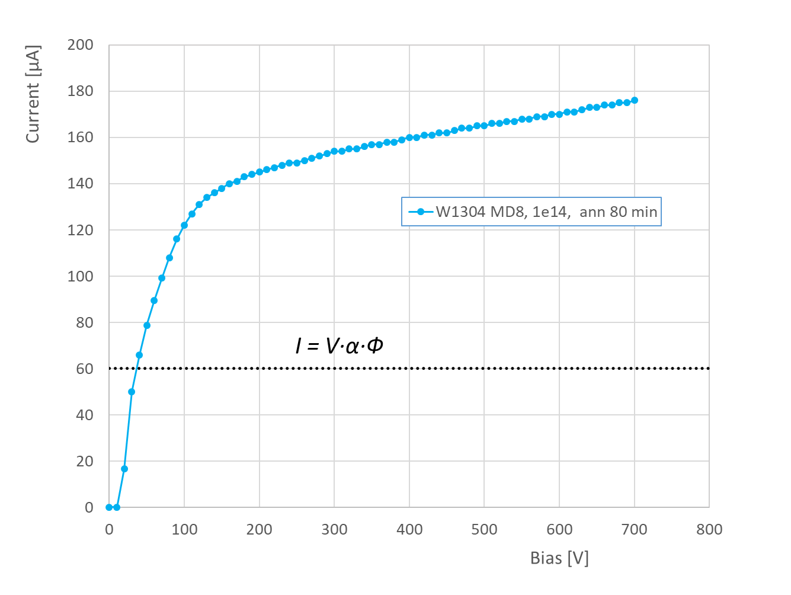
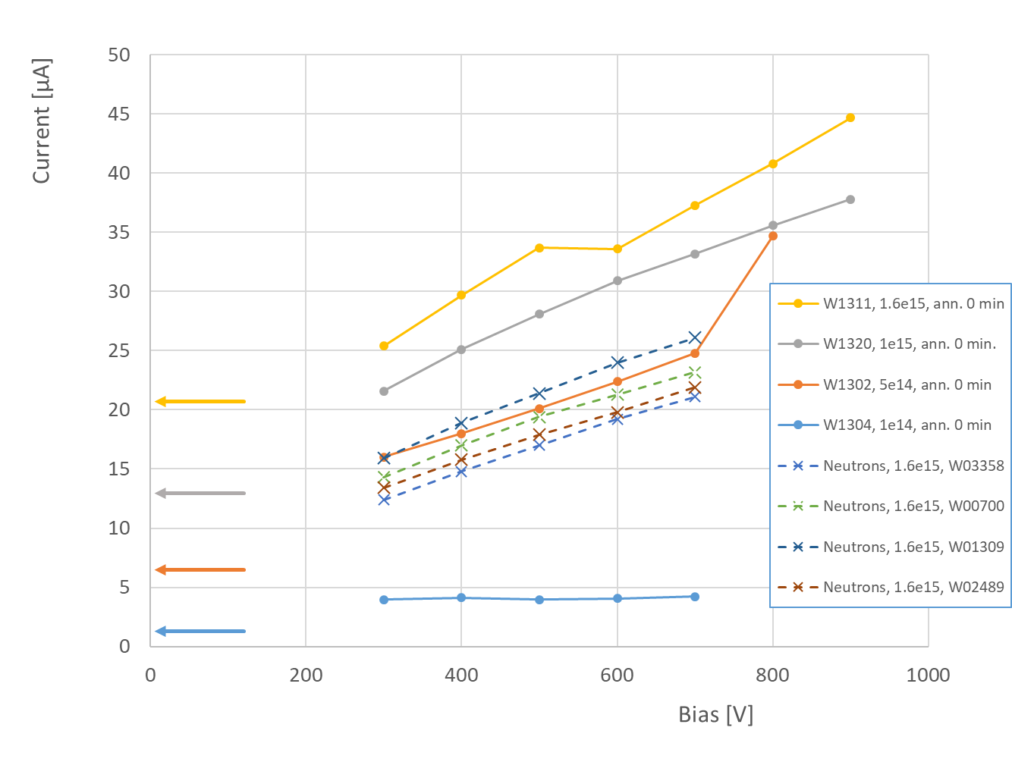
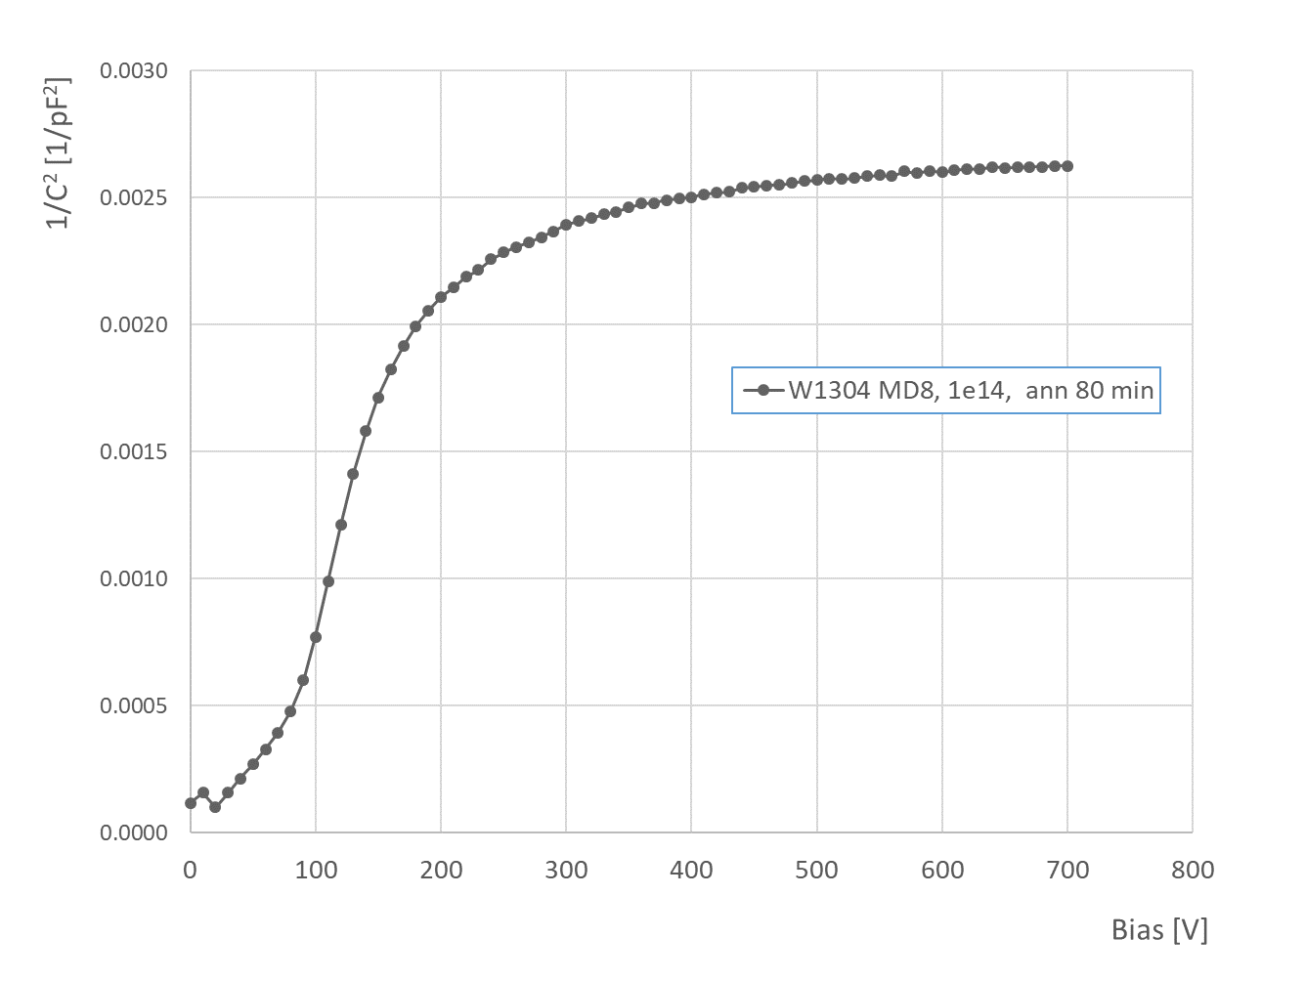
Current
sample VPA8186- W1304 nominal Ф_{eq} = 1e14 n/cm
➔ at this fluence V_{fd} ~ 200 V
➔ measured with MD8 diode at 20C after annealing 80 min at 60 C
→ simple diode structure (but guard rings not contacted)
Mini detectors
I-V
Protons 1.6e15
1.6e15
1e15
5e14
1e14
C-V
V_{fd} ~ 200 V
current higher than after neutron irradiation to same fluence
➔ higher than I=V∙α∙Ф_{eq} (indicated by arrows in the graph)
measured current much higher than expected
Are actual fluences higher than nominal?

Slide 5
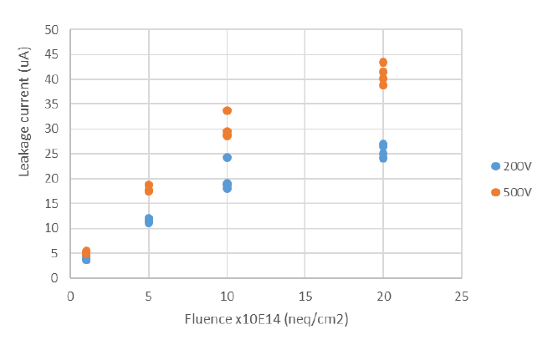
Current
PS irradiation results with A17 presented at strip sensor meeting 23. Nov. 2018 https://indico.cern.ch/event/776393/
U. Soldevila
A17, PS irradiation, 2018
IRRAD irradiation (2021,2022): 1.6e15: current ~ 35 uA @ 500 V
➔ consistent with 2018 measurements
with: Ф_{eq} = 1.5e15 n/cm² , α = 4e-17 Acm, T = -20°C, fully depleted mini sensor, area 8x8 mm²: I = 21 µA
→ current larger than calculated
→ after neutron irradiation to 1.6e15 current ~ 20 uA @ 500 V

Slide 6
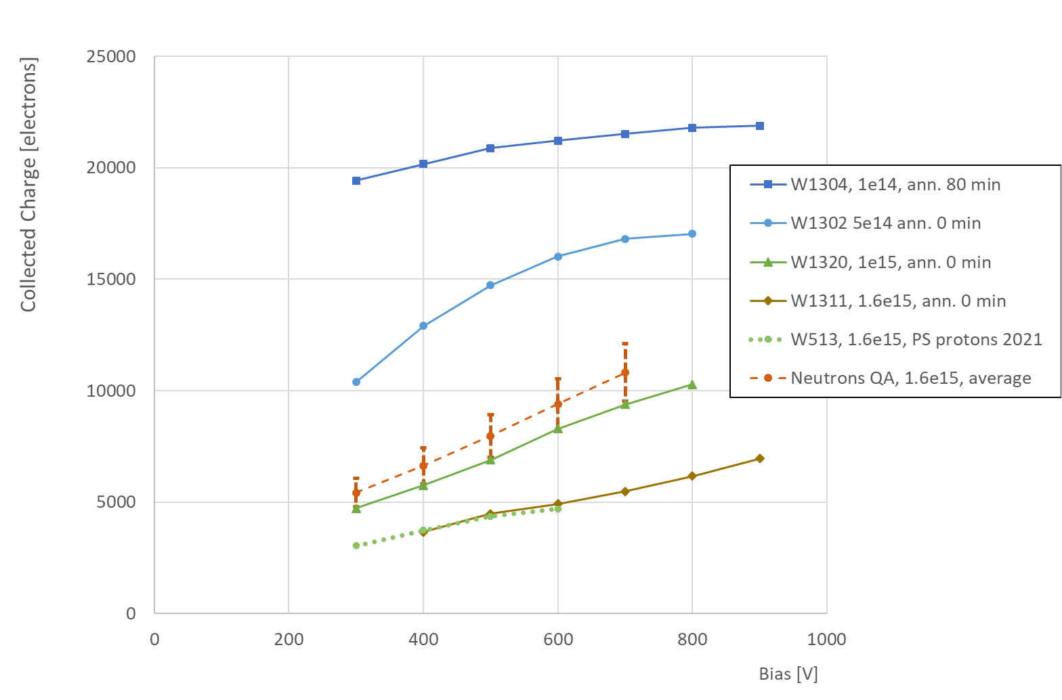
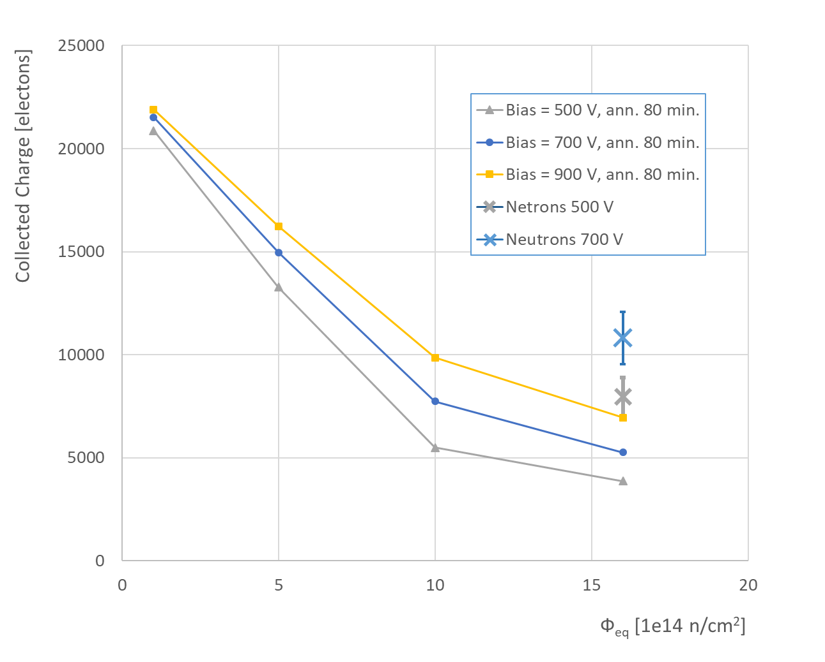
Charge collection
PS protons 1.6e15: consistent with 2021
Much smaller than after 1.6e15 neutrons

Slide 7
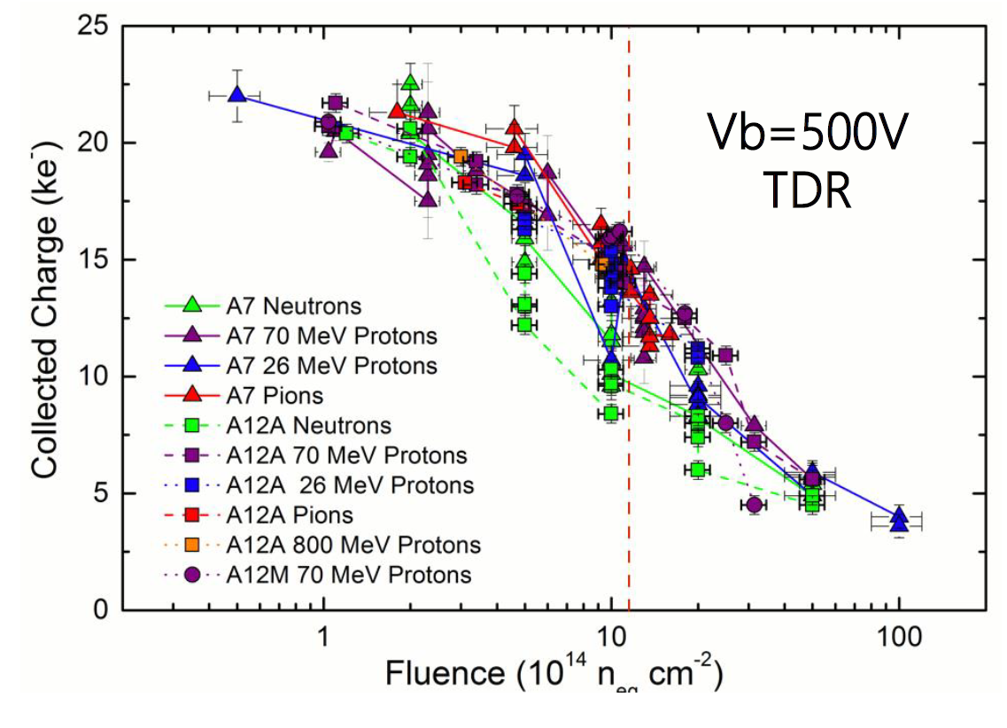
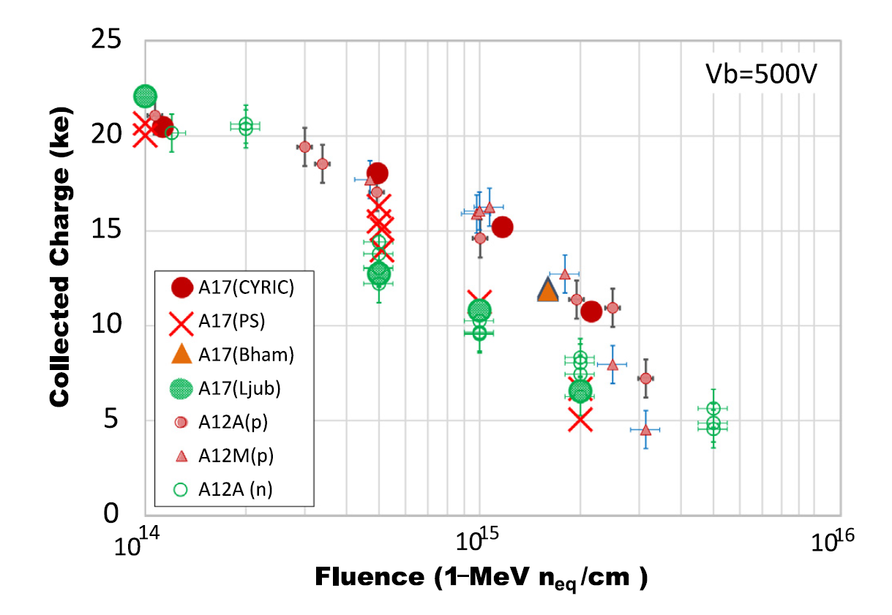
Compare with previous IRRAD irradiations
K. Hara et al., NIMA 983 (2020) 164422
https://doi.org/10.1016/j.nima.2020.164422
K. Hara et al., NIMA 831 (2016) 181-188
https://doi.org/10.1016/j.nima.2016.04.035
QA Ljub
IRRAD 21
IRRAD 22
These are 26 MeV and 70 MeV protons
in these measurements CCE after neutron irradiation lower than after protons
  but no IRRAD data
results from 2018: PS protons at Ф > 1e15 similar as neutrons
irradiation of QA samples with PS protons (2021)
➔ lower than expected but not very far from results with A17
→ measured ~ 6 ± 1 ke…. , expected ~ 8 ± 1 ke

Slide 8
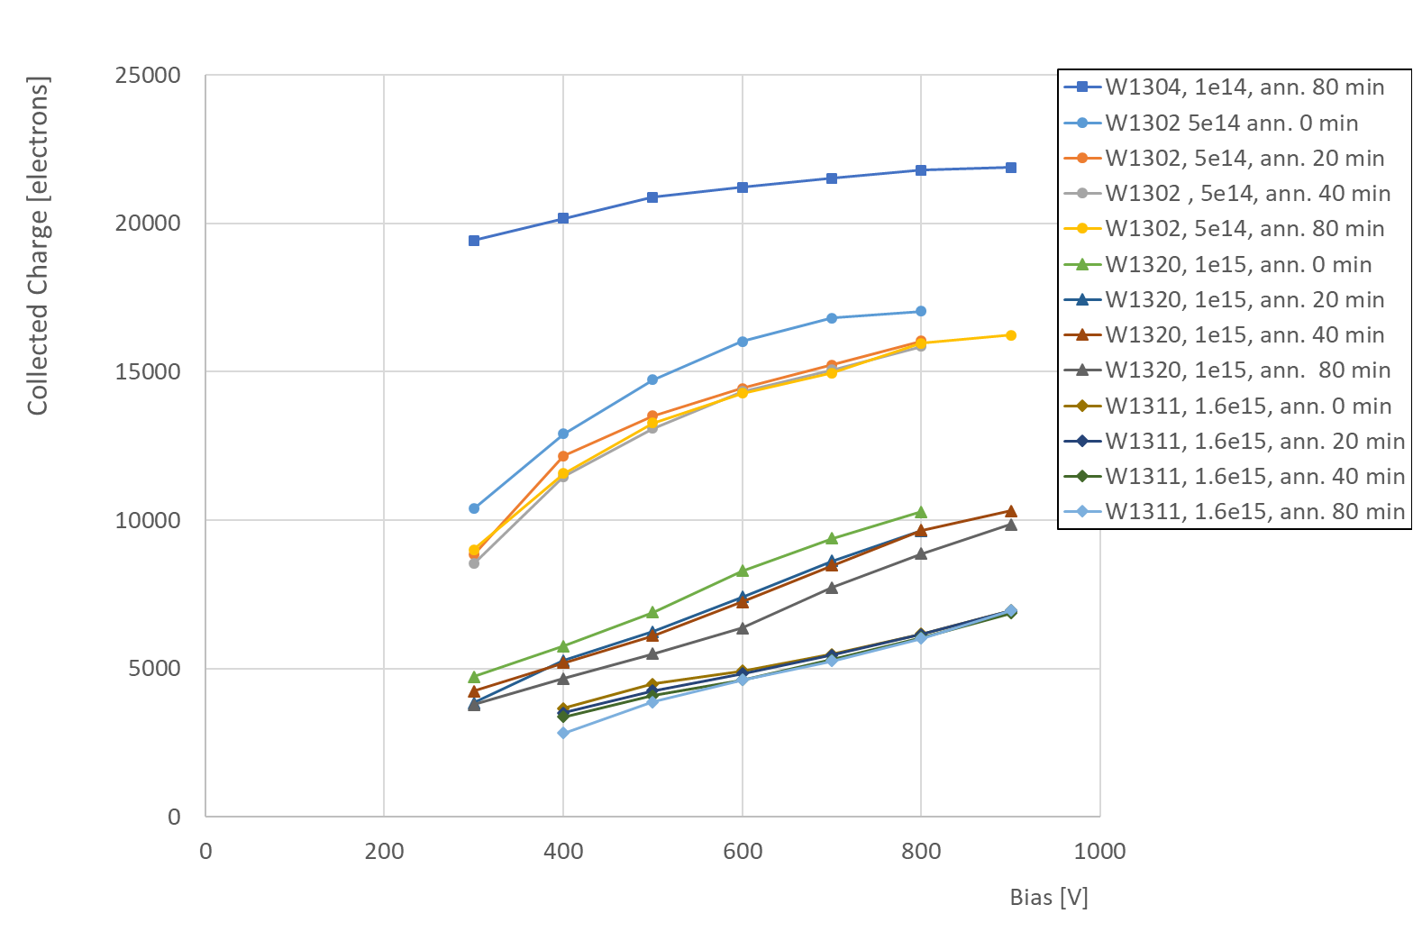
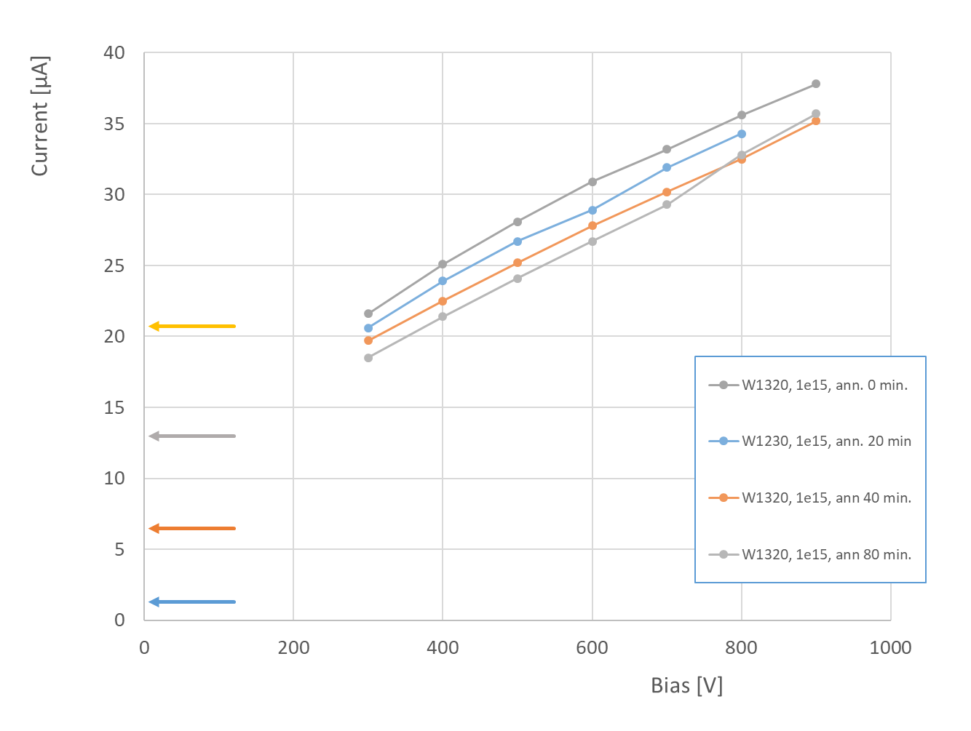
Annealing
Charge drops with annealing
→ note: 0 min means ~ 7 days at RT
Current drops with annealing

Slide 9
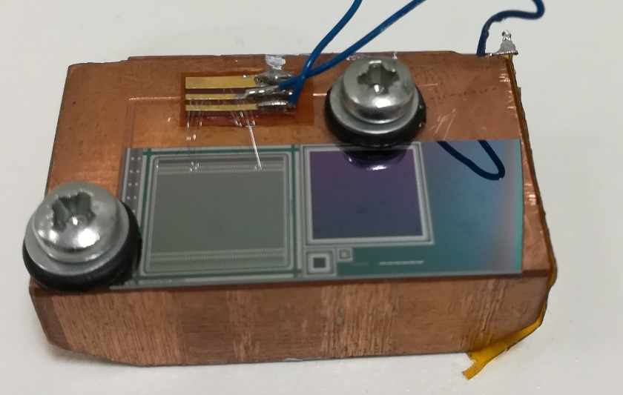
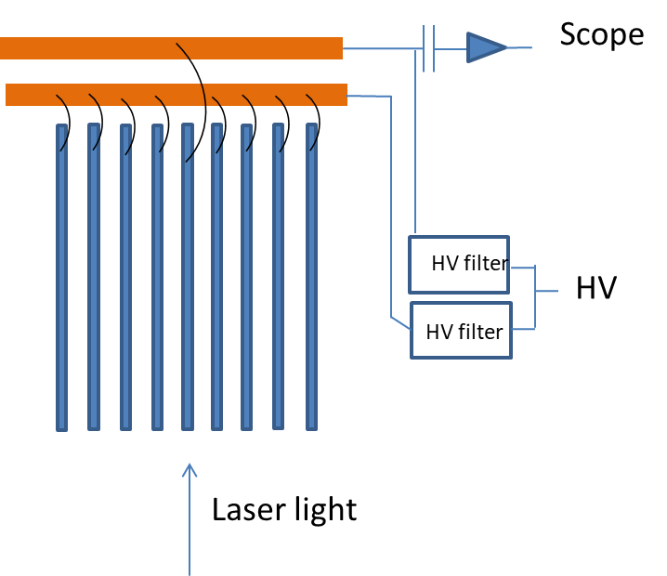
E-TCT test with QA minis irradiated with 24 GeV protons in IRRAD
because of dimensions and cutting of the sample E-TCT was measured with laser along the strip
  different weighting field than in “standard” configuration with laser perpendicular to the strip direction
  charge generated only under one strip therefore weighting field “realistic” → as when charged particle crosses
Standard E-TCT doesn’t work well
because of too wide edge
Laser
Scan under the strip form top to back side

Slide 10
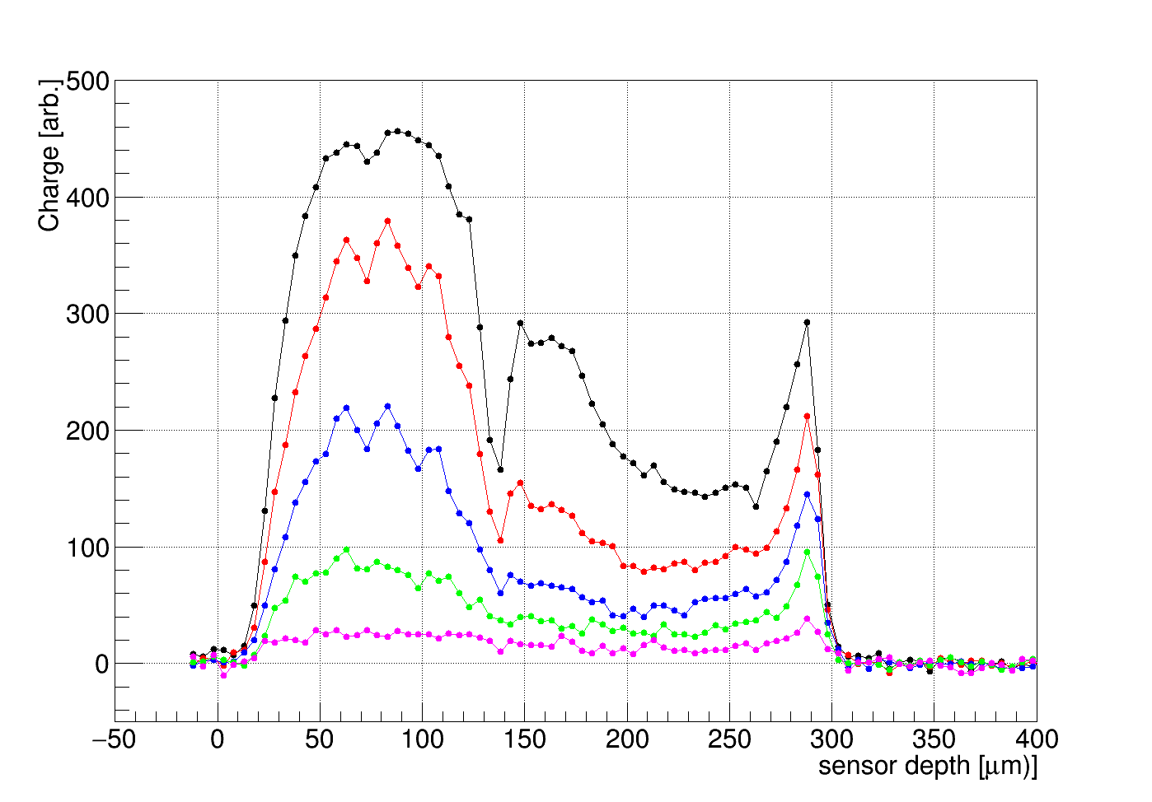

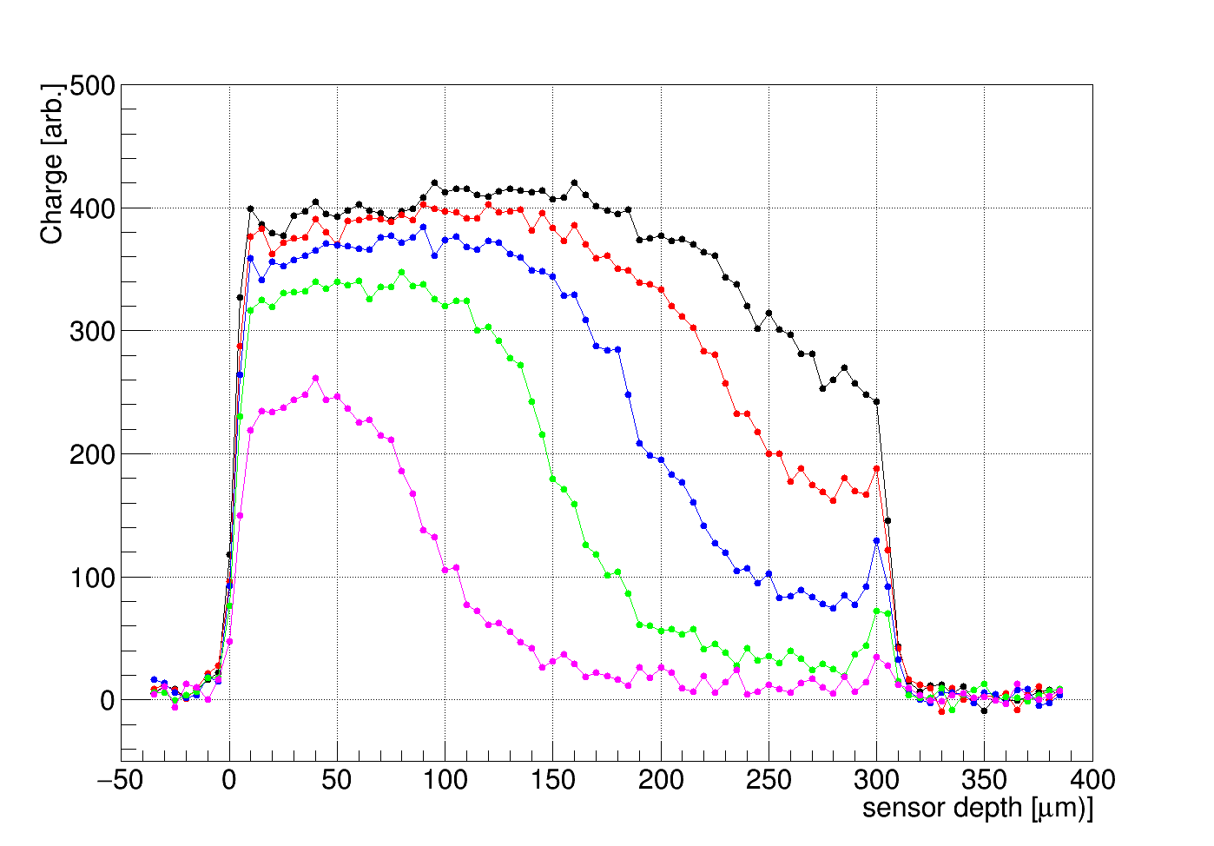
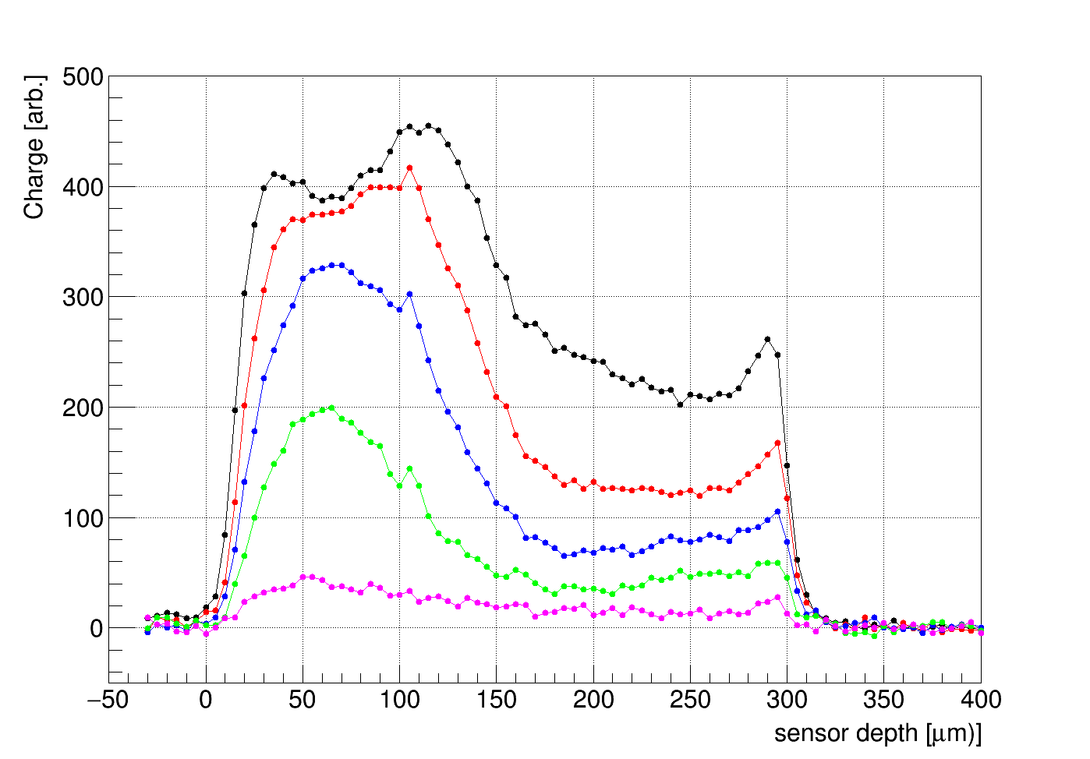
Edge TCT
VPA38186-W1297
VPA38186-W1299
PS protons, 1.6e15
Neutrons 1.6e15
PS protons, 1e15
900 V
700 V
500 V
300 V
100 V
900 V
700 V
500 V
300 V
100 V
900 V
700 V
500 V
300 V
100 V
different charge collection profiles for neutrons and protons at same Ф_{eq}
  rapid drop of profile height with bias voltage
  ➔ for neutrons profile under strip gets narrower but height doesn’t drop so rapidly as in the case of protons
(narrower total profile width in proton sample (it is less than 300 um) because of polishing → see next slide)

Slide 11
Polishing quality
PS protons (1.6e15) VPA38186-W1297
Neutron sample 1.6e15 (VPX37412-W704)
Edge damaged by polishing, no or small E-TCT signal from this part

Slide 12
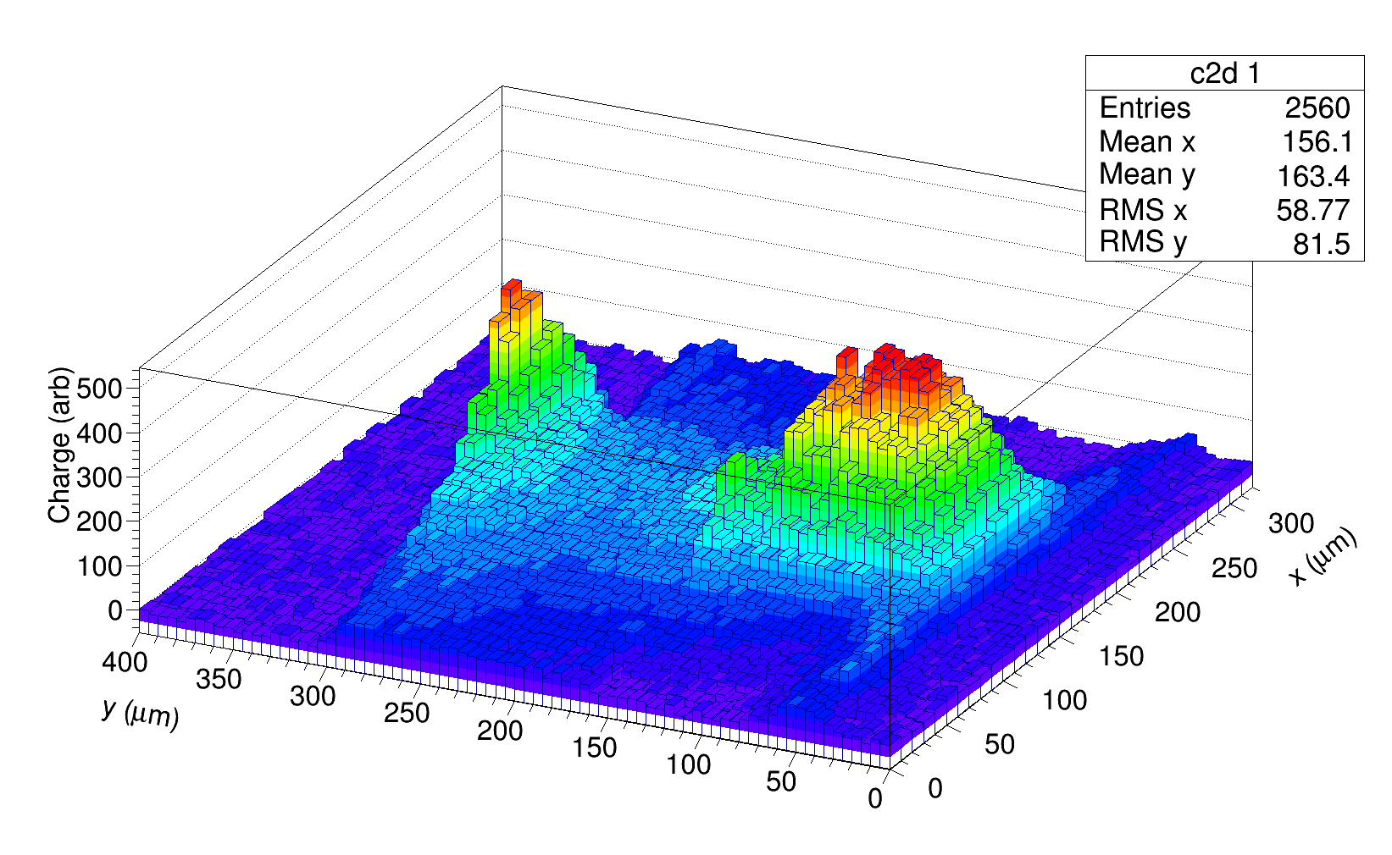
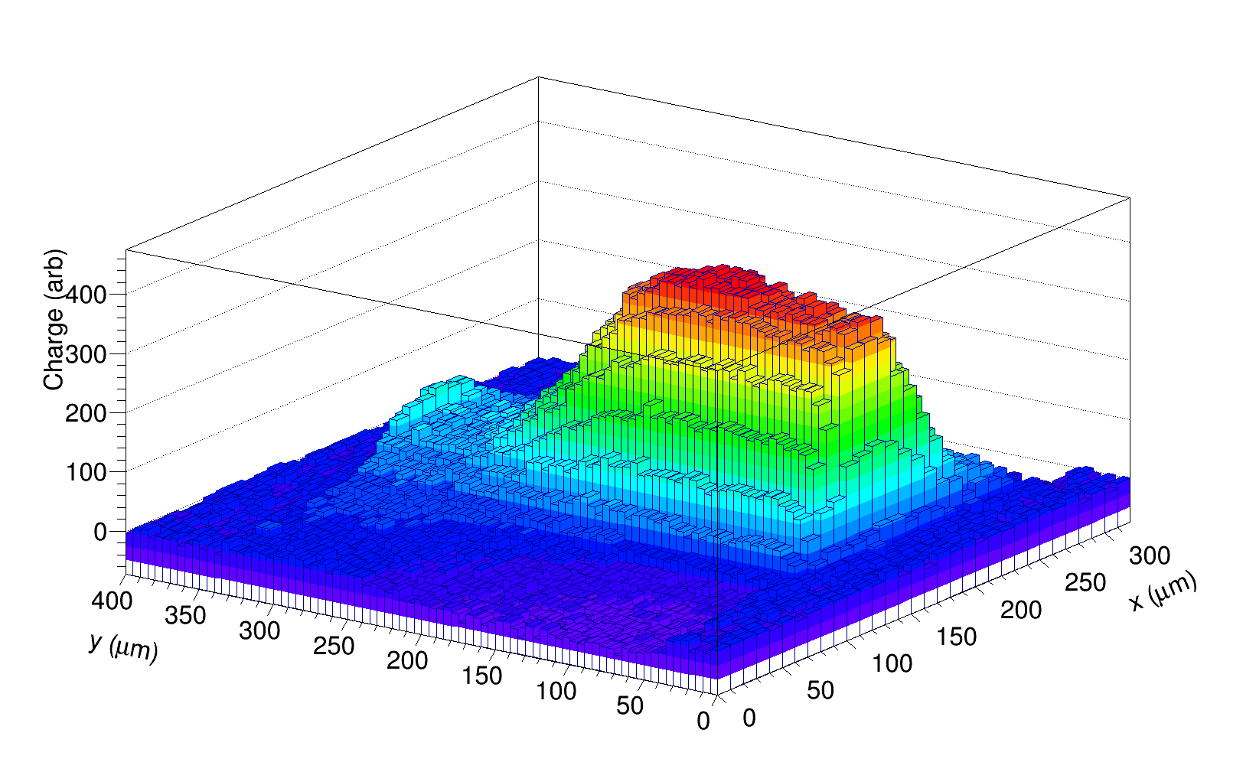
E - TCT profiles
PS protons
Neutrons
Neutrons
1.6e15
Bias = 500V
VPA38186-W1297
PS protons
1.6e15
Bias = 500V
VPX37412-W704
strip
Sensor depth
Sensor depth
strip
large differences between charge collection profiles for proton and neutron irradiation
significant contribution of charge from the back of detector after proton irradiation
→ field at back (low weighting potential) ➔ reduces field at front (high weighting potential) ➔ smaller charge collection

Slide 13
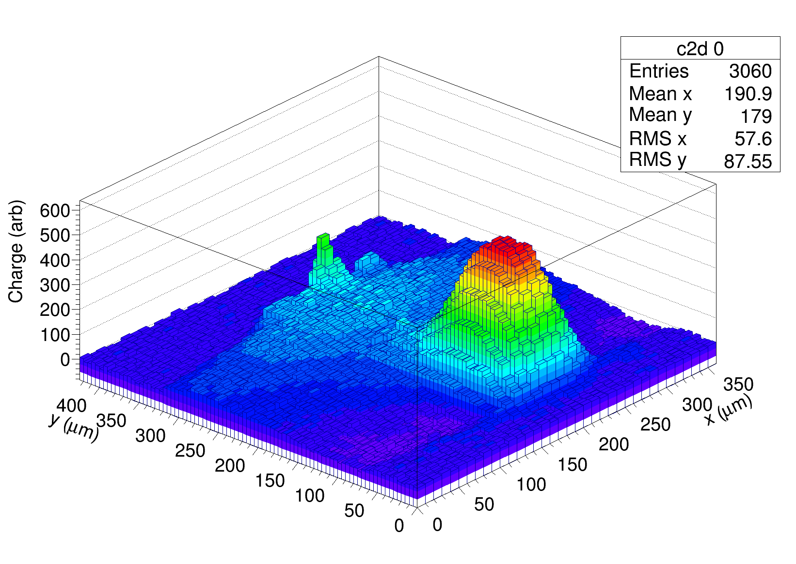
E - TCT profiles
VPA38186-W1297
Neutrons
1.6e15
Bias = 500V
PS protons
1.6e15
Bias = 500V
VPX37412-W704
strip
Sensor depth
strip
Sensor depth
PS protons
1e15
Bias = 500 V

Slide 14
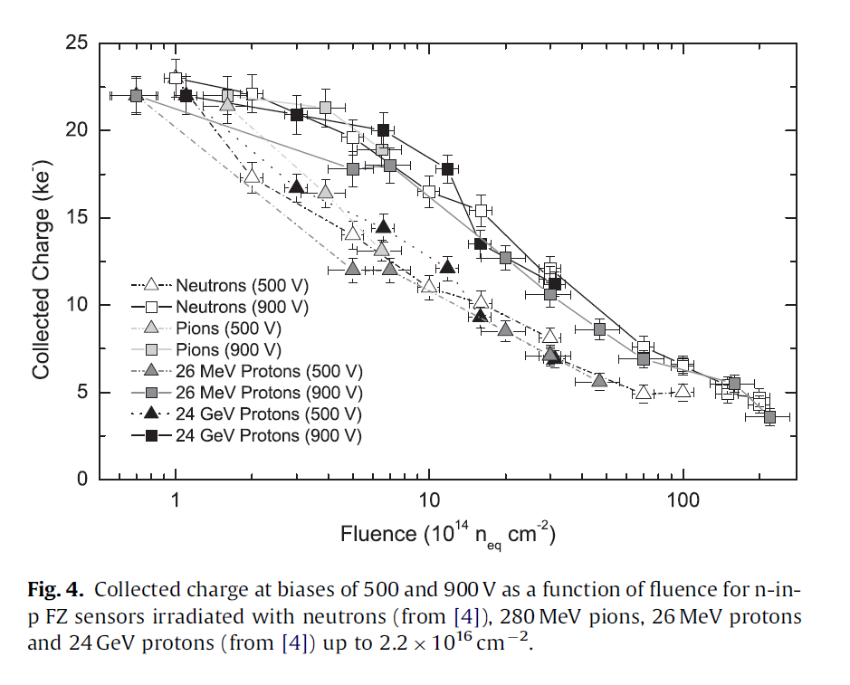
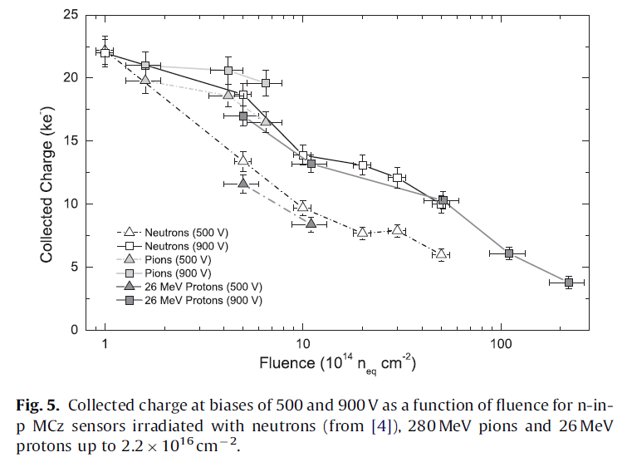
Older results with PS protons
A. Affolder, P. Allport, G. Casse NIMA623 (2010)177–179, https://doi.org/10.1016/j.nima.2010.02.187
MCZ
(no PS protons)
FZ material
FZ p-type, MCZ p-type
➔ not much difference can be seen between pions, MeV protons, GeV protons and neutrons above 1e15 n/cm2

