Slide 1
Overview of studies with QA pieces irradiated at IRRAD (CERN)
Short summary of contributions from many:
Vitaliy, Jiri, Robert, Andrew, Ioannis, Phil, Shigeki et al.
V. Cindro, I. Mandić et al.
ITk strip sensor meeting 12.1.2022

Slide 2
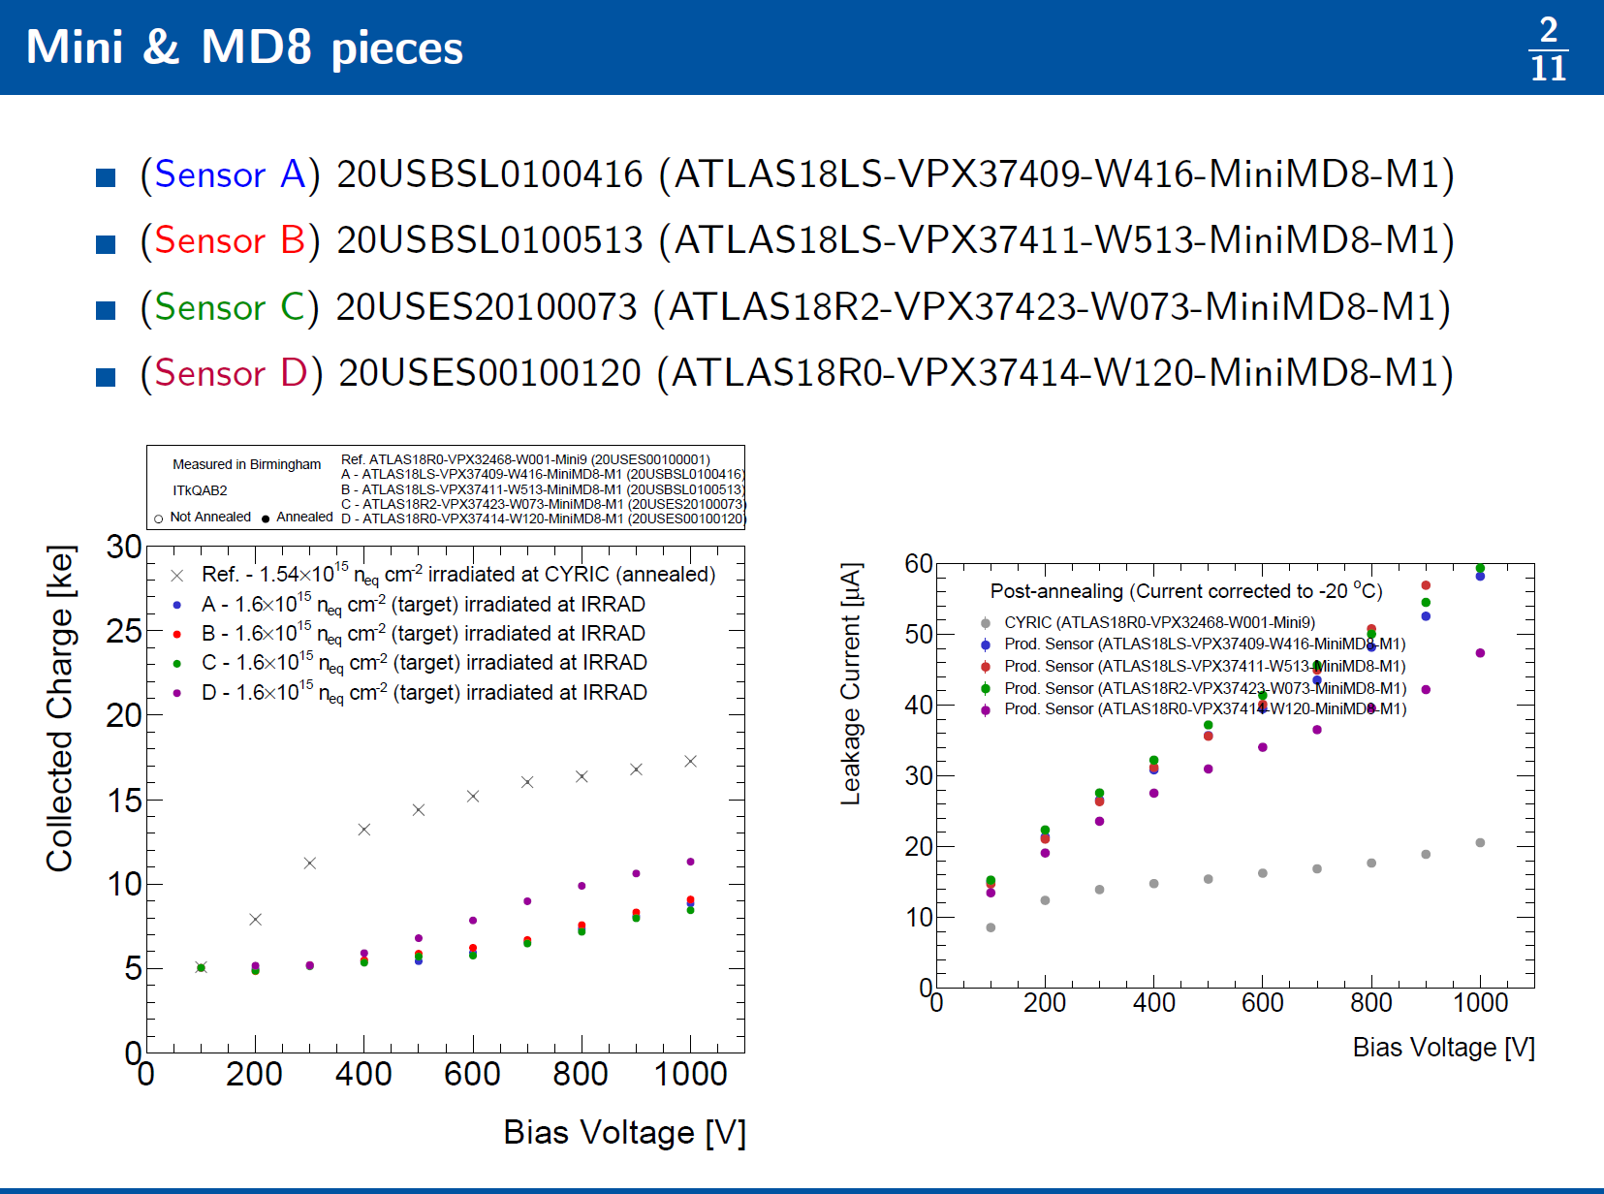
Motivation
https://indico.cern.ch/event/1104938 (Itk strip sensor 15th of December 2021)
Low charge measured after irradiation of QA samples at IRRAD (24 GeV p) to 1.6e15 n_{eq}/cm²
5.9 ± 0.6 ke at 500 V
➔ much lower than after CYRIC irradiation
➔ below QA qualification value 6.5 ke
➔ charge lower than after neutron irradiation
(expected to be the most damaging)
leakage current higher (in mini strip detector and in MD8 diode) than after other irradiations
Charge collection measurements were repeated by:
Ljubljana (VPX37411: 4.4 ke @ 500 V)
Toronto (VPX37414: 6.6 ke @ 500 V)
→ Birmingham results confirmed
A. Chisholm et al., https://cernbox.cern.ch/index.php/s/eOPo7BkGuCleNDS

Slide 3
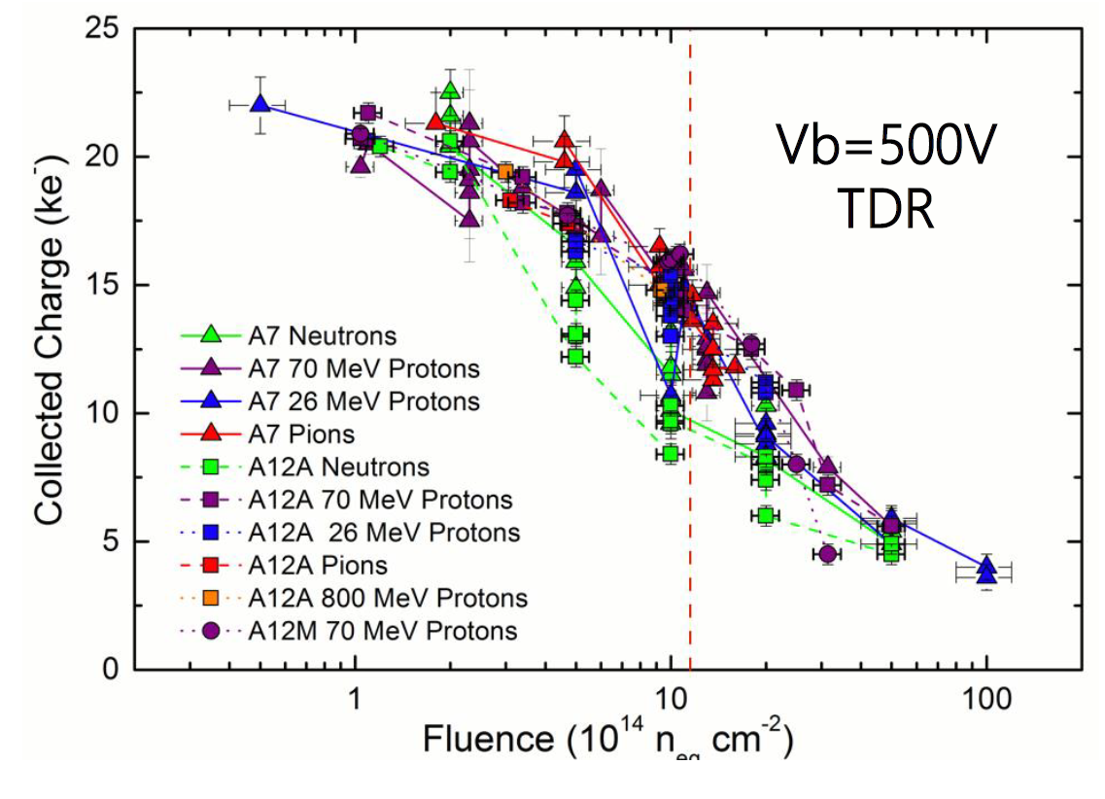
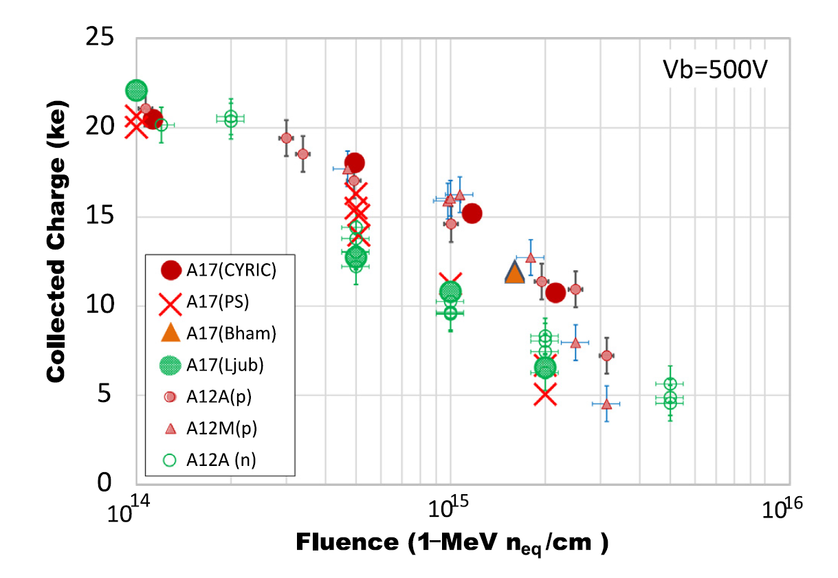
Compare with previous IRRAD irradiations
K. Hara et al., NIMA 983 (2020) 164422
https://doi.org/10.1016/j.nima.2020.164422
K. Hara et al., NIMA 831 (2016) 181-188
https://doi.org/10.1016/j.nima.2016.04.035
These are 26 MeV and 70 MeV protons
QA IRRAD data (2021)
in these measurements CCE after neutron irradiation lower than after protons
  but no IRRAD data
results from 2018: PS protons at Ф > 1e15 similar as neutrons
irradiation of QA samples with PS protons (2021)
➔ lower than expected but not very far from results with A17
→ measured ~ 6 ± 1 ke…. , expected ~ 8 ± 1 ke

Slide 4
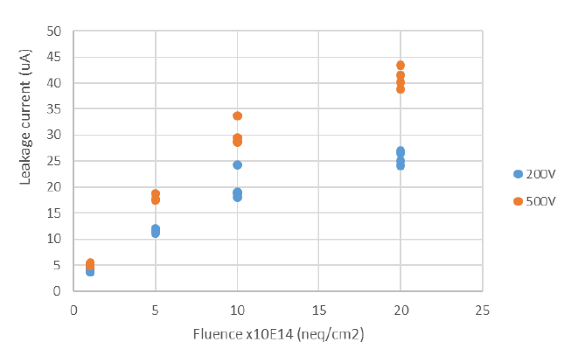
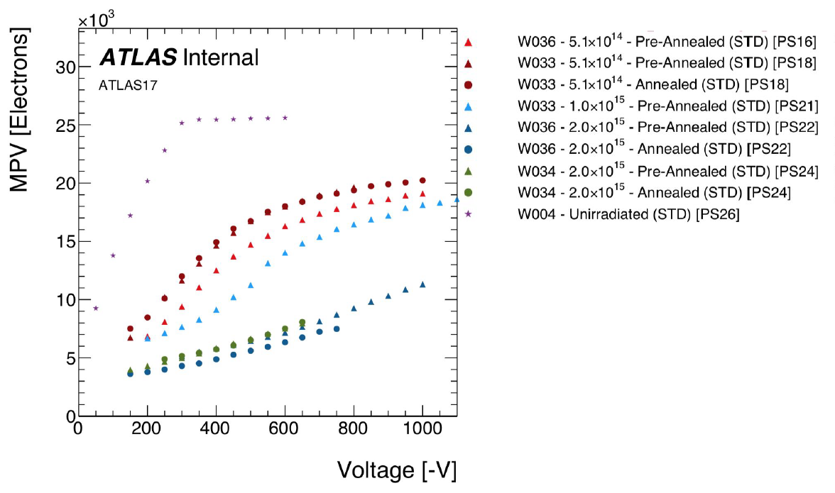
Compare with previous IRRAD irradiations
Annealing
Current
Birmingham reports at ITk meeting 15th Dec. 2021:
➔ “no improvement in CCE after annealing, though
leakage current is reduced”
no effect of annealing on CCE after PS irradiation reported also by Toronto in 2018 ( https://indico.cern.ch/event/776393/ )
(but Valencia measured some effect of annealing at 5e14 in 2018)
PS irradiation results with A17 presented at strip sensor meeting 23. Nov. 2018
https://indico.cern.ch/event/776393/
U. Soldevila
A17, PS irradiation, 2018
QA irradiation (2020): 1.5e15: current ~ 35 uA @ 500 V
➔ consistent with 2018 measurements
with: Ф_{eq} = 1.5e15 n/cm² , α = 4e-17 Acm, T = -20°C, fully depleted mini sensor, area 8x8 mm²: I = 21 µA
→ current larger than calculated
no effect of annealing might be a sign of unintentional annealing during irradiation

Slide 5
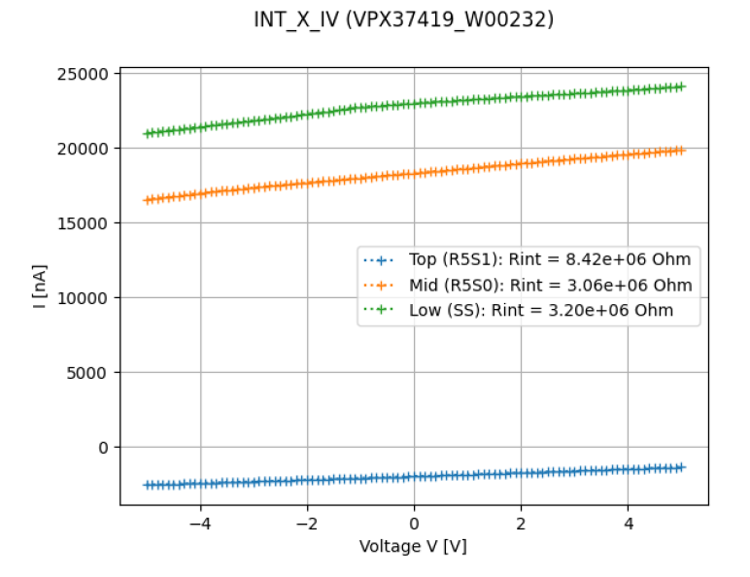
Interstrip resistance
A. Chisholm et al., ITk sensor meeting 15.12.2021:
low measured values, lower than specification ( R_{int} > 10x R_{bias} )
not directly comparable with 2018 measurements
(now measured on Test-chip, in 2018 with mini sensors, …)
➔ low R_{int} values may be a sign of larger TID than expected (66 Mrad)

Slide 6
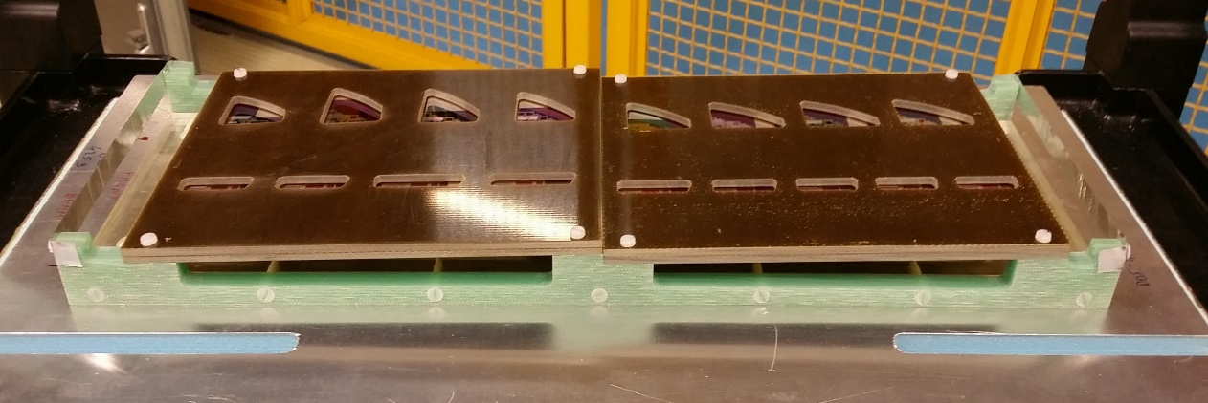
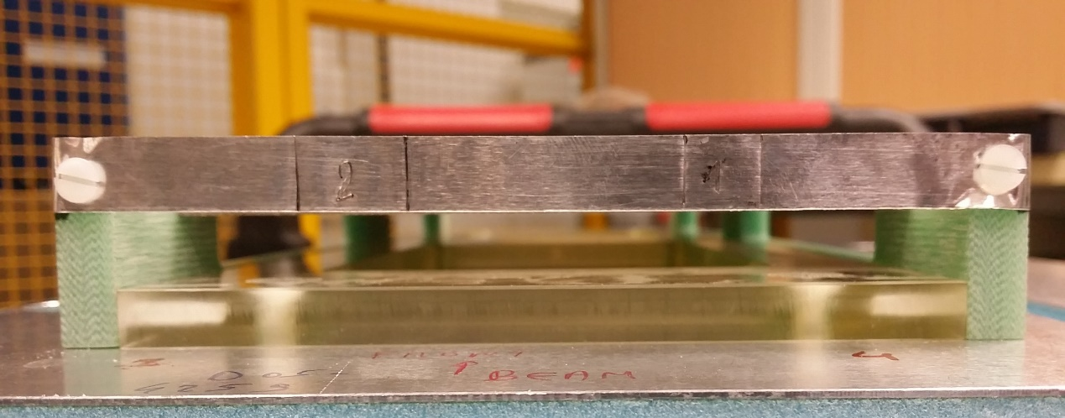
Dosimetry
Testchip&MD8 holders
Mini&MD8 holders
J. Kroll (20.12.2021):
Requested fluneces:
Testchip&MD8: TID = 66 Mrad -> 2.182E15 p/cm²
Mini&MD8: fluence = 1.6E15 neq/cm2
-> 83.45 Mrad -> 2.759E15 p/cm²
Delivered:
Testchip&MD8:
- DOS-004259.2 -> 2.23e15 (err. 7%)
- DOS-004260.2 -> 2.36e15 (err. 7%)
- Average -> 2.30e15 p/cm²
Mini&MD8
- DOS-004259.1 -> 2.74e15 (err. 7%)
- DOS-004260.1 -> 2.48e15 (err. 7%)
- Average -> 2.61e15 p/cm²
Hardness factor for PS protons: 0.58
average 1 MeV n equivalent fluence:
Testchip&MD8: Ф_{eq} = 1.3 ± 0.1n/cm²
Mini&MD8: Ф_{eq} = 1.5 ± 0.1 n/cm²
average delivered fluences as requested
temperature during irradiation was -20 C
back Al
Beam
front Al
1 cm x 2 cm Al
in front of Testchip& MD8
→ scanned in x
1 cmx 1 cm Al piece in line
with Mini&MD8 samples
→ no scanning

Slide 7
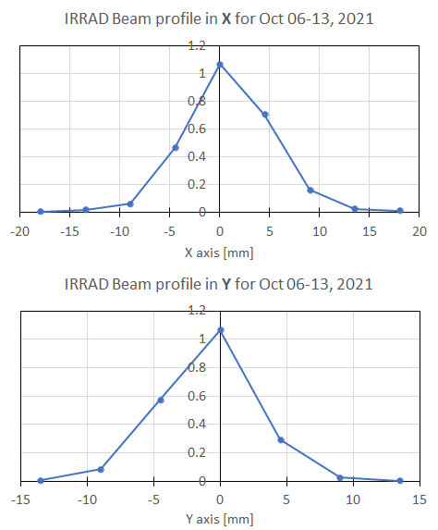
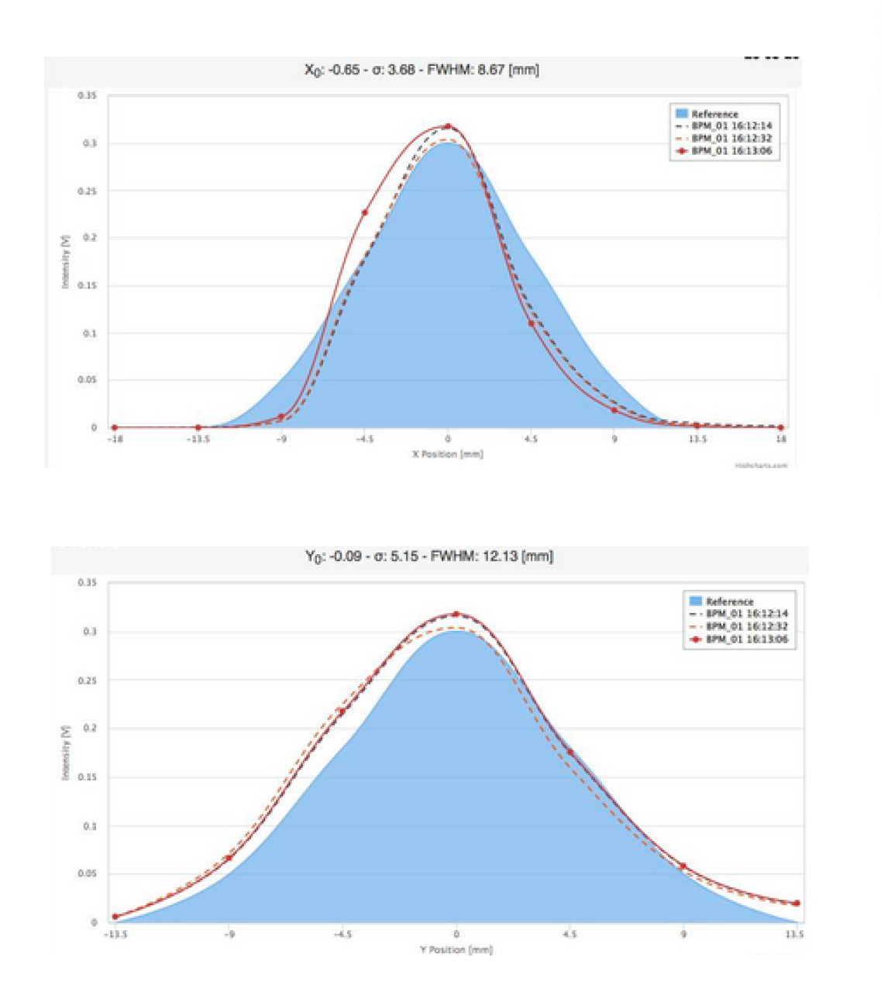
Uniformity of irradiation
This QA irradiation (plot made by Vitaliy):
J. Keller, J Kroll,
https://indico.cern.ch/event/694901/contributions/2849730/
subcontributions/247249/attachments/1588666/2513066/Keller18-01-24.pdf
PS beam profile
x: FWHM = 8.7 mm
➔ scanning possible
y: FWHM = 12.1 mm
position of the device in the beam matters
any misalignment can cause significant effects, especially if there is no scanning

Slide 8
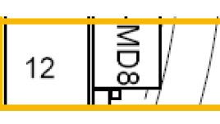
Sample projection
Vitaliy 22.12.2021:
The inclined angle shrinks the sensor profile in the plane orthogonal to the beam:
Side view
Sensor size | In sensor plane | Projection orthogonal to the beam
Physical | 10x10 mm² | 0.702*10 mm² (with sensor thickness)
Active | 8x8 mm² | 0.626*8 mm² (with sensor thickness)
Beam direction
Vertical size = length*sin(α) + thickness*cos(α)
α = 2.25°
The strips in the test structures are horizontal and orthogonal to the beam => The strip-to-strip fluence variation, even for a “pencil beam” should be small, given the small vertical extent of the sensor.
Beam
If there was no scanning in x might expect
nonuniform irradiation along strips:
10 mm device centered in the beam:
centre almost 2x higher fluence than end of strip
measured charge may depend on collimation
and position of Sr-90 source
Strip orientation
Top-down view

Slide 9
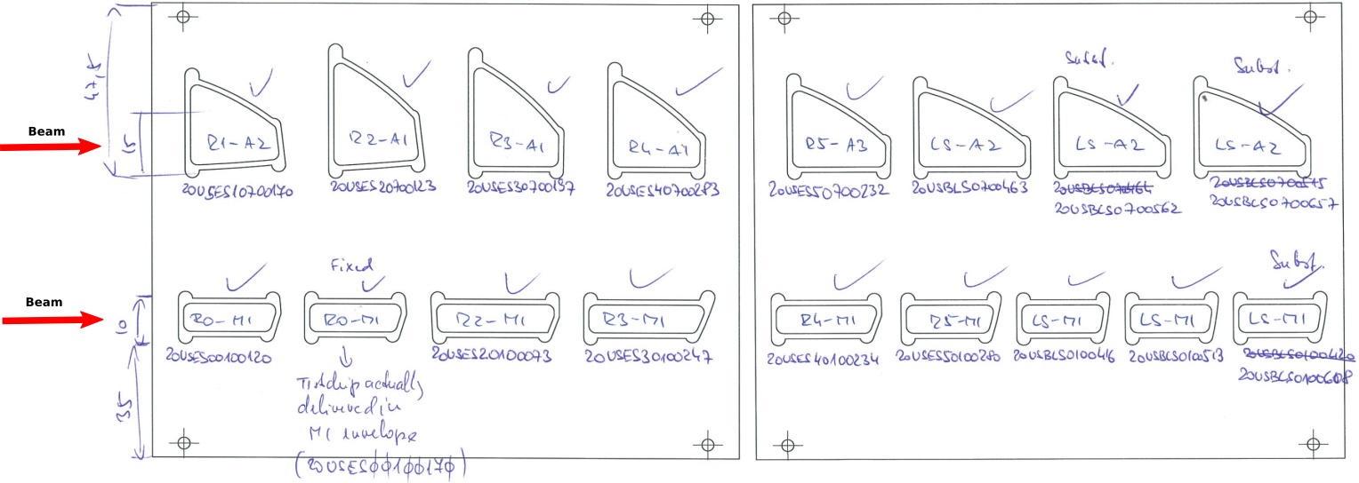
CCE for different positions
Vitaliy 22.12.2021:
1.37 mm
If indeed the beam is over-focused, the CCE would depend on the sample position. They are spaced by ~35 mm horizontally => 1.37 mm vertically. This may start to matter.
From Birmingham presentation in Dec 15 meeting by Andy, read the numbers off the plots for CCE(500V) and Ileak(500V). Associating them with the sample position: a hint of the edge samples having a larger signal and less current for both sample holders? (Or rather, the central/right ones having a smaller signal and higher current?)
Sensors
In the beam
23 μA
24 μA
21 μA
25 μA
27 μA
6.9 ke-
5.5 ke-
5.5 ke-
6.4 ke-
5.2 ke-
5.9 ke-
5.2 ke- at 400 V
30 μA
35 μA
38 μA
30 μA
35 μA
35 μA
35 μA

Slide 10
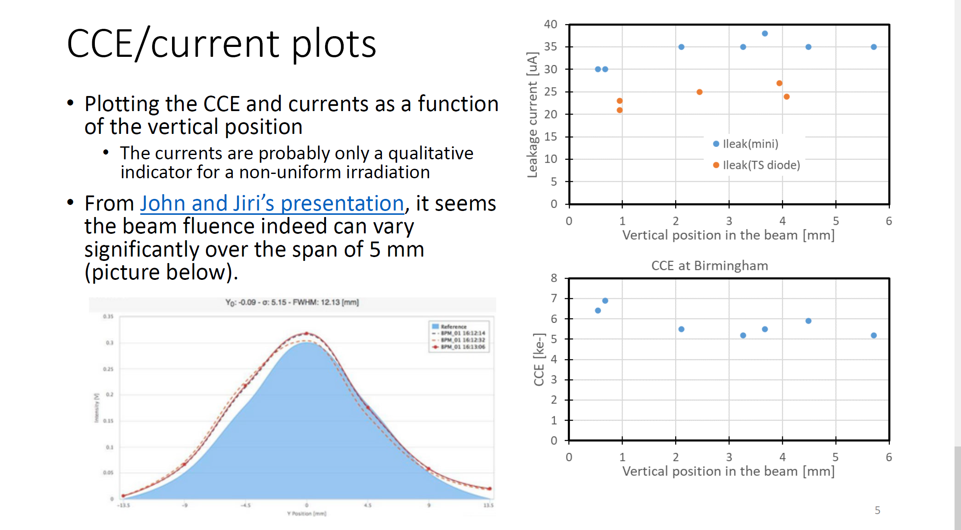
Vitaliy 22.12.2021:

Slide 11
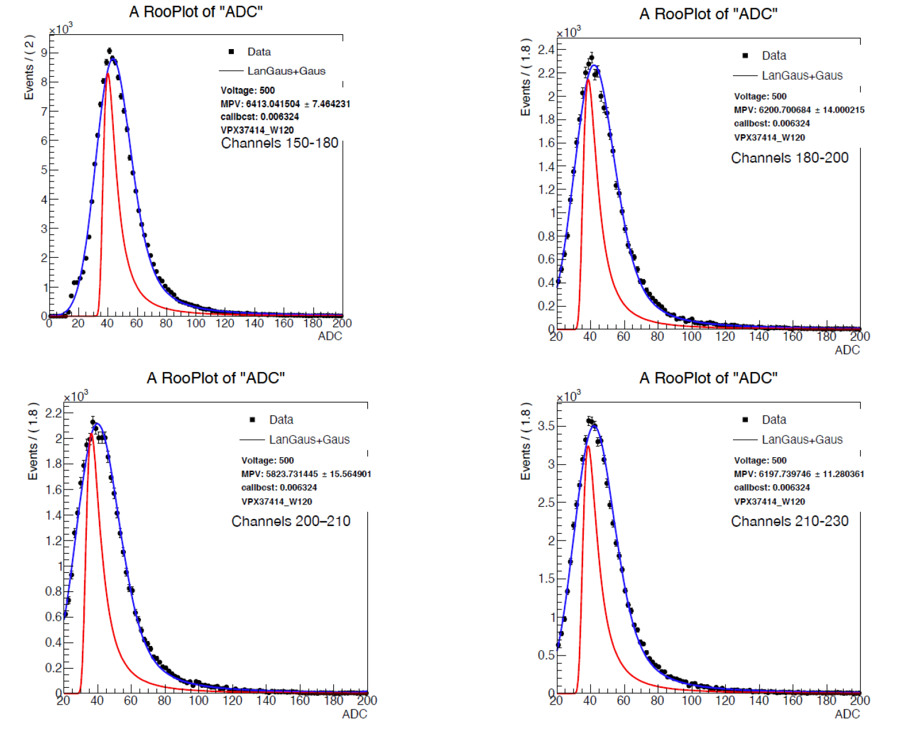
Uniformity in y direction
Measured by Toronto, 22.12.2021
check collected charge on different ranges of strips
➔ no significant differences
➔ only ~ 0.5 mm vertical distance across one sensor
VPX3414-W120 (IRRAD)
6.4 ke
6.2
5.8
6.2

Slide 12
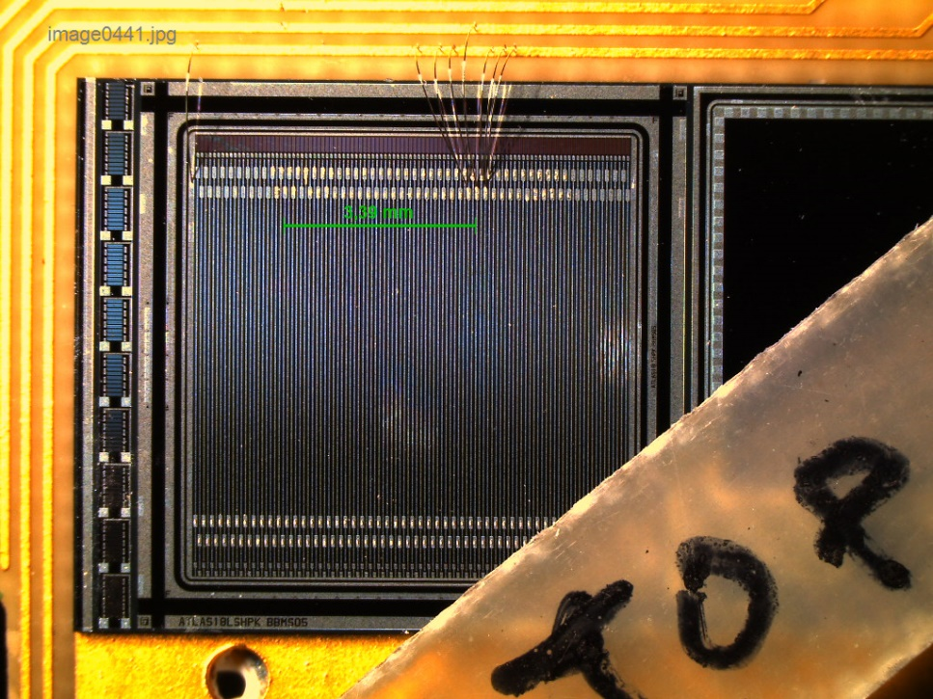
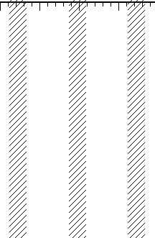
Top TCT
narrow laser beam (~ 10 µm at FWHM) directed to the surface of the sensor
scan the surface: 5 µm steps in x, 200 µm steps in y
at each position measure collected charge caused by short (1 ns) IR laser pulse on the strip connected to the amp.
scan near 2 strips, 3.4 mm apart
Strip 1
Strip 2
3.4 mm
HV
y
Scan the surface
with narrow laser beam
x
strips
y
x

Slide 13
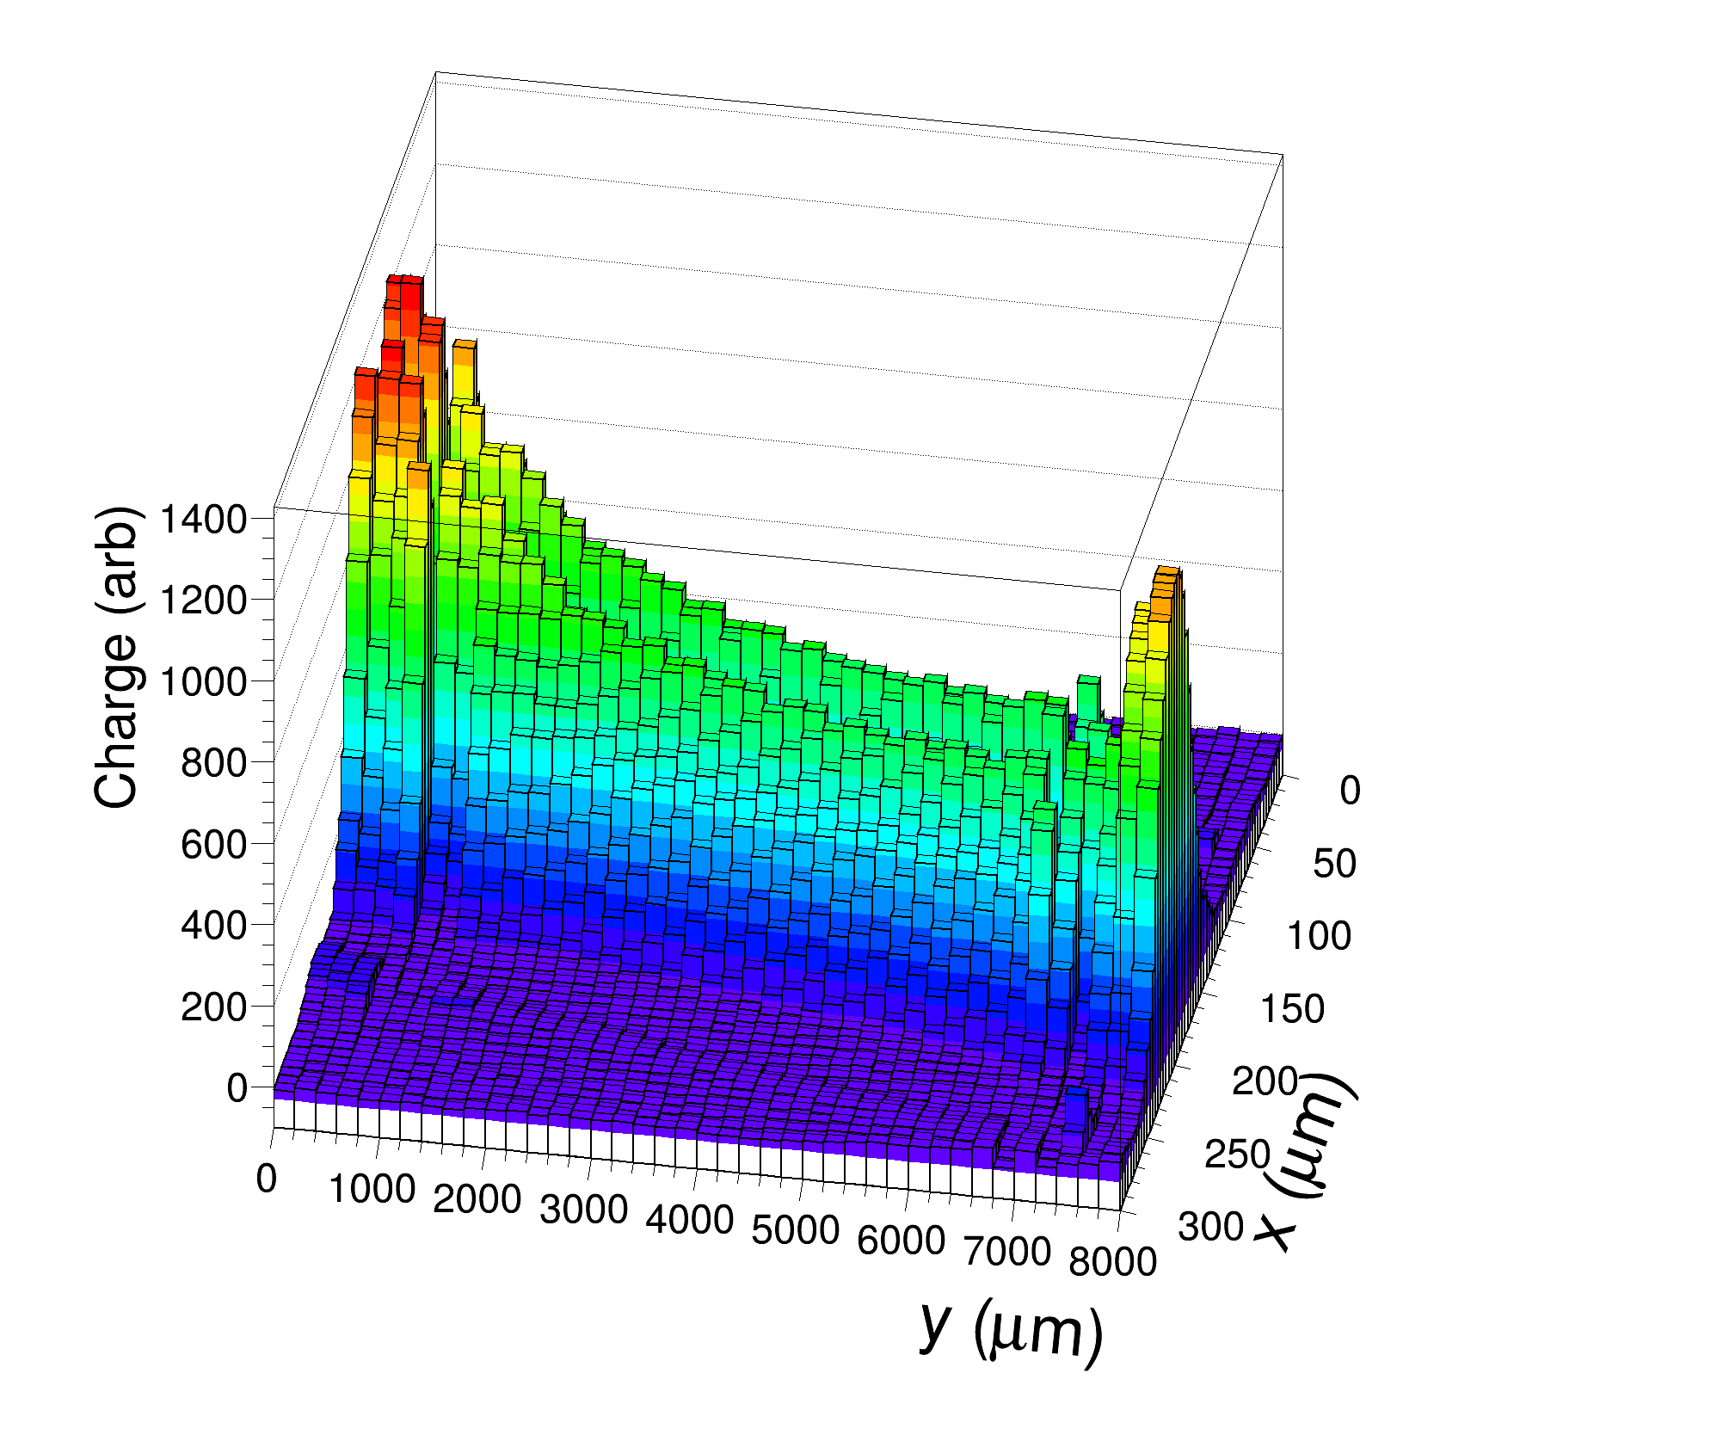
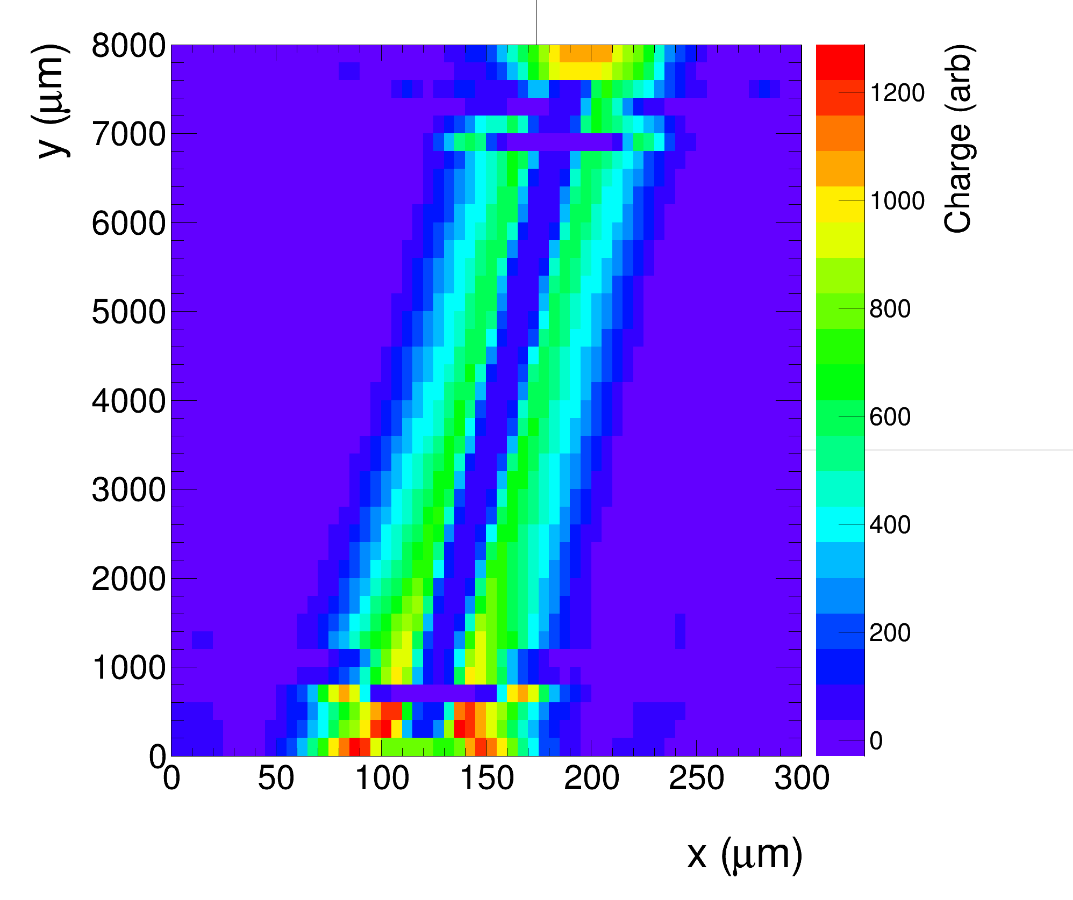
Top TCT
IRRAD sample, Bias = 500 V
Strip metal
(detector not perfectly aligned with y axis of the TCT system)
Slope of collected charge along the strip can be seen

Slide 14
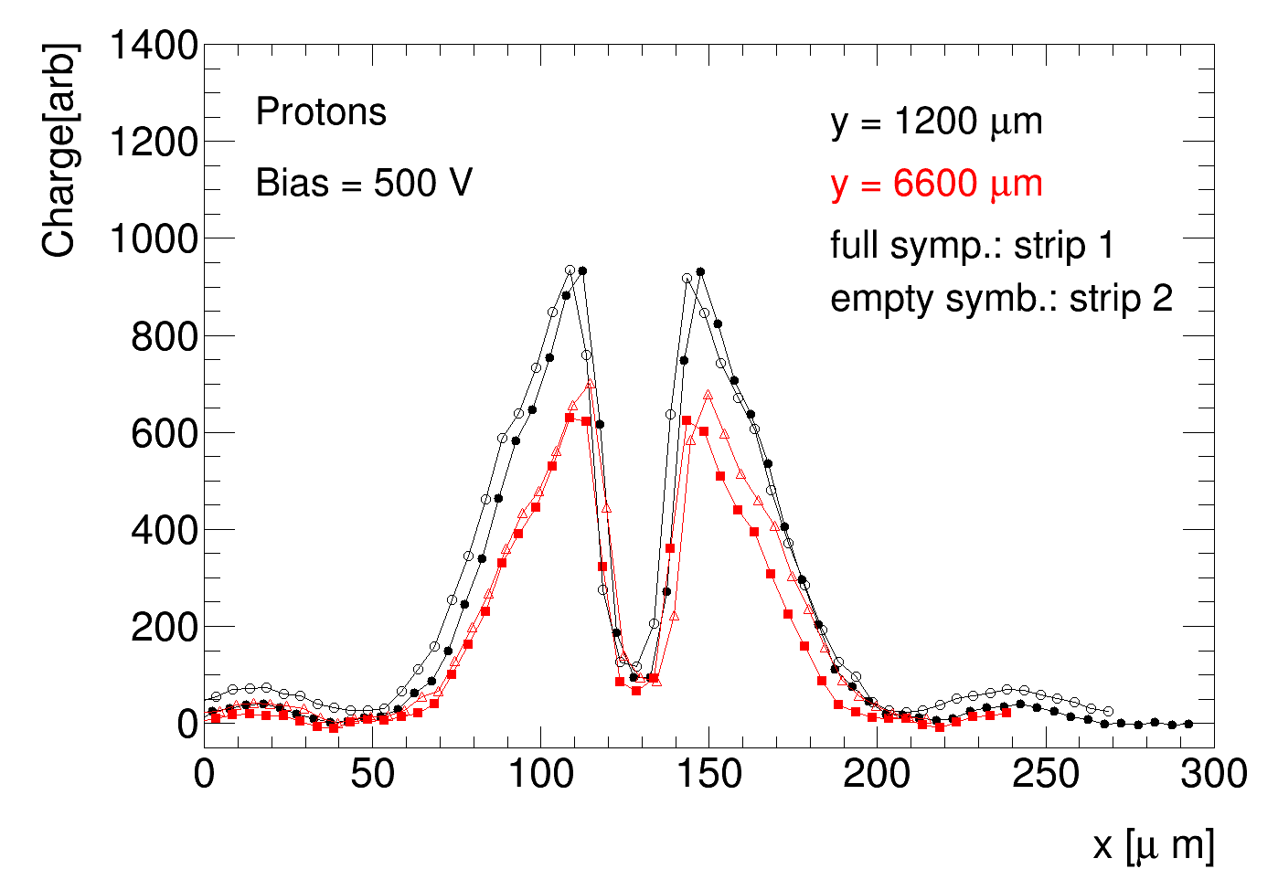
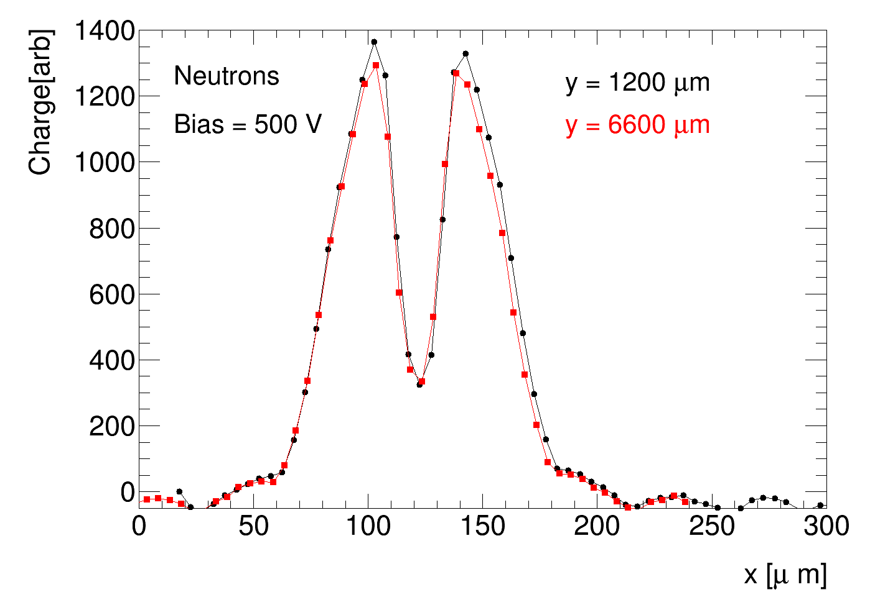
Top TCT
Compare slices of collected charge along x at two different y (from 2D plots on previous slides)
IRRAD protons: about 30 % difference between charge collected at low and high y
Neutrons (1.6e15): no significant differences between measurements at two y
strip metal
(laser beam wider than for IRRAD sample)
strip metal
points scaled to same laser intensity → charges measured with different samples can be roughly compared
charge measured with IRRAD sample between 50% and 70% of charge measured with neutron sample
➔ roughly consistent with Sr-90 measurements
➔ high charge (y = 1200 µm) measured with IRRAD sample still smaller than with neutron sample

Slide 15
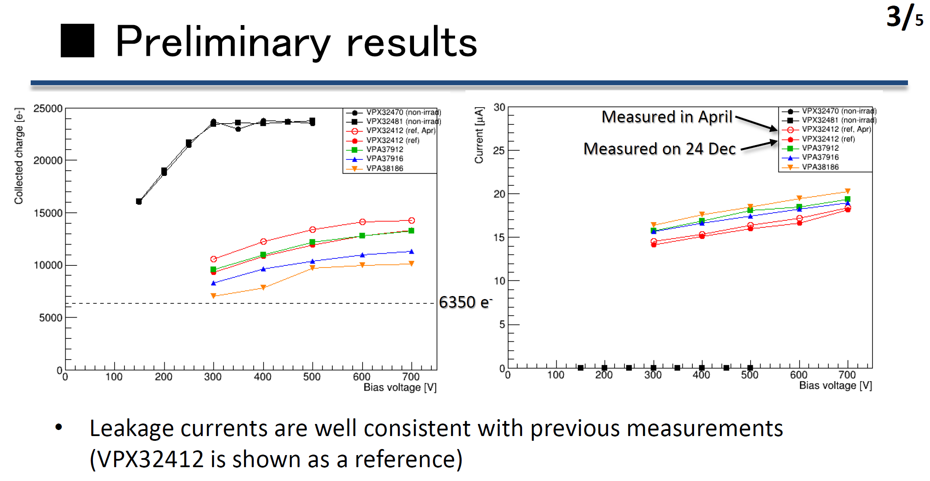
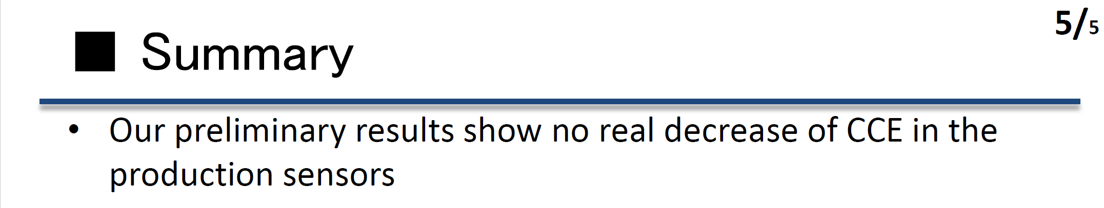
Production sensors irradiated at CYRIC
Shigeki Hirose 24.12.2021:
production sensors irradiated with
CYRIC protons behave as expected!

Slide 16
Conclusions
CCE measured with QA samples irradiated with 24 GeV p at IRRAD in 2021 low but not so unusual
→ not very far from results with A17 samples:
  expect similar CCE after irradiation with IRRAD protons and neutrons to fluences above 1e15 n/cm²
after 2021 irradiation in IRRAD measured charge somewhat lower than after neutrons at same equivalent
fluences but
➔ irradiation in PS more complicated: nonuniform exposure, small misalignments can have significant effects …
→ expect variations between devices and between irradiation campaigns
➔ results from 2021 irradiation on low side but probably within uncertainties
there are effects which are not well understood, indicating that there may be other effects than misalignments
and beam nonuniformity
→ small effect of annealing on measured CCE
→ high leakage current
→ low R_{int}
CCE after irradiation with PS protons not inconsistent with previous results
CCE after irradiation of production samples with CYRIC protons as expected
CCE after neutron irradiation as expected
➔ production detectors not different than expected

Slide 17
Backup slides

Slide 18
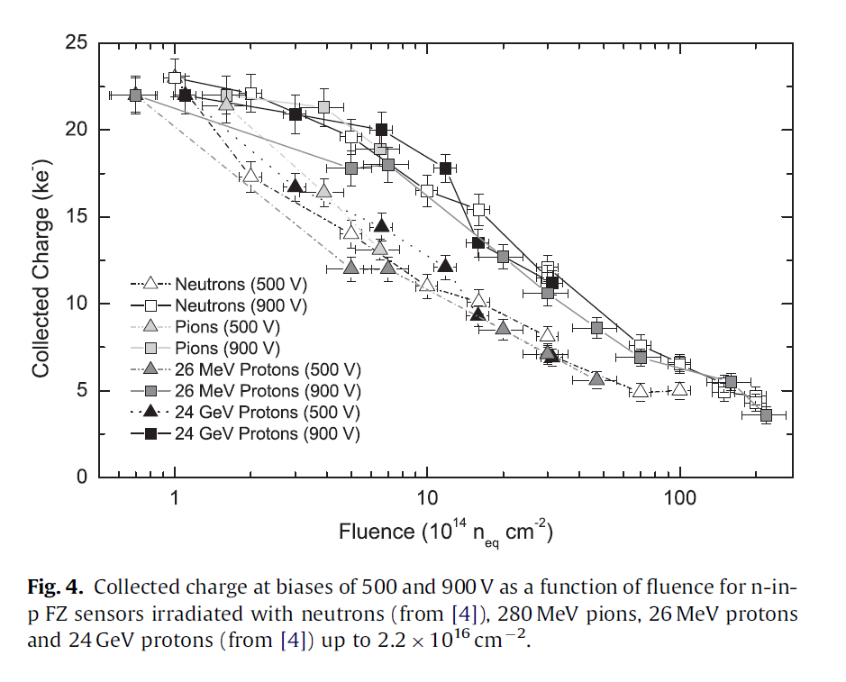
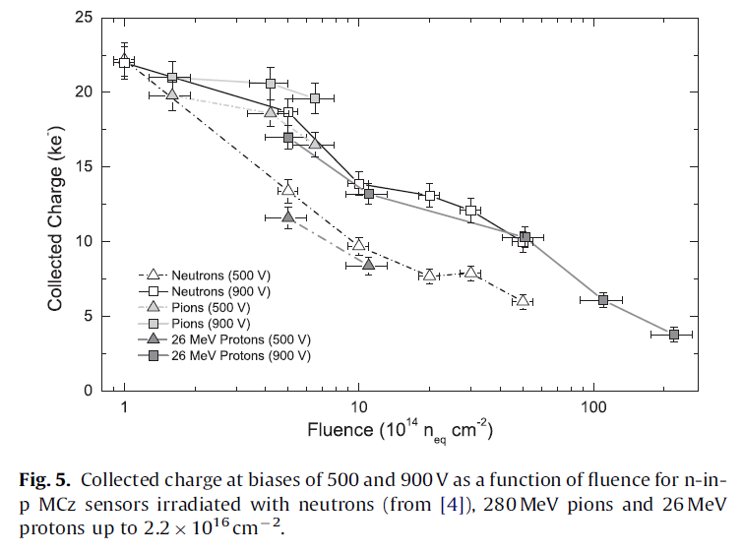
Older results with PS protons
A. Affolder, P. Allport, G. Casse NIMA623 (2010)177–179, https://doi.org/10.1016/j.nima.2010.02.187
MCZ
(no PS protons)
FZ material
FZ p-type, MCZ p-type
➔ not much difference can be seen between pions, MeV protons, GeV protons and neutrons above 1e15 n/cm2

Slide 19
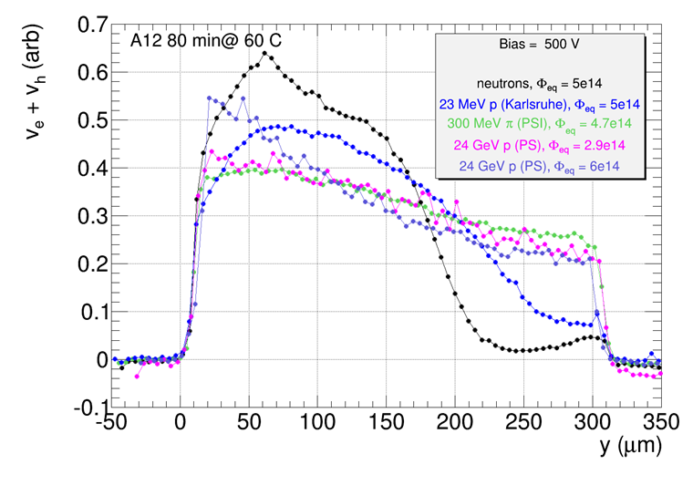
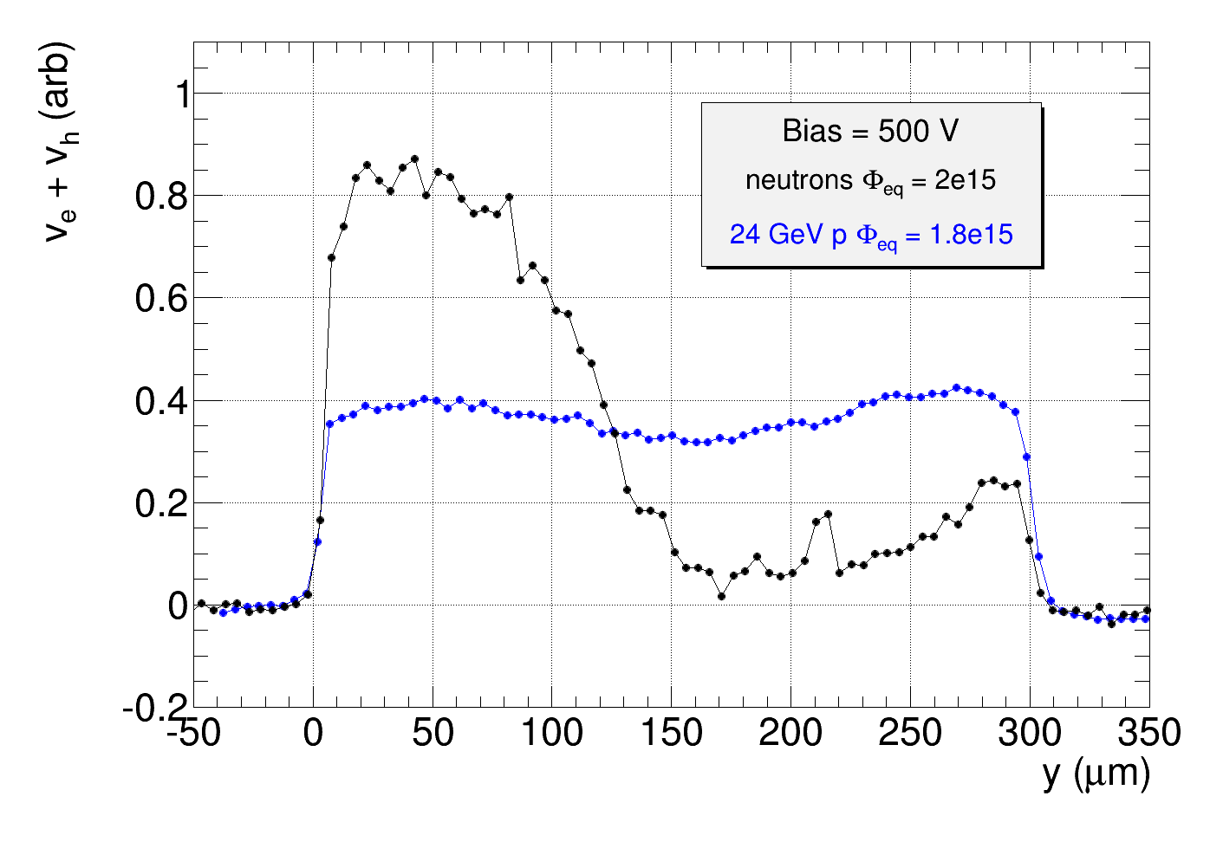
Effects of irradiation with neutrons, low energy protons or PS protons different
E-TCT, profiles normalized to same integral from 0-300 µm
ITk strip sensor meeting 21st of October 2015 https://indico.cern.ch/event/448475/
very different effect on velocity profile (function of E-field in the detector) after irradiation with different particles
PS protons profile uniform with two double peak structure (i.e. high field at the back side of the sensor)
➔ electric field profile influences charge collection
➔ effective trapping probabilities may depend on irradiation particle

