Slide 1
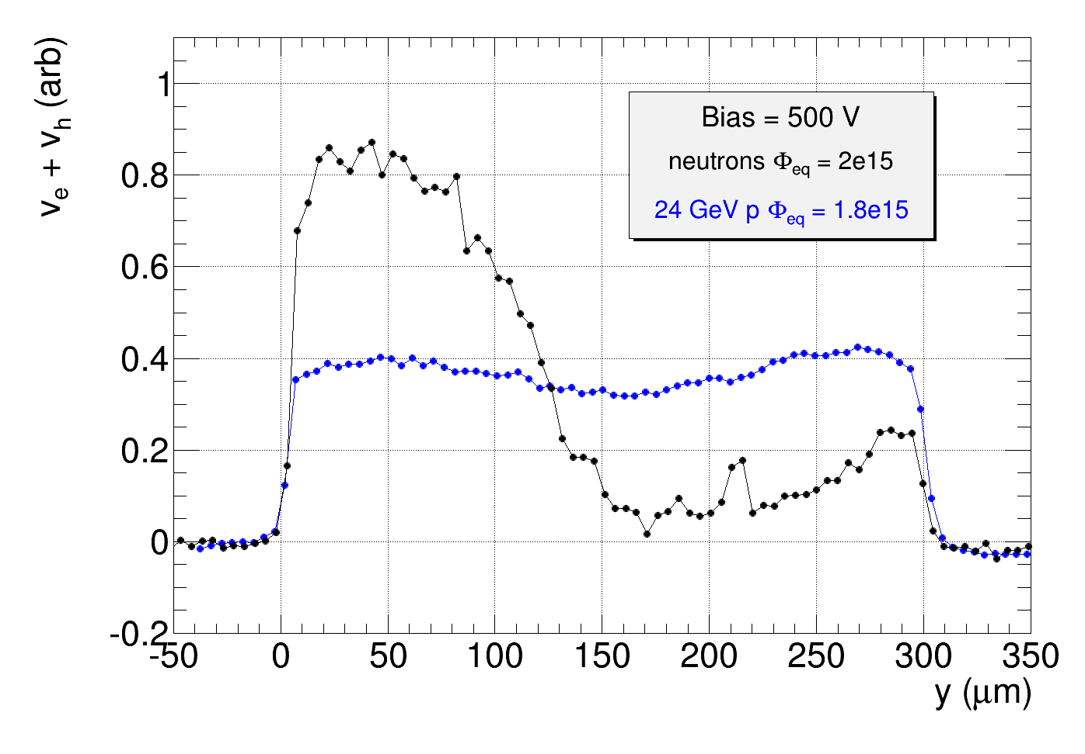
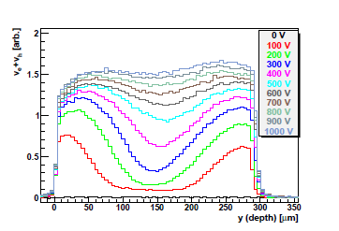
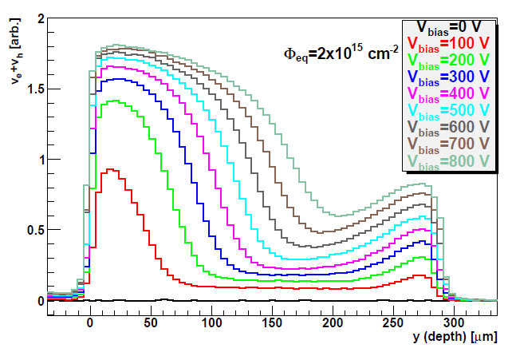
Velocity profiles measured with E-TCT give information about electric field in the detectors
after IRRAD protons or PSI pion irradiation profiles different than after neutron irradiation
➔ check the effect of electric field shape on collected charge of a MIP
A12
Proton and neutron profiles normalized to same integral from 0-300 um:
https://indico.cern.ch/event/448475/contributions/1113821/attachments/1174185/1696612/StripSensor_IM_Oct_2015.pdf
A07, Pions, Φ_{eq} = 1.6e15
G. Kramberger et al., 2014 JINST 9 P10016
A07, neutrons:

Slide 2
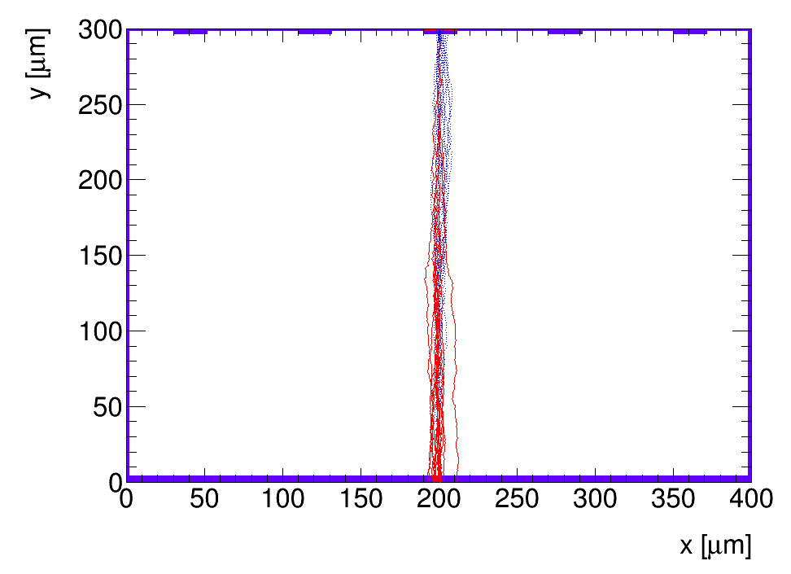
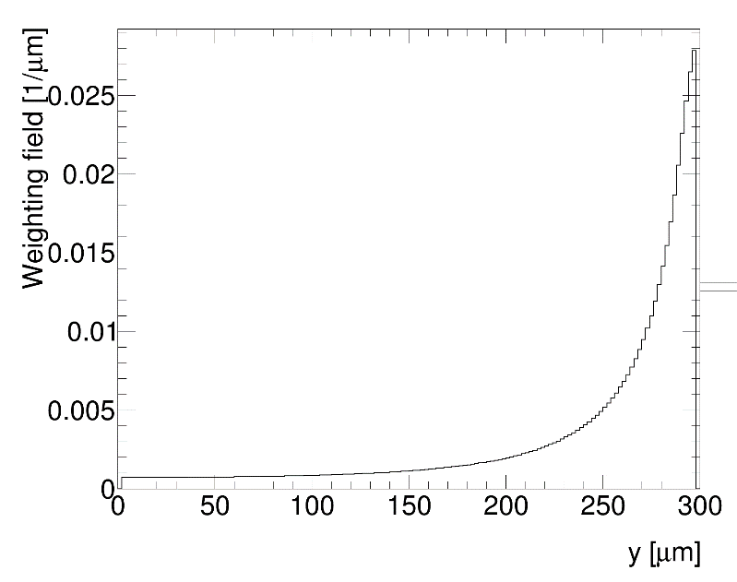
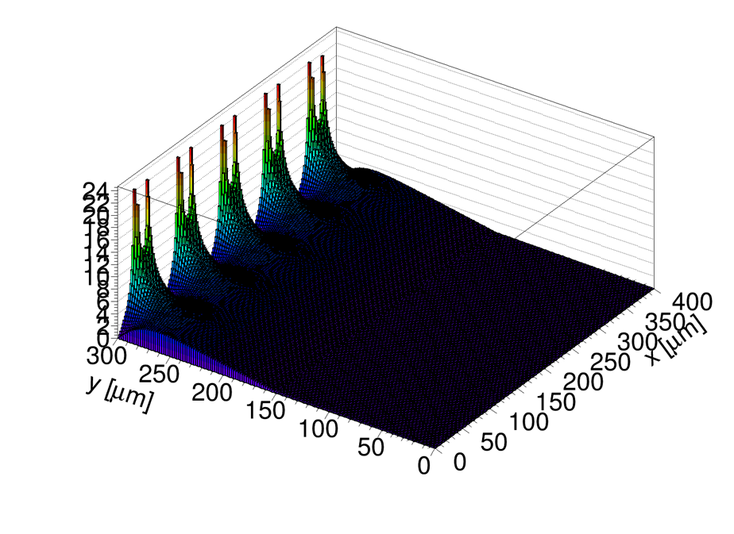
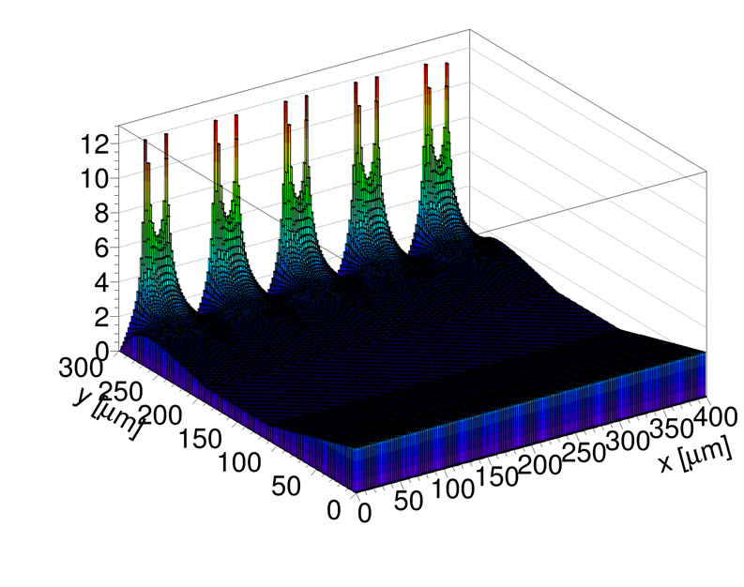
Try a simple simulation to see the effect of field shape on charge collection
Use KDetSim (http://kdetsim.org/ , written by G. Kramberger
Weighting field
KDetSim
300 um thick strip detector,
Calculate charge collected after passage
of a MIP perpendicular through
the centre of the strip
E field

Slide 3
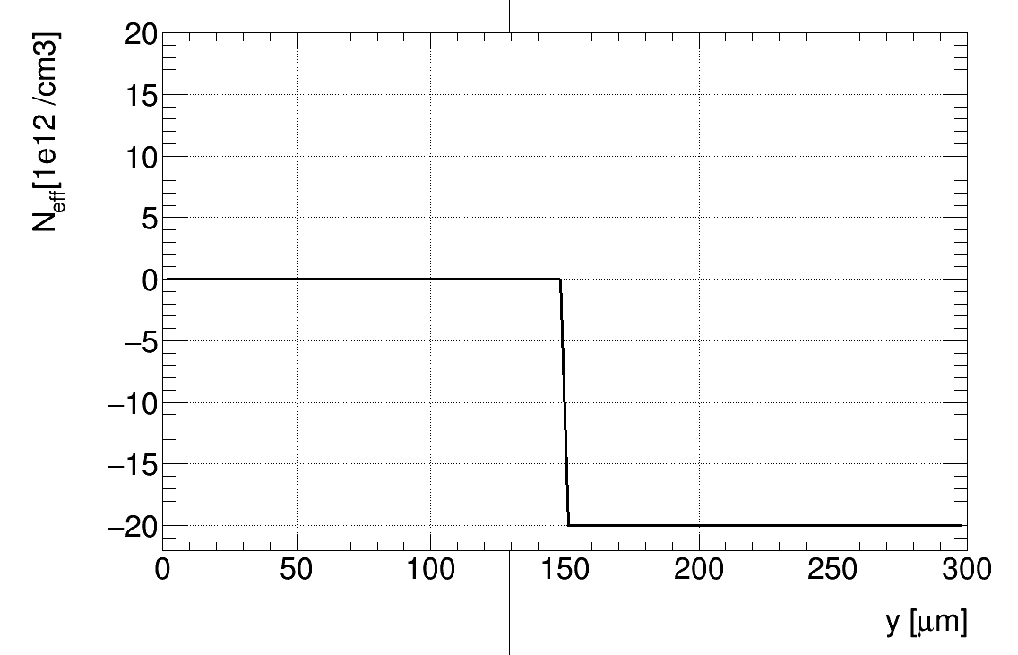
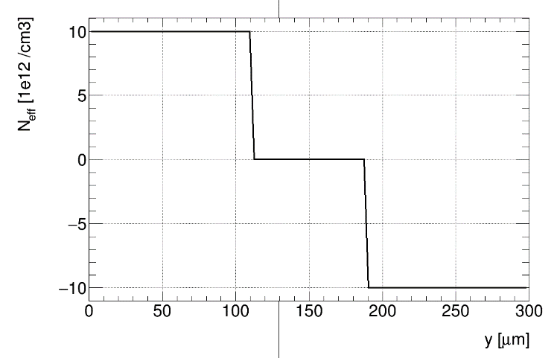
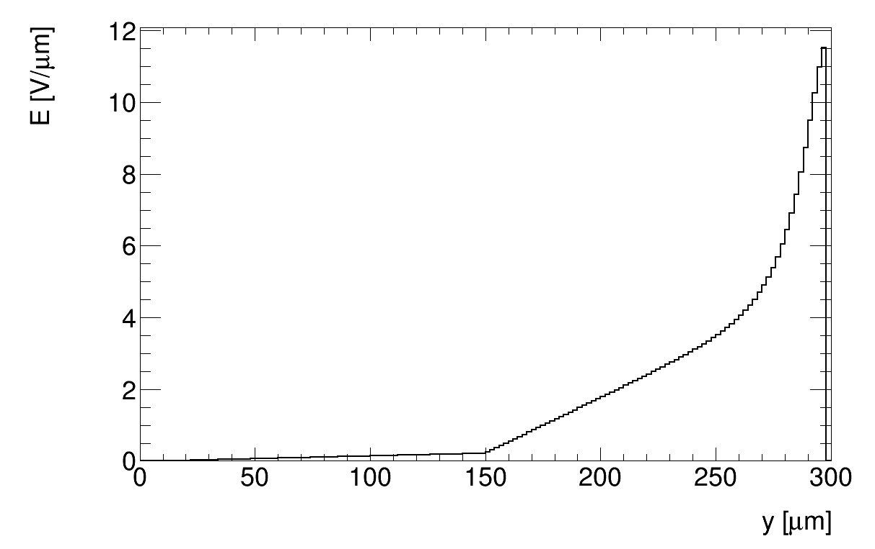
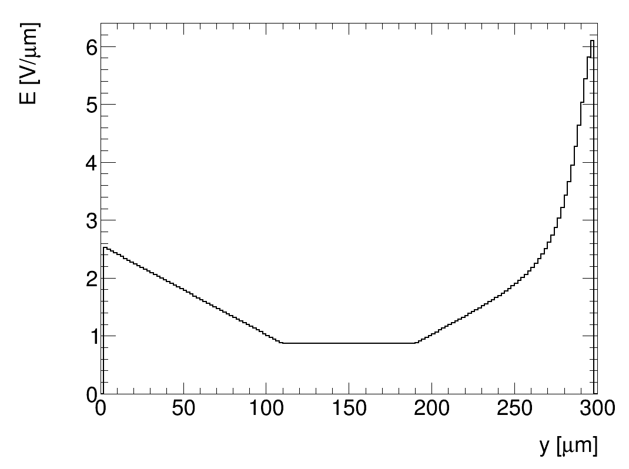
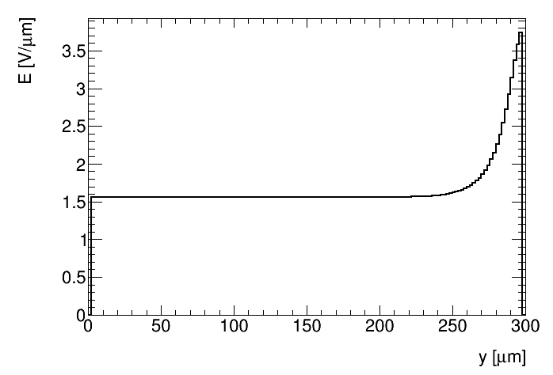
input to the simulation is the effective space charge concentration
➔ chosen to very roughly match measured velocity profiles
“neutron like” N_{eff}
“proton like” N_{eff}
+
N_{eff} = 0
-
-
Electric field at x at the middle of the strip
neutrons
Bias = 500 V
no space charge
Bias = 500 V
protons
Bias = 500 V

Slide 4
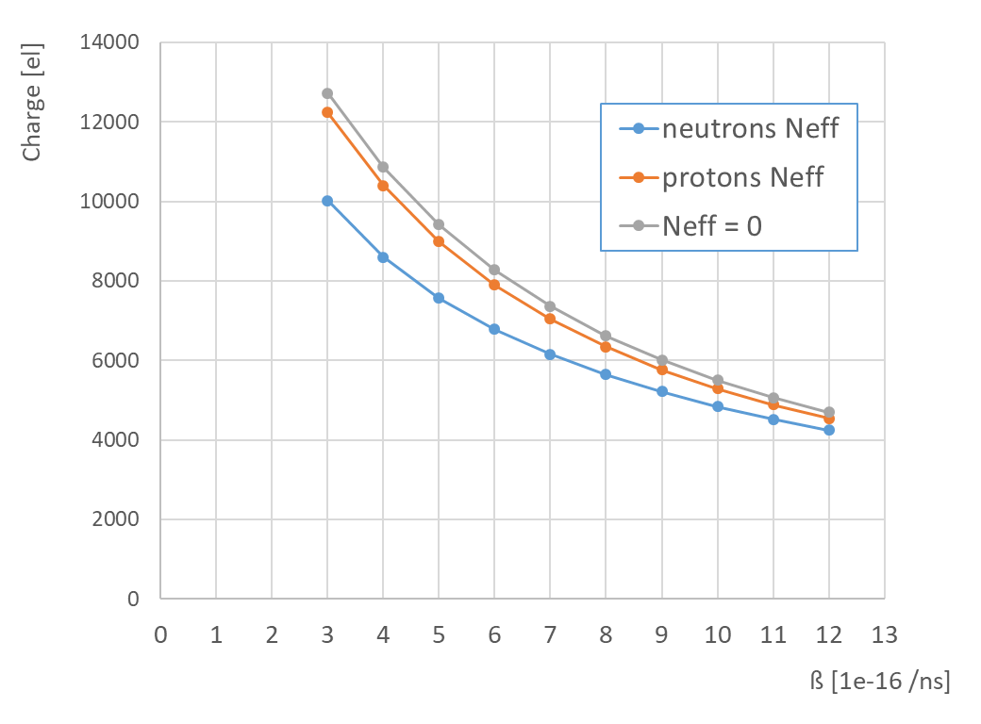
Charge trapping:
Plot shows collected charge as a function
of trapping constant for electric fields shown on previous slide
(assuming 23050 electron is full charge collection and Ф = 1.6e15)
Q = Q₀ ∙ exp( –t/τ )
1/τ = ß ∙ Ф_{eq}
Measurements of trapping constant ß with IRRAD protons:
W. Adam et al 2016 JINST 11 P04023, measured on n-type Si at Ф = 1.5e15 neq/cm2, ß ~ 3e-16 /ns
V. Cindro et al., NIMA 599 (2009) 60–65, measured in p-type DOFZ up to Ф = 3e14 neq/cm2, ß ~ 4e-16 /ns (similar for neutrons)
G. Kramberger et al., NIMA 481 (2002) 297-305, measured in n-type materials, up to Ф = 3e14 neq/cm2, ß ~ 7e-16 (ß ~5e16 for neutron irradiation)
Phi = 1.6e15
at same trapping probability larger charge is expected after proton irradiation if electric field from the previous slide is assumed
same (or smaller) charge after proton irradiation than neutron irradiation indicates larger trapping probability after PS protons
➔ seen in G. Kramberger et al., NIMA 481 (2002) 297-305
Warning:
In this example charge is calculated for a perpendicular track through the middle of the strip. In Sr-90 measurements tracks cross at
different points and under different angles and clustering is performed so numbers should not be directly compared to Alibava measurements

