Slide 1
IHEP preproduction sensors- irradiation test results
Weekly report
Iskra Velkovska

Slide 2
Test method: scanning TCT between two LGADs
Parameters: Vgl , Vfd , Gain, Ileak…
Interpad region
LGAD1
LGAD2
Measurements made at room temperature to -30℃.

Slide 3
TCT scans for irradiated/unirradiated samples at 20℃

Slide 4
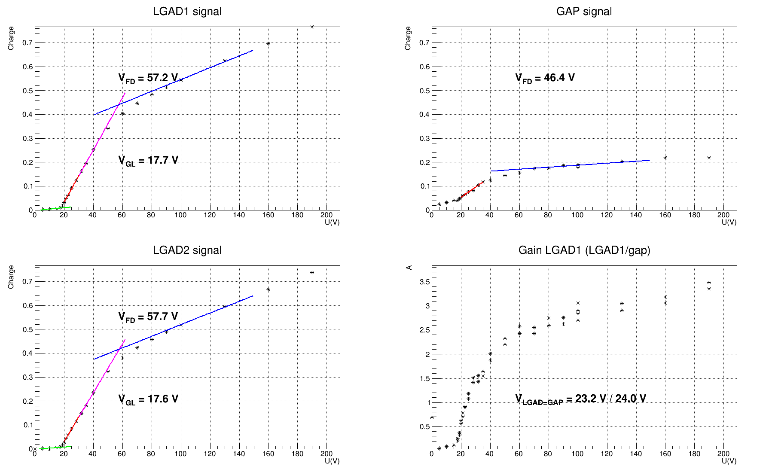
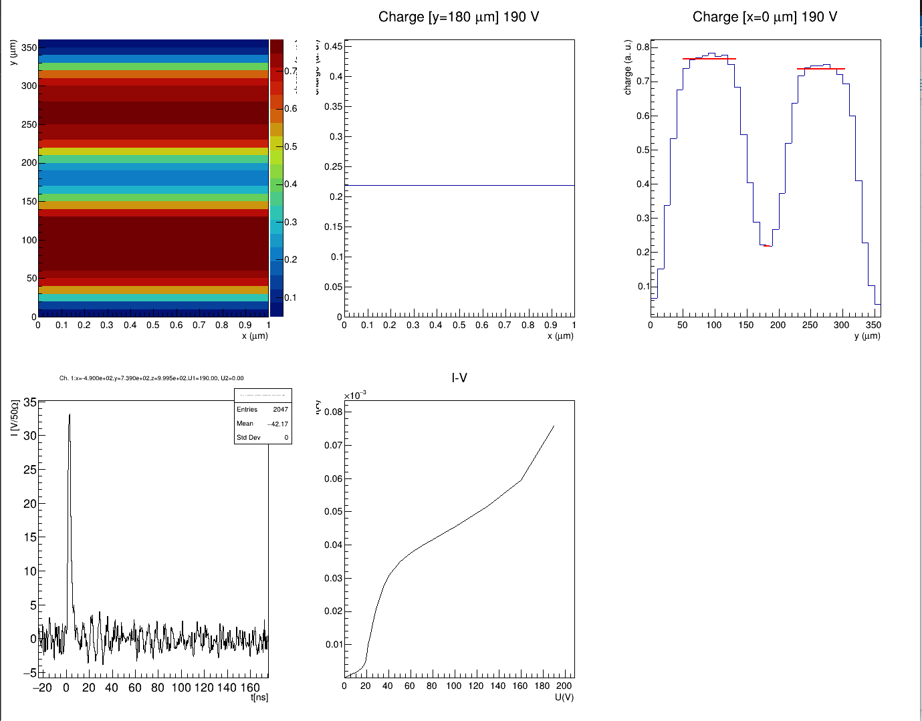
V1R2-31_2.5E15 at T= 293K

Slide 5
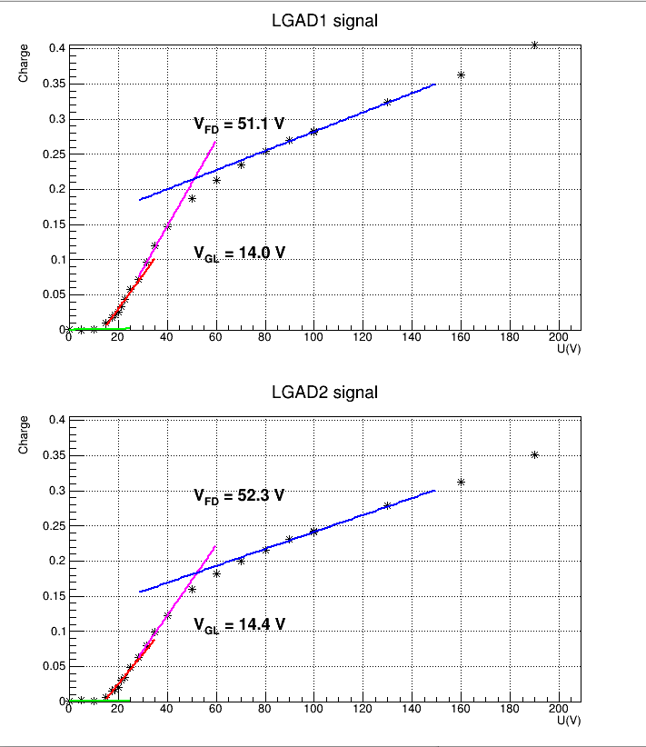
V1R2-31_2.5E15
T=293 K
T=243 K

Slide 6
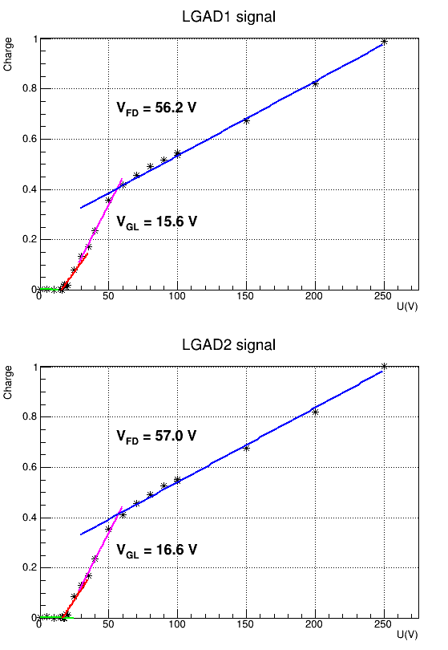
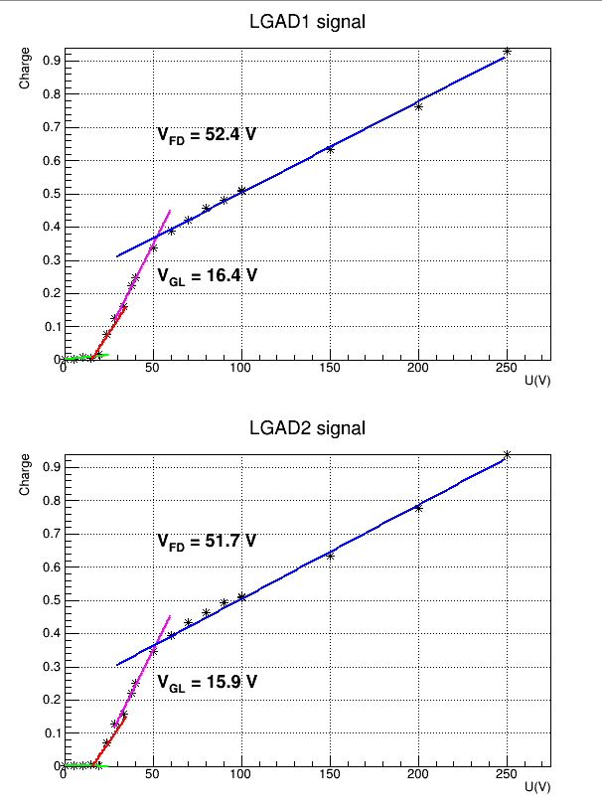
V1R2-21_1.5E15
T=293 K
T=243 K

Slide 7
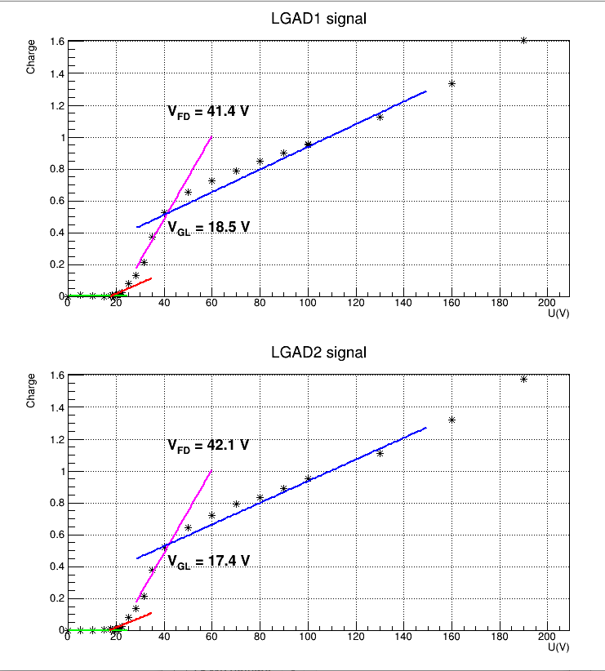
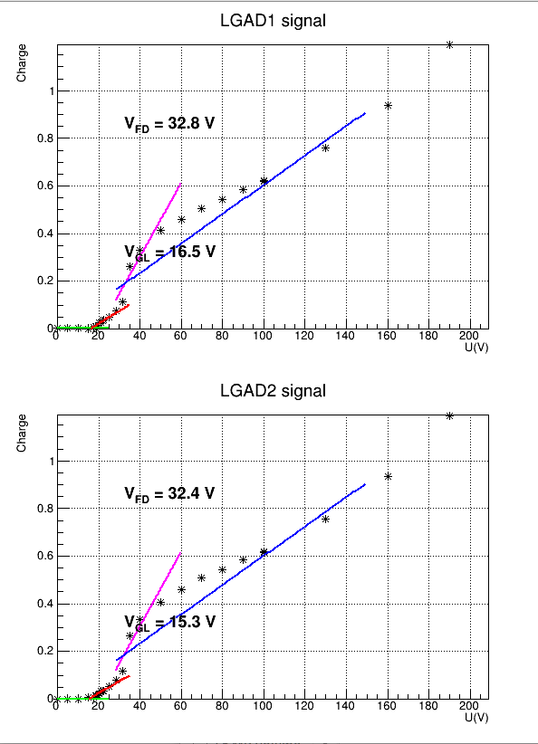
V1R2-32_8E14
T= 293 K
T= 243 K

Slide 8
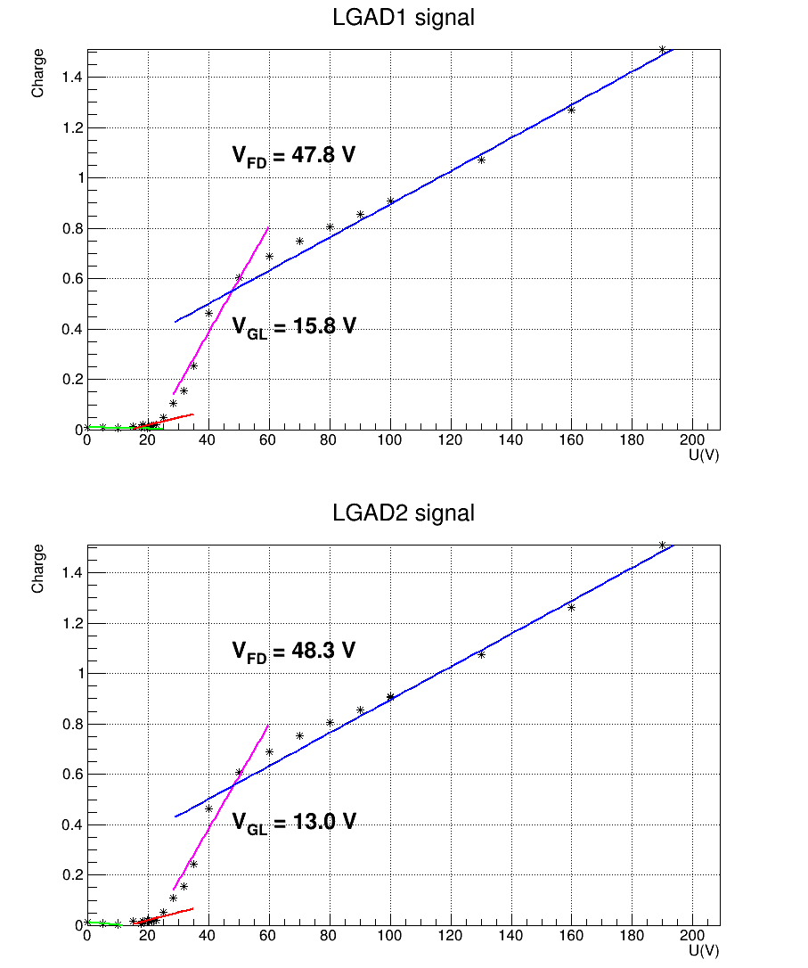
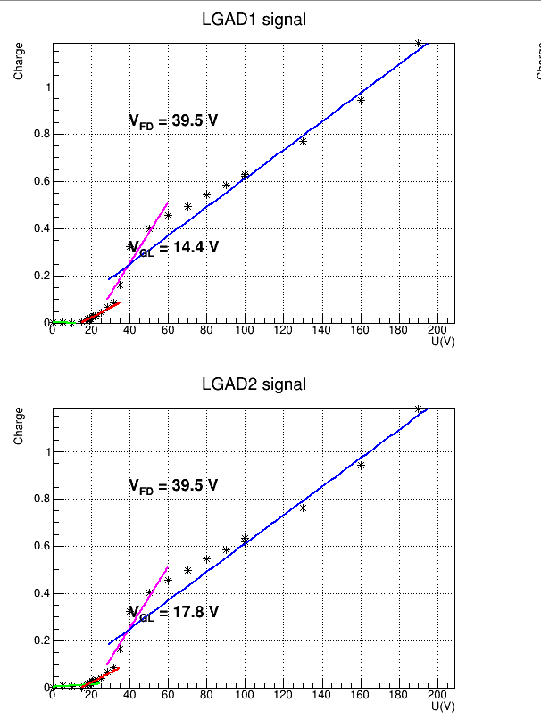
V1R2-39_8E14
T= 293 K
T= 243 K

Slide 9
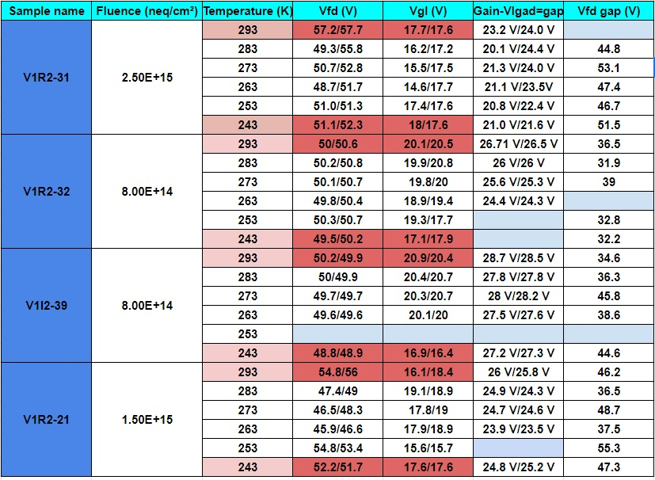
Temperature scan-results

