Slide 1
Polarimetry for Vacuum Magnetic Birefringence
Laura (Lo) Roberts
Max Planck Institute for Gravitational Physics/ Leibniz Universität
2nd Training School COST Action COSMIC WISPers
Ljubljana, Slovenia
Wednesday, June 12, 2024

Slide 2
Nonlinear effects in vacuum
2nd Training School COST Action COSMIC WISPers (CA21106)

Slide 3
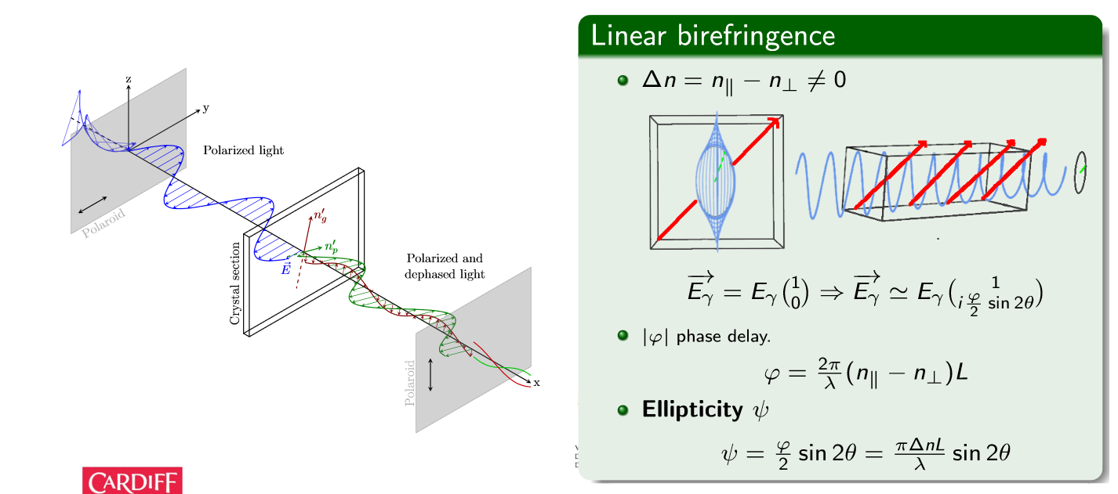
First..
2nd Training School COST Action COSMIC WISPers (CA21106)

Slide 4
The PVLAS Experiment- rotating permanent magnets
1.6 m
2.5 T @ 8Hz
2nd Training School COST Action COSMIC WISPers (CA21106)

Slide 5
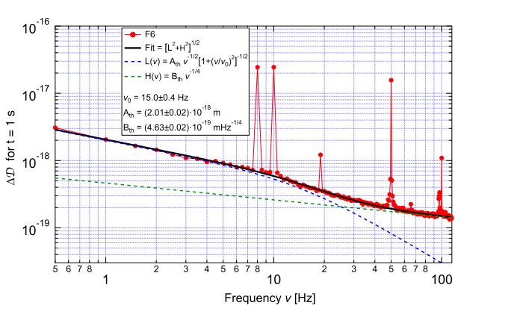
Birefringence Noise Limit – Thermal?
Investigating optical path length difference sensitivity:
$$S_{ΔD}=\frac{λ}{Nπ}S_{ψ}$$
2nd Training School COST Action COSMIC WISPers (CA21106)

Slide 6
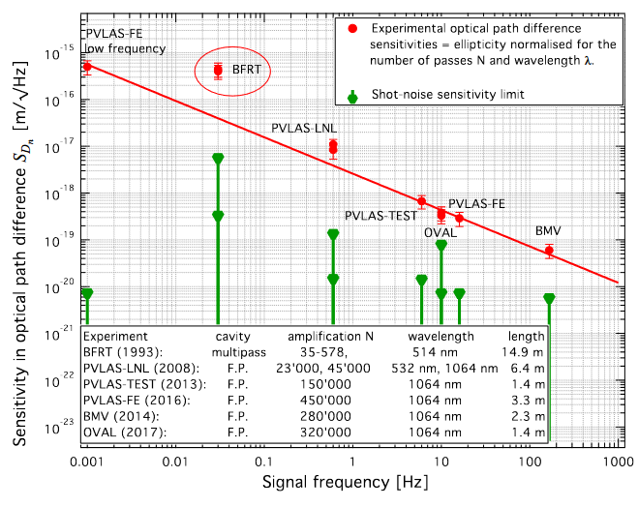
Learning from the past:
Birefringence Noise $∝ \frac{1}{f^{0.8}}$
Parameters to maximize:
$${SNR ∝B}^{2}Lf^{0.8}$$
2nd Training School COST Action COSMIC WISPers (CA21106)

Slide 7
New proposed VMB experiment – electromagnet
2nd Training School COST Action COSMIC WISPers (CA21106)

Slide 8
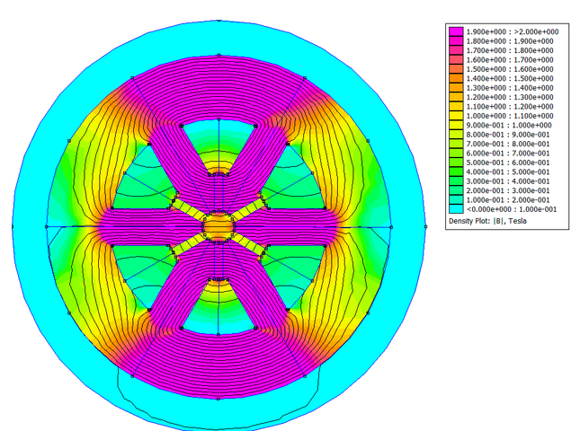
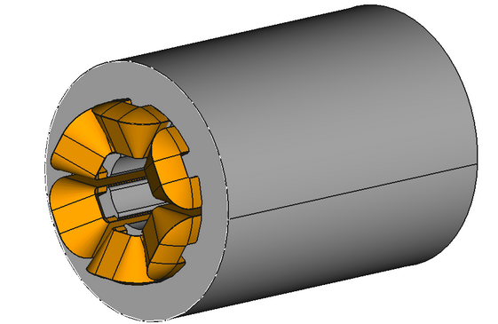
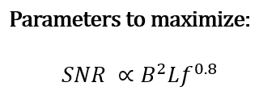
The magnet system:
Consists of 2, 40cm long magnets
1.2 Tesla dipole field in center
Rotates electromagnetically at a tunable frequency up to kHz
2nd Training School COST Action COSMIC WISPers (CA21106)

Slide 9
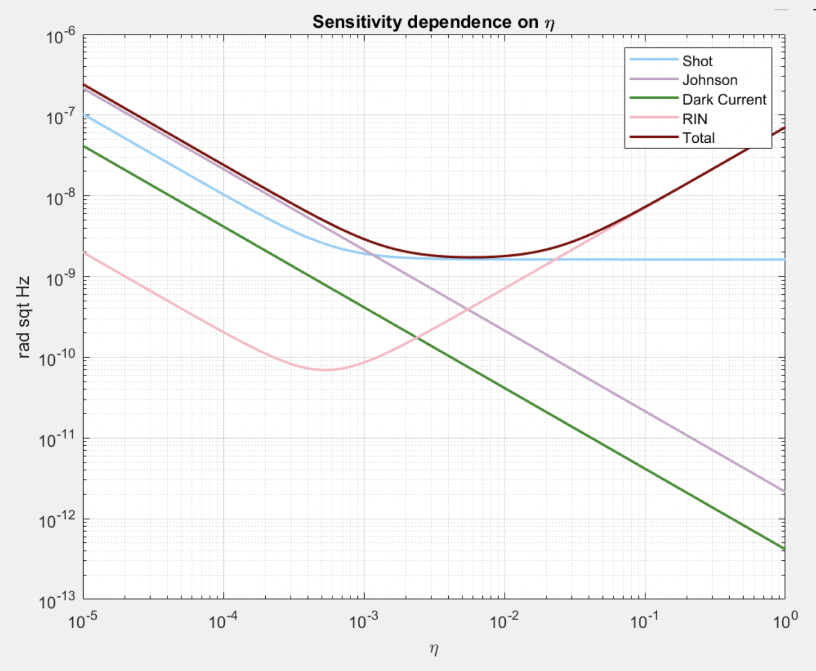
Intrinsic noise sensitivity
Parameter | Value
$$I_{0}$$ | 100mW
$$σ^{2}$$ | $${10}^{−7}$$
$$i_{dark}$$ | 25 fA/$\sqrt{Hz}$
$$N_{@50kHz}^{RIN}$$ | $${10}^{−7}/\sqrt{Hz}$$
T | 300K
G | $${10}^{6 }Ω$$
q | 0.6 A/W
$$ψ_{QED}$$
Note: $η$is modulation depth of the pem
2nd Training School COST Action COSMIC WISPers (CA21106)

Slide 10
Thank you!

Slide 11
Intrinsic noise sources
Shot noise: $S_{ψ, shot}= \sqrt{\left(\frac{2e}{qI_{0}}\right)\left(\frac{σ^{2}+η_{0}^{2}/2}{η_{0}}\right)}$
Johnson noise: $S_{ψ, J}= \sqrt{\frac{4k_{B}T}{G}}\frac{1}{qI_{0}η_{0}}$
Dark current: $S_{dark}= \frac{i_{dark}}{qI_{0}η_{0}}$
Relative Intensity Noise (RIN): $S_{RIN}=\frac{N_{@50kHz}^{RIN}}{η_{0}}\sqrt{{\left(σ^{2}+η_{0}^{2}/2\right)}^{2}+{\left(η_{0}^{2}/2\right)}^{2}}$
Total: $S_{total}= \sqrt{{S_{ψ, shot}}^{2}+{S_{ψ, J}}^{2}+{S_{dark}}^{2}+{S_{RIN}}^{2}+}$

Slide 12
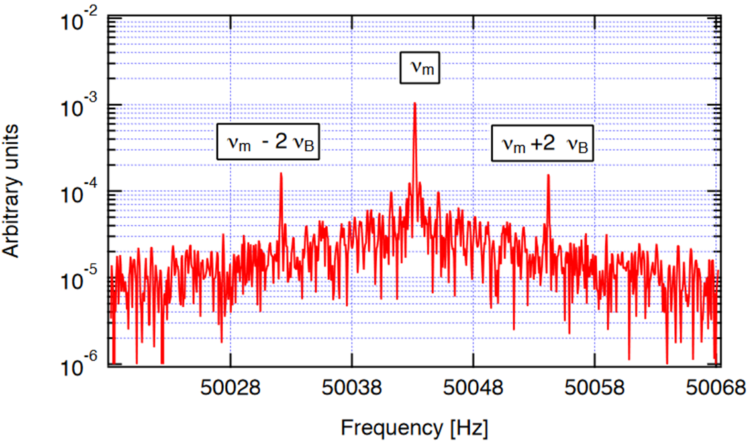
what we are looking for:
$I_{⊥}\left(t\right)≅I_{0}\left[η^{2}\left(t\right)+2η\left(t\right)ψ\left(t\right)\right]+𝒪\left[{ψ\left(t\right)}^{2}\right], where ψ=\frac{φ}{2}\sin\left(2θ\right)=\frac{πΔnL}{λ}$

