Slide 1
A Baryonic axion and the case of neutron oscillation
Théo Brugeat
Laboratory of Subatomic Physic and Cosmology
Theoretical physics team
In collaboration with Christopher Smith and Sacha Davidson
(To appear soon)

Slide 2
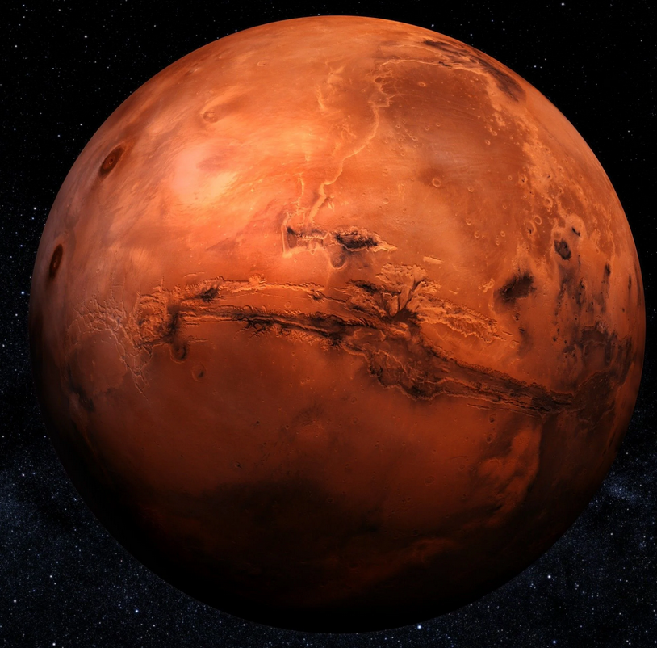
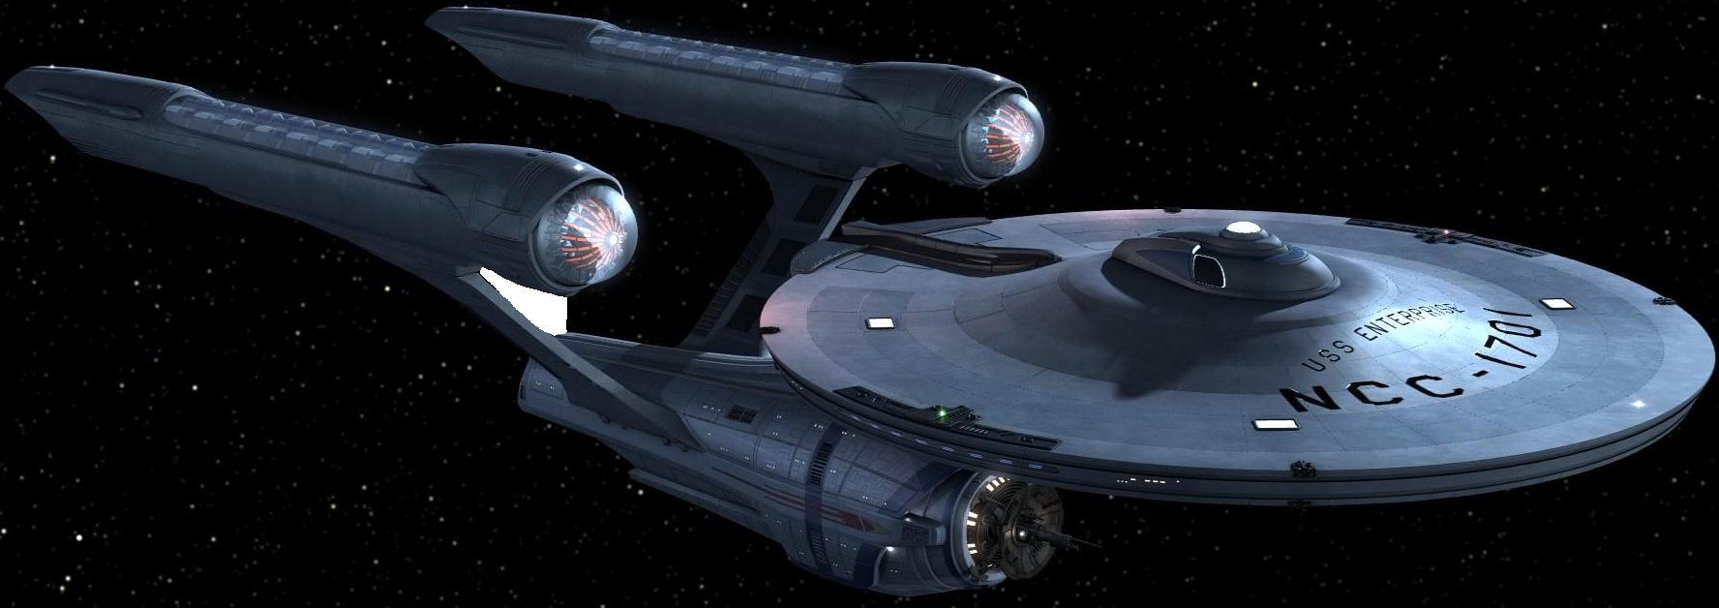
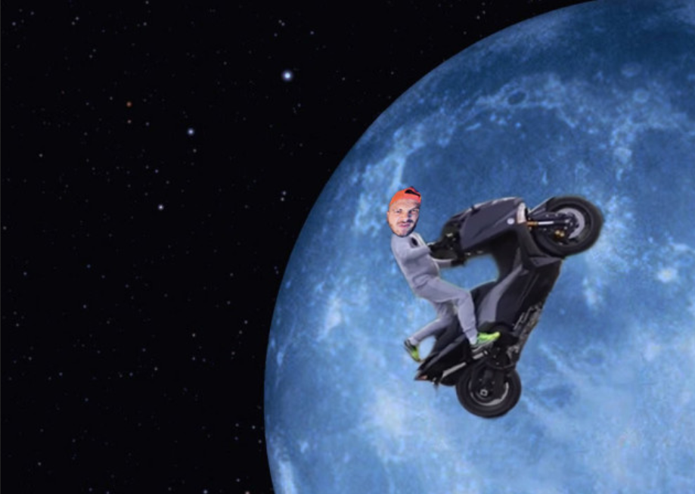
Can we go on Mars the Star Trek way ?

Slide 3
Outline
Baryon number violation
Neutron-antineutron oscillations
Rabbi resonances
Baryonic axion from leptoquarks
Consequences for Oscillations
Conclusion

Slide 4
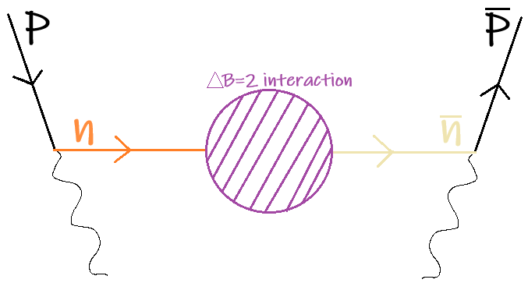
Baryonic Violation
Matter-antimatter asymmetry requires the Sakharov’s conditions for Baryogenesis :
C and CP violation
Thermal inequilibrium
B violating process
We focus on ΔB = 2 model of neutron-antineutron oscillations.
The standard Lagrangian considered is :

Slide 5
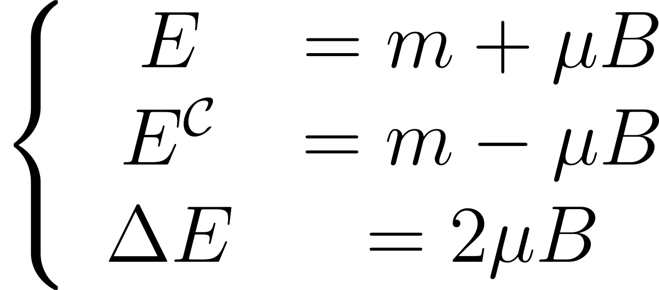
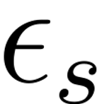
Standard Neutron-Antineutron Oscillations
Once we reach the Non-Relativistic description of this model we have :
The remaining object are the spin components aligned with the magnetic field. This lead to the following expression for the transition probability [R.N.Mohapatra (2008) ] :
For :
Current bound given by the ILL (Grenoble) : .

Slide 6
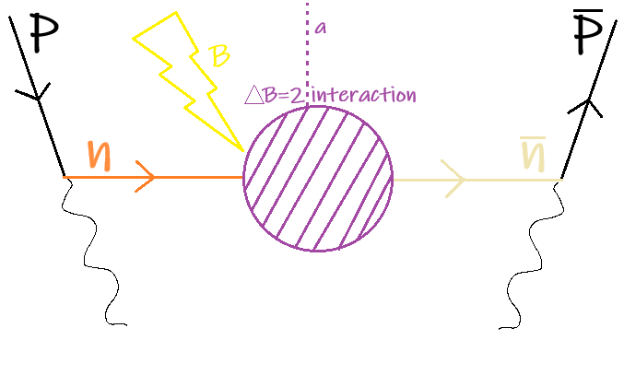
Enhancing the oscillations with Dark Matter
If Dark Matter induce such coupling with : .
This induces resonances a la Rabi.
Can maximise the amplitude, by tuning the magnetic field to DM oscillations.

Slide 7
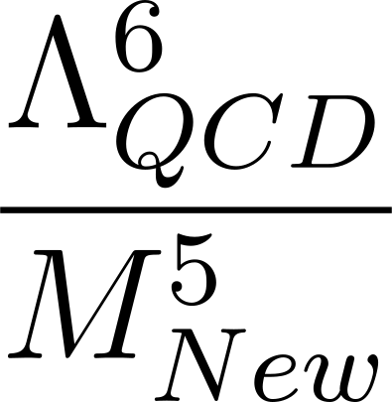
Enhancing the oscillations with Dark Matter
If Dark Matter induce such coupling with : .
This induces resonances a la Rabi.
Can maximise the amplitude, by tuning the magnetic field to DM oscillations.
In such case, half of the neutrons can be converted ! One problem, the tuning is to be of precision ...
Still, how such coupling could arise in the UV ?
In the SM there is 2 possible (ΔB,ΔL) = (2,0) couplings : uudddd and QQQQdd
6 Quarks required
Reduced magnitude : .

Slide 8
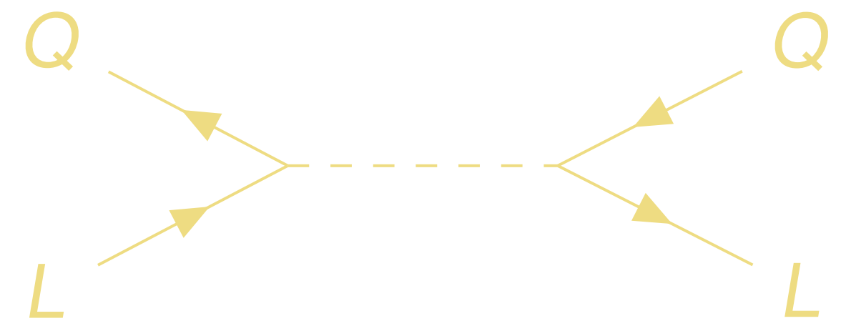
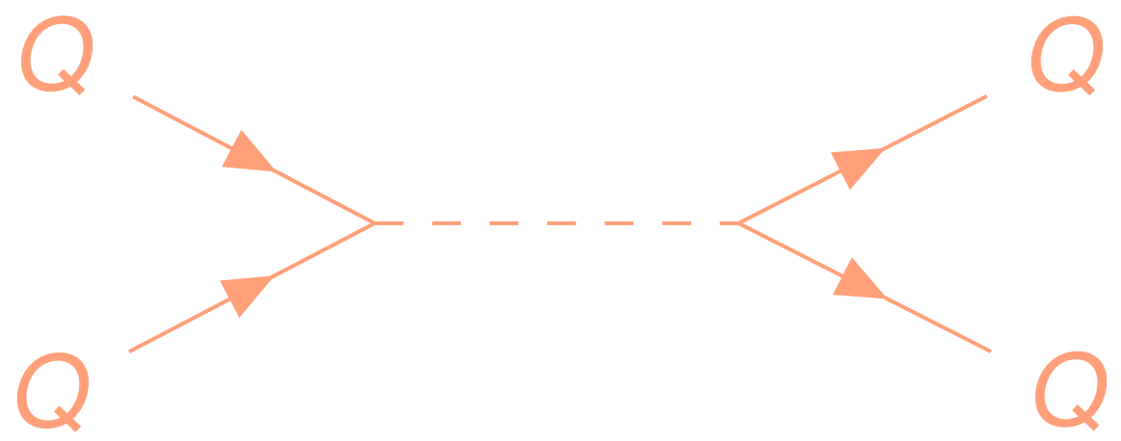
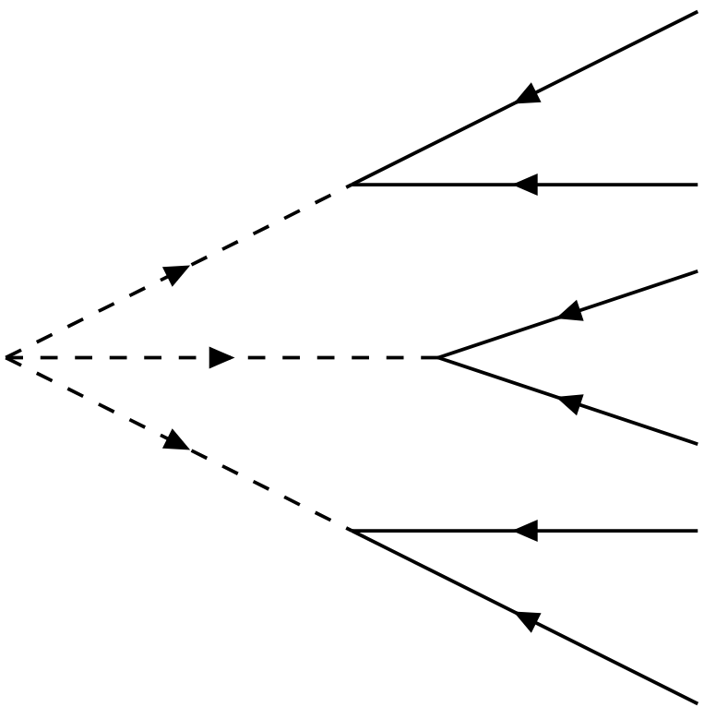
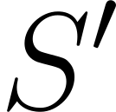
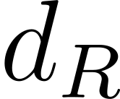
Leptoquark and Diquarks : mediators of B-violation
Leptoquark and Diquark are mediating Fermi interactions to colored pairs of Quark/Leptons. They arise naturally in some theories (SUSY).
They are classified according to their SM charges and carry Leptonic/Baryonic Number.
They can be used to construct (ΔB,ΔL) = (2,0) couplings.
On the right : scalar coupling, requiring 2 di-quarks.

Slide 9
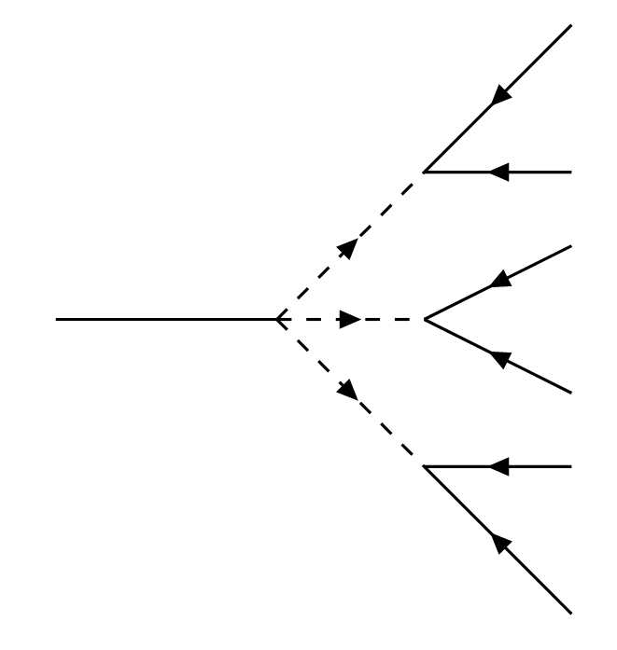
Restauring the symmetry with a Goldstone mechanism
Couple the Peccei-Quinn scalar field to compensate the Baryonic violation.
When it acquires its VEV, Baryonic symmetry is spontaneously broken :
Correspond to a scalar coupling [Arias-Aragón,Smith(2022)] :
It is possible to build another one by adding a massive vector field (harder to realize):

Slide 10
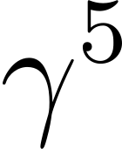
Adapting the oscillations
Constant axion must not contribute.
matrices makes N-R approximation tedious.
We adapted « Bogolyubov transformation » [Tureanu,Fujikawa (2021)] in the Weyl formalism [Berezhiani,Vainshtein (2015)] leading to solvable 4x4 N-R system.
Reparametrization invariance leaves a peculiar situation.
No reparametrization for !
With Weyl : Natural way to transform the Axial Baryonic violating coupling into Vector current.
C/CP hard to define, currently looking for invariants a la Jarlskog.
All this leads to a Baryonic axion decoupled from neutron oscillations.

Slide 11
Conclusion
The neutron oscillation coupled to DM is treated using Weyl representation,
Baryonic violation : Playground for building axion models with new phenomenology,
Pseudo scalar DM does not lead to resonances, what about other effects ?

Slide 12
Thanks for your attention !

