Slide 1
Using Functional Methods in Quantum Axion-Electrodynamics
Henrique Gonçalves
MSc Student at Instituto Superior Técnico
2nd Training School COST Action COSMIC WISPers (CA21106)
Ljubljana, 10-14 June 2024
Notes:
The distribution of dark matter (colored in blue) in six galaxy clusters, mapped from the visible-light images from the Hubble Space Telescope. (Source: NASA, ESA, STScI, and CXC) Credit: NASA, ESA, STScI, and CXC

Slide 2
Presentation outline
Introduction & Motivation
Quantum Field Theory of Axion-Electrodynamics
Calculating Correlation Functions
Conclusions and Future Work

Slide 3
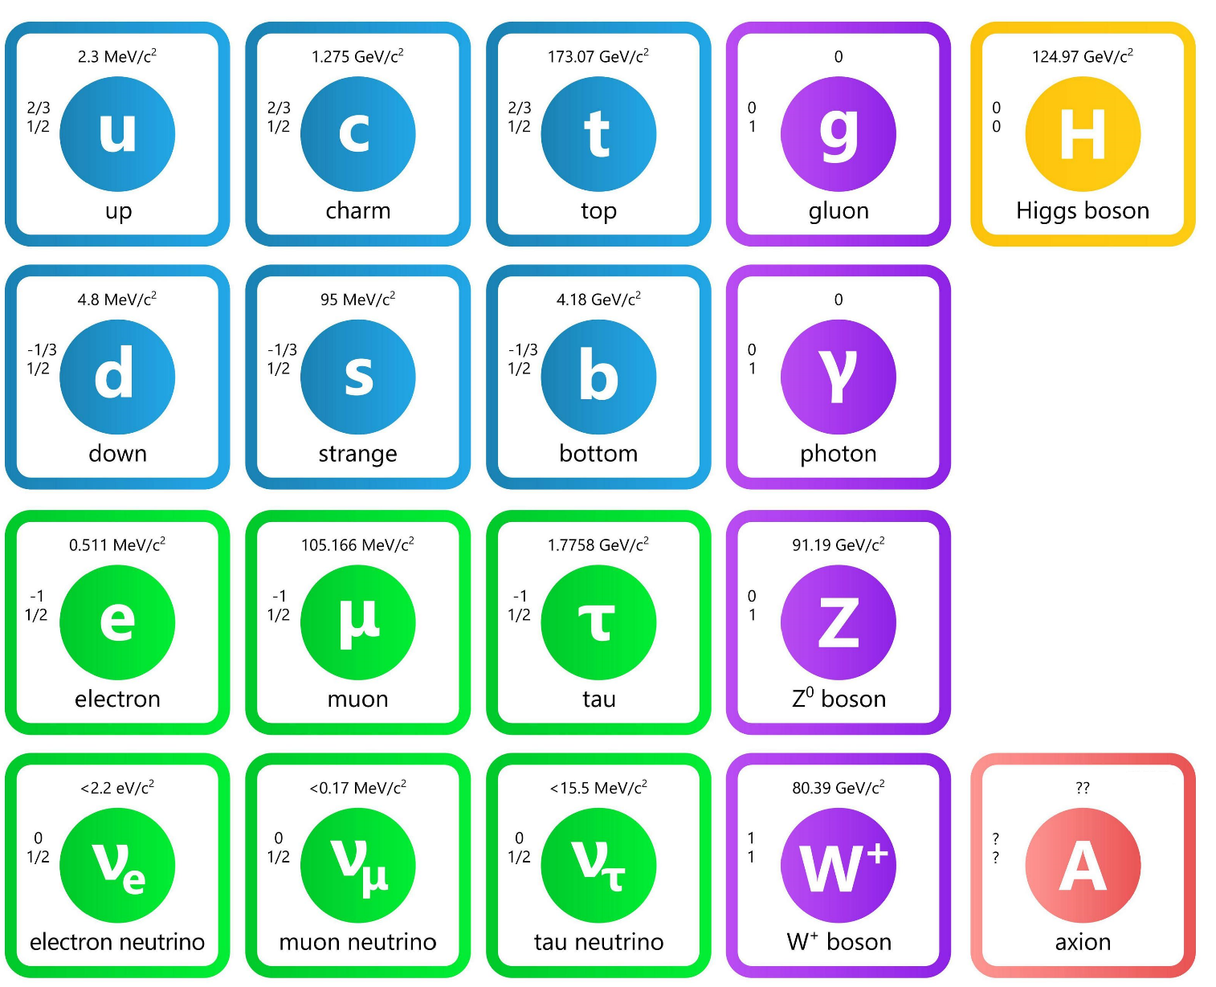
Axions in the Standard Model
This restores CP-symmetry but has other consequences:
Modified Electromagnetic Theory!
New interactions!

Slide 4
Axions in Eletromagnetism: A simple example
The introduction of the axion field results in a Modified Electromagnetic Theory
$g$ is the axion-photon coupling parameter (dimensions of ${Energy}^{−1}$)
This parameter defines the strength of the interaction with EM fields!
* written in Natural units

Slide 5
Axions: New Field Equations
We can determine the Euler-Lagrange equations:
Modified (Symmetric) Maxwell’s equations (in the absence of magnetic currents)
Axial
coupling!
Klein-Gordon equation for $φ$ evolution

Slide 6
Quantum Axion-Electrodynamics
We can write the Lagrangian density of our theory:
After using the Faddeev-Popov method for gauge fixing and integrating by parts
free-field lagrangian
Interaction part
* written in Natural units

Slide 7
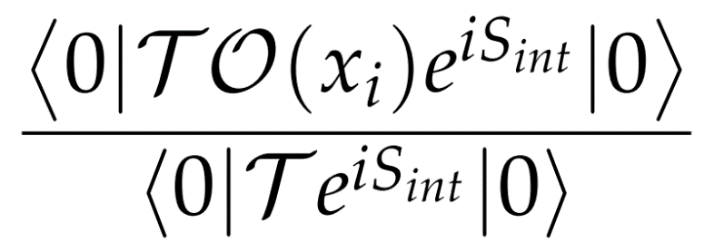
Generating Functional $Z[J]$
By definition, this is given by:
We only need the Generating Functional of the Free Theory

Slide 8
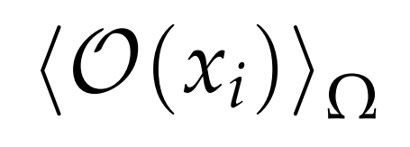
Correlation Functions: General Formula
Going back to the second equation
We need to expand $e^{iS_{int}}$
Such that..

Slide 9
Correlation Functions in QED + Axion
In QED, the only coupling constant is $e$
$e$ , $g_{φγ}$ , $g_{φψ}$
When we add Axions:
Solution: Expand in all of them!
Thus, up to first order ($e^{1}$, $g_{φγ}^{1}$, $g_{φψ}^{1}$)

Slide 10
2-Point Correlation Functions: LO Propagators
Dirac field Propagator
Photon field Propagator
Axion field Propagator

Slide 11
3-Point Correlation Functions
QED Vertex:
From rules 1 (and 2)

Slide 12
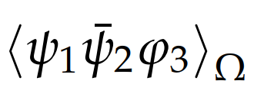
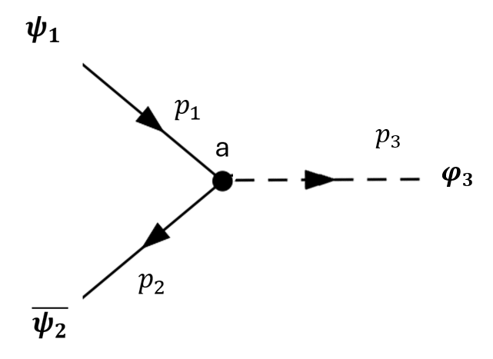
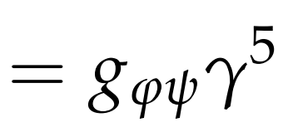
3-Point Correlation Functions
Fermion-Axion Vertex:
From rules 1, 2a
Luckily the last term doesn’t vanish. After some math, Fourier Transforming and using the LSZ reduction formula, we get:
Purely quantum effect!

Slide 13
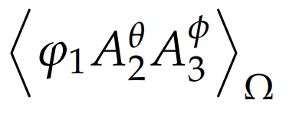
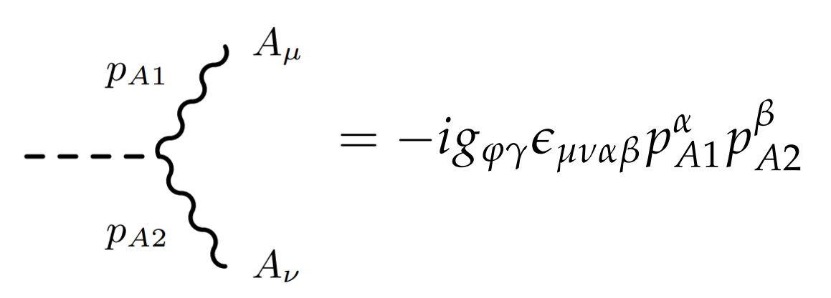
3-Point Correlation Functions
Axion-Photon Vertex:
From rules 1 and 2
After some algebra and Fourier transforming everything, we get
LSZ

Slide 14
Conclusions
We have successfully derived the Feynman Rules for our effective theory (in vacuo)

Slide 15
Future Work
Add new effective terms to our lagrangian and change the equations of motion
Use our Feynman rules to calculate Amplitudes and compare them with experiments.
Introduce a medium (plasma), and compute new amplitudes in a plasma and discover new physics (Quantum Axion-Plasmadynamics).

Slide 16
Thank you for your attention!
Any questions? ☺
Instituto Superior Técnico

Slide 17
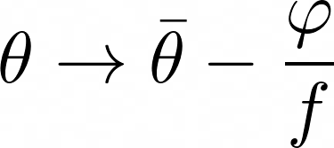
Axions in the Standard Model
Hypothetical particles proposed in 1977 by R. Peccei and H. Quinn to solve the “Strong CP problem”
CP violating term!
PQ mechanism: Promote θ to a complex dynamical field
Axion is the Goldstone boson, emerging from the spontaneous symmetry breaking of a continuous symmetry, denoted $U{\left(1\right)}_{PQ}$
This mechanism restores CP-symmetry but has other consequences:
Modified Electromagnetic Theory!
New interactions!

Slide 18
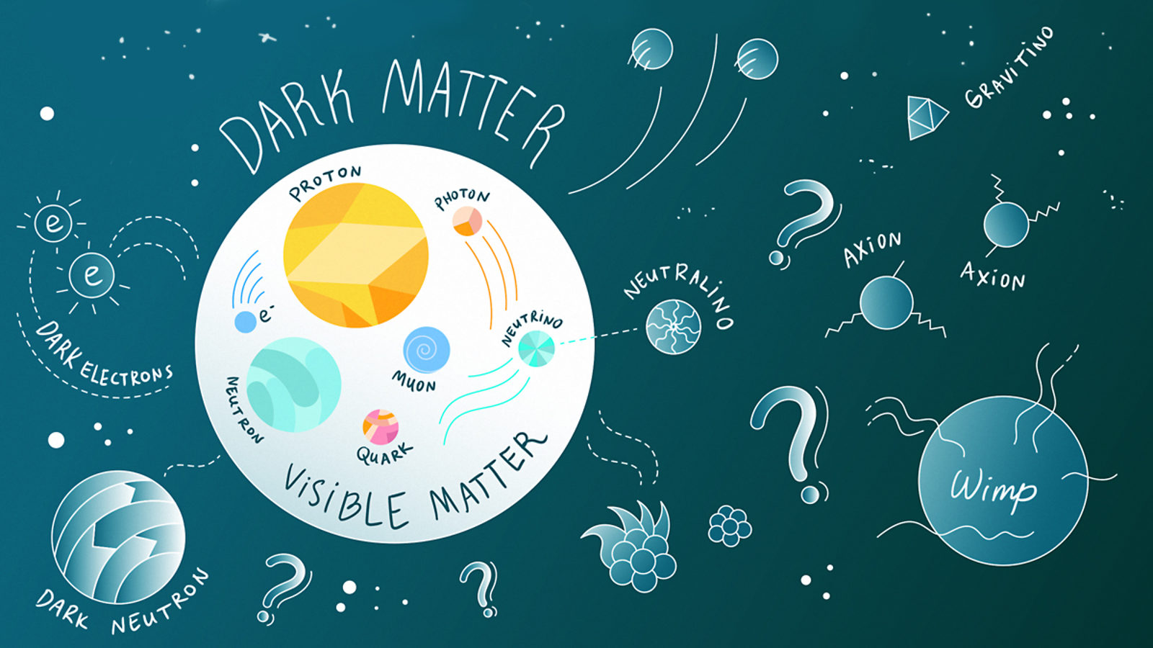
Axions as Dark Matter candidates
Notes:
WISPs (very Weakly Interacting Slim Particles)

Slide 19
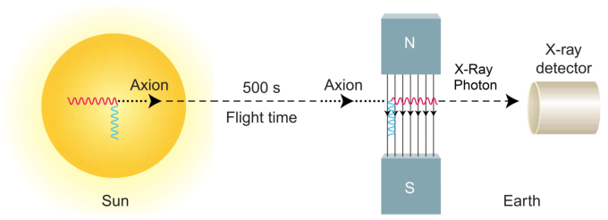
Axions as Dark Matter candidates
Axions and Axionlike particles (ALPs) are very well motivated Dark Matter candidates
They couple very weakly to ordinary matter and photons
Current predictions point to a very small mass (of the order of meV)
Several experiments have been proposed, based on “passive” detection methods

Slide 20
Extra [help for slide 7]

Slide 21
Calculating Correlation Functions
We use the usual definition,
Rule 1: correlation functions in the free theory with odd number of photons ($A_{μ}$), odd number of axions ($φ$) or different numbers of $ψ$’s and $\overline{ψ}$’s vanish

Slide 22
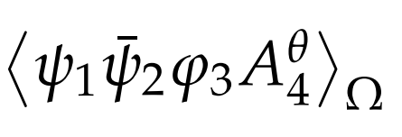
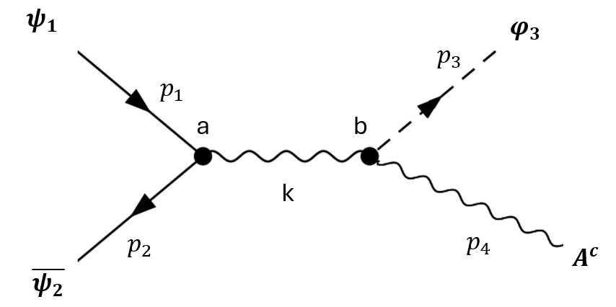
4-Point Correlation Functions
Goal: Add higher order terms to the effective lagrangian
Quartic Vertex:
From rule 1
We need to go beyond LO! (Appendix E)

Slide 23
4-Point Correlation Functions
Doing this just like before..
Simplify:

Slide 24
4-Point Correlation Functions
Finally, do Inverse FT ( prescription $p^{β}=i ∂^{β}$ )and consider $k^{2}→4m_{ψ}^{2}$, we get

Slide 25
Axions in plasmas: Axion-Plasmon Polariton
Recent studies have investigated the interaction between axions and plasmas
To do so, we must complete our system of equations to model the plasma
Fluid model of Plasmas
We consider a strong, homogeneous Magnetic field, $\vec{B}=B_{0}\vec{e_{z}}$ and study the
perturbations along the $\vec{B}$-field

Slide 26
Axions in plasmas: Axion-Plasmon Polariton
We proceed by linearizing our system of equations around the quasineutrality condition, such that $n_{e}\sim n_{0}+\tilde{n_{1}}$ and $φ\sim \tilde{φ_{1}}$
After applying a Fourier Transform, we obtain an Eigenvalue equation
Dispersion Relation of the Upper (U) and Lower (L) Polariton modes
Raby frequency, $Ω$
Quantifies the strength of the coupling between these modes

Slide 27
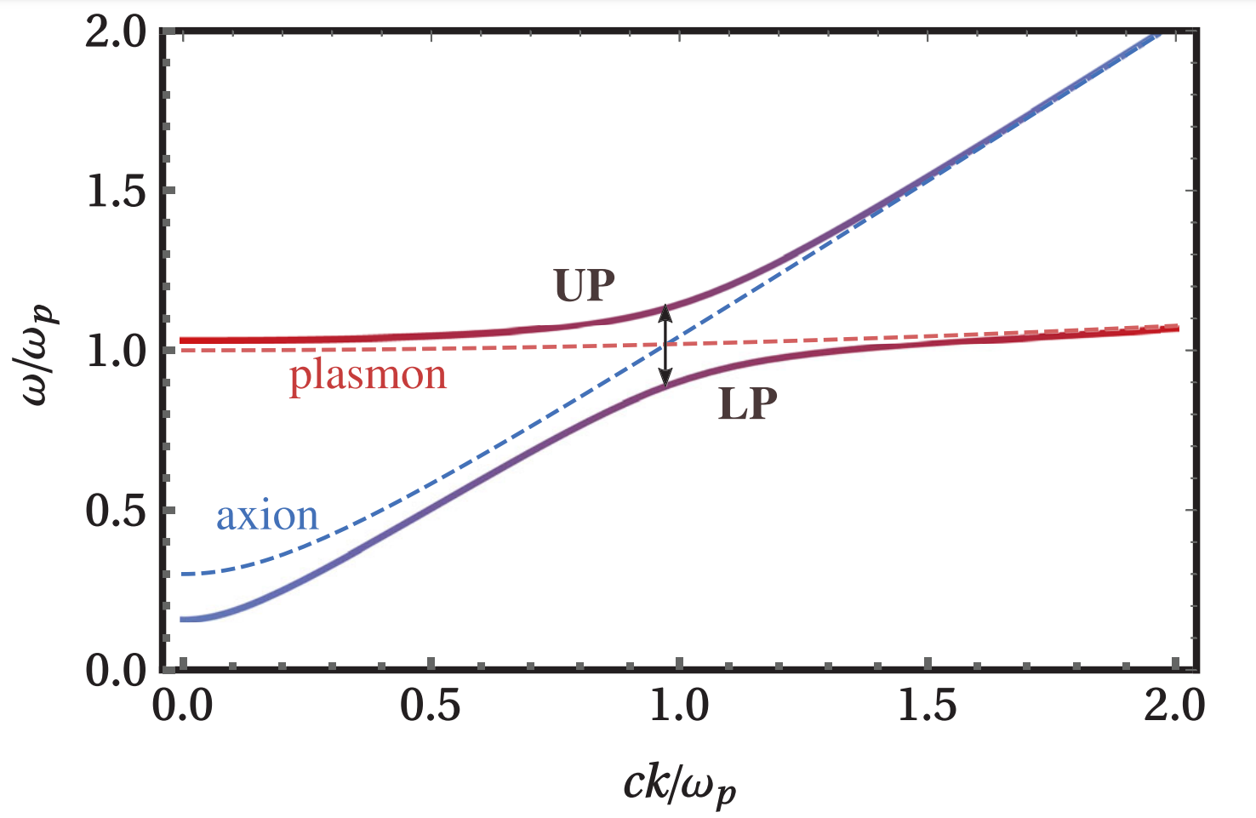
Axions in plasmas: Dispersion relation
Plotting this dispersion relation:
The Upper Polariton mode switches from a plasmonlike flat dispersion curve ($\sim ω_{p}$) to an axionlike dispersion curve ($\sim ck$)
Physically this means there is hybridization between the axions and plasmons

Slide 28
Axions in plasmas: Active Production
We can exploit this phenomenon to increase the probability of axion conversion!
Since $Γ_{φ→pl}≫Γ_{φ→γγ}$ Plasmon-Axion conversion dominates over Primakoff production!
New PSW schemes in magnetized plasmas:
Use Beam-Plasma Instability to produce unstable electron waves
Plasmons admix to axions, increasing the small-axion component!
Plasmons are converted into axions Active Axion Production!

Slide 29
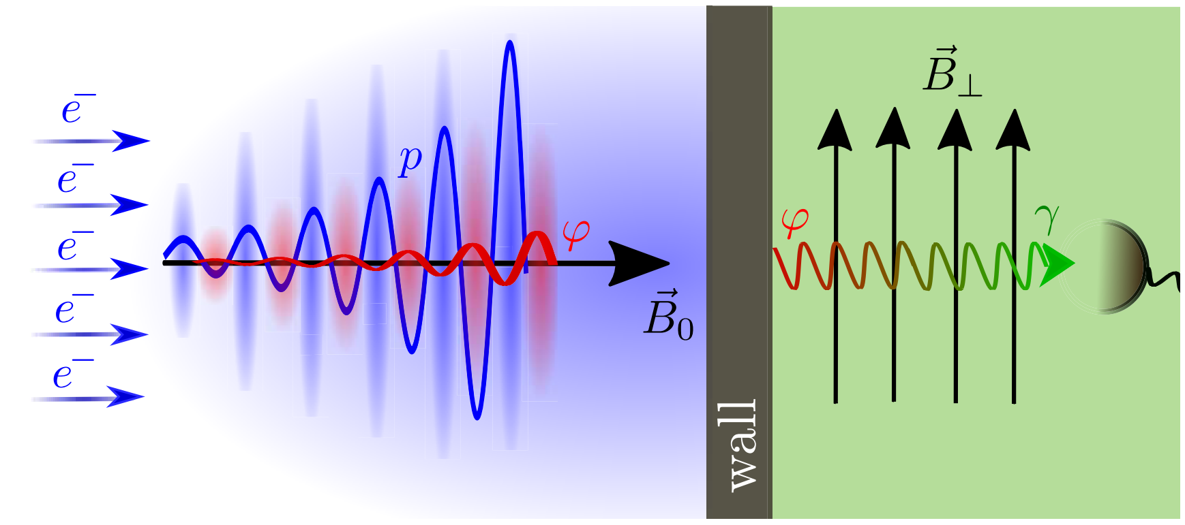
Axions in plasmas: PSW experiment
The following scheme was proposed:
Produced Axions are sent to a regeneration chamber, where they are reconverted into detectable Photons
Highly increases Axion-Photon conversion, competing with other LSW experiments!

Slide 30
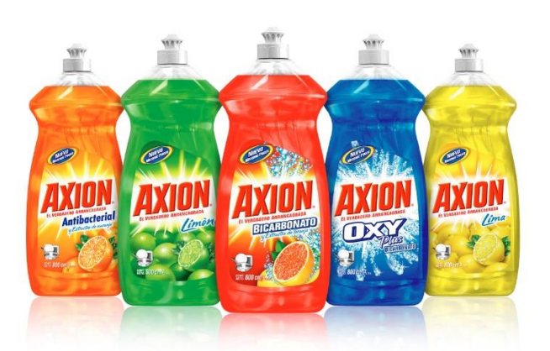
fun

