Slide 1
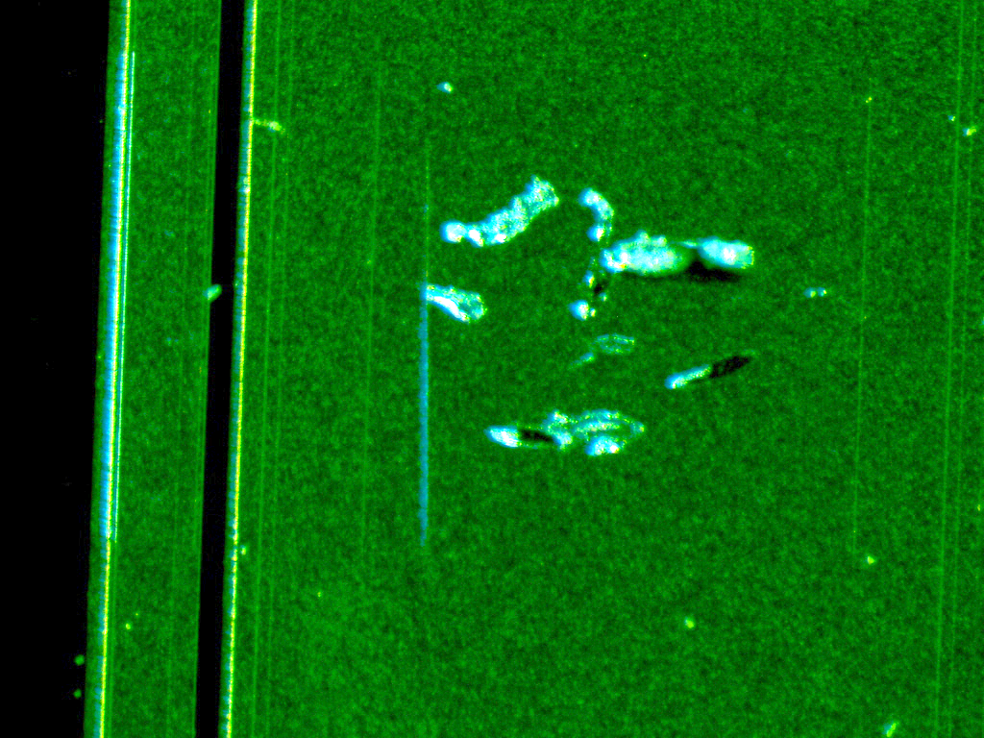
QCTS measurements
F9 database:
https://docs.google.com/spreadsheets/d/1um1xUsOMzj5rGVuCReQqf53B1h4MXAHaCTQQISyXkPY/edit#gid=762628997
6 out of 12 samples from W2 damaged (of the remaining 4 not yet used at all) – high I leak in one LGAD - 2 damaged by probe station needles (scratch) - 2 damaged by wire bonding - 1 destructive electrical breakdown in timing at 180 V (-30°C) - 1 crushed by accident
3 good W3 samples measured (none damaged, 9 not yet used)

Slide 2
Timing – Reference HPK 50D
Signal size in Reference HPK 50D at 300 V reduced by 50 % since last week
No investigation yet if it comes from the board or from the sensor
12 Dec
MPV 200 mV
post 12 Dec
MPV 100 mV

