Slide 1
Sample preparation for HGTD Long Term Stability test
Bojan Hiti
Jožef Stefan Institute
15 March 2024

Slide 2
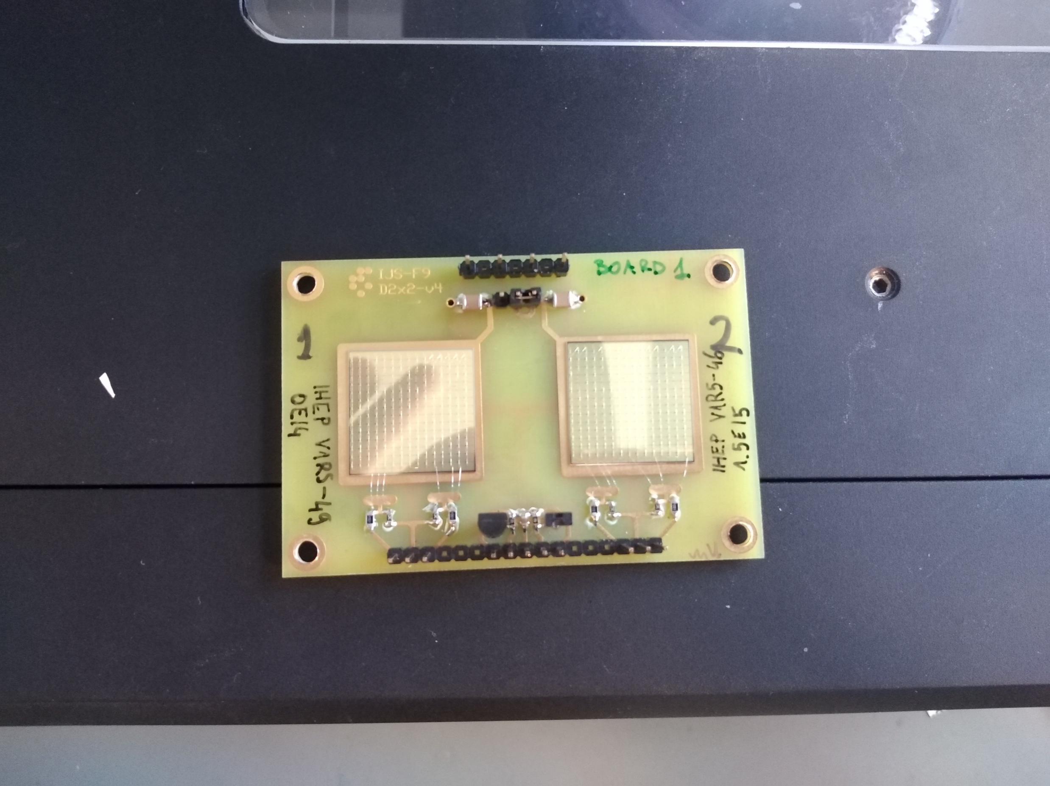
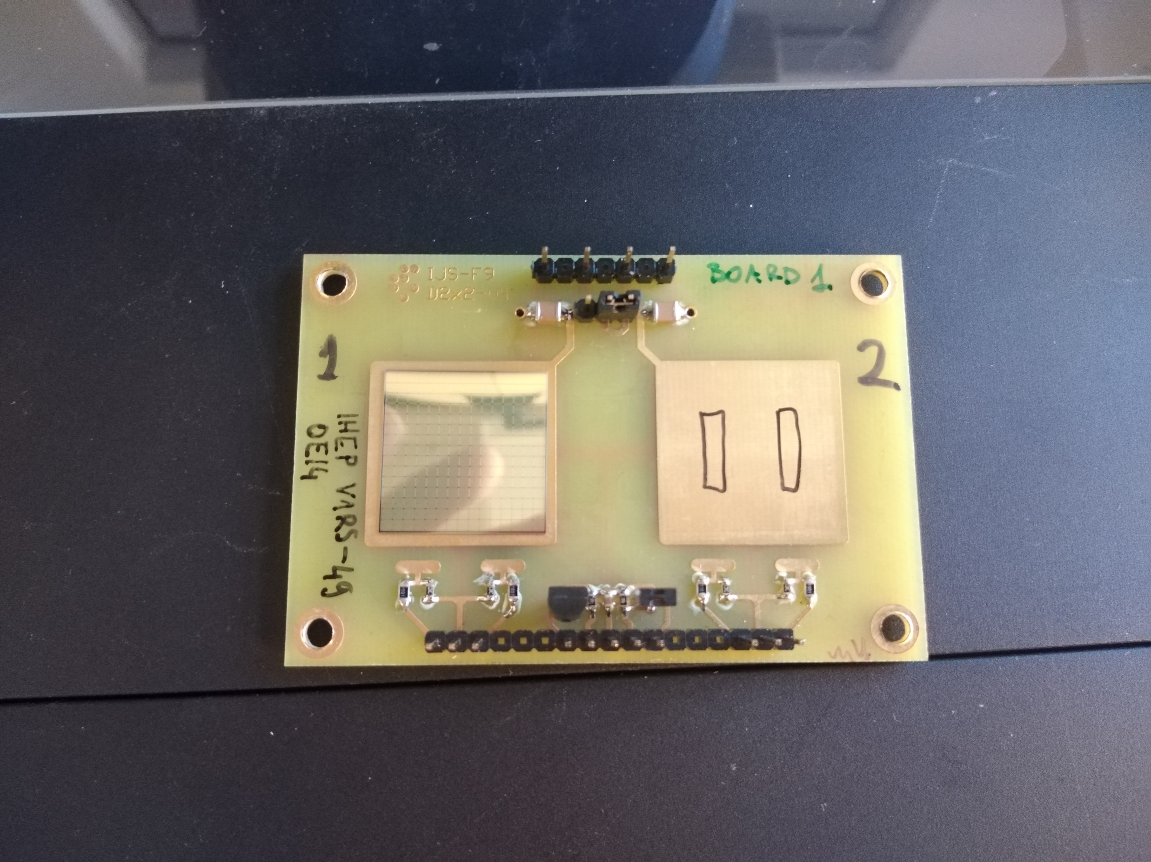
Board 1
Shape of Tesa conductive tape strips
B1 Sample 1 –V1R5-49 0e14
B1 Sample 2 –V1R5-46 15e14
irradiated samples annealed 80 min @ 60 °C

Slide 3
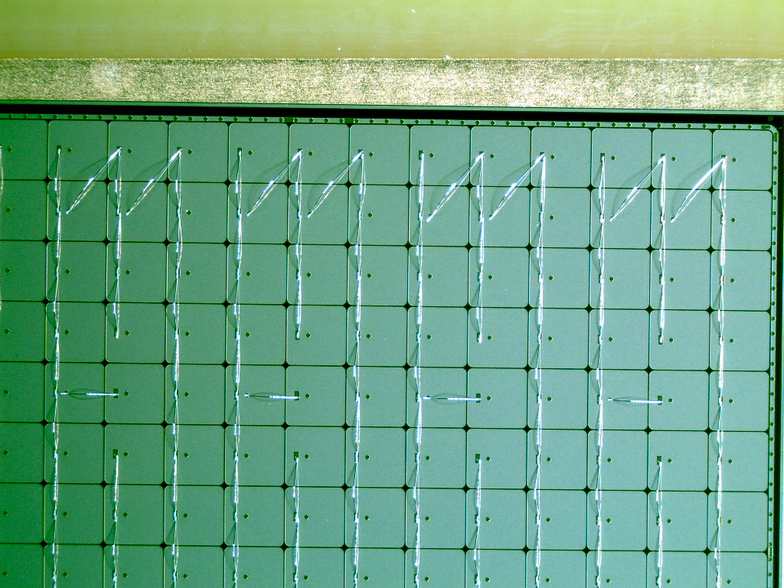
Sensor bonding
“Leaf” pads – can be made floating by tearing their wire bond
All 15 x 15 pads connected together and connected to readout via 1 kOhm resistor
Guard ring connected to ground via separate 1 kOhm resistor

Slide 4
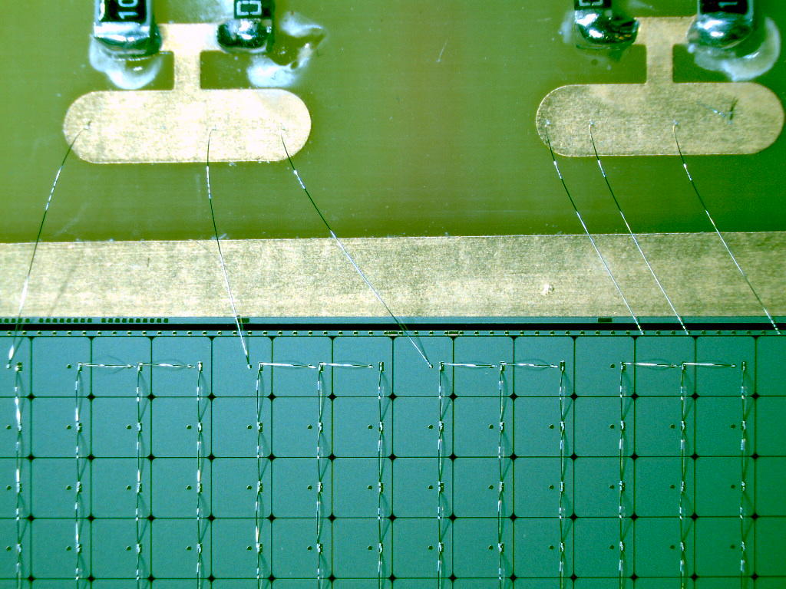
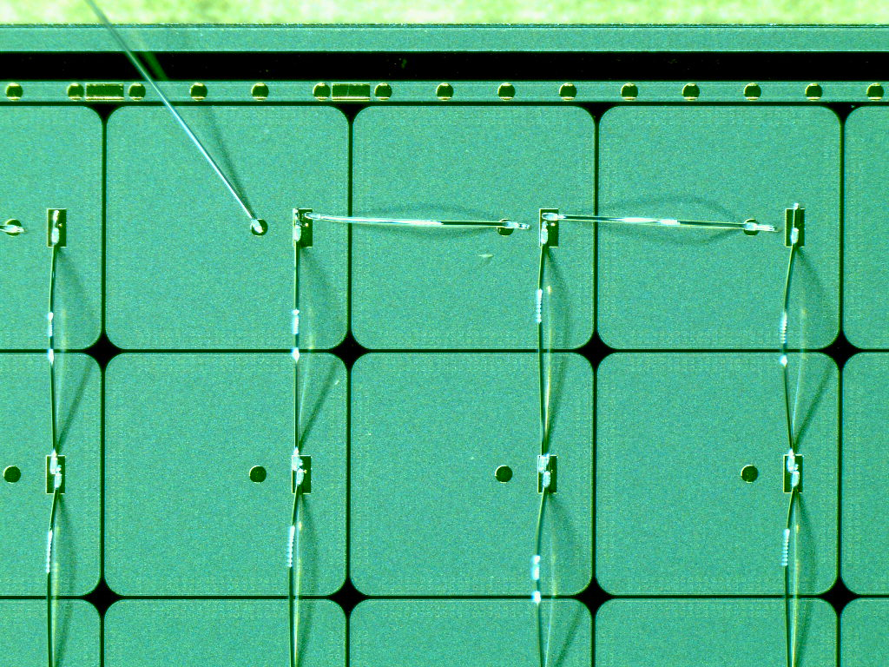
Readout & Guard Ring connection detail
Using both Bump Bond and Probe Needle pads on some pixels

