Slide 1
PyBounce package: advances report
Alen Gajer, FMF
Mentor: Prof. Dr. Miha Nemevšek

Slide 2
Introduction
Theory overview (what PyBounce tries to reproduce)
Finding $R_{in}$
Comparrison with FindBounce
Extended bounce
What still has to be done

Slide 3
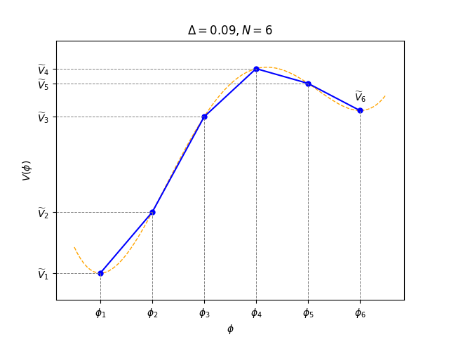
Single Field Polygonal Bounce
Solving Euler-Lagrange equation
Linear approximation of the potential:
Notes:
Mogoče spremeni barve grafa, da bojo primerne za projektor.
Lets quickly go over the idea behind FindBounce and PyBounce.
- The goal is to calculate the action that will get us the decay rate, this equation shows the action for any D and arbitrary number of fields.
- Solving the Euler-Lagrange equation gives us the differential equation that we need to solve
- Now comes the approximation. We approx. the potential with linear segments.
- If we now choose the segmentation, we can obtain the parameters a_s, given any potential V. (equidistant segmentation)

Slide 4
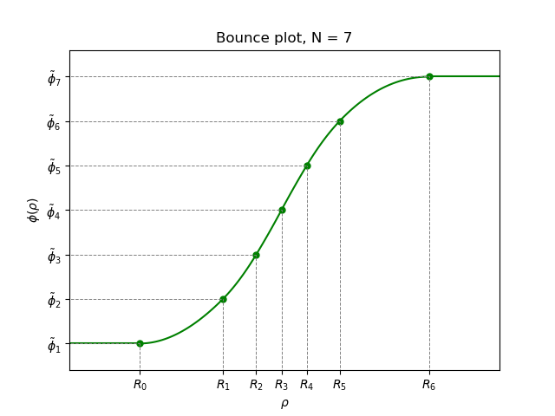
Bounce function
Linear potential solution
Notes:
- Now we insert the linear potential into the differential equation and get the solution for phi on each segment.
- We now glue the solutions together to get the whole bounce function.

Slide 5
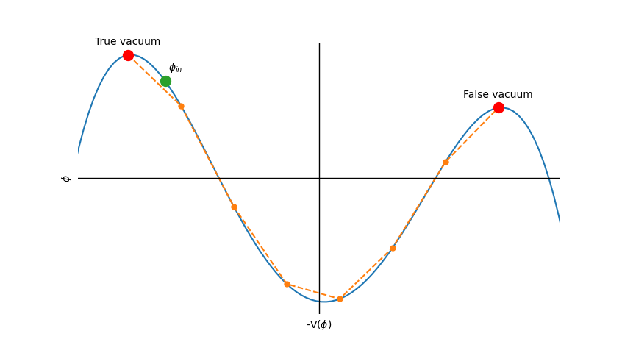
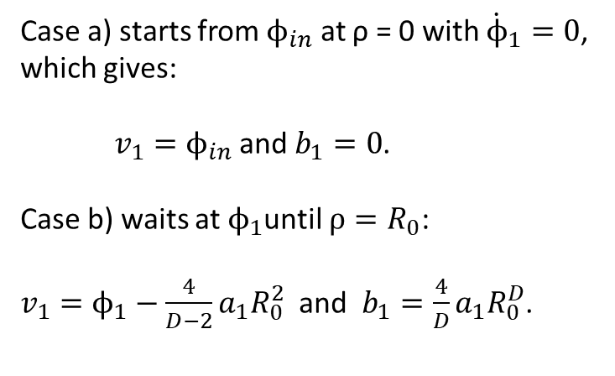
Two cases
Case a) starts from $ϕ_{in}$ at ρ = 0 with ${\dot{ϕ}}_{1}=0$, which gives:
$v_{1}=ϕ_{in}$ and $b_{1}=0$.
Case b) waits at $ϕ_{1}$until $ρ=R_{0}$:
$v_{1}=ϕ_{1}−\frac{4}{D−2}a_{1}R_{0}^{2}$ and $b_{1}=\frac{4}{D}a_{1}R_{0}^{D}$.
Notes:
Because we are dealing with a finite number of segments, we have two different possibilities:
- case a), where the solution starts from phi_0 at ro=0 and phi_dot =0. That gives us the consition for the first segment.
- case b), where the solution waits at phi_1 until ro reaches R_0. Here the starting conditions are…
This can be visualized using the inverted potential

Slide 6
Recursive formulas
Recursive formulas:
Matching conditions:
Notes:
From the matching conditions, we can derive the recursive formula for parameters v_s, b_s and R_s.
And for D=4,3 the formula for R looks like this.

Slide 7
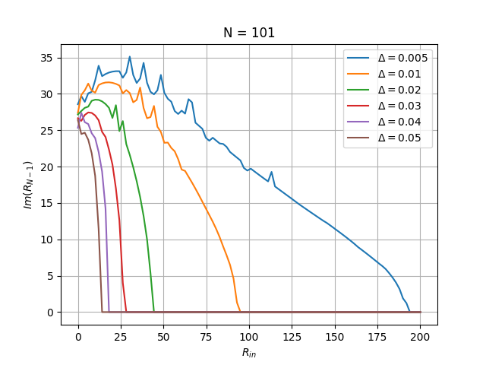
Finding $R_{in}$
Boundary equation:
Looking at $R_{N−1}$:
$Im\left(R_{N−1}\right)=0$
$$R_{N−1}$$
Notes:
If we can somehow find the initial radius we can then compute through the recursive formulas all the other parameters.
There are a few options. First we look at the boundary equation which can be derived from the recursive formulas. This method was given up on, because it was unstable in the first iterations of the package.
The second method could be by solving the equation Im(R_N-1)=0. The issue here is that this equation holds for all R greater than R_in and as we can see the gradiend is almost infinite near the solution. Thus the root finding algorithms struggle.

Slide 8
Bounce action and Derrick‘s theorem
Notes:
The third option that is used in both FindBounce and PyBounce is to use Derrick‘s theorem.
With Derrick‘s theorem, which I will not go into detail, we can derive this equation, which we solve to find the initial radius.

Slide 9
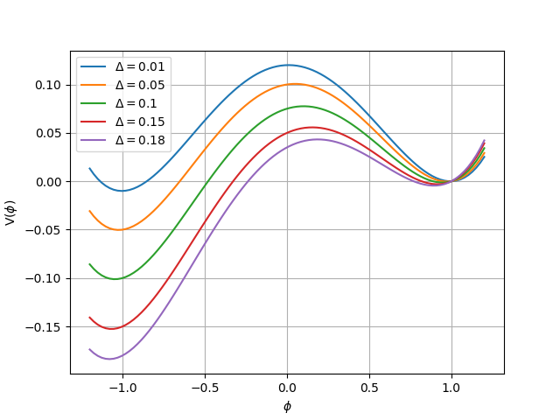
The test potential
Simple: Only one parameter
Large Δ → Inflection
Small Δ → Degeneration
Notes:
To test PyBounce I use the simple potential, with only one changing parameter, delta.
As delta gets larger we approach the inflection point, and as it gets smaller we approach the degeneration point or the thin wall limit.
The end goal ofcourse is to make PyBounce work with any metastable potential.

Slide 10
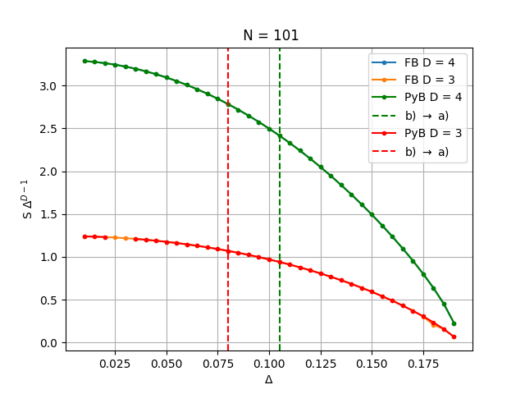
Comparing FindBounce and PyBounce
Notes:
Here we compare the two packages by using the quantity S*\Delta^(D-1).
This plot depicts the Single Field Bounce accross the whole domain.
This means from the thin wall limit, to the point where the false vacuum minimum vanishes.
The dashed lines represent the transition from case b) to case a).
And as we can see the calculations from both packages look preety similar. But the differences are visible when we zoom in.

Slide 11
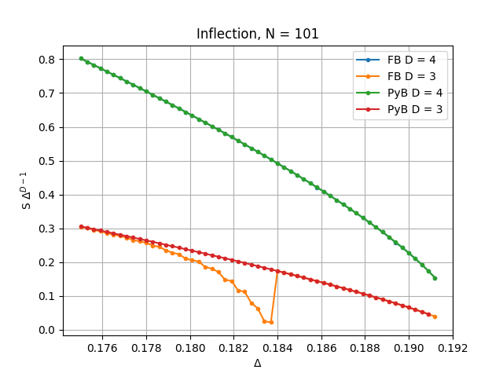
Close to the inflection point
Point at which the false vacuum dissapears
Notes:
FindBounce struggles at D=3 and exerts weird behaviour which needs to be researched further, but is likely due to some index error.

Slide 12
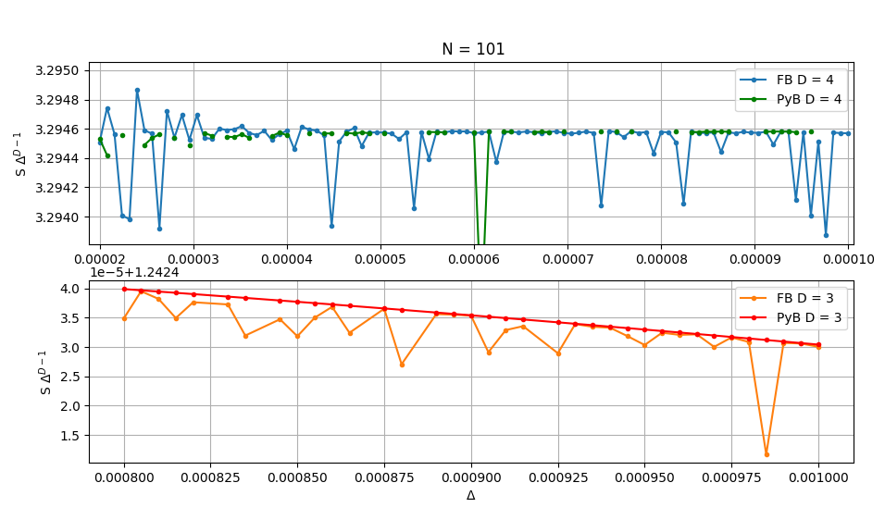
Close to the degeneration point
Numerical fluctuations, due to floating point precission
Notes:
Here the algorithms start to break down, because there is a limit to the floating point precission. Thus when trying to multiply extreemly large numbers with extreemly small numbers we get a large error.
FindBounce really starts to strugle with D=3 that is why its plotted from 0.0008. Here we can also se PyBounce performing better than FindBounce.
In D=4 however the plot might be missleading because it seem as if the PyBounce predictions are more contained, but if we look closer we see that some points were not even calculated due to errors.

Slide 13
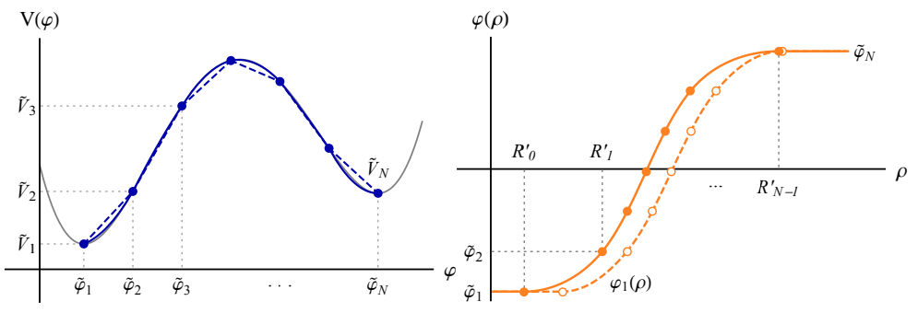
Extended Bounce
Second order pertrubation
Almost complete
FindBounce uses numerical root finding algorithms for finding $r_{0}$
$r_{0}$ can be calculated anallytically or implemented differently, which could mean shorter runtime

Slide 14
To be added
Extended bounce
Multifield bounce
Code generalization

