Slide 1
ATLAS High Granularity Timing Detector and Production Activities at F9
Bojan Hiti
Jožef Stefan Institute
Seminar, February 2024

Slide 2
Outline
Part 1: ATLAS-HGTD at HL-LHC
HL-LHC and motivation for ATLAS-HGTD
HGTD detector components
LGAD Sensors
Readout chip
Integration into experiment
Part 2: ATLAS-HGTD production activities at JSI F9
Sensor Process Quality Control
Sensor Irradiation Tests
Production of Flex Tail circuits

Slide 3
Part 1: ATLAS-HGTD at HL-LHC

Slide 4
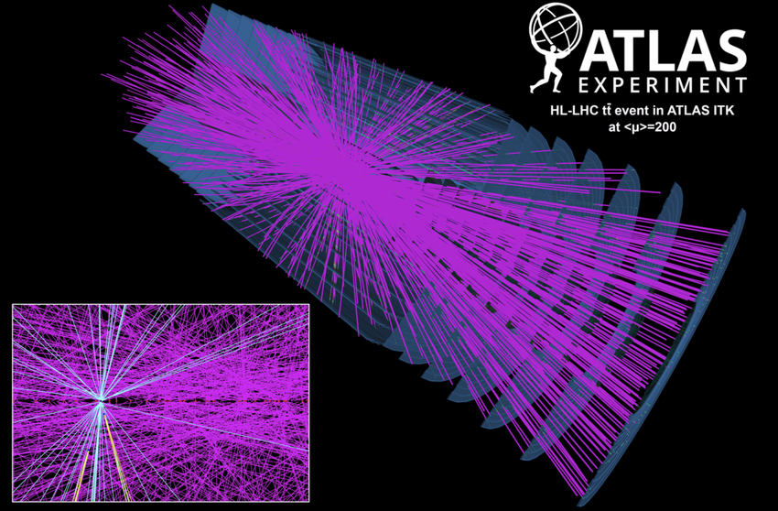
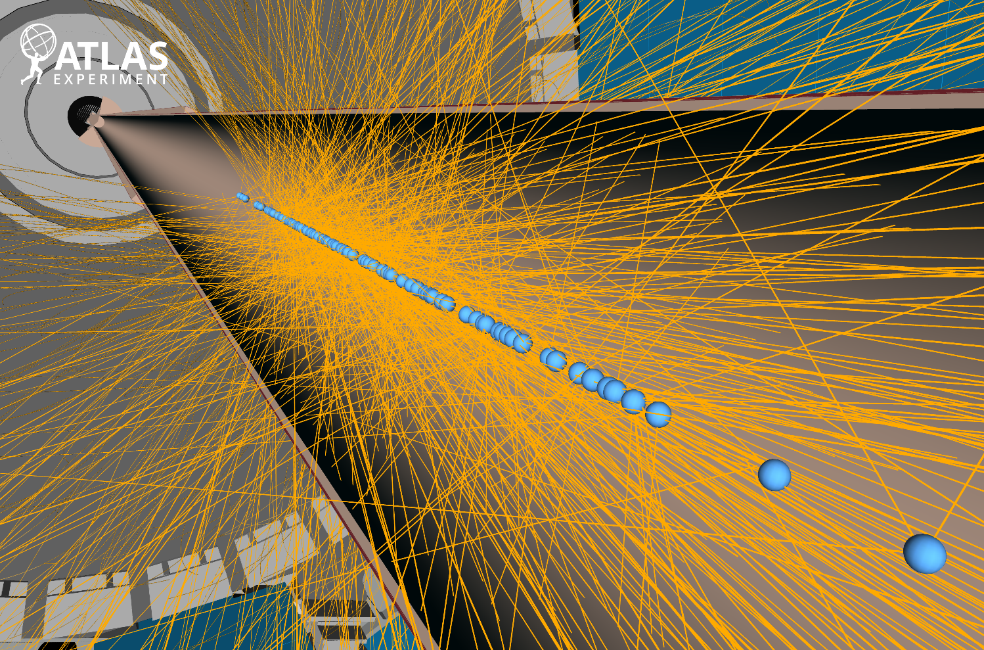
High Luminosity LHC (HL-LHC)
schedule updated January 2022
Collisions within
30–60 mm
175–260 ps
ATLAS experiment pileup:
LHC run 3: <μ> = 40
HL-LHC: <μ> = 200

Slide 5
ATLAS phase II upgrade
[slide from T. Affolder, Lepton Photon 2021]

Slide 6
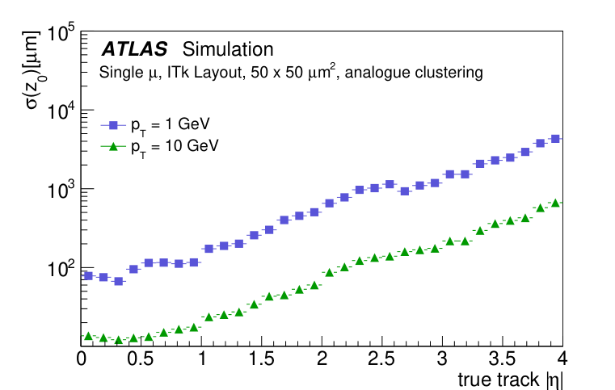
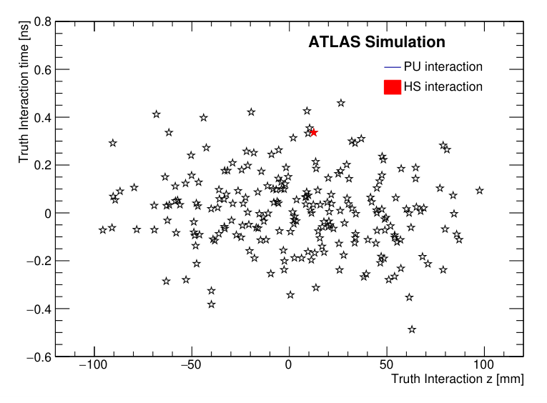
ATLAS High Granularity Timing Detector
Pile-up a big experimental challenge at HL-LHC
At <μ> = 200 most probable pile-up density 1.44 vertices/mm → vertex spacing 0.6 mm
New tracker ATLAS ITk alone not sufficient for vertex separation in forward direction
ATLAS High Granularity Timing Detector (HGTD)
Track time information, resolution 50 ps
In addition luminosity measurement by particle counting (target 1 % precision)
z₀ resolution with ITk only
σ = 50 ps
600 μm
HGTD
ITk

Slide 7
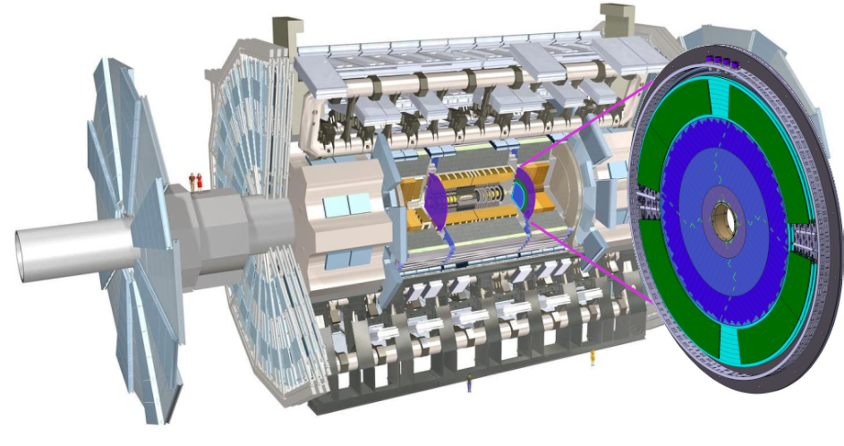
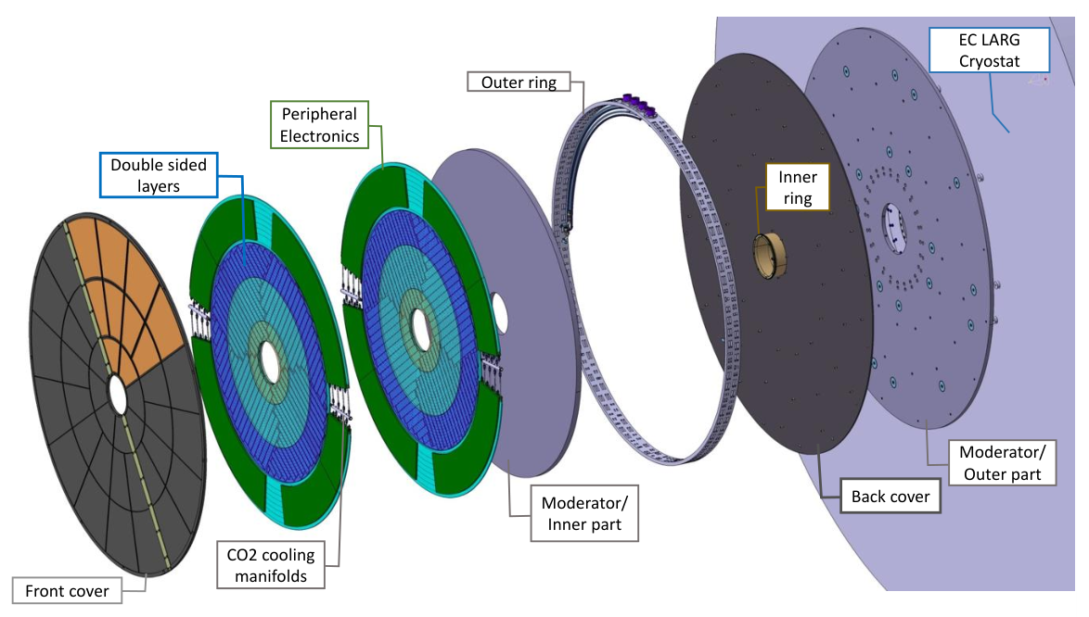
ATLAS HGTD basic information
active region
12 cm < r < 64 cm
Two double sided instrumented layers
(= 4 sensor layers)
location between barrel and endcap calorimeters
Rapidity coverage | 2.4 < |η|< 4.0
Position in z | ± 3.5 m
Number of channels | 3.6 M
Pad size | 1.3 mm × 1.3 mm
Operating temperature | –30 °C (CO₂)
Time resolution (beginning) | 30 ps
Time resolution (End-Of-Life) | 50 ps
total thickness 75 mm

Slide 8
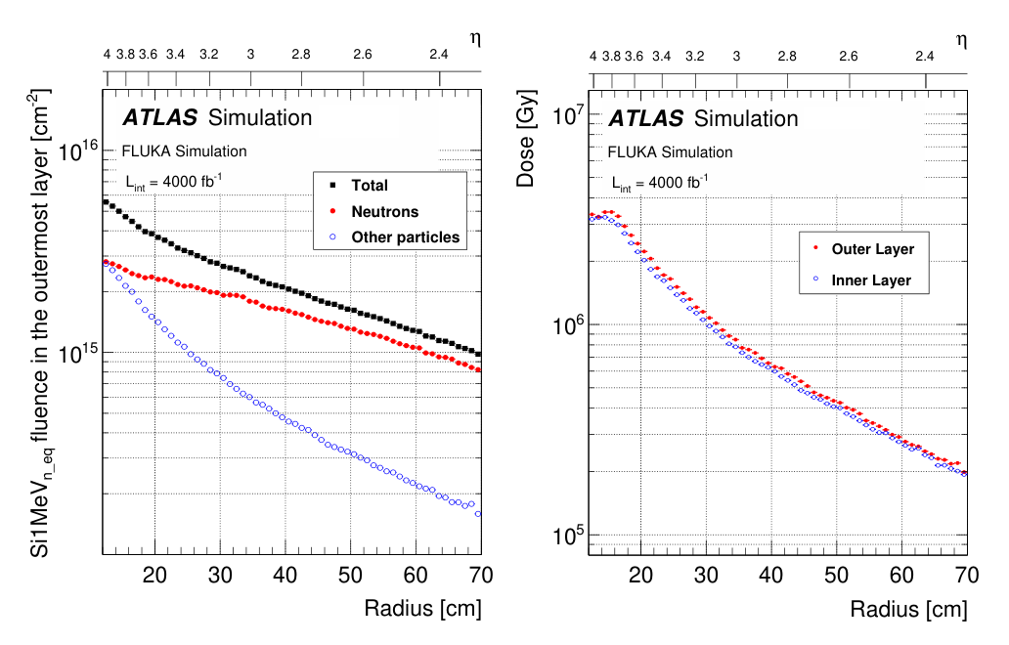
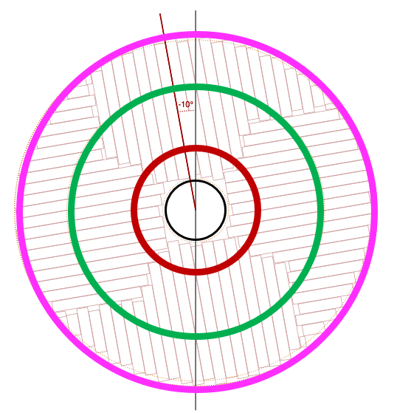
HGTD Radiation Environment
Radiation damage in HGTD after 4000 fb⁻¹ up to 8.3e15 n_{eq} cm⁻², 7.5 MGy (including safety factors)
HGTD designed for End-of-Life (EOL) fluence 2.5 × 10¹⁵ n_{eq} cm⁻², TID 2 MGy → detector replacements planned
Segmentation in three concentric rings:
Inner ring (r ≤ 230 mm) replaced every 1000 fb⁻¹
Middle ring (r < 470 mm) replaced at 2000 fb⁻¹
Outer ring (r < 640 mm) will not be replaced
1
2
3

Slide 9
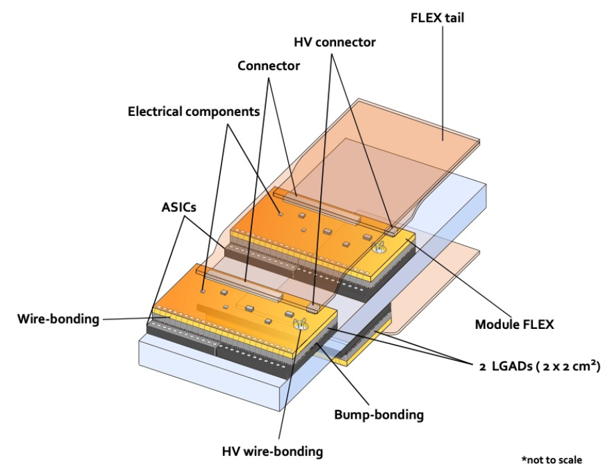
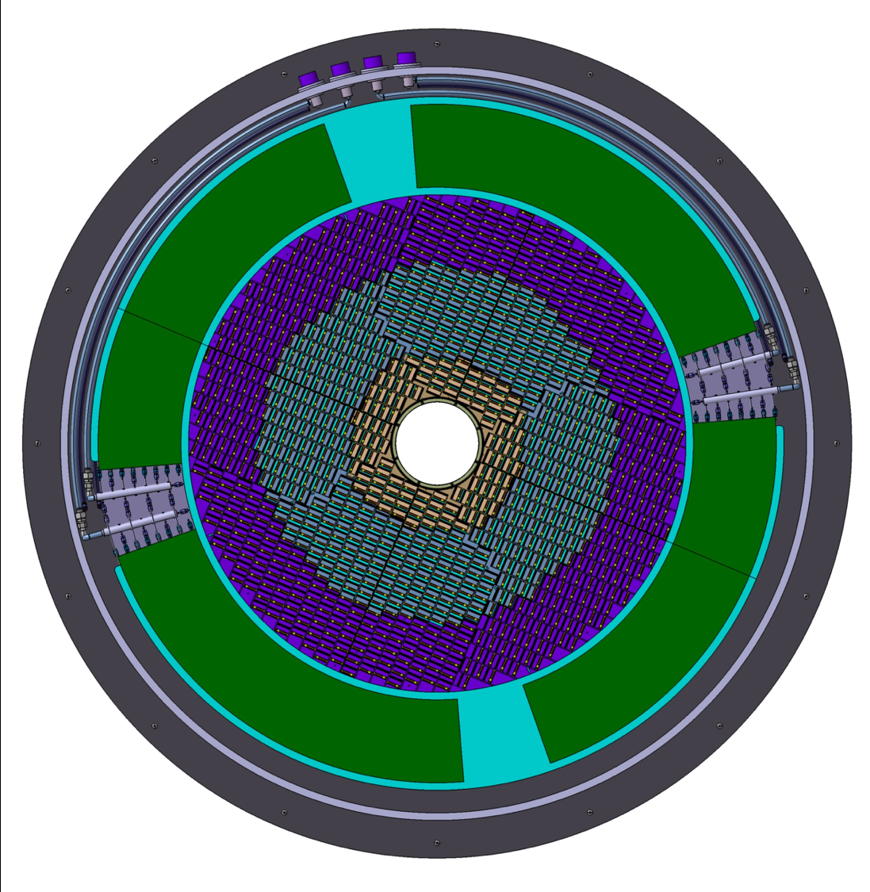
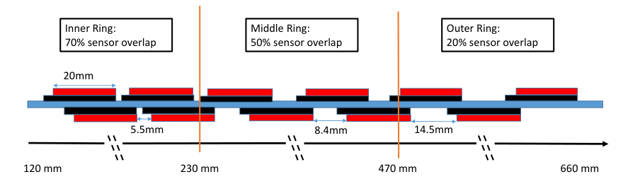
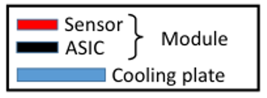
HGTD Modules
Module = two single-chip Hybrids (sensor + readout chip) connected to the same flex PCB (Module Flex)
Total dimension 2 cm × 4 cm
15 × 30 channels (15 × 15 per hybrid), 1.3 mm × 1.3 mm channel size
Total of 8032 modules
Rows of hybrids connected via Flex Tails to the Peripheral Electronics Boards (PEB) @ 660 < r < 920 mm
Module overlap optimized on each ring, ensure 2–3 hits per track
modules
PEB

Slide 10
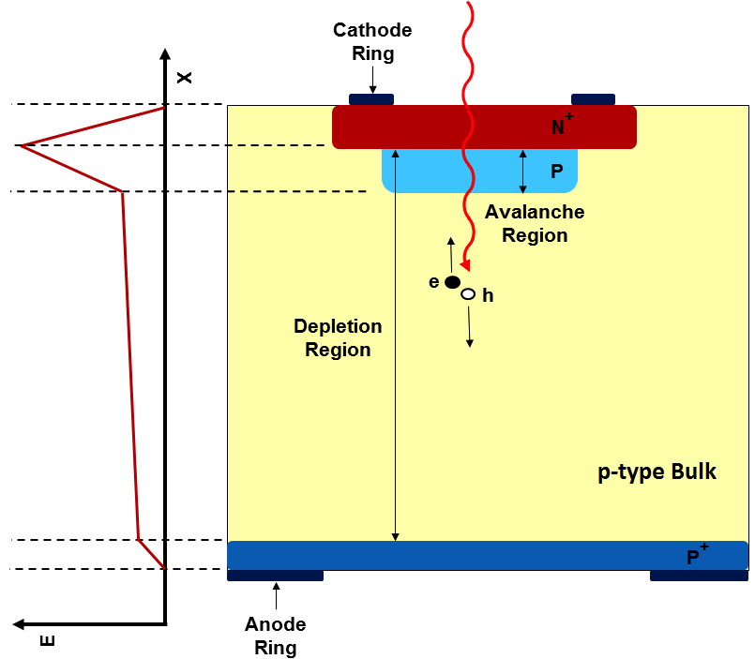
HGTD Sensors: Low Gain Avalanche Detector (LGAD)
Hit time resolution $σ_{hit}$≤ 70 ps per layer is required - beyond standard HEP devices
$σ_{track}=σ_{hit}/\sqrt{N_{hits}}$
Low Gain Avalanche Detector (LGAD) – new silicon sensor technology pioneered by CNM Barcelona and CERN-RD50
n-on-p silicon sensor with additional p⁺ Gain Layer
Charge multiplication by impact ionization – improved Signal-to-Noise
Operation in linear regime with typical gain factor 10–20
Active sensor thickness 50 μm, physical thickness of silicon 300 μm
[G. Pellegrini, G. Kramberger et al.: Technology developments and first measurements of Low Gain Avalanche Detectors (LGAD) for high energy physics applications, NIM A, 2014]
${σ_{det}}^{2}=σ_{Landau}^{2}+σ_{elec}^{2}$+ $σ_{clock}^{2}$
$σ$_{Landau} .. non uniform charge deposition by MIP (limit 25 ps in 50 μm thick sensors)
$σ$_{Elec} .. due to readout electronics (25 ps/70 ps – start of HL-LHC/4000 fb⁻¹) $σ$_{Clock} .. due to LHC clock jitter (15 ps)

Slide 11
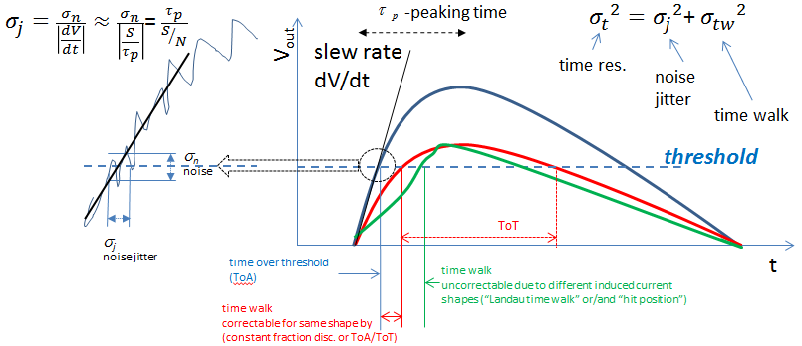
Why gain?
To minimize noise jitter fast signals with high Signal-to-Noise ratio are required
LGAD requirements for HGTD: 4 fC collected charge after 2.5e15
50 ps LGAD time resolution
To minimize Landau fluctuation contribution need thin detectors
→but less signal, need Gain
1 fc = 6250 e⁻

Slide 12
LGAD radiation effects
LGAD internal gain vital for a good time resolution
Impact ionization increases exponentially with electric field in gain layer → LGAD performance critically depends on voltage drop in Gain Layer
Displacement damage by irradiation reduces effective doping concentration in p-type silicon
Acceptor removal: electrically active Boron gets deactivated by formation of the B_{i}O_{i} defect → N_{B}, V_{gl} reduces
Larger bias voltage needed to sustain the same E-field/Gain → but physical limits
Defect engineering to improve radiation hardness
Carbon coimplantation to screen Boron in the lattice → slower removal
10s of Volts
From sensor overdepletion
100s of Volts
$$V_{gl}=\frac{e_{0}w^{2}}{2εε_{Si}}N_{B}$$
$$E_{gain layer}≈\frac{V_{gl}}{w}+\frac{V_{od}}{d}$$
V_{gl} .. gain layer depletion voltage
→depends on Gain Layer doping N_{B}
N_{b} .. effective acceptor concentration
w .. gain layer thickness (1–2 μm)
d .. active device thickness (50 μm)

Slide 13
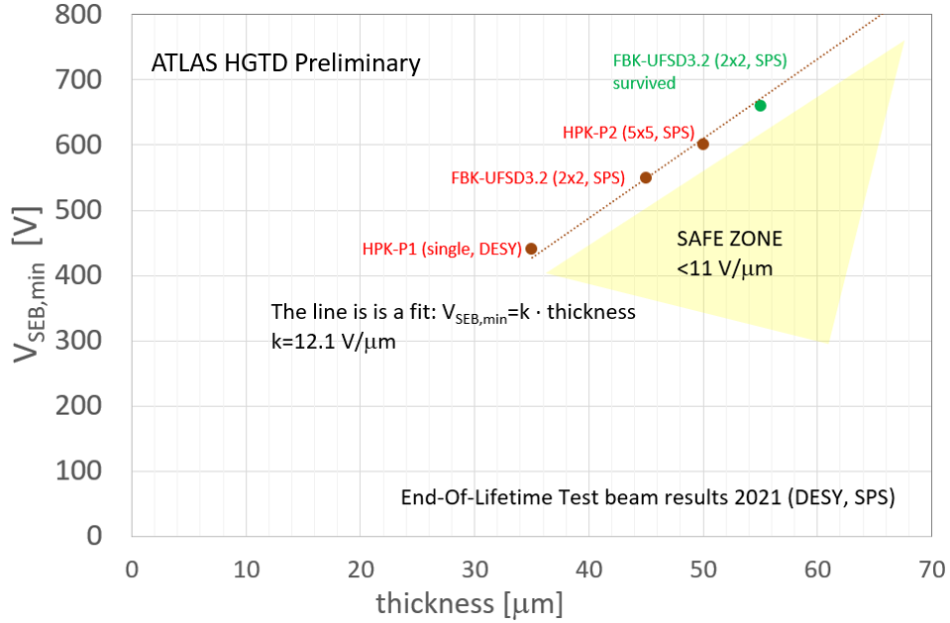
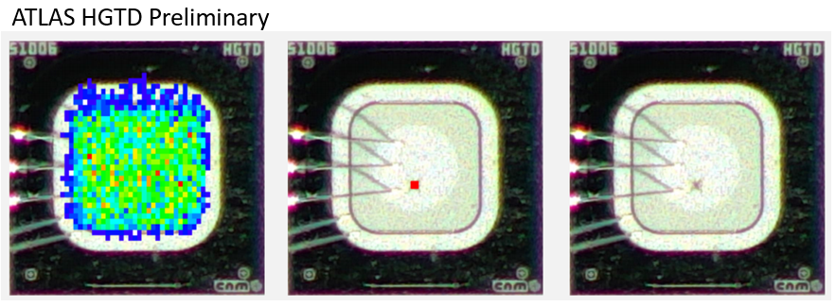
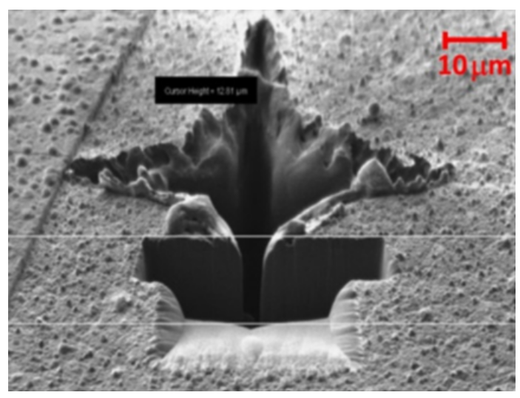
LGAD Single Event Burnout (SEB)
Single Event Burnout – Catastrophic failure in highly irradiated LGAD devices
Caused in particle beam by rare events with massive charge deposition (10s MeV)
Localized destructive electrical breakdown, “crater”
Threshold at average electric field in LGAD exceeding 11 V/µm (550 V for 50 µm thick devices)
“Natural limit” for LGAD radiation hardness
Cannot further increase bias voltage to mitigate gain loss due to radiation damage

Slide 14
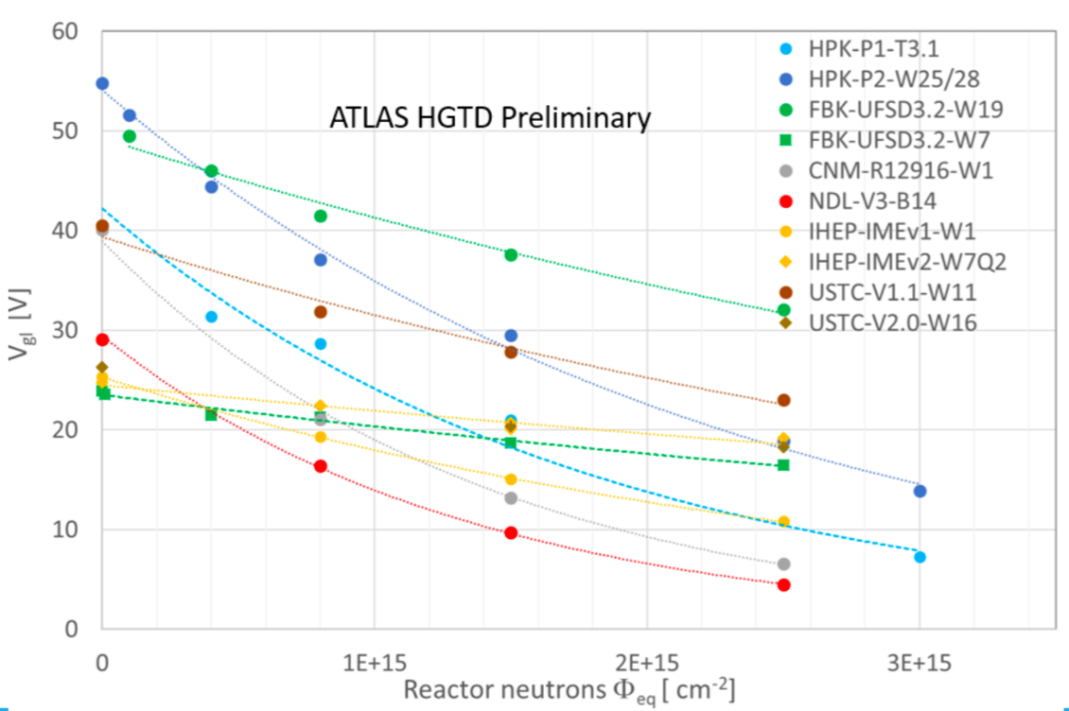
LGAD radiation hardness
Since 2014 extensive R&D program for development and optimization of LGAD devices for HL-LHC
Evaluated prototypes from 5+ manufacturers
Carbon enriched designs meet HGTD radiation hardness specifications
For HGTD production selected two Chinese designs:
IHEP-IME (Beijing, China)
USTC-IME (Hefei, China)
LGAD sensor preproduction started in 2023

Slide 15
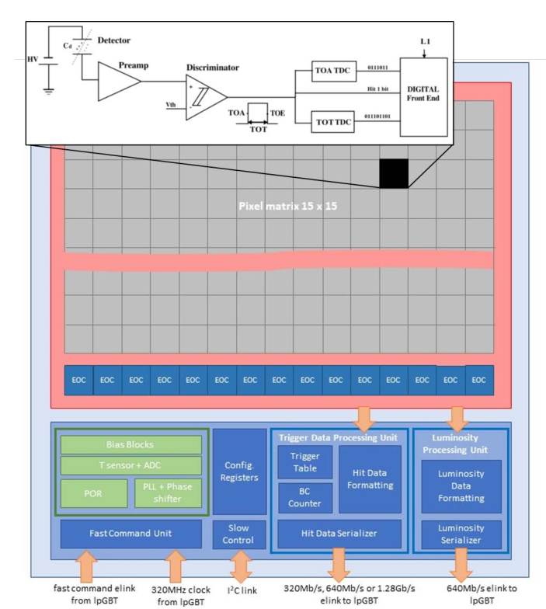
ALTIROC: HGTD readout chip
ASIC produced in 130 nm CMOS process by TSMC (radhard)
Pixel chip with low number of channels optimized for timing
Small jitter: 25 ps at 10 fC (< 70 ps at 4 fC)
2 fC minimum discriminator threshold
Time-to-Digital Converters (TDC) for measurements of
Time of Arrival, w.r.t. LHC clock
Time over Threshold, for time walk correction using constant fraction discrimination
Development status
ALTIROC 0 & 1: small prototypes for analog front end tests
ALTIROC 2: First full size prototype (15 × 15 pixels) with full electronic chain
ALTIROC 3: Current version, performance up to specifications on testbench and after irradiation
ALTIROC A: Planned production version, minor fixes to ALTIROC 3 design, planned submission February 2024

Slide 16
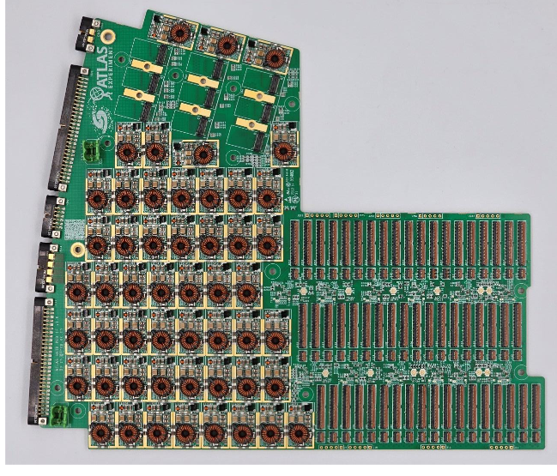
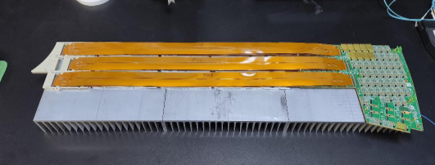
Peripheral Electronics Board (PEB)
Circuit for distribution of services & control to modules, data aggregation and optical links
Located at 660 < r < 920 mm
“The most complex electrical circuit of high energy physics”
Up to 9 groups with 12 lpGBTs, 52 Bpol12v, support up to 55 front-end modules per PCB
22 layer PCB, Micro-via size down to 0.1 mm – difficult manufacturing

Slide 17
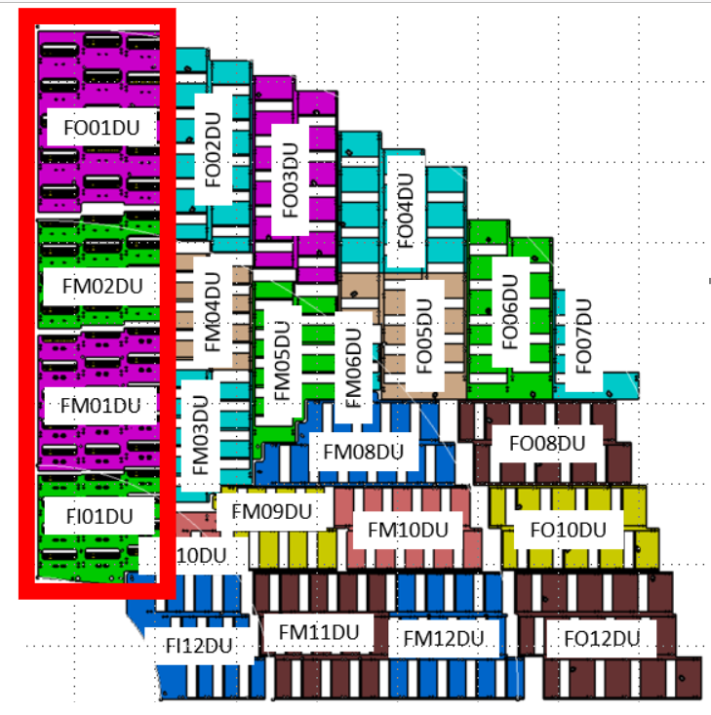
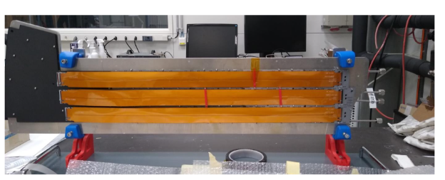
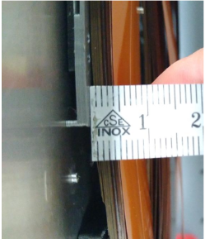
HGTD module and detector assembly
Module Production: Hybridization → Flex gluing →Metrology → Wire bonding → Module testing
6 assembly sites – Europe, Morocco, China
10s of Modules grouped into Detector Units – mechanical support and cooling
24 Detector Units per quarter disk
Flex tails to connect modules with Peripheral Electronic Boards
54-Module Demonstrator being assembled at CERN
Two out of four Detector Units delivered

Slide 18
HGTD production timeline
Feb 2024
Sensors
Hybridization
ALTIROC
Modules
Module Flex
Detector Units
Support Units
prepared for installation
Fall 2026
Spring 2027
Flex Tails
HGTD A
HGTD C
PEB

Slide 19
Part 2: ATLAS-HGTD at F9

Slide 20
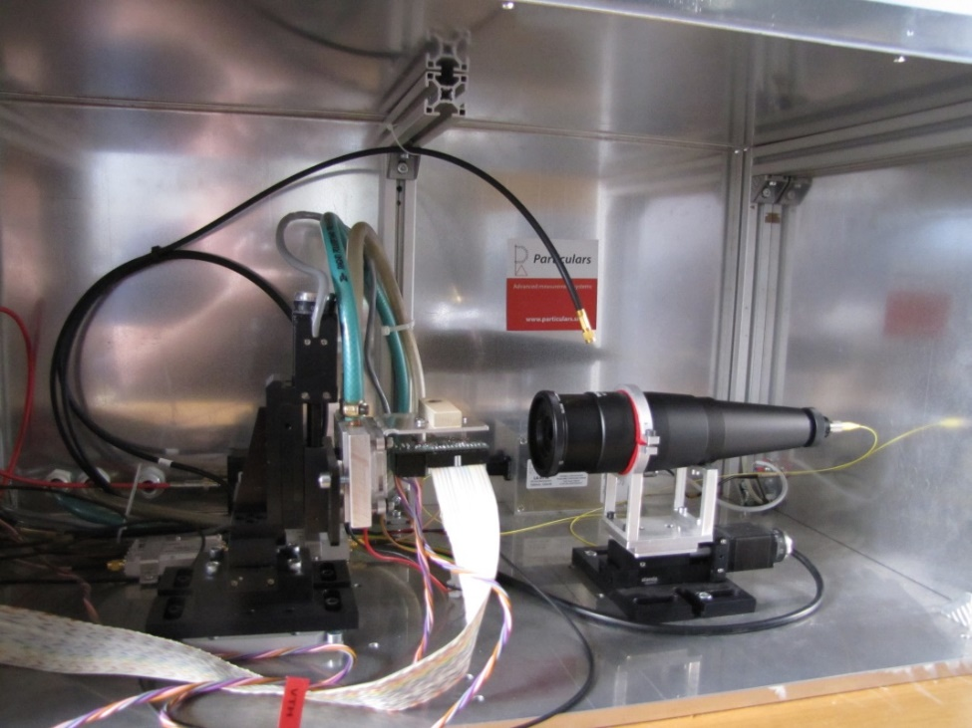
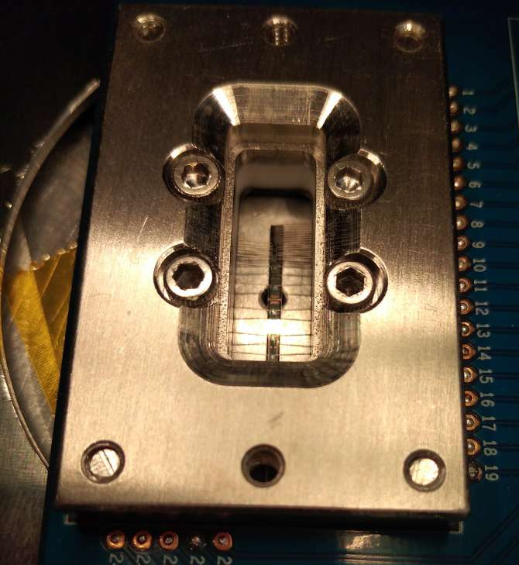
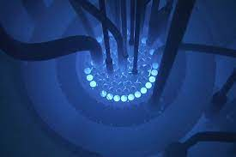
ATLAS HGTD at F9 – 3 activities
Current HGTD team:
G. Kramberger, B. Hiti, I. Velkovska, J. Debevc, M. Terglav
Past Members:
A. Howard, Ž. Kljun, L. Potočnik
2 Sensor Irradiation Tests
3 Flex tail production
1 Process Quality Control

Slide 21
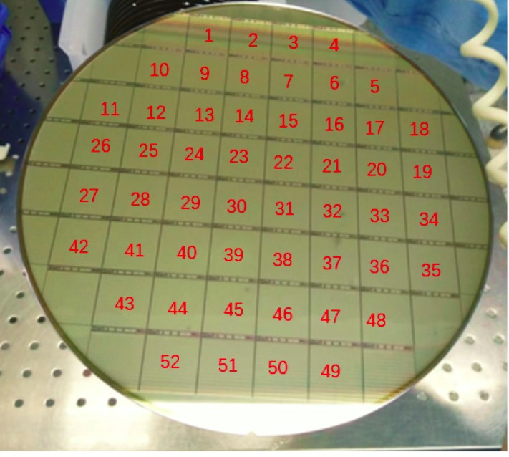
HGTD Production Sensor & QCTS
> 21.000 good Sensors (≈ 1000 wafers) will be required for HGTD
Produced on 8-inch wafers
90 % IHEP-IME design, 10 % USTC-IME design
Each wafer holds 52 Main Sensors (15×15, 2×2 cm)
Dedicated Quality Control Test Structure (QCTS) adjacent to each Main Sensor
Used for Quality Control throughout production
Current status of HGTD preproduction (5 % of total):
7 wafers distributed for preliminary testing
130+ wafers in last stages of processing (UBM deposition)
5 sites involved in sensor Quality Control testing:
IHEP (China), USTC (China), CERN, Sao Paulo (Brazil), JSI
main 15 x 15 sensor
QCTS

Slide 22
F9 HGTD Process Quality Control
Standardized monitoring of sensor properties on each wafer via QCTS
Check if manufacturing process parameters within specification – PQC
Probe card (30 needle) used to contact all structures simultaneously
Automated electrical test performed
Baseline: PQC with unirradiated samples from each wafer
Main test sites are Sao Paulo (also DAQ development) and CERN
JSI is backup site in case of problems
Jernej Debevc working on setup commissioning
Gate Controlled Diodes
- Surface currents
MOS Capacitor
- SiO₂ properties
PIN diode
- Si bulk properties
1 x 1 LGAD, 1 x 2 LGAD
- LGAD performance
Van der Pauw structures
- Resistivity measurement

Slide 23
F9 HGTD Irradiation Tests
Irradiation Tests (IT) to monitor sensor radiation hardness throughout production
LGAD radiation hardness very sensitive to manufacturing variations (1 % variation in [B] makes a difference)
Neutron irradiation at JSI TRIGA reactor and performance characterization at JSI → JSI is the main test site
Run 1–2 tests on each wafer (total ≈ 1000 tests)
Must be fast and well understood – new TCT method developed
Wafer acceptance criteria – will be based on statistics from multiple samples
Goals:
Check that sensor performance within specifications after EOL fluence of 2.5 × 10¹⁵ n_{eq} cm⁻² (4 fC @ 550 V, 50 ps)
Also group similar wafers for building modules (in ATLAS two sensors will share same high voltage)
Samples tested in HGTD preproduction:
5 + 2 wafers (IHEP + USTC)
Neutron fluences 4e14 – 3.5e15 n_{eq} cm⁻², annealing 80 min at 60° C
Some samples irradiated above EOL fluence to ensure they fail IT
IT in scope of ATLAS Qualification Task by Iskra Velkovska, measurements also by student Matic Terglav

Slide 24
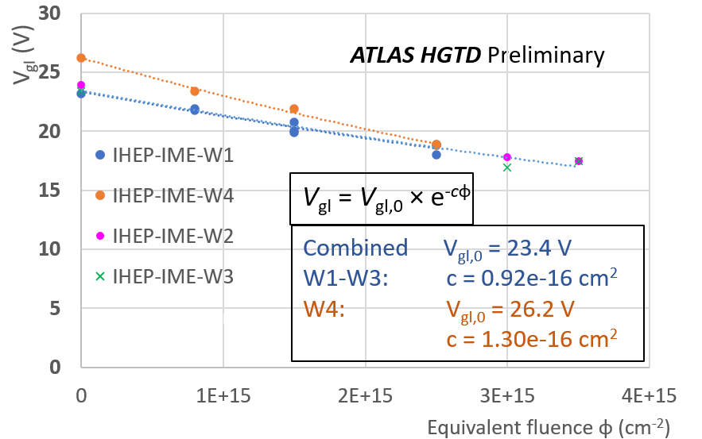
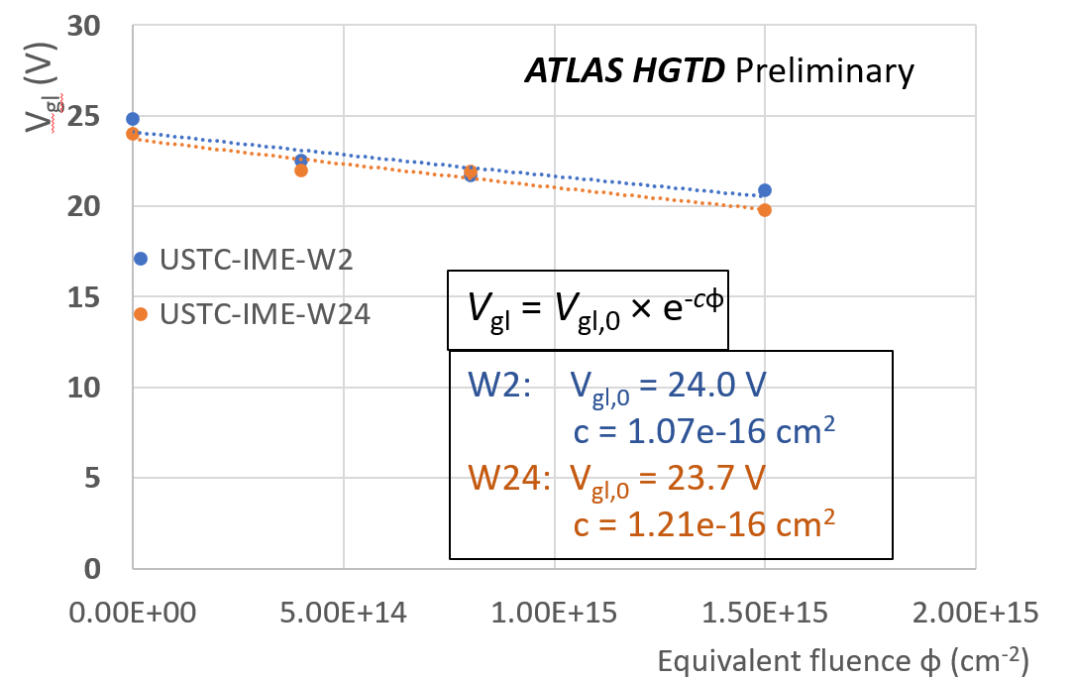
CV: Acceptor removal parameter
IHEP-IME
USTC-IME
CV: Acceptor removal parameter c in all IHEP-IME and USTC-IME wafers is around 1e-16 cm⁻² (slight differences)
Promising result in terms of acceptor removal → indicates good radiation hardness

Slide 25
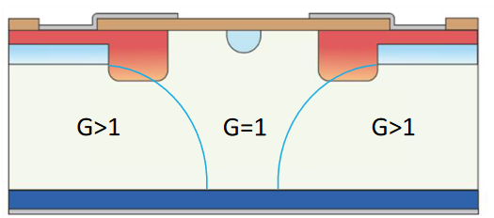
IT – TCT test method
Particulars setup
New laser TCT based test method developed for IT
Charge collection measurement with a focused infrared laser
Top-TCT, room temperature
Test structure 1 × 2 LGAD on QCTS
Interpad region: LGAD–PIN–LGAD
No gain in interpad region – PIN diode (= standard silicon pad sensor)
Measure LGAD performance and calibrate it against PIN
scan direction
laser beam (FWHM 10 µm)
optical window for laser beam

Slide 26
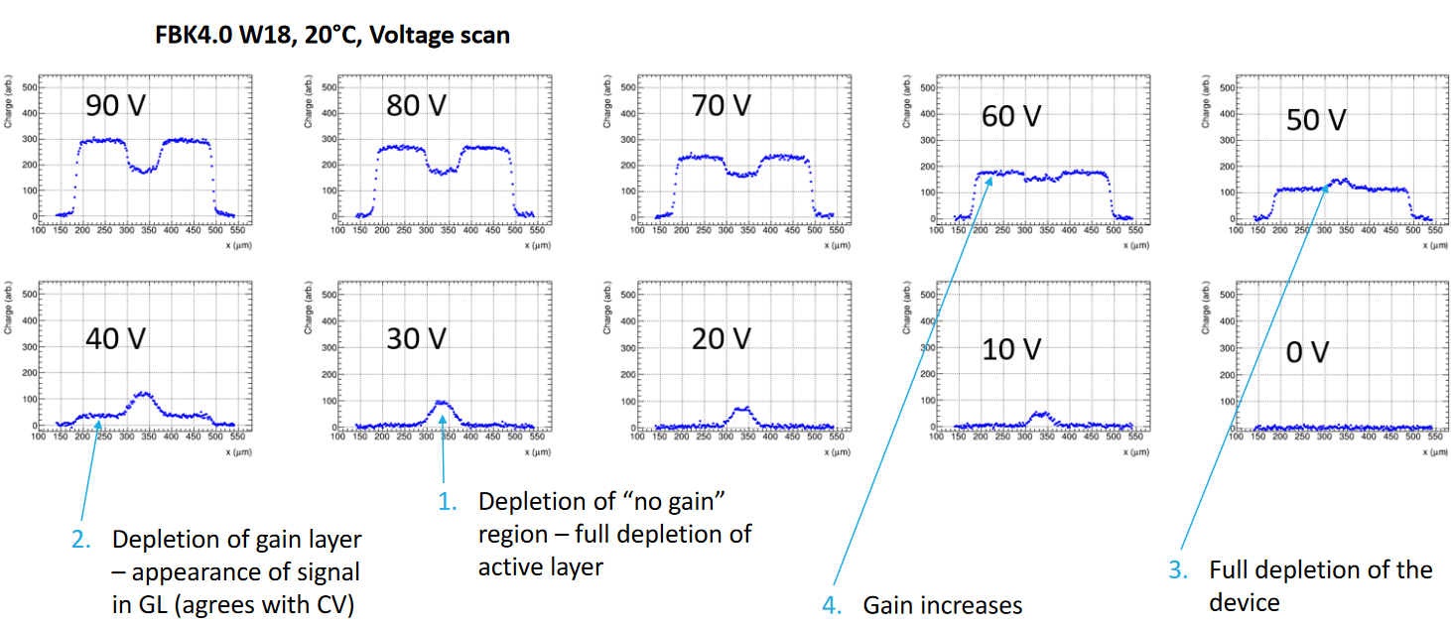
TCT-IT concept
both LGADs connected to same readout channel
LGAD1
LGAD2
GAP
Slide taken from P. Skomina, 42nd RD50 Workshop

Slide 27
TCT-IT method
Measure collected charge as a function of voltage in LGADs and PIN and determine:
Gain layer depletion voltage V_{gl} – onset of observable signal
Sensor depletion voltage V_{fd} – end of sharp signal increase
Gain vs. bias voltage A – ratio of LGAD and PIN collected charge
Interpad distance – between both LGADs
Leakage current
These parameters are used to qualify sensor performance/radiation hardness
Indirect method – calibration against other methods
scan direction
beam direction
LGAD1
LGAD2
Collected charge (a.u.)
V_{bias} = 100 V
PIN
charge = signal integral [0, 3 ns]

Slide 28
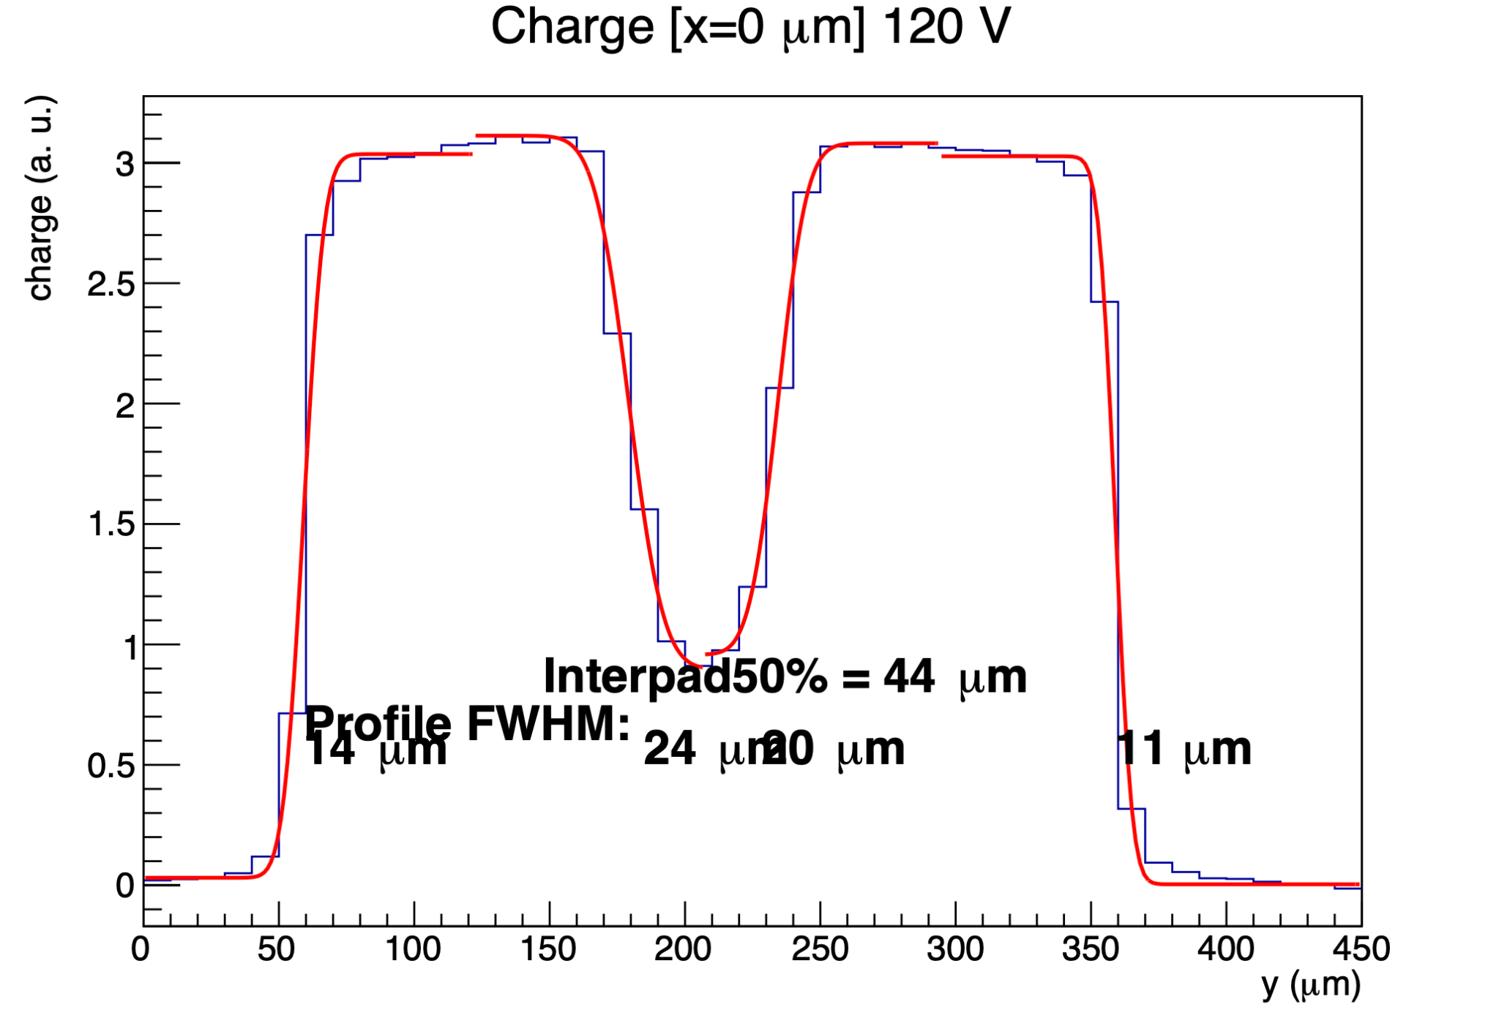
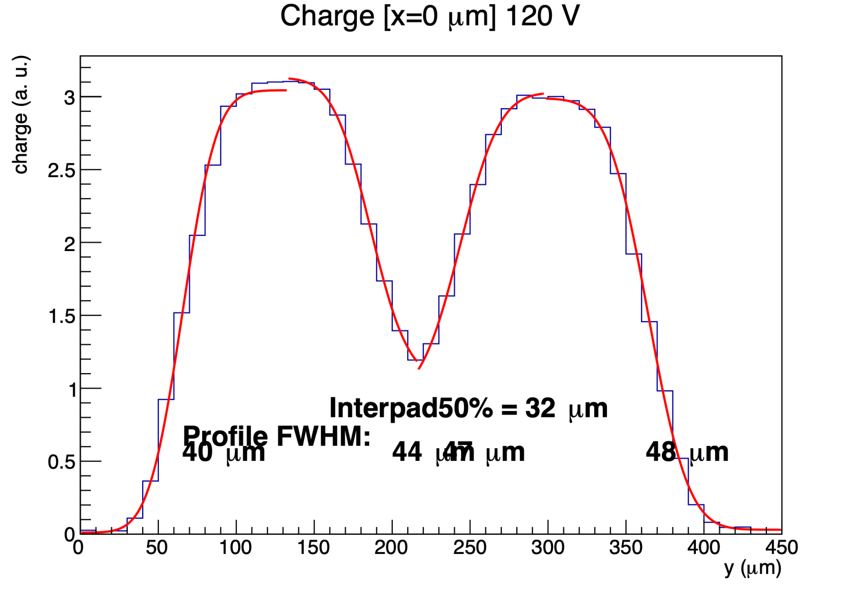
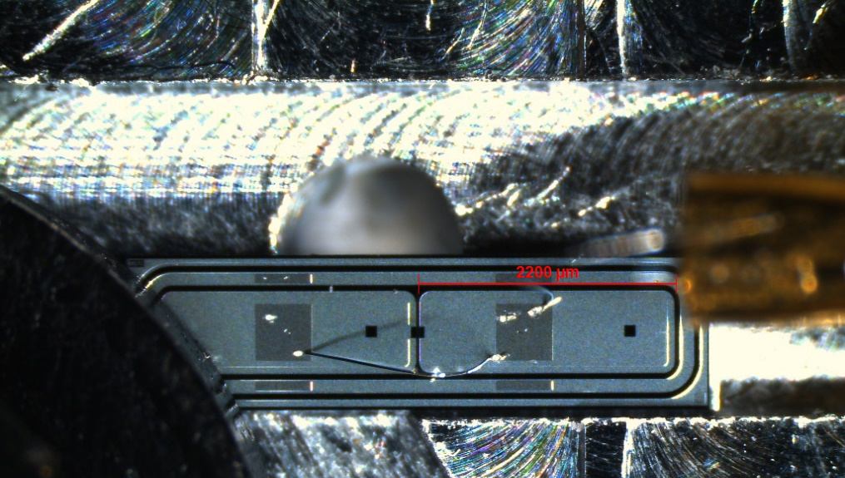
TCT-IT Quality of Life improvements
Sample in focus
Sample out of focus
Sample placement: dedicated Al holder with a groove for precise placement
Precise orientation and known position (simpler & faster measurement preparation)
degraded charge measurement in PIN
Fixing screw
+
Rubber washer
Data quality test Automated check that sample is in beam focus
scan direction
groove
Automated analysis scripts and uploading of results in CERN production database

Slide 29
TCT-IT Results: V_{gl}
V_{gl} as a function of fluence for different wafers
Falling consistently with fluence (acceptor removal)
Clear separation between fluences – good sensitivity
Results reasonably consistent between wafers
USTC-IME samples do not follow the trend of IHEP-IME
Data comes from first measurements during method commissioning – learning curve
More statistics required when samples available

Slide 30
TCT-IT Results: Gain
0e14
13 - 20
LGAD Gain at 100 V (= fixed voltage)
Falling consistently with fluence (due to smaller V_{gl})
Relatively good separation between fluences – sensitivity
More statistics needed for fluences ≥ 2.5e15 to determine measurement uncertainty
More statistics required, especially with USTC-IME

Slide 31
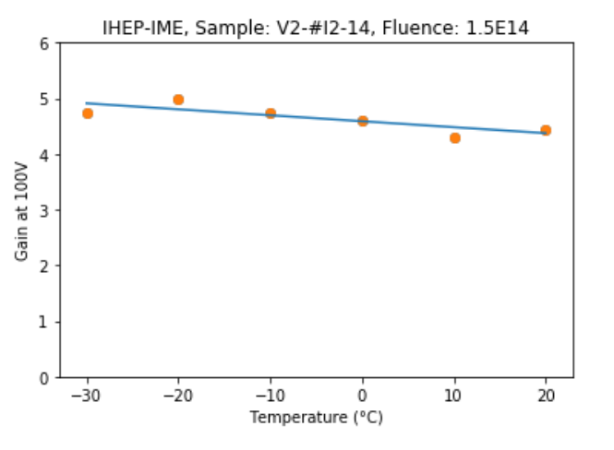
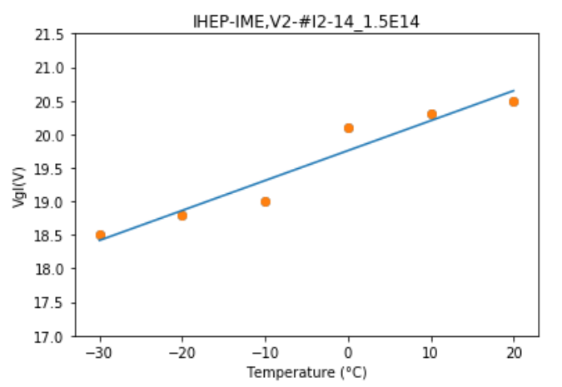
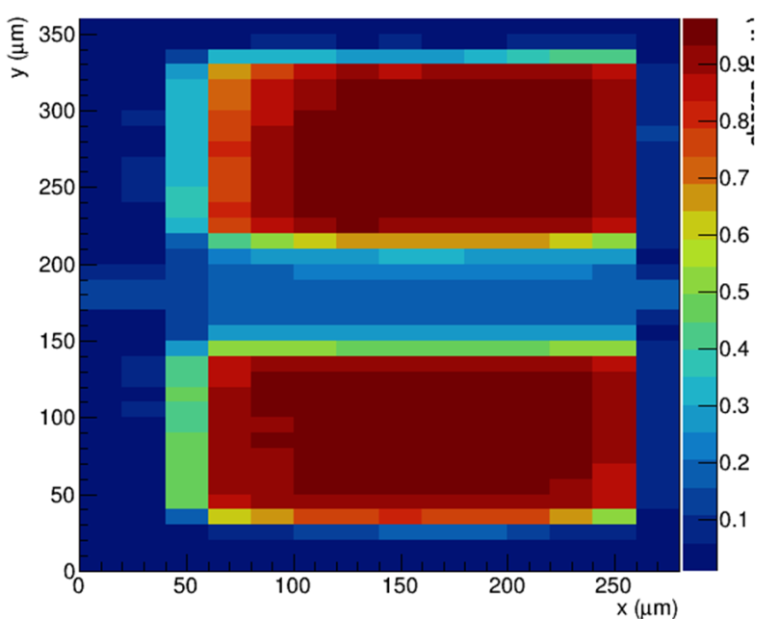
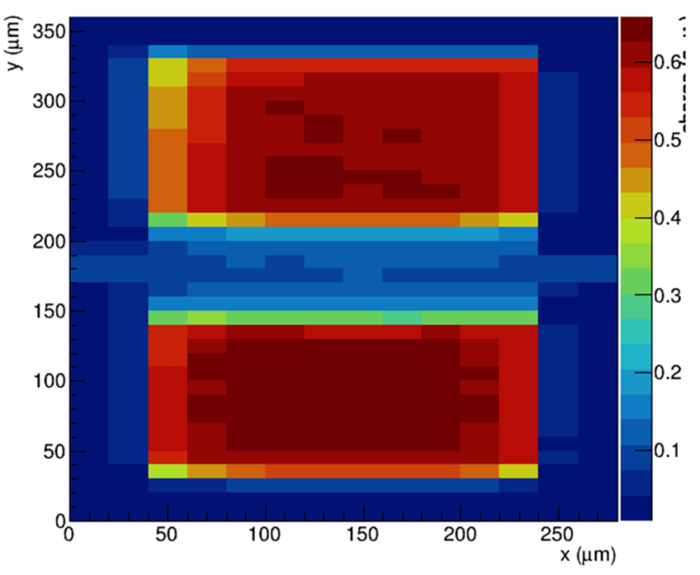
IT: systematic effects
Extensive setup validation studies during TCT-IT commissioning to evaluate systematic effects
No nasty systematic effects found
Reproducibility (3× same test)
Temperature dependence [-30°C, 20°C]
Sample | T (K) | Vgl (V) | Gain at 100 V
V1R2-21_1.5e15 | 293 | 18.1 / 18.2 | 4.2/4.1
 |  | 18.3 / 18.3 | 4.1/4.2
 |  | 18.4 / 18.4 | 4.2/4.2
Gain @ 100 V
Mechanical shifts with temperature
20 °C
-30 °C
Vgl (V)
LGAD2
gap
LGAD1

Slide 32
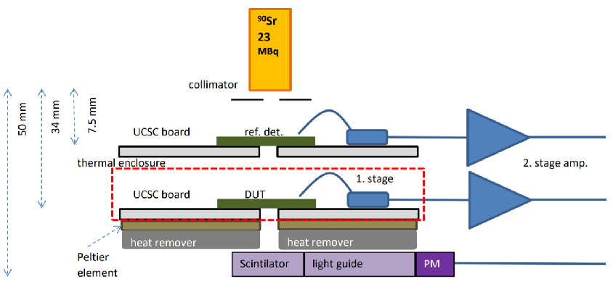
⁹⁰Sr measurements
TCT-IT not directly measuring MIP charge and time resolution
Charge Collection and Time Resolution measured with Sr90 and used for TCT-IT calibration
Sr90 is a pure β emitter – laboratory MIP source
Setup with two LGADs (time reference and DUT)
DUT cooled to –30° C
Trigger on reference LGAD + PMT (“MIP” selection)
DUT not part of the trigger
Up to 2 measurements per day, relatively time consuming
In production will only be used for diagnostics of problematic wafers / occasional calibration

Slide 33
Sr90 results: charge and time resolution
operational regime outside specifications (4 fC, 50 ps, 550 V)
Results between wafers and manufacturers very similar (do not see the discrepancy from TCT-IT)
Same sample measured first at JSI, then IHEP → excellent agreement
HGTD Preproduction: Collected charge and time resolution well within specifications even at EOL fluence

Slide 34
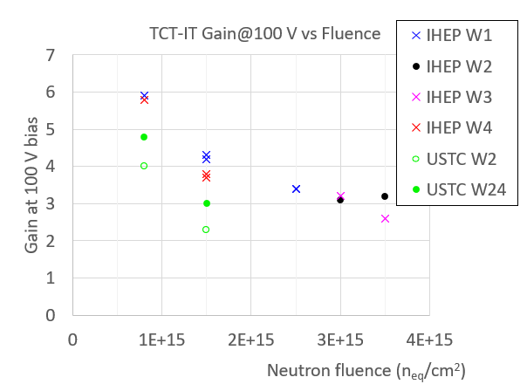
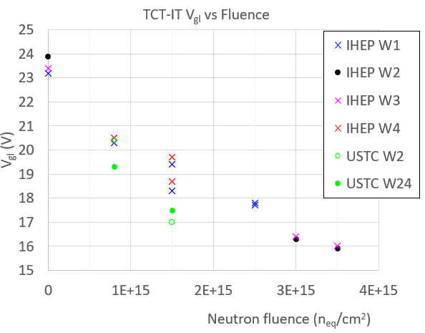
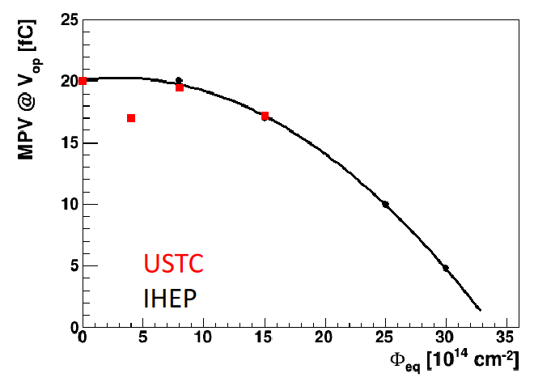
Sr90 results at extreme fluences (3e15, 3.5e15)
Excellent performance of all wafers up to now. How do we know what IT failure will look like?
→ Sample irradiation above EOL fluence: 3e15, 3.5e15 n_{eq}/cm²
Collected charge just above 4 fC at 550 V
This indicates rough acceptance criteria in TCT-IT:
Vgl > 17 V @ 2.5e15 (for IHEP-IME)
Gain(100 V) > 3 @ 2.5e15 (for IHEP-IME)

Slide 35
Outlook: Wafer Acceptance/Rejection process
Predefined Acceptance Criteria
Irradiation to 1.5e15 (2.5e15 ? ),
≈ 5 QCTS/wafer
TCT-IT sample 1
Not OK
TCT-IT sample 2
Not OK
TCT-IT sample 3
Not OK
?
?
?
Wafer rejected
OK
PQC sample 1
OK
Sr90
OK
Predefined Acceptance Criteria
Will constrain parameters (in some yet undefined way*):
V_{gl}, Gain (100 V), I_{leak}, Interpad distance, (Sr90 charge)
*Based on statistical distributions of tested samples, for example 2σ
Wafer accepted
Occasional full (irradiated) sensor test on probe station, compare to specs (Maybe)

Slide 36
ATLAS HGTD Flex Tail production
Flex Tails: lightweight multichannel cables connecting HGTD modules with Peripheral Electronic Boards
Built on Polymide (Kapton) substrate – flexible
Many stacked on top of each other → small thickness
≈ 10,000 pieces, 79 flavors (lengths)
5 cm–70 cm, same connector ends, different body length
JSI has experience with flex cable production for ITk strip endcap modules – collaboration with SLO industry (Elgoline)
Potential for further collaboration in HGTD
Current activity status
HGTD 54-module Demonstrator being built
JSI provided 5 prototype flex cables – work OK
Vendor selection and production orders not yet done

Slide 37
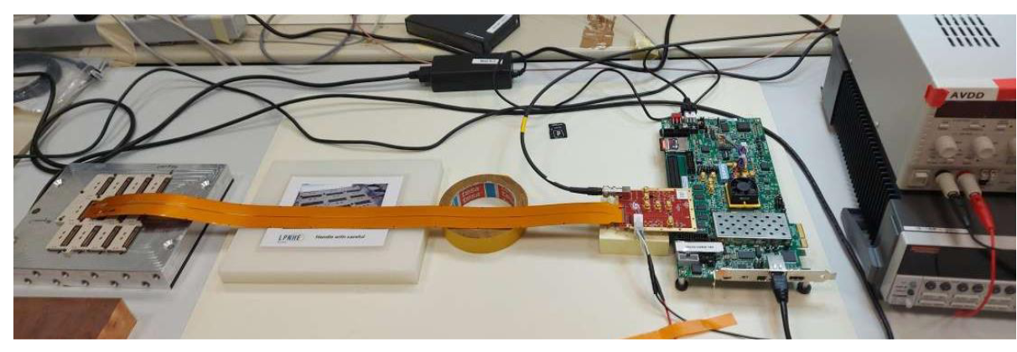
HGTD Flex Tail MoU
JSI to provide:
8.5 % of total Flex Tails
33.3 % of total Flex Tail testing
Irradiation tests
FPGA based test setup copied from Uni Mainz for testing

Slide 38
Summary
ATLAS HGTD for HL-LHC is a step forward in particle detector technology
It will provide:
Precise particle timing information ≤ 50 ps (!)
Bonus: Luminosity measurement (1 %)
LGAD sensors – technology developed in HEP (including JSI) for HL-LHC detectors
Preproduction currently ongoing, planned completion of HGTD A/C in Fall 2026/Spring 2027
Production activities at F9
Process Quality Control – backup site
Irradiation Test Quality Control – main site, new test method developed
Flex tail production – cooperation with Slovenian industry

