Slide 1
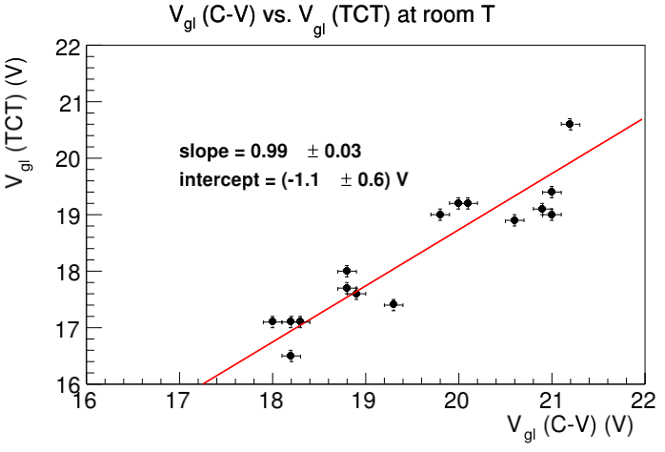
Correlation in measured Vgl: probe station – TCT
1.5e15 – 3e15 (3 wafers IHEP, 2 wafers USTC)

Slide 2
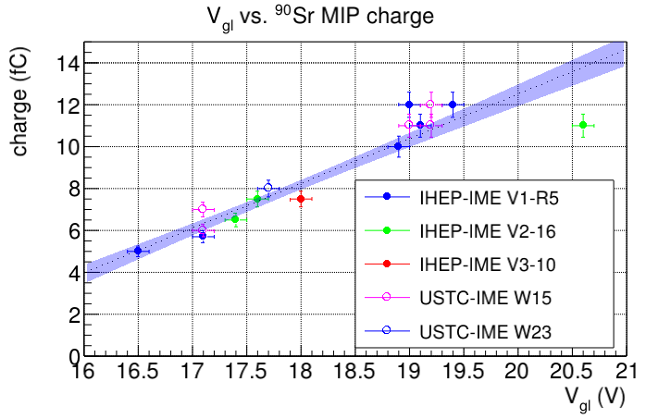

Slide 3
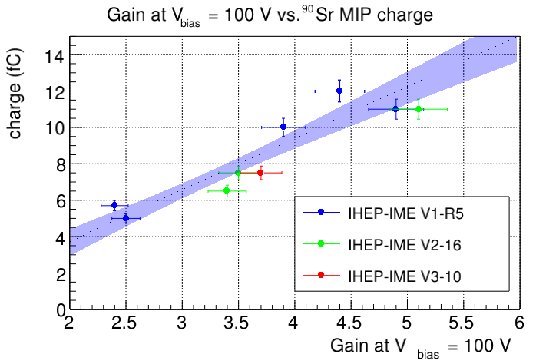
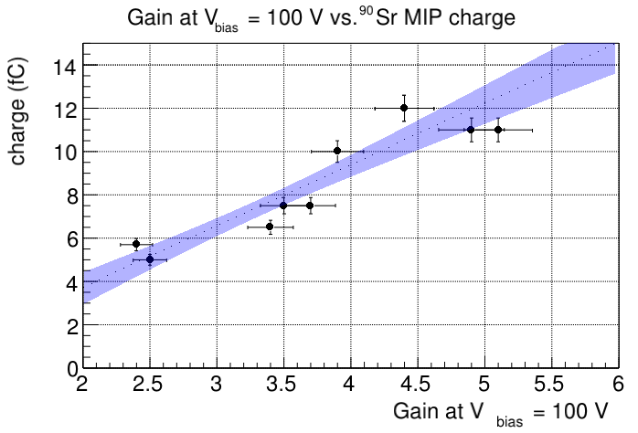
Same plots, just with/-out wafer labels

