Slide 1
PIC modelling needs for fusion plasma
D. Tskhakaya and BIT1 team

Slide 2
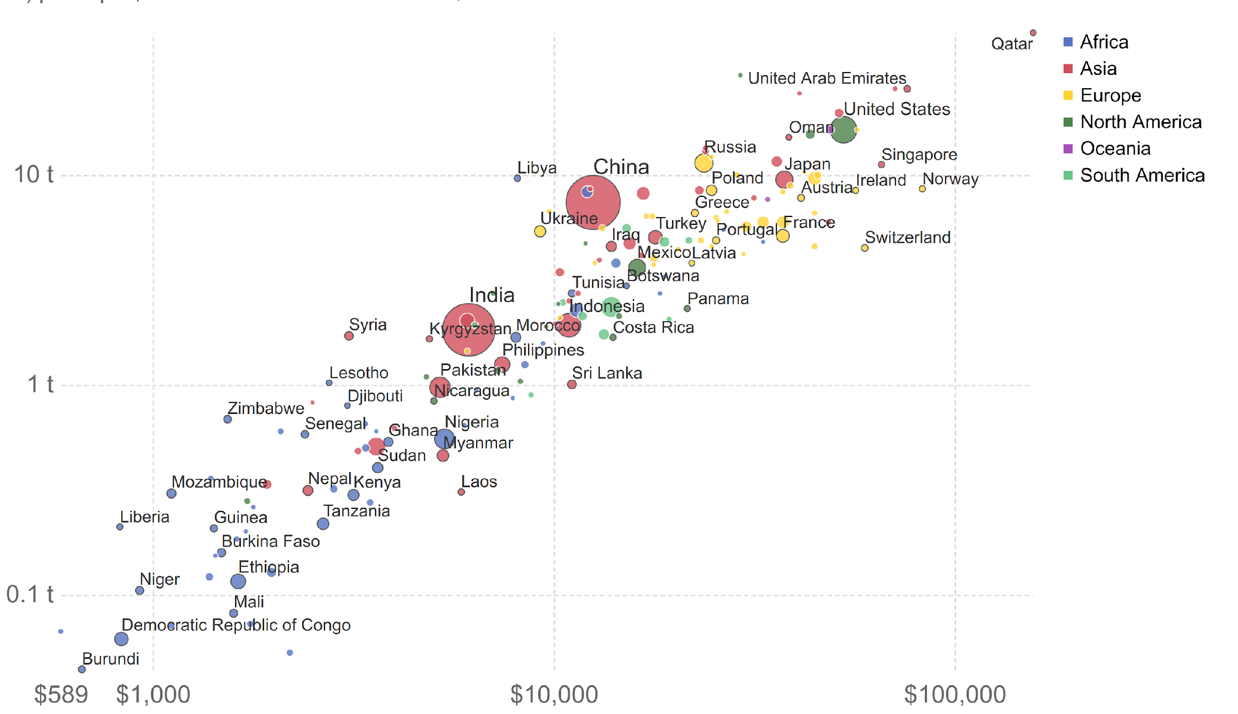

Energy = motor of economy
Cortecy of Jan Horáček
ČR
Mostly nuclear and water
CO₂ produced by transportation
Annual emissions CO₂ / person
$3 GDP = 1 kg CO₂
Economy is local but CO₂ & CH₄ is global
https://ourworldindata.org/co2-and-other-greenhouse-gas-emissions
Gross domestic product [$ / year / person]
Notes:
2
2
max 40 EU politicians, climate change mentioned - don’t show it. Show fusion challenges, timeline, ITER project

Slide 3
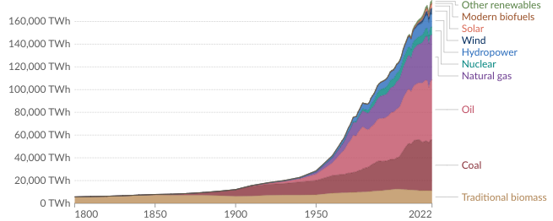
Energy consumption & CO₂ emissions still both rise +1.5% / year whilst “Net Zero 2050” requires -7%/year
After Earth summit 1990, Kyoto 2005, Paris 2015 → still 78 % is fossil !
Because $3 GDP = 1 kg CO₂
still applies for all the countries
planet warm up Area
~45 GtCO₂ / year
1000 GtCO₂ = +2ºC
fusion for future
We need fusion energy

Slide 4

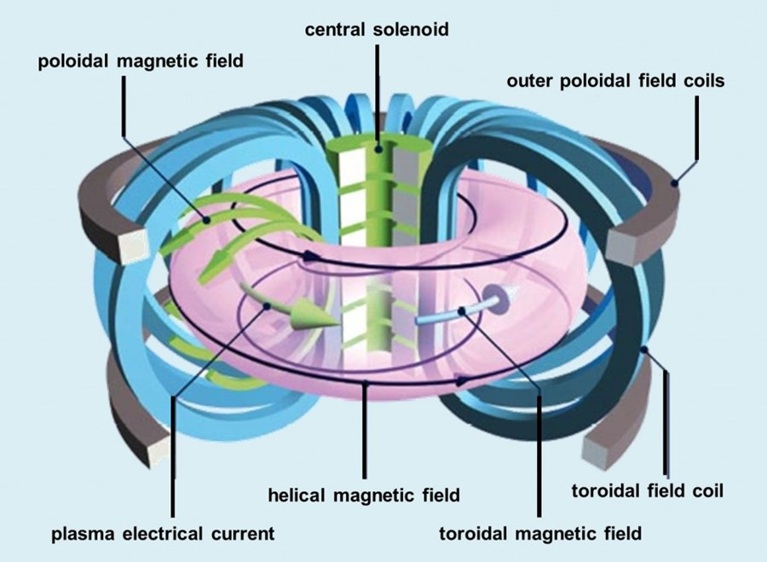
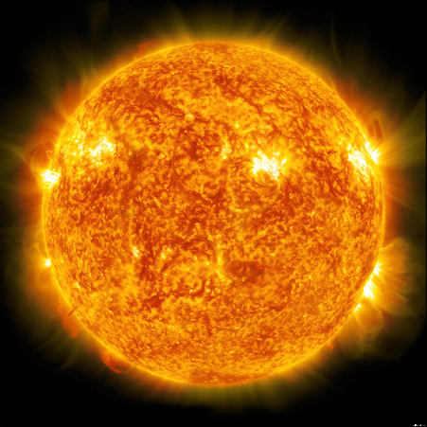
Magnetic Confinement (MC) fusion
Tokamaks

Slide 5
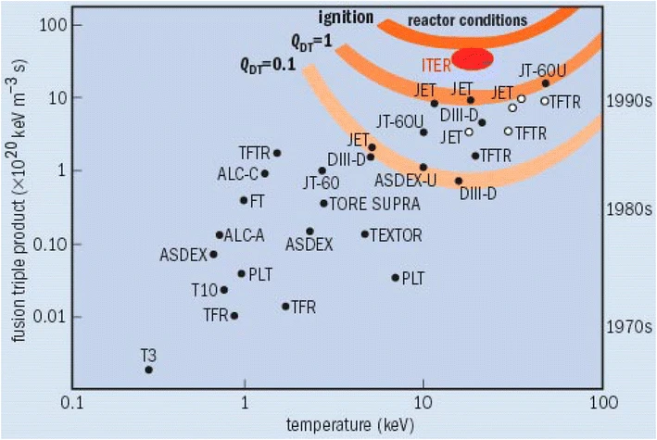
Magnetic Confinement Fusion (MCF)
Ignition condition
Energy confinement time
Density Temperature
Scalings
R – Major radius of a fusion device
Future reactor should be a large size device
From: https://en.wikipedia.org/wiki/Lawson_criterion
A. Horvath, E. Rachlew, Ambio 45 (2016),

Slide 6
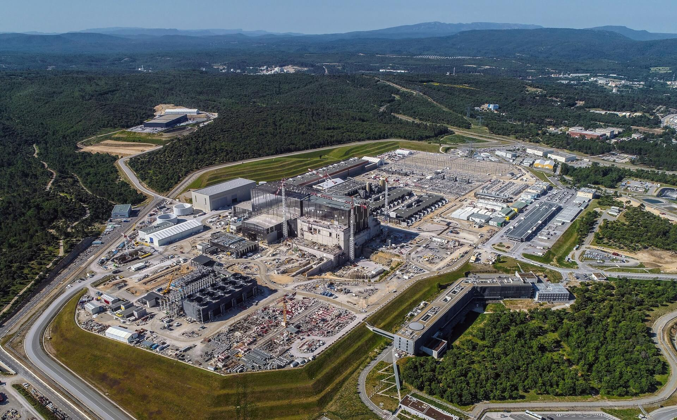
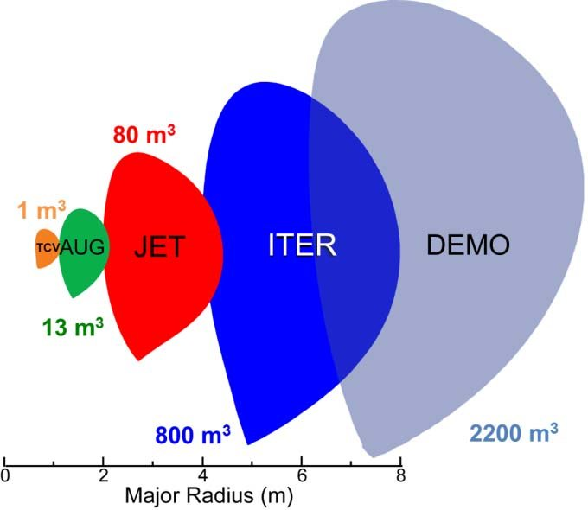
Test fusion facilities: tokamaks and stellarators
Under construction
Under planning
1.3 m³
1
1
CU
ITER

Slide 7
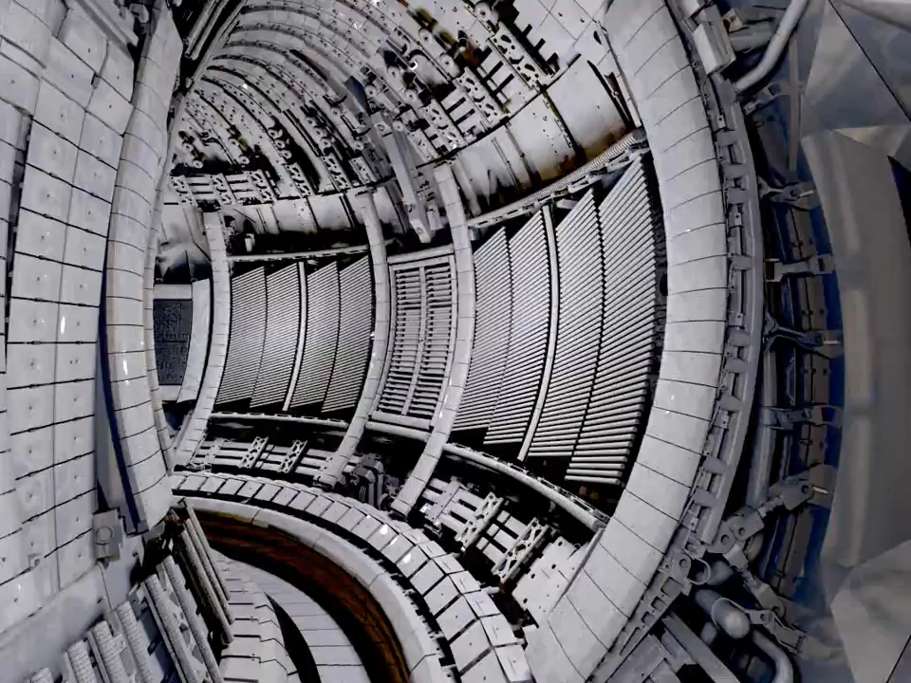

Inside JET tokamak
Temperature required for fusion > 10⁸ C°
As cold as possible plasma edge to reduce wall heat loads and material sputtering
Plasma temperature at the wall ~ 10⁵ C°
Extreme gradients!
Movies are the courtesy of EUROfusion: https://www.euro-fusion.org

Slide 8
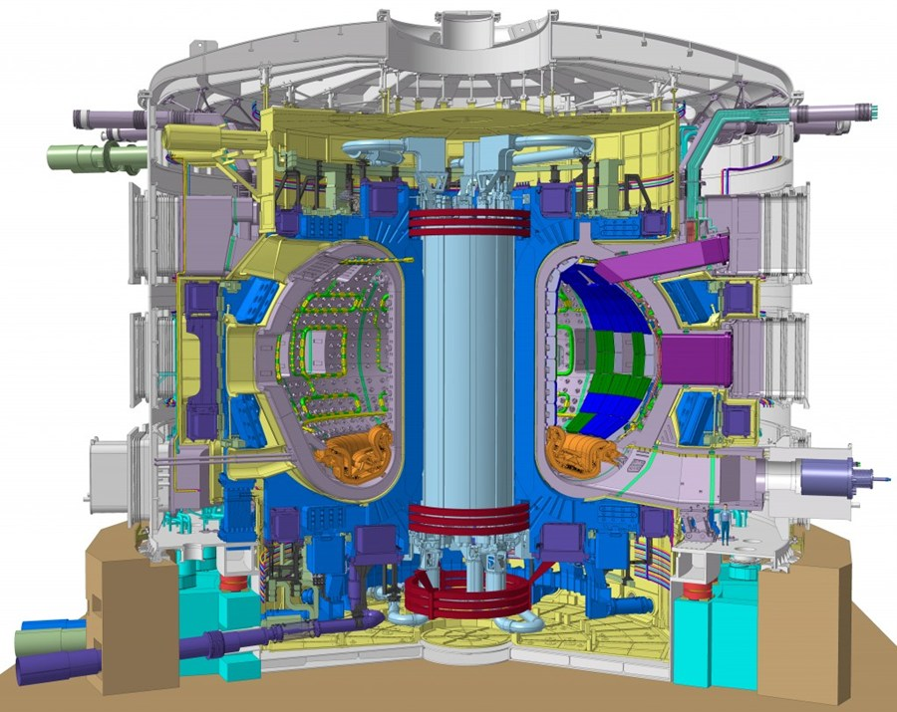
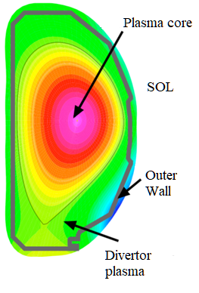
Different methods for MCF plasma study
Plasma-surface interaction (T < 1eV, l ~ nm, τ ∼10⁻¹⁴ s – 1 year)
Monte Carlo (MC)
Molecular dynamics
Other methods for studying arcing, surface morphology, neutron irradiation damage, …
RF
heating
NBI
heating
Plasma heating (E ~ 0.1 – 1 MeV, l ~1 – 100 cm, τ ∼ 10⁻⁴ – 1 s)
NBI codes (MC)
RF heating and current drive (MC, Maxw. S, RayT., GK)
SOL (plasma, neutrals, impurity, T ~ 1-300 eV, l ~1-100 mm, τ ~ 10⁻⁵ – 10⁻² s)
(gyro-)Fluid
Gyrokinetic
Full kinetic
Monte Carlo
Plasma core (plasma, impurity, T > 1 keV, l ~1-100 cm, τ ~ 10⁻³ – 1 s)
MHD (transport/equilibrium)
Gyrokinetic (GK)
Runaway Electron transport
+ Machine Learning

Slide 9
“Plasma” composition in MCF devices
Plasma fueling & impurity seeding
Electrons and main ions (D⁺, T⁺,…)
Fuel neutrals (D, T, D₂, T₂, …)
Impurity particles
seeded (N, Ne, Ar, Xe, …)
intrinsic (C, W, Be, Li, Fe, Sn, …)
Dust particles (1-100 µ)
First wall
Plasma–wall interaction
Scrape-off Layer
(SOL)
+Their nonlinear interaction
+Interaction with the wall components
Divertors

Slide 10
Full kinetic plasma model
+ Field equations (e.g):
Direct Fokker-Planck, or Vlassov equation solvers.
Particle codes
Discrate system of linear equations requiring (sparce) matrix solvers
Numericaly more stable, nonstructured grids Hard to implement collisions
Higher dimensionality, MC directly applicable Numericaly less stable, restictions on grids
1D3V, 2D2V, 3D1V, 3D2V, 3D3V
Computationally very expensive

Slide 11
The main principle of PIC simulation
Point particles
Discretized space
Particle
weighting
assigning particle density to the spatial grids
Different weighting schemes
0 order
1st order
n
2nd order

Slide 12
PIC + MC schematic
Plasma, impurity and neutral particle interactions + interaction with plasma facing components

Slide 13
Requirements for PIC simulation
Full particle trajectory is followed: smallest/shortest time/space scales have to be resolved
During one time step particle should not jump over multiple grid cells
Requirements on the EM solver
k-2 k-1 k k+1 k+2 X
Fusion plasma edge
There should be sufficient simulation particles

Slide 14
Analytic theory of finite size particle plasma in a discrete space
Dispersion relation

Slide 15
Requirements for PIC simulation
1. Numerical fluctuation:
Fluctuation amplitude
For the real plasma N_{D} > 10⁶
In PIC simulation N_{D} < 10⁴
Reminder
Diffusion in usual space
2. Energy conservation
Diffusion in velocity space
Numerical heating

Slide 16
BIT1 - PIC MC model
Separatrix
Plasma and heat source
Inner
divertor
e, D⁺
Outer
divertor
D recycling
C, W sputtering
Ne injection
Outer wall
Plasma sheath
Nonlinear energy and momentum conserving collision operators
Linear, energy and angular dependent PSI model
Plasma particles are treated in 1D, neutrals - in 2D, impurity – removal according to D_{anom}
Code output: plasma profiles, energy, velocity and angular DF of all particles, synthetic diagnostics
Up to 10⁷ grid cells in poloidal direction

Slide 17
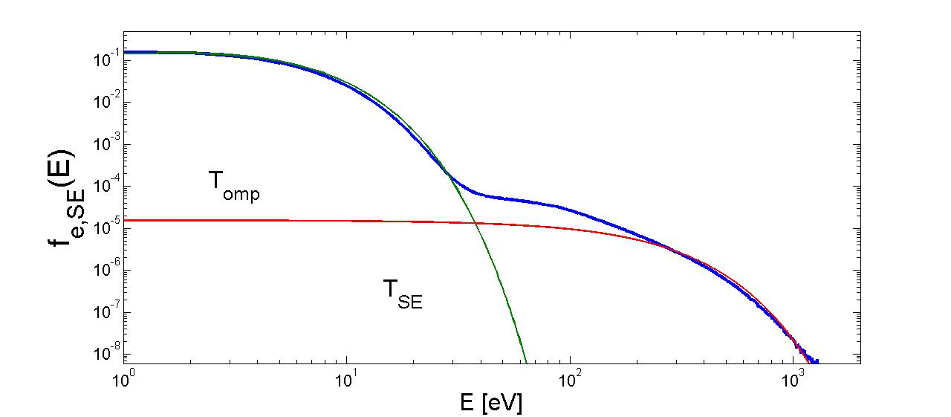
Examples: electron energy DF at the sheath
Main carriers of the power to the divertors
Fully kinetic approach is required to find these results
Transport in the SOL can be nonlocal: heat flux is not defined by local parameters

Slide 18
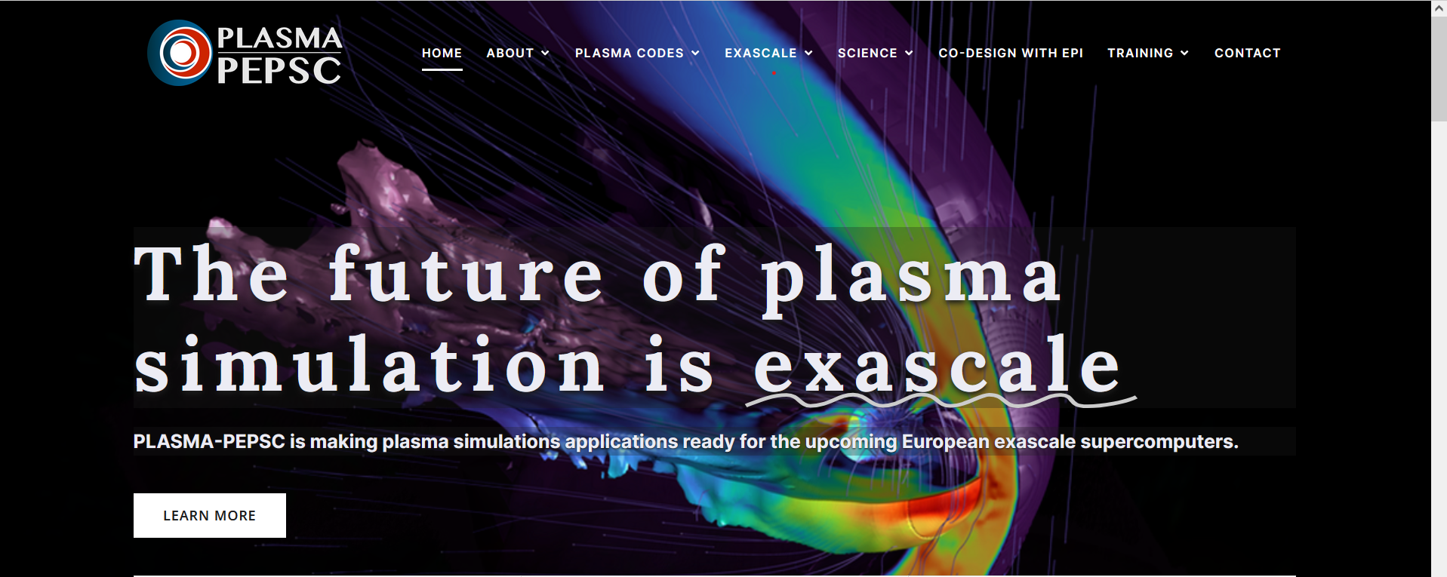
Exascaling if BIT1 (Plasma PEPSC)
BIT1 simulations of next generation fusion devices (ITER, DEMO, etc.) require >100 M CPU hours and can take few months
Development of the exascale version
https://plasma-pepsc.eu/
Horizon project – Plasma PEPSC
See details in the next presentations

Slide 19
Thank you for your attention ☺

Slide 20
Backup slides
Type | Satisfied | known | expression
Small spatial and time meshes | yes | yes
Energy conservation | yes | partially
Accuracy at the far end | partially | not
Restriction for curvilinear coordinates | partially | not

Slide 21
Main problems for PIC modelling (2)
3. Accuracy at the “far end”
10 m
Only 3 digit accuracy!
4. PIC for curvilinear coordinates
[Tskhakaya et al, CPP 2007]

Slide 22
Uniform mesh
Nonuniform mesh
[Tskhakaya, CPP 2007]
For 1D there exists a solution [Duras, CPP 2014]
No solution has been found for 2D and 3D yet!

